Slide 1
SAE Formula Chassis
Gustavo Ruiz: Chassis Lead
Brandon Guzman: Test Engineer & Firewall designer
Ryan Meger: Front Wing and Rear Suspension Box
Alexandra Brister: Cockpit Engineer
Carson Kent: Airfoils and Rear Wing Design

Slide 2
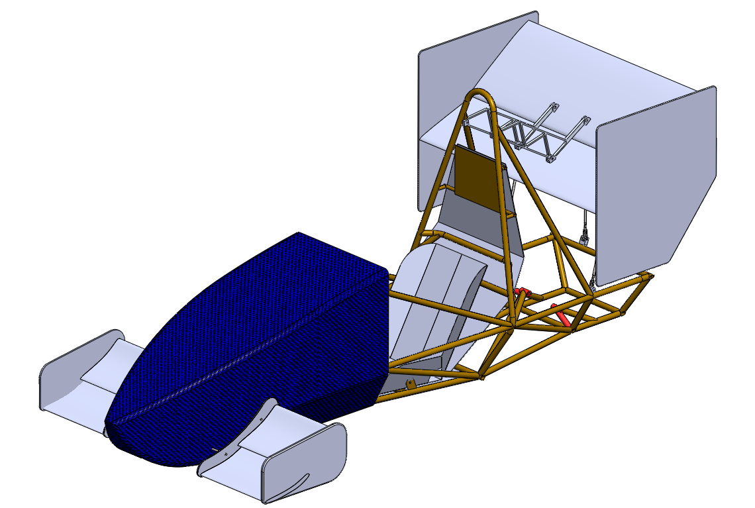
Hardware Status Update
GR

Slide 3
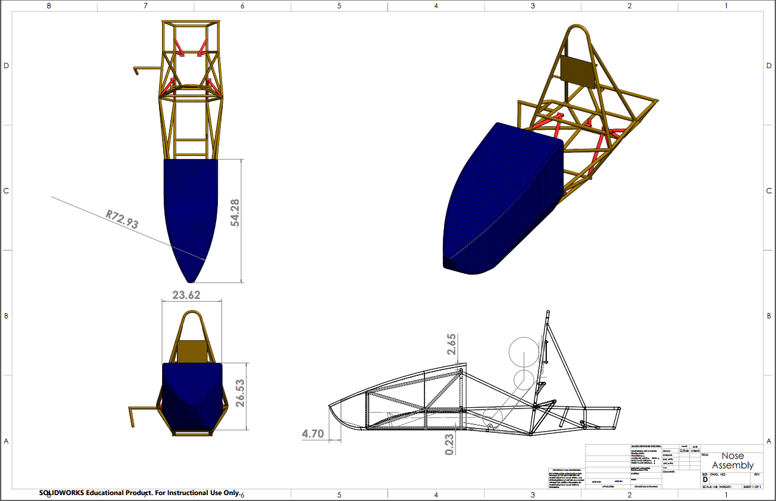
Design Efforts: Nose Cone
GR

Slide 4
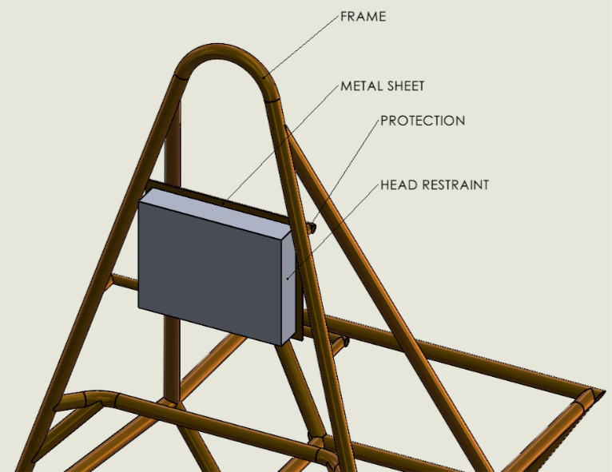
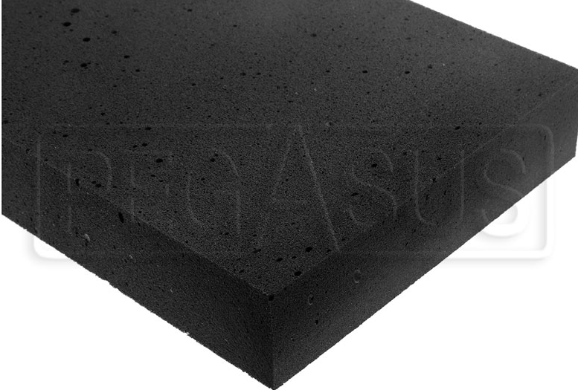
Design Efforts: Head Restraint
SFI Spec 45.2 EAM Rigid Foam, 2" Thick
GR

Slide 5
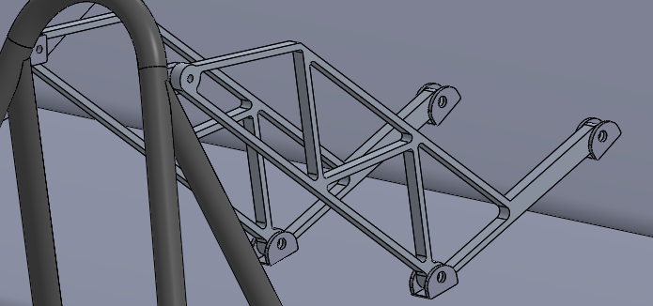
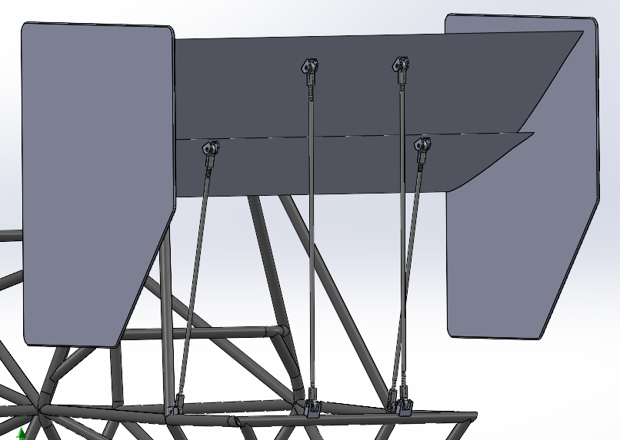
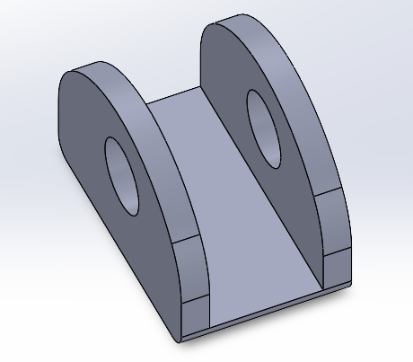
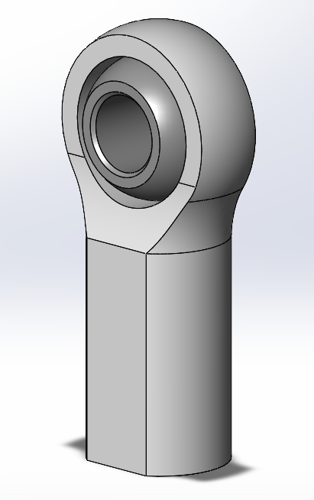
Design Efforts: Rear Wing
CK

Slide 6
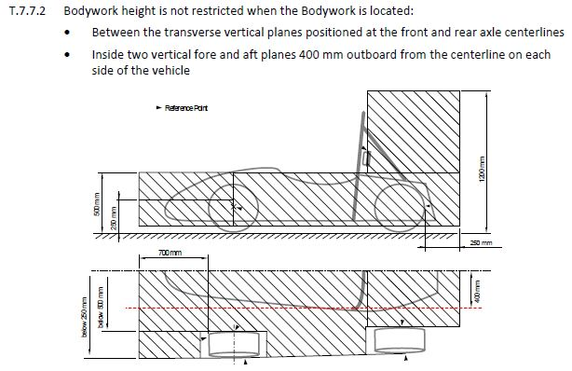
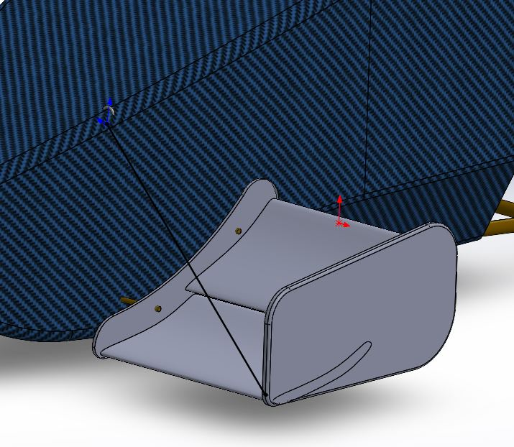
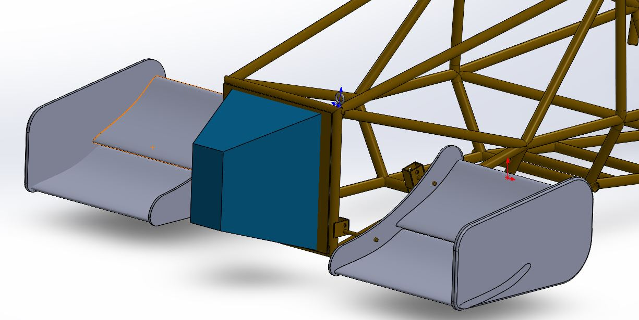
Design Efforts: Front Wing
RM

Slide 7
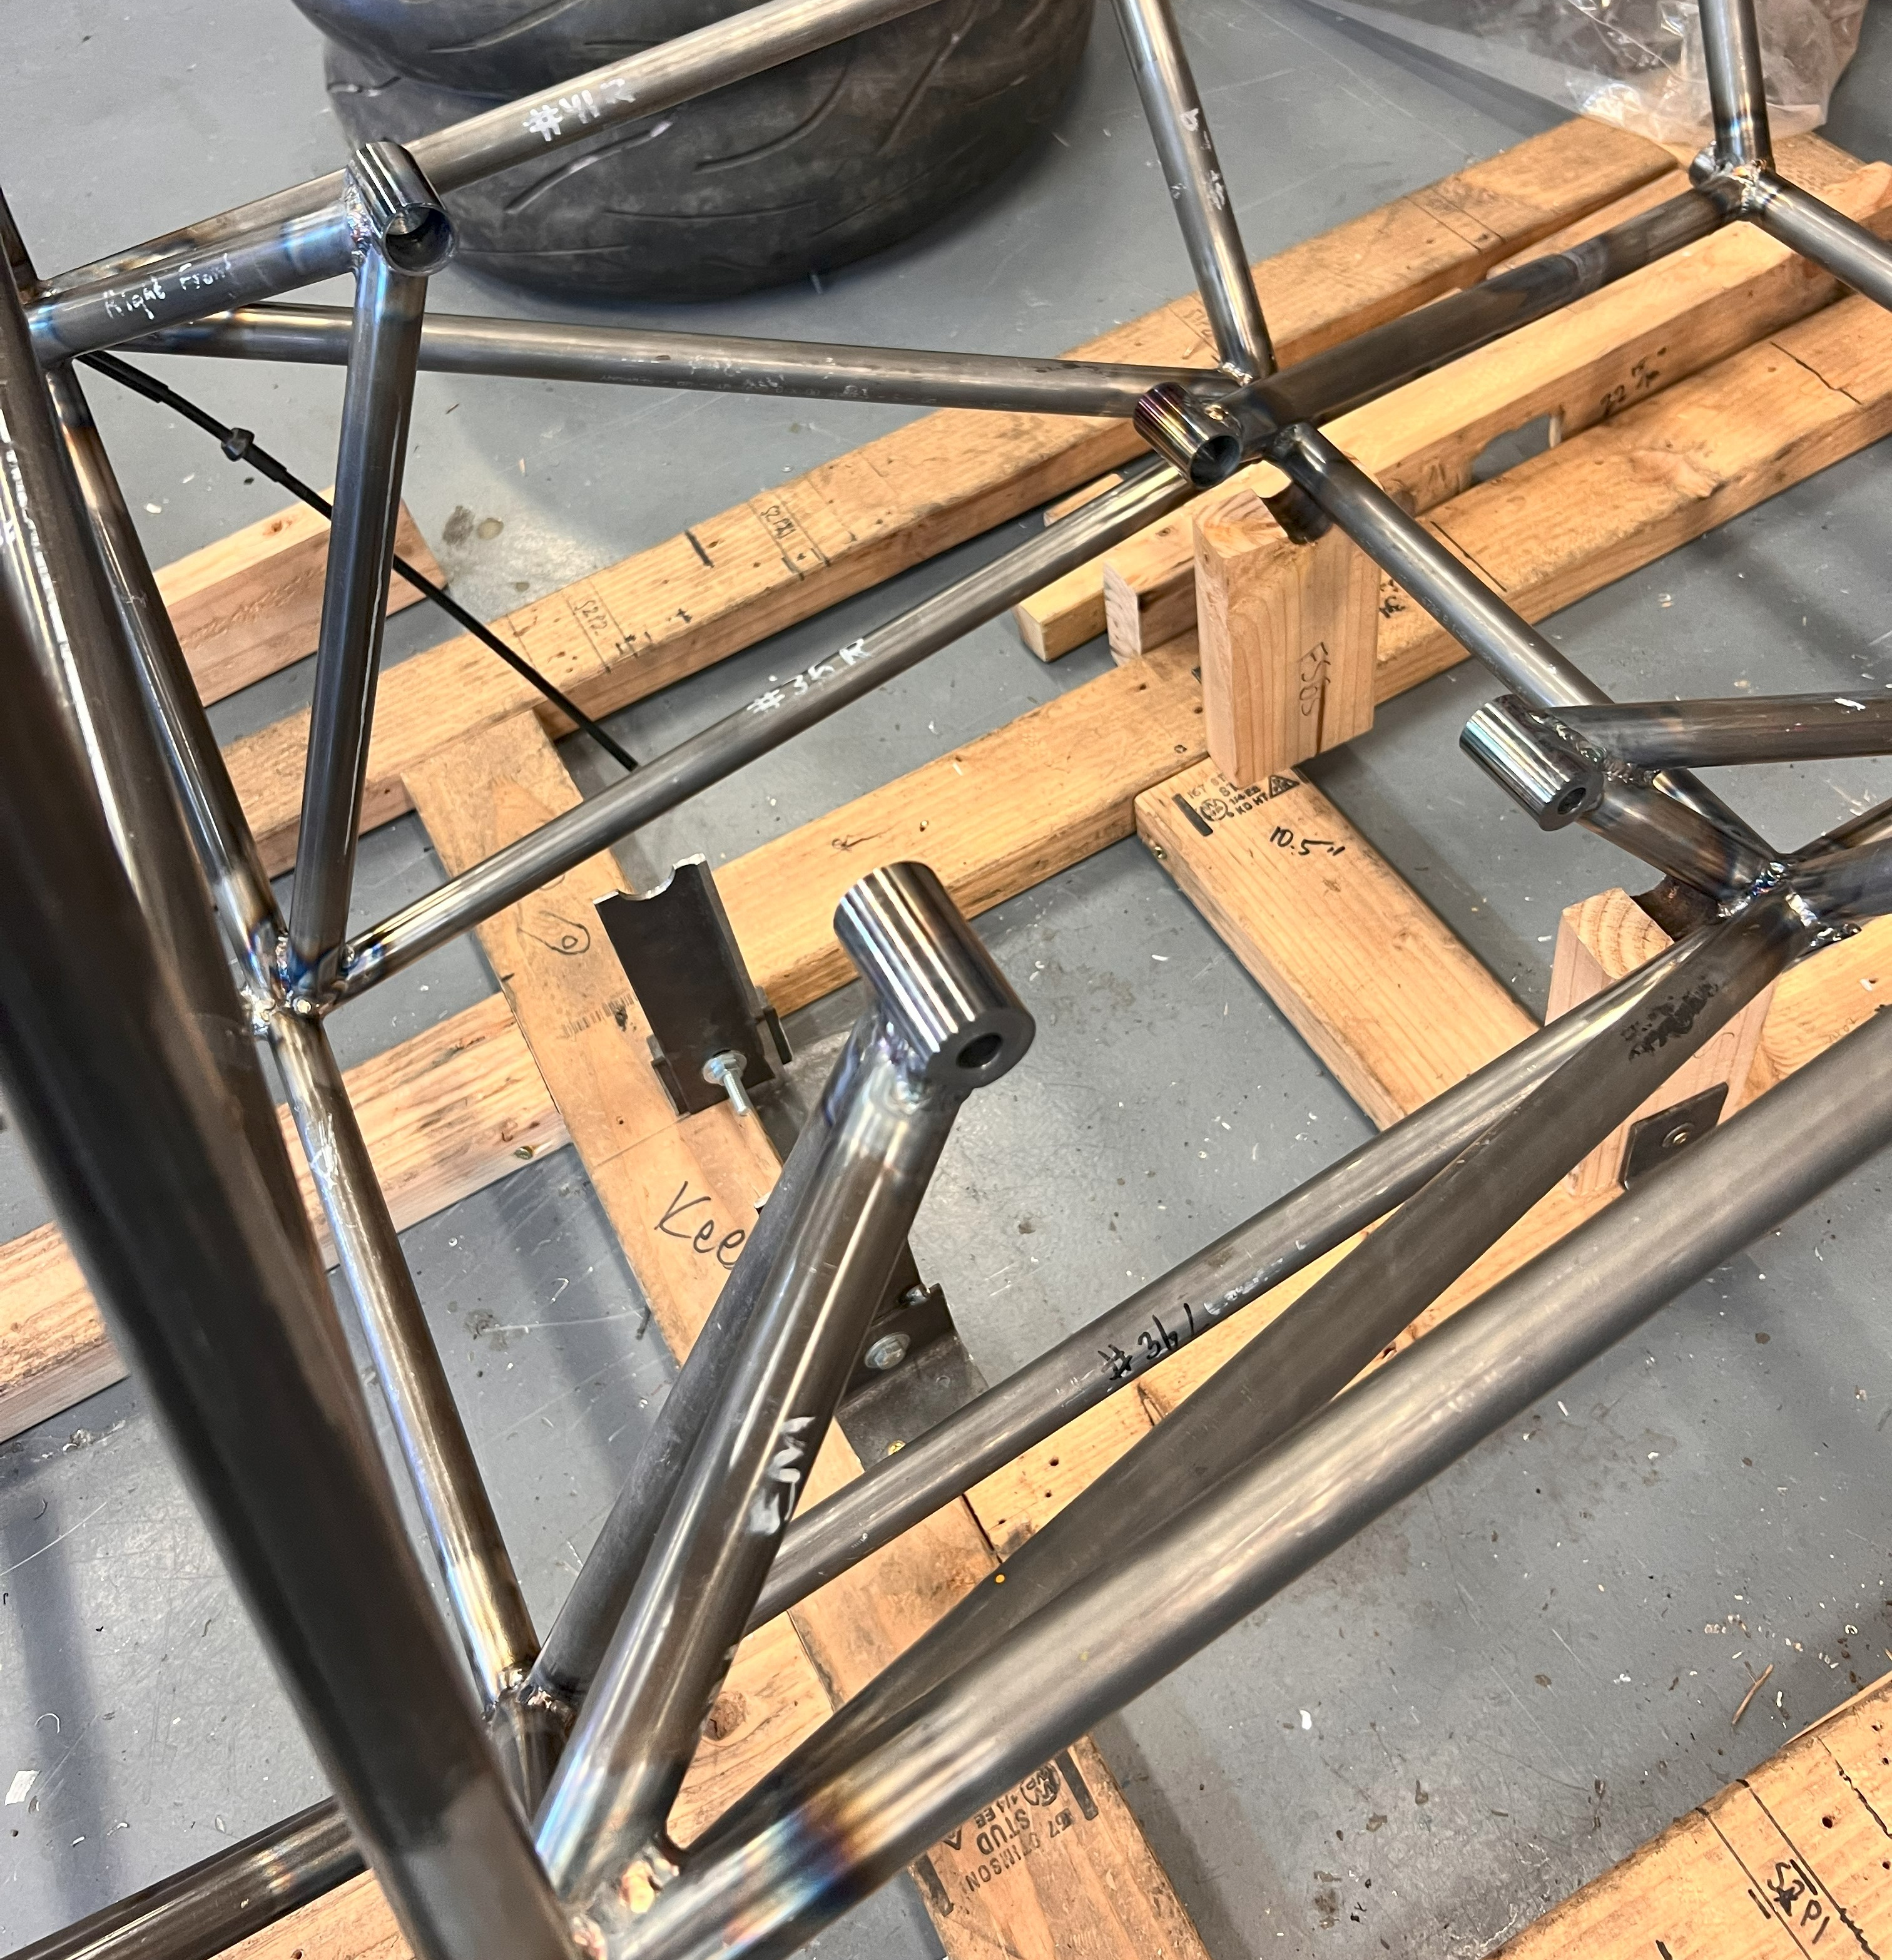
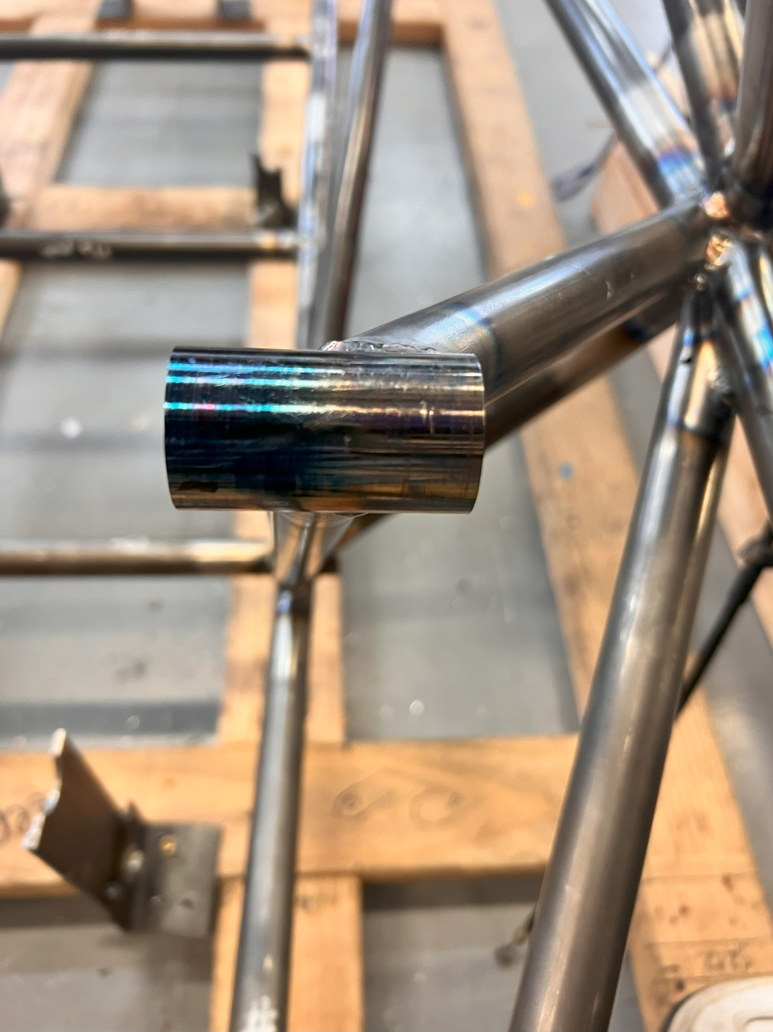
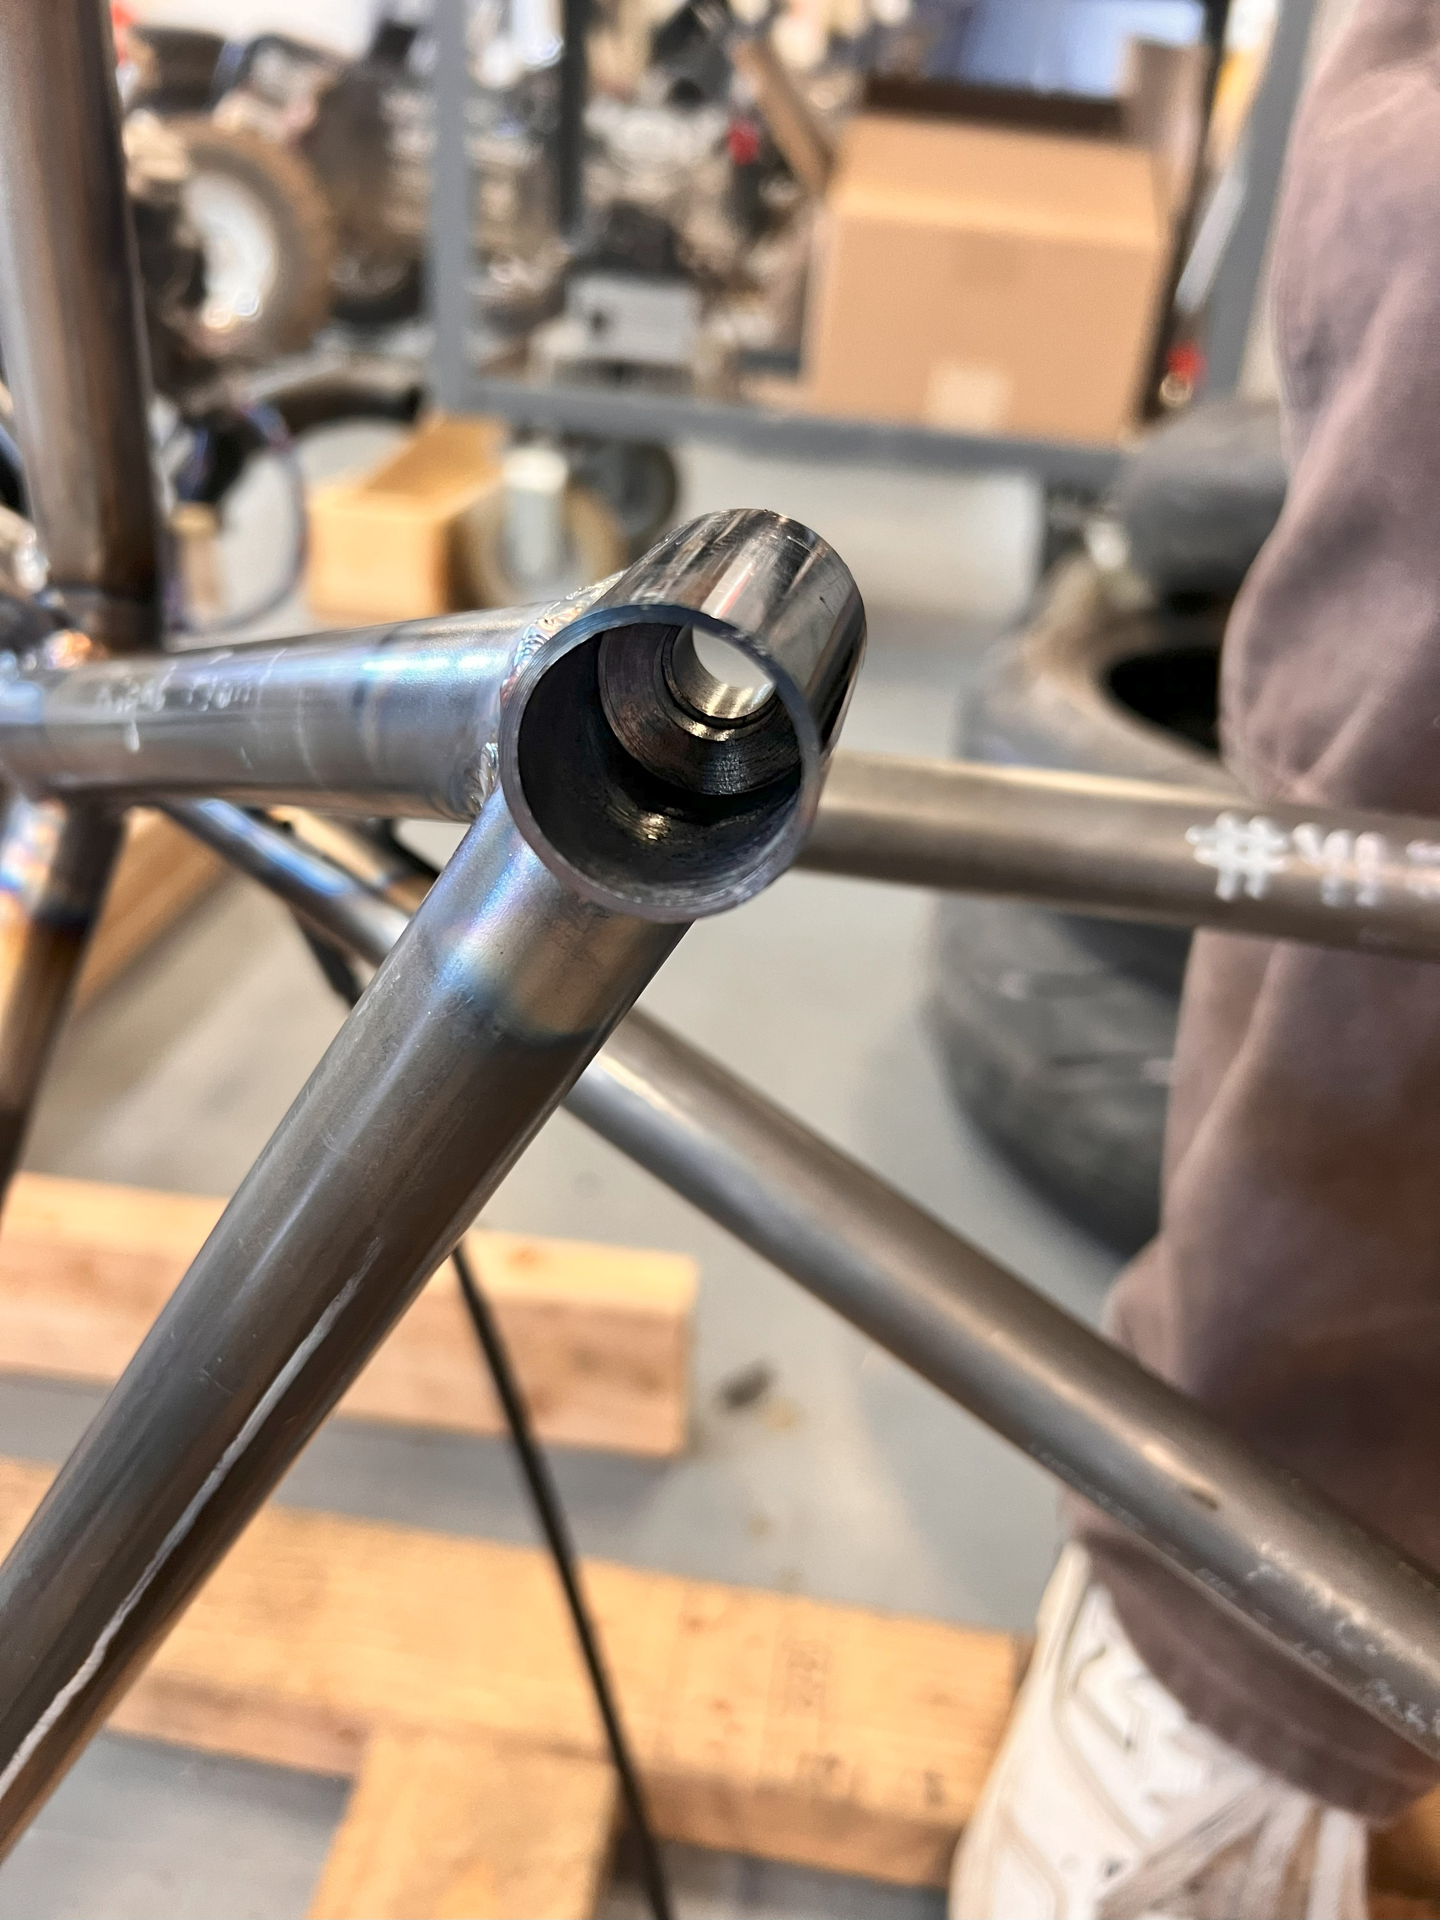
Design & Manuf. Efforts: Engine Mounts
RM

Slide 8
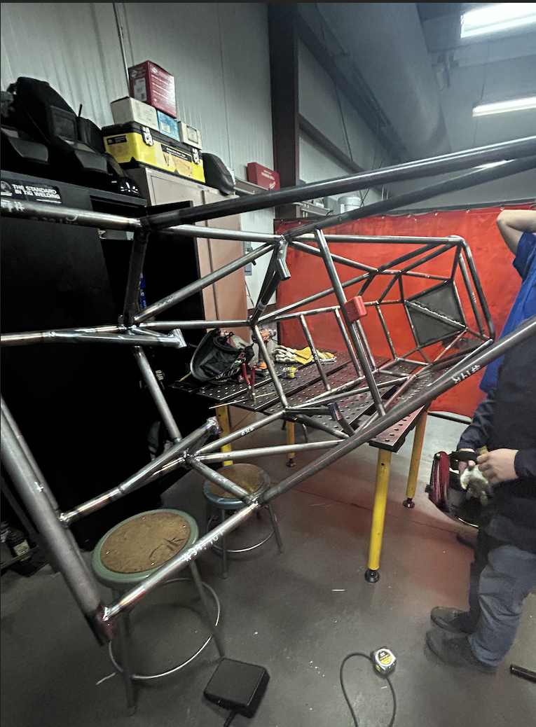
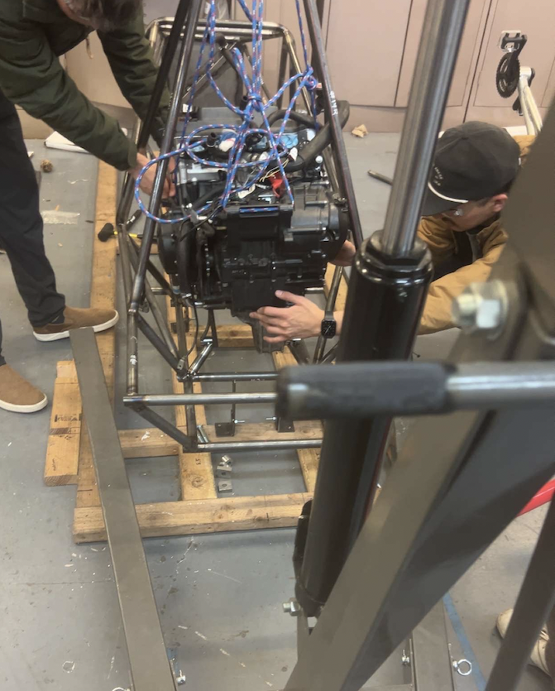
Manufacturing Efforts: Engine Mounts
Engine Mounts:
Fitment is complete
Mounts have been welded in
RM

Slide 9
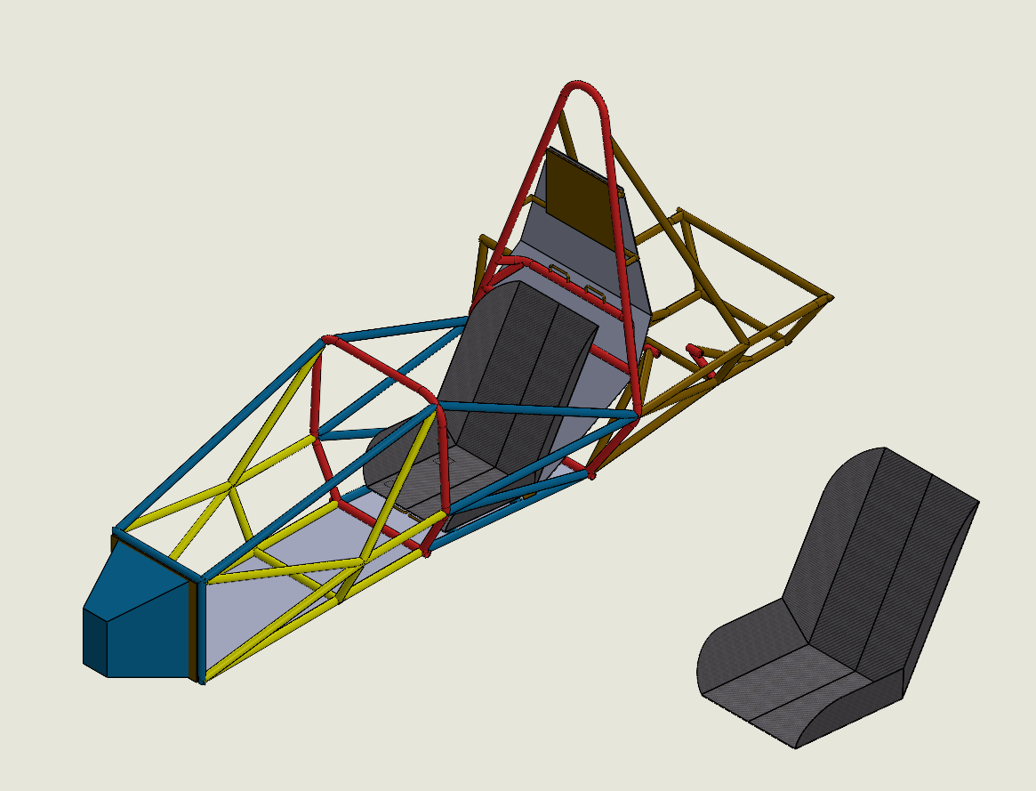
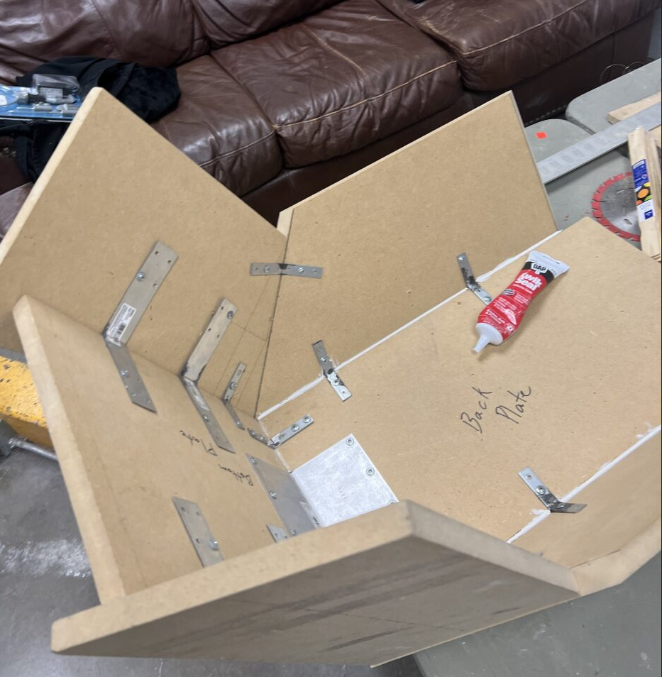
Design Efforts: Seat
Seat Mold
AB

Slide 10
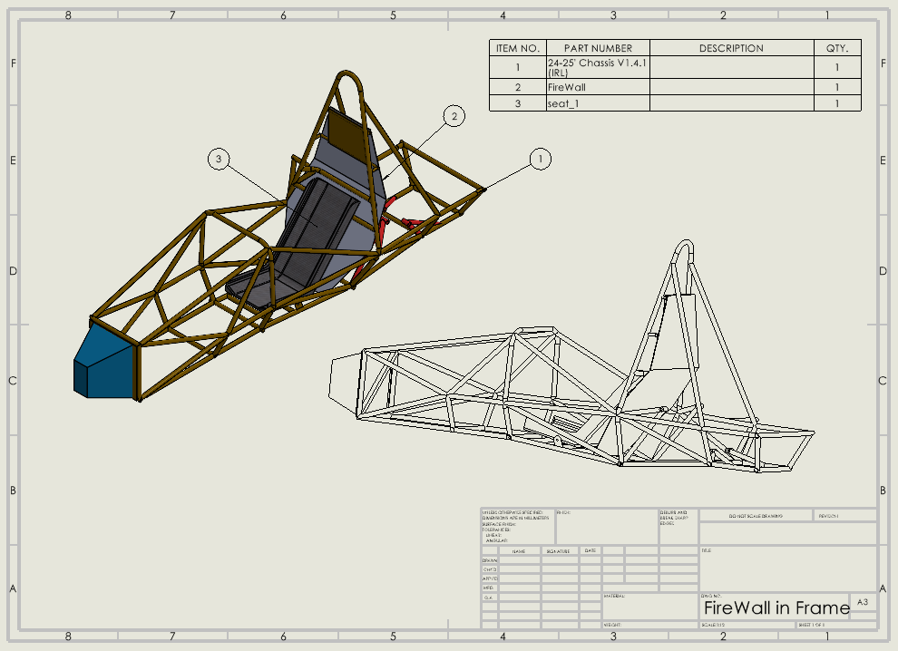
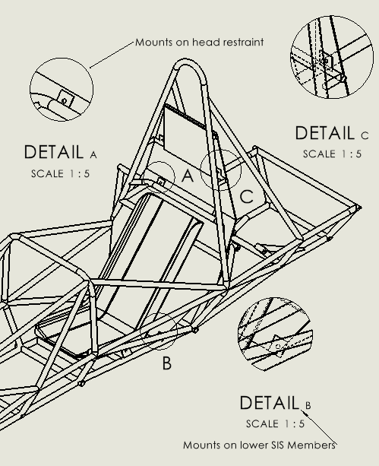
Design Efforts: Firewall
Firewall model:
Will be iterated on to be 1-2 removable components
All material is on hand
BG

Slide 11
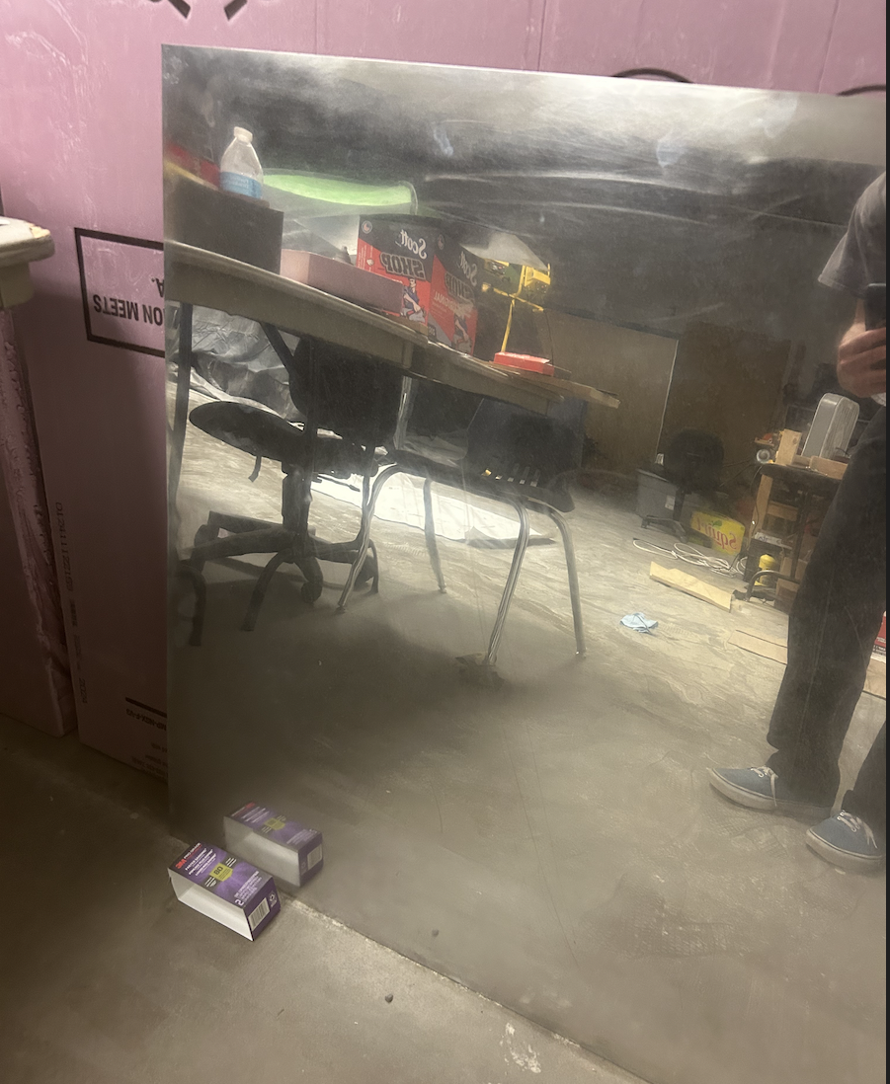
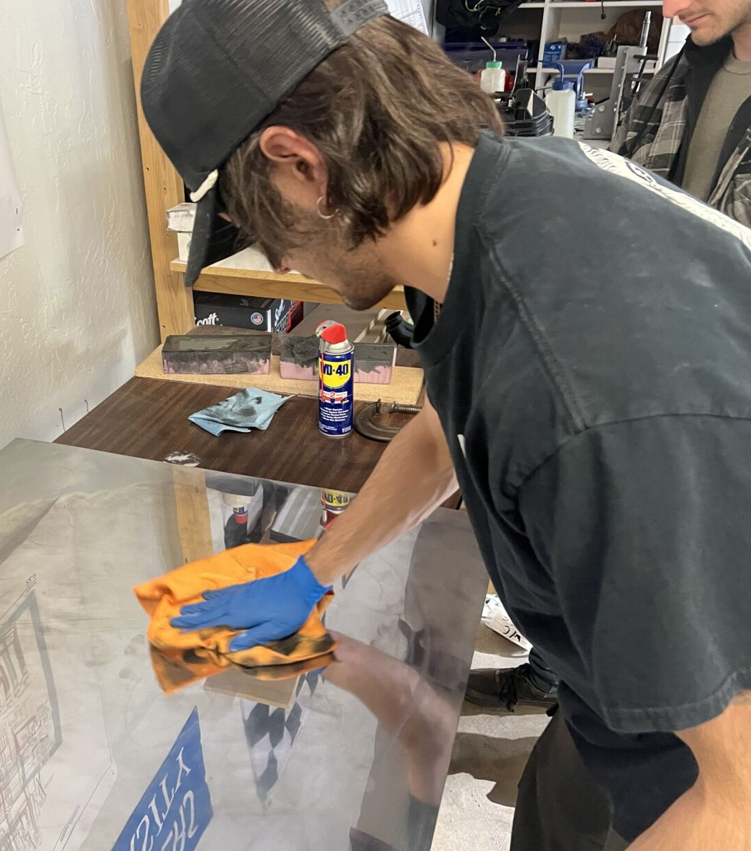
Design Efforts: Firewall
Firewall model:
Mounts need to be cut and drilled for screws
Material needs to be bent
BG

Slide 12
Purchase Plan (TopLevelBudget)
Chassis Budget
Category | Units | $/Unit | Total
Frame
Size A Tubing | 18.02 | $28.75 | $518.08
Size B Tubing | 36.1 | $7.10 | $256.31
Size C Tubing | 40.4 | $11.33 | $457.73
Size D Square Tubing | 1 | $45.60 | $45.60
Front Bulkhead Sheet | 1 | $56.36 | $56.36
Prototype
PVC 1in Pipe | 10 | $8.48 | $84.80
Duct Tape | 2 | $8.98 | $17.96
Jigging
Material |  | $336.40 | $336.40
Welding
Tig Rods ER70S-D2 | 1 | $50.00 | $50.00
Argon | 1 | $65.00 | $65.00
Safety Equipments
Impact Attenuator | 1 | $210.00 | $210.00
Harness | 1 | $260.00 | $260.00
Tabs & Fasteners | 1 | $200.00 | $200.00
Head Restraint | 1 | $100.00 | $100.00
Seat | 1 | $350.00 | $350.00
Floor Closeout | 1 | $100.00 | $100.00
Firewall | 1 | $150.00 | $150.00
Aero
Body Panels | 1 | $300.00 | $300.00
Aero Molds | 1 | $2,000.00 | $2,000.00
Front Nose Cone | 1 | $500.00 | $500.00
 |  | Total | $6,058.24
Current Expenses
Total Available | $6,058.24
Anticipated Expenses | $143.18
Actual Expenses to Date | $3,769.88
Resulting Balance | $2,288.36
Recently Purchased
Front Wing Mounting
Bondo for Nose Cone
Head Restraint Padding
Orbital Sander
Anticipated Expenses
Rear Wing System
Floorboard Aluminum Sheet
GR

Slide 13
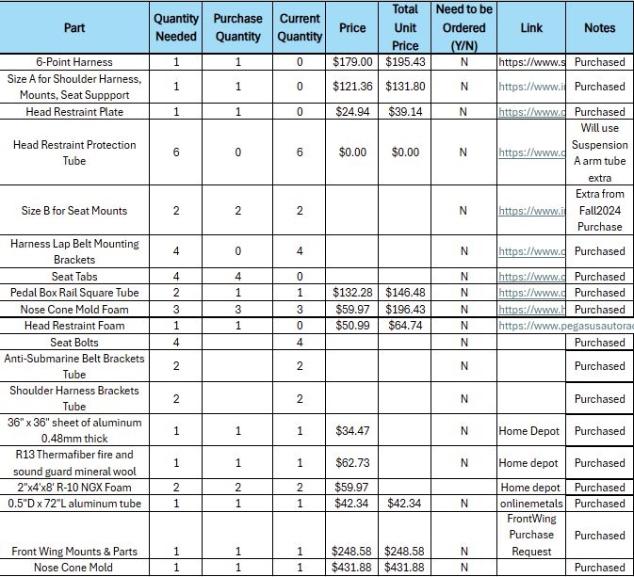
Purchasing Plan (Purchased/On hand)
Have purchased ~ 90% of materials
On Hand ~ 85%
RM

Slide 14
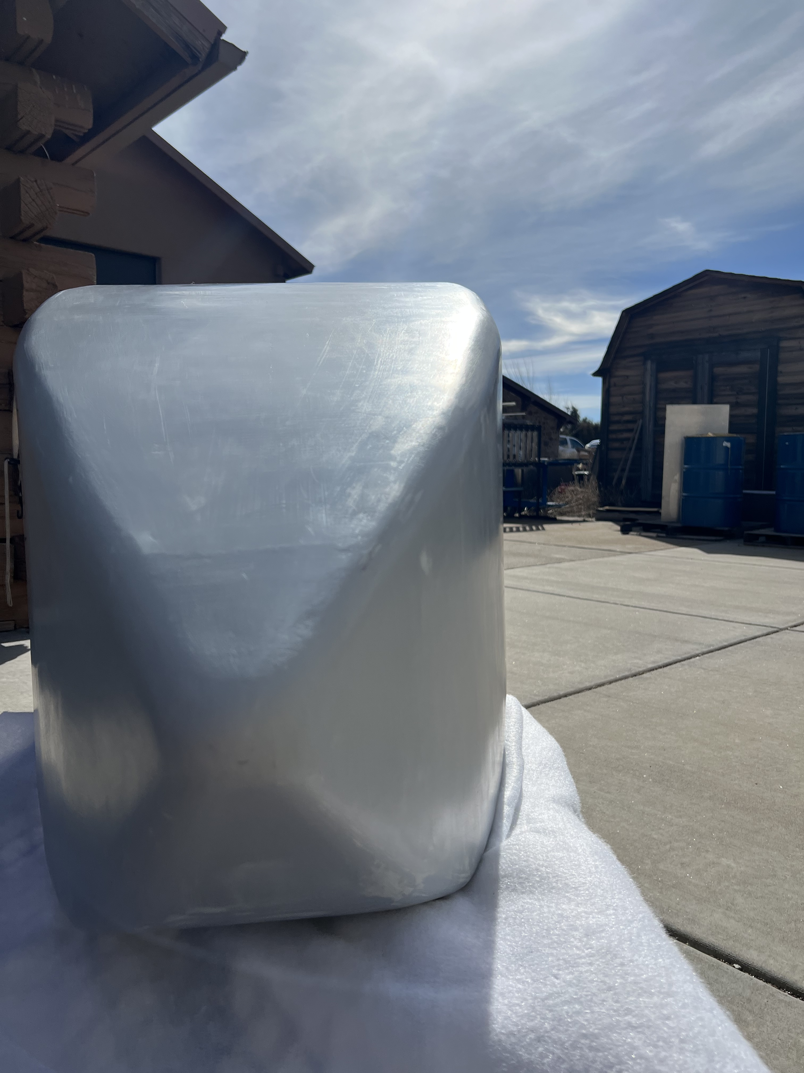
Manufacturing Plan (What is being manufactured)
Nose cone:
Has been sealed and release agent applied
Layup process starts tomorrow(2/25/25)
GR

Slide 15
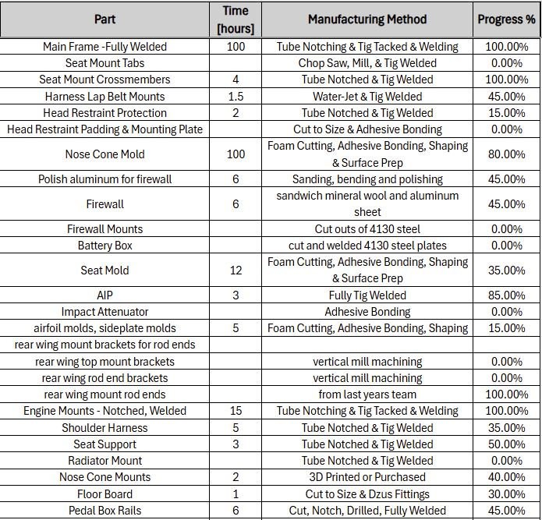
Manufacturing Plan (Yet to be manufactured)
50% Manufactured:
Have majority of Aero Component on hand, manufacturing will be done this week.
Mounts need to be cut and drilled.
Firewall/Battery box needs to be bent(Fuel tank).
Shoulder harness may need to be made again(Engine placement).
BG

Slide 16
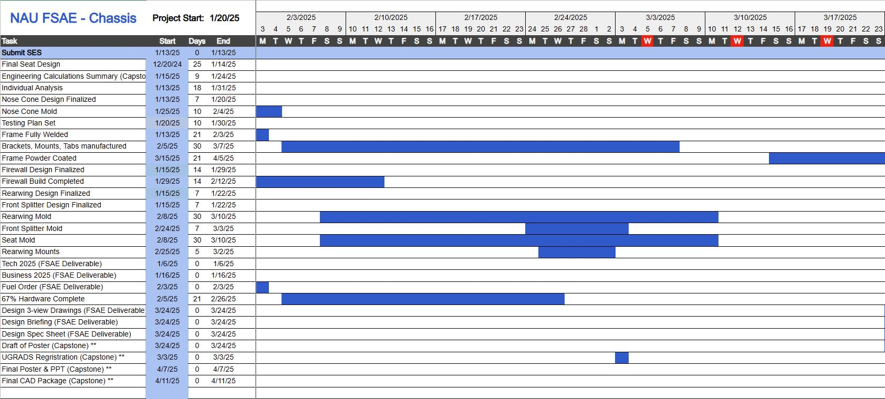
Gantt Chart
Behind Schedule :(
CK

Slide 17
Thank You!

