Slide 1
NG Super Sonic Rocket
Presenters: Austin Paothatat, Avery Charley, Koi Quiver,
Lindsey Dineyazhe

Slide 2
Project Description
Our team is building a two-stage supersonic rocket out of Carbon Fiber Materials. The goal is to meet a set of advanced requirements no other Capstone Team. These include an altitude of 40,000ft, a sustained speed of Mach 2, and hold a 10 lb. payload. The budget for this project is $7,000 and the team expects to use every dollar to achieve this goal.
Stakeholders
Northrop Grumman
Austin 9/26/24 NG Super Sonic Rocket

Slide 3
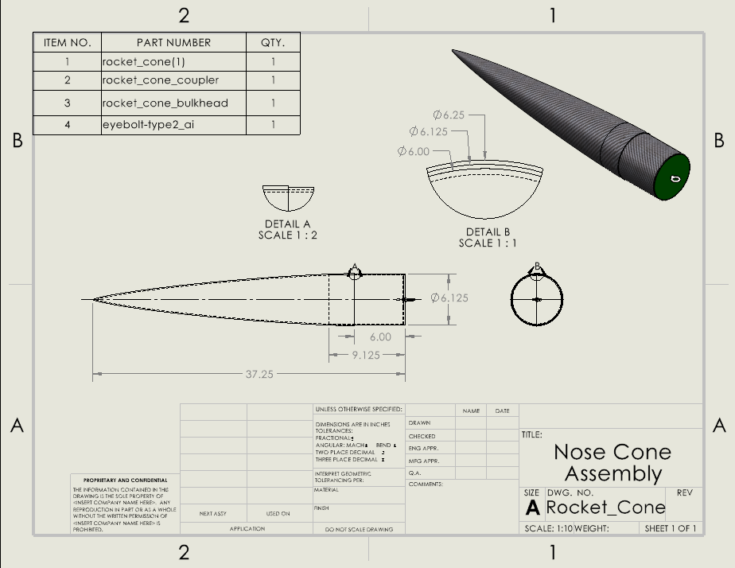
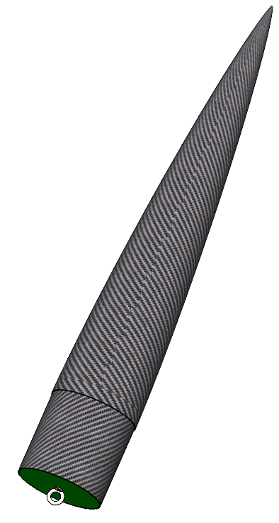
CAD: Nose Cone
Lindsey 4/1/24 NG Super Sonic Rocket
Notes:
Nose cone helps to reduce aerodynamic drag, control, and stability which helps with speed, acceleration, altitude, and fuel usage.

Slide 4
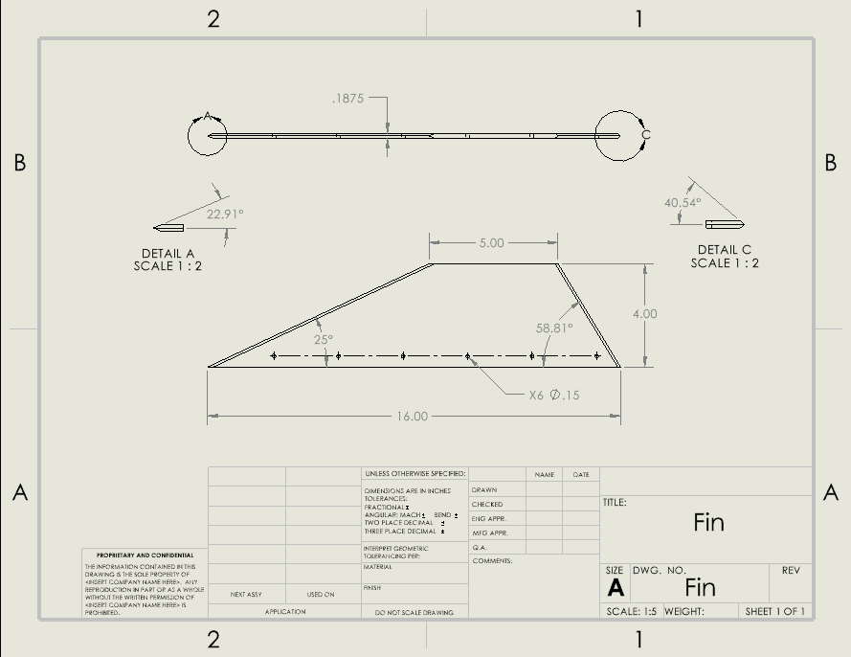
CAD: Fins
Lindsey 4/1/24 NG Super Sonic Rocket
Notes:
Controls direction and stability, also helps with speed, acceleration, and altitude.

Slide 5
CAD: 2nd Stage Assembly
Koi 4/1/24 NG Super Sonic Rocket

Slide 6
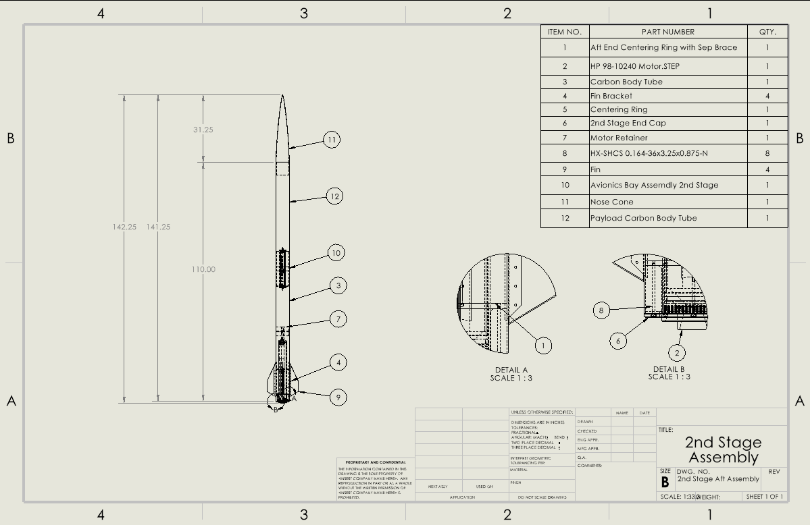
CAD: 2nd Stage Assembly
Koi 4/1/24 NG Super Sonic Rocket

Slide 7
CAD: Sep System
Separation system is now a protected design under Northrop Grumman Space Systems, Launch Vehicles Division.
No technical data, visuals or prototypes will be displayed or discussed for the remainder of the project.
Avery 4/1/24 NG Super Sonic Rocket

Slide 8
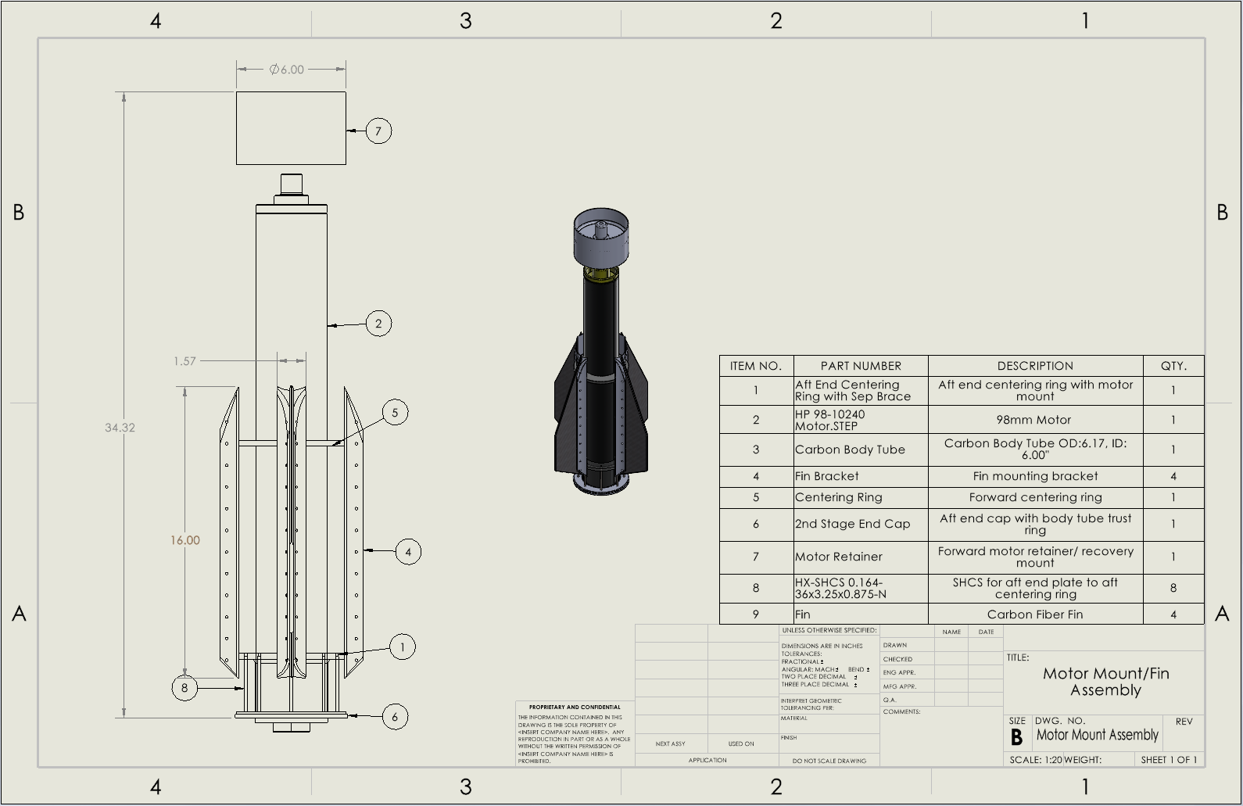
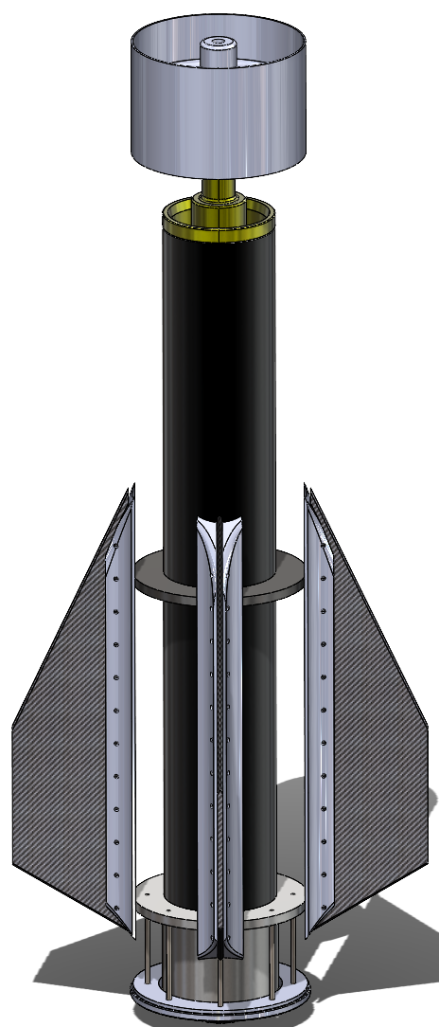
CAD: Motor Mount
Austin 4/1/24 NG Super Sonic Rocket

Slide 9
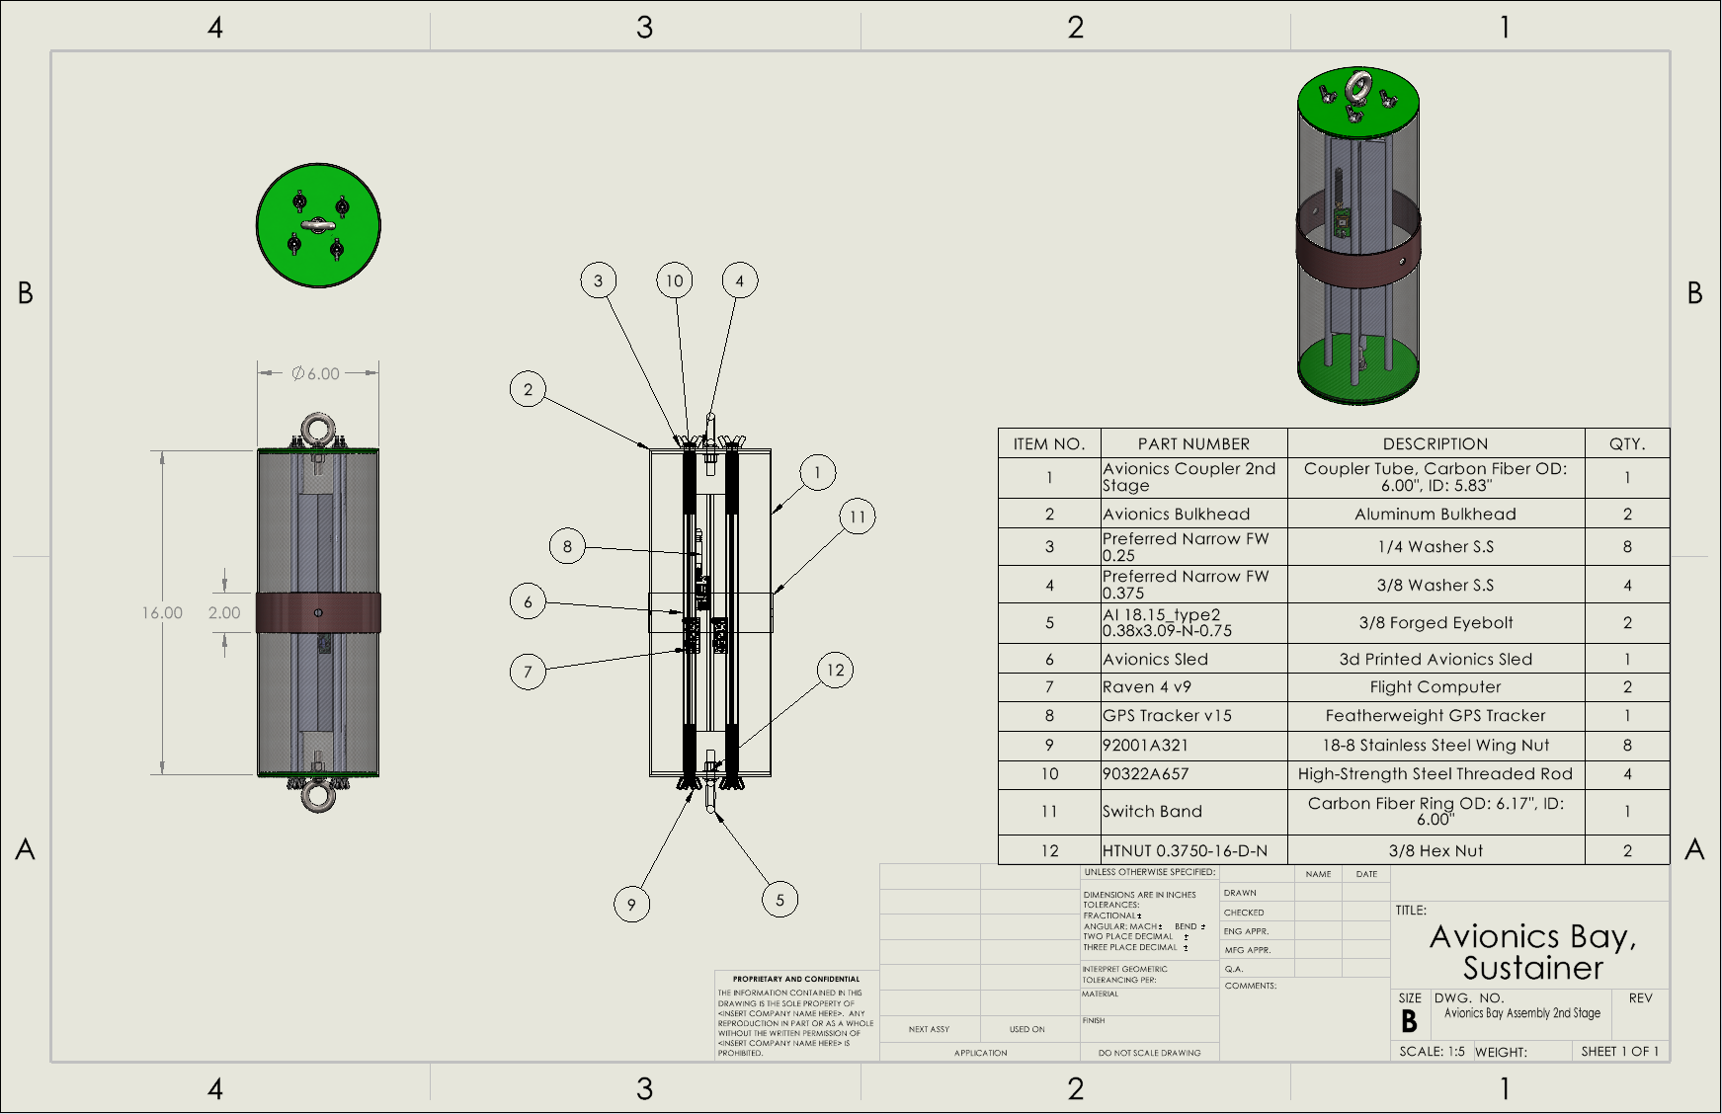
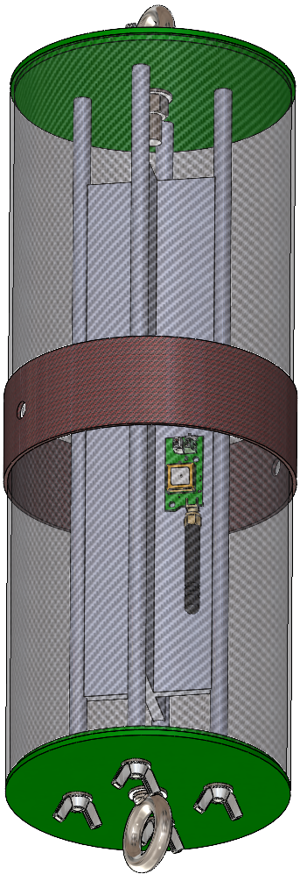
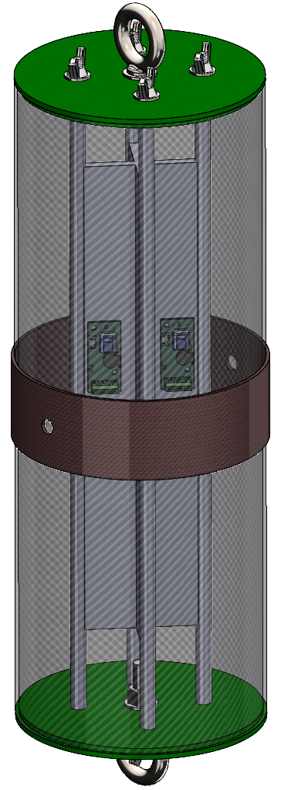
CAD: Avionics
Austin 4/1/24 NG Super Sonic Rocket

Slide 10
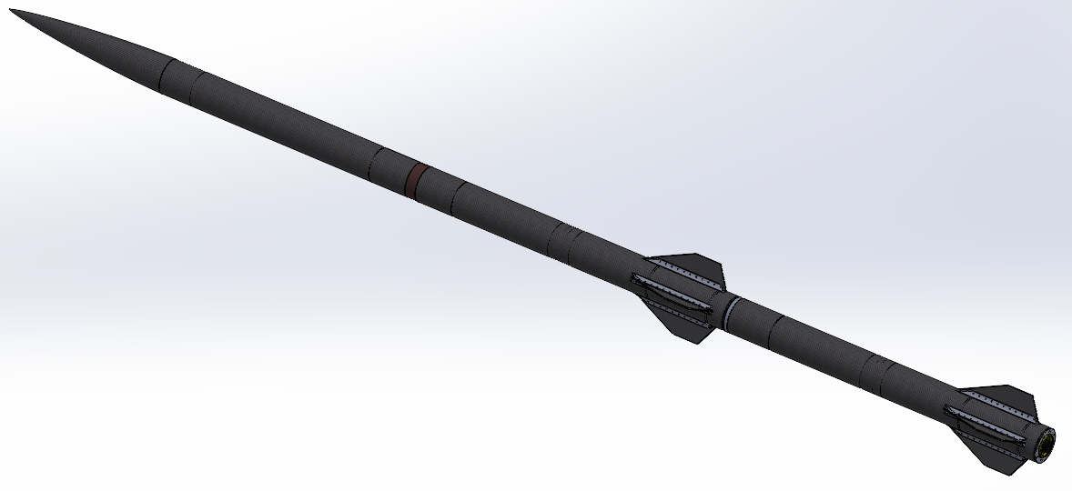
CAD: Full Launch Vehicle
Austin 4/1/24 NG Super Sonic Rocket

Slide 11
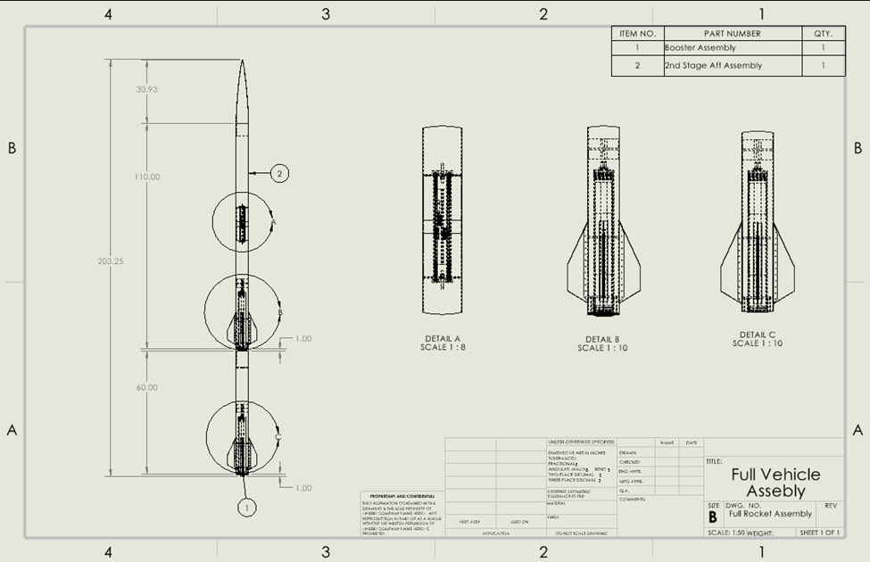
CAD: Full Launch Vehicle
Austin 4/1/24 NG Super Sonic Rocket

Slide 12
Design Requirements ER and CR
ER Description/Goals Ranks:
Vehicle Speed – Mach 2.0 or
Vehicle Acceleration – 12 g's
Payload Weight – 10 lbs
Separation Event – Successful or Not
Body Material - 45lbs
Altitude – 40000 ft
Body Diameter – Inner dia. 6.00 in
Reusable – 5 uses
Payload volume – 282.7 in^3
CR Description Ranks:
Max Velocity – Set a goal
Altitude – Set a goal
Separation Event – Specific Separation Method
Payload Weight – Specific goal
Lightweight – General Goal
Cost of Production – General Goal
Reusable – General Goal
Payload Volume – Not set
*The client would like the design in US English units.
Koi 4/1/24 NG Super Sonic Rocket

Slide 13
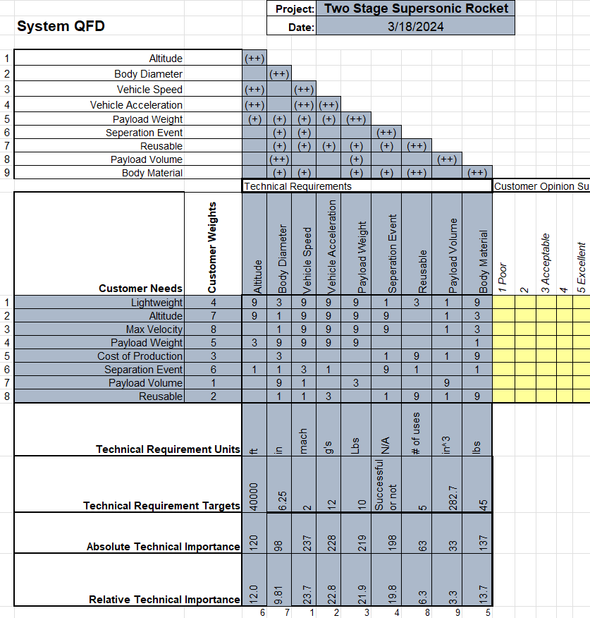
Design Requirements QFD
Discussions with Client changed the weights and rankings of CR's.
Changed the weights of ER's.
Re-weighted the body rankings
ER Importance:
Vehicle Speed
Vehicle Acceleration
Payload Weight
Separation Event
Body Material
Altitude
Body Diameter
Reusable
Payload volume
Koi 4/1/24 NG Super Sonic Rocket

Slide 14
Engineering Calculations: Sep. System
Upper Stage
Conditions of Separation
Altitude = 9500 ft
Velocity = 430mph (630.67ft/s)
Holding Strength:
10.12lbf * 6 = 60.72lbf ≥ W₁ = 13.01lbf
Assisted Separation Strength:
F = -kx = -1.9lbf/in(-4.658in)→ 8.85lbf
Number of Springs (6) → 53.1lbf
Lower Stage
W = 13.01lbf
$$F_{d}=\frac{1}{2}ρV^{2}AC_{d}$$
W = 48.53lbf
$$W=mg$$
F_{f} = 857.76lbf
F_{D} = 60.18lbf
F_{f} = 1586.81lbf
$$ΔF=800lbf$$
Sep. System
Avery 4/1/24 NG Super Sonic Rocket

Slide 15
Engineering Calculations: Nosecone
Fineness Ratio
Stagnation Temperature
$$T_{stag}=T_{s}\left(1+\frac{γ−1}{2}∗Ma^{2}\right)$$
$T_{stag}=$387 K
$$T_{s}=215K$$
γ = 1.4
Ma = 2
Typical cure temperatures for carbon fiber pre-pregs ~ 250 °F or 350 °F, therefore a resin system that is cured at 350 °F would be preferred
Lindsey 4/1/24 NG Super Sonic Rocket

Slide 16
Engineering Calculations: Rocksim
Austin 4/1/24 NG Super Sonic Rocket

Slide 17
Engineering Calculations: Fin Drag
Used the Drag Force formula:​
​
​
​
Variables:​
C_d = 0.005​
V = Mach 2 = 1535 (mph) = 686 (m/s)​
A = 26 (in^2) = 0.103226 (m^2)​
P = 8.80349*10^-2 (kg/m^3) = 0.0880349 (kg/m^3)​
​
Answer:​
D = 10.7 N = 2.403 (lbf) (Individual fin)​
D_tot = 10.7 N * 8 = 85.53 (N) = 19.23 (lbf) (total of all fins)​
​
Assumptions: Coefficient is of a flat plate at turbulent flow, the density of air is at an elevation of 20,000ft, the area used is the planform area. Some error due to compressiblility at Mach 2.​
Koi 4/1/24 NG Super Sonic Rocket

Slide 18
Failure Mode Element Analysis
Item # | Item | Failure | Root Cause | Likelihood 1 = least 5 = most | Severity 1 = least 5 = most | Precaution | Performance 1 = least 5 = most | Schedule 1 = least 5 = most | Cost 1 = least 5 = most
1.1 | Separation System (Staging) | Fails to Separate, buckling, thermal, | Electrical Failure, Mechanical failure | 3 | 5 | Ground Testing before launch to certify system | 1 | 3 | 3
1.2 | Separation System (Structural) | Failure in flight of sep. system, impact, thermal | System detaches mid-flight/ aero forces exceed limits | 2 | 4 | Ensure system is secured before flight. | 1 | 3 | 3
1.4 | Body (Structural) | Body bending, cracks, deformities | Forces during flight/temperature | 2 | 5 | Visual/NDT inspections | 2 | 2 | 3
1.5 | Fins (Structural) | Bending, cracks, deformities | Material deformation, adhesive epoxy failure | 2 | 5 | Visual/ NDT inspections | 2 | 2 | 3
1.6 | Avionics | Flight computers do not set off energetics | Battery failure, electrical short, match failure | 2 | 5 | Ground testing with energetics | 4 | 2 | 3
Avery 4/1/24 NG Super Sonic Rocket

Slide 19
Testing Procedures
Structural Component Testing: Composite material strength testing, Separation system, Fin assembly.
These components will be simulated and tested to ASME D638 and other applicable standards.
Meets our structural testing requirement
Functionality Test of Systems: Avionics deployment, Separation system deployment, Payload ground testing
All systems will be tested individually for this series of tests.
Proves function of systems apart of the staging system and payload
Systems Test: Full dress rehearsal of the launch vehicle (Not including energetics)
Proves launch vehicle is ready for flight and functions as expected
Subscale Testing: Built and tested subscale launch vehicle
Further proves components and will be used for scale up data collection and improvements. This will be launched to collected data.
Full scale launch: Final launch vehicle will be constructed and ran through the testing procedures and complete a full flight.
Austin 4/1/24 NG Super Sonic Rocket

Slide 20
Budget Plans
Budget | Description | Amount
Funding Available | Northrop Grumman | $7,000
Pending Expenses | Sep system parts | ~$60
Anticipated Expenses | Avionics, RockSim Licenses, Rocket motor propellant, Separation System parts | ~$3,000
Balance |  | $6,040
Funding:
1) Northrop Grumman - $7,000
2) Fundraising 10% - $700
GoFundMe - $160
Friends/Family Donations
Potential fundraising collaboration w/Rocket Club
In-contact with Nova Kinetics for material donations
Lead with McMaster-Carr for hardware donations
Donations from other organizations suggested by client
PHOTO
Lindsey 4/1/24 NG Super Sonic Rocket

Slide 21
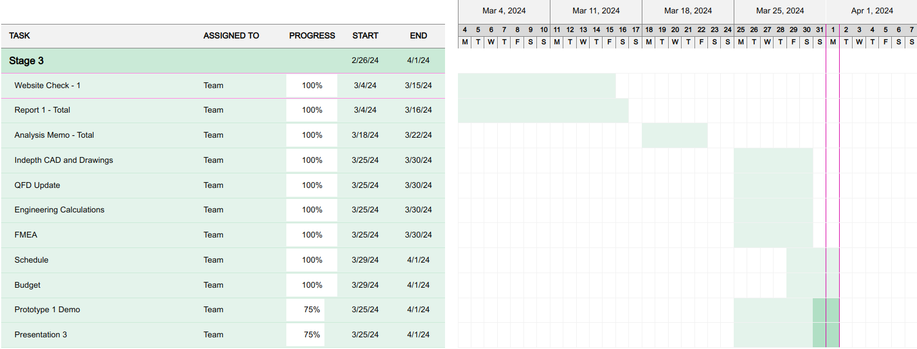
Schedule (02/26-04/01)
Lindsey 4/1/24 NG Super Sonic Rocket

Slide 22
Next Steps
Website Update
Prototype 2
Analysis on designed components
Prototype revision and testing
Continuing fundraising and reaching out for sponsorship and donations
Planning for next semester
Lindsey 4/1/24 NG Super Sonic Rocket

Slide 23
Conclusion
Thank you!
Questions?
PHOTO
NG Super Sonic Rocket

Slide 24
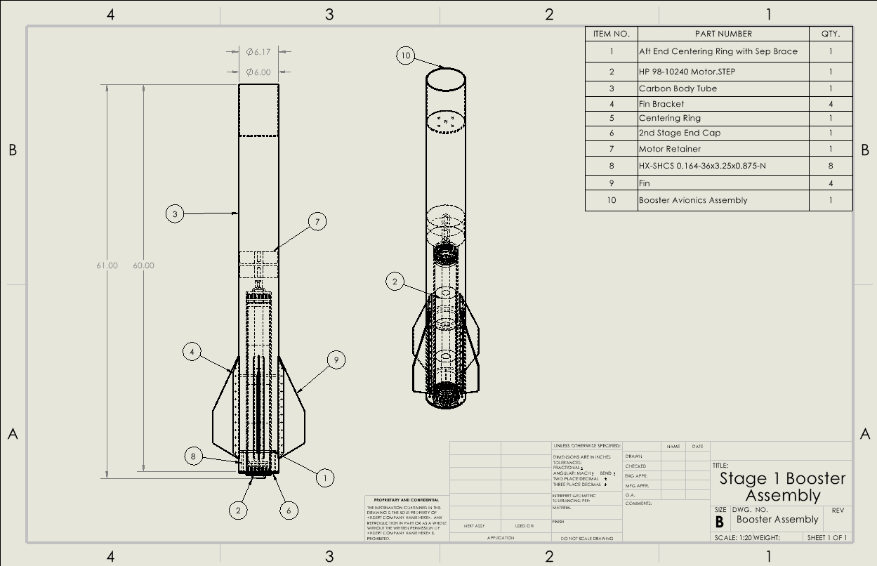
CAD: Booster Assembly
Koi 4/1/24 NG Super Sonic Rocket

