Slide 1

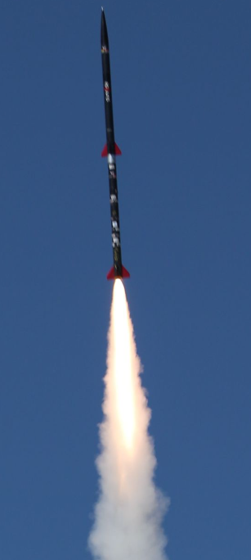
NG Super Sonic Rocket
Presenters: Austin Paothatat, Avery Charley, Koi Quiver,
Lindsey Dineyazhe
Figure 1: Two stage rocket
University of Sheffield [1]

Slide 2

Project Description
Our team is working towards building a two-stage supersonic rocket that will make use of advanced composite materials. Our foremost goal is to not only meet but surpass our customers’ expectations while keeping the budget under $7,300. Some important details to note are that we plan to conduct test flights in Fall 2024 and have a small-scale prototype ready by late April.
Stakeholders
  Northrop Grumman
Avery 2/5/24 NG Super Sonic Rocket

Slide 3
Project Purpose
Provide launch vehicle for future capstone payload
Research and design a two-stage rocket capable of recording data
Provide a test bed for a future space shot rocket
Funding:
Northrop Grumman Space Systems, $7,300
Avery 2/5/24 NG Super Sonic Rocket

Slide 4
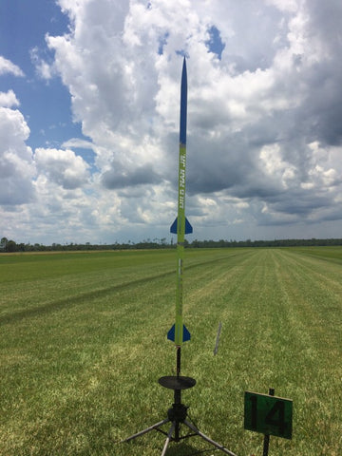
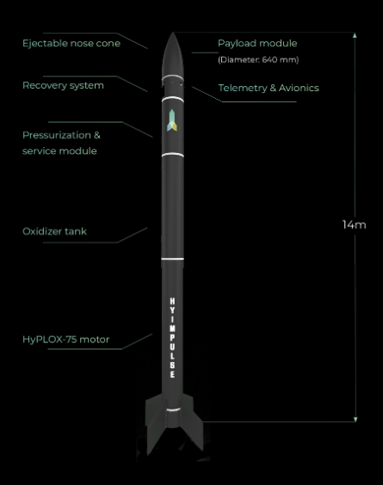
Background and Bench Marking
Hyimpulse:
Commerical launch provider
Pros:
Exceeds requirements
Recoverable rocket and payload
Cons:
Expensive
Requires large team and ground support equipment
Wildman Jr Kit:
Pros:
Small diameter
Low cost
Simple design
Cons:
No payload capability
Doesn't meet our requirements
Figure 1: Wildman two stage rocket kit [1]
Figure 2: Hyimpulse sounding rocket [2]
Austin 2/5/24 NG Super Sonic Rocket

Slide 5
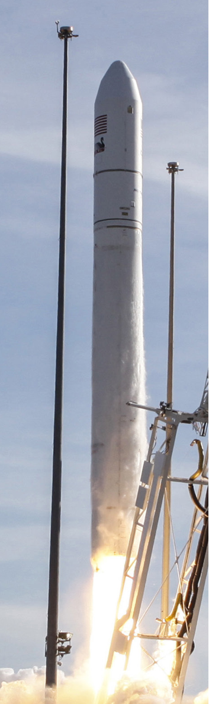
Customer Requirements
Develop a two- stage launch vehicle
Vehicle will be constructed of composite material
Rocket will reach an altitude of at least 40,000 ft AGL (Above Ground Level)
Scaled prototype rocket required as a proof of concept
Final launch vehicle will be required to carry a maximum 10 Lb payload that will fit within a 6" diameter bay
Vehicle require to reach and maintain over Mach 2 or roughly 1500 mph and maximize time spent at that speed or greater
Acceleration of the vehicle needs to meet a minimum of 12g's
Vehicle trajectory will be simulated in Matlab and in Rocksim
Composite structural components will be simulated and tested to ASME standards
Current payload will carry instrumentation to measure vibrations during flight test and the ability for the team to predict them
Vehicle required to use commercial rocket motors
Recovery of entire launch vehicle for reuse
Figure 3: NG Antares Launch vehicle [3]
Austin 2/5/24 NG Super Sonic Rocket

Slide 6
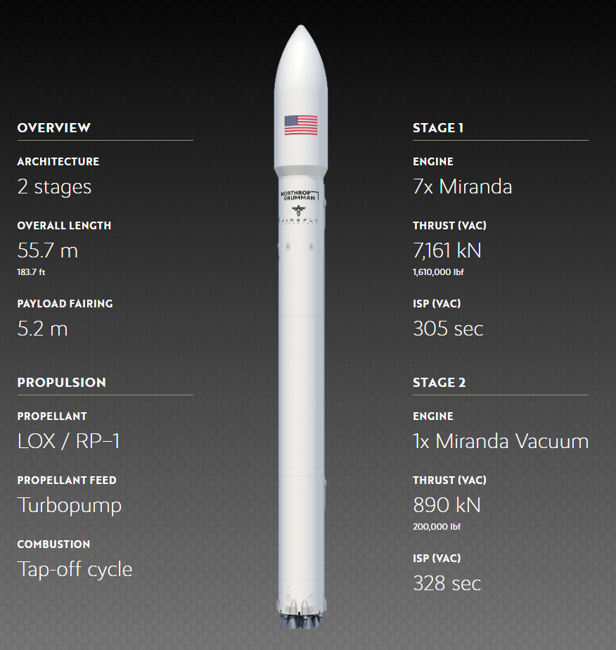
Engineering Requirements
Altitude of at least 40,000 ft AGL (Above Ground Level)
Required to carry a maximum 10 Lb payload
Require to reach and maintain over Mach 2 or roughly 1500 mph and maximize time spent at that speed or greater
Acceleration of the vehicle needs to meet a minimum of 12g's
Composite structural components will be simulated and tested to ASME standards
Current payload will carry instrumentation to measure vibrations during flight test and the ability to predict them
Recovery of entire launch vehicle for reuse
Figure 4: NG MLV Launch vehicle [4]
Koi 2/5/24 NG Super Sonic Rocket

Slide 7
QFD
Customer Weights: 9 (Greatest) – 1 (Least)
QFD Body Requirements:
  Strong - 9
  Moderate - 3
  Weak - 1
  None – 0
Results:
  Motors (1) - Pre-determined
  Payload capacity (2) - Pre-determined
  Aerodynamics (3) - Ability to engineer (1)
  Vehicle Acc. (4) - Ability to engineer (2)
  Altitude (5) - Ability to engineer (3)
  Vehicle Speed (6) - Ability to engineer (4)
  Body Material (7) - Semi-determined (6)
  Separation System (8) - Ability to engineer (5)
  Body Diameter (9) - Semi-Determined (7)
Koi 2/5/24 NG Super Sonic Rocket

Slide 8
State-of-the-Art Literature
Review
Literature Review: Staging
Books:
  J. D. Anderson, Fundamentals of Aerodynamics, 6th ed. New York, NY: McGraw-Hill Education, 2017.
  Chandler Karp, A., & Jens, E. T. (2024). Hybrid Rocket Propulsion Design Handbook (First edition.). Academic Press. Chapter 10 p 232
  D. P. MISHRA, Fundamentals of Rocket Propulsion. Boca Raton, FL: CRC PRESS, 2020.
Articles:
  L. Zhu, J. Song, B. Hu, and Z. Xu, “Numerical Investigation on the Interaction between Rocket Jet and Supersonic Inflow,” Journal of Physics: Conference Series, vol. 2460, no. 1, p. 012066, Apr. 2023. doi:10.1088/1742-6596/2460/1/012066
  O. Eryilmaz and E. Sancak, “Effect of Silane Coupling Treatments on Mechanical Properties of Epoxy Based High-Strength Carbon Fiber Regular (2 x 2) Braided Fabric Composites,” Polymer Composites, vol. 42, no. 12, pp. 6233–6954, Dec. 2021. doi:https://doi.org/10.1002/pc.26311
Website:
  R. Nakka, “Fins for Rocket Stability,” Richard Nakka’s Experimental Rocketry Site, http://www.nakka-rocketry.net/fins.html (accessed Feb. 5, 2024).
Avery 2/5/24 NG Super Sonic Rocket

Slide 9


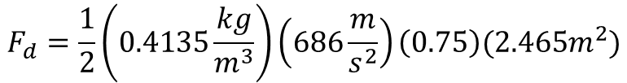
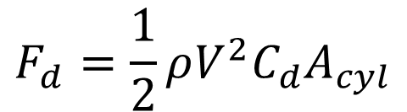

Drag Force for Separation
Drag Equation
Parameters
  Density ($ρ$) at 10,000m = $0.4135\frac{kg}{m^{3}}$
  Velocity (V) at Mach 2+ = $686+\frac{m}{s^{2}}$
  Coefficient of Drag ($C_{d}$) = $\sim 0.75 −0.89$
  Cylinder Area (A)
    Diameter (~8in) x length (~6ft) = $\sim 2.465 m^{2}$
    Diameter (~6in) x length (~5ft) = $\sim 1.532 m^{2}$
$$F_{d}=\frac{1}{2}ρV^{2}C_{d}A_{cyl}$$
Lower Stage
$$F_{d}=\frac{1}{2}\left(0.4135\frac{kg}{m^{3}}\right)\left(686\frac{m}{s^{2}}\right)\left(0.75\right)(2.465m^{2})$$
$$F_{d}=262.21N$$
PHOTO
Mechanical connection between stages needs to be less than Drag Force on 1st Stage.
$$F_{s}≤F_{d}=262.21 N$$
Avery 2/5/24 NG Super Sonic Rocket

Slide 10
State-of-the-Art Literature Review
Literature Review: Rocket Design
Books:
  Rocket Propulsion. Laxmi Publications Pvt Ltd, 2016.
    Basic rocket design textbook, goes into fundamentals of rocket science
  F. R. (Feliks R. Gantmakher, L. M. Levin, and E. T. J. Davies, The flight of uncontrolled rockets. Oxford, England: Pergamon Press, 1964.
    Trajectory textbook for uncontrolled flight, will be useful in simulating vehicle in our Matlab code.
Articles:
  G. Srinivas and M. V. S. Prakash, “Aerodynamics and flow characterisation of multistage rockets,” IOP conference series. Materials Science and Engineering, vol. 197, no. 1, pp. 12077-, 2017, doi: 10.1088/1757-899X/197/1/012077.
    Covers aerodynamics on two-stage launch vehicle configurations
  A. Okninski, “Multidisciplinary optimisation of single-stage sounding rockets using solid propulsion,” Aerospace science and technology, vol. 71, pp. 412–419, 2017, doi: 10.1016/j.ast.2017.09.039.
    Can be used to optimize the second stage to get maximum performance
Dissertations:
  Z. Doucet, “Multistage 2-DOF Rocket Trajectory Simulation Program for Freshmen Level Engineering Students,” ProQuest Dissertations Publishing, 2019.
    Reference for trajectory simulation in our matlab code requirement
Websites:
  “Glenn Research Center,” NASA, https://www1.grc.nasa.gov/ (accessed Feb. 4, 2024).
    Overall source for fundamental rocketry
Austin 2/5/24 NG Super Sonic Rocket

Slide 11
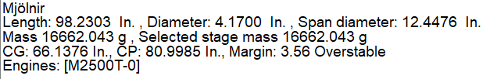
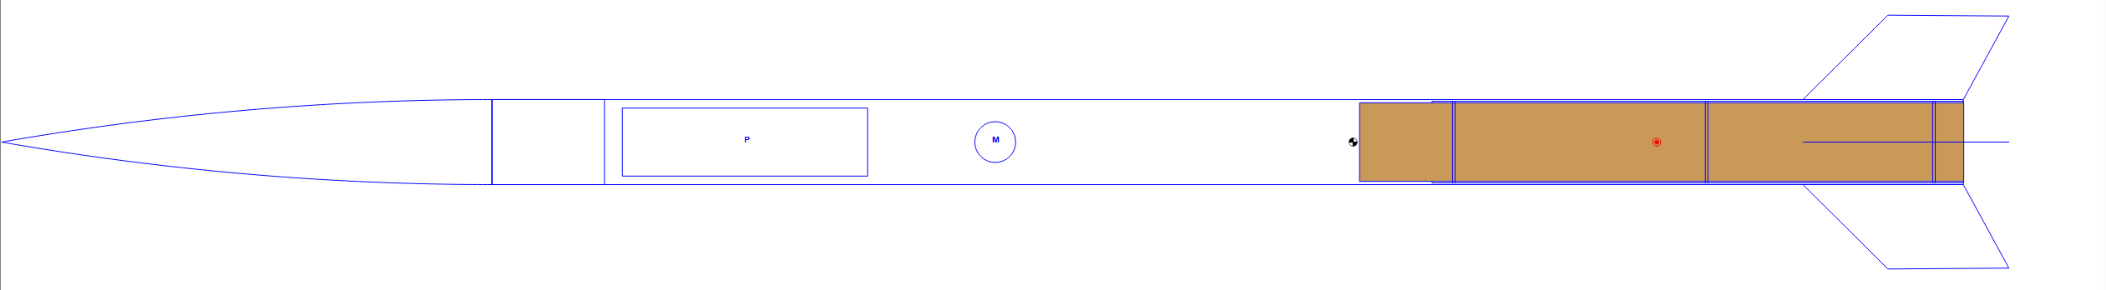
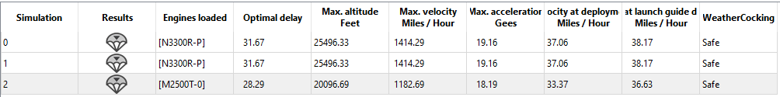
Rocket Simulation
Mathematical Modeling: Rocksim Simulation Tool
PHOTO
[3] Engineering ToolBox
Austin 2/5/24 NG Super Sonic Rocket

Slide 12
State-of-the-Art Literature
Review
Literature Review: Aerodynamics and rocket design
Books:
  W. H. Dorrance, Viscous hypersonic flow : theory of reacting and hypersonic boundary layers. Mineola, New York: Dover Publications, Inc, 2017.
    This book has equations and information on how to try and calculate for hypersonic aerodynamics. Focuses on drag and friction of the rocket.
  Sutton, Rocket Propulsion Elements. John Wiley & Sons, 2001.
    This book is fundamental information on how to calculate rocket motor propulsion. Along with rocket fundamentals.
Articles:
  A. Iyer and A. Pant, “A REVIEW ON NOSE CONE DESIGNS FOR DIFFERENT FLIGHT REGIMES,” International Research Journal of Engineering and Technology (IRJET), vol. 07, no. 08, pp. 3546–3554, Aug. 2020, Available: https://www.irjet.net/archives/V7/i8/IRJET-V7I8605.pdf
    Information and guidance on which designs of nose cones affect supersonic flight. Along with design benefits and disadvantages of each design with calculations.
  A. Mishra, K. Gandhi, K. Sharma, N. Sumanth, and Y. Krishna. Teja, “CONCEPTUAL DESIGN AND ANALYSIS OF TWO STAGE SOUNDING ROCKET,” International Journal of Universal Science and Engineering, vol. 07, pp. 53–73, Aug. 2021.
    Information on general two stage rocket design and analysis. Used to understand how to fundamentally build two stage rockets.
  P. Davies et al., “Preliminary design and test of high altitude two-stage rockets in New Zealand,” Aerospace Science and Technology, vol. 128, pp. 107741–107741, Sep. 2022, doi: https://doi.org/10.1016/j.ast.2022.107741.
    Information on how to design a high altitude two stage rocket. In depth procedures and calculations.
  P. Żurawka, N. Sahbon, D. Pytlak, M. Sochacki, A. Puchalski and S. Murpani, "Multi-objective optimization of a fin shape for a passive supersonic rocket stage," 2023 IEEE Aerospace Conference, Big Sky, MT, USA, 2023, pp. 1-12, doi: 10.1109/AERO55745.2023.10115859.
    Information on how to design rocket fins. Rocket some information on rocket fin design for supersonic applications.
Koi 2/5/24 NG Super Sonic Rocket

Slide 13




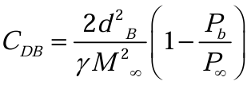

Nose Cone Drag
Initial Formulas:
Known Variables:
C_f = 0.75
D_b = 12in
M_inf = 2.0 Mach
P_inf = 2.7 psi
After Known Variables:
Zero Lift Drag
Skin Friction Drag
Wetted Area and Viscosity Drag
Base Drag
Zero Lift Drag
Skin Friction Drag
Wetted Area and Viscosity Drag
Base Drag
Unknown Variables:
S_w = wetted Area
V = volume
S = area
L = length
K_vw = thermal conductivity
P_b = pressure at base
Gamma = ratio of specific heats
PHOTO
[14] A. Iyer and A. Pant, “A REVIEW ON NOSE CONE DESIGNS FOR DIFFERENT FLIGHT REGIMES,”
Koi 2/5/24 NG Super Sonic Rocket

Slide 14
State-of-the-Art Literature
Review
Literature Review: Nose Cone Design
Books/Chapters:
  A Kanni Raj, "A - C F D - Applied Computational Fluid Dynamic Analysis of Thermal and Fluid Flow Over Space Shuttle Or Rocket Nose Cone". Createspace Independent Publishing Platform, 2016.
    Analyses thermal and fluid flow over a rocket nose cone to assess what kind of nose cone would be better able to withstand high temperatures that are generated from aerodynamic heating.
  Eugen Sänger, "Rocket Flight Engineering". 1965.
    Discusses all components of rocketry, some chapters focusing on nose cone design best for supersonic flight.
Papers:
  B. Mathew, O. Bandyo, A. Tomar, A. Kumar, A. Ahuja, and K. Patil, “A review on computational drag analysis of rocket nose cone.” Available: https://ceur-ws.org/Vol-2875/PAPER_11.pdf
    Identifies various nosecone shapes and their characteristics at different Mach numbers to determine best used for minimizing drag and heat generation.
  Airesearc, E. Perkins, L. Jorgensen, and S. Sommer, “NATIONAL ADVISORY COMMITTEE FOR AERONAUTICS INVESTIGATION OF THE DRAG OF VARIOUS AXIALLY SYMMETRIC NOSE SHAPES OF FINENESS RATIO 3 FOR MACH NUMBERS FROM 1.24 TO 7.4.” Available: https://ntrs.nasa.gov/api/citations/19930091022/downloads/19930091022.pdf
    Determine best nose cone shapes for various Mach numbers with a fineness ratio of 3.
  M. Ajuwon et al., “Optimization Design of Rocket Nosecone for Achieving Desired Apogee by Empirical Research and Simulation-Based Comparison.” Available: http://ieworldconference.org/content/SISE2020/Papers/Ajuwon.pdf
    Determine best nose cone shapes for various Mach numbers with a fineness ratio of 3.
Online Resources:
  “Richard Nakka’s Experimental Rocketry Site,” www.nakka-rocketry.net. https://www.nakka-rocketry.net/RD_nosecone.html.
    An overview of nose cone components and terms for better understand of design.
Lindsey 2/5/24 NG Super Sonic Rocket

Slide 15

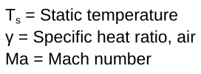
Stagnation Temperature on Nose Cone
*Maximum stagnation temperature of nosecone needs to be below the melting point of the material of the nose cone to avoid damage and melting.
[3] Engineering ToolBox
Lindsey 2/5/24 NG Super Sonic Rocket

Slide 16
Budget Plans
Funding:
1) $7,000 – Northrop Grumman
2) Fundraising 10% - $700
  Material donations
  GoFundMe
Budget | Description | Amount
Funding Available | Northrop Grumman | $7,000
Expenses To Date | None | -$0
Anticipated Upcoming Expenses | Avionics, RockSim Licenses, Rocket Certifications | ≤$1,500
Balance |  | $7,000
PHOTO
Lindsey 2/5/24 NG Super Sonic Rocket

Slide 17
Schedule
Gantt Chart: Updated Gantt chart up to presentation 1.
 |  |  |  |  |  | Jan 22, 2024 |  |  |  |  |  |  | Jan 29, 2024 |  |  |  |  |  |  | Feb 5, 2024 |  |  |  |  |  |  | Feb 12, 2024
TASK | ASSIGNED TO | PROGRESS | START | END |  | 22 | 23 | 24 | 25 | 26 | 27 | 28 | 29 | 30 | 31 | 1 | 2 | 3 | 4 | 5 | 6 | 7 | 8 | 9 | 10 | 11 | 12 | 13 | 14 | 15 | 16 | 17 | 18
 |  |  |  |  |  | M | T | W | T | F | S | S | M | T | W | T | F | S | S | M | T | W | T | F | S | S | M | T | W | T | F | S | S
Stage 1 | Team |  | 1/22/24 | 2/5/24
Team Selection | Team | 100% | 1/22/24 | 1/22/24
Staff/Team Meeting 1 | Team | 100% | 1/22/24 | 1/22/24
Client Meeting 1 | Team | 100% | 1/26/24 | 1/26/24
Team Charter | Team | 100% | 1/22/24 | 1/26/24
Staff/Team Meeting 2 | Team | 100% | 1/29/24 | 1/29/24
Client Meeting 2 | Team | 100% | 1/30/24 | 1/30/24
Presentation 1 | Team | 100% | 1/29/24 | 2/5/24
Lindsey 2/5/24 NG Super Sonic Rocket

Slide 18
Conclusion
Thank you!
Questions?
PHOTO
2/5/24 NG Super Sonic Rocket

Slide 19
References
[1] “Karman Alpha,” Karman Alpha, https://sunride.sites.sheffield.ac.uk/legacy-projects/karman-alpha (accessed Feb. 4, 2024).
[2] “JR STG UPG-WM,” wildmanrocketry.com, https://wildmanrocketry.com/products/jr-stg-upg-wm?_pos=6&_sid=9da97005a&_ss=r (accessed Feb. 4, 2024).
[3] T. Schnell, “Sounding Rocket,” Home, https://www.hyimpulse.de/en/products/4-project-2-sounding-rocket (accessed Feb. 4, 2024).
[4] “Antares Rocket,” Northrop Grumman, https://www.northropgrumman.com/space/antares-rocket (accessed Feb. 4, 2024).
[5] “Medium Launch Vehicle,” Firefly Aerospace, https://fireflyspace.com/mlv/ (accessed Feb. 4, 2024).
[6] R. Nakka, “Fins for Rocket Stability,” Richard Nakka’s Experimental Rocketry Site, http://www.nakka-rocketry.net/fins.html (accessed Feb. 5, 2024).
[7] O. Eryilmaz and E. Sancak, “Effect of Silane Coupling Treatments on Mechanical Properties of Epoxy Based High-Strength Carbon Fiber Regular (2 x 2) Braided Fabric Composites,” Polymer Composites, vol. 42, no. 12, pp. 6233–6954, Dec. 2021. doi:https://doi.org/10.1002/pc.26311
[8] L. Zhu, J. Song, B. Hu, and Z. Xu, “Numerical Investigation on the Interaction Between Rocket Jet and Supersonic Inflow,” Journal of Physics: Conference Series, vol. 2460, no. 1, p. 012066, Apr. 2023. doi:10.1088/1742-6596/2460/1/012066
[9] J. D. Anderson, Fundamentals of Aerodynamics, 6th ed. New York, NY: McGraw-Hill Education, 2017.
[10]Chandler Karp, A., & Jens, E. T. (2024). Hybrid Rocket Propulsion Design Handbook (First edition.). Academic Press. Chapter 10 p 232
[11] D. P. MISHRA, Fundamentals of Rocket Propulsion. Boca Raton, FL: CRC PRESS, 2020.
[12] W. H. Dorrance, Viscous Hypersonic Flow : Theory of Reacting and Hypersonic Boundary Layers. Mineola, New York: Dover Publications, Inc, 2017.
[13] Sutton, Rocket Propulsion Elements. John Wiley & Sons, 2001.
[14] A. Iyer and A. Pant, “A REVIEW ON NOSE CONE DESIGNS FOR DIFFERENT FLIGHT REGIMES,” International Research Journal of Engineering and Technology (IRJET), vol. 07, no. 08, pp. 3546–3554, Aug. 2020, Available: https://www.irjet.net/archives/V7/i8/IRJET-V7I8605.pdf
PHOTO

Slide 20
References
  [15] A. Mishra, K. Gandhi, K. Sharma, N. Sumanth, and Y. Krishna. Teja, “CONCEPTUAL DESIGN AND ANALYSIS OF TWO STAGE SOUNDING ROCKET,” International Journal of Universal Science and Engineering, vol. 07, pp. 53–73, Aug. 2021.
  [16] P. Davies et al., “Preliminary Design and Test of High Altitude Two-Stage Rockets in New Zealand,” Aerospace Science and Technology, vol. 128, pp. 107741–107741, Sep. 2022, doi: https://doi.org/10.1016/j.ast.2022.107741.
  [17] P. Żurawka, N. Sahbon, D. Pytlak, M. Sochacki, A. Puchalski and S. Murpani, "Multi-Objective Optimization of a Fin Shape for a Passive Supersonic Rocket Stage," 2023 IEEE Aerospace Conference, Big Sky, MT, USA, 2023, pp. 1-12, doi: 10.1109/AERO55745.2023.10115859.
PHOTO

