Slide 1
Northern Arizona University Preliminary Design Review
Presenters: Brandon Knutson, Isaiah Padilla, Daniel Cooke, Mason Goodman, Mica Nellis, Russel Stringham

Slide 2
Summary
The NAU engineering team is designing a robotic drilling arm that is required to perform various tasks that are included but not limited to, being fully autonomous, drilling through composite materials, and various bolt clearances. Throughout the team’s design process so far, we have had various concepts considered and eventually ruled out through Failure Modes and Effects Analysis (FMEA), as well as Most Viable Product and benchmarking different subsystems within the design. Once the team produced a design that would perform all required tasks effectively and efficiently a first prototype was created of a four-axis robotic drilling arm:
Axis 1: Base axis of the robot allowing for movement left to right
Axis 2: Allows robotic arm to move forward and backwards from its center controlling the lower half
Axis 3: Provides robots the ability to move in the x, y, and z controlling upper arm allowing for vertical reach
Axis 4: End-effector location allowing “wrist” to rotate
This was the best option for the team thus far, overall, we believe this design will ensure our success going forward.
The next steps for the team will be to create a final CAD design as well as a bill of materials (BOM) as well as the second report discussing all progress and changes thus far. We hope to begin ordering parts for final design in preparation for Northrop Grumman Design Day.

Slide 3
Introduction
Purpose & Review:
Our team is designing a robotic drilling arm for Northrop Grumman Space Systems
Drill through composite materials to bolt secondary structures such as brackets or tubing
Have a robotic drilling arm that can locate any point on a cylinder and apply enough force to drill through composite material, also allowing for various bolt clearances
Fully automated design allowing for custom locations
Make a design that is more efficient for Northrop Grumman
Allow for more “in-house” manufacturability
Save Northrop Grumman the cost of performing tests away from the facility

Slide 4
System Requirements
Working Volume
Max Diameter: 50’’
Max Height: 48’’
Cylindrical Surface
Drilling Capabilities
Material: Composite material equivalent to ¼‘’ thick aluminum.
Multiple drill bits for varying hole sizes.
Varying directions and surface conditions.
Drilling Tolerance: .003’’
Fully Autonomous
User should be able to use control system to select a preprogrammed setting for the desired job.
E-stop that can detect overheating or system malfunction and automatically shut down.
Mobility
System should be on wheels, capable of being moved by no more than two people for placement.
System will be locked in place.
Cylinder will be lowered around system and locked in place.
Total Product Weight: < 200 Pounds
Other
Cost effective: Low product and maintenance costs.
Must be able to work continuously through a 10 -hour workday.
Strictly electronic running on standard household appliance power access (no hydraulics).

Slide 5
Functional Model

Slide 6
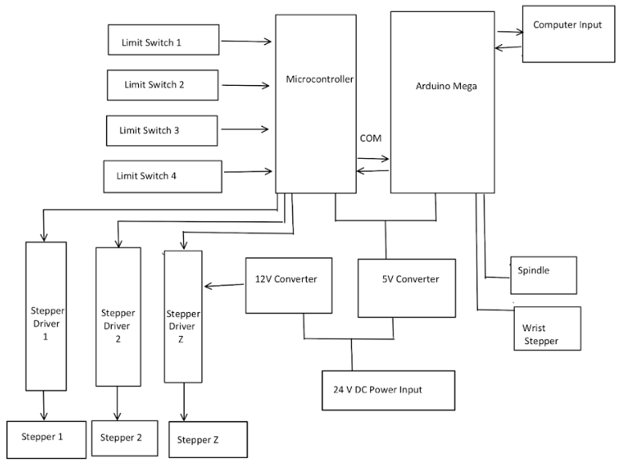
System Block Diagram

Slide 7
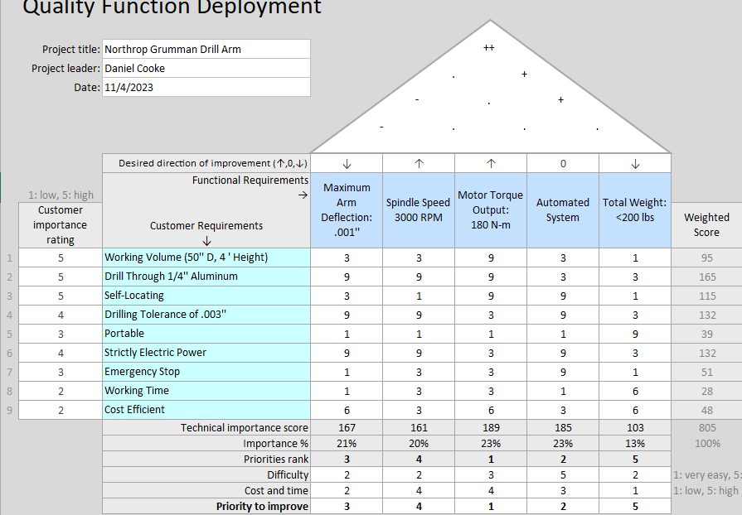
Quality Function Deployment
Functional Requirements
Spindle Speed: 3000 RPM
Motor Torque Output: 180 N-m (With Gearbox)
Motor Holding Torque: 148 N-m (With Gearbox)
Max Arm Deflection: .001’’
Max Arm Reach: 29’’
Total Product Weight: < 200 lbs
Power Source: Standard Household 220V PS
Slewing Drive ROM: 360$°$
Stepper Motor ROM: 180$°$

Slide 8
Verification Methods
Kinematic Verification
SolidWorks - Motion Study.
Verifies range of motion, working volume, and interferences.
Initial Prototype
Deflection Analysis
SolidWorks - FEA
Study with varying beam shapes and material
80/20 Deflection Test
Measured deflection of 80/20 Aluminum under static loading to compare with FEA analysis.
Interactive Protype Assessment
Protype Drilling Test
Ensure rpm of spindle meets design needs
Movement Oriented Extended Run Time Test
Industry applicable design based on daily needs
Real - World Simulation
Overall evaluation of customer request

Slide 9
Verification Matrix

Slide 10
Design Concepts
Computation Power | Power Transmission | Closed Loop System | Base Rotation
Arduino Mega Ramps Board | Stepper Motors, Planetary Gear Boxes, Belts | External Magnetic Encoders, I2C Bus | Slewing Drive Extendable legs
Design | Geometry | Motors | Coordinate Systems
6 DOF | 3 near identical members assembled to create a highly maneuverable appendage. | 6+ | Denavit-Hartenberg
Spherical | Used and extendable arm appendage originating from a fixed point that could correct orientation and wrist joint | 4+ | Spherical
Geometric | Use of fixed parallel and perpendicular linkages to keep constant orientation with respect to operation material | 3+ | Cylindrical
[1,2,3]

Slide 11
Design concept
Spindle
110V Wall Power
Human Interface
Computational Device
Motor Drivers
Stepper Motor's
Gearboxes' and Belt's
Motor Encoder
Operational Movement

Slide 12
PUGH sTUDY
Criteria | 6 DOF (Base Line) | Spherical | Geometric
Portability | 0 | 0 | +1
Cost | 0 | +1 | +1
Accuracy | 0 | -1 | +1
Manufacturing | 0 | -1 | +1
Resources | 0 | -1 | 0
Total | 0 | -2 | +4

Slide 13
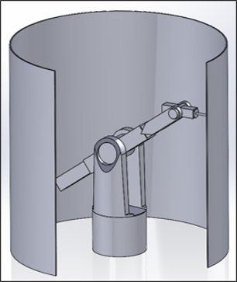
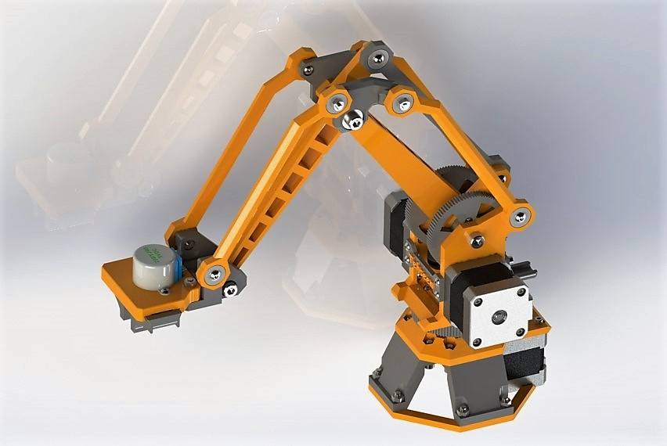
Design concept
6 DOF
Spherical
Geometric
[6,7]

Slide 14
Point Design
Research
Pregenerated and New Concepts
Available Resources (Physical and Intellectual)
Conceptualization
CAD design (Critical)
FEA Testing
Prototyping
Geometry
Electronic (Critical)
Testing
Member Loading (Critical)
Finalization
Addition of Adjustable Triplate
Accuracy and Repeatability
Possible Revision to Parts, Wiring and Code (Critical)

Slide 15
Risk Analysis

Slide 16
Risk Analysis

Slide 17
ENGINEERING ANALYSIS OF MVP Ease of Manufacturing
Manufacturing Considerations
Likelihood of damaged parts dictated manufacturing approached.
Linkages were kept robust and requiring as minimal machining as possible making them cheap and easy to replace.
Vertical Mills have a table travel of over two feet so linkages can be done in one operation reducing tolerance stack up.
Reducing the use of steel because of weight and difficulty of machining

Slide 18
Engineering analysis - MVP Definition
Our Minimum Viable Product is a Portable and Power Efficient device, It will weight under 200lbs in total and be able to use wall power to operate, its purpose and function is to machine holes into cylindrical structures that will then go on to be the bases for mission critical subassemblies. The reasoning for this device is found in the demand for a flexible system that can fill possible gaps in the manufacturing process.
The hope for the final product of this teams robotic drilling arm is to be able to drill through an aluminum cylinder. To do this the robotic drilling arm that is designed needs to be accurate as well as have enough force to accomplish such drilling.

Slide 19
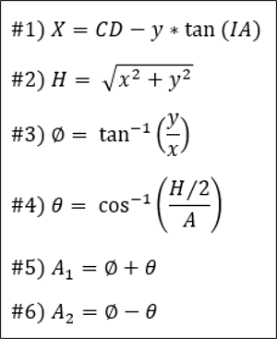
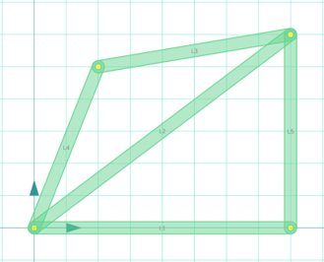
ENGINEERING ANALYSIS OF MVP - Motion Control
Input Hole Position and Cylinder Dimensions
Use #1 to calculate X position
Use # 2 and 3 to calculate Reach (H) and Phi
Use #4 to find Theta
Use #5 and 6 to find angular position of motors

Slide 20
ENGINEERING ANALYSIS OF MVP Geometry Analysis
Geometry mathematically allows for constant perpendicularity with operating surface regardless of position.
Design relies on precision geometry to keep a Spindle platform parallel to the ground and perpendicular to the drilling surface. Achievable using the machinery available.
The Triplate is given the opportunity for an adjustable upgrade that allows for the drilling of sloped surfaces.

Slide 21
Engineering Analysis of MVP - Drill Bit
Three drill bit materials available for usage
Cobalt
High Speed Steel
Titanium Aluminum Nitride (TiAlN) Coating
Previous table compared each bit's material properties
Cobalt bits are the best according to the matrix
This is supported by customer feedback declaring cobalt to be the best for drilling aluminum
Primarily due to better thermal conductivity than other materials

Slide 22
Engineering Analysis of MVP - Drill Bit
Material [9] | Cobalt | High Speed Steel | Titanium Aluminum Nitride (TiAlN) Coating
Properties | S(y) = 225 MPa[10] E = 211 GPa K (thermal conductivity) = 69.21 W/m-K | S(y) = 180 – 500 MPa [11] E = 200 GPa [12] K = 41 W/m-K [13] | E = 600 GPa [14] G (shear) = 240 GPa K = 19.0 W/m-K
Advantages | Preferred material for drilling aluminum, best thermal conductivity, mid yield strength and acceptable E-value | Can have higher yield strength than cobalt but comes at the cost of a worse thermal conductivity value | Coating for drill bits, not a full material, have a long lifespan, and are good for drilling both hard and soft metal
Disadvantages | Costly and can be brittle if not cared for properly | Not suitable for drilling through tougher materials | Once coating wears out, the bit cannot be used until the coating is reapplied

Slide 23
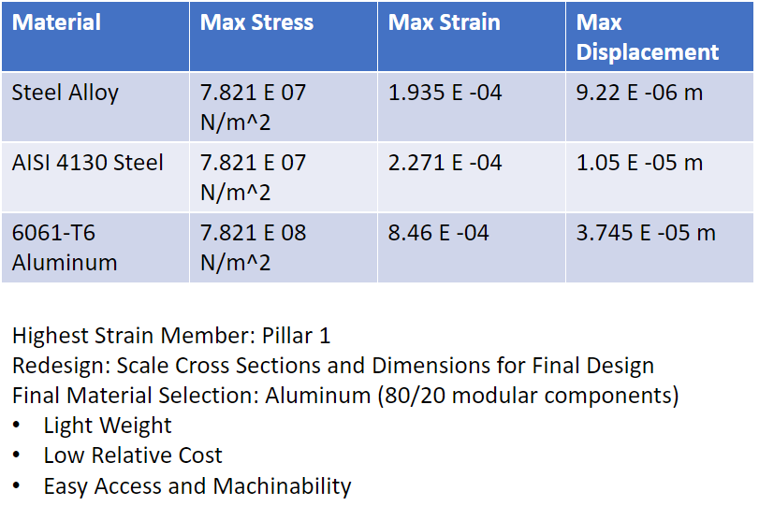
Engineering Analysis of MVP - Deflection
Analysis Conditions
Max Extended Length: 29’’
Exaggerated Reaction Force: 112 lbs
Angle of Maximum Reach: 59 Degrees
End Effector Weight: 22 lbs
Beam Thickness: 4 inches
Drilling Tolerance: .003’’
Max Allowable Deflection: .001’’ = 2.54E -05 m
Aluminum will not yield under static loading during normal operation.

Slide 24
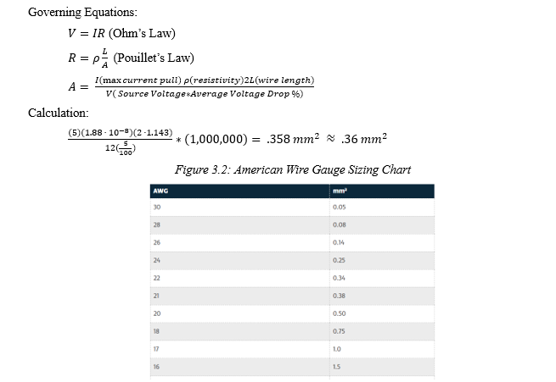
Engineering Analysis of MVP- Wiring Size for Nema Motor
Provides Group Baseline for Wiring Needs Regarding Power
Additional Unknowns for Affect Final Power Supply Determination
21 AWG needed for NEMA Motors

Slide 25
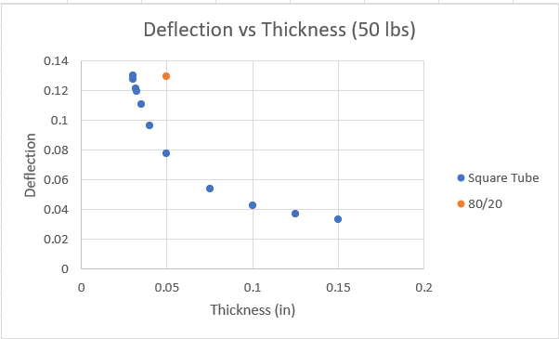
Engineering Analysis of MVP - Deflection
80/20 Cantilever Beam Loading Characteristics
Square Tube Deflection Comparison
Equivalent Tube Wall Thickness: .0303’’
Conclusion: Can reduce weight and material used while maintaining rigidity.

Slide 26
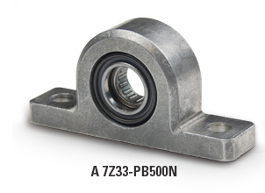
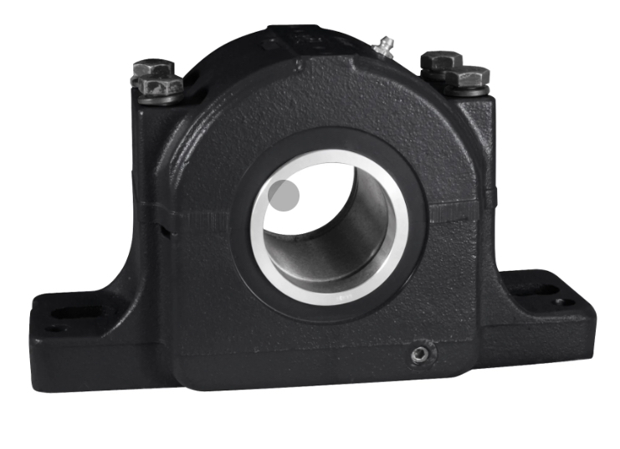
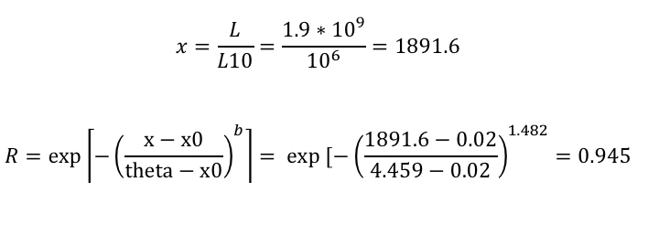
Engineering Analysis of MVP - Bearings
Using the specifications below in GlobalSpec:
Max Speed: 1000 rpm
Max Load: 40 lbs
Max Base-Center Distance: 2 inches
Max Drill Hole Distance: 5 inches
Finding reliability of pillow block bearings (number 1 shown below)
Figure: Pillow Block Bearing 1
Figure: Pillow Block Bearing 2

Slide 27
Engineering Analysis of MVP - Bearings
Bearing Type | Advantages | Disadvantages
Pillow Block Bearing | Extremely durable and has high max speeds | Takes up more space because of mounting block
Thin Section Bearing | Often used within robotic arms and take up very little space when designing | Cannot withstand as much weight and speed

Slide 28
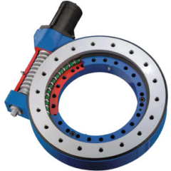
Engineering Analysis of MVP - Bearings
Specifications:
Single Row ball bearing
For heavy load applications
Bore: 145.01 - 524.99 mm
Outside Diameter: 351 – 781 mm
Overall Width: 81.99 - 130 mm
Static Axial Load: 55,329 – 240,816 kg
Static Radial Load: 20,408 - 89,796 kg
External gear only
Figure: Slewing Drive for Base Movement

Slide 29
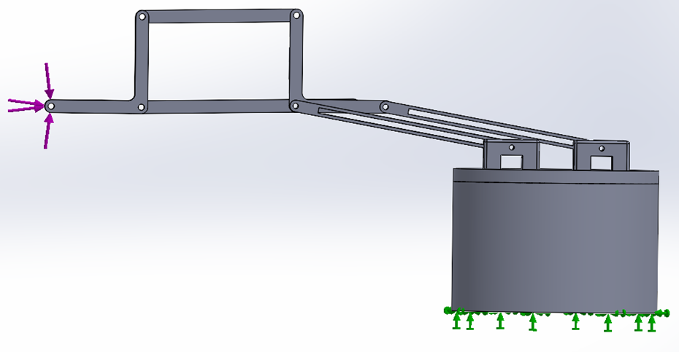
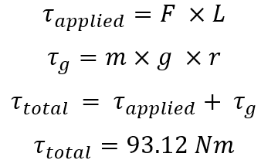
Engineering Analysis of MVP –Holding torque
Gravity
Holding Torque at Full Extension:
Force Applied: 25 N
Fixed Point
Weight of arm (m): 25 kg (245.17 N)
Length of arm (L): 0.7366 m (2.42 ft)
Distance to center of mass (r): 0.3048 m (1 ft)
Gravity (g): 9.81 m/s^2

Slide 30
Rationale for Mvp
Function: This device is wanted by the Northrop Grumman Organization to create a flexible and autonomous solution to manufacturing short comings
Form: The device is manufactured to one perform the requirements of this Function but to also be obtainable using the manufacturing and assembly methods accessible to the Northern Arizona University students. Examples of this is the primary use of aluminum for its weight and ease of manufacturing. The sizing of the system was limited by the constraints of both the material property, the capacity of our machines, and the availability of hardware.

Slide 31
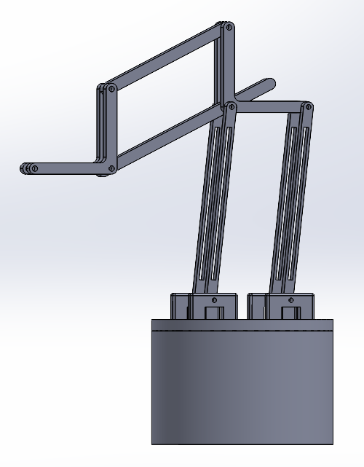
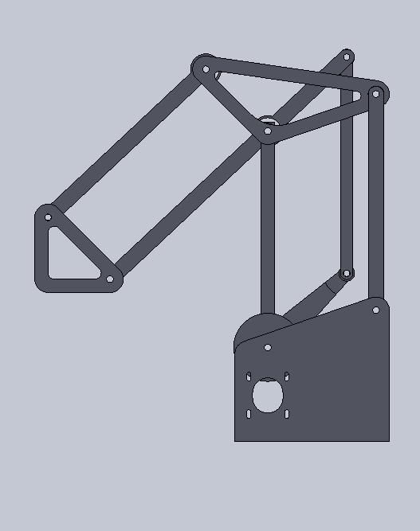
Prototype After MVP Analysis

Slide 32
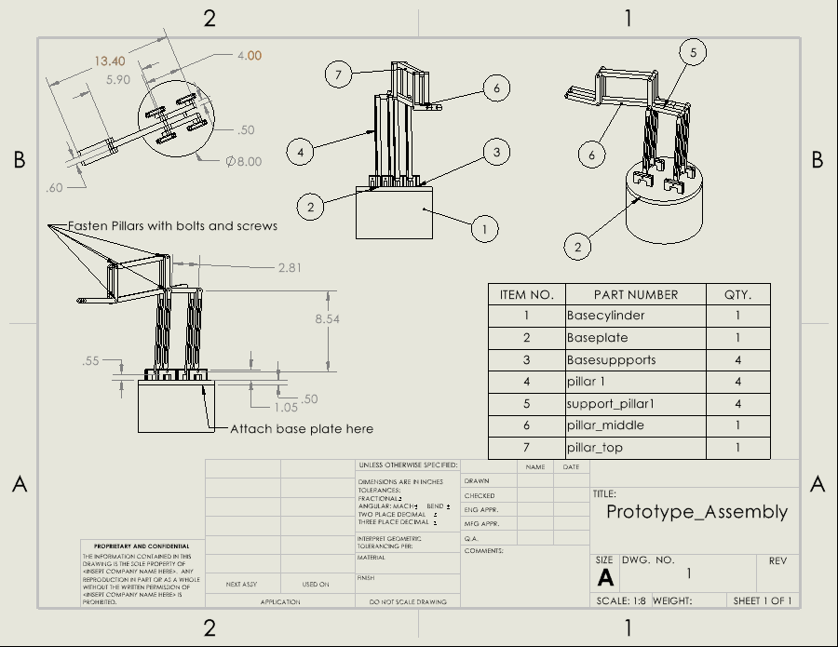
Prototype After MVP Analysis

Slide 33
Project Status
Prototype 1 completion
Continue making updates to website
Wrapping up Final CAD model and BOM
Started manufacturing Prototype 2
Ordering part for final product
Begin manufacturing final product next semester

Slide 34
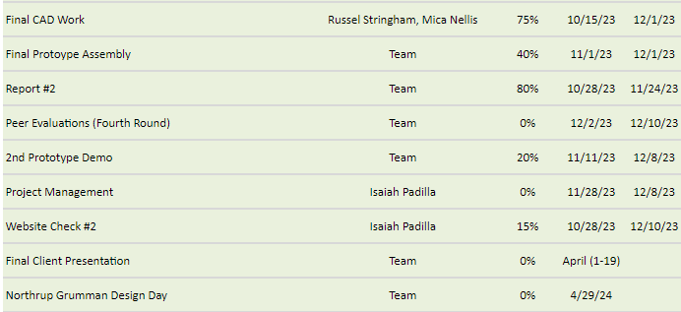
Future Deliverables
Gantt Chart – Future Deliverables

Slide 35
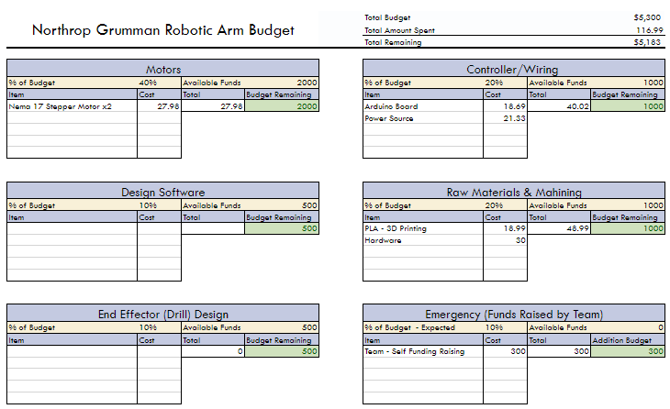
Cost Analysis

Slide 36
References
[1] “A Guide to Arduino & the I2C Protocol (Two Wire) | Arduino Documentation,” docs.arduino.cc. https://docs.arduino.cc/learn/communication/wire
‌[2] X. Yin, “Kinematics Analysis and Simulation of 6-DOF Industrial Robot.” Accessed: Nov. 26, 2023. [Online]. Available: https://www.ijres.org/papers/Volume%206/Vol-Issue7/Version-1/D0607012734.pdf
‌[3] R. Gate, 6 DOF robot Joints that enable rotation. Accessed: Nov. 26, 2023. [Photot]. Available: https://www.researchgate.net/figure/6-DOF-robot-Joints-that-enable-rotation-about-the-local-z-axis-are-denoted-by-the_fig2_309366491
‌[4] [“Datasheet Directory,” Globalspec.com, 2020. https://www.globalspec.com/specsearch/partspecs?partId=
[5] R. G. Budynas and J. K. Nisbett, Shigley’s Mechanical Engineering Design, 11th edition, SI units, 11th ed, S.l., NY: MCGRAW-HILL EDUCATION (AS,2020, pp. 937-953)
[6] 20sffactory, “community_robot_arm,” GitHub, Nov. 24, 2023. https://github.com/20sffactory/community_robot_arm (accessed Nov. 30, 2023).
‌[7] “6DOF Robot Arm 6-Axis Aluminum Robotic Arm with Servos Unfinished Standard Version - Free Shipping - ThanksBuyer,” www.thanksbuyer.com. https://www.thanksbuyer.com/6dof-robot-arm-6-axis-aluminum-robotic-arm-with-servos-unfinished-standard-version-60681 (accessed Nov. 30, 2023).

