Slide 1
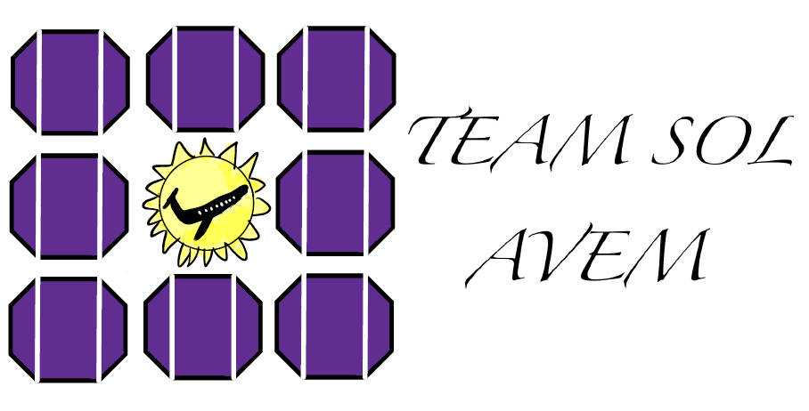
Final Proposal Presentation
Presented By:
Mitchell Anderson
Joel Freedman
Gage King
Radley Rel

Slide 2


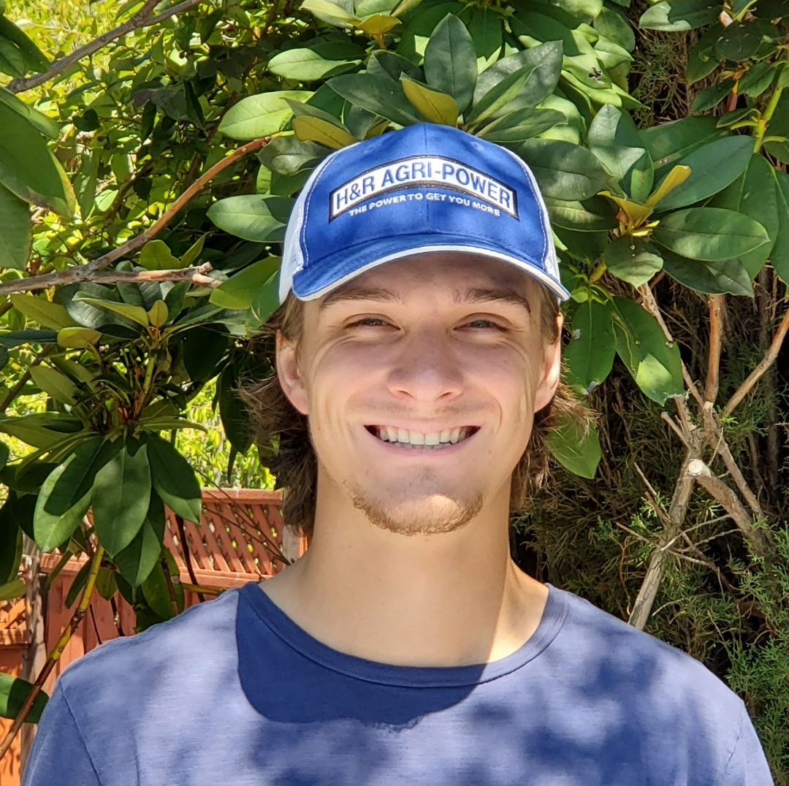




Our Team
Mitchell Anderson: Project Manager and Airfoil/Aircraft Design
Joel Freedman: Logistics Manager/Test Engineer and Wing Selection/Flight Control Design
Gage King: CAD Engineer/Manufacturing and Engine/On-Board Component Selection Design
Radley Rel: Financial Manager and On-Board System/Solar Design
Gabriel Martin : Electrical Engineering Lead
Sultan Alhazawbar: Electrical Engineering Team
Kelly Gallagher: Industry Advisor

Slide 3
Agenda
Project Description
Computational Analysis
Design Requirements
Design Validation
Questions
Schedule & Design Phase
Refresher
Testing
Budget
Final CAD

Slide 4
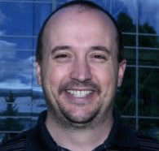
Project Description
Team Goal: The goal of this project is to design and manufacture a Solar Powered Unmanned Aerial Vehicle (UAV).
Team Purpose: Our team's focus is creating an aircraft that can fly off solar power and battery system with a designated payload.
Importance: Offers a huge opportunity to not only design an aircraft and fly it successfully, but to power it with renewable solar energy.
Client: David Willy

Slide 5
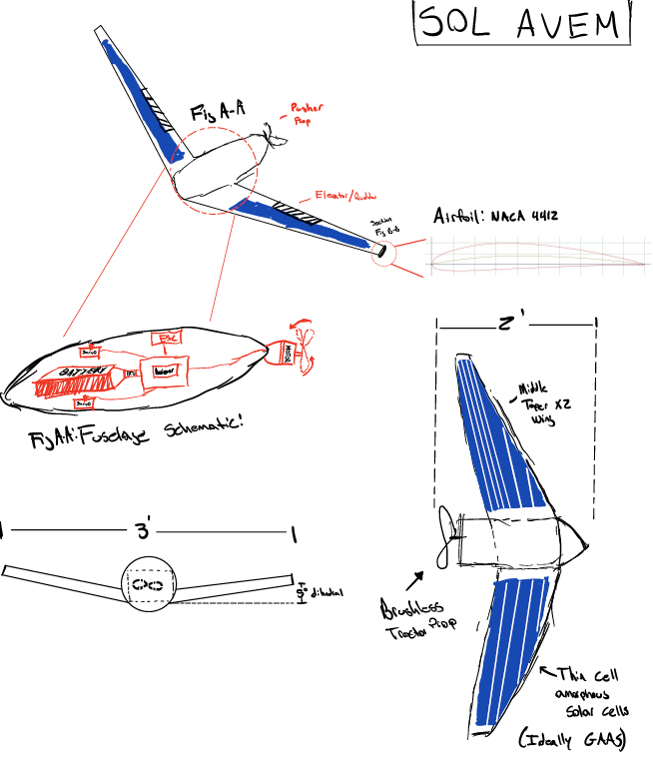
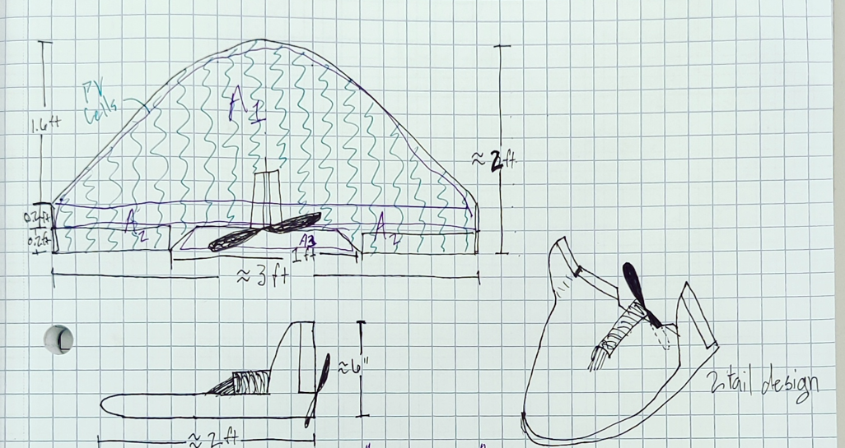
Where We Left off

Slide 6
Customer and Engineering Relationships
Flight Time
Operating Radius
Cargo Capacity
Total Mass
Reparable/Reusable
Solar Energy Harvest
Thrust
Powered Flight
Solar Integration
Payload
Affordability
Simplicity

Slide 7
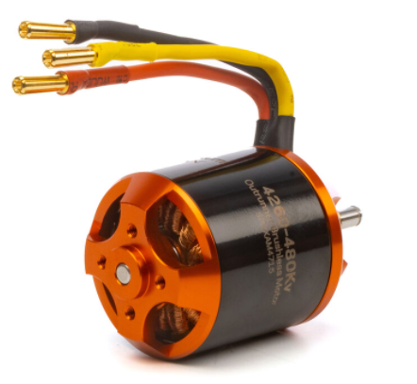
Database
Motor (Brushless) | Weight (g) | Input Watts | Input Voltage | Planform Area (mm^2) | Price($) | Application
Avian 4260-480Kv Outrunner Brushless Motor | 268 | 810 | 18.5-22.2V (5-6S LiPo) | 2623 | 99.99 | Sport airplanes up to 9.5lbs (4310g) and 3D airplanes up to 6lbs (2720g)
Park 370 Brushless Outrunner, 1200Kv with 4mm Hollow Shaft: 3.5mm Bullet | 45.35 | 120 | 7.2-12 | 1828.8 | 45.99 | Excellent motor for small 3D airplanes 7–14 oz (200–400 g)
Power 360 Brushless Outrunner Motor, 180Kv, 6.5mm Bullet | 500 | 6000 | 44.4 | 14630.4 | 413.99 | For high-power airplanes weighing 15 to 25 pounds (6.8 to 11.0 kilograms)
Power 32 Brushless Outrunner Motor, 770Kv, 3.5mm Bullet | 150 | 800 | 12-16.8 | 2880.36 | 86.99 | airplanes weighing 3.5–6 lb (1.6–2.7 kg)
Avian 5065-450Kv Outrunner Brushless Motor | 400 | 1200 | 18.5 - 22.2V / 5-6S LiPo | 3366 | 139.99 | Recommended Model Flying weight – 3D 4080 g (9 lbs) - Sport 6520 g (14.5 lbs)
 | Components | Max (g) | Min (g) | Avg (g)
 | Motor | 500 | 45.35 | 272.67
 | Battery | 230 | 16.9 | 91.6
 | Servo (2X) | 85 | 25.2 | 56.48
 | Reciever | 80 | 6 | 32.4
 | ESC | 68 | 5.5 | 45.7
 | Material | 1726 | 192.314 | 957.65
 | Wire | 89.13 | 89.13 | 89.13
Total w/o Solar (Grams) |  | 2778.13 | 380.394 | 1545.63
Total w/o Solar (Grams) | Solar (40%) | 3889.382 | 532.5516 | 2163.882
Total in Pounds (lbs) |  | 8.574609 | 1.174074 | 4.770538
 | Max | Min | Avg
Weight (g) | 500 | 45.35 | 272.67
Input (Watts) | 6000 | 120 | 2032.5
Input (Voltage) | 44.4 | 7.2 | 20.12
Planform Area (mm^2) | 14630.4 | 1828.8 | 5065.712
Price($) | 413.99 | 45.99 | 157.39

Slide 8

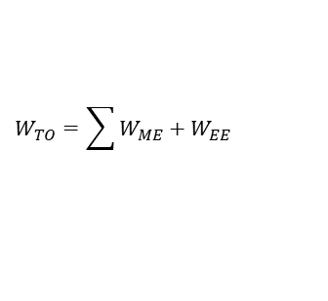
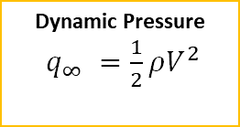

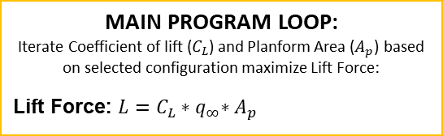
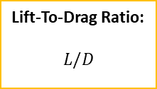




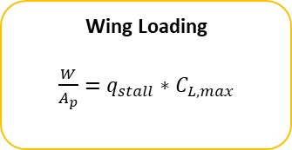
Flowchart
Weight Estimation (Referencing Database Values)
ME: Motor, Battery, Servo, Receiver, ESC, Dry Weight (Material)
EE: Boost Controller, Battery and Solar
Dynamic Pressure
$q_{∞} =\frac{1}{2}ρV^{2}$
Aerodynamic Analysis
$$W_{TO}=\sum{W_{ME}+W_{EE}}$$
MAIN PROGRAM LOOP:
Iterate Coefficient of lift ($C_{L}$) and Planform Area ($A_{p}$) based on selected configuration maximize Lift Force:
Lift Force: $L=C_{L}{∗q}_{∞}∗A_{p}$
Lift-To-Drag Ratio:
$$L/D$$
MAIN PROGRAM LOOP
Iterate Coefficient of Drag ($D_{L}$) and Cross Section Area ($A_{x}$) based on selected configuration minimize Drag Force
Drag Force: $D=C_{D}∗q_{∞}∗A_{x}$
Wing Loading
$\frac{W}{A_{p}}=$ $q_{stall}$ ${∗C}_{L,max}$
Thrust-To-Weight
$$T=\frac{π}{4}D^{2}ρV∆V$$
Center of Gravity
Velocity
Take-off
Velocity:
Velocity Stall:
$$\overline{x}=\frac{x_{ME Comp}+x_{EE Comp}}{ME comp+EE comp}$$
$$V_{TO}=1.2\sqrt{\frac{2\left(W_{TO}/A_{p}\right)}{ρC_{L_{max}}}}$$
$$V_{s}=\sqrt{\frac{2W}{ρA_{p}C_{L_{max}}}}$$
Take Off Distance
Assumptions:
Simplified area for lift/drag calculation
Model wing as straight beam
Load is evenly distributed
$$S_{g}=\frac{1.21\left(\frac{W}{A_{p}}\right)}{gρC_{L}\left(\frac{T}{W}\right)}$$

Slide 9
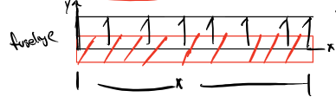
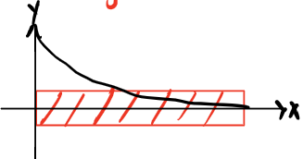
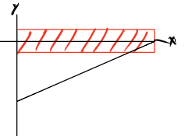




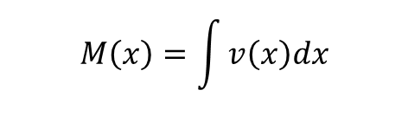
Flowchart
Structural Analysis
Distributed Load
Bending Moment
Shear Force
$$v\left(x\right)=−\int{w\left(x\right)dx}$$
$$M\left(x\right)=\int{v\left(x\right)dx}$$
$$w\left(x\right)=\frac{F}{x}$$
Bending Stress
$$σ_{x}\left(y\right)=\frac{M_{z}y}{I_{z}}$$
Assumptions:
Simplified area for lift/drag calculation
Model wing as straight beam
Load is evenly distributed

Slide 10
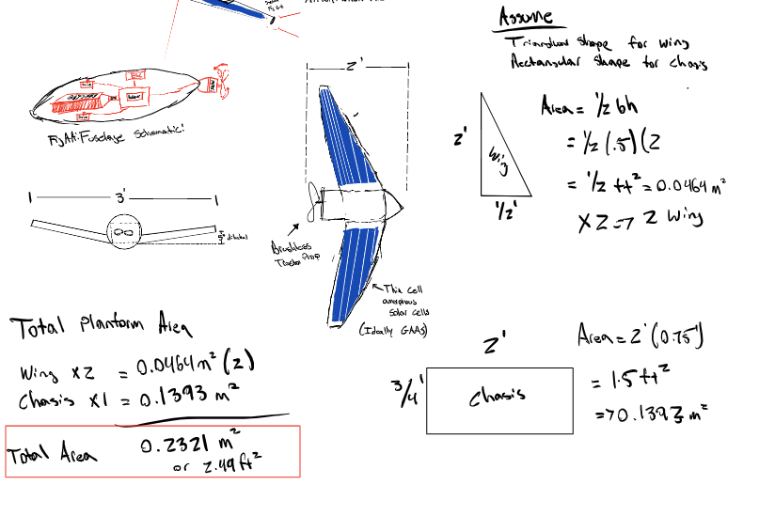
Computation Iterations
Rough Area to Calculate Lift and Weight
CAD to get higher fidelity area
Send exact area and weight back
Use exact are and rerun calculations to determine lift and weight
Use exact weight to determine component purchase

Slide 11
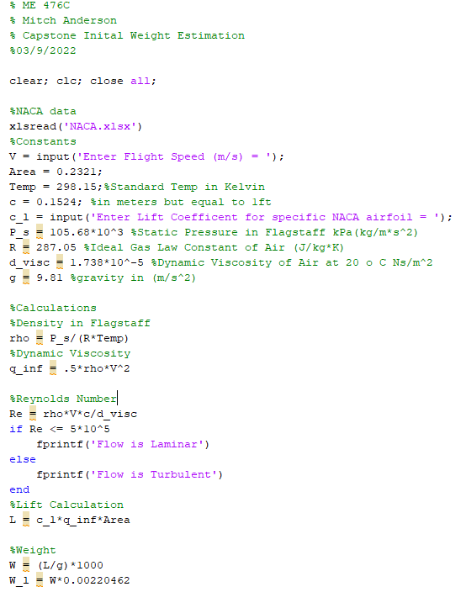
Computation Results
Maximum Lift =
  38.11 N
  8.5646 Lbs.
Stall Velocity =
  12.89 m/s
  42.30 ft/s

Slide 12
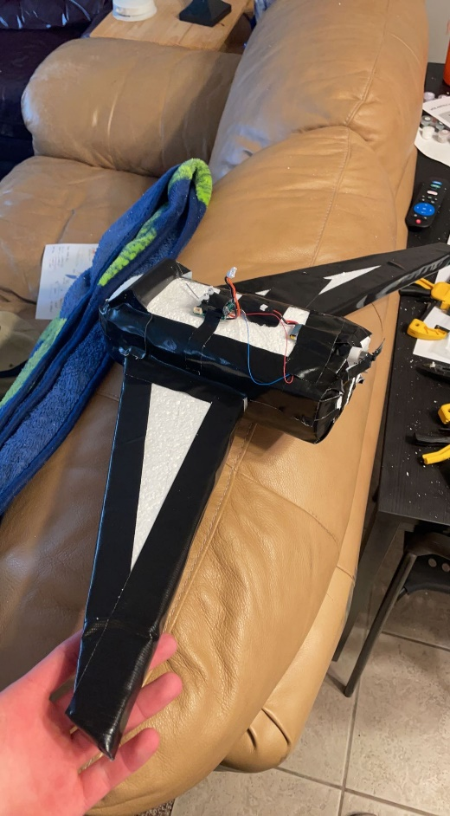
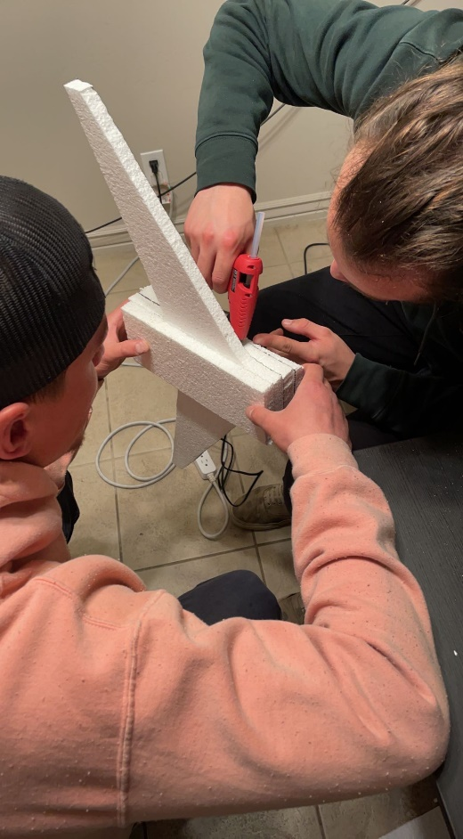
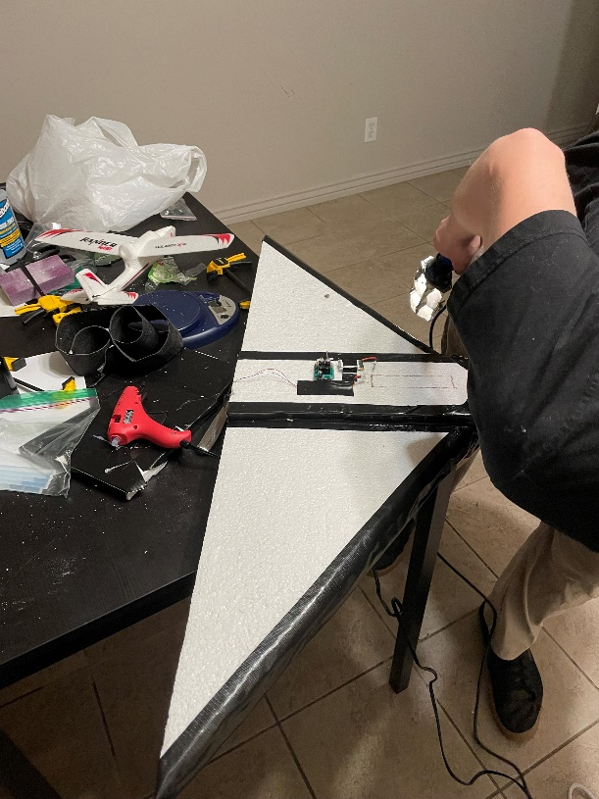
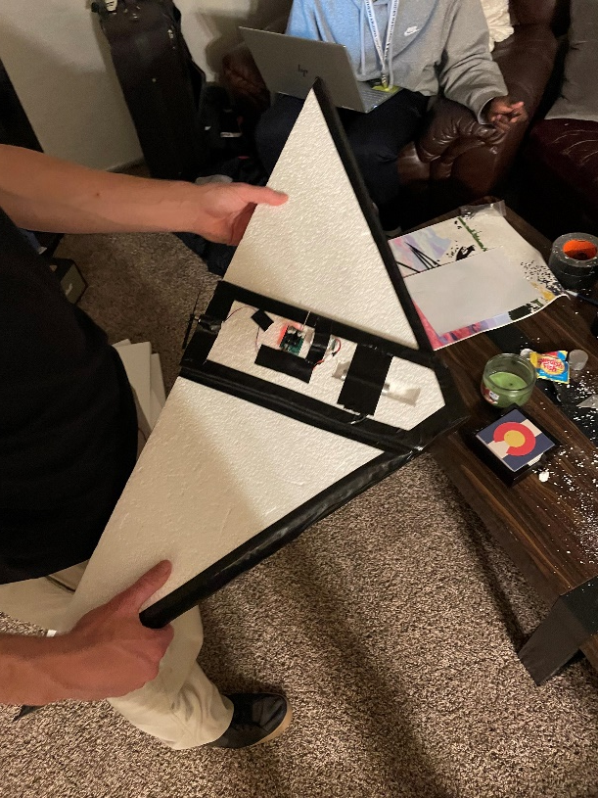
Prototyping

Slide 13

Testing Procedure
Testing Conditions:
Location: Rolle Center
Temperature: Room Temp (20℃)
Wind Speed: 0 mph (indoors)
Measurements:
Length of Flight
Velocity
Time
Procedure:
Set up on basketball court
Measure out distance using measuring tape from base line
  1 m
  12 ft
  24 ft
Logger Pro Calibration
  Use 1 m measurement for reference
  Film practice throw
  Import video as .MOV file
  Track position of each frame
  Output: Time,x(m),y(m),V(x),V(y)
Testing:
Flying Wing w/o motor (3 trials)
Flying Wing with motor (3 trials)
Sol Avem w/o motor assistance (3 trials)
Sol Avem with motor assistance (3 trials)

Slide 14
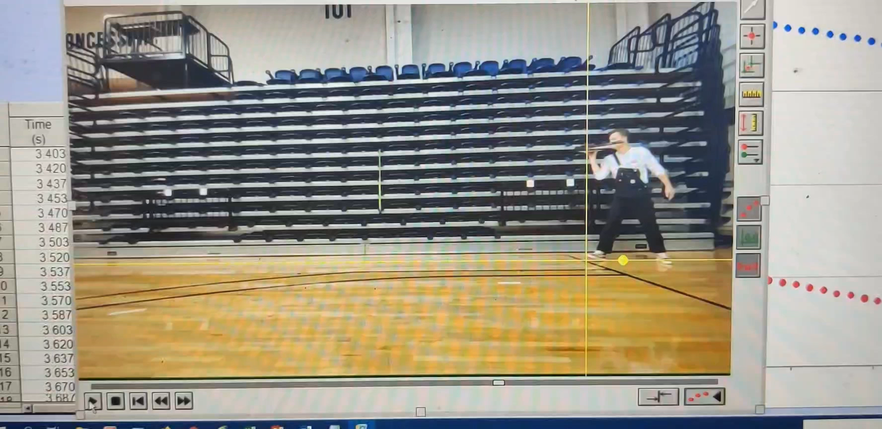
Data collection

Slide 15
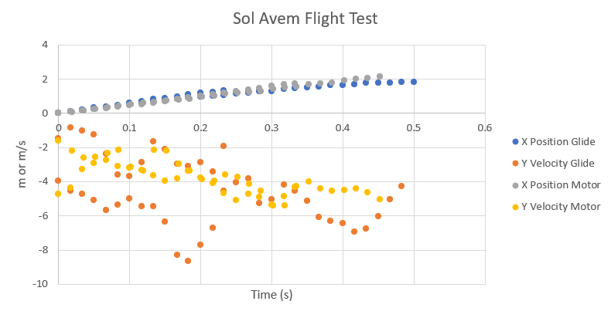
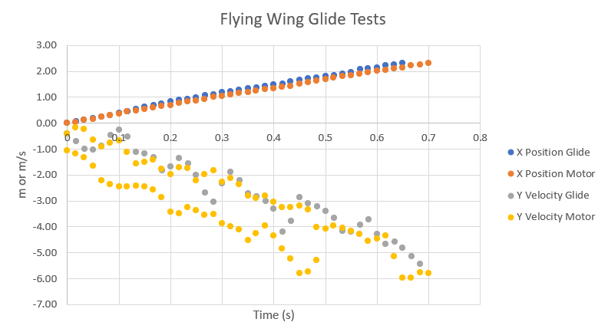
Testing & analysis

Slide 16
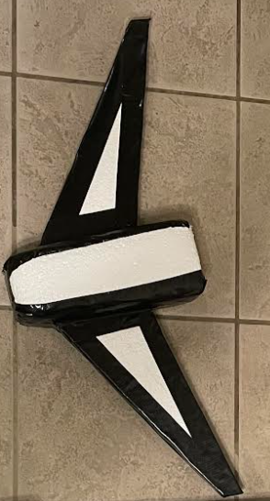
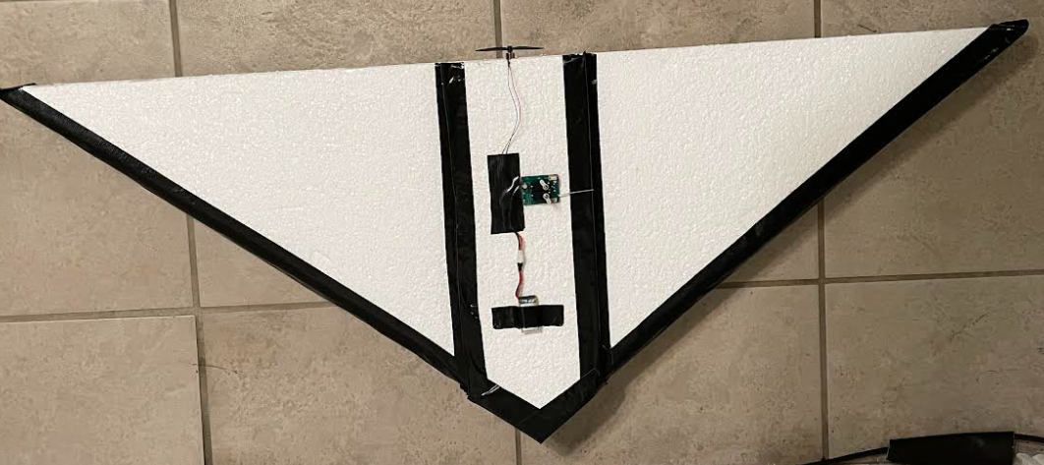
Design Selection
Pros:
Structurally Sound
Extended Flight
Simple Fabrication
Larger Planform Area

Slide 17
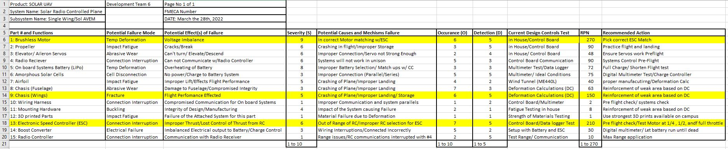
Failure Mode Effect Analysis

Slide 18
FMEA SUMMARY & FURTHER TESTING
FMEA aided in identifying critical failure modes
Highest Risk Priority is Failure of Motor System RPN of 270
Development of Pre-Flight Checklist
Failure Modes Identified to reduce Risk in prototyping
Testing Procedures going forward
Transitioning to outdoor flight testing
Test Flight Area provided by Flagstaff Flyers R/C club

Slide 19
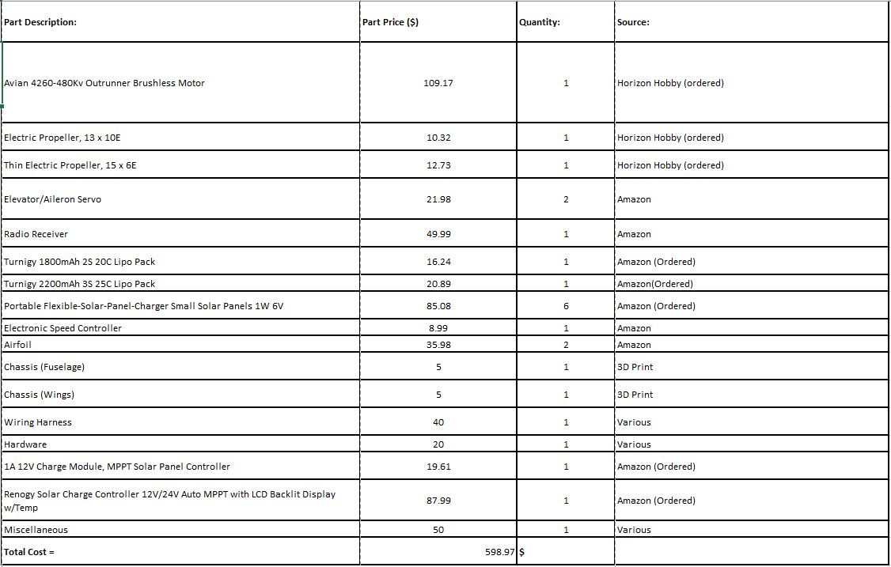
BOM

Slide 20
Budget
Total Budget of $1500
ME Components: $255
EE Components: $315
Remaining Budget: $930

Slide 21
Team Contributions
Mitchell Anderson: Project Manager and Airfoil/Aircraft Design
Joel Freedman: Logistics Manager/Test Engineer and Wing Selection/Flight Control Design
Gage King: CAD Engineer/Manufacturing and Engine/On-Board Component Selection Design
Radley Rel: Financial Manager and On-Board System/Solar Design
2D Calculations
Testing
Design
Prototyping
Design
CAD
Prototyping
Testing
Prototyping
Design
Prototyping
Testing
2D Calculations

Slide 22
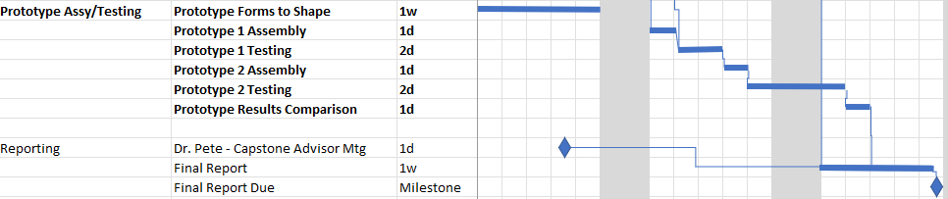
Schedule
& Phase
First Semester Requirements:
Aircraft Research & Benchmarking
Aircraft Design &Testing
Final Prototype Design
Second Semester:
Final Iteration of Aircraft Design
Solar Output Integration
Solar Flight by Week 30

Slide 23
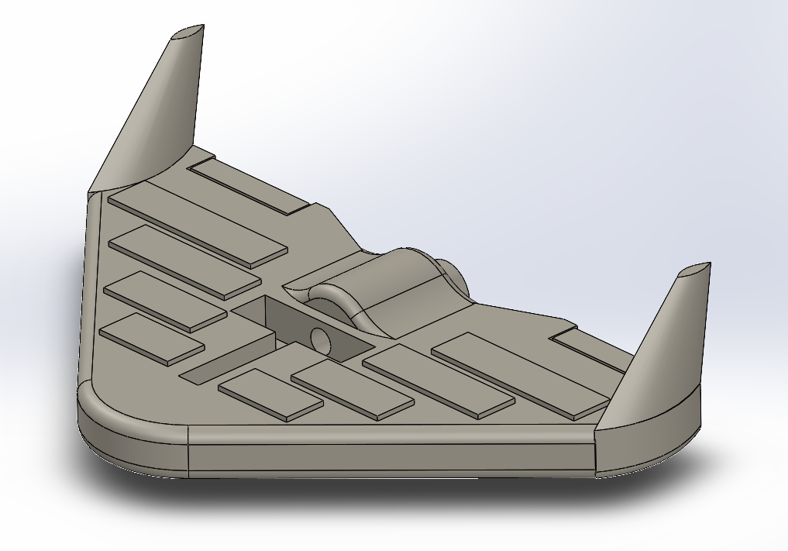
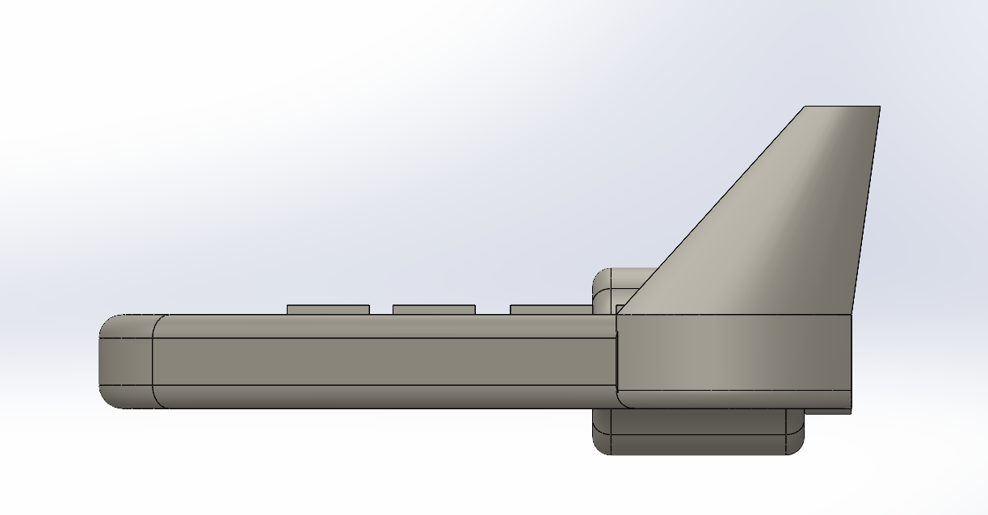
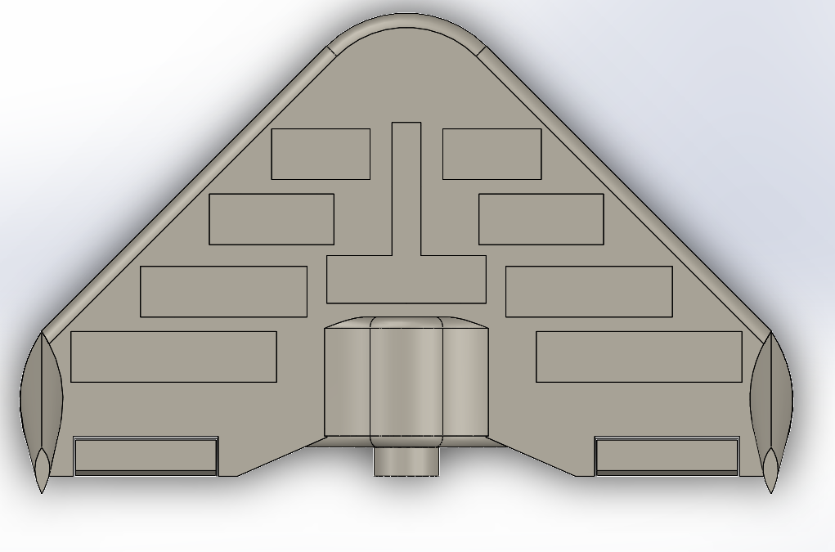
Final Cad
Side View
Isometric View
Top View

Slide 24
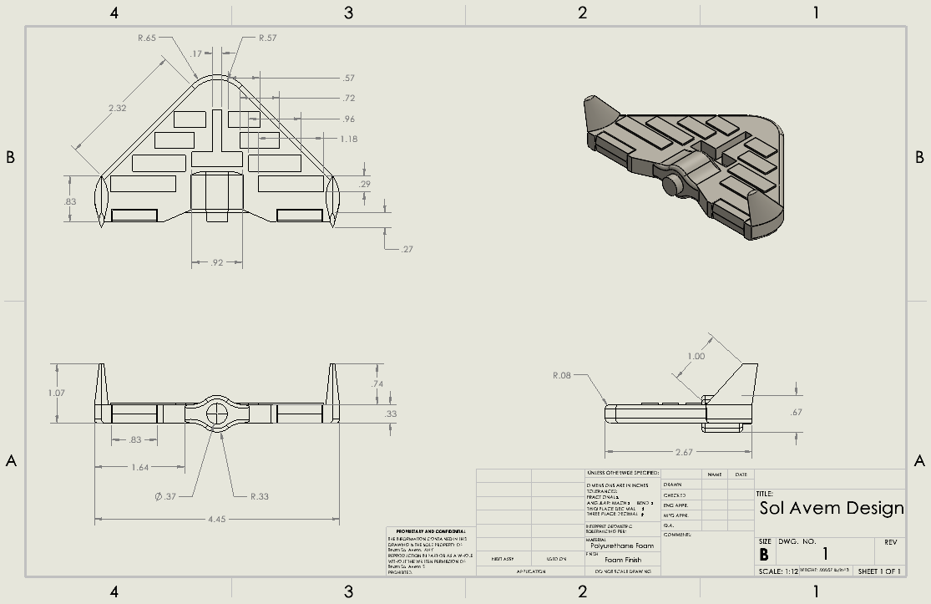
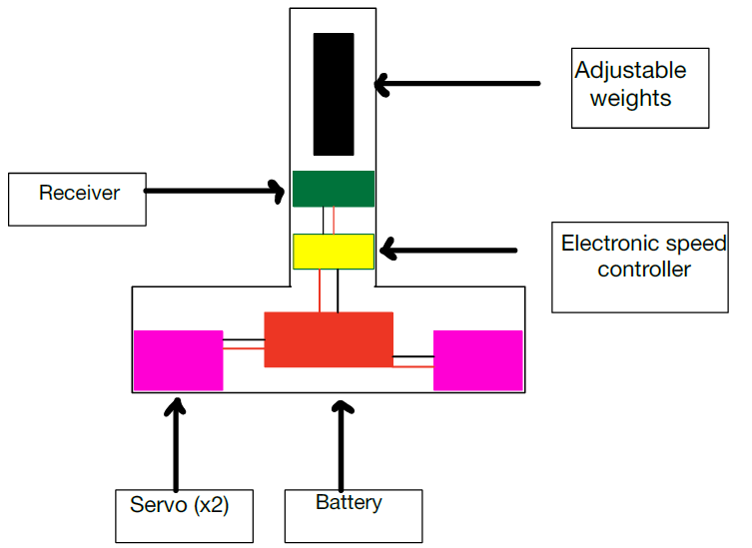
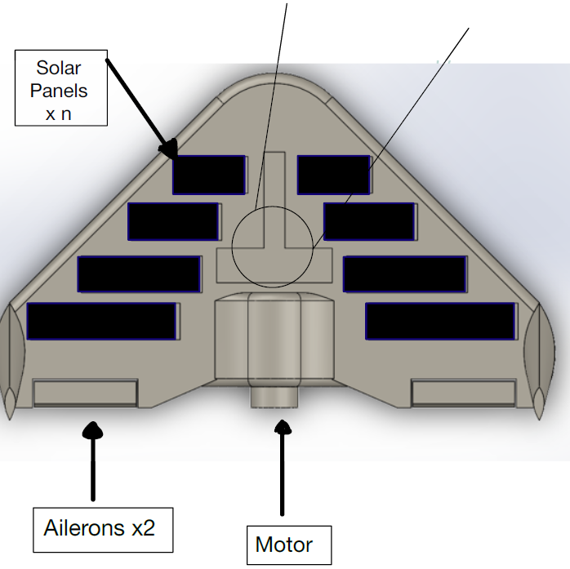
Components & Dimensions

Slide 25

Questions?

