Slide 1
Final Presentation
Gore Capstone Team 5: Skylar Gilmore, Lumini M., Alex Nagle

Slide 2
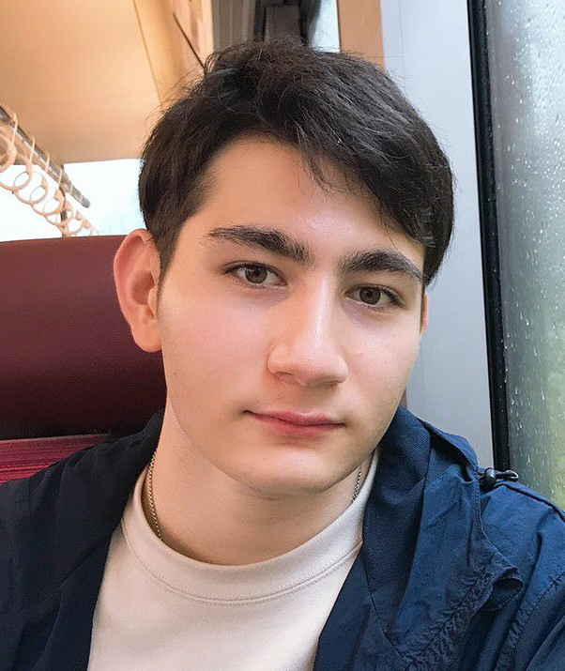


Introductions
Alex Nagle
Lumini M.
Skylar Gilmore
Project Lead
Test Engineer
Financial Manager
Logistics Manager
CAD Manager
Website Lead
Manufacturing Manager
Skylar G., 3/29/22,Gore Stent, 1​

Slide 3

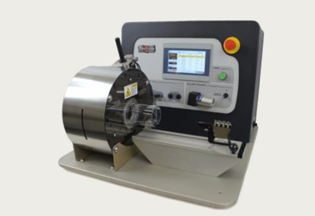
Project Description
"The goal of this project is to design and develop a low force stent crimping machine utilizing a crush iris with a radial force readout. "
The scope of the project within the mechanical team would be in selection of materials and the overall design of the machine.
Figure 1: Gore Logo [1]
Figure 2: Model CX with Large Twin-Cam [2]
Skylar G., 3/29/22,Gore Stent, 2​

Slide 4
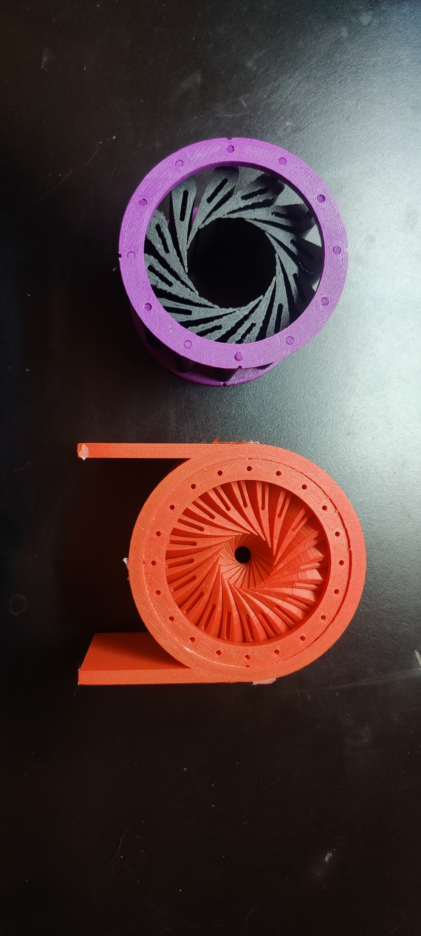
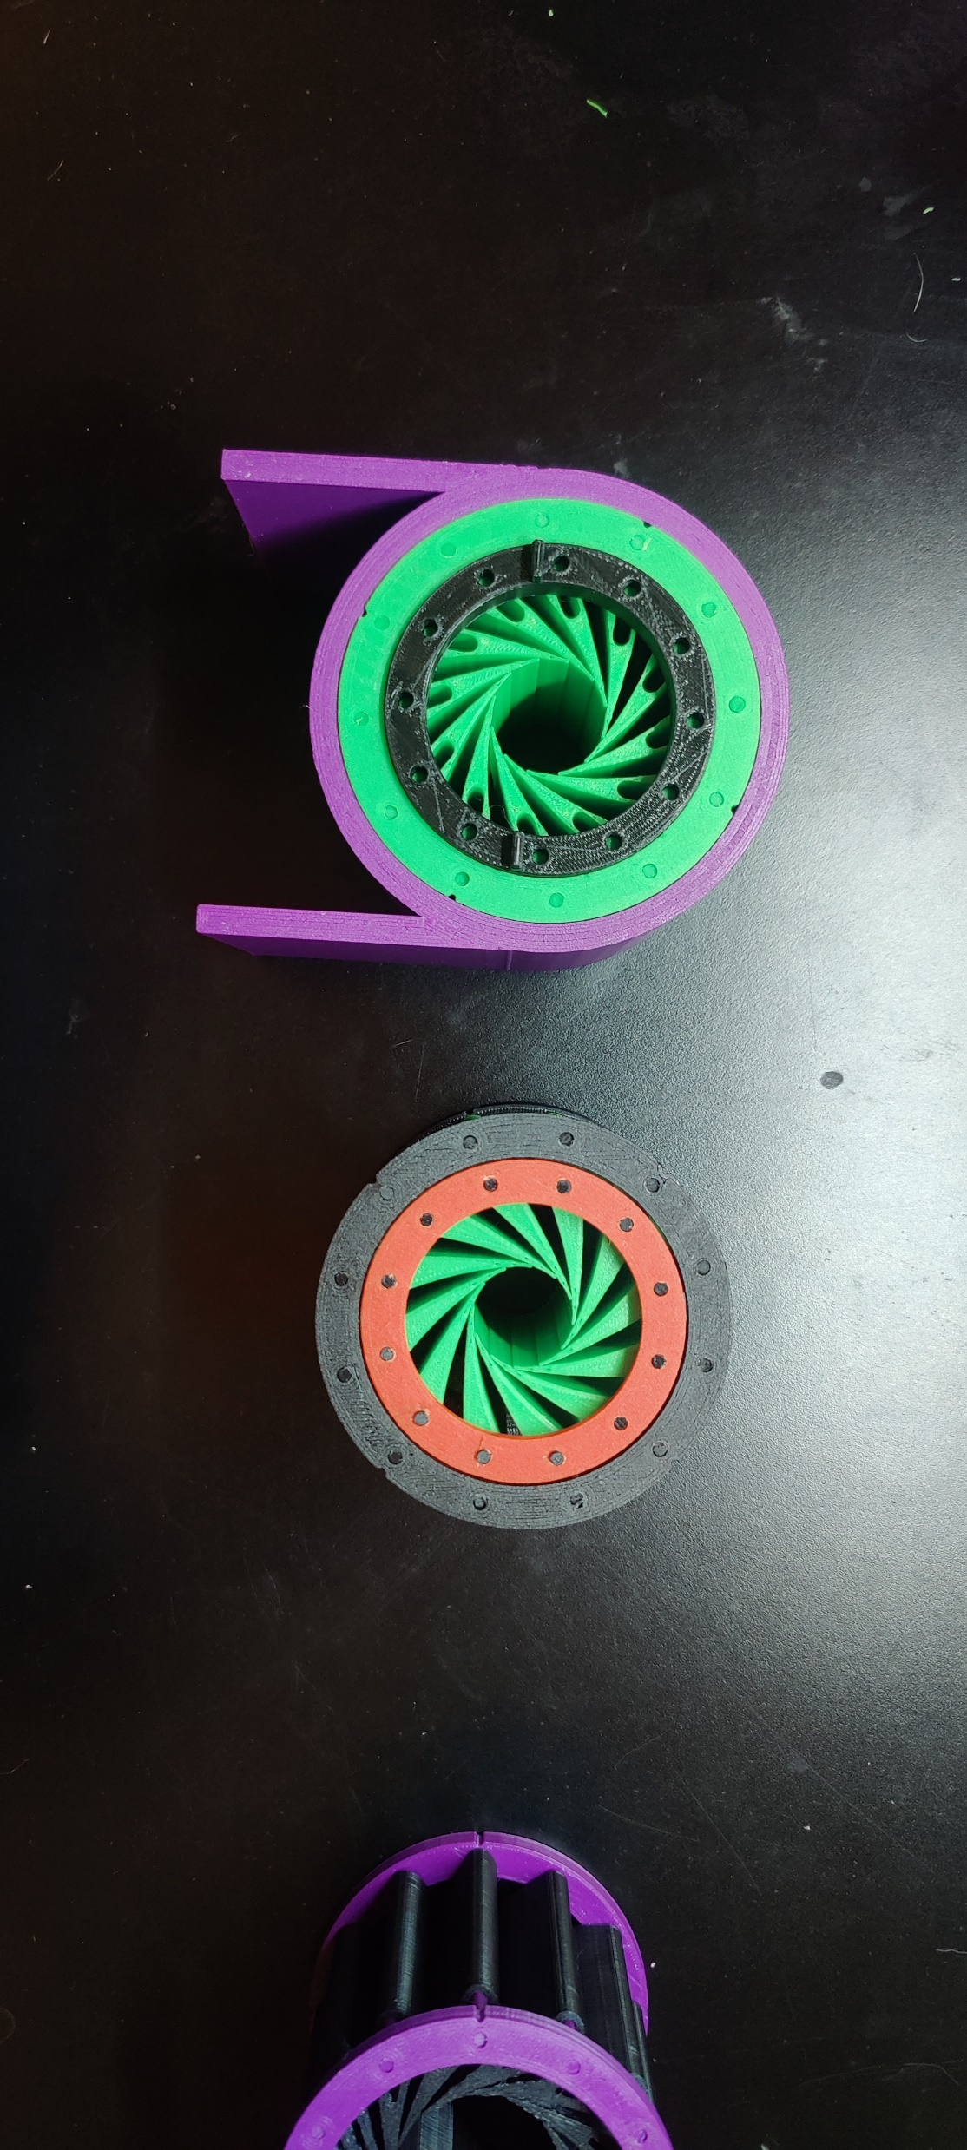
Current Prototype
Table 1: Bill of Materials
Part | QTY
Curved Leaflet | 12
Outer shell | 1
First ring | 2
Inner ring | 1
Inner ring with knobs | 1
Pins | 24
Figure 3: Current Prototypes
Skylar G., 3/29/22,Gore Stent, 3

Slide 5
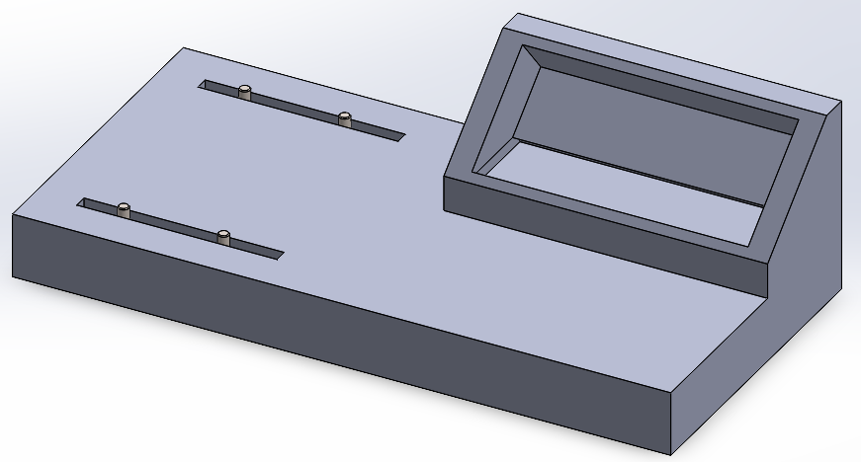
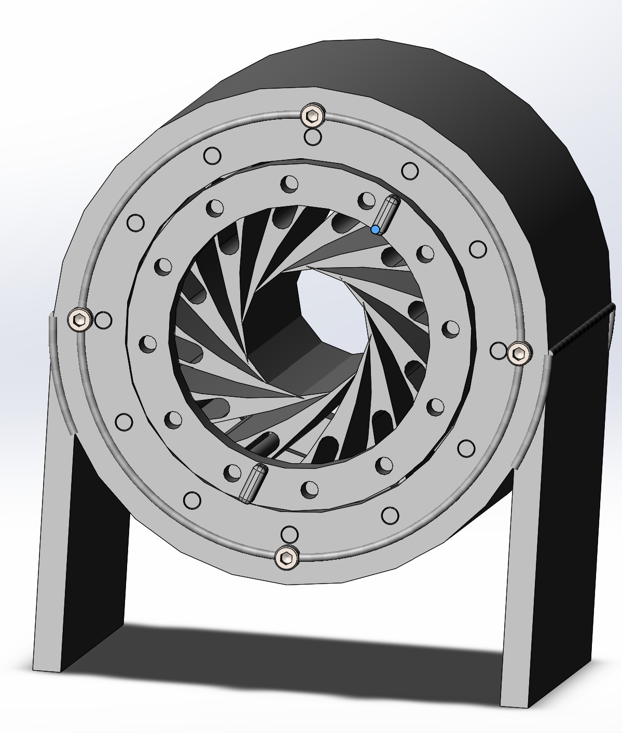
Design Description -Final Design
Leaflet
Weld
Pin
Figure 5: Touch Screen Base
Shell
Screw for outer plate
Preliminary Ring
Inner Ring with movement knob
Figure 4: Curved Iris CAD
Skylar G., 3/29/22,Gore Stent, 4

Slide 6
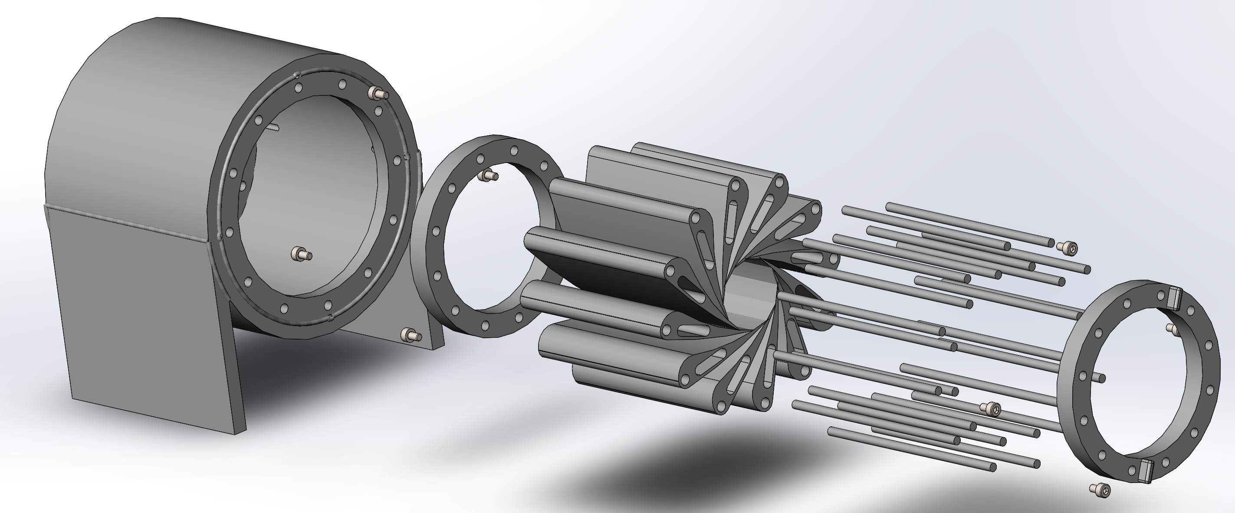
Design Description -Final Design
Figure 6: Exploded View
Skylar G., 3/29/22,Gore Stent, 5

Slide 7
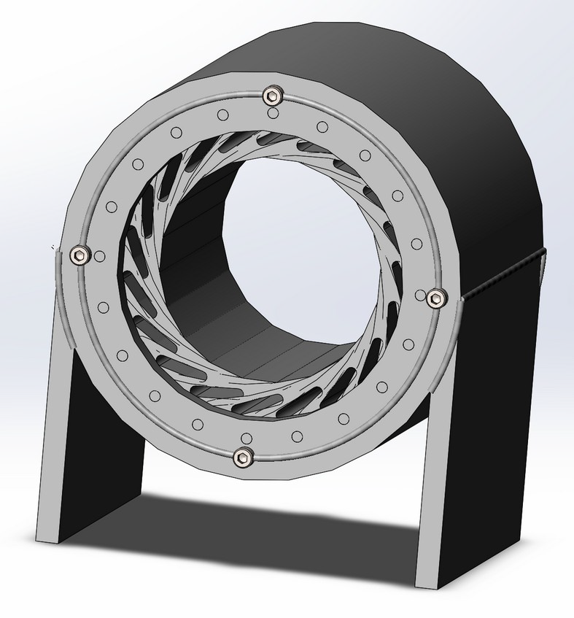
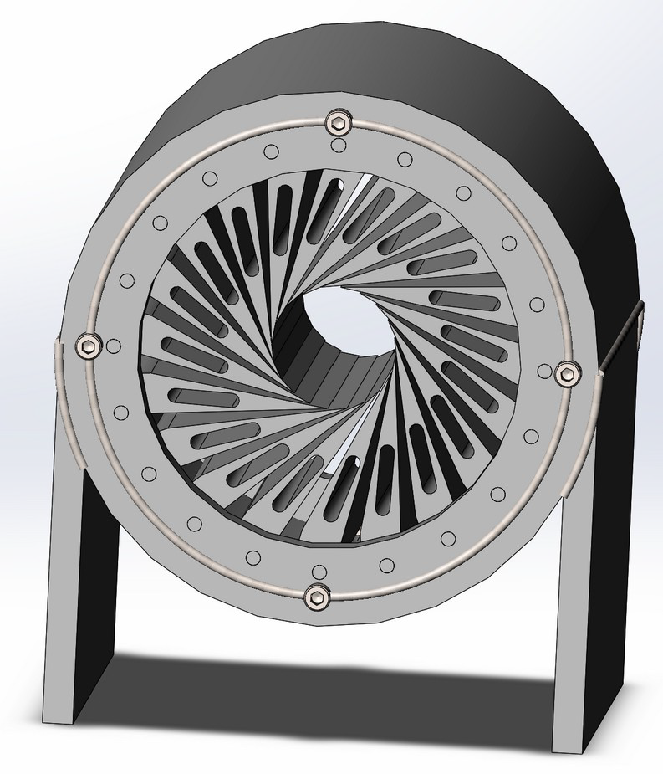
Design Requirements
Table 2: Customer Requirements
Customer Requirements | Components/Methods in the device to meet the requirements
ANSI Safety Standards & OSHA Safety Standards | Electric shock warning, Lockout & Emergency stop [3]
Iris Design and iterative design process | 3 different iris designs – Curved iris Straight iris Plate rotation iris
Cost Control | 3D printed iris
Max Stent Length/Capacity to work under both Radial Force and Diameter | Will be obtained through the Engineering Analysis
Working Model | Manually operating prototype
To crimp | Iris design
Figure 7. Curved Iris CAD
Figure 8. Straight Edge Iris CAD
Lulu M., 3/29/22,Gore Stent, 6

Slide 8
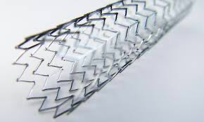
Click t ad text
Engineering Analysis
Figure 9. Nitinol stent [4]
Calculations for the
Required minimum
and maximum
diameters
Self-expandable stents using hoop strength calculations
H = PD /2t
H – hoop stress.
D- Diameter
t- Thickness
P – Internal Pressure
Materia/Type Dependence
Calculations for
Required radial forces
Radial reaction force (RF) at each increment to force response over time .
E- artery’s young’s modulus
Di – Internal Diameter
L – Stent Length
t - Thickness
Device Power
Requirement
GUI unit and the Crimping system
Wall power and standby battery
Lulu M., 3/29/22,Gore Stent, 7​

Slide 9
Design Validation
Table 3: FMEA Analysis
Failure Mode and Effects Analysis
Process Function | Potential Failure Mode | Potential Effects of Failure | Severity | Potential Causes | Occurrence | Prevention Action
Iris Crimping | Does not crimp the stent, incorrectly deforms stent. Pinches the stent | Deformed Stent. Uncrimped Stent | 5 | Iris Blades get stuck on stent. Not an equal force throughout the iris | 3 | Testing, changing the number of blades and well as the lengths
Force & Diameter Readout | Incorrect readout. Not accurate | Incorrect readout of the current force and diameter. Misinformation | 4 | Inaccurate measuring system. Calibration Error | 2 | Accurate testing of the GUI and programming of the software
Crimp Release | Does not release the stent/iris does not open up | Cannot get the stent out. Crushes the stent/deforms stent | 4 | Gears are stuck and do not release. Not enough range for motion | 2 | Correct gear system to work machine, oil and maintenance.
Emergency Stop | Does not immediately stop and shut down | Does not stop and crushes stent or may injure workers | 5 | Slow response from button to system. Connection error | 1 | Secure connection between the emergency stop and the crimping machine
Desired Control of Diameter or Force | Crimps too hard or not hard enough. Does not crimp to desired diameter | Inaccurate measuring crushes/deforms stent. Inaccurate crimping | 4 | Inaccurate measuring system. Calibration Error. Connection with the control system and machine | 2 | Accurate testing of the GUI and programming of the software
Alex N., 3/29/22,Gore Stent, 8

Slide 10
Design Validation
Table 4: Requirements
Engineering Requirements​
Emergency Stop​
User Control of Force or Diameter​
Iris style clamp​
GUI force​
GUI Diameter​
3
Iris crimp depth 46mm devices 80 mm length can be 1.5 times size​
Force 132.94(N) 28.9 N/cm max​
Individual Part Testing and Iterations - 5 Minimum​
Engineering Requirements to Test
Emergency stop can be tested by running the crimper and using the emergency stop button, timing how long it takes to shut down
Control of the Force and Diameter by running the crimper and actively measuring once it is at the desired length or force.
GUI Display will be measured for accuracy similar to the user control test method.
Alex N., 3/29/22,Gore Stent, 9

Slide 11
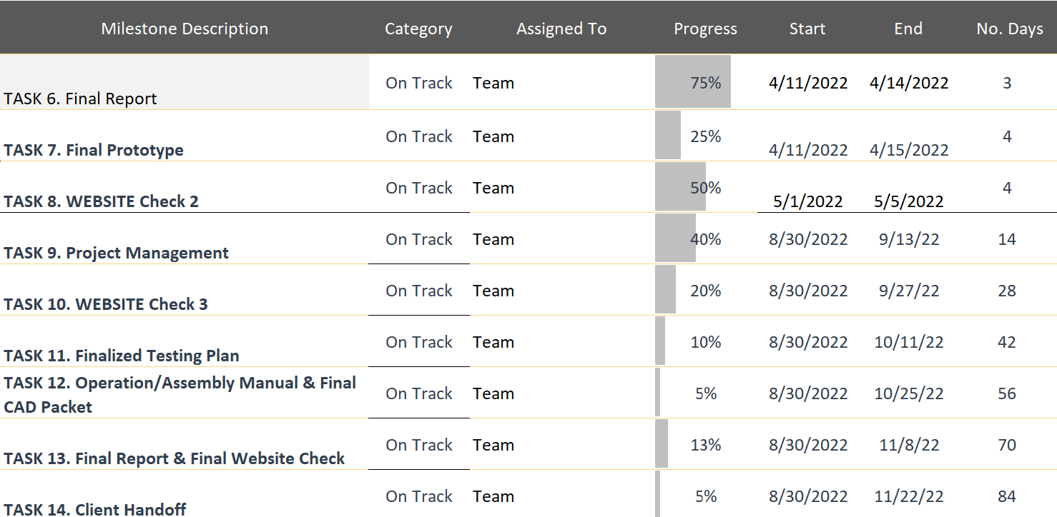
Schedule
Table 5: Gantt Chart
Alex N., 3/29/22,Gore Stent, 1​0

Slide 12
Project Budget (Needs Update)
Table 6: Budget Breakdown
Total Budget | $3,000.00
Amount allocated to Mechanical components | $2,500.00
Amount allocated to Electrical components | $500.00
Remaining Budget to date (02/21/2022) | $2,940.00
Expenses to date (03/29/2022) | $60.00
Anticipated Costs | Amount allocation ($)
Raw Materials | $400.00
Electronics | $100.00
Gear Assembly | $300.00
Motor Assemble | $400.00
Screw and inserts | $100.00
Milling Iris | $200.00
Spare Components | $500.00
Alex N., 3/29/22,Gore Stent, 1​1

Slide 13
References
[1] "W. L. Gore & Associates," W. L. Gore & Associates, Inc., 13 June 2017. [Online]. Available: http://www.gore.com/. [Accessed 18 February 2022]. [2] “Model CX,” Blockwise Engineering, 12-Sep-2020. [Online]. Available: http://blockwise.com/stent-crimpers/cx/#CXLTC. [Accessed: 28-Jan-2022]. [3]
"Occupational Safety and Health Administration," United States Department of Labour , 22 March 2005. [Online]. Available: https://www.osha.gov/laws-regs/oshact/toc. [Accessed 28 March 2022]
[4] "Nitinol Technology Leader Uses Laser Cutting Machine for Precision Products," COHERENT , 2022. [Online]. Available: https://www.coherent.com/news/success-stories/nitinol-innovative-technology. [Accessed 28 March 2022].
2/3/22,Gore Stent, 12

Slide 14
Questions?
Alex Nagle, 2/22/22,Gore Stent, 13

