Slide 1
67% Build
Gore Capstone
22Sp05_GoreIris
Alex Nagle
Skylar Gilmore
Lumini Senaviratne

Slide 2



Team
Alex Nagle
Lumini M.
Skylar Gilmore
Project Lead
Test Engineer
Financial Manager
Logistics Manager
CAD Manager
Website Lead
Manufacturing Manager

Slide 3
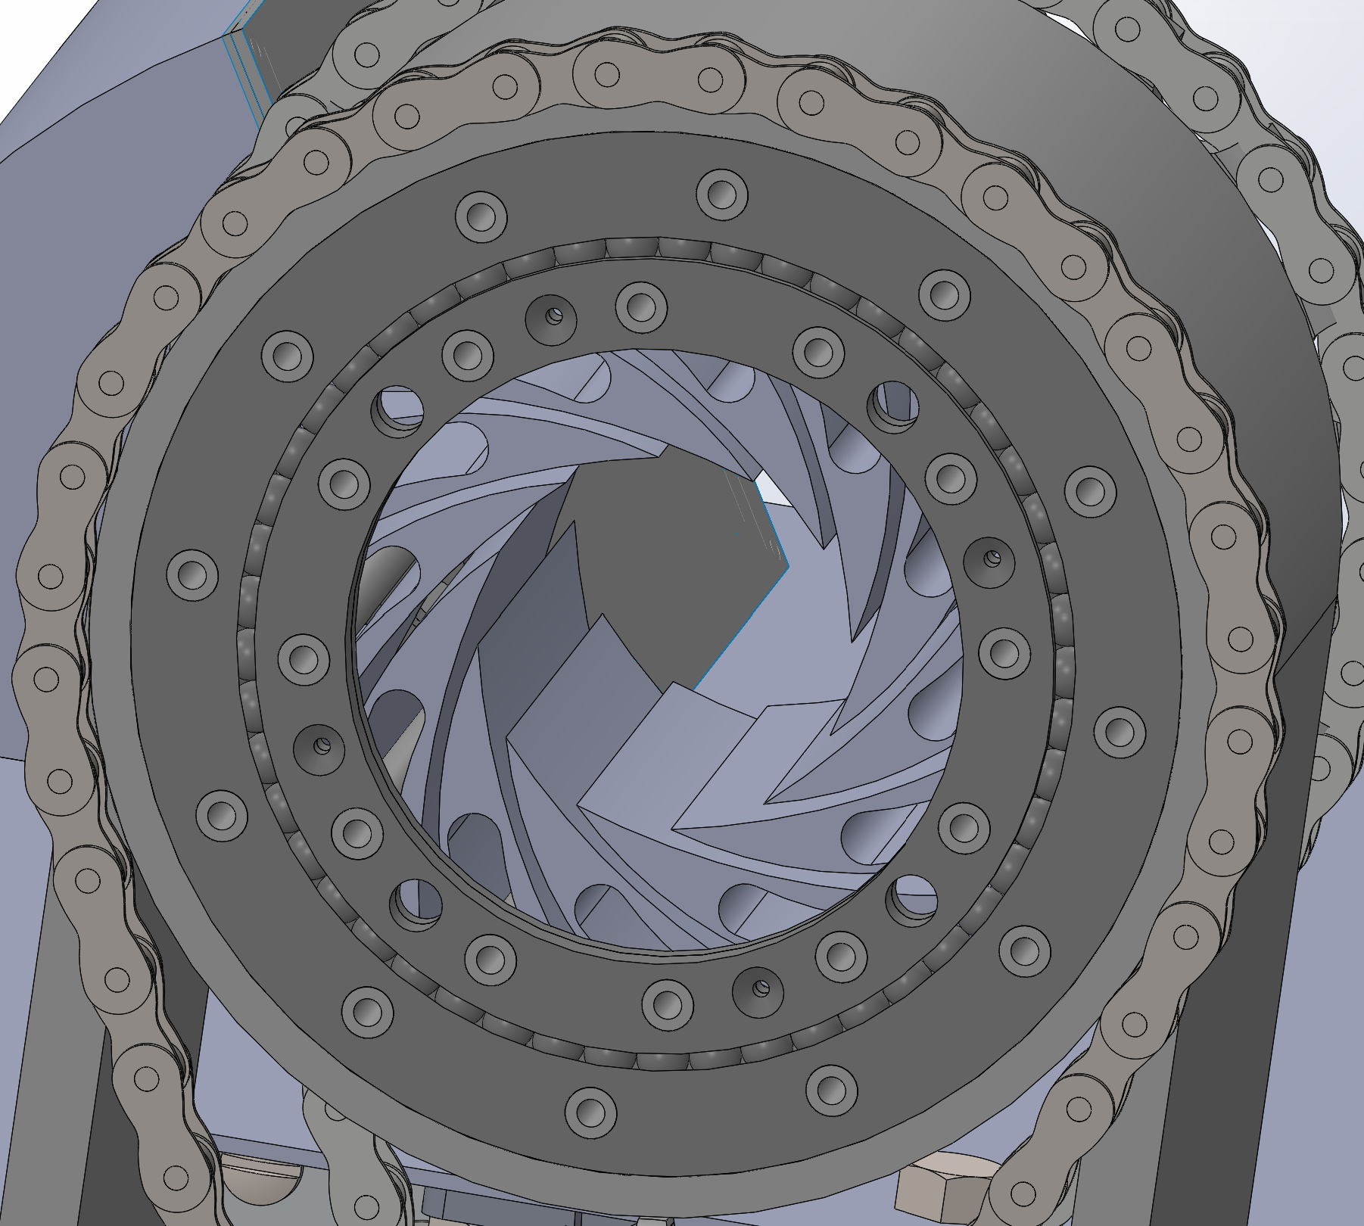
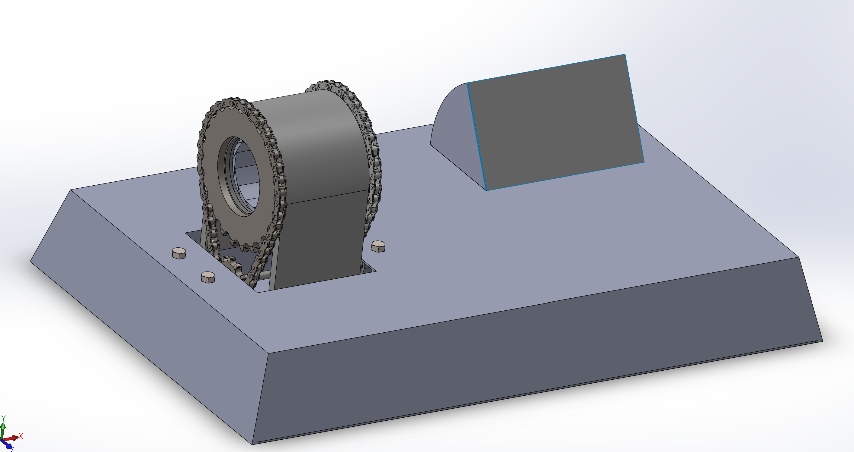
Complete CAD
Figure 1: Complete Assembly
Figure 2: CAD for Slew Bearing

Slide 4
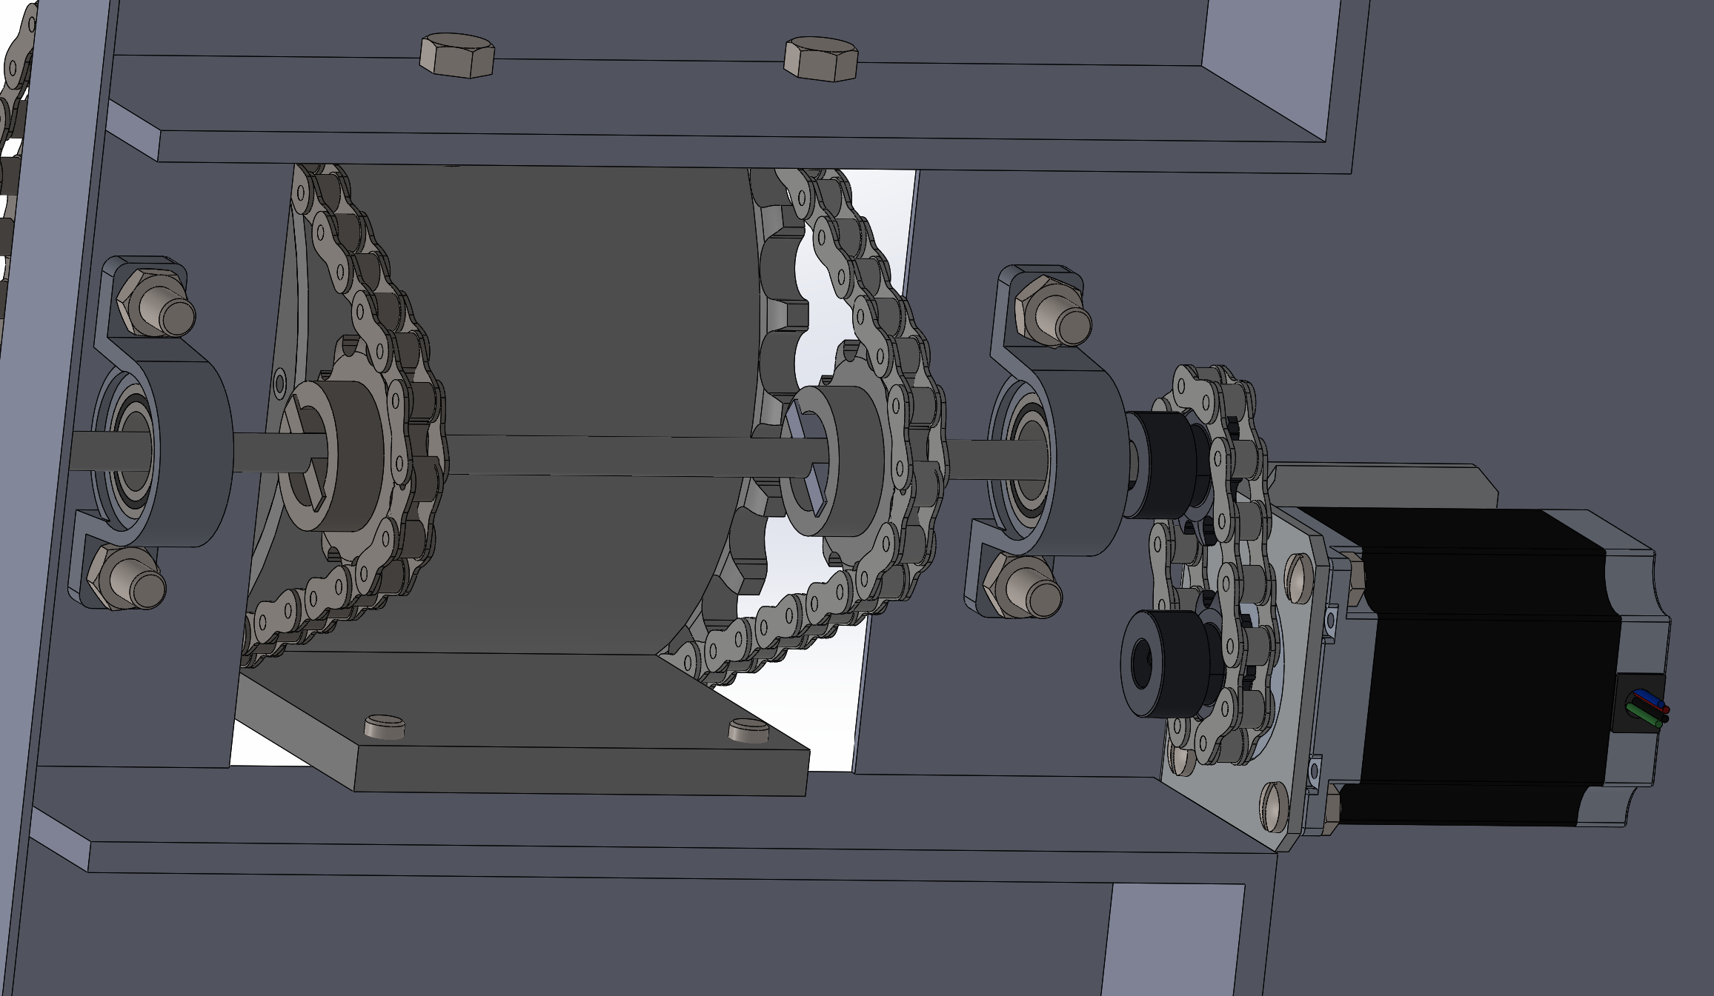
Complete CAD
Figure 3: Gear System

Slide 5
Bill of Materials

Slide 6
Manufacturing Plan
What's Left?
Cut hole for screen
Mount the pins for the base bottom
Mount slewing bearing
Mount Gear Parts
Finishing

Slide 7
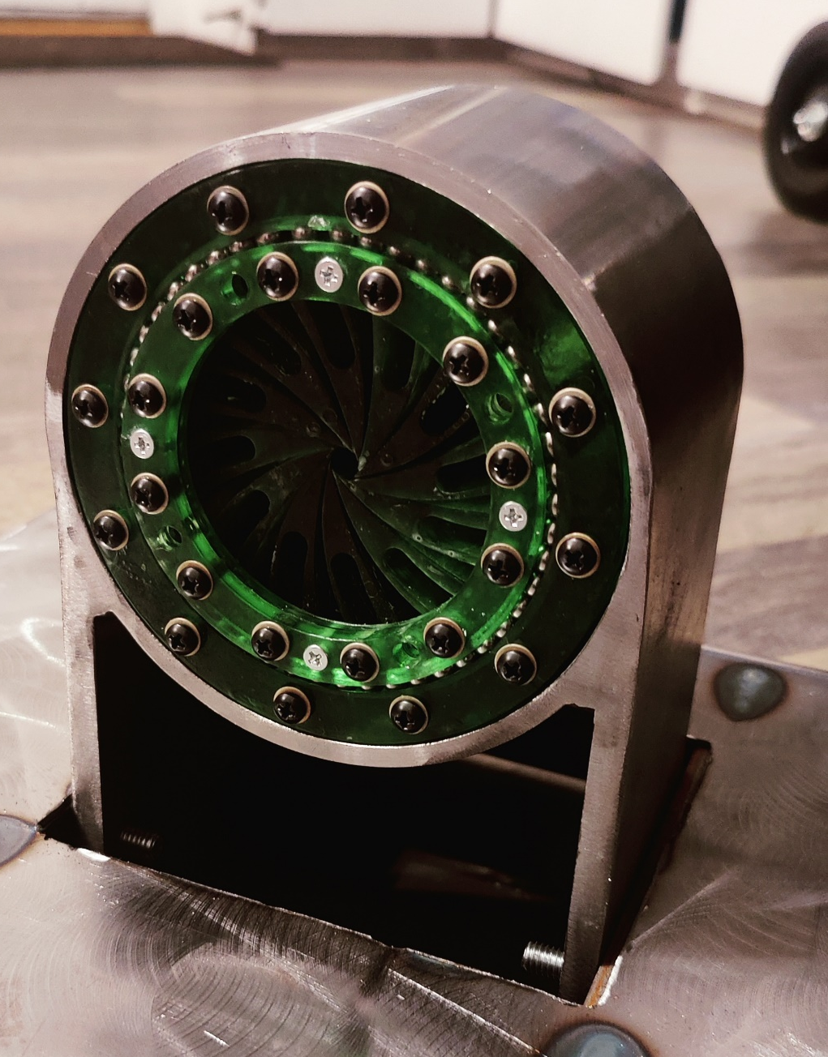
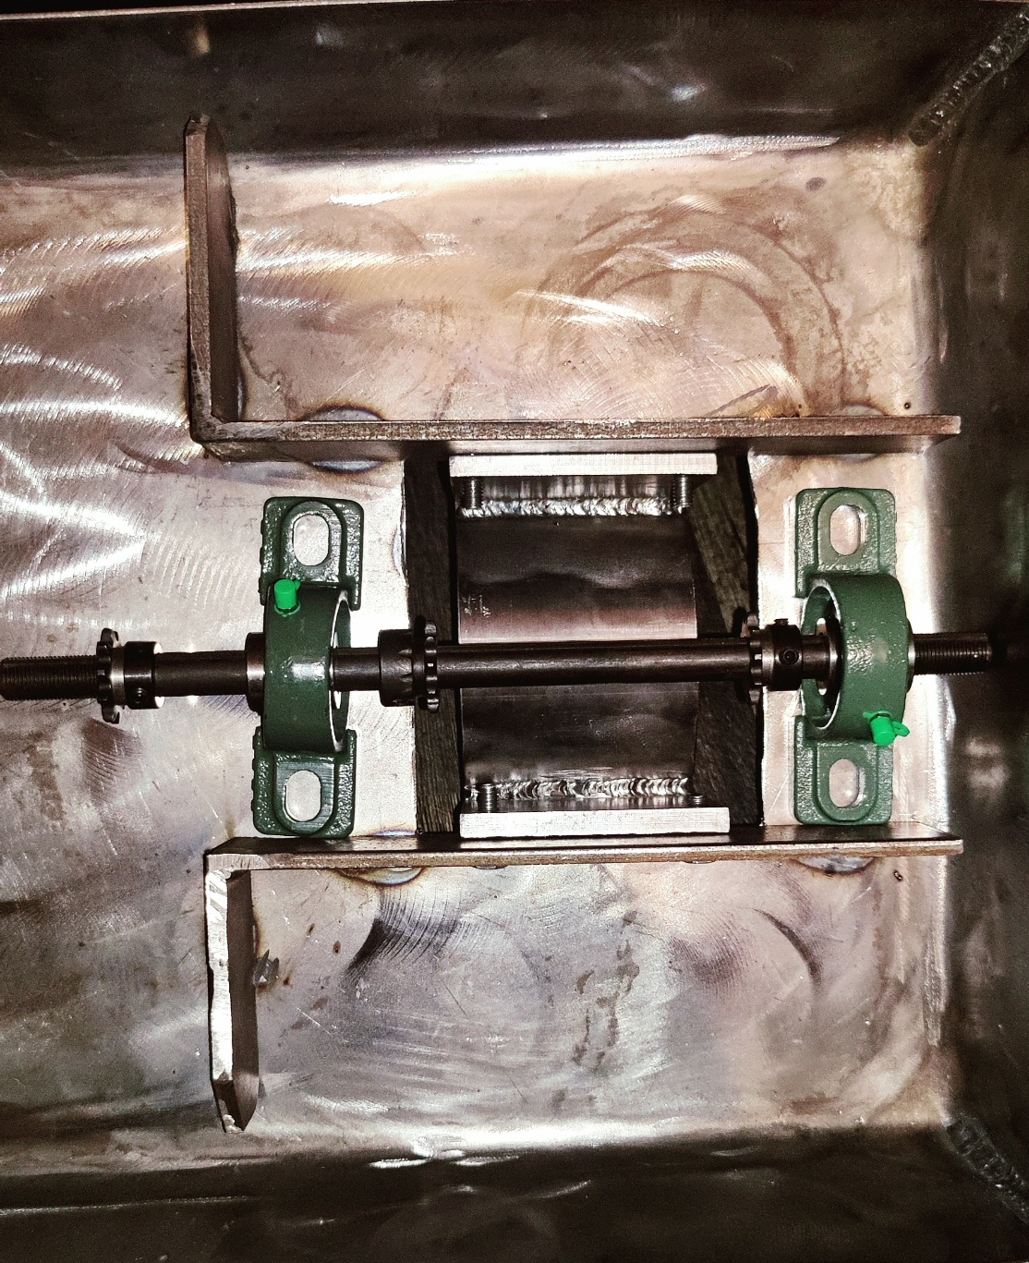
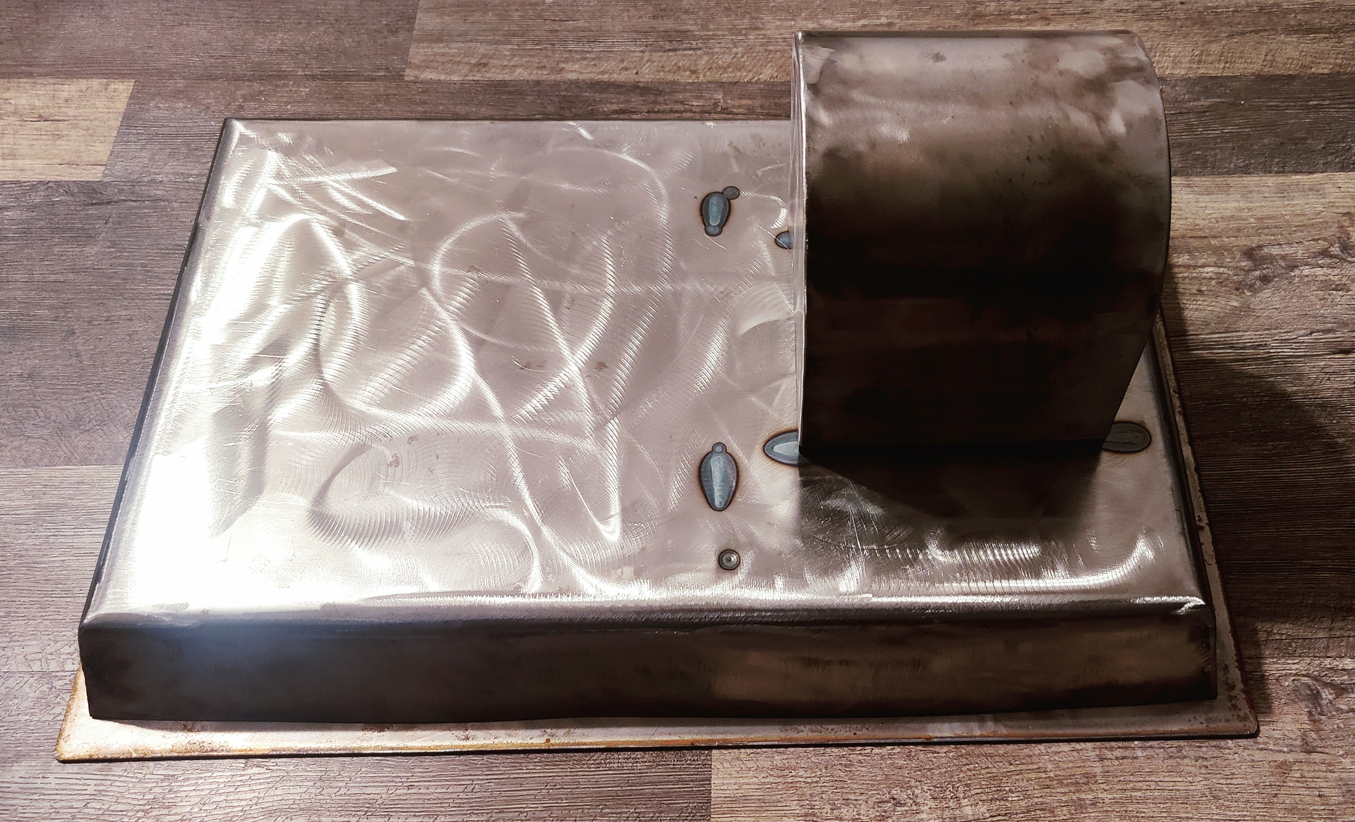
Manufacturing Plan
Figure 4: Manufactured Components
Figure 5: Manufactured Iris Shell
Figure 6: Mounting Points

Slide 8
Purchasing Plan
Part | QTY | Supplier | Raw Material | Purchased
Outer Shell | 1 | American Metals | 5in Tube | Yes
Shell Legs | 2 | American Metals | 2' x2' 3/8" Plate | Yes
Primary Retaining Ring | 1 | American Metals | 2' x2' 3/8" Plate | Yes
Inner Ring | 1 | American Metals | 2' x2' 3/8" Plate | Yes
Stationary Pins | 12 | American Metals | 3/8" Steel Rod 10' | Yes
Motion Pins | 12 | American Metals | 1/4" Steel Rod 10' | Yes
Leaflets | 12 | NAU Idea Lab | Onex | Yes
Project Base | 1 | American Metals | 4'x4' 14 Gauge Plate | Yes
Base Bottom Cover | 1 | American Metals | 4'x4' 14 Gauge Plate | Yes
Base Pins | 6 | American Metals | 3/8" Steel Rod 10' | Yes
Base Support | 3 | American Metals | 2"x 1/4" Bar 10' | Yes
Pillow Block Bushings | 2 | Amazon | N/A | Yes
Sprocket | 2 | Amazon | N/A | Yes
Motor Hub Cog | 1 | Amazon | N/A | Yes
#35 Chain | 1 | Tractor Supply | N/A | Yes
5/8 Axle | 1 | BMI Parts | N/A | Yes
Cog | 3 | BMI Parts | N/A | Yes
Sprocket Collars | 1 | Amazon | N/A | Yes
Safety Plate | 2 | American Metals | 4'x4' 14 Gauge Plate | Yes
Rubber Feet | 6 | Amazon | N/A | Yes
Bolts | 6 | HomeCo | Brass | Yes
Total To Purchase | 77 | Total Purchased | 77 | 68%

Slide 9
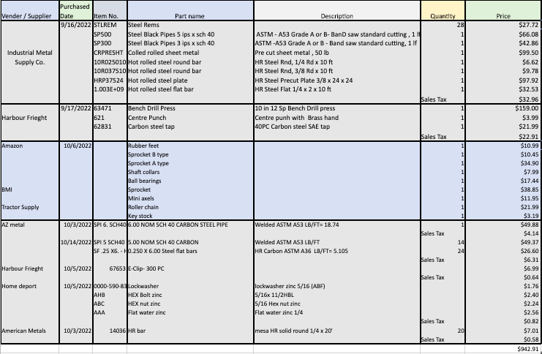
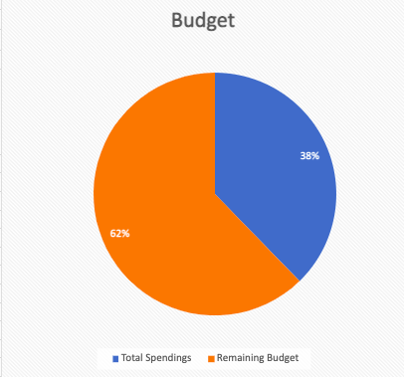
Budget as of 21st of October
Category | Amounts | Percentage of the Total | Reimbursement portion | Purchasing orders
Total Budget | $2,500.00 | 100%
Total Spendings | $942.91 | 38% | 31% | 6%
Remaining Budget | $1,557.09 | 62%

Slide 10
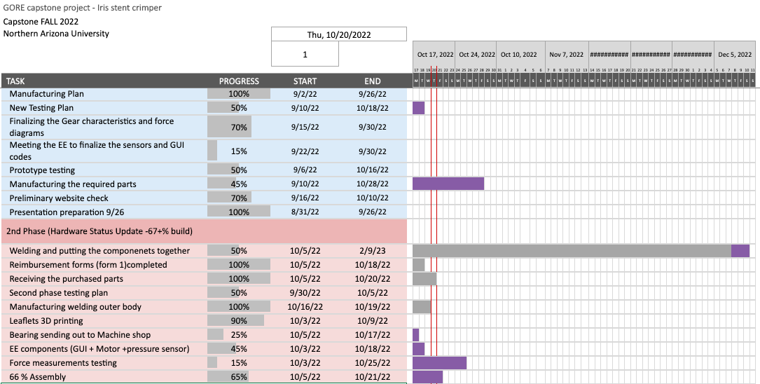
Gantt Chart

