Slide 1
33% Build
Gore Capstone
Team 5
Alex Nagle
Skylar Gilmore
Lumini Senaviratne

Slide 2
Team
Alex Nagle
Lumini M.
Skylar Gilmore
Project Lead
Test Engineer
Financial Manager
Logistics Manager
CAD Manager
Website Lead
Manufacturing Manager

Slide 3
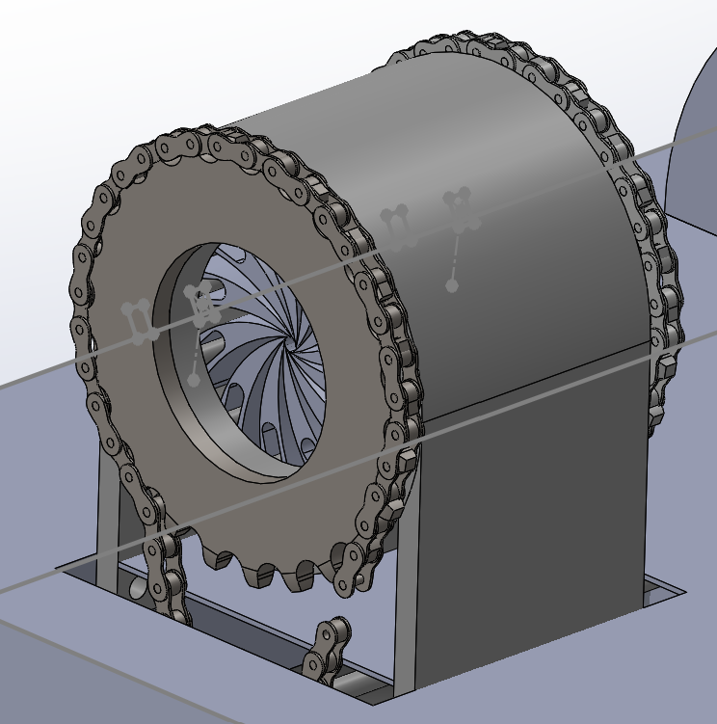
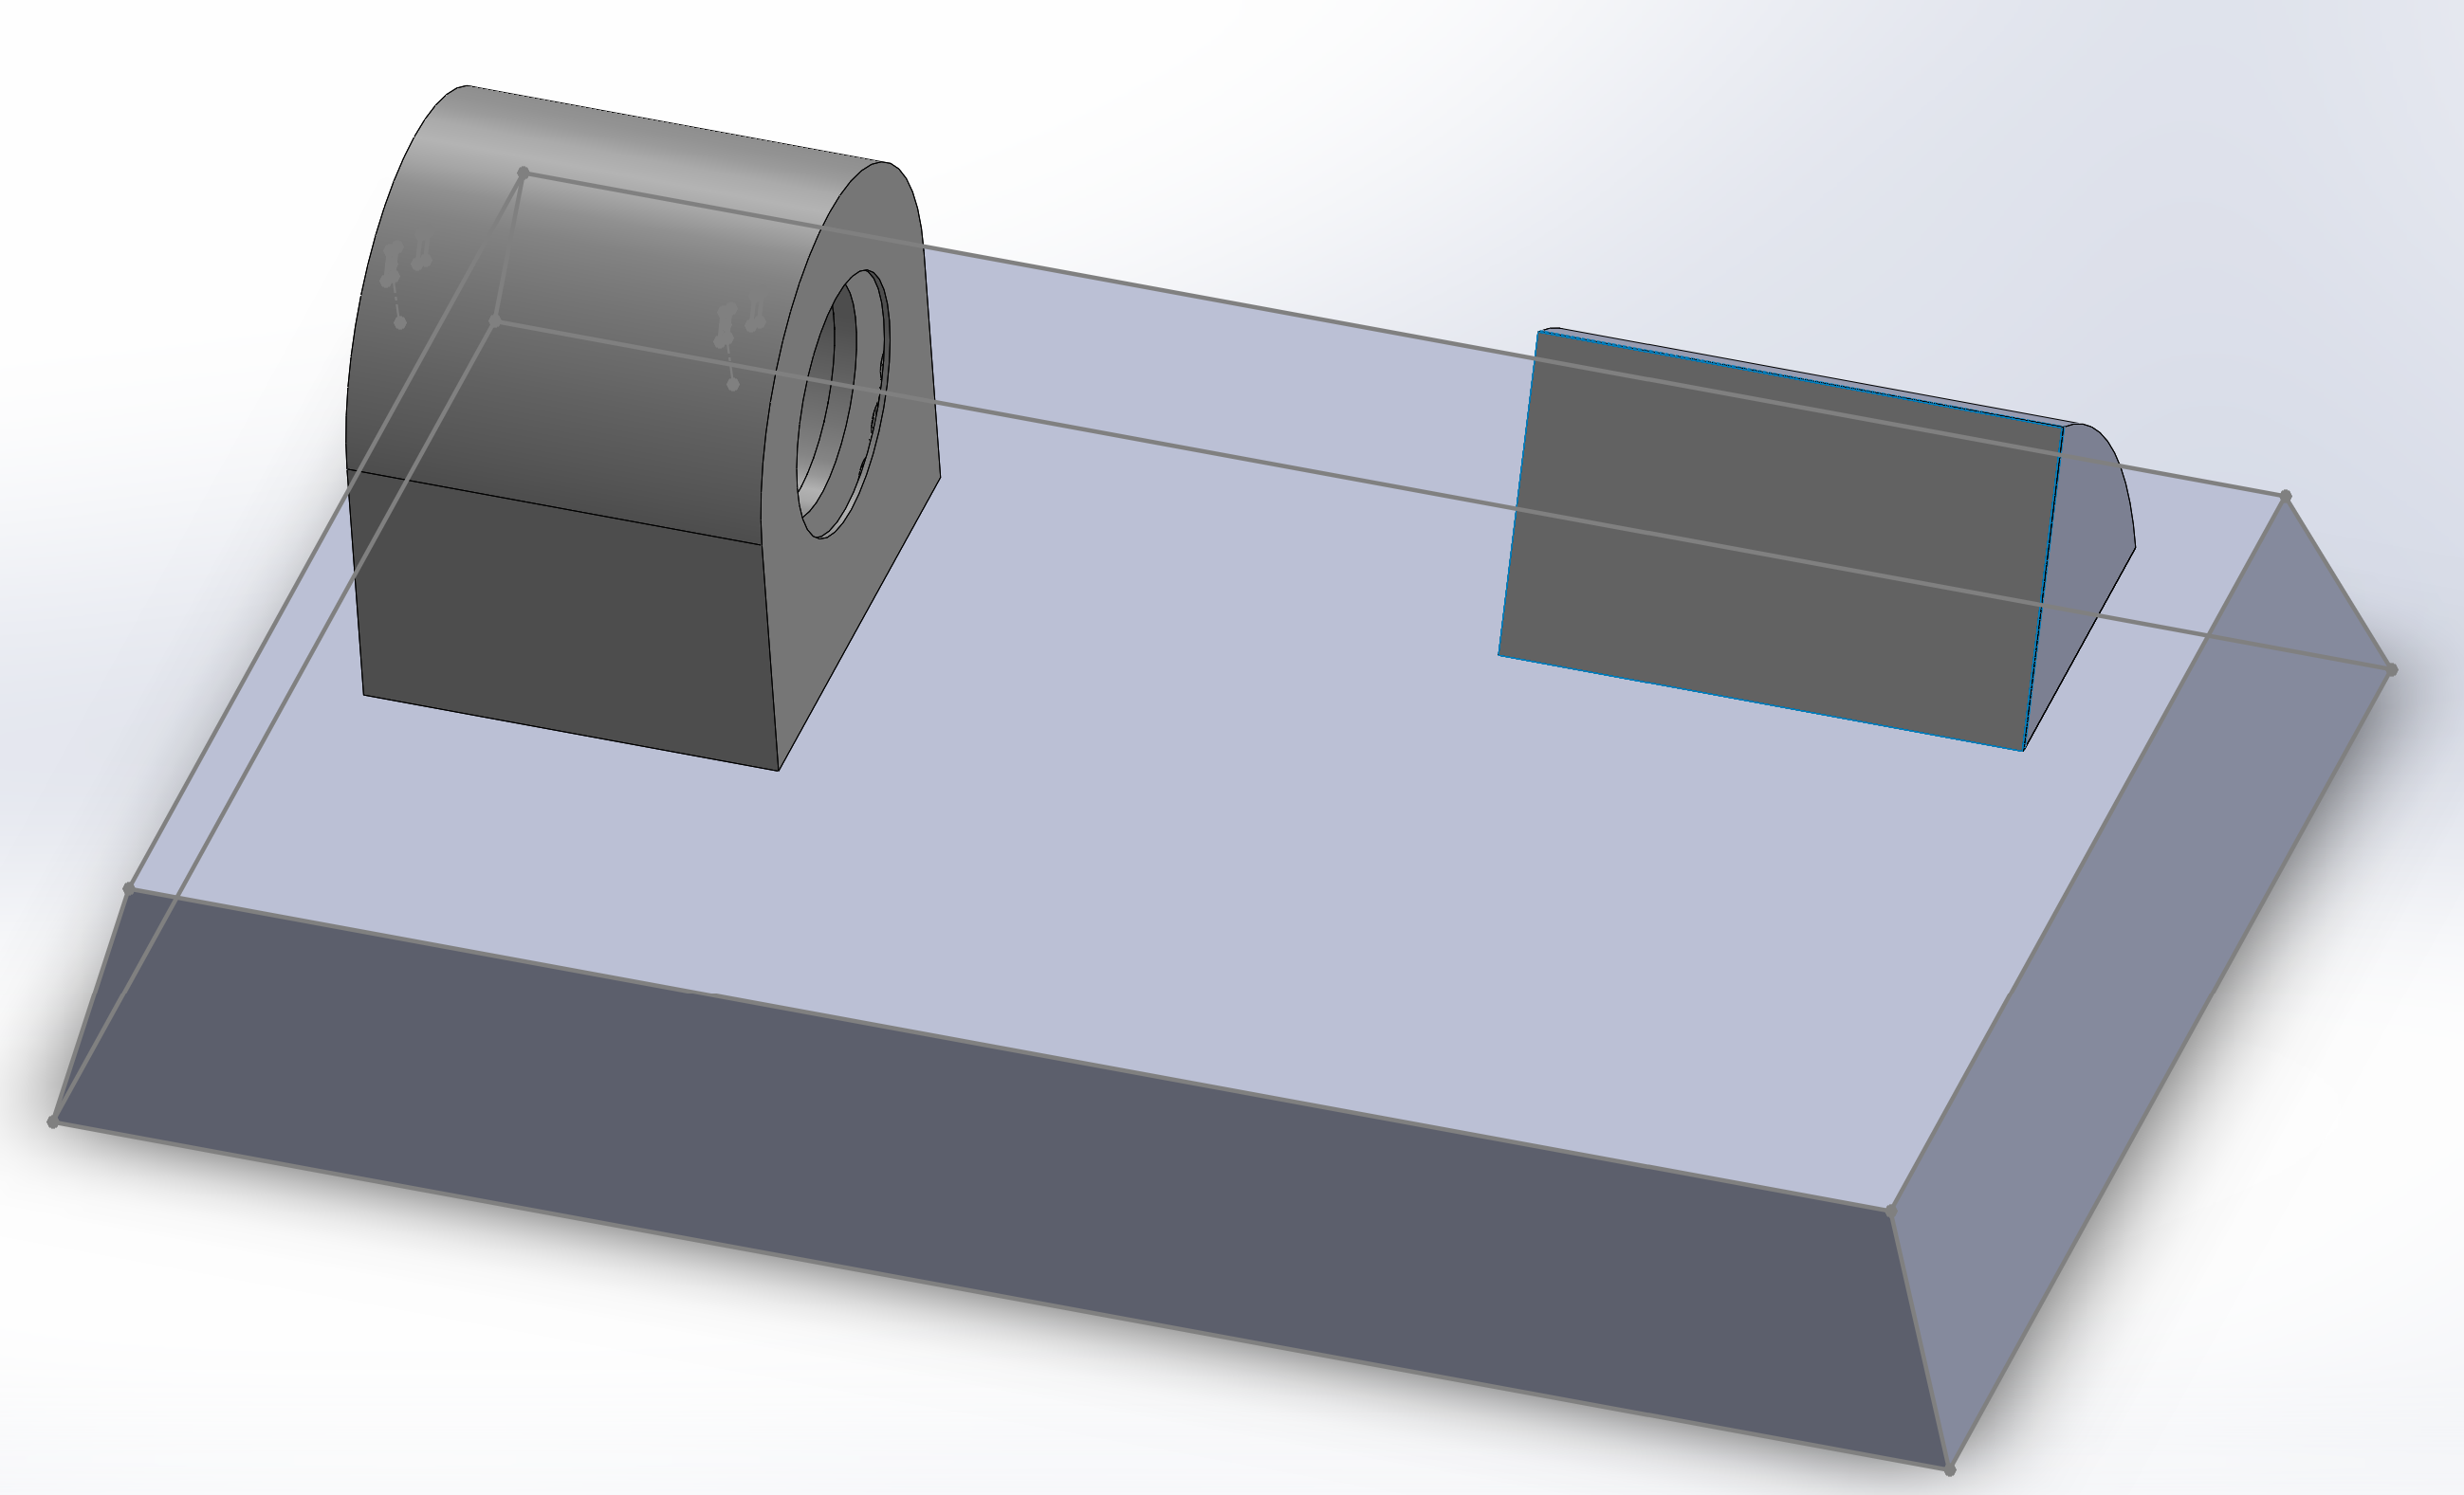
Complete CAD
Figure 1: Iris CAD
Figure 2: Complete Assembly

Slide 4
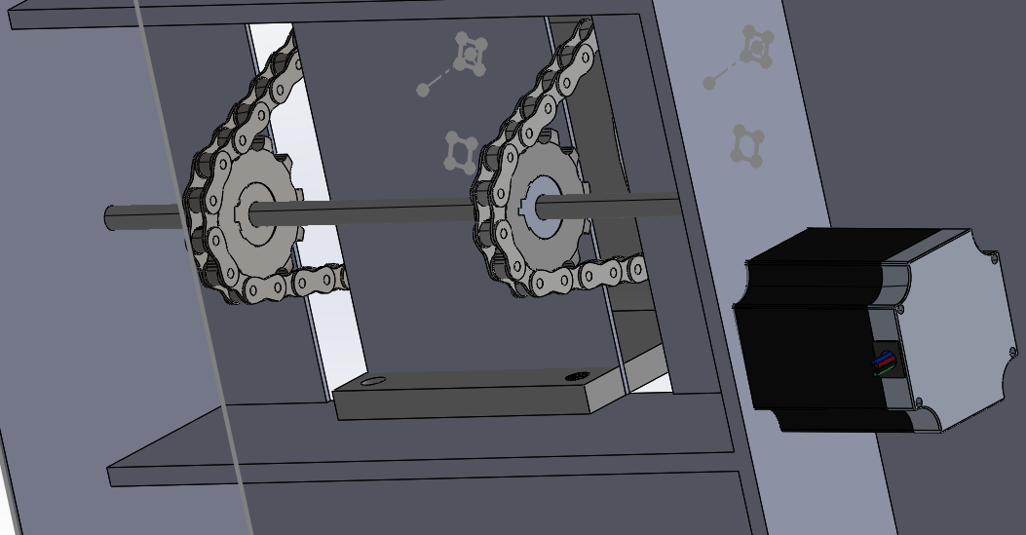
Complete CAD
The Motor will be connected to the rod using a 10 teeth gear
The shaft will have 2 chain gears with a gear ratio of 10 to 48
By having two chain gear we are preventing binding within the crimper
From calculations the crimper should have roughly 3 N of radial force
Figure 3: CAD for Lower Construction

Slide 5
Bill of Materials
Part | QTY | Type | Raw Material | Supplier | Material | Construction Time
Outer Shell | 1 | Manufactured | 5in Tube | American Metals | Mild Steel | 30 Minutes
Shell Legs | 2 | Manufactured | 2' x2' 3/8" Plate | American Metals | Mild Steel | 30 Minutes
Primary Retaining Ring | 1 | Manufactured | 2' x2' 3/8" Plate | American Metals | Mild Steel | 30 Minutes
Inner Ring | 1 | Manufactured | 2' x2' 3/8" Plate | American Metals | Mild Steel | 30 Minutes
Stationary Pins | 12 | Manufactured | 3/8" Steel Rod 10' | American Metals | Mild Steel | 45 Minutes
Motion Pins | 12 | Manufactured | 1/4" Steel Rod 10' | American Metals | Mild Steel | 45 Minutes
Leaflets | 12 | Manufactured | Onyx | NAU Idea Lab | Carbon Fiber Reinforced | 4 Weeks
Project Base | 1 | Manufactured | 4'x4' 14 Gauge Plate | American Metals | Mild Steel | 2 Hours
Base Bottom Cover | 1 | Manufactured | 4'x4' 14 Gauge Plate | American Metals | Mild Steel | 30 Minutes
Base Pins | 6 | Manufactured | 3/8" Steel Rod 10' | American Metals | Mild Steel | 2 Hours
Base Support | 3 | Manufactured | 2"x 1/4" Bar 10' | American Metals | Mild Steel | 30 Minutes
Pillow Block Bushings | 2 | Purchased | N/A | Amazon | Iron | 30 Minutes
Sprocket | 2 | Purchased | N/A | Amazon | Steel | 2 Hours
Motor Hub Cog | 1 | Purchased | N/A | Amazon | Steel | N/A
#35 Chain | 1 | Purchased | N/A | Tractor Supply | Steel | N/A
5/8 Axle | 1 | Purchased | N/A | BMI Parts | Steel | N/A
Cog | 3 | Purchased | N/A | BMI Parts | Mild Steel | N/A
Sprocket Collars | 1 | Purchased | N/A | Amazon | Aluminum | N/A
Safety Plate | 2 | Manufactured | 4'x4' 14 Gauge Plate | American Metals | Mild Steel | 2 Hours
Rubber Feet | 6 | Purchased | N/A | Amazon | Rubber | N/A
Bolts | 6 | Purchased | Brass | HomeCo | Brass | N/A

Slide 6
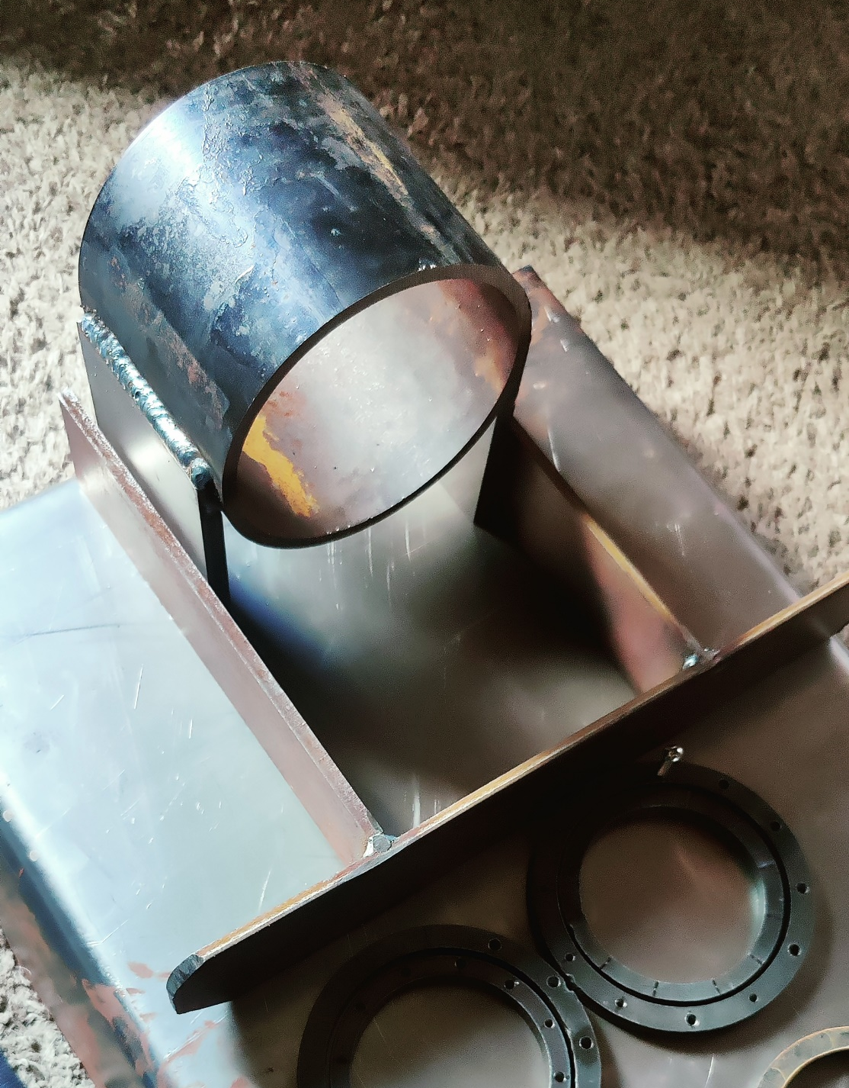
Manufacturing Plan
Part | QTY | Raw Material
Outer Shell | 1 | 5in Tube
Shell Legs | 2 | 2' x2' 3/8" Plate
Primary Retaining Ring | 1 | 2' x2' 3/8" Plate
Inner Ring | 1 | 2' x2' 3/8" Plate
Stationary Pins | 12 | 3/8" Steel Rod 10'
Motion Pins | 12 | 1/4" Steel Rod 10'
Leaflets | 12 | Onyx
Project Base | 1 | 4'x4' 14 Gauge Plate
Base Bottom Cover | 1 | 4'x4' 14 Gauge Plate
Base Pins | 6 | 3/8" Steel Rod 10'
Base Support | 3 | 2"x 1/4" Bar 10'
Pillow Block Bushings | 2 | N/A
Sprocket | 2 | N/A
Motor Hub Cog | 1 | N/A
#35 Chain | 1 | N/A
5/8 Axle | 1 | N/A
Cog | 3 | N/A
Sprocket Collars | 1 | N/A
Safety Plate | 2 | 4'x4' 14 Gauge Plate
Rubber Feet | 6 | N/A
Bolts | 6 | Brass
Figure 4: Manufactured Components
Figure 5: Manufactured Iris Shell

Slide 7
Purchasing Plan
Part | QTY | Supplier | Raw Material | Purchased
Outer Shell | 1 | American Metals | 5in Tube | Yes
Shell Legs | 2 | American Metals | 2' x2' 3/8" Plate | Yes
Primary Retaining Ring | 1 | American Metals | 2' x2' 3/8" Plate | Yes
Inner Ring | 1 | American Metals | 2' x2' 3/8" Plate | Yes
Stationary Pins | 12 | American Metals | 3/8" Steel Rod 10' | Yes
Motion Pins | 12 | American Metals | 1/4" Steel Rod 10' | Yes
Leaflets | 12 | NAU Idea Lab | Onex | Yes
Project Base | 1 | American Metals | 4'x4' 14 Gauge Plate | Yes
Base Bottom Cover | 1 | American Metals | 4'x4' 14 Gauge Plate | Yes
Base Pins | 6 | American Metals | 3/8" Steel Rod 10' | Yes
Base Support | 3 | American Metals | 2"x 1/4" Bar 10' | Yes
Pillow Block Bushings | 2 | Amazon | N/A | No
Sprocket | 2 | Amazon | N/A | No
Motor Hub Cog | 1 | Amazon | N/A | No
#35 Chain | 1 | Tractor Supply | N/A | No
5/8 Axle | 1 | BMI Parts | N/A | No
Cog | 3 | BMI Parts | N/A | No
Sprocket Collars | 1 | Amazon | N/A | No
Safety Plate | 2 | American Metals | 4'x4' 14 Gauge Plate | No
Rubber Feet | 6 | Amazon | N/A | No
Bolts | 6 | HomeCo | Brass | No
Total To Purchase | 77 | Total Purchased | 52 | 68%

Slide 8
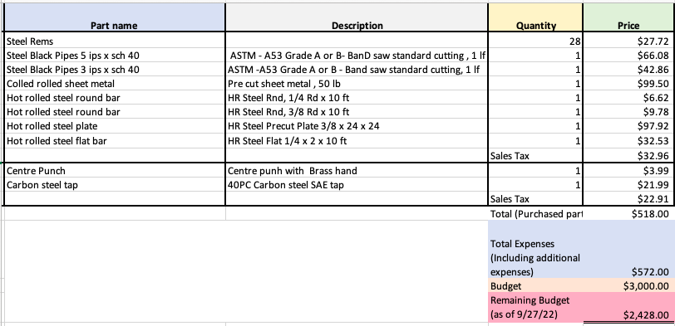
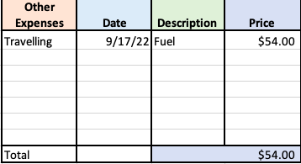
Budget

Slide 9
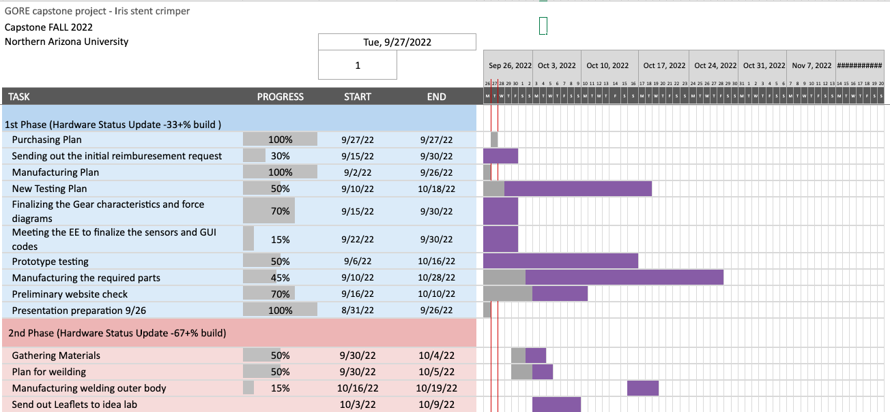
Gantt Chart

