Slide 1
Boeing Drone: Initial Testing
Project 03
Team Hi-Jacks
Damien Brothers, Dante Faria, Jay Khunt, Colby Murphy, and Thomas Schreiber

Slide 2
Design Requirement Summary
Requirement Number | Customer Requirement
CR1 | Lightweight
CR2 | High thrust to weight ratio
CR3 | High frame strength
CR4 | Long flight time
CR5 | Ease of manufacturing
CR6 | Inexpensive
CR7 | Optimized component locations
CR8 | Minimal hardware
CR9 | Flyable
REQUIREMENT NUMBER | ENGINEERING REQUIREMENT
ER1 | Weight < 3 pounds
ER2 | Thrust to weight ratio greater than 1.81
ER3 | Able to withstand forces of flight & landing/takeoff
ER4 | Flight time of 10 minutes
ER5 | Simple to produce
ER6 | Total project < $5000
ER7 | Central COG and 90° FOV
ER8 | Total parts < 30
ER9 | Ability to takeoff, maneuver, and land
Damien, 2

Slide 3
Top Level Testing Summary
Test | what | how | where | Relevant Design Requirements
Takeoff | PERCENT THROTTLE NEDDED FOR AIRBORNE | THROTTLE WILL BE INCREASED BY 5% FOR EVERY TRIAL | INDOORS/OUTDOORS OR QGroundControl | CR1, CR2, CR9, ER2, ER9
Maneuvering | STABILITY, MANEUVERING, SAFETY WHILE AIRBORNE | SLECTION OF SETTINGS OF MANUAL CONTROLS | QGroundControl | CR1, CR2, CR3, CR9, ER1, ER9
Flight stability | STABILITY, MANEUVERING, SAFETY WHILE TAKEOFF/ LANDING | SELECTION OF DIFFERENT MODES FROM QGroundControl | QGroundControl | CR3, CR7, ER3, ER7
Flight characteristics | PROPERRTY OF THE BODY AND ACCESSORIES OF DRONE. FOR EX. THURST-TO-WEIGHT RATIO, FLIGHT TIME, LOAD CAPACIITY, MAX. SPEED, ETC. | BY COMPUTING ALL THE COMPONENTS IN eClac | eClac | CR2, CR4, ER2, ER4
Landing | STABILITY, MANEUVERING, SAFETY WHILE LANDING | LANDING DRONE IN DIFFERENT TERRAINS/HEIGHTS | OUTDOORS | CR1, CR2, CR9, ER2, ER9
Drop Test Simulation | MATERIAL TESTING AND IMPACTS | DROP TEST SIMULATION | SolidWorks | CR3, CR5, CR6, CR8, ER3, ER8
Thrust to weight ratio | PERFORMANCE OF MOTORS | BY COMPUTING ALL THE COMPONENTS IN eClac | eClac | CR2, ER2
Weight | WEIGHT REDUCTION FROM ORIGINAL DESIGN | PUTTING ALL THE PARTS TOGETHER AND WEIGHING | WEIGING SCALE | CR1, ER1
Jay, 3

Slide 4
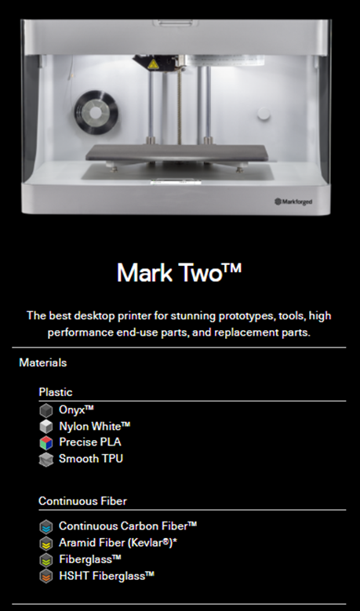
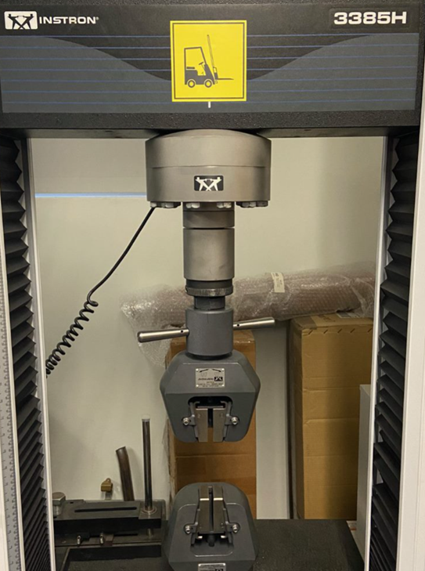
Dog Bone Testing
Experiment: Material Testing
§Markforged Mark Two (12 x 5 x 6in)
–Created 20 ASTM D638 Type 1 Dog Bones
–Printed Horizontally
–50% Infill
–Internal Reinforcement
§Instron 3385H
–Smaller Clamps Installed
Colby, 4

Slide 5
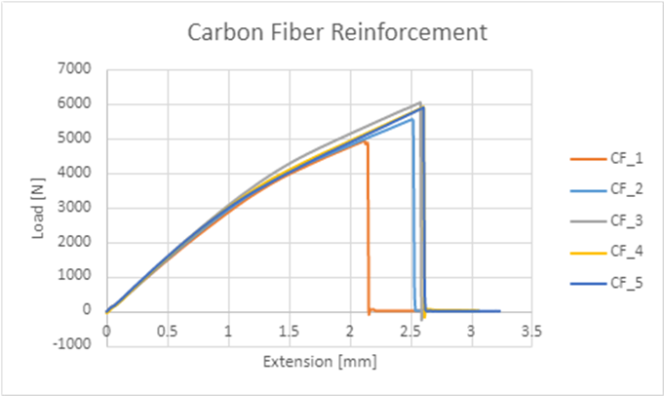
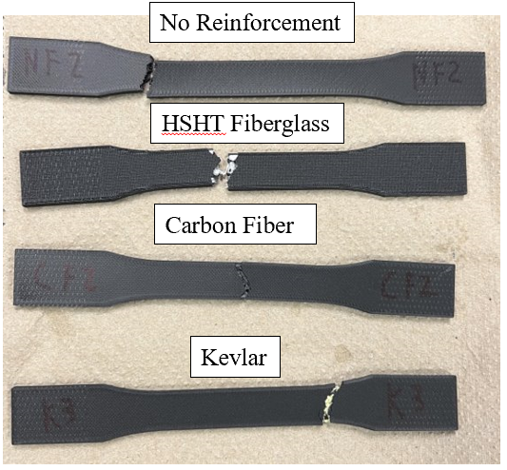
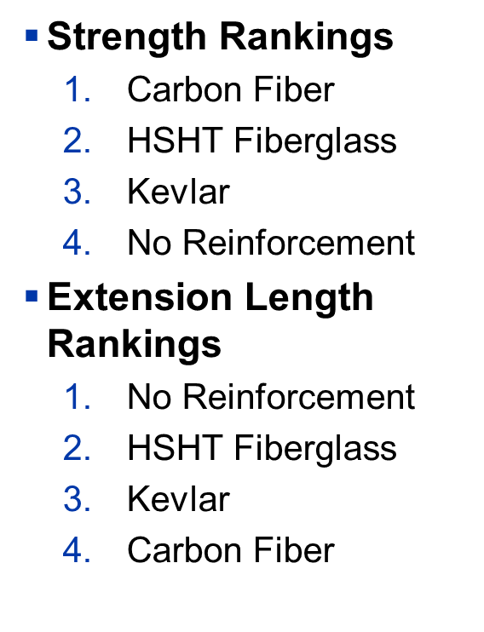
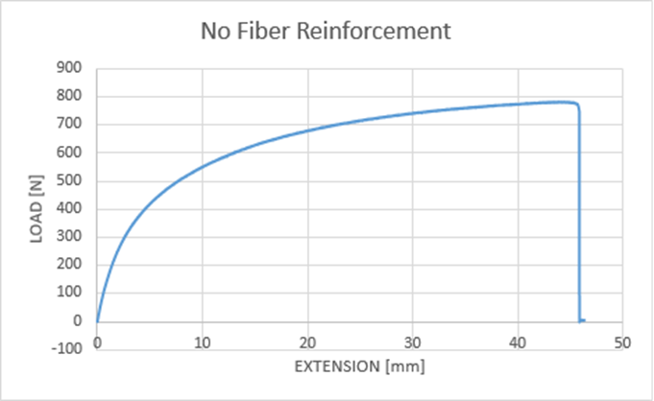
Dog Bone Testing Results
Colby, 5

Slide 6
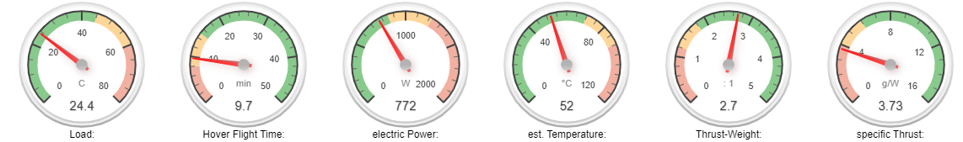
eCalc Testing
Experiment: Weight, thrust to weight, flight time
Procedure: eCalc analysis
Results
  Frame weight: 2.4 lbs.
  Total weight: 5.9 lbs.
  Thrust to weight ratio: 2.7
  Flight time: 9.7 minutes
  Range: 2.35 miles
Tommy, 6

Slide 7
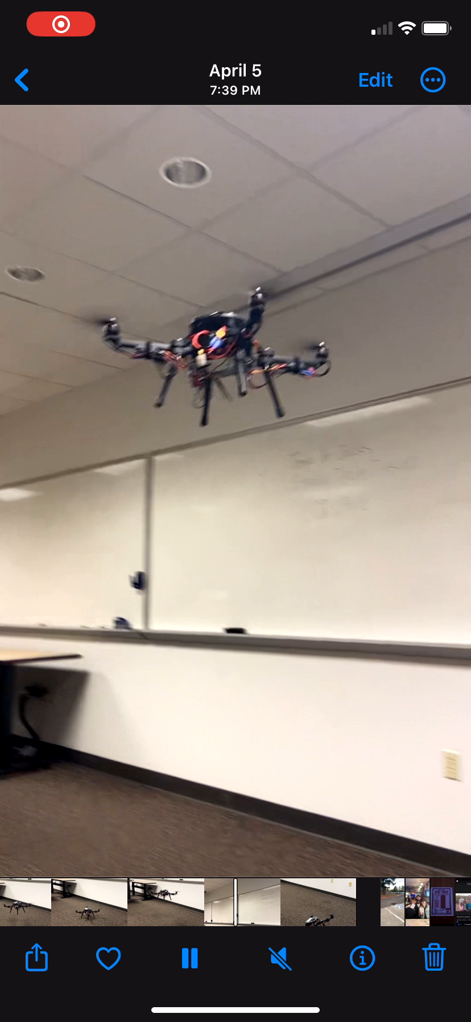
Detailed Testing Plan
Maneuverability and Stability
  QGroundControl
Takeoff
  Controller settings
  Weight testing
  QGroundControl
Landing
  Weight Testing
  QGroundControl
  Nervous due to uncontrolled testing style
Real-world Battery Test
  Multimeter and QGroundControl
Dante, 7

Slide 8
Specification Sheet Preparation
ENGINEERING REQUIREMENT | TARGET | TOLERANCE | MEASURED/ CALCULATED VALUE | ER MET? (✓ OR X) | CLIENT ACCEPTABLE? (✓ OR X)
ER1 - WEIGHT | < 3lbs | +0.0lbs | 2.4lbs | ✓ | ✓
ER2 – THRUST:WEIGHT | >1.81 | -0 | 2.7 | ✓ | ✓
ER3 – FORCE | 2000 psi | - 500 psi | 6000psi | ✓ | ✓
ER4 – FLIGHT | >10 minutes | - 0 seconds | 9.7 minutes | X | X
ER5 – PRODUCTION | 7 days | +/- 3 days | 4 days | ✓ | ✓
ER6 – COST | < $5,000 | +$0 | $2400 | ✓ | ✓
ER7 – CG & FOV | < ½” | +/- 1/8” | ~1/2” | ✓ | ✓
ER8 – # OF PARTS | < 30 parts | +/- 3 parts | 27 parts | ✓ | ✓
ER9 – FLIGHT SAFETY | 90% | +/- 5% | 87% | ✓ | ✓
Damien, 8

Slide 9
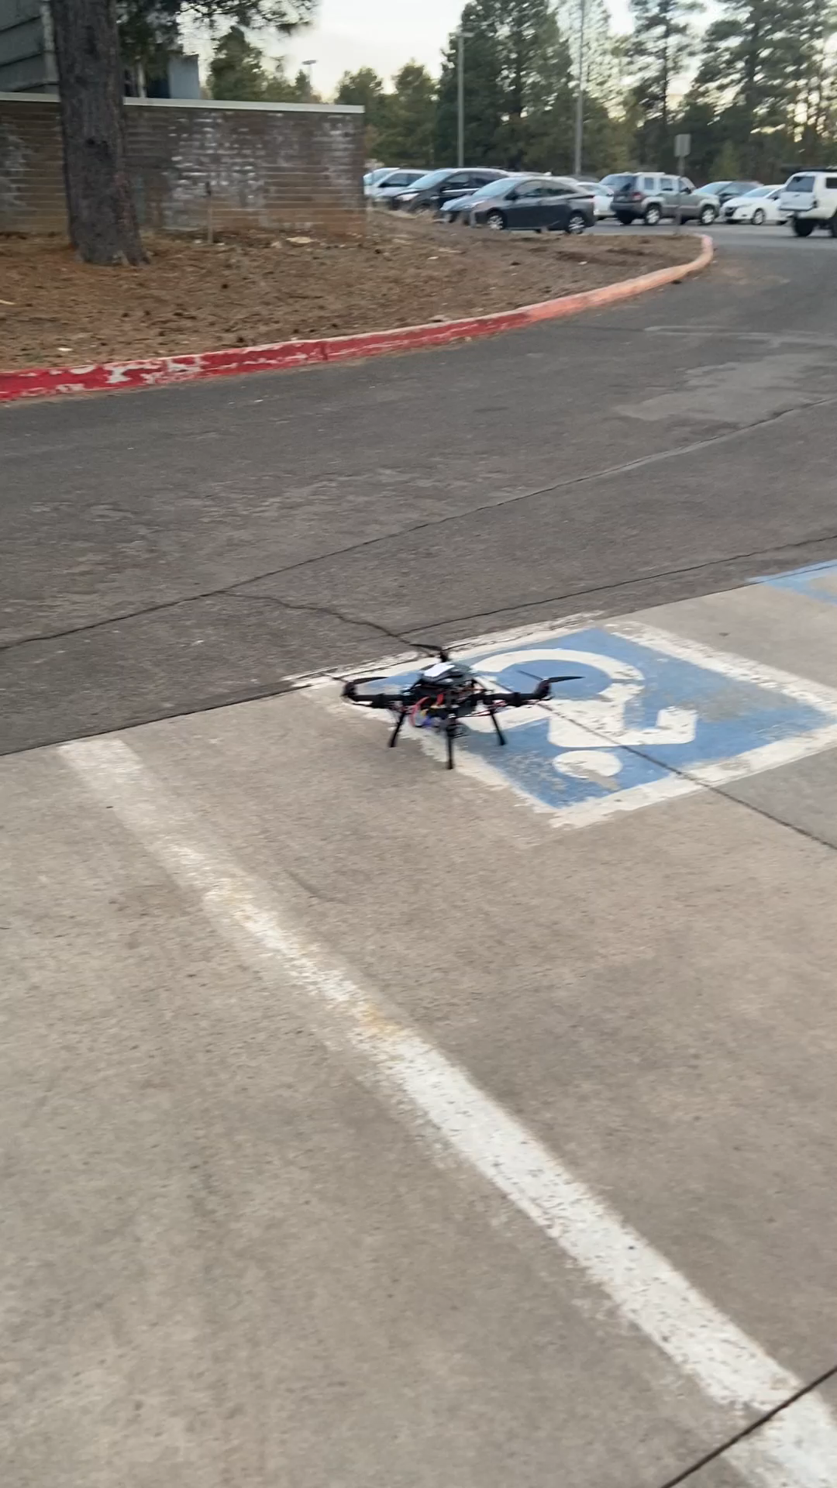
Demonstration
Flight is about the same as last time
  No changes in any parameters of flight or manual controls yet
  Focusing more on testing now which also consist of flight parameters and manual controls
Issues:​
  Wobbly landings
  Manual controls are irregular
Jay, 9

Slide 10
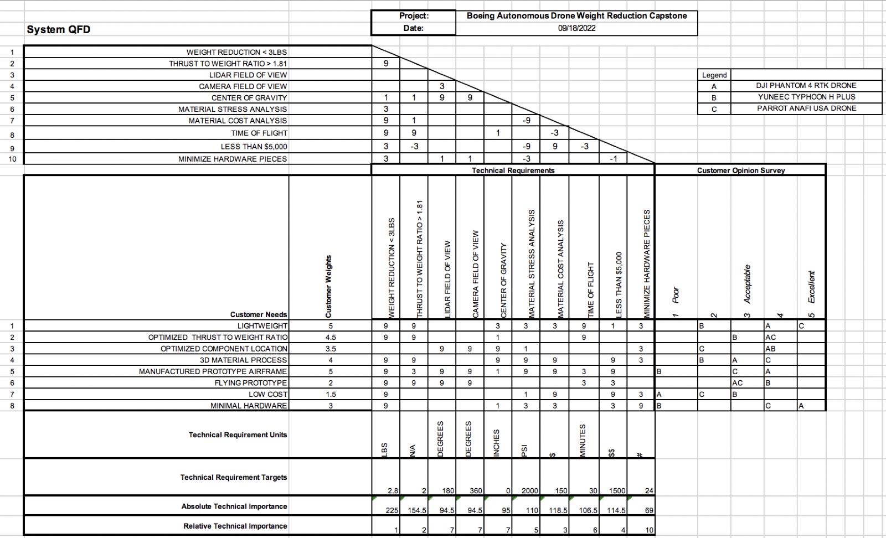
QFD
Requirement Number | Engineering Requirement
ER1 | Weight less than 3lbs
ER2 | Thrust to weight ratio greater than 1.81
ER3 | Able to withstand impacts and forces of flight
eR4 | Flight time around 10 minutes
ER5 | Simple to produce
ER6 | Total project less than $5000
ER7 | Central CG and good FOV
ER8 | Fewer Parts
ER9 | Ability to takeoff, maneuver, and land
Dante, 10

Slide 11

Questions??

