Slide 1
Boeing Drone: Final Testing
Project 03
Team Hi-Jacks
Damien Brothers, Dante Faria, Jay Khunt, Colby Murphy, and Thomas Schreiber

Slide 2
Design Requirement Summary
Requirement Number | Customer Requirement
CR1 | Lightweight
CR2 | High thrust to weight ratio
CR3 | High frame strength
CR4 | Long flight time
CR5 | Ease of manufacturing
CR6 | Inexpensive
CR7 | Optimized component locations
CR8 | Minimal hardware
CR9 | Flyable
REQUIREMENT NUMBER | ENGINEERING REQUIREMENT
ER1 | Weight < 3 pounds
ER2 | Thrust to weight ratio greater than 1.81
ER3 | Able to withstand forces of flight & landing/takeoff
ER4 | Flight time of 10 minutes
ER5 | Simple to produce
ER6 | Total project < $5000
ER7 | Central COG and 90° FOV
ER8 | Total parts < 30
ER9 | Ability to takeoff, maneuver, and land
Dante, 2

Slide 3
Top Level Testing Summary
Test | What? | How? | Where? | Relevant Design Requirements | Results
Takeoff | STABILITY, MANEUVERING, SAFETY WHILETAKEOFF AND PERCENT THROTTLE NEDDED FOR AIRBORNE | THROTTLE WILL BE INCREASED BY 5% FOR EVERY TRIAL | INDOORS/OUTDOORS OR QGroundControl | CR1, CR2, CR9, ER2, ER9 | SLIGHT UNSTABLE BUT MANAGABLE AND FLYABLE WITH MANUAL MODE AND TAKEOFF THROTTLE AT 40%
Maneuvering | STABILITY, MANEUVERING, SAFETY WHILE AIRBORNE | SLECTION OF SETTINGS OF MANUAL CONTROLS | QGroundControl | CR1, CR2, CR3, CR9, ER1, ER9 | ABLE TO INPUT EACH AND EVERY COMMAND AT 60% THROTTLE
Flight stability | STABILITY, MANEUVERING, SAFETY WHILE TAKEOFF/ LANDING | SELECTION OF DIFFERENT MODES FROM QGroundControl | QGroundControl | CR3, CR7, ER3, ER7 | STABLE WITH MANUAL MODE
Landing | STABILITY, MANEUVERING, SAFETY WHILE LANDING | LANDING DRONE IN DIFFERENT TERRAINS/HEIGHTS | OUTDOORS | CR1, CR2, CR9, ER2, ER9 | NO WOBBLINESS AND SMOOTHER LANDING WITH MANUAL MODE AT DESIGNATED AREA
Flight characteristics | PROPERRTY OF THE BODY AND ACCESSORIES OF DRONE. FOR EX. THURST-TO-WEIGHT RATIO, FLIGHT TIME, LOAD CAPACIITY, MAX. SPEED, ETC. | BY COMPUTING ALL THE COMPONENTS IN eClac | eCalc | CR2, CR4, ER2, ER4 | MEETS ALL CRITERIA
Thrust to weight ratio | PERFORMANCE OF MOTORS | BY COMPUTING ALL THE COMPONENTS IN eClac | eCalc | CR2, ER2 | 2.7
Weight | WEIGHT REDUCTION FROM ORIGINAL DESIGN | PUTTING ALL THE PARTS TOGETHER AND WEIGHING | WEIGING SCALE | CR1, ER1 | 2.2LBS
Drop Test Simulation | MATERIAL TESTING AND IMPACTS | DROP TEST SIMULATION | SolidWorks | CR3, CR5, CR6, CR8, ER3, ER8 | ARMS HELD THE FORCE AND LEGS BROKE BUT NO ENERGY TRANSFERRED TO ANY OTHER PARTS
Battery | FLIGHT TIME OPTIMIZED BY BATTERY LIFE | HOVERING THE DRONE UNTIL BATTERY DIES | OUTDOORS (PHYSICALLY ON DRONE) | CR4, CR9, ER4, ER9 | 12.5 MINUTES
Jay, 3

Slide 4
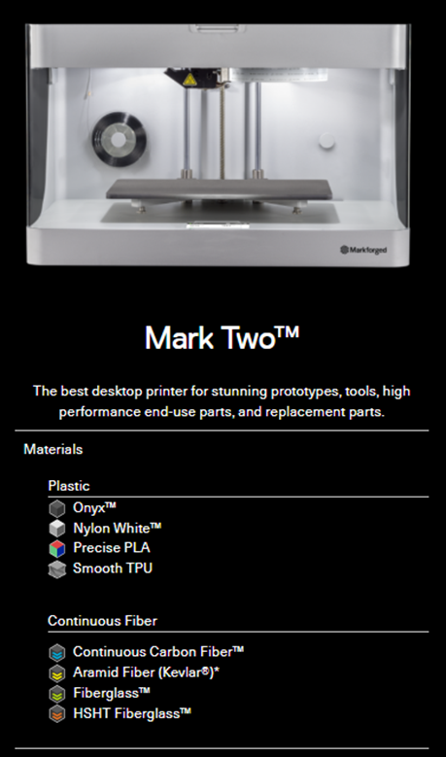
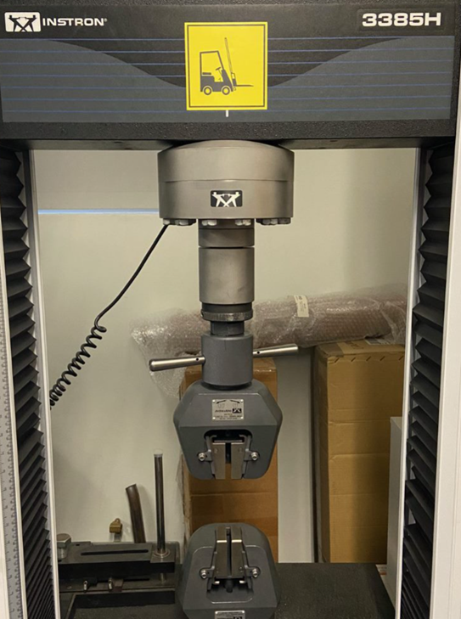
Dog Bone Testing
Experiment: Material Testing
§Markforged Mark Two (12 x 5 x 6in)
–Created 20 ASTM D638 Type 1 Dog Bones
–Printed Horizontally
–50% Infill
–Internal Reinforcement
§Instron 3385H
–Smaller Clamps Installed
Colby, 4

Slide 5
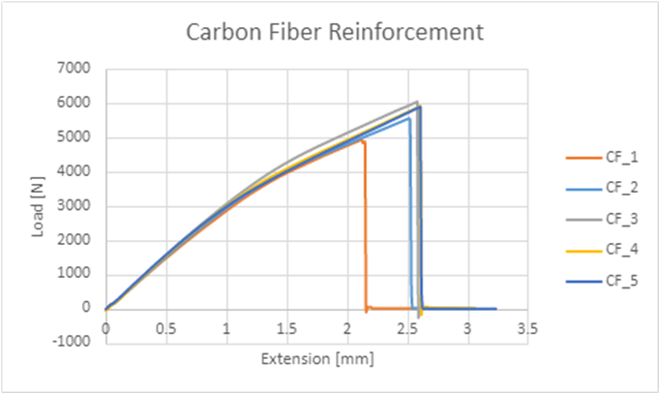
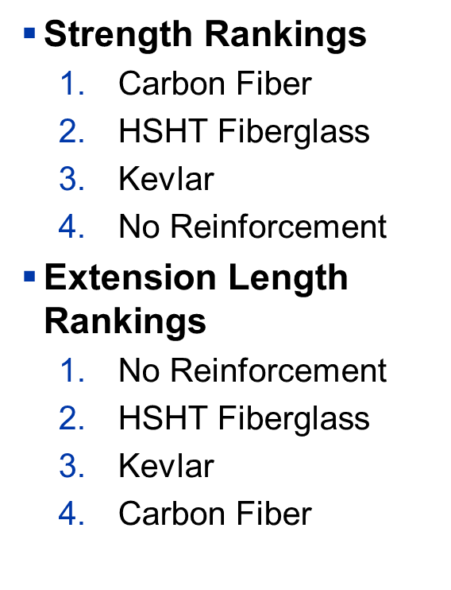
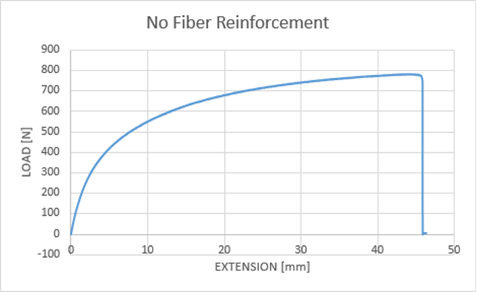
Dog Bone Testing Results
Colby, 5

Slide 6
Takeoff
Design Requirements:
CR1, CR2, CR9, ER2, ER9
Equipment:
Drone and controller
Manual Mode
Method: Slowly increase throttle until takeoff while noting what the throttle is at
Results
When throttle is moved quickly to 40%, takeoff is smooth and vertical.
Anything below 40% just spins motors
Similar controls no matter what the battery life is
Dante, 6

Slide 7
Maneuverability
Design Requirements:
CR1, CR2, CR3, CR9, ER1, ER9
Equipment:
Drone and Controller
Manual Mode
Method:
Hover at ~5ft
Use pitch, roll, and yaw
Results:
Drone can handle each input in a safe and controlled manner
Human error-subsiding
End points need slight tweak depending on environment
Colby, 7

Slide 8
Flight Stability
Design Requirements:
CR3, CR7, ER3, ER7
Equipment:
Drone and Controller
Manual Mode
Method:
Hover at ~5ft
Observe movements not given from controller
Results:
Drone shakes slightly on takeoff with manual mode.
Hovers in place for a few seconds with slight drift.
Very controllable
Controller inputs are sensitive but usable
Colby , 8

Slide 9
Landing
Design Requirements:
CR1, CR2, CR9, ER2, ER9
Equipment
Drone and Controller
Manual Mode
Method:
Takeoff
Fly for 30 seconds
Land in designated area
Results:
Smoother landing with manual mode, no wobble
Slightly harder to control but with better performance
Able to touch down each time in specific area
Tommy, 9

Slide 10
Flight Characteristics
Experiment: Weight, thrust to weight, flight time
Procedure: eCalc analysis
Results
Frame weight: 2.2 lbs.
Total weight: 5.9 lbs.
Thrust to weight ratio: 2.7
Flight time: 9.7 minutes
Range: 2.35 miles
Tommy, 10

Slide 11
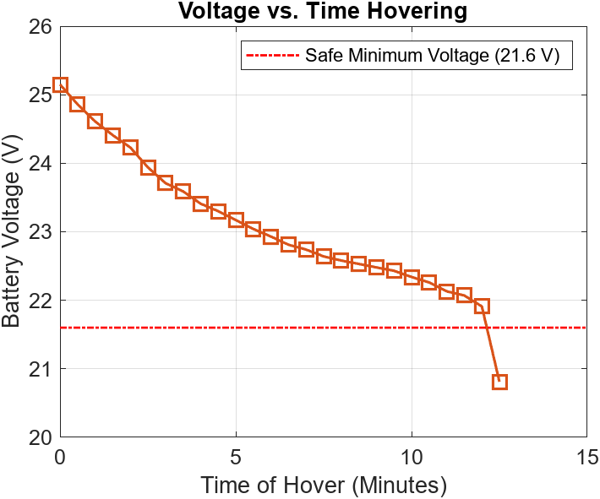
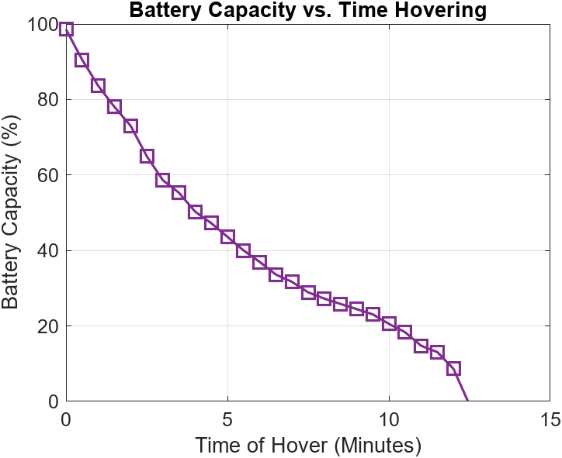
Real World Battery Test
Hover Testing
Hovered using manual flight mode
~5 ft in the air to avoid prop wash
Recorded Battery Voltage
Once every 30 seconds
Made it to 12.5 Minutes before voltage drop-off
Tommy, 11

Slide 12
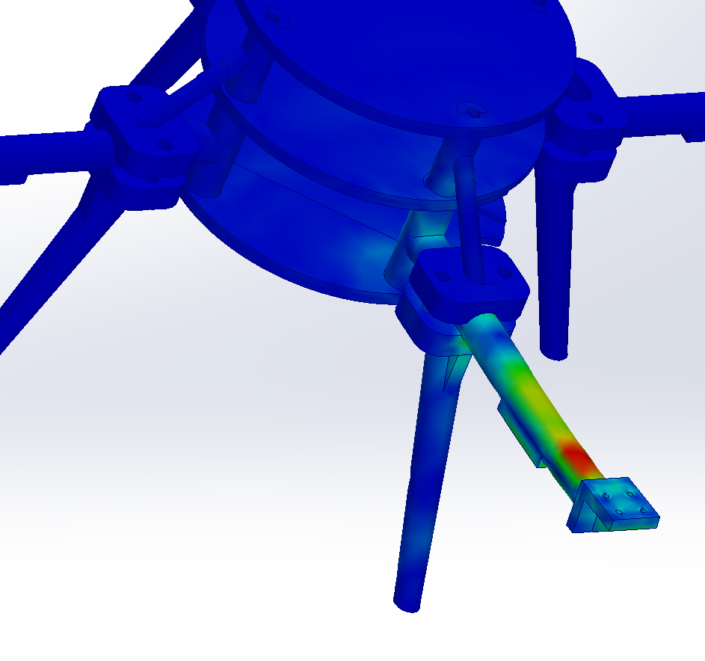
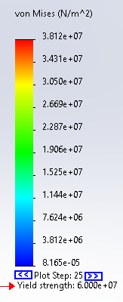
Drop Test
Design Requirements:
CR1, CR2, CR9, ER2, ER9
Equipment Used:
SolidWorks
Method:
Drop test simulation from 10 feet, onto various components.
Results:
Damien, 12

Slide 13
Specification Sheet
CUSTOMER REQUIREMENT | CR MET? (✓ OR X) | CLIENT ACCEPTABLE? (✓ OR X)
CR1 | ✓ | ✓
CR2 | ✓ | ✓
CR3 | ✓ | ✓
CR4 | ✓ | ✓
CR5 | ✓ | ✓
CR6 | ✓ | ✓
CR7 | ✓ | ✓
CR8 | ✓ | ✓
CR9 | ✓ | ✓
Damien, 13

Slide 14
Specification Sheet
ENGINEERING REQUIREMENT | TARGET | TOLERANCE | MEASURED/ CALCULATED VALUE | ER MET? (✓ OR X) | CLIENT ACCEPTABLE? (✓ OR X)
ER1 - WEIGHT | < 3lbs | +0.0lbs | 2.4lbs | ✓ | ✓
ER2 – THRUST:WEIGHT | >1.81 | -0 | 2.7 | ✓ | ✓
ER3 – FORCE | 2000 psi | - 500 psi | 6000psi | ✓ | ✓
ER4 – FLIGHT | >10 minutes | +/- 2 minutes | 12.5 minutes | ✓ | ✓
ER5 – PRODUCTION | 7 days | +/- 3 days | 4 days | ✓ | ✓
ER6 – COST | < $5,000 | +$0 | $2400 | ✓ | ✓
ER7 – CG | < ½” | +/- 1/8” | ~1/4” | ✓ | ✓
ER8 – # OF PARTS | < 30 parts | +/- 5 parts | 27 parts | ✓ | ✓
ER9 – FLIGHT SAFETY | 90% | +/- 5% | 87% | ✓ | ✓
Damien, 14

Slide 15
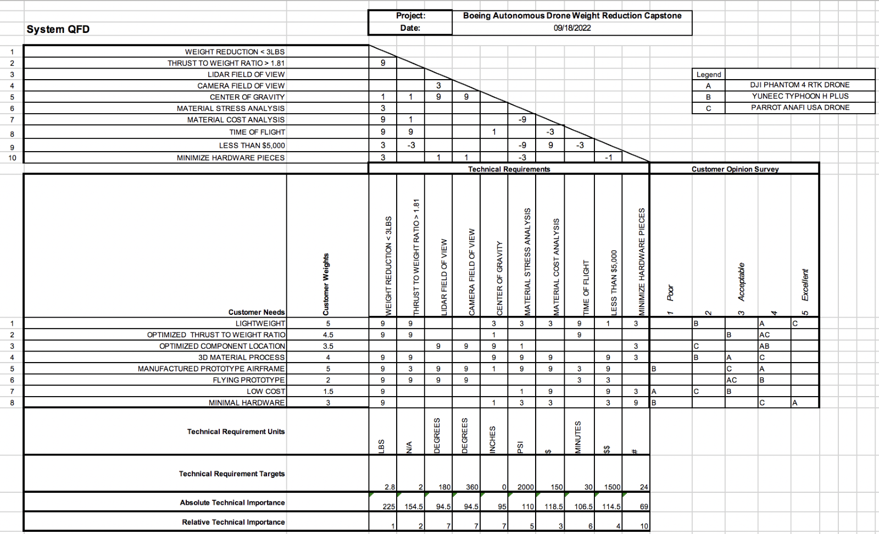
QFD
Requirement Number | Engineering Requirement
ER1 | Weight less than 3lbs
ER2 | Thrust to weight ratio greater than 1.81
ER3 | Able to withstand impacts and forces of flight
eR4 | Flight time around 10 minutes
ER5 | Simple to produce
ER6 | Total project less than $5000
ER7 | Central CG and good FOV
ER8 | Fewer Parts
ER9 | Ability to takeoff, maneuver, and land
Dante, 15

Slide 16
Demonstration
Changes made
'Stability Mode' was changed to 'Manual Mode’ in QGroundControl to improve the flight.
Results
Flight stability has been improved
Better takeoff, maneuverability, and landing
Much stable controls
No wobbliness
Jay, 16

Slide 17
Prototype 1
Parts | Materials | Manufactured when? | Manufactured where? | Cost
Discs | ABS | 10/11/2022 | MakersLab | $30
Arms | ABS | 10/11/2022 | MakersLab | $36.49
Prototype 2
Discs W/Key | ABS | 12/2/2022 | IDEA Lab | $35
Arms W/Spacers | Non-reinforced Onyx | 12/2/2022 | Hubs.com | $178.12
Legs W/Arm Clamps | Non-reinforced Onyx | 12/2/2022 | Hubs.com | $119.08
Spacers W/Arm Clamps | Non-reinforced Onyx | 12/2/2022 | Hubs.com | $76.16
Prototype 2 Replacement parts
Discs W/Key | ABS | 3/8/2023 | IDEA Lab | $88.8
Arms W/Spacers | Carbon infused Onyx | 3/8/2023 | IDEA Lab | $146.34
Legs W/Arm Clamps | Non-reinforced Onyx | 3/8/2023 | IDEA Lab | $119.08
Spacers W/Arm Clamps | Carbon infused Onyx | 3/8/2023 | IDEA Lab | $49.31
Prototype 3
Discs W/Key | ABS | 4/14/2023 | Hubs.com | $214.67
Arms W/Spacers | Non-reinforced Onyx | 4/14/2023 | Hubs.com | $260.08
Legs W/Arm Clamps | Non-reinforced Onyx | 4/14/2023 | Hubs.com | $117.52
Spacers W/Arm Clamps | Non-reinforced Onyx | 4/14/2023 | Hubs.com | $75.68

