Slide 1
SAE BAJA
TEAM MEMBERS:
OMER ALAMOUDI
MUSAED FRAIDOUN
SALEM AL MARRI
RASHID ALGELMOD
CHUJIAN WANG
Omer / SAE Baja/11-18-2021

Slide 2
REVIEW
SAE Baja Car Design
Systems Assigned
  Brakes
  Suspension
  Steering
  Dashboard
Analytical Project
Calculations Performed
Finite Element Analysis
Motion Analysis
Omer / SAE Baja/11-18-2021

Slide 3
REQUIREMENTS & SPECIFICATION
Table 1: Engineering requirement
Result Parameter | Value | Remarks
Track Width | 62±2 inches | 61.5 inches
Drivers Weight | < 225 lb | 130 Ib
Vehicle Weight | 375 ±5 lb | Complete Vehicle not Designed
Spring Compression | 4.5 ±0.5 in
Braking Distance | ≤ 23 ft | Input for Calculations
Brakes Temperature | < 100°C | 85.15°C
Braking Time | < 5 sec | 1.15 s
Steering Effort | 8+5 lb-inch | 7.5 Ib-inch
Speed Detection Accuracy | < 5
Display Delay | < 25 ms
Omer / SAE Baja/11-18-2021

Slide 4
REQUIREMENTS & SPECIFICATION
Table 2: Customer Requirements
Customer Requirements | Remarks
All-terrain Vehicle | ✅
Light Weight | ✅
Safe Design | ✅
Comfort for the rider | ✅
Ease of Maintenance | ✅
Short Stopping Distance | ✅
Reliable and Durable | ✅
Heat | ✅
Cost
Omer / SAE Baja/11-18-2021

Slide 5
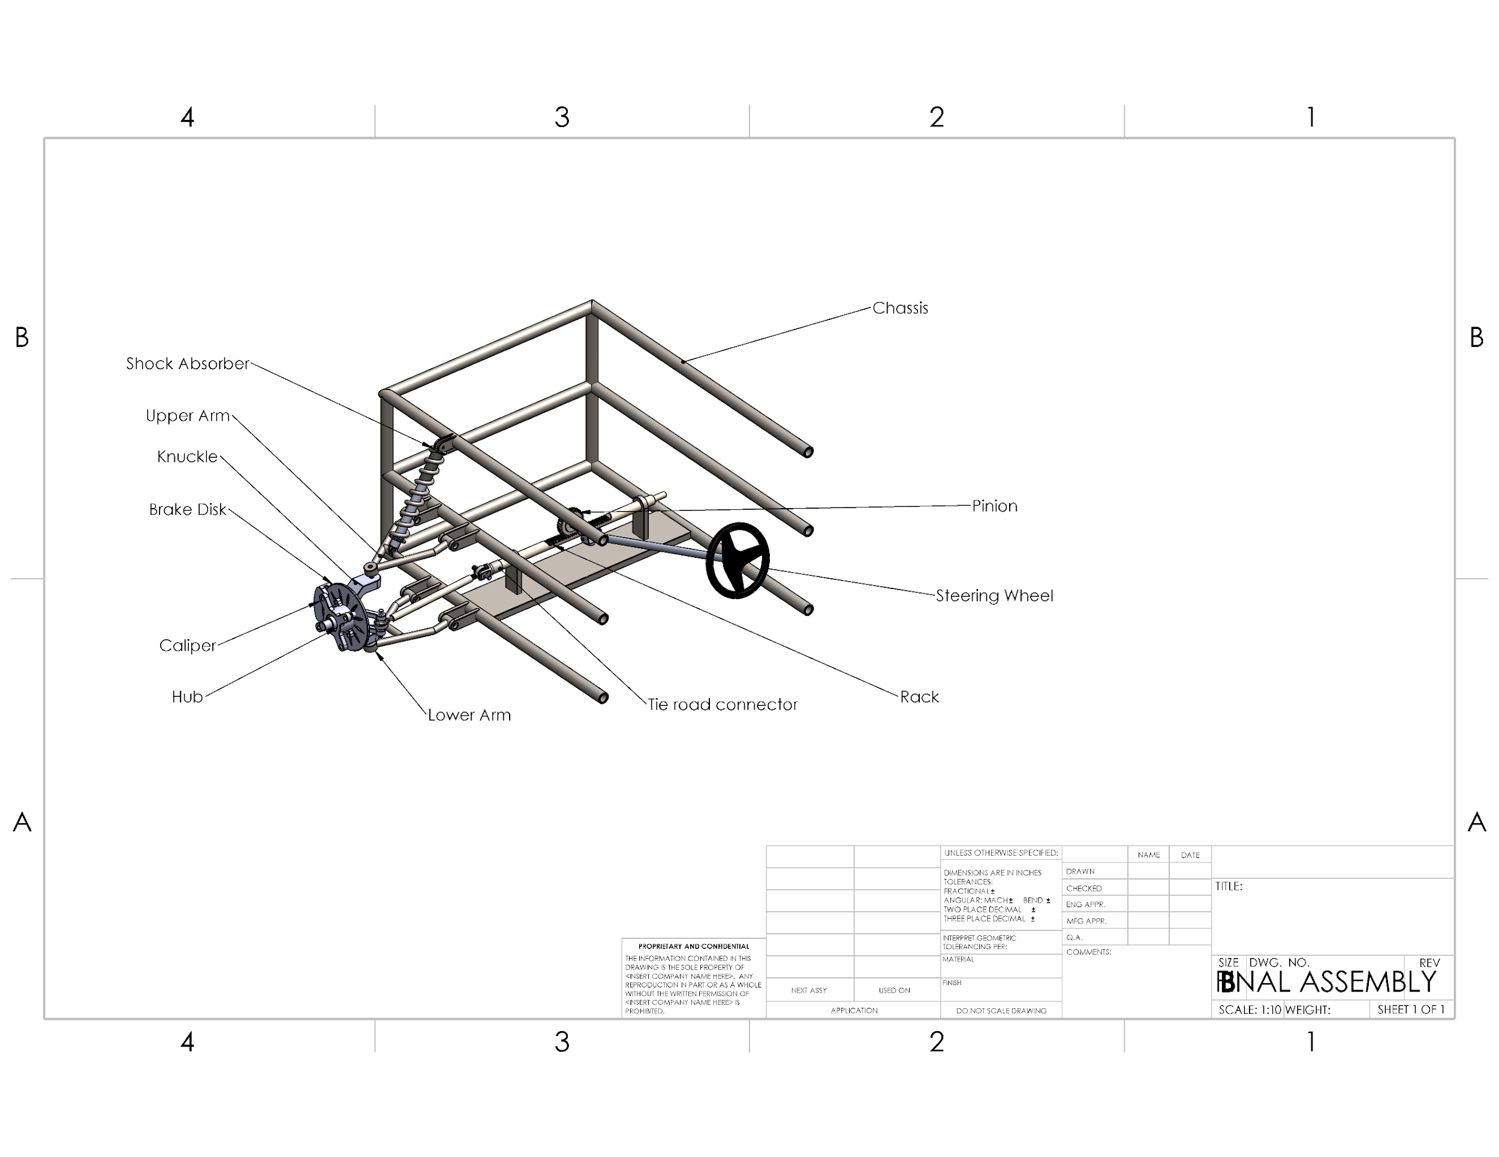
FINAL PRODUCT
Figure 1: Final CAD Model
Omer / SAE Baja/11-18-2021

Slide 6
DESIGN SOLUTION:
Calculations are performed
Parts created and assembled in SolidWorks
Critical parts determined
FEA performed for the critical parts
Safety factor is calculated.
Omer / SAE Baja/11-18-2021

Slide 7
DESIGN SOLUTION:
SAE Baja
Brake System
Suspension System
Steering System
Dashboard System
Brake Disk
Upper Arm
Lower Arm
Shock absorber and spring
Rack and Pinion
Omer / SAE Baja/11-18-2021

Slide 8
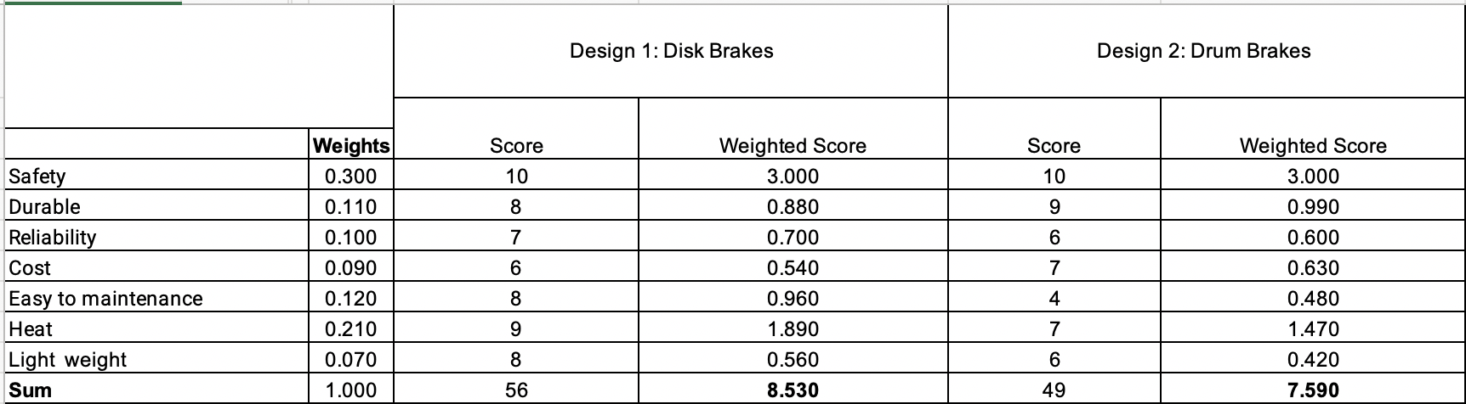
DESIGN MAKING- BRAKE SYSTEM
Table 3: Decision Matrix of Brake system
Musaed / SAE Baja/11-18-2021

Slide 9
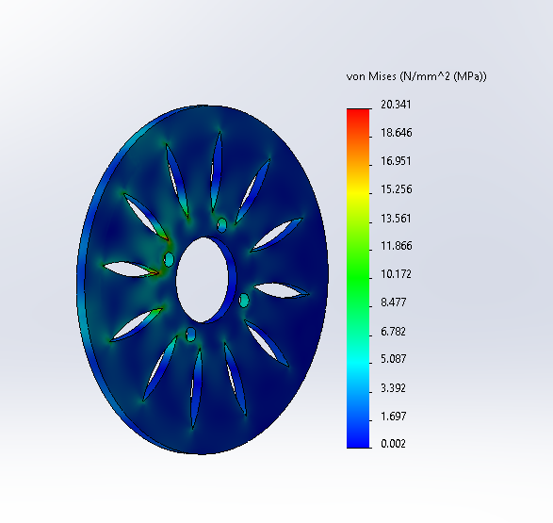
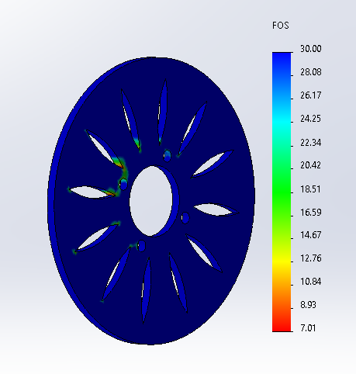
TESTING: (BRAKES FEA):
Figure 4: FOS OF Brakes
Figure 3: Von Mises stress
Table 4: Testing Result of Brakes
Result Parameter | Value
Maximum Disk Temperature (°C) | 85.15
Von Mises Stresses (psi) | 2950
Factor of Safety-FOS | 7
Musaed / SAE Baja/11-18-2021

Slide 10
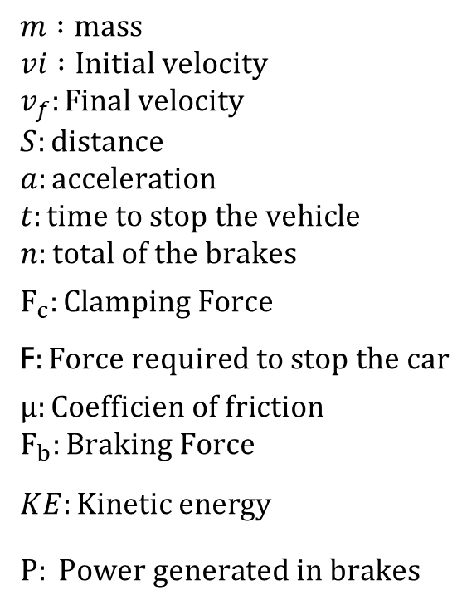
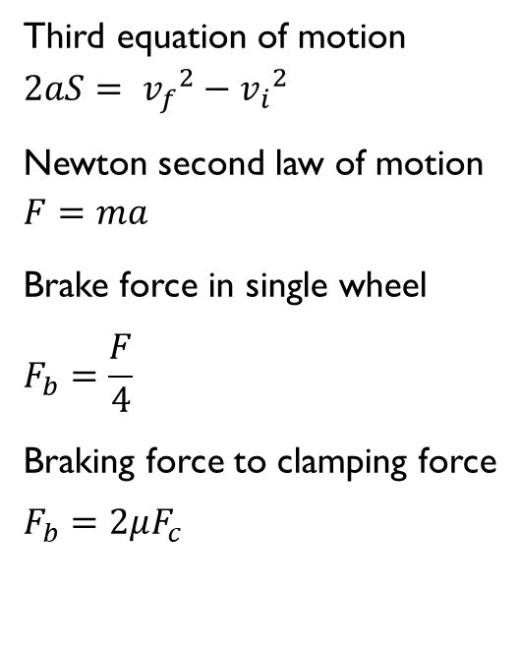
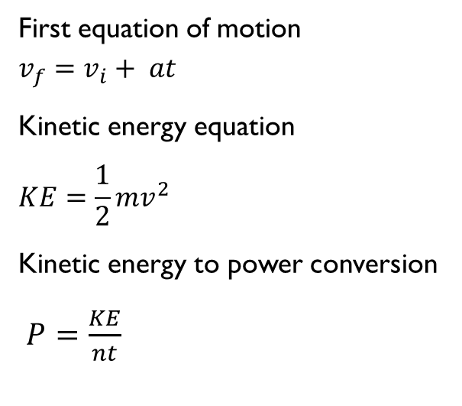
BRAKE SYSTEM (CALCULATIONS)
Abbreviations:
Equations used:
Musaed / SAE Baja/11-18-2021

Slide 11
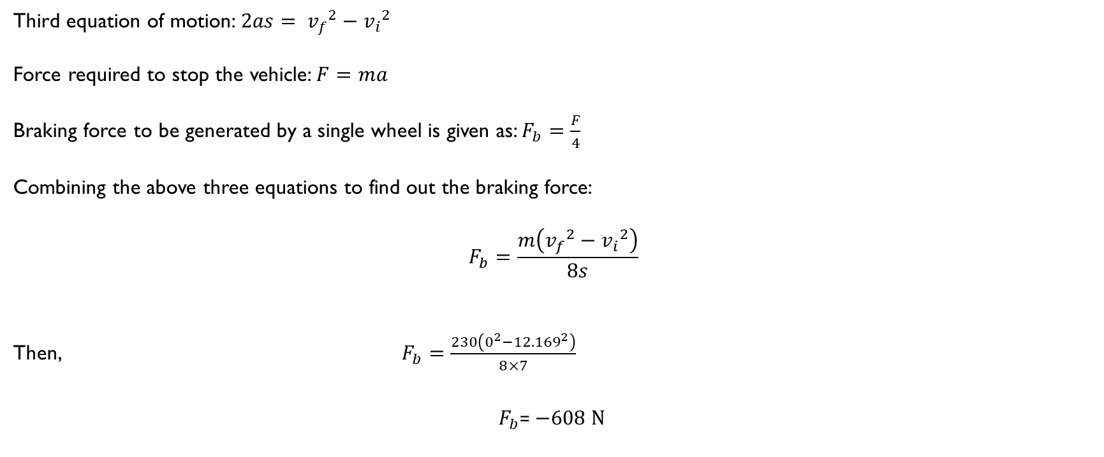
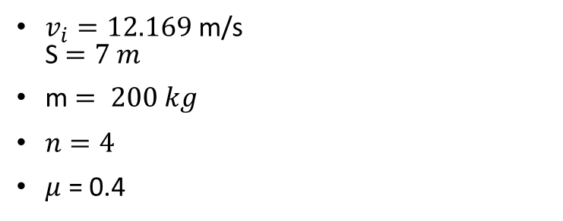
BRAKE SYSTEM CALCULATIONS
Inputs:
Musaed / SAE Baja/11-18-2021

Slide 12
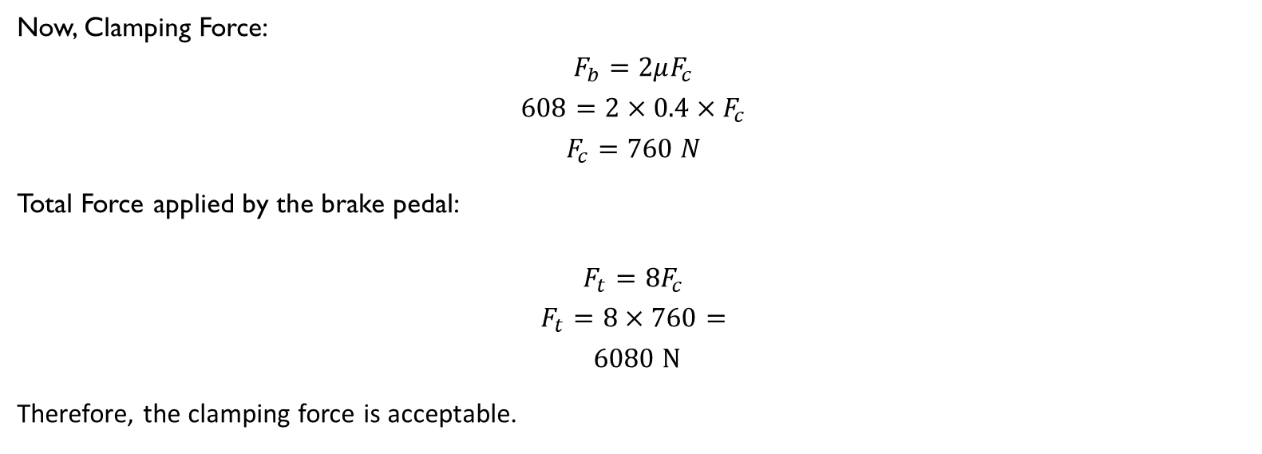
BRAKE SYSTEM ( UPDATED CALCULATION )
Musaed / SAE Baja/11-18-2021

Slide 13
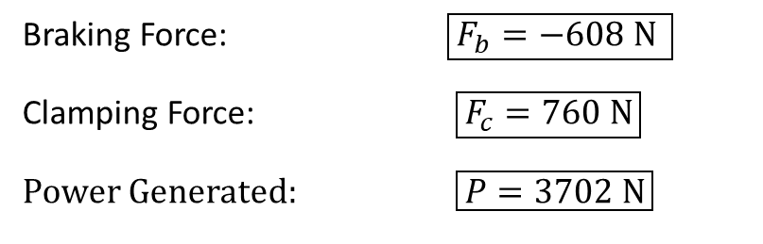
BRAKE SYSTEM (CALCULATIONS)
Results:
Finite Element Analysis
Musaed / SAE Baja/11-18-2021

Slide 14
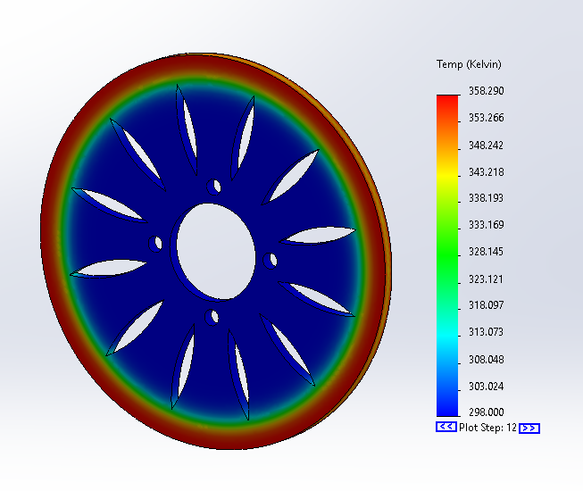
TESTING: (BRAKES FEA)
Figure 5:
Musaed / SAE Baja/11-18-2021

Slide 15
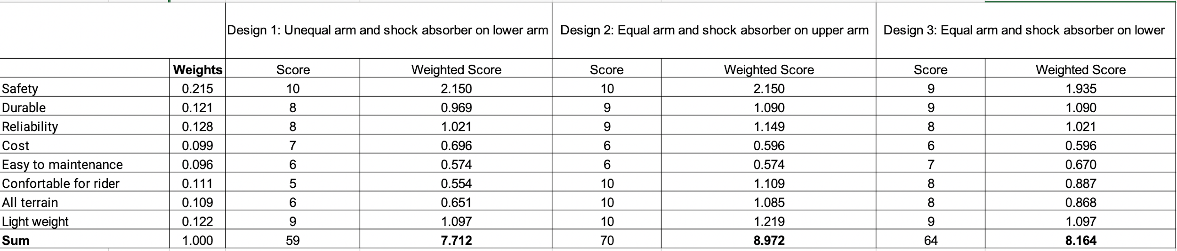
DESIGN MAKING- FRONT SUSPENSION
Table 5: Decision Matrix of Front Suspension
Rashid / SAE Baja/11-18-2021

Slide 16
MANUFACTURING AND TESTING :
Analytical project Instead of manufacturing
Using FEA Testing
Salem / SAE Baja/11-18-2021

Slide 17
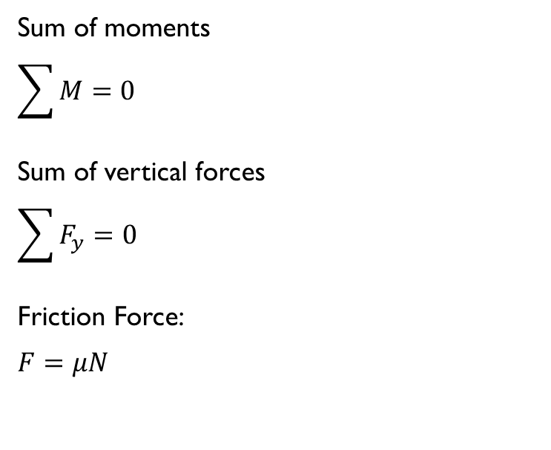
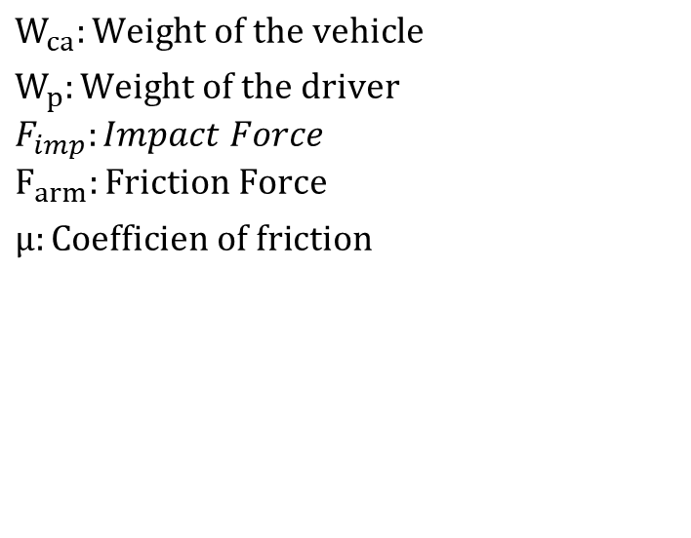
SUSPENSION SYSTEM-UPPER ARM (ANALYSIS)
Abbreviations:
Equations used:
Salem / SAE Baja/11-18-2021

Slide 18
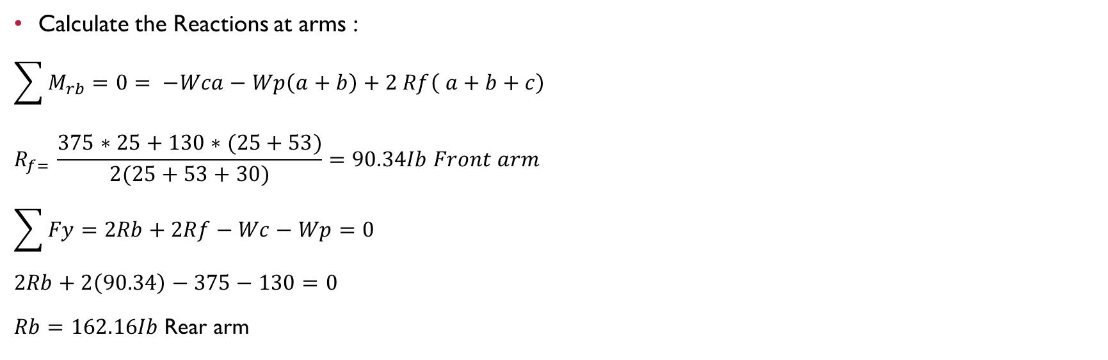
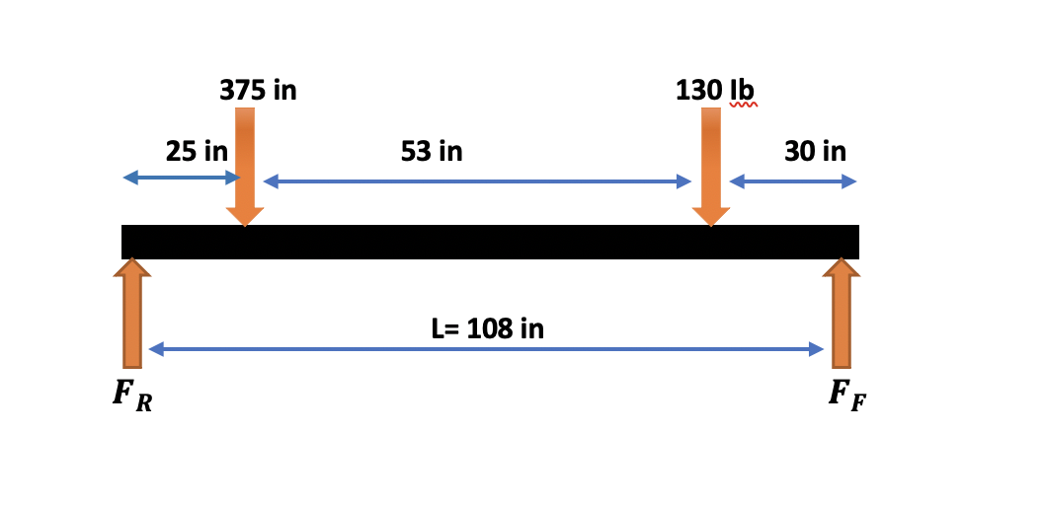
SUSPENSION SYSTEM-UPPER ARM (ANALYSIS)
Figure 5: Free Body Diagram
Salem / SAE Baja/11-18-2021

Slide 19
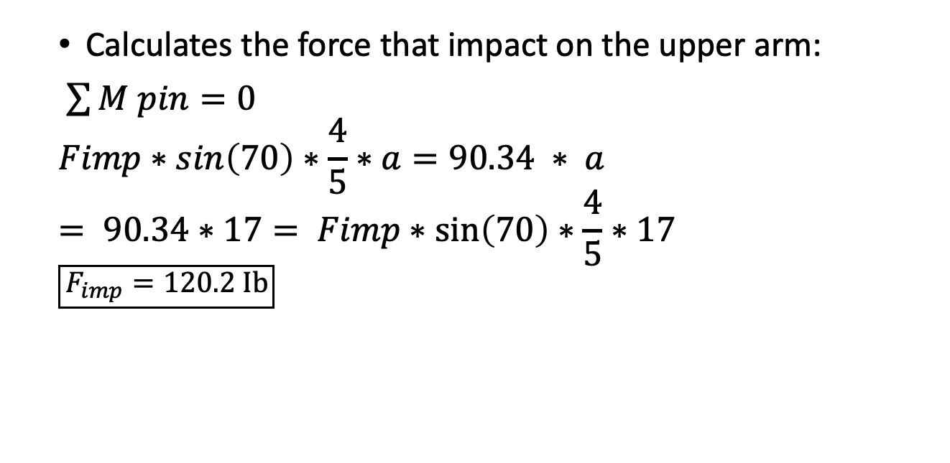
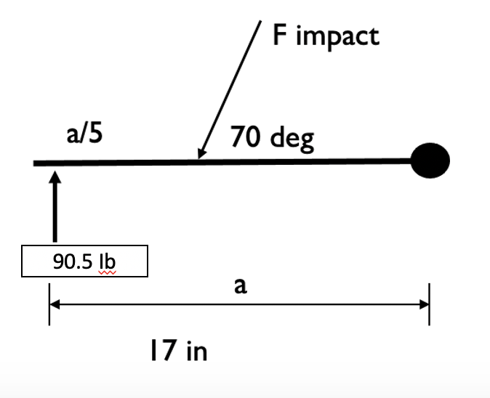
SUSPENSION SYSTEM-UPPER ARM (ANALYSIS)
Figure 6: Free Body Diagram of impact force
Rashid / SAE Baja/11-18-2021

Slide 20
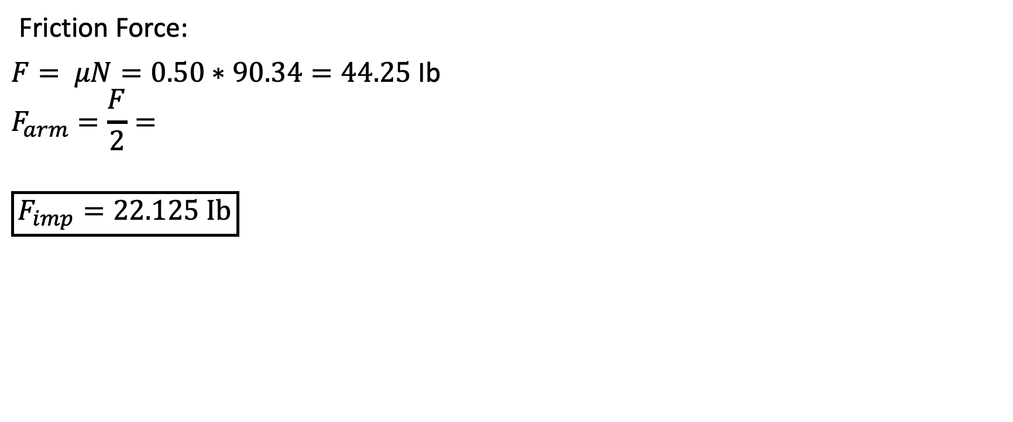
SUSPENSION SYSTEM-UPPER ARM (ANALYSIS)
Salem / SAE Baja/11-18-2021

Slide 21
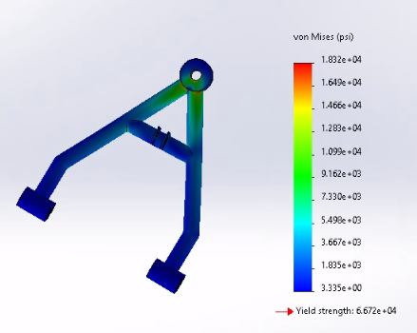
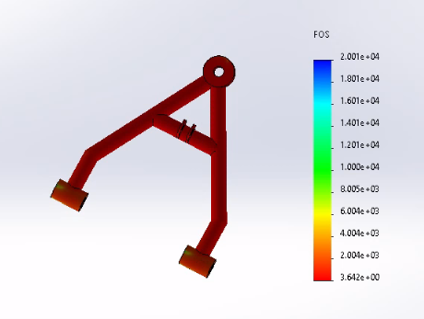
TESTING UPPER ARM: ( SUSPENSION FEA)
Figure 7: Von Missis Stress of Upper arm
Figure 8: FOS of Upper arm
Table 6: Testing Result of upper arm
Result Parameter | Value
Von Mises Stresses (psi) | 18320
Factor of Safety-FOS | 3.642
Salem / SAE Baja/11-18-2021

Slide 22
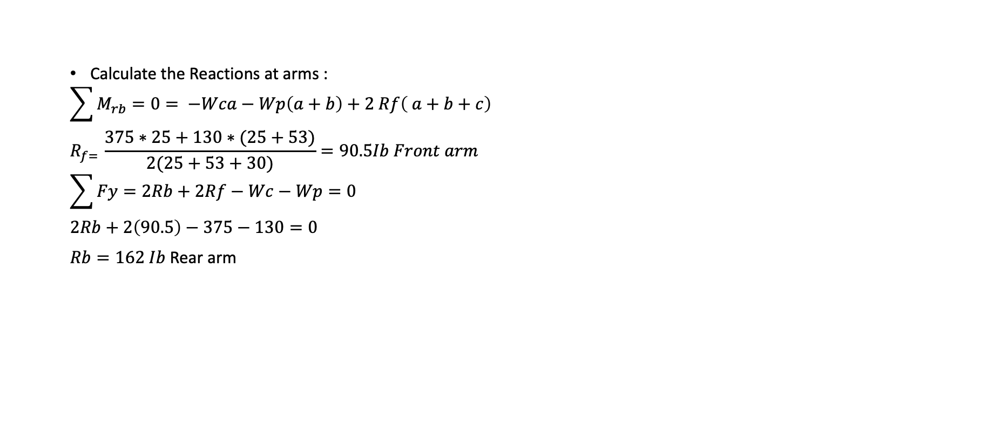
SUSPENSION SYSTEM-LOWER ARM (ANALYSIS)
Friction Force
F= μN
F =0.5*90.5=45.25 Ib
Farm=F/2=22.625 Ib
Figure 9: Free Body Diagram
Rashid / SAE Baja/11-18-2021

Slide 23
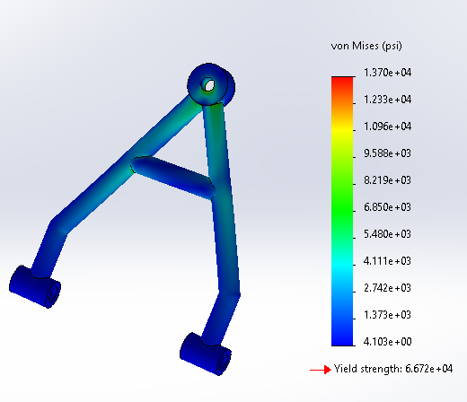
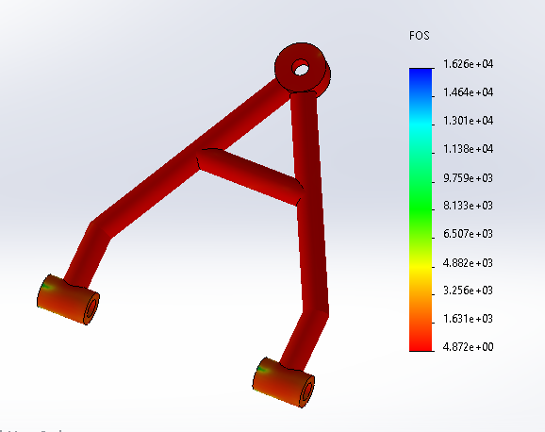
TESTING LOWER ARM: ( SUSPENSION FEA)
Figure 10: Von Missis Stress of lower arm
Figure 11: FOS of lower arm
Table 6: Testing Result of Lower Arm
Result Parameter | Value
Von Mises Stresses (psi) | 1370
Factor of Safety-FOS | 4.872
Rashid / SAE Baja/11-18-2021

Slide 24
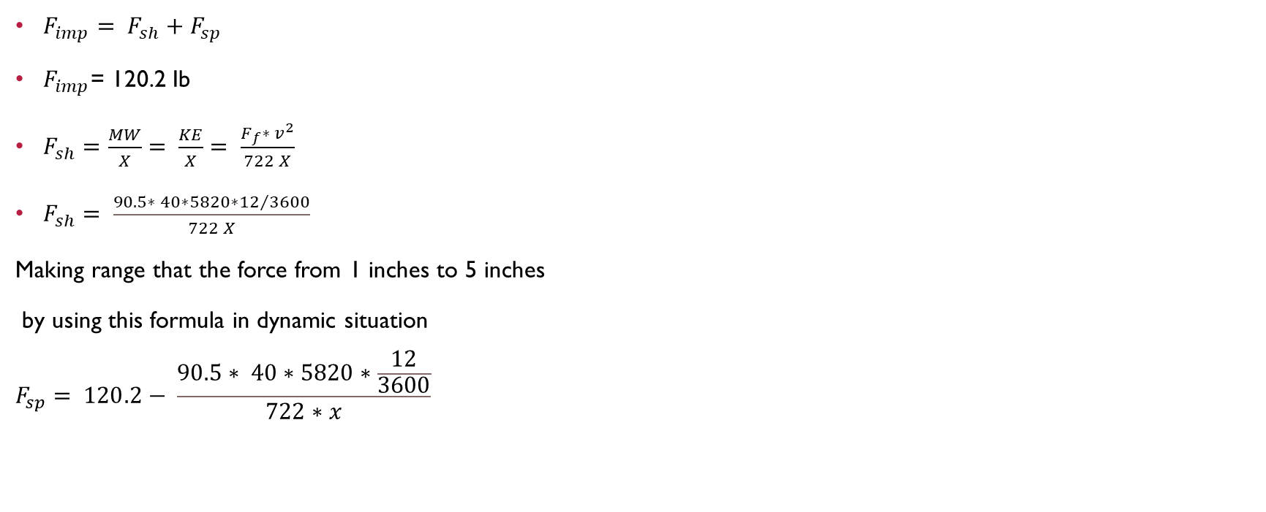
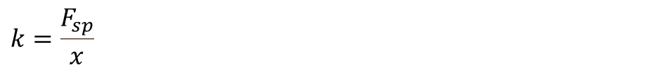
COIL SPRING
Figure 12: spring force difference with changing deflection of the shock absorber
To calculate the stiffness at each force and deflection from 1 to 5
Figure 13: spring rate differences with changing deflection of the shock absorber
Rashid / SAE Baja/11-18-2021

Slide 25
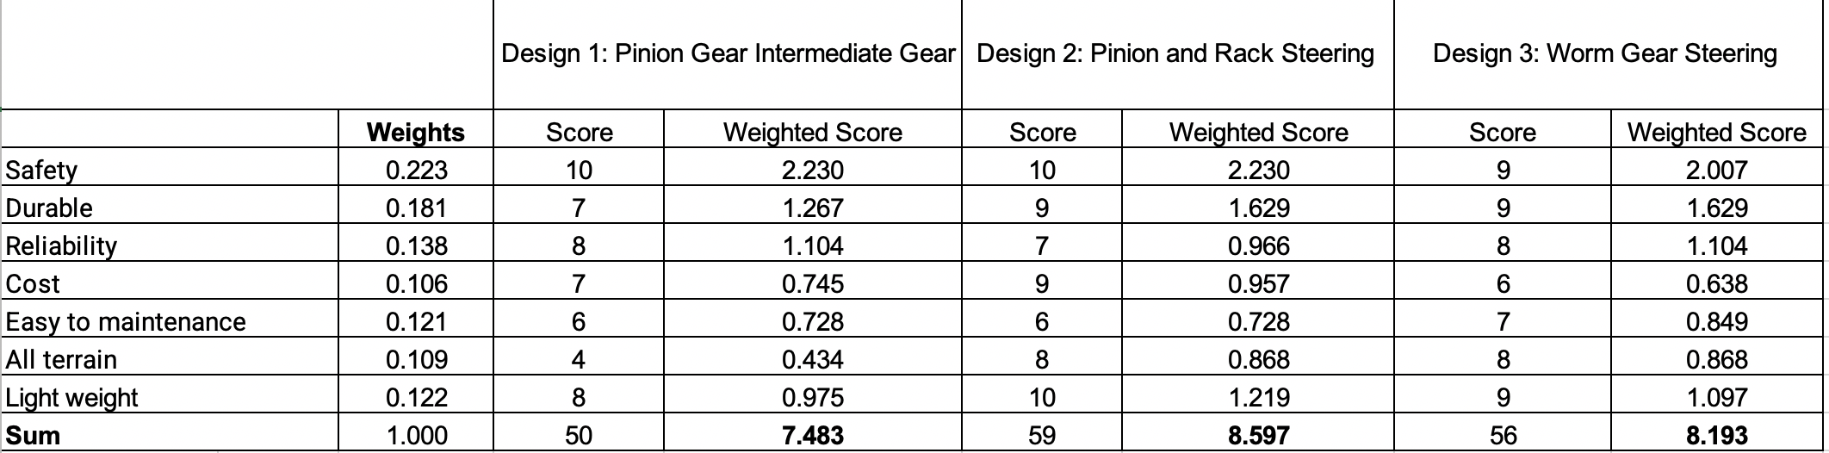
DESIGN MAKING – STEERING
Table 7: Decision Matrix of steering
Salem / SAE Baja/11-18-2021

Slide 26
MANUFACTURING AND TESTING :
Analytical project Instead of manufacturing
Using FEA Testing
Salem / SAE Baja/11-18-2021

Slide 27
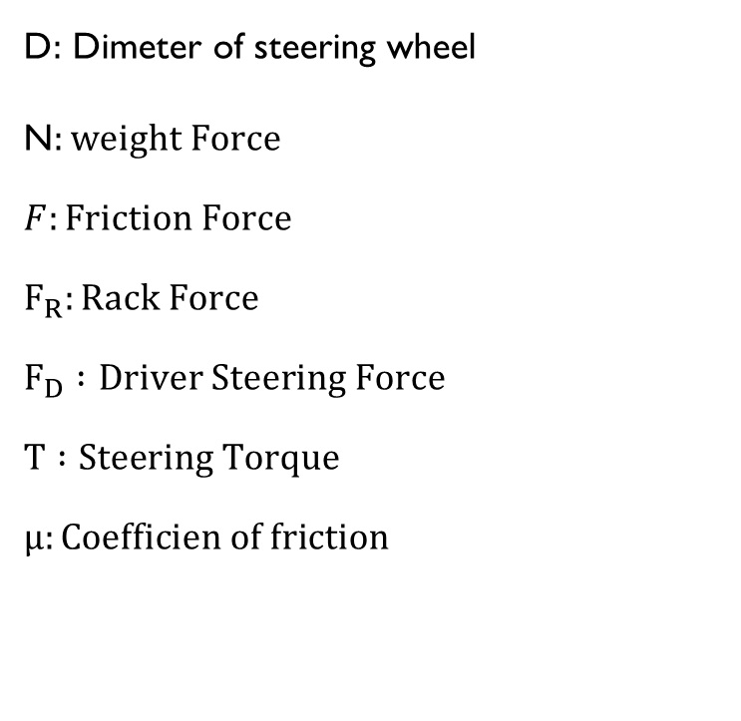
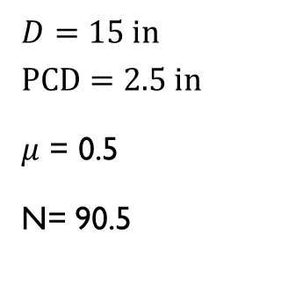
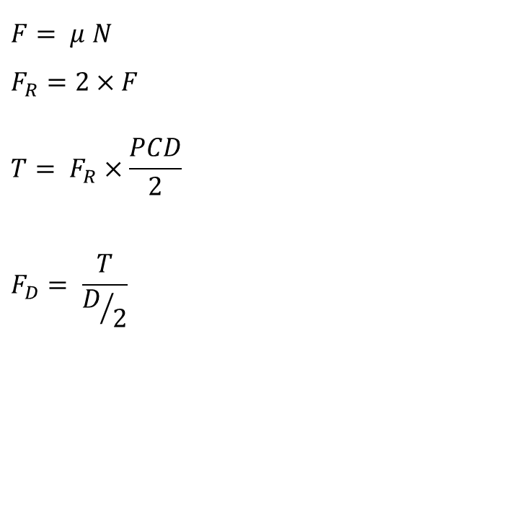
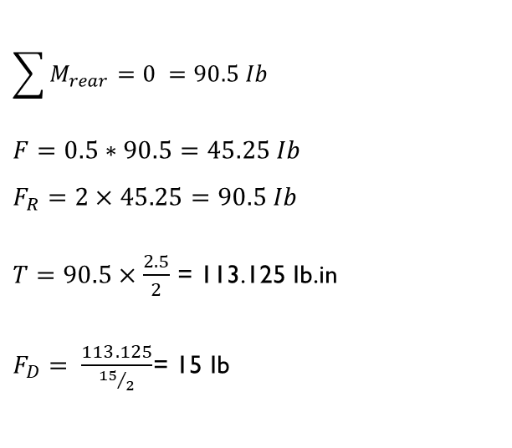
STEERING SYSTEM(ANALYSIS)
Abbreviations:
Equations used:
Analysis:
Inputs:
Salem / SAE Baja/11-18-2021

Slide 28
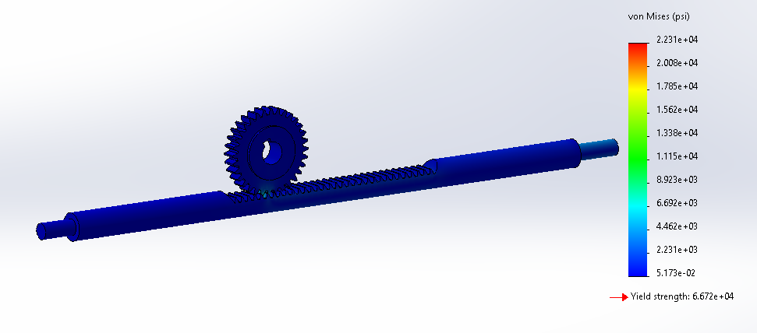
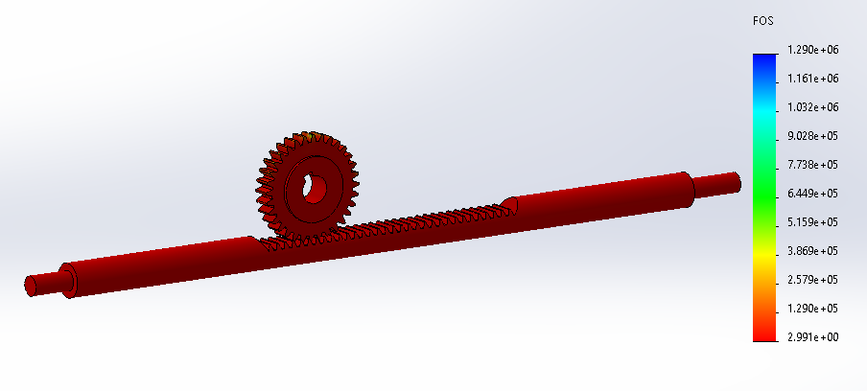
TESTING OF RACK AND PINION: ( STEERING FEA):
Figure 14: Von Missis Stress of Steering
Figure 15: FOS of Steering
Table 8: Testing Result of Steering
Result Parameter | Value
Rack and Pinion
Von Mises Stresses (psi) | 22310
Factor of Safety-FOS | 3
Salem / SAE Baja/11-18-2021

Slide 29
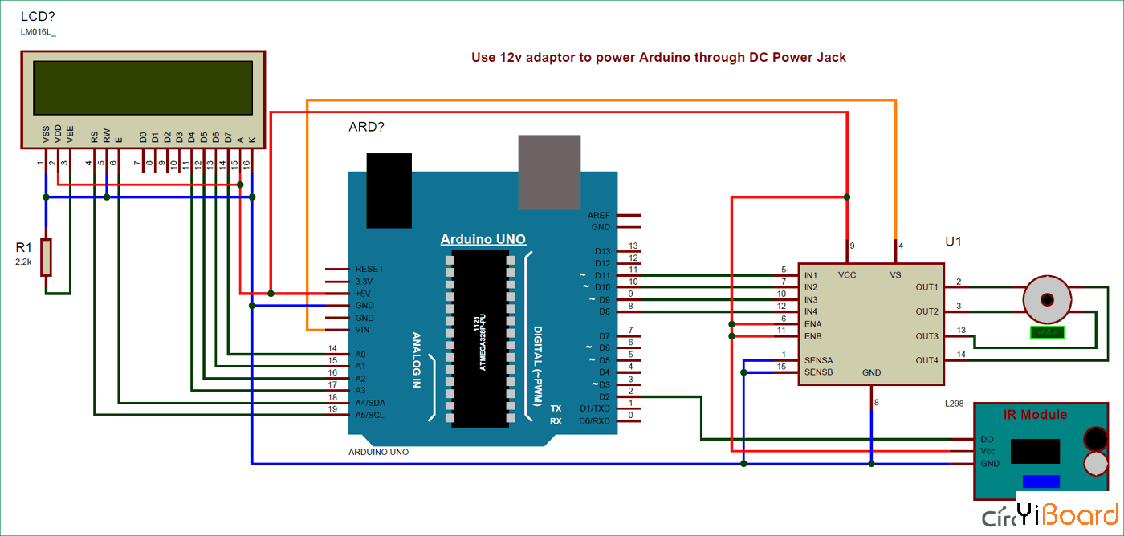
DESIGN MAKING-DASHBOARD
Figure 16: Schematic of dashboard

Slide 30
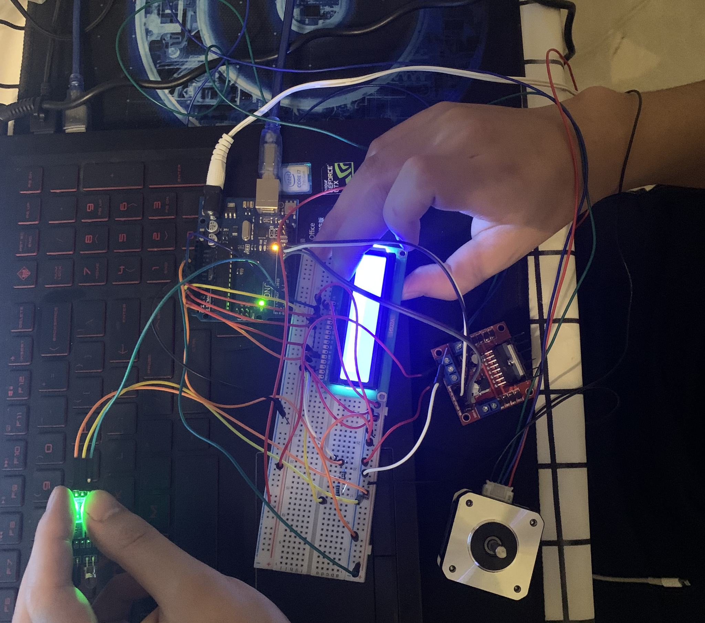
MANUFACTURING – DASHBOARD
Figure 17: Hardware of dashboard.

Slide 31
BUDGET
Item | Description | Quantity | Price
Arduino kit | Provide a platform,wires, and component for the circuit | 1 | 36.99 USD
LCD | Display the detected data | 1 | 15.96 USD
Infrared speed Sensor | detect the rpm and speed data | 1 | 6.99 USD
Stepper motor | Reflect the speed through the rotation angle of the stepper motor | 1 | 18.63 USD
Driver of motor | Drive the motor | 1 | 5.58 USD
Overall |  |  | 84.15 USD

Slide 32
TESTING – DASHBOARD
Functional Test
Measure the speed of the fan with an infrared speedometer.
The speed of the fan can be changed by changing different gears.
Accuracy test
Manually rotate the small wheel to test the measurement accuracy of the sensor for the gap.

Slide 33
FUTURE WORK
Full Product Video
Motion Analysis for Systems

Slide 34
Thank you

