Slide 1
SAE Baja
Spring 2021
Preliminary Presentation
Team members:
Omer Alamoudi,
Rashid Algelmod
Musaed Fraidoun
Salem Almarri
Chujian Wang
Client:
David M. Willy

Slide 2
Project Description:
This project includes an SAE-BAJA off-roading vehicle design which can be abide by SAE BAJA completion rules in order to compete.
The design will include three components:
Front suspension.
Brake systems.
Dashboard.
Sponsor

Slide 3
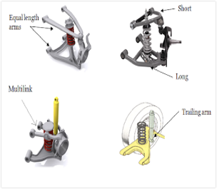
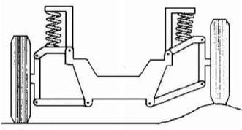
Project Background & Benchmarking Front suspension system:
Suspension system is a device which transfers all forces and moments between wheel and ground to the body. It consists of-
Spring
Damper
Trailing Arms [1]
Double Wishbones [4]
Figure 2: Double Wishbones [4]
Figure 1: Trailing Arms [1]

Slide 4
Project Background & Benchmarking /brake system:
The concept of energy conversion is used by brakes, which convert kinetic energy into heat, thereby delaying vehicle velocity. This is done by fiction, along with the clamping force exerted by caliper pads, between the brake rotor and pads.
The rules state that the braking mechanism must be capable of simultaneously locking all four wheels .
More significantly, however, the device must be able to be used by the driver reliably, repeatedly during the endurance case.
The main objective is to develop a light, compact, powerful and reliable braking system that can lock all four buggy wheels on almost all terrain types at the same time

Slide 5
Project Background & Benchmarking Dashboard system:
The dashboard is a component that displays information related to the vertical. During the driving, the driver needs to not only observe the surrounding environment but also concern about the state of the vertical.
The data displayed on the instrument panel is detected by the sensor in the corresponding part, and displayed on the instrument panel through the circuit and the wire.
The shown data include speed, fuel level and rpm.
Figure 3: Dashboard

Slide 6
Literature Review Front Suspension:
Fundamental analysis of automobile suspension. (Society of Automobile Engineers) (salem)[1]
Pros and cons of different types of suspensions. (Society of Automobile Engineers) (Salem)[1]
Historical background and thorough analysis of off-road vehicle suspensions. (Mike Ingalsbee) (Salem)[2]
Component design and characteristics of high-speed off-road vehicle suspensions. (Bruce McLaurin) (Salem) [3]

Slide 7
Literature Review Front Suspension:
Suresh, Ganzi. (2013). Design Optimization of a Wishbone Suspension of a Passenger Car.(Rashid) [4]
Analysis of the Kinematics and Compliance of a Passive Suspension System using Adams (Rashid) [5]
MacPherson Strut VS Double Wishbone.(Rashid) [6]

Slide 8
Literature Review Front Suspension:
Tripp Schlereth and Stephen Sparks (2009). 2010 BAJA SAE SUSPENSION. Final Project Report. [7] (Musaed)
Jack Swanson, et al. (2007). Vehicle #65 Baja SAE Design Report. [8] (Musaed)
Bruce P. Minaker , Zheng Yao(2017). Design And Analysis Of An Interconnected Suspension For A Small Off-Road Vehicle. [11] (Musaed)
Swapnil Pravin Bansode (2020). MODELING OF MULTIBODY DYNAMICS IN FORMULA SAE VEHICLE SUSPENSION SYSTEMS. [13] (Musaed)

Slide 9
Literature Review Brake System:
Myles Sloan, Chung Hyun Goh, Fredericka Brown(2018). BAJA SAE: Building an Engineer [14] (Omer)
Baja (SAE 2018). Collegiate Design Series Baja SAE Rules [9] (Omer)
Design and Analysis of Braking System for Baja All-Terrain vehicle [18] (Omer)
Brake system - UR Baja SAE (2021) [24]

Slide 10
Literature Review of Dashboard:
Design of an SAE Baja Racing Off-Road Vehicle Powertrain (2015), Eric T. Payne.[22] (Chujian)
Murata Power Solutions, 2000 RPM Tachometer. (Chujian)
Baja build part 44. (Additional) Telemetry RPM sensor，BajaGeekEric. (Chujian)
Modeling and Tuning of CVT Systems for SAE® Baja Vehicles (2020), Sean Sebastian Skinner.[21] (Chujian)
Design and Optimization of a Baja SAE Vehicle (2015), Allan Burgess ，Matthew Cote，Eric Crevoiserat and Jorge Martinez. [20] (Chujian)

Slide 11
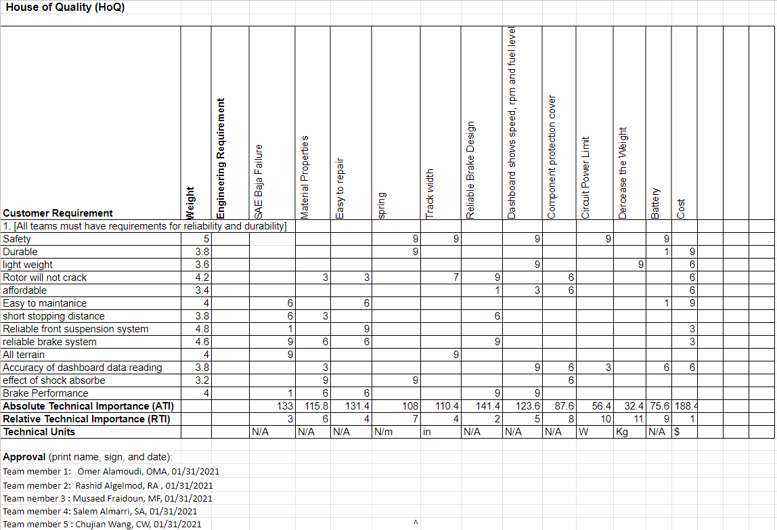
Customer and Engineering Requirements:

Slide 12
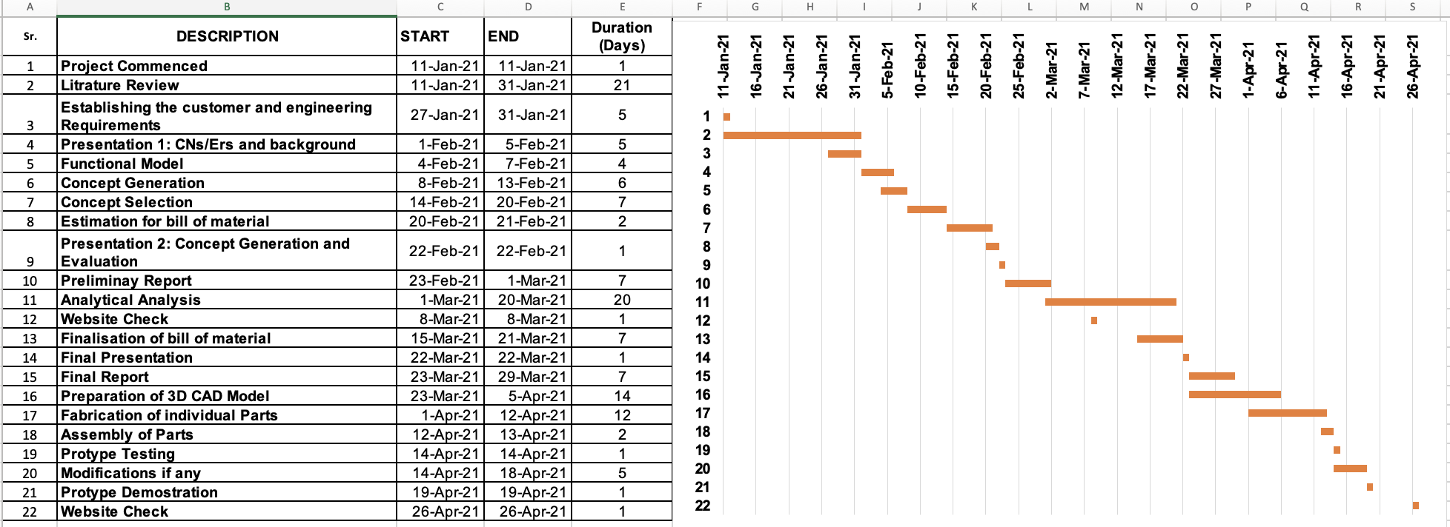
Schedule:

Slide 13
Budget:
Rough estimate:
Front Suspension Cost: 5000 $[25]
Brakes: 1000$ [26]
Dashboard: 400$[23]

Slide 14
Questions?

Slide 15
Reference:
[1] S. of Automotive Engineers, “Suspension - CCNY SAE,” Google Sites, 01-Nov-2014. [Online]. Available: https://sites.google.com/site/ccnysae/past-competitions/2012-baja/component-redesigns/suspension. [Accessed: 30-Jan-2021].
[2] M. Ingalsbee, “Off Road Suspension 101: An In-Depth Look,” Off Road Xtreme, 19-Dec-2017. [Online]. Available: https://www.offroadxtreme.com/engine-tech/brakes-suspension/off-road-suspension-101-an-inside-look/. [Accessed: 30-Jan-2021].
[3] B. Maclaurin, High speed off-road vehicles: suspensions, tracks, wheels and dynamics, 1st ed. Hoboken, NJ: Wiley, 2018.
[4]Suresh, Ganzi. (2013). Design Optimization of a Wishbone Suspension of a Passenger Car.
[5] Skedsoft.com. 2021. Macpherson Strut Front Suspension System Design. [online] Available at: <https://www.skedsoft.com/books/automobile-engineering/macpherson-strut-front-suspension-system-design> [Accessed 29 January 2021].
[6]Stevens, M., 2021. MacPherson Strut vs Double Wishbone Suspension (Pros and Cons). [online] CarTreatments.com. Available at: <https://cartreatments.com/pros-and-cons-of-macpherson-vs-double-wishbone-suspension/> [Accessed 30 January 2021].
[7] Tripp Schlereth and Stephen Sparks (2009). 2010 BAJA SAE SUSPENSION. Final Project Report, MECH 5220 – Virtual Prototyping, Spring 2010. Auburn University.
[8] Jack Swanson, et al. (2007). Vehicle #65
[9] Baja SAE (2018). Collegiate Design Series Baja SAE Rules.

Slide 16
References :
[10] Baja SAE Design Report. Undergraduate Mechanical Engineering at the University of Colorado at Boulder Copyright © 2007 SAE International.
[11] Bruce P. Minaker , Zheng Yao(2017). Design And Analysis Of An Interconnected Suspension For A Small Off-Road Vehicle. A r c h i v e o f m e c h a n i c a l e n g i n e e r i n g Vol. Lxiv 2017 Number 1.
[12] Allan Burgess (2015). Design and Optimization of a Baja SAE Vehicle. B.Sc. Project faculty of Worcester Polytechnic Institute In partial fulfillment of the requirements for the Degree of Bachelor of Science
[13] Swapnil Pravin Bansode (2020). MODELING OF MULTIBODY DYNAMICS IN FORMULA SAE VEHICLE SUSPENSION SYSTEMS. A Thesis Submitted to the Faculty of Purdue University
[14] Myles Sloan, Chung Hyun Goh, Fredericka Brown(2018). BAJA SAE: Building an Engineer. Proceedings of the 2018 ASEE Gulf-Southwest Section Annual Conference The University of Texas at Austin April 4-6.
[15] William F. Milliken, Douglas L. Milliken. (1995). Race Car Vehicle Dynamics Society of Automotive Engineers, Inc.
[16]2021 baja-rulebook https://www.bajasae.net/cdsweb/gen/DownloadDocument.aspx?DocumentID=a63dc4c6-5dc3-4d36-a44a-50ae30c00a37
[17] American national standards institute https://www.ansi.org/
[18] Sourav Pattnaik (2020). Design and Analysis of Braking System for Baja All-Terrain vehicle. International Research Journal of Engineering and Technology (IRJET) .Volume: 07 Issue: 02.
[19]] Vivek Singh Negi , Nayan Deshmukh , Amit Deshpande (2017). Design of Braking System of BAJA Vehicle. International Journal of Advance Engineering and Research Development Volume 4, Issue 11.
[20] Matthew Cote，Eric Crevoiserat and Jorge Martinez， Design and Optimization of a Baja SAE Vehicle (2015), Allan Burgess ，Worcester Polytechnic Institute， April 27th, 2015
[21] Skinner, Sean Sebastian, "Modeling and Tuning of CVT Systems for SAE® Baja Vehicles" (2020). GraduateTheses, Dissertations, and Problem Reports. 7590.
[22] Payne, Eric T., "Design of an SAE Baja Racing Off-Road Vehicle Powertrain" (2015). Honors Research Projects. 30.
[23] Wes Clawson Eddie Samuels, Dashboard and Wireless Transfer Module, the University of Rochester SAE Baja Team report
[24] “Brake System - UR Baja SAE” ,Sa.rochester.edu, 2021. [Online] .

Slide 17
References:
[25] cost car buyer [online]. Available: https://www.cashcarsbuyer.com/suspension-repair-cost/. [Accessed: 30-Jan-2021].
[26] auto serives coast [online]. Available: https://autoservicecosts.com/brake-pad-replacement-cost/. [Accessed: 31-Jan-2021].

