Slide 1



Northrop Grumman Umbilical
Jonathan Armijo
Leah Blakney
Griffin Brandt
Jack Shields
March 3rd, 2022

Slide 2
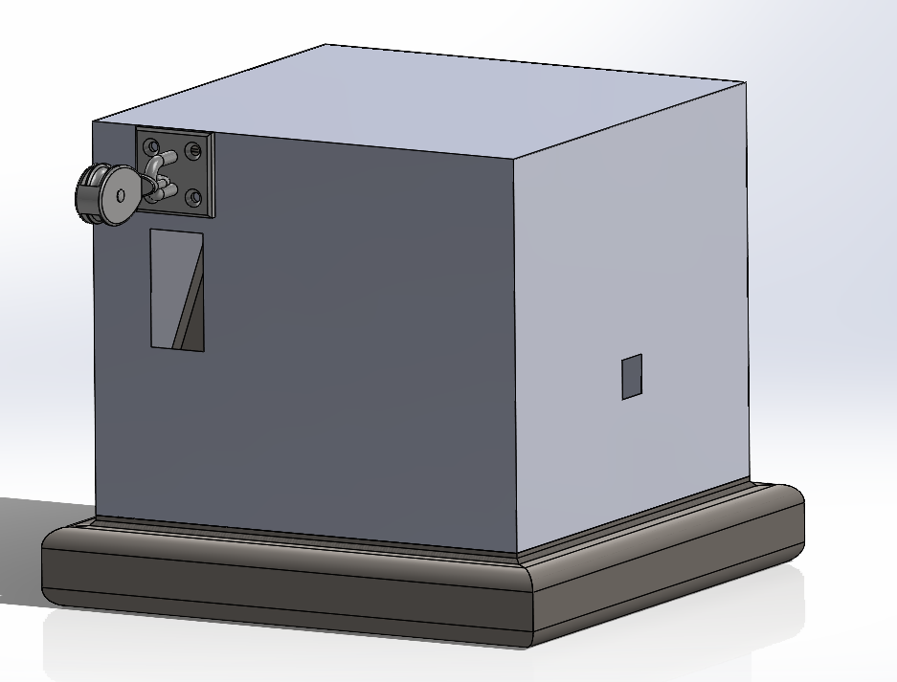
Design Efforts – Current CAD
Added in heat shield
Added a pully to seamlessly guide the cable into the winch
Figure 1: CAD Assembly – Heat Shield
NG – 3/3/2022
Griffin Brandt - 2

Slide 3
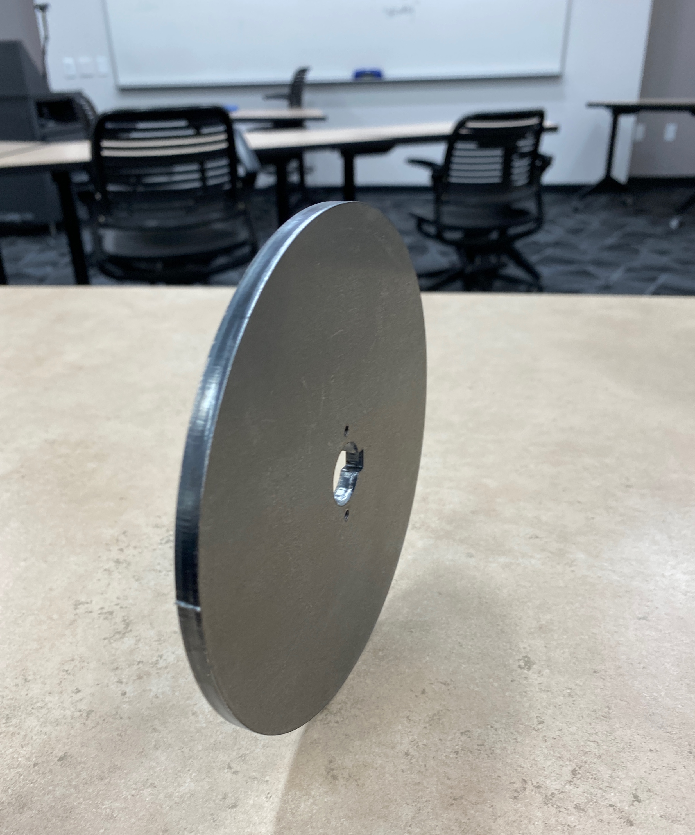
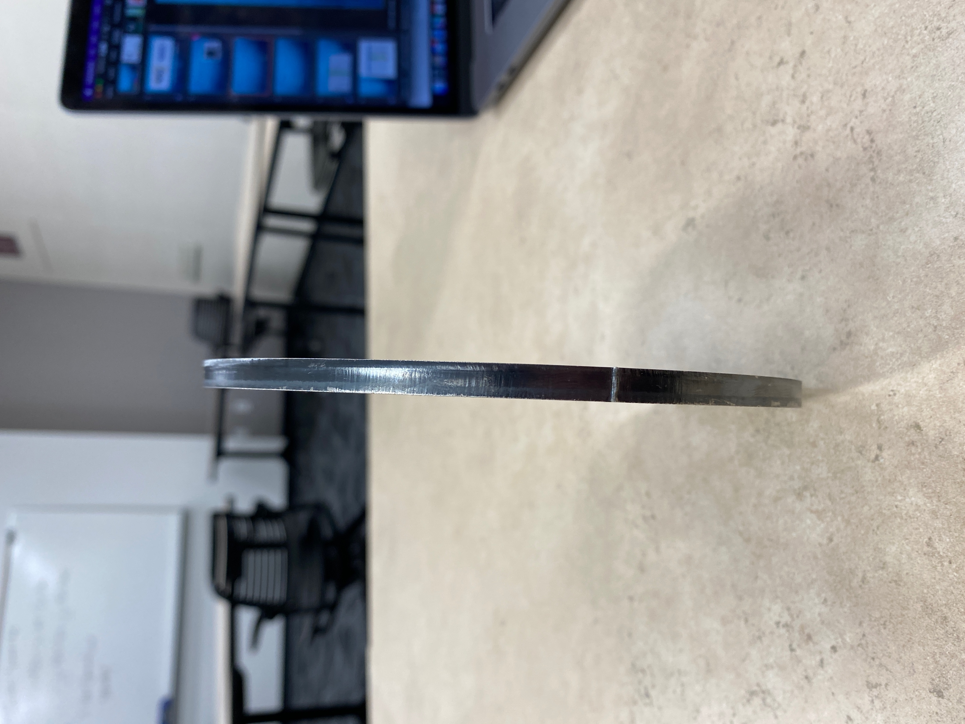
Design Efforts – Design Changes
Need to change wheel parts- Larger diameter + thinner
Moment of inertia is too large
Figure 2: Angle View Wheel
Figure 3: Width View Wheel
NG – 3/3/2022
Jonathan Armijo - 3

Slide 4
Design Efforts - Testing Plan
Motor Startup – Complete
Cable Type
Temperature
Side Force
Retraction Speed
NG – 3/3/2022
Leah Blakney - 4

Slide 5
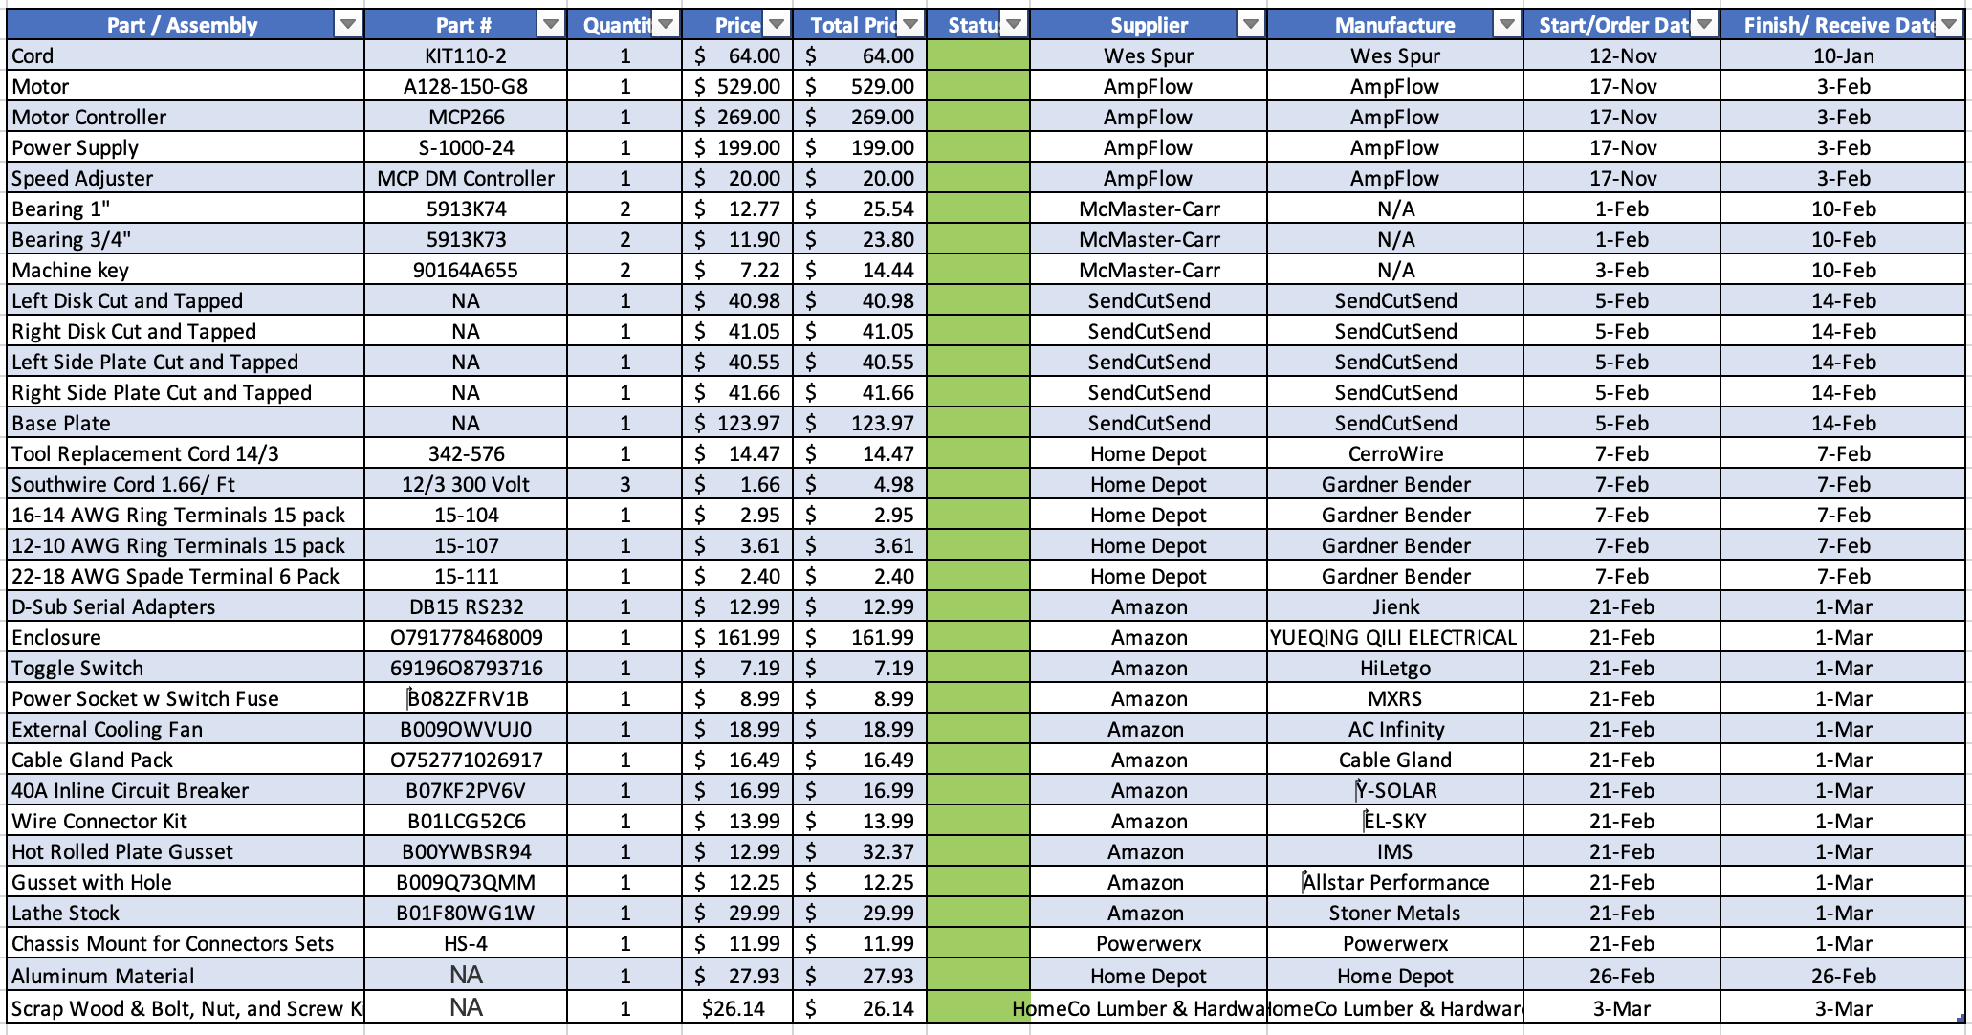
Purchasing Plan
Table 1: Purchasing Plan
Total Price of Parts $1859.69
All Part Ordered except for any additional materials needed
Those parts will be purchased with final reimbursement
NG – 3/3/2022
Jack Shields - 5

Slide 6

Manufacturing PLan
Table 2: Manufacturing Plan
Part / Assembly | Part # | Quantity | Price | Total Price | Status | Supplier | Manufacture | Start/Order Date | Finish/ Receive Date
Left Disk Cut and Tapped | NA | 1 | $40.98 | $40.98 |  | SendCutSend | SendCutSend | 5-Feb | 14-Feb
Right Disk Cut and Tapped | NA | 1 | $41.05 | $41.05 |  | SendCutSend | SendCutSend | 5-Feb | 14-Feb
Left Side Plate Cut and Tapped | NA | 1 | $40.55 | $40.55 |  | SendCutSend | SendCutSend | 5-Feb | 14-Feb
Right Side Plate Cut and Tapped | NA | 1 | $41.66 | $41.66 |  | SendCutSend | SendCutSend | 5-Feb | 14-Feb
Base Plate | NA | 1 | $123.97 | $123.97 |  | SendCutSend | SendCutSend | 5-Feb | 14-Feb
Welding, R/L Plate to Base | N/A | 1 | N/A | N/A |  | N/A | Machine Shop | 25-Feb | 25-Feb
Inside Wheel | N/A | 1 | N/A | N/A | 90% | Home Depot | Jonathan/ Machine Shop | 25-Feb | 4-Mar
Shaft | N/A | 1 | N/A | N/A | 60% | Home Depot | Jonathan/ Machine Shop | 25-Feb | 4-Mar
Electrical Layout | N/A | 1 | N/A | N/A | 40% | N/A | Jonathan | 4-Mar | 11-Mar
Heat Shield Model | #1001195035 | 1 | N/A | N/A | 10% | Home Depot | Griffin/ Machine Shop | 7-Mar | 11-Mar
Machine Assembly | N/A | 1 | N/A | N/A | 20% | N/A | Griffin/ Machine Shop | 7-Mar | 11-Mar
Electrical Assembly | N/A | 1 | N/A | N/A | 20% | N/A | Jonathan/ Machine Shop | 7-Mar | 18-Mar
Full Assembly | N/A | 1 | N/A | N/A |  | N/A | Team | 14-Mar | 18-Mar
Currently still manufacturing three parts.
Assembly to be completed once parts are finished.
Electrical still in processes.
Once assembled build heat shield to realistic dimensions.
NG – 3/3/2022
Griffin Brandt - 6

Slide 7
Demonstration
Still being manufactured and assembled
Electrical components received two days ago; haven’t put together
NG – 3/3/2022
Jonathan Armijo- 7

Slide 8
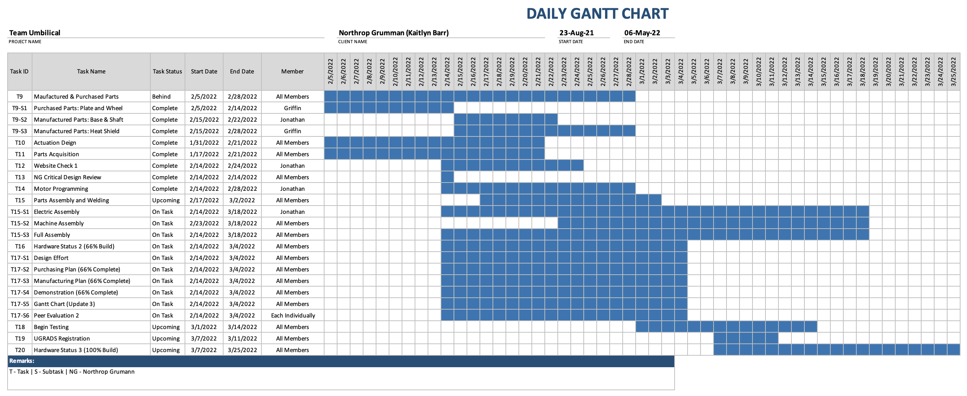
Gantt Chart
Table 3: Gantt Chart
NG – 3/3/2022
Jack Shields - 8

Slide 9

Questions?
NG – 3/3/2022
Team - 9

Slide 10
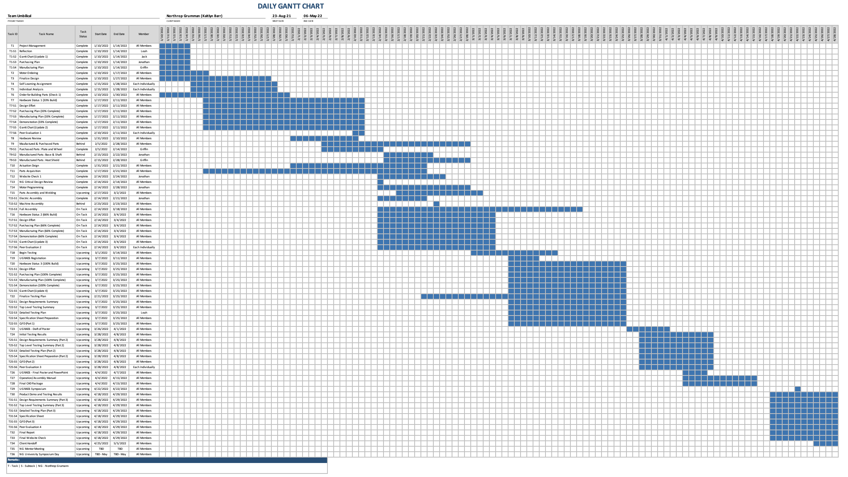
Full Gantt Chart

Slide 11
Reference:
https://punstoppable.com/rocket-puns

