Slide 1


Northrop Grumman Umbilical
Critical Design Review
Jonathan Armijo
Leah Blakney
Griffin Brandt
Jack Shields
February 14th, 2022

Slide 2
Project Description
Background: ​
Umbilical cables provide electrical power, communications, pressurized gasses, etc. to launch vehicles​
To avoid interference, it is important to retract the umbilical
Goal: ​
Design an umbilical retraction system to pull the umbilical away from the vehicle during launch​
NG - February 14th, 2021
Leah Blakney - 2

Slide 3
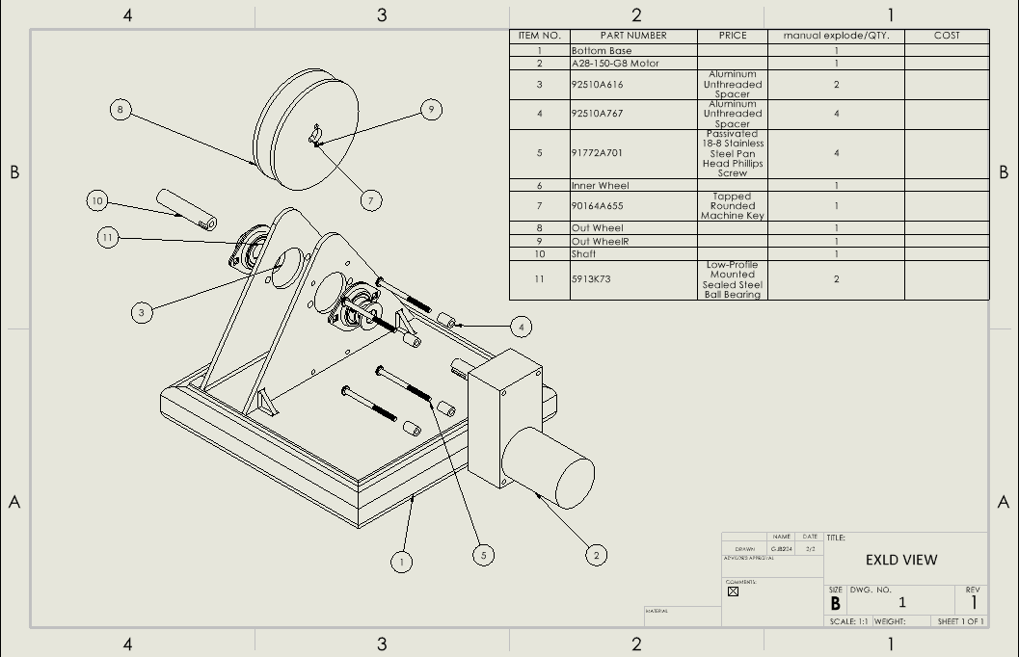
Cad Design efforts
Bottom Structure to be build from wood for testing.
Heat Shield is built, not included here to show full design.
All plates are welded.
Misc. Nuts and Bolts needed; they broke SolidWorks.
Figure 1: Exploded View CAD
NG - February 14th, 2021
Griffin Brandt- 3

Slide 4
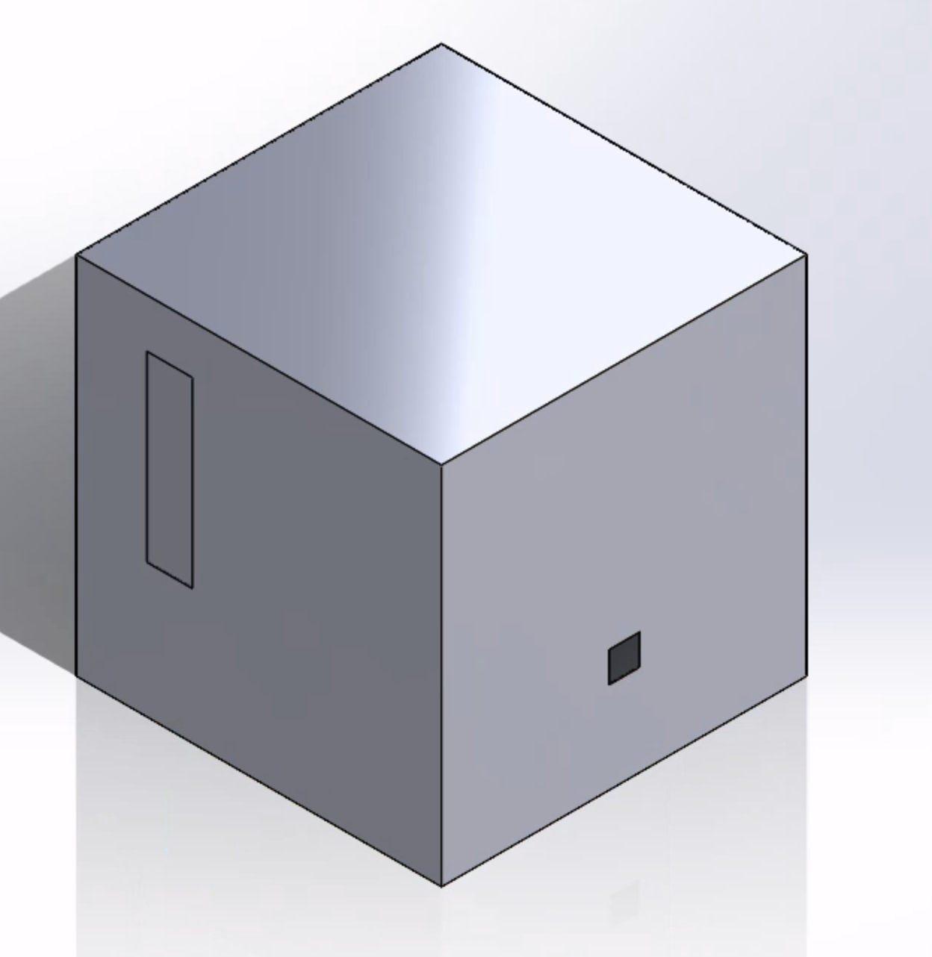
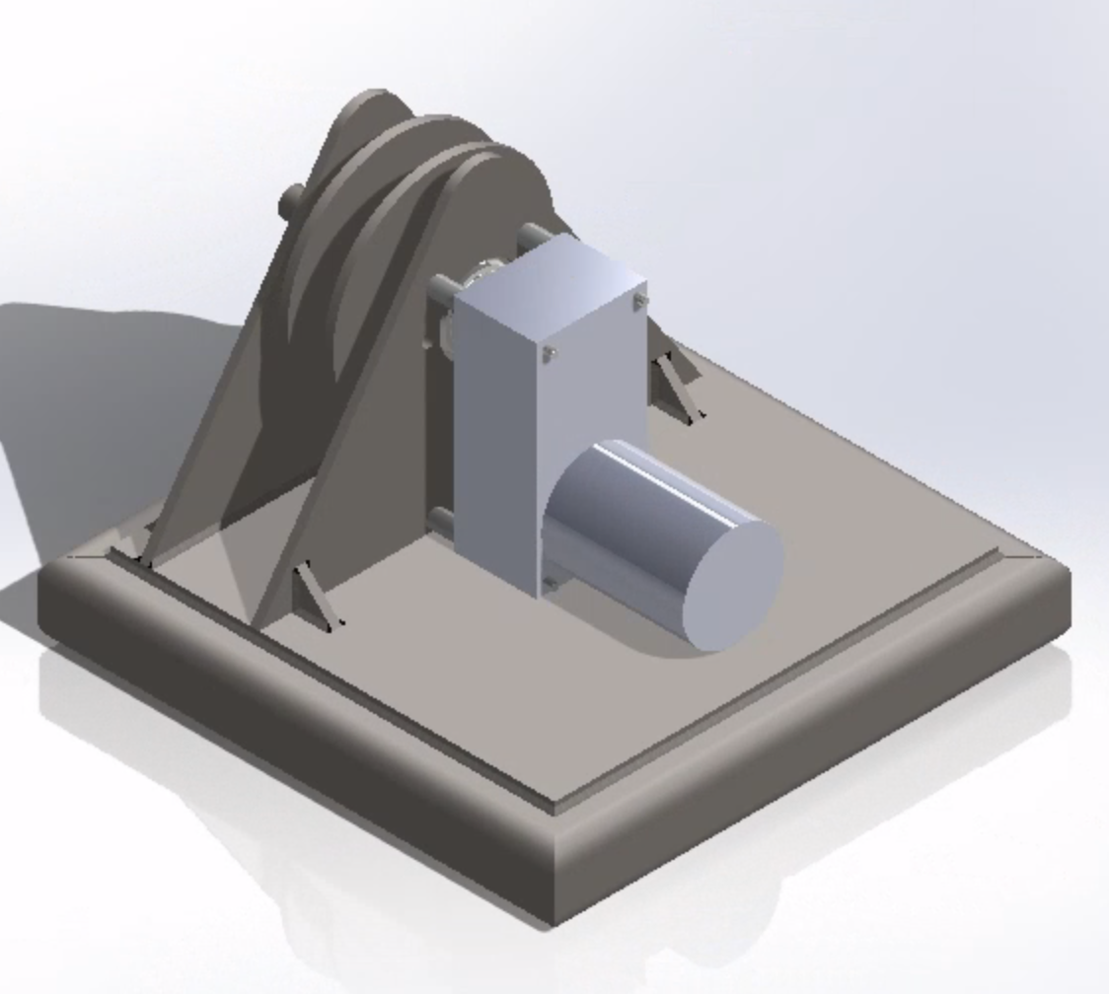
Heat Shield
Aluminum sheet metal.
Screws into base of the model.
Figure 2: Heat Shield
Figure 3: Isometric View CAD
NG - February 14th, 2021
Griffin Brandt- 4

Slide 5
Actuation System
1st – Umbilical is in slack before take off. Pull string taut and connected to bail wire
2nd – Vehicle takes off, umbilical extends.
– Causes pull string to flip switch, signal to motor.
3rd -- Umbilical detaches from rocket naturally, pull string comes with bail wire
4th – Trigger is pulled and starts winding in umbilical.
NG - February 14th, 2021
Figure 4: Actuation Plan
Jonathan Armijo - 5

Slide 6
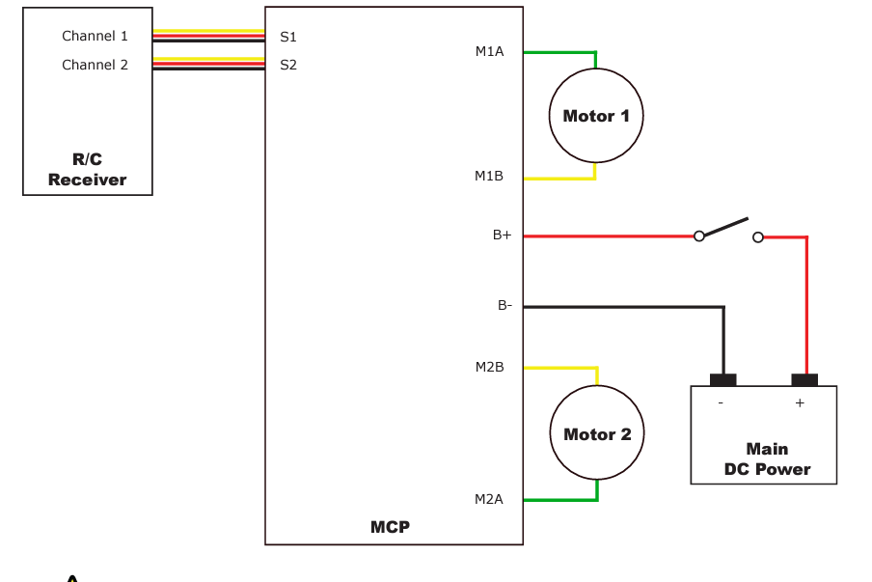
Electrical Schematic/Actuation System
Figure 4: Circuit Diagram
NG - February 14th, 2021
Jonathan Armijo - 6

Slide 7
Purchasing Plan
Table 1: Purchasing Plan
Part / Assembly | Part # | Quantity | Price | Total Price | Status | Supplier | Manufacture | Start/Order Date | Finish/ Receive Date
Cord | KIT110-2 | 1 | $ 64.00 | $ 64.00 |  | Wes Spur | Wes Spur | 12-Nov | 10-Jan
Motor | A128-150-G8 | 1 | $ 529.00 | $ 529.00 |  | AmpFlow | AmpFlow | 17-Nov | 3-Feb
Motor Controller | MCP266 | 1 | $ 269.00 | $ 269.00 |  | AmpFlow | AmpFlow | 17-Nov | 3-Feb
Power Supply | S-1000-24 | 1 | $ 199.00 | $ 199.00 |  | AmpFlow | AmpFlow | 17-Nov | 3-Feb
Speed Adjuster | NA | 1 | $ 20.00 | $ 20.00 |  | AmpFlow | AmpFlow | 17-Nov | 3-Feb
Bearing 1" | 5913K74 | 2 | $ 12.77 | $ 25.54 |  | McMaster-Carr | N/A | 1-Feb | 10-Feb
Bearing 3/4" | 5913K73 | 2 | $ 11.90 | $ 23.80 |  | McMaster-Carr | N/A | 1-Feb | 10-Feb
Machine key | 90164A655 | 1 | $ 14.44 | $ 14.44 |  | McMaster-Carr | N/A | 3-Feb | 10-Feb
Left Disk Cut and Tapped | NA | 1 | $ 40.98 | $ 40.98 |  | SendCutSend | SendCutSend | 5-Feb | 14-Feb
Right Disk Cut and Tapped | NA | 1 | $ 41.05 | $ 41.05 |  | SendCutSend | SendCutSend | 5-Feb | 14-Feb
Left Side Plate Cut and Tapped | NA | 1 | $ 40.55 | $ 40.55 |  | SendCutSend | SendCutSend | 5-Feb | 14-Feb
Right Side Plate Cut and Tapped | NA | 1 | $ 41.66 | $ 41.66 |  | SendCutSend | SendCutSend | 5-Feb | 14-Feb
Base Plate | NA | 1 | $ 123.97 | $ 123.97 |  | SendCutSend | SendCutSend | 5-Feb | 14-Feb
Tool Replacement Cord 14/3 | 342-576 | 1 | $ 14.47 | $ 14.47 |  | Home Depot | CerroWire | 7-Feb | 7-Feb
Southwire Cord 1.66/ Ft | 12/3 300 Volt | 3 | $ 1.66 | $ 4.98 |  | Home Depot | Gardner Bender | 7-Feb | 7-Feb
16-14 AWG Ring Terminals 15 pack | 15-104 | 1 | $ 2.95 | $ 2.95 |  | Home Depot | Gardner Bender | 7-Feb | 7-Feb
12-10 AWG Ring Terminals 15 pack | 15-107 | 1 | $ 3.61 | $ 3.61 |  | Home Depot | Gardner Bender | 7-Feb | 7-Feb
22-18 AWG Spade Terminal 6 Pack | 15-111 | 1 | $ 2.40 | $ 2.40 |  | Home Depot | Gardner Bender | 7-Feb | 7-Feb
Enclosure | PTQ-11068-C | 1 | $ 105.34 | $ 105.34 |  | Bud Industries | Allied Electronics | 16-Feb | TBD
Fused AC Port | 6200.4215 | 2 | $ 4.12 | $ 8.24 |  | Mouser | Schurter | 16-Feb | TBD
Cable Gland | 2DPF9 | 6 | $ 2.71 | $ 16.26 |  | Grainger | Hubbel | 16-Feb | TBD
USB Port | 292304-1 | 1 | $2.49 | $2.49 |  | Digi-Key | TE Connectivity AMP Connectors | 16-Feb | TBD
On-hand
Ordered
Needs ordering
60% of parts on hand
22% On order
18% Need to be purchased
Total cost thus far is $1593.60
NG - February 14th, 2021
Jonathan Armijo - 7

Slide 8
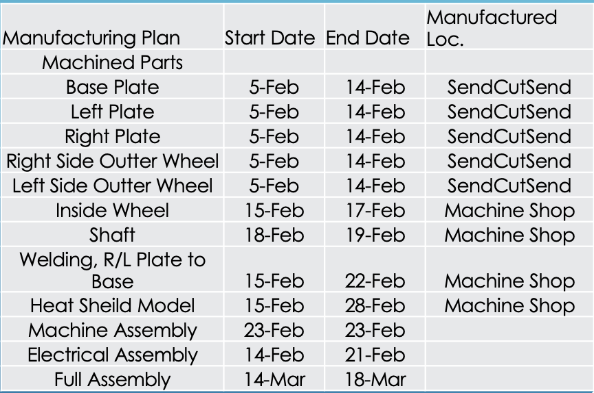
Manufacturing Plan
All metal cutouts are currently being built.
Once received they will need to be welded
All other parts have arrived or can be bought at local hardware stores.
Table 3: Manufacturing Plan
NG - February 14th, 2021
Griffin Brandt - 8

Slide 9
Full Bill of Materials
Table 4: B.O.M
Part / Assembly | Part # | Quantity | Price | Total Price | Status | Supplier | Manufacture | Start/Order Date | Finish/ Receive Date
Cord | KIT110-2 | 1 | $64.00 | $ 64.00 |  | Wes Spur | Wes Spur | 12-Nov | 10-Jan
Motor | A128-150-G8 | 1 | $529.00 | $ 529.00 |  | AmpFlow | AmpFlow | 17-Nov | 3-Feb
Motor Controller | MCP266 | 1 | $269.00 | $ 269.00 |  | AmpFlow | AmpFlow | 17-Nov | 3-Feb
Power Supply | S-1000-24 | 1 | $199.00 | $ 199.00 |  | AmpFlow | AmpFlow | 17-Nov | 3-Feb
Speed Adjuster | NA | 1 | $20.00 | $ 20.00 |  | AmpFlow | AmpFlow | 17-Nov | 3-Feb
Bearing 1" | 5913K74 | 2 | $12.77 | $ 25.54 |  | McMaster-Carr | N/A | 1-Feb | 10-Feb
Bearing 3/4" | 5913K73 | 2 | $11.90 | $ 23.80 |  | McMaster-Carr | N/A | 1-Feb | 10-Feb
Machine key | 90164A655 | 1 | $14.44 | $14.44 |  | McMaster-Carr | N/A | 3-Feb | 10-Feb
Left Disk Cut and Tapped | NA | 1 | $40.98 | $40.98 |  | SendCutSend | SendCutSend | 5-Feb | 14-Feb
Right Disk Cut and Tapped | NA | 1 | $41.05 | $41.05 |  | SendCutSend | SendCutSend | 5-Feb | 14-Feb
Left Side Plate Cut and Tapped | NA | 1 | $40.55 | $40.55 |  | SendCutSend | SendCutSend | 5-Feb | 14-Feb
Right Side Plate Cut and Tapped | NA | 1 | $41.66 | $41.66 |  | SendCutSend | SendCutSend | 5-Feb | 14-Feb
Base Plate | NA | 1 | $123.97 | $123.97 |  | SendCutSend | SendCutSend | 5-Feb | 14-Feb
Tool Replacement Cord 14/3 | 342-576 | 1 | $14.47 | $14.47 |  | Home Depot | CerroWire | 7-Feb | 7-Feb
Southwire Cord 1.66/ Ft | 12/3 300 Volt | 3 | $1.66 | $4.98 |  | Home Depot | Gardner Bender | 7-Feb | 7-Feb
16-14 AWG Ring Terminals 15 pack | 15-104 | 1 | $2.95 | $2.95 |  | Home Depot | Gardner Bender | 7-Feb | 7-Feb
12-10 AWG Ring Terminals 15 pack | 15-107 | 1 | $3.61 | $3.61 |  | Home Depot | Gardner Bender | 7-Feb | 7-Feb
22-18 AWG Spade Terminal 6 Pack | 15-111 | 1 | $2.40 | $2.40 |  | Home Depot | Gardner Bender | 7-Feb | 7-Feb
Enclosure | TBD | 1 | TBD | TBD |  | Amazon | Bud Industries | 14-Feb | 14-Feb
Fused AC Port | TBD | 1 | TBD | TBD |  | Amazon | Qualtek | 14-Feb | 14-Feb
Cable Gland | TBD | 4 | TBD | TBD |  | Amazon | Infineon | 14-Feb | 14-Feb
MOSFET for Voltage Clamp | BUK965R8-100E | 1 | $3.53 | $3.53 |  | Digi-Key | Digi-Key | 14-Feb | 21-Feb
Inside Wheel | N/A | 1 | $37.99 | N/A |  | Home Depot | Jonathan/ Machine Shop | 15-Feb | 17-Feb
Shaft | N/A | 1 | Same Piece | N/A |  | Home Depot | Jonathan/ Machine Shop | 18-Feb | 19-Feb
Welding, R/L Plate to Base | N/A | 1 | N/A | N/A |  | N/A | Machine Shop | 15-Feb | 22-Feb
Heat Sheild Model | #1001195035 | 1 | $25.99 | N/A |  | Home Depot | Griffin/ Machine Shop | 15-Feb | 28-Feb
Machine Assembly | N/A | 1 | N/A | N/A |  | N/A | Griffin/ Machine Shop | 23-Feb | 23-Feb
Electrical Assembly | N/A | 1 | N/A | N/A |  | N/A | Jonathan/ Machine Shop | 14-Feb | 21-Feb
Full Assembly | N/A | 1 | N/A | N/A |  | N/A | Team | 14-Mar | 18-Mar
NG - February 14th, 2021
Jack Shields - 9

Slide 10
Testing Plan
Motor Startup - Complete
Cable – Flame Resistance & Abrasion Test
Temperature Range Functionality
Side Force Evaluation
Retraction Speed
NG - February 14th, 2021
Leah Blakney - 10

Slide 11
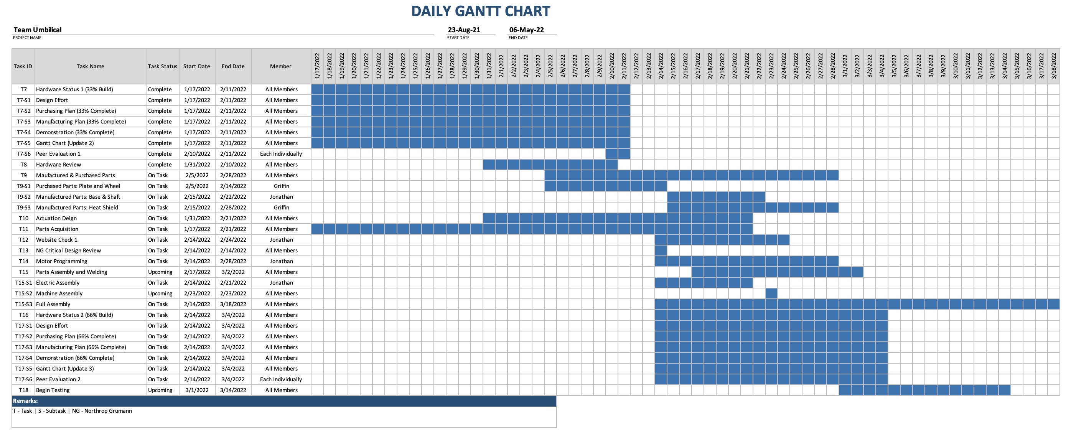
Gantt Chart Update
Table 4: Gantt Chart
NG - February 14th, 2021
Jack Shields - 11

Slide 12
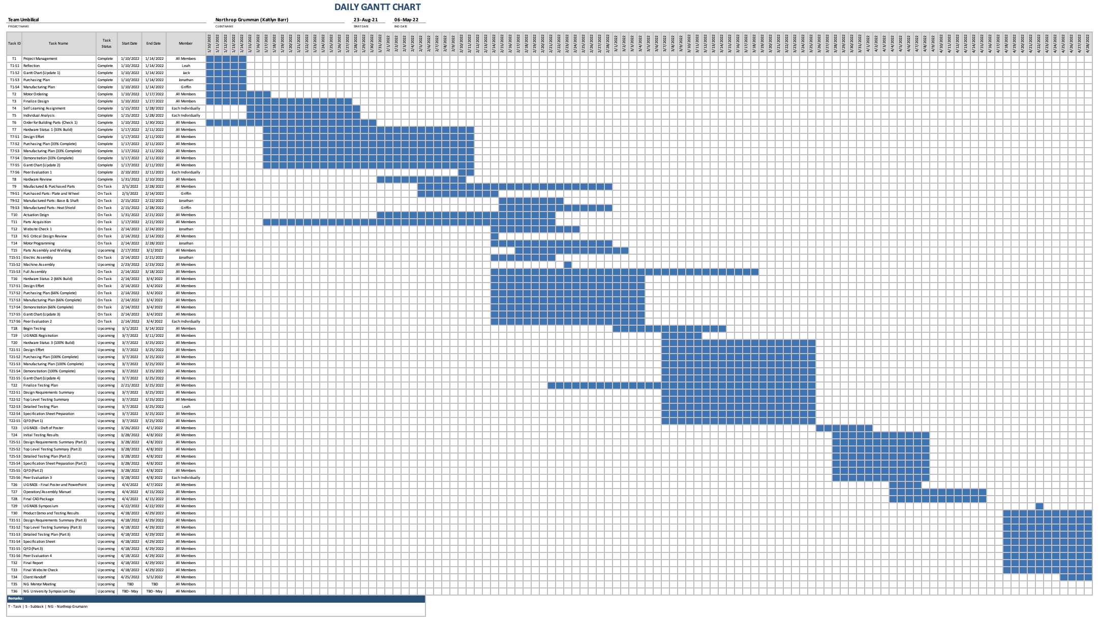
Appendix: Full Gantt Chart

