Slide 1
Environmental Control System Door Redesign
Timothy Anderson, Andrea Hernandez, Sam Mangialardi, Alexander Soto, Jake West, Michael Wilson
Final Presentation
UGRADS
April 12th to 16th, 2021
Figure 1: Antares Rocket [1]

Slide 2
Outline
Section 1: Project Intro
Section 2: Design Solution and Decision Process
Section 3: Manufacturing and Testing
Section 4: Future Work and Budget

Slide 3
Section 1:
Project Introduction

Slide 4
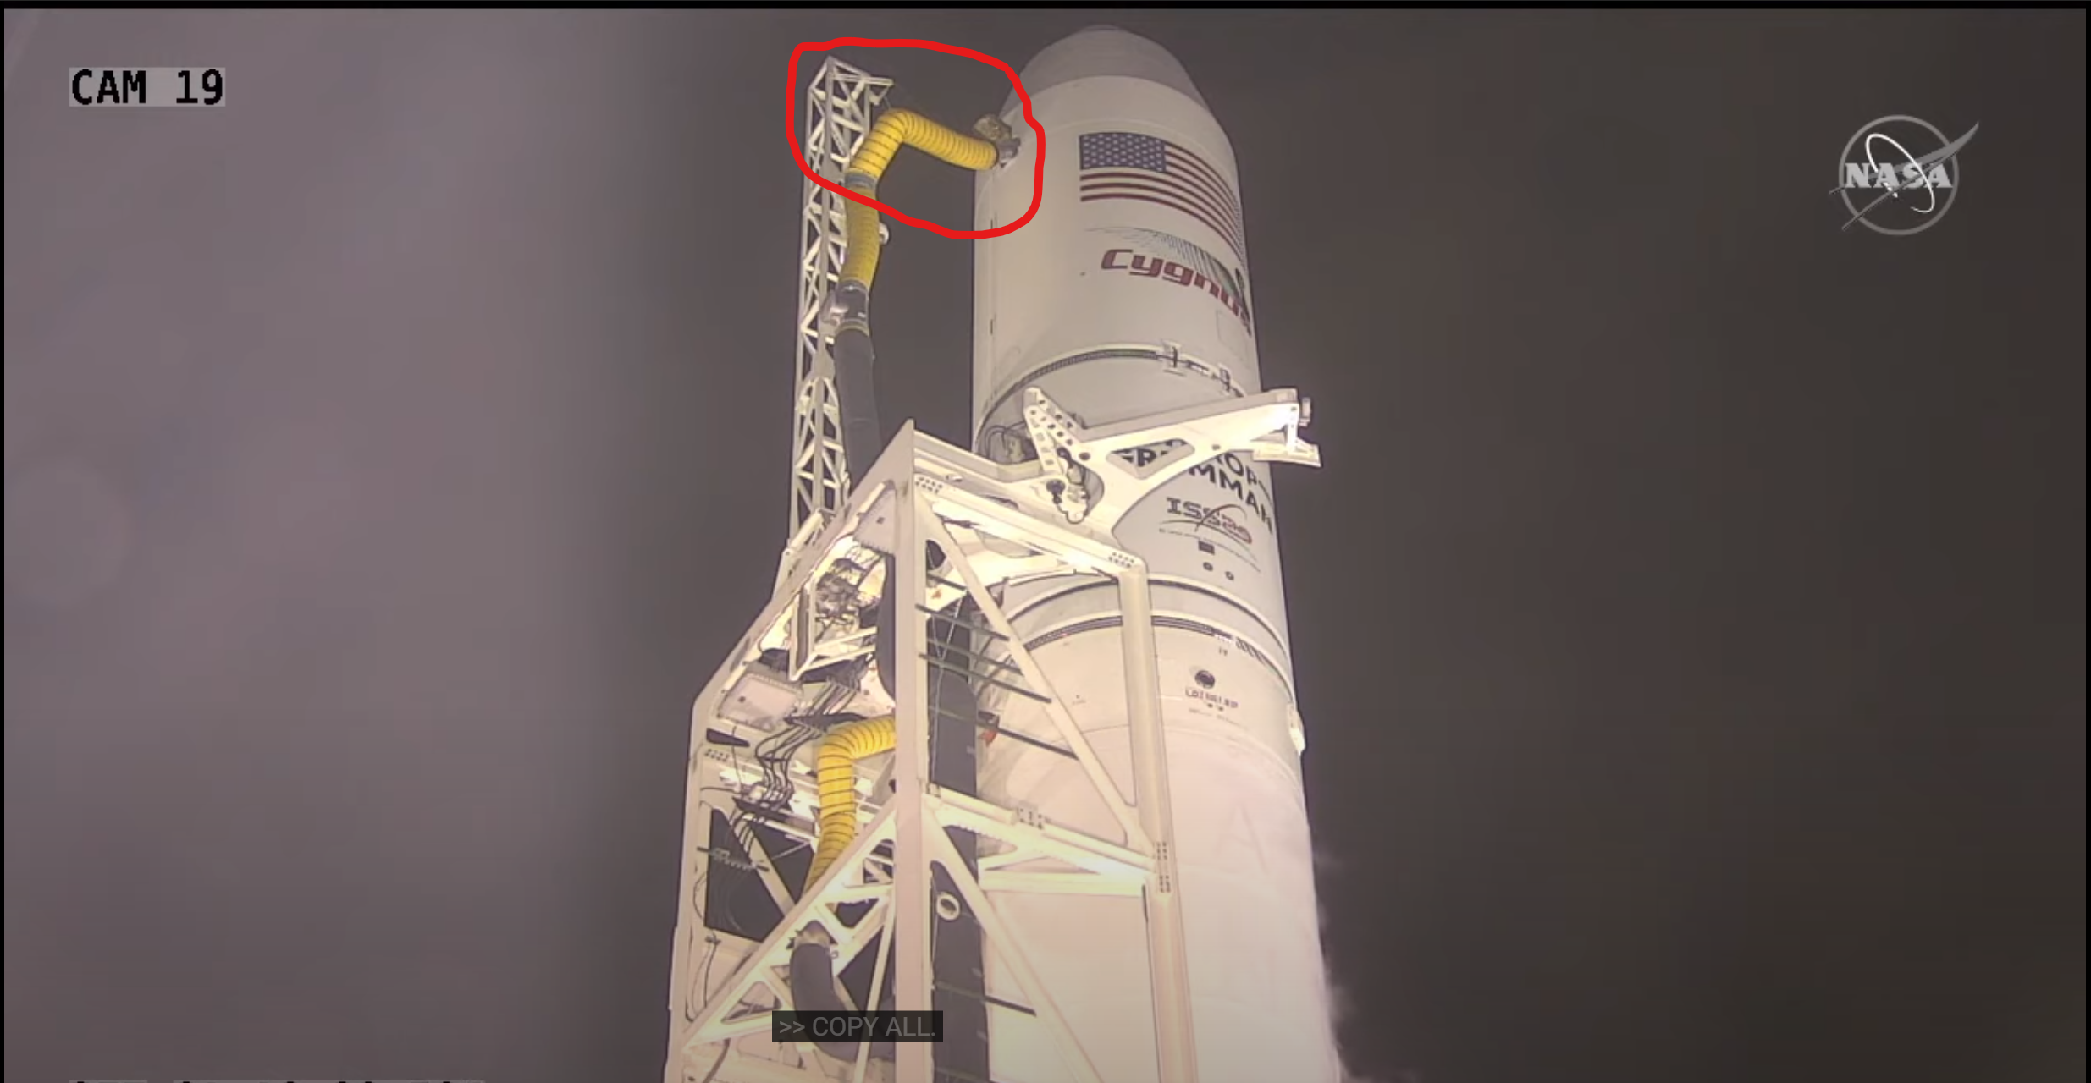
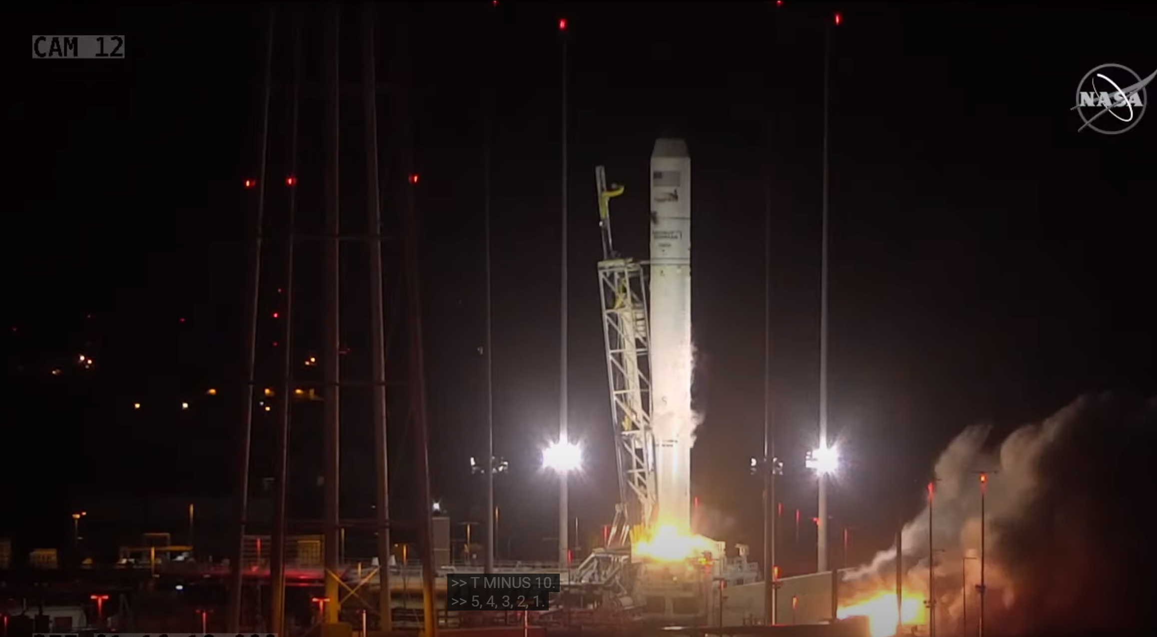
Project Intro
Problem: Antares Door “burps” while in flight
Goal:
Improve the latching system for the Antares rocket.
Our objective is to investigate potential failures of the door.
A successful design could be implemented into other launch vehicles.
Figure 2: Nozzle in place [2]
Figure 3: Nozzle is removed [2]

Slide 5
Customer Requirements
Table 1: Rated Customer Requirements
# | Customer Requirement | Rating
1 | Ease/safety of installation | 7
2 | Scalable | 8
3 | Reopenable | 4
4 | Withstand pressure differential | 10
5 | No contaminates | 8
6 | Does not use gravity or acceleration | 6
7 | Activates on launch | 10
8 | Does not interfere with nearby systems | 9
9 | Professionalism | 5
10 | Does not influence aerodynamics | 9
11 | ESD safe | 7
12 | Indicates open/close status | 1
The level of importance was determined by a rating from 1-10. ​
Priority: ​
  Pressure differential ​
  Activates on launch characteristics​
  No interference with nearby systems​
Nice to have:​
  Indicate Open/Closed status.​
​

Slide 6
Engineering Requirements
Table 2: Listed Engineering Requirements
Provided by Northrop Grumman project proposal
High standard of design performance, reliability, durability, and safety
Quantitative Requirements
Engineering Requirement | Limiting Value
Safety Factor | Metallic: 1.6 yield and 2.0 for ultimate Plastic or composite: 2.0 ultimate and 2.3 for buckling
Vibrations | 24 Gs for 9 secs
Pressure differential | 7.5 psi
Budget | $8,000
Dimensions | Inlet Area: 203 in^2
Weight | 5 lbm
Pressure Limit on Fairing | 810 psi

Slide 7
Section 2: Design Solution

Slide 8
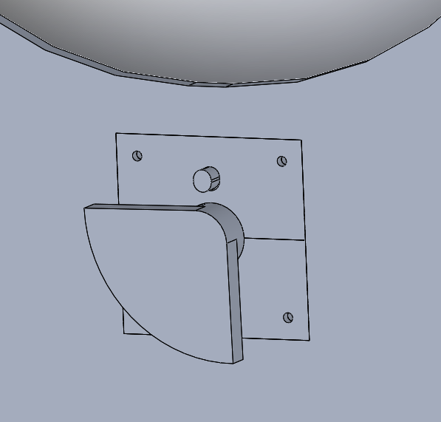
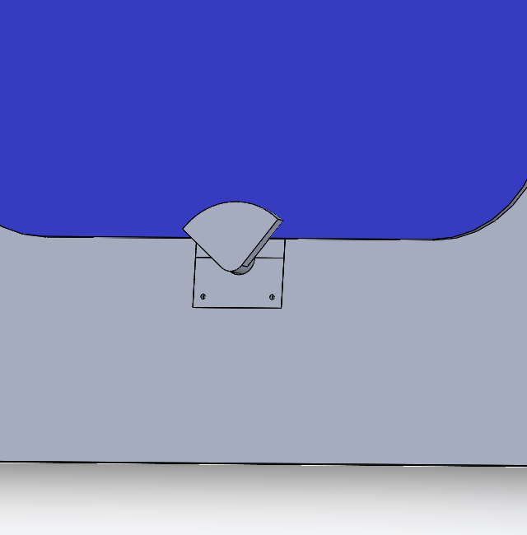
Twisting Latch Design
Uses exterior hinge design, with a solid aluminum door.
Latching system activates as the door hits the fairing.
Latch twists 90 degrees until it locks down the door to the fairing.
The design can be reopenable by hand, by turning the latch counterclockwise with enough force to overcome the torsion spring.
Figure 4: (a) Open Door View
(b) Closed Door View

Slide 9
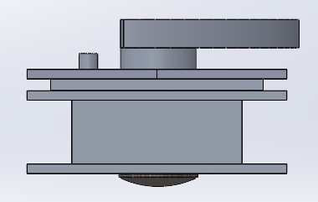
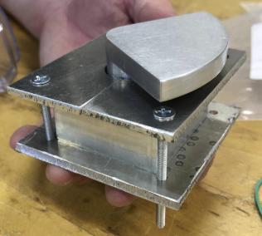
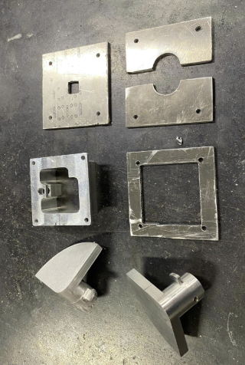
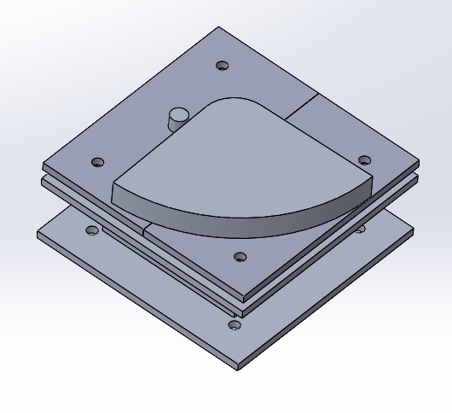
Final Design
The design allows for use in multiple fairing sizes.
Fast activation as it used a torsion spring to rotate
Friction on the threads prevents further rotation, holding the latch in place.
Figure 5: Side View
Figure 6: Manufactured Design
Figure 8: Major Individual Components
Figure 7: Iso View

Slide 10
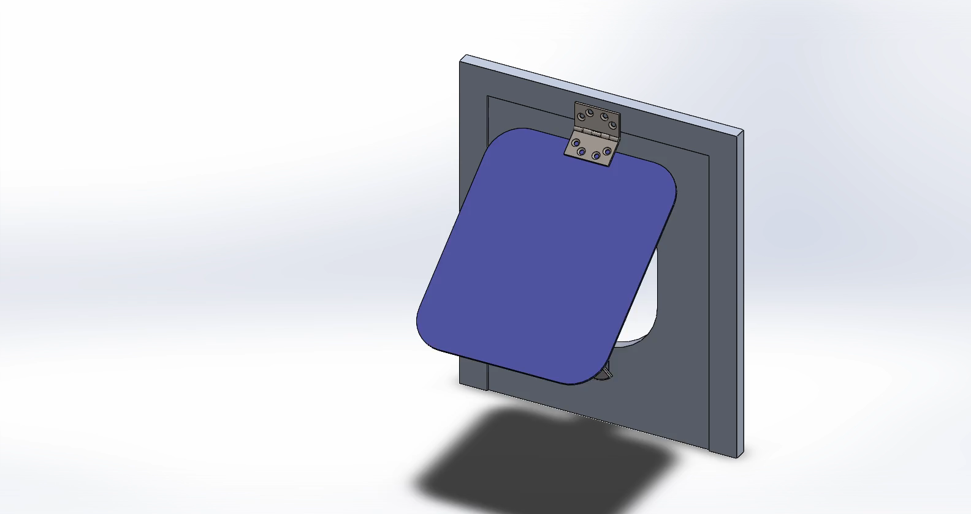
Full System Activation
Figure 9: Animation

Slide 11

Latching System Activation
Figure 10: Interior Animation

Slide 12
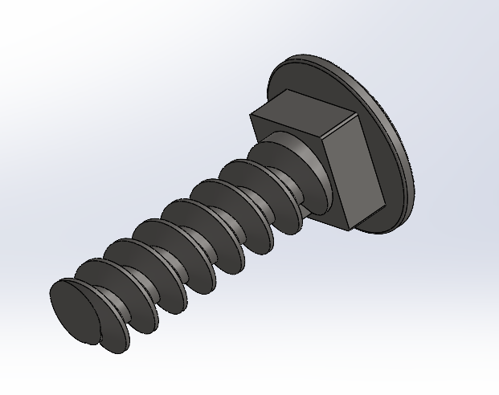
Thread Analysis NEW
Table 3: Power screw calculations
Variable Description | Variable | Value | Units
Alpha angle | 2a | 14.5000
Minor diameter | dr | 0.3125 | inches
Major diameter | d | 0.3750 | inches
Mean diameter | dm | 0.3438 | inches
Number of engaged threads | nt | 3.0000
Pitch | p | 0.0625 | inches
Lead | l | 0.0625 | inches
Force applied, axial | F | 1000.0000 | lb
Coefficient of friction threaded pair-nut material | f | 0.1700
Coefficient of friction thrust collar running | f_{c} | 0.0900
Coefficient of friction thrust collar starting | f_{c} | 0.1500
Collar diameter max. | dc_max | 0.6300 | inches
Collar diameter min. | dc_min | 0.3500 | inches
Diameter of collar | dc | 0.4900 | inches
Torque required to raise | TR | 77.2892 | in*lb
Torque required to lower | TL | 56.7793 | in*lb
Excel Calculator [8]
Figure 11: Screw full view
Variable Description | Variable | Value | Units
Elastic 304 steel | E | 28000.0000 | kpsi
Body shear stress | τ | 2579.6984 | kpsi
Compressive axial stress | σ | -2607.5946 | kpsi
Bearing Stress | σB | -2252.0135 | kpsi
Threaded Root bearing pressure | σb | 7431.6446 | kpsi
Notes:
Based on …
Number of engaged threads (nt) = 1 and lead change can be done
Force applied as 200ls.
Friction
SELF locking we wanted in the design
Didn’t want it to rise
assupmtion

Slide 13
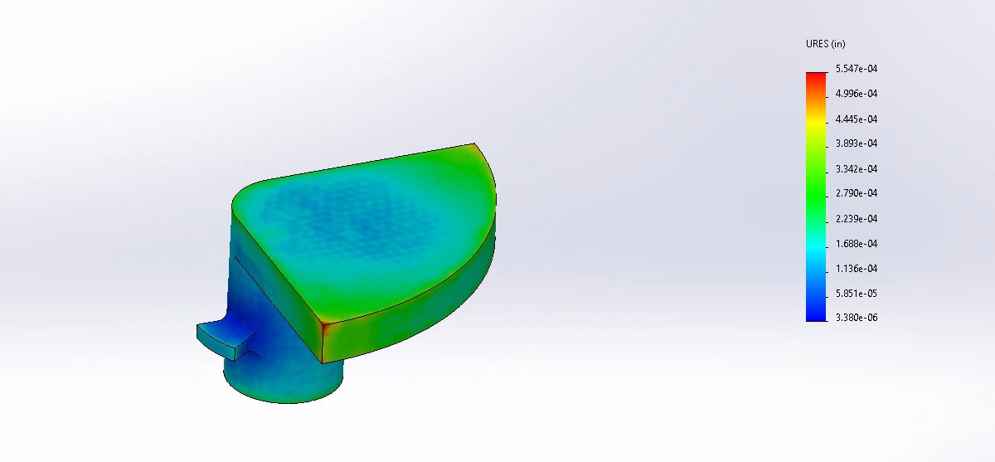
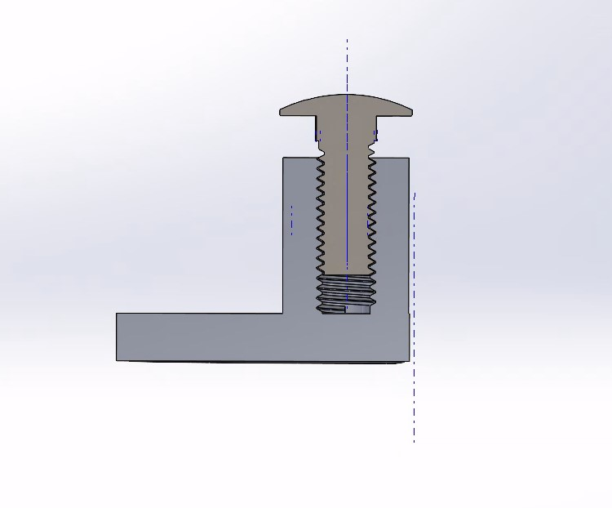
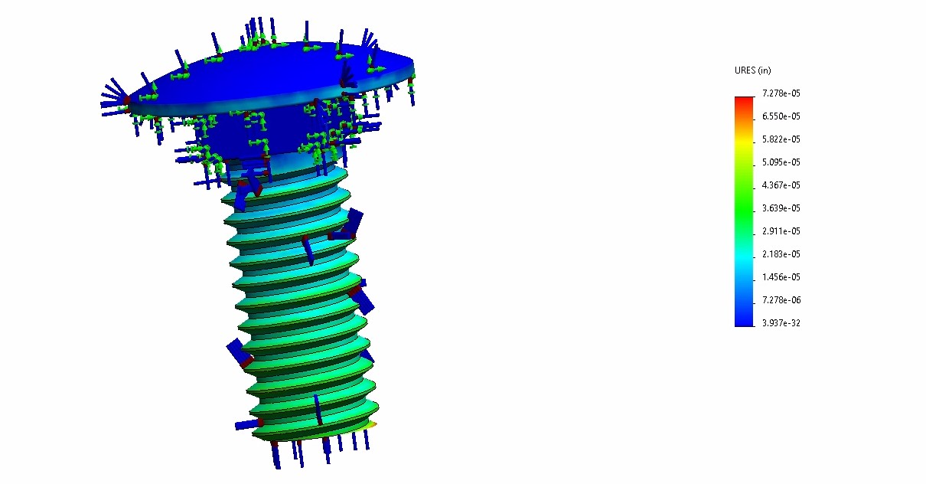
Thermal Expansion
Thermal analysis ran in Solidworks.
Range from 0-100C
Figure 13: Deformed Latch
Figure 12: Deformed Latch and Bolt Assembled
Figure 14: Deformed Bolt

Slide 14
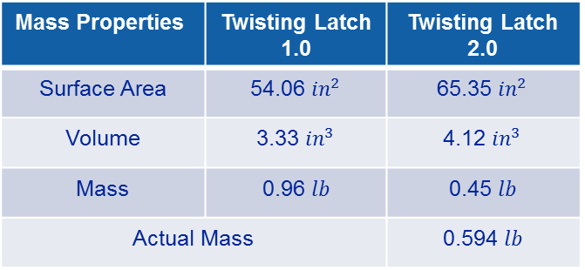
Weight Analysis
Table 4 : Part description list
Table 5 : Weight analysis of full system
Part | Material
Housing | Aluminum 7075 T7
Shaft | Aluminum 7075 T7
Bolt | AISI 304 Steel
Bottom Plate | Aluminum 7075 T7
Top Plate | Aluminum 7075 T7
Sandwich Plate | Aluminum 7075 T7
Pin | Aluminum 7075 T7
Compression Spring | Music Wire ASTM A228
Torsion Spring | Music Wire ASTM A228
Mass Properties | Twisting Latch 1.0 | Twisting Latch 2.0
Surface Area | 54.06 ${in}^{2}$ | 65.35 ${in}^{2}$
Volume | 3.33 ${in}^{3}$ | 4.12 ${in}^{3}$
Mass | 0.96 $lb$ | 0.45 $lb$
Actual Mass |  | 0.594 $lb$
The new material selection reduces design weight by over 50%.
A low weight provides an advantage due to the high cost/lb. for space flight.

Slide 15
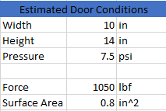


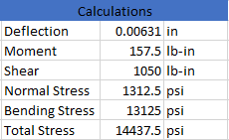
Thickness of Latch Analysis
Latch Thickness= .3in
Factor of Safety, Yield = 4.37
Factor of Safety, Ultimate= 5.07
Table 6: Latch Analysis [11]
Figure 15: Cantilever Beam Representing Latch

Slide 16
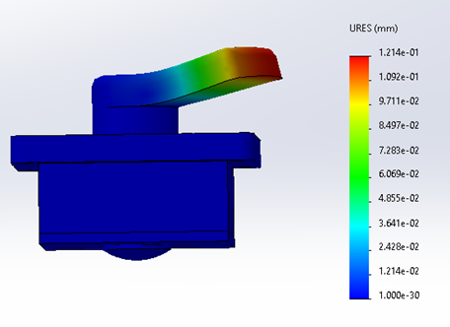
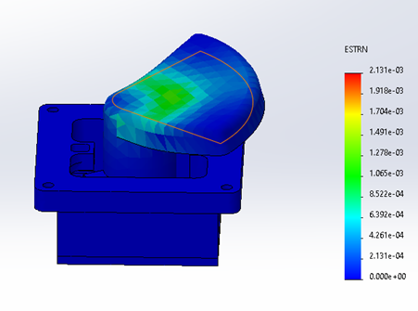
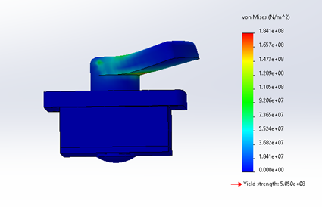
FEA Analysis
FEA assumed 1050 lbf on the latch.
It also assumed the shaft would not move due to the top plate restricting movement.
Max Deformation found was 0.01214 mm or 0.000478 in.
Figure 16: FEA Deformation
Figure 17: FEA Strain
Figure 18: FEA Stress

Slide 17
Section 3:
Manufacturing and Testing

Slide 18
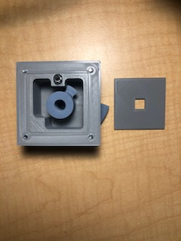
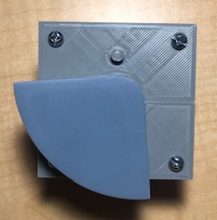
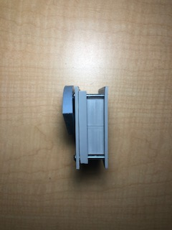
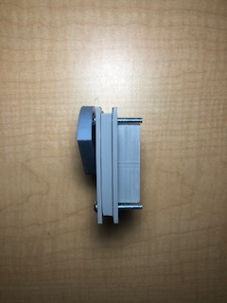
3D Printed Proof Of Concept
Printed with PLA and Photopolymer Resin.
Tolerance of +- 0.01 in.
Fully functional movement.
Figure 19: Scalability Comparison of Prototype
Figure 20: Front of Prototype
Figure 21: Back of Prototype

Slide 19
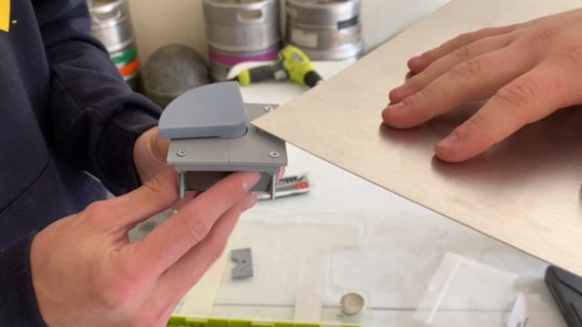
3D Printed Proof Of Concept Cont.
Figure 22: Video of functional 3D system.

Slide 20
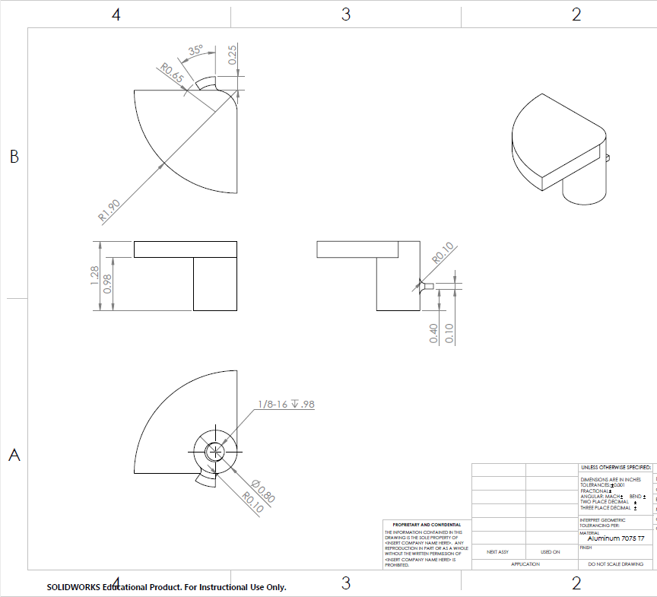
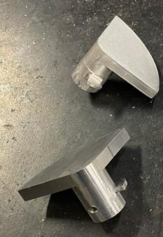
Manufacturing
NAU Machine Shop Shaft Work Order
Two copies were manufactured
First one had wrong tab thickness
Second had crooked threads
Team made adjustments to make parts functional
Figure 23: Engineering drawing of shaft.
Figure 24: Manufactured shafts

Slide 21
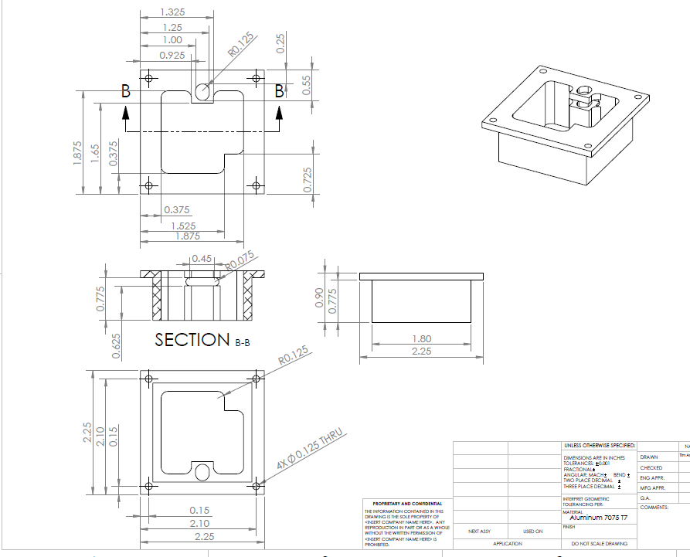
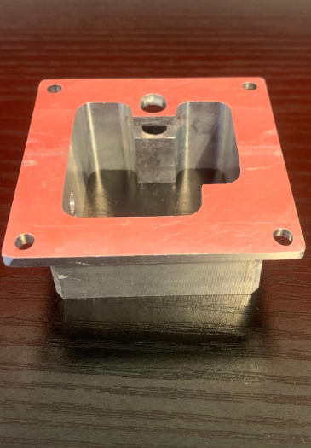
Manufacturing Cont.
NAU Machine Shop Housing Work Order
Housing was machined accurately.
Bolt holes were designed too small and too close to the housing walls.
Team solved this issue by drilling the holes larger and chamfering the housing walls.
Figure 25: Engineering drawing of housing
Figure 26: Manufactured Housing

Slide 22
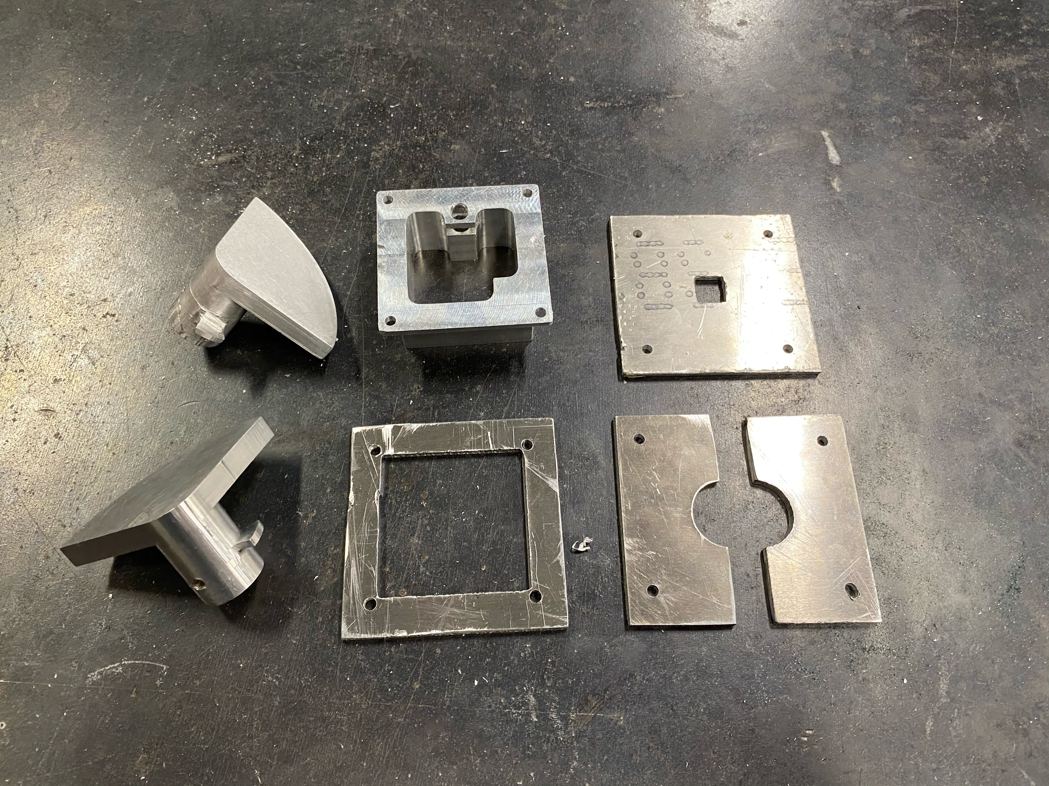
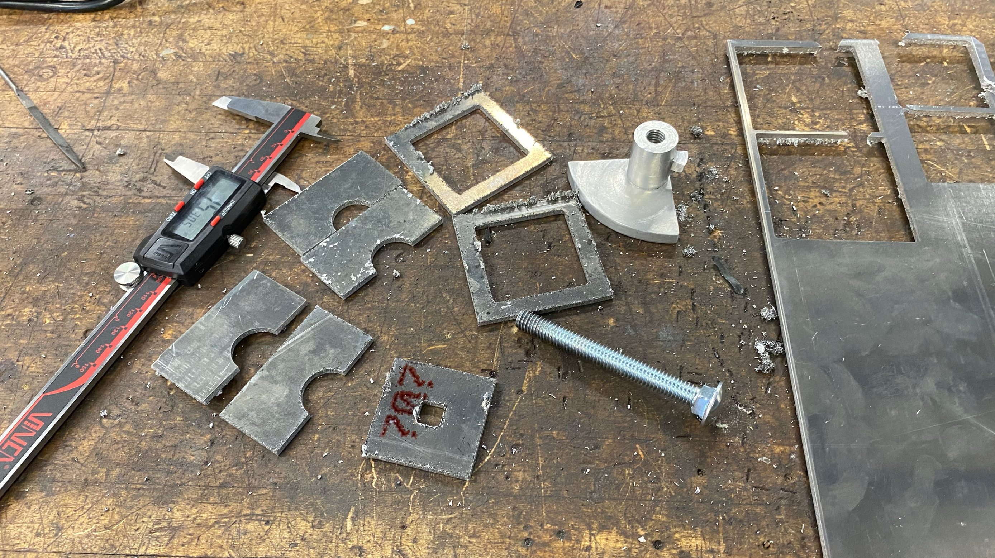
Manufacturing Cont.
NAU Machine Shop Plate Manufacturing
Plates cut out with CNC Plasma Cutting table
Tolerances of Plasma Cutter were +/- 0.125 inches
Required filing by hand to fit
Bolt holes drilled to line up with housing
Figure 28: Completed Plates
Figure 27: Plates after plasma cutting

Slide 23
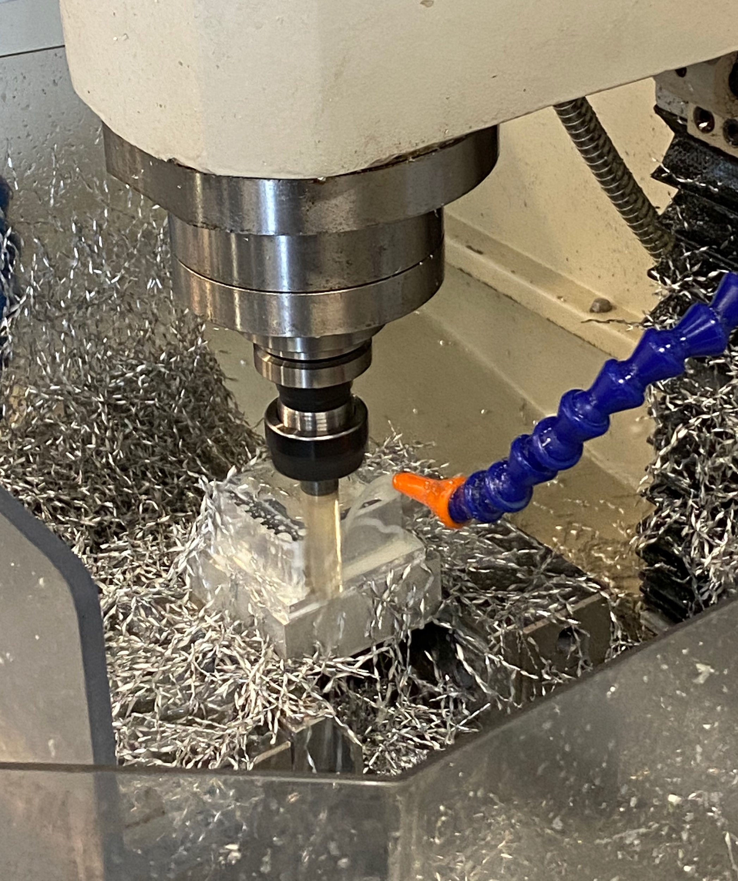
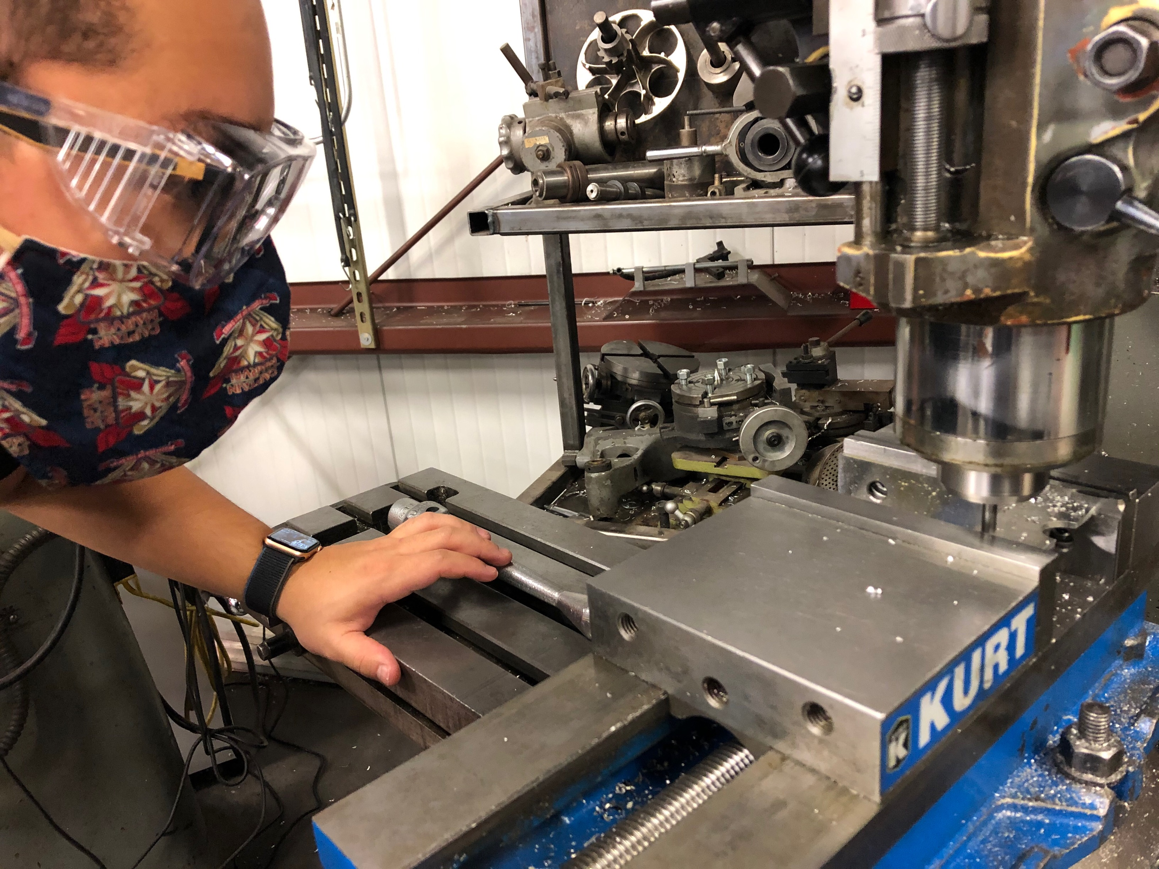
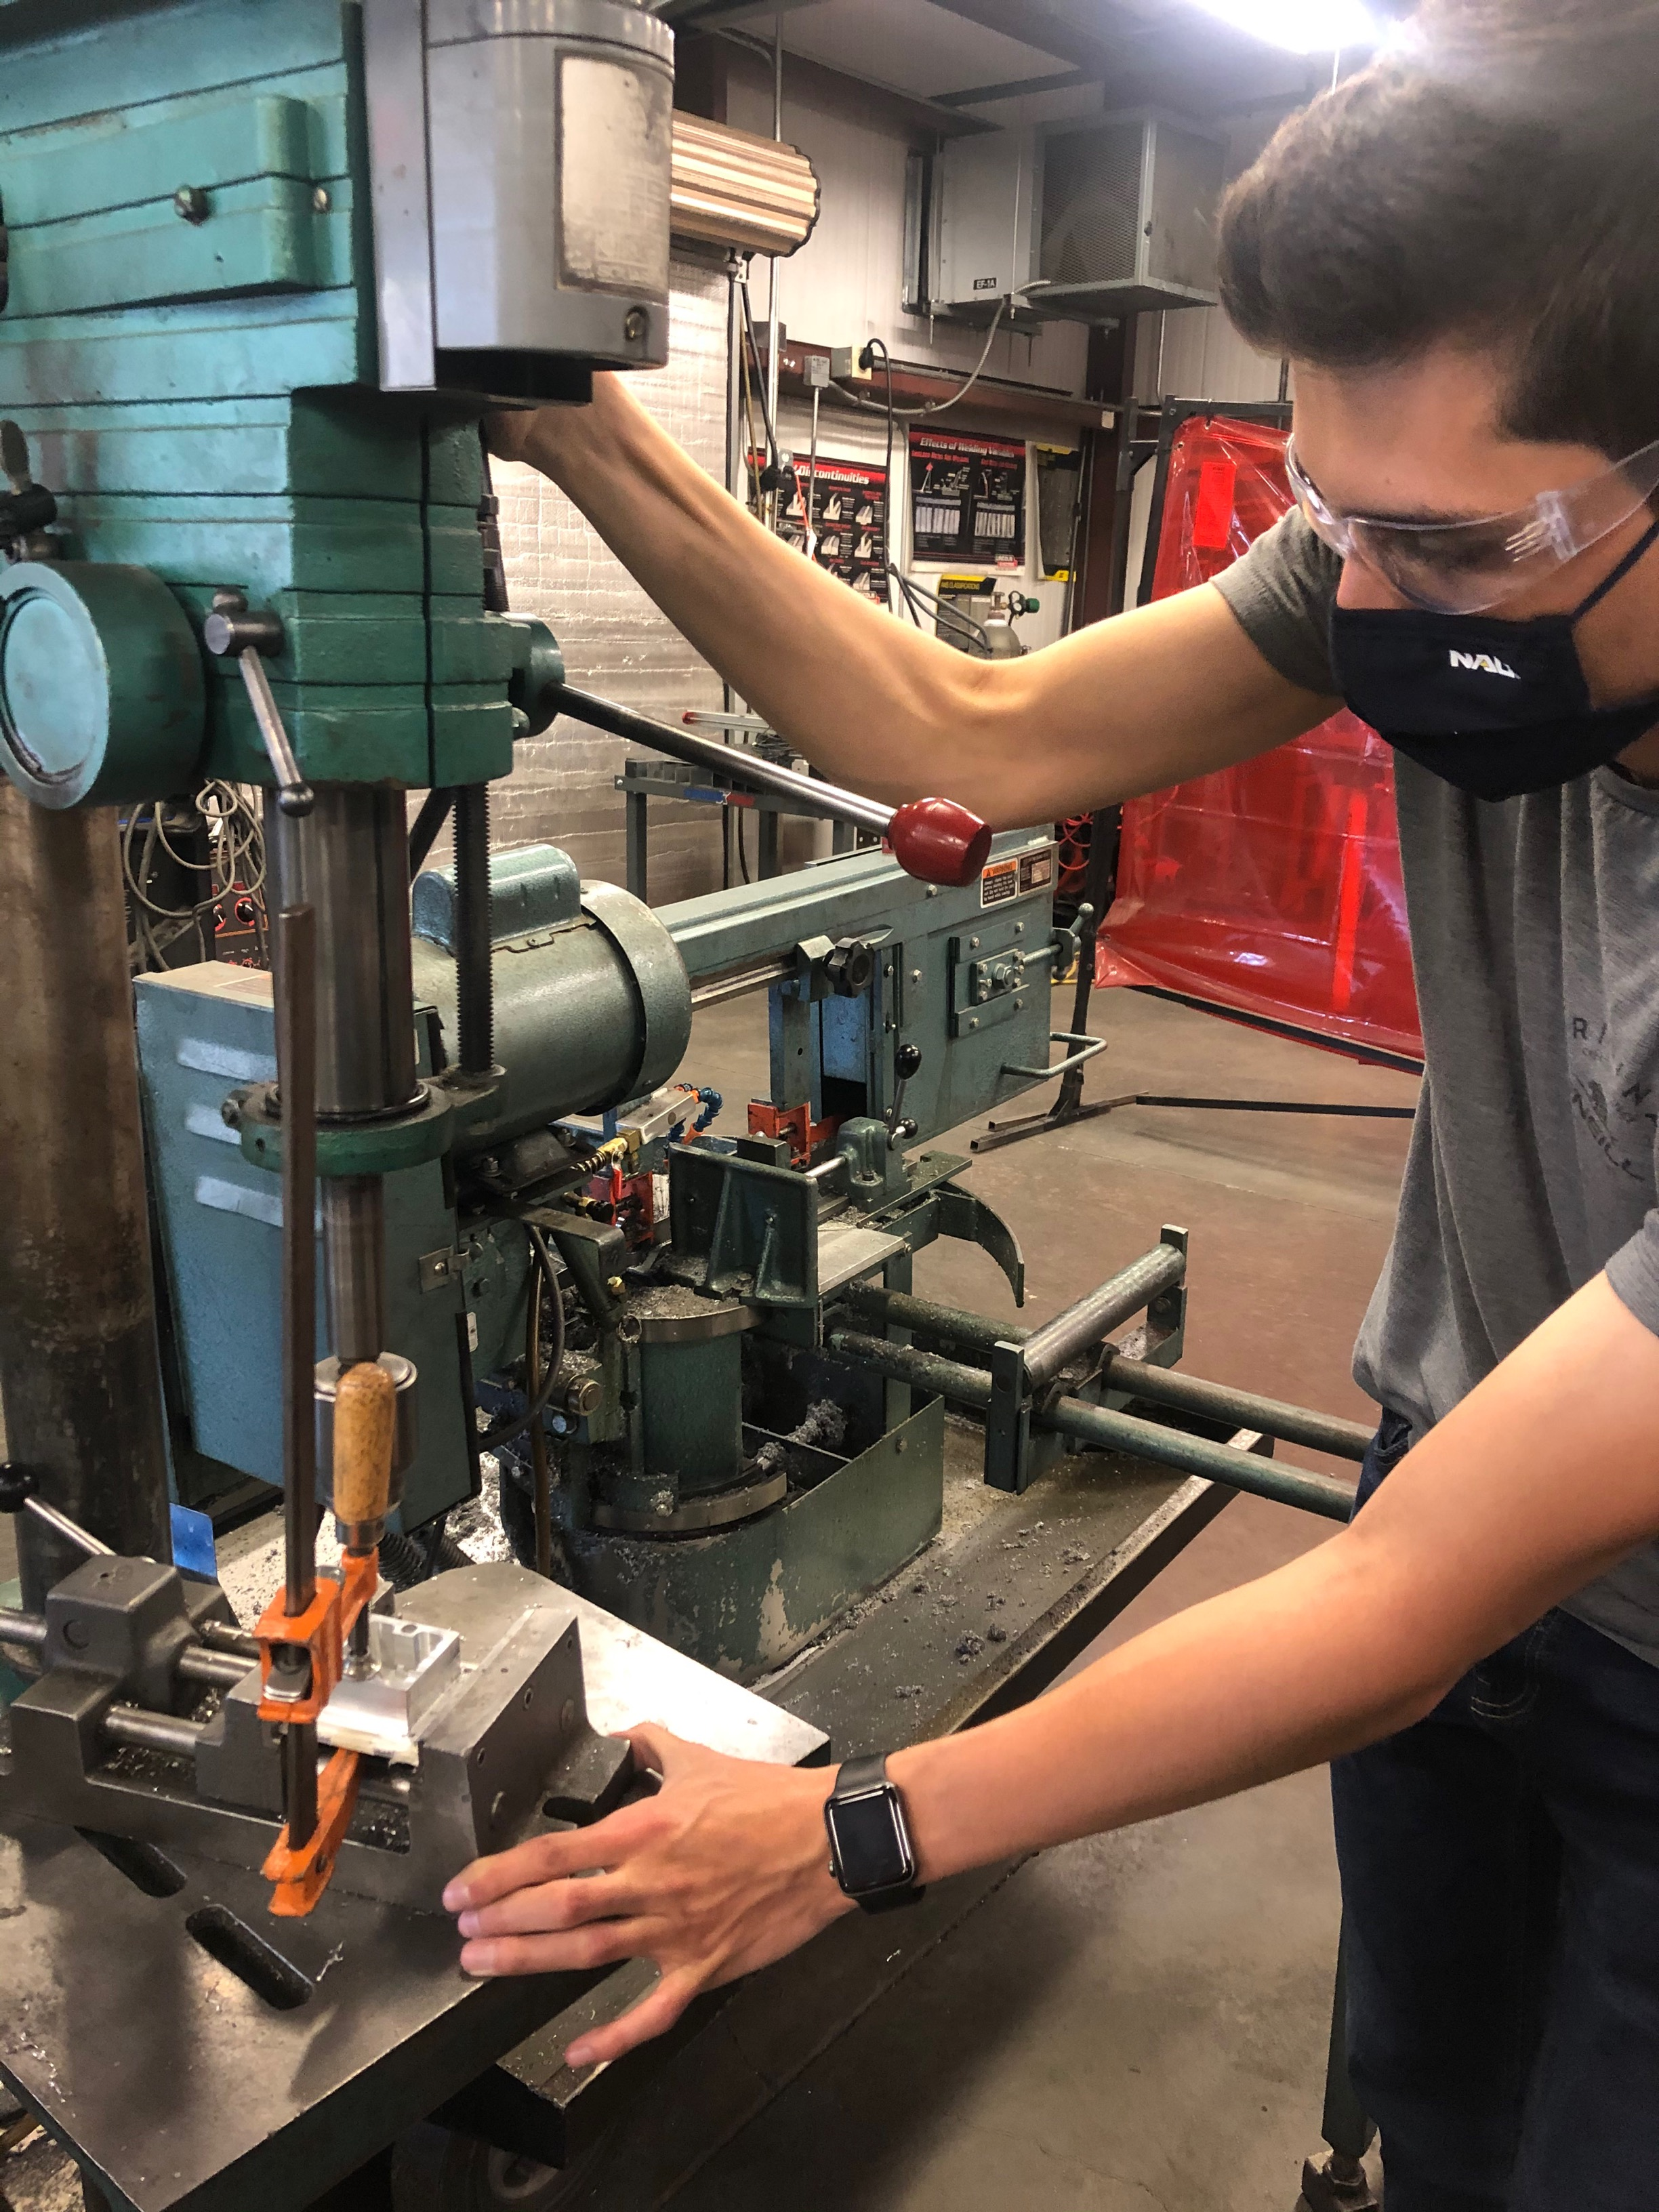
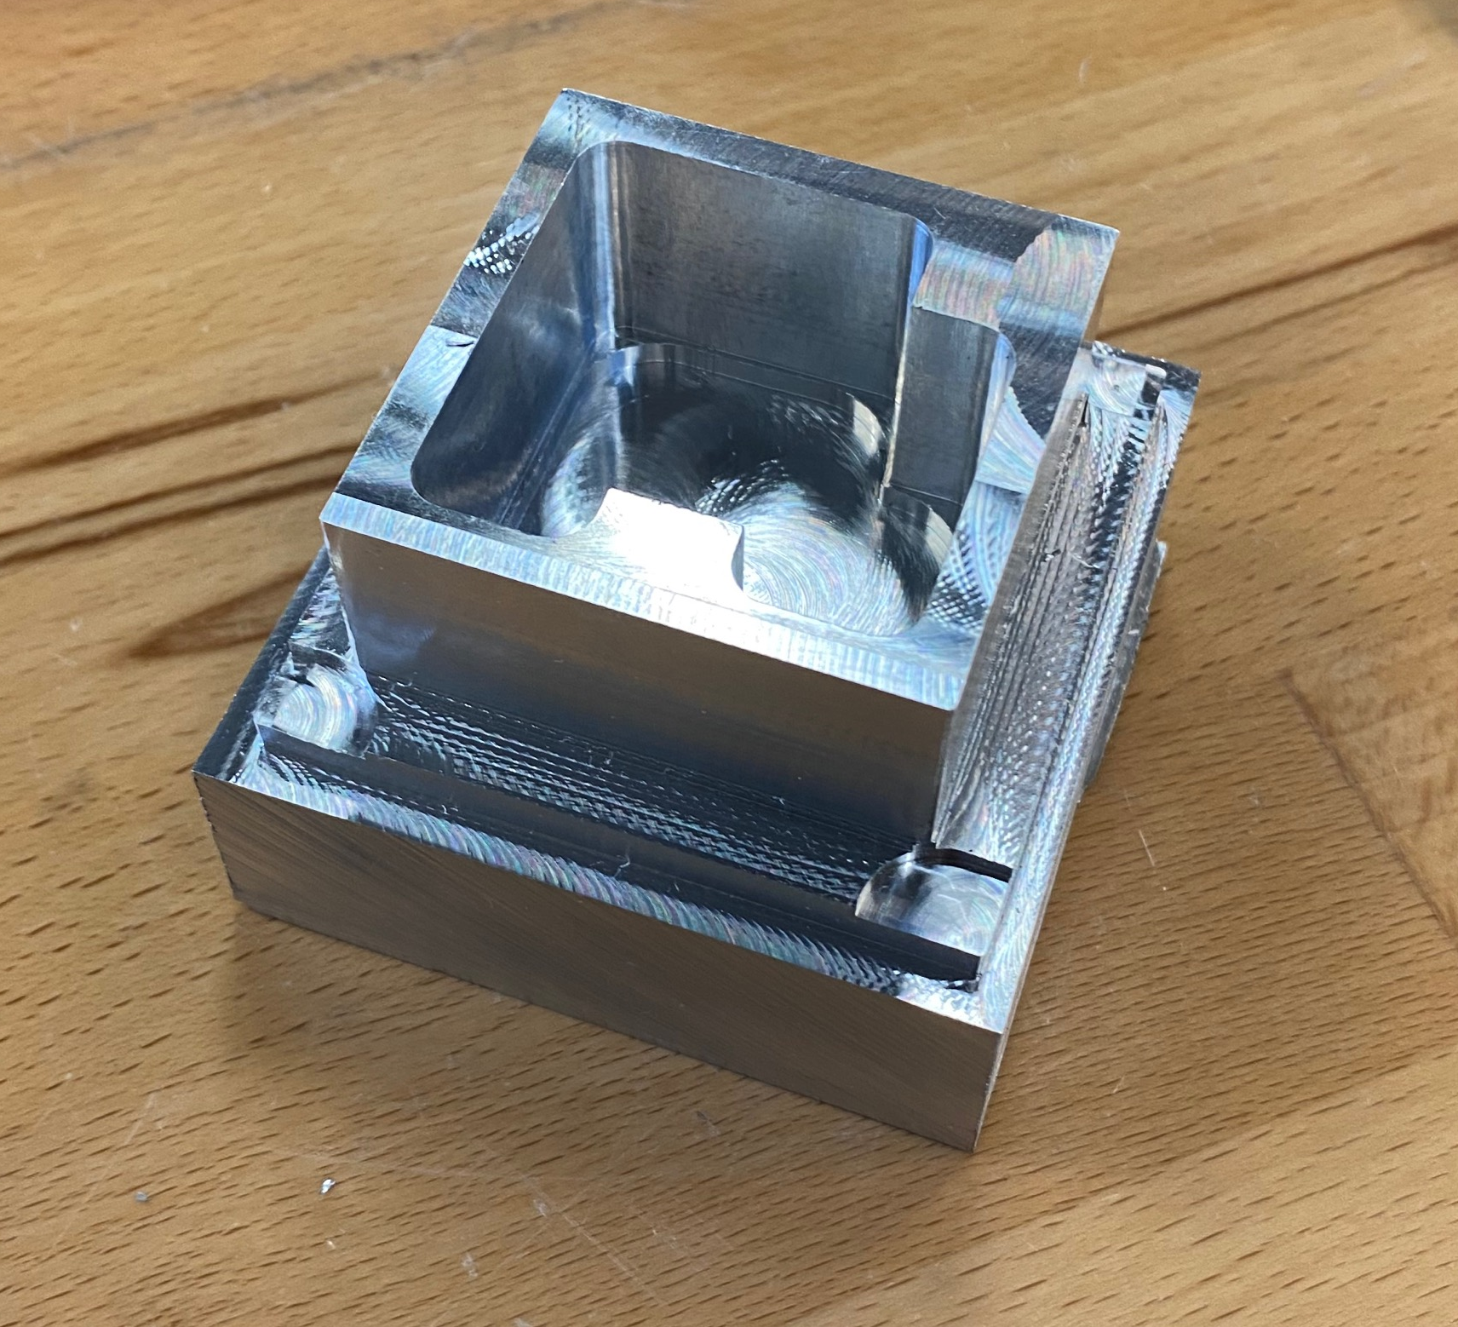
Manufacturing Cont.
Created a mock housing using CNC Tormac
Drilled holes into sandwich plates
Figure 29: Drilling Counterbore in plates for bolts.
Figure 30: Drilling Holes for the Sandwich Plates
Figure 31: Mock Housing
Figure 32: CNC Tormac

Slide 24
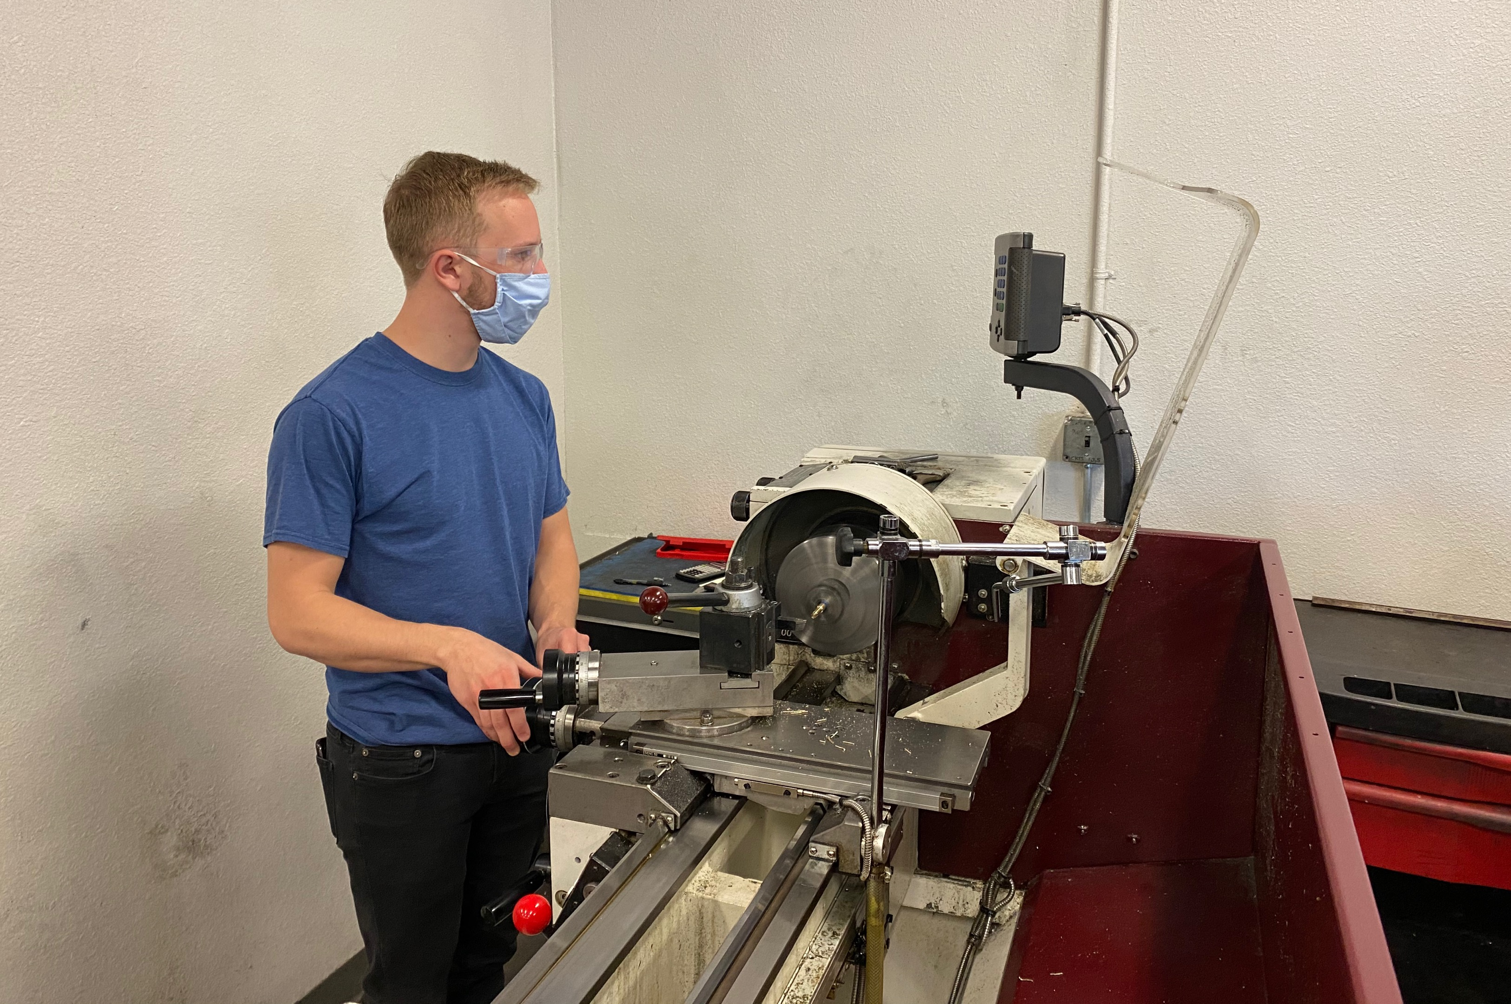
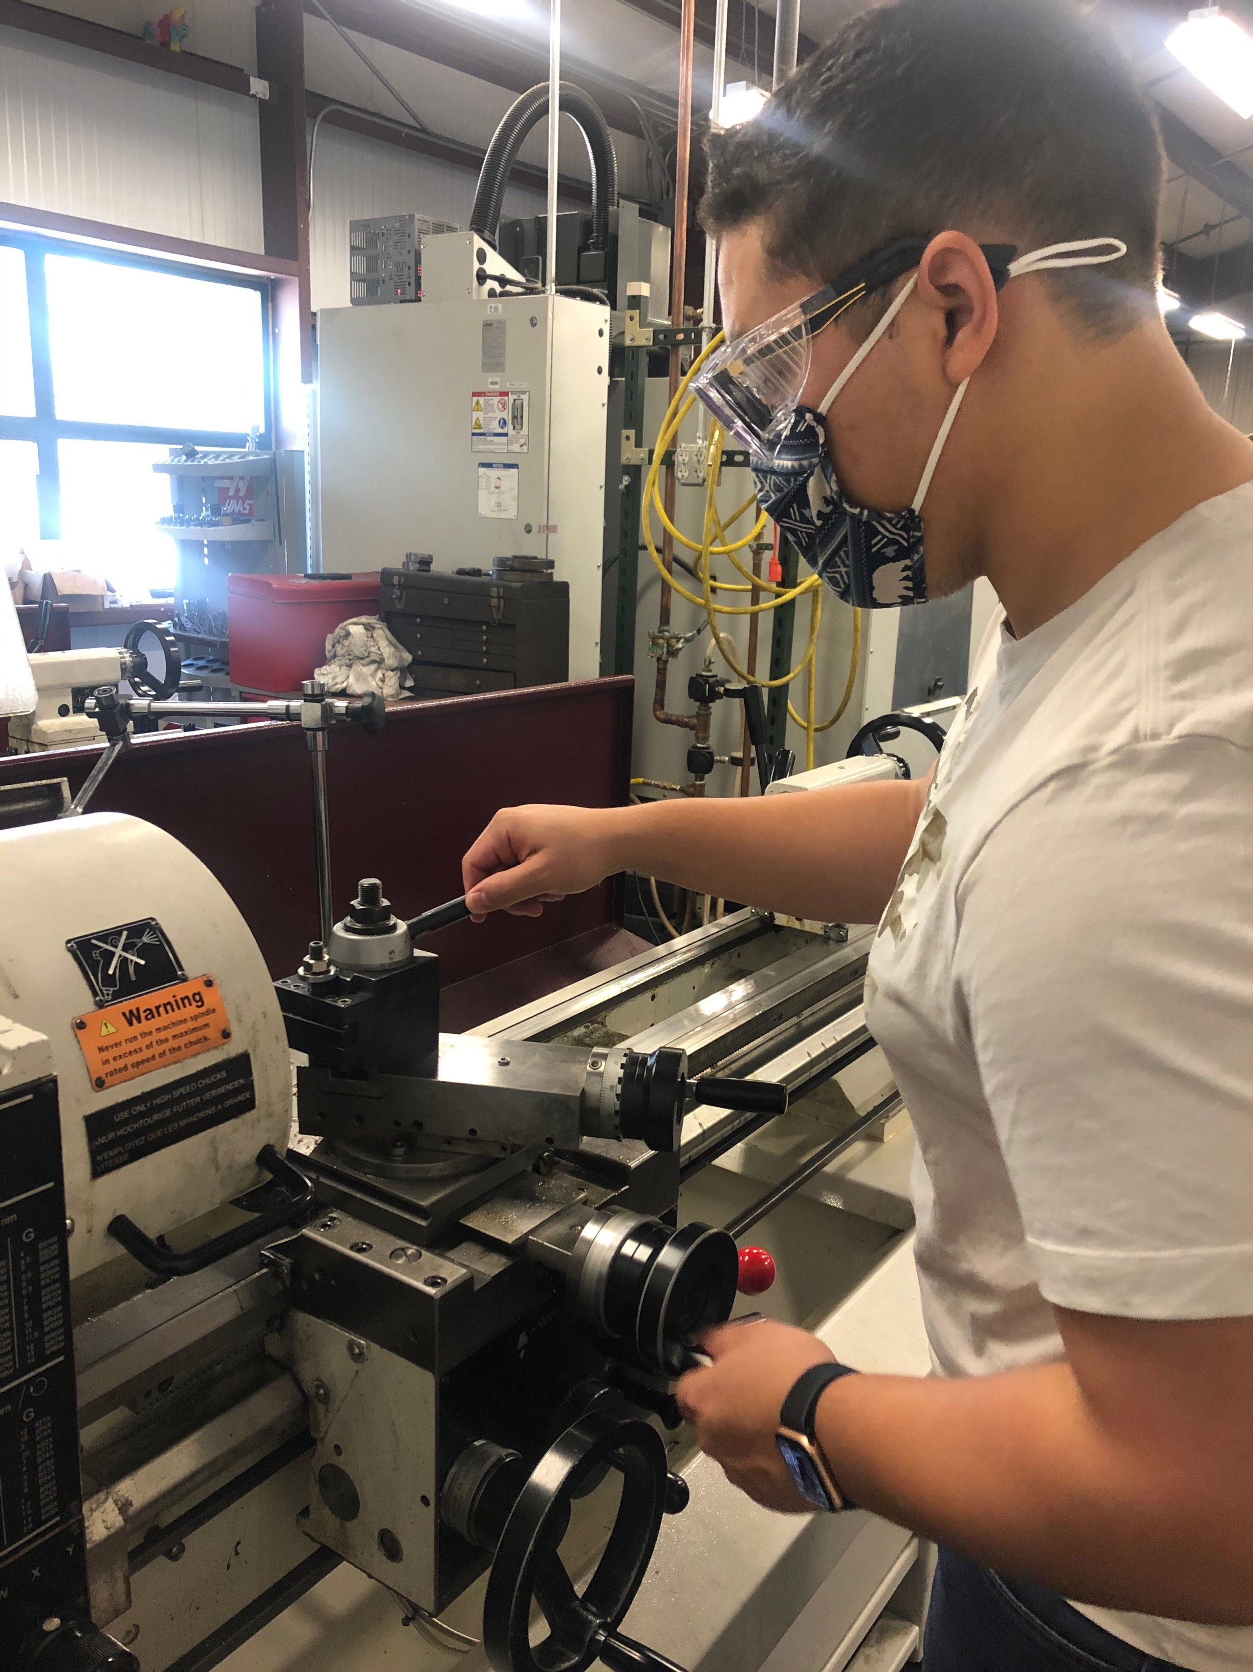
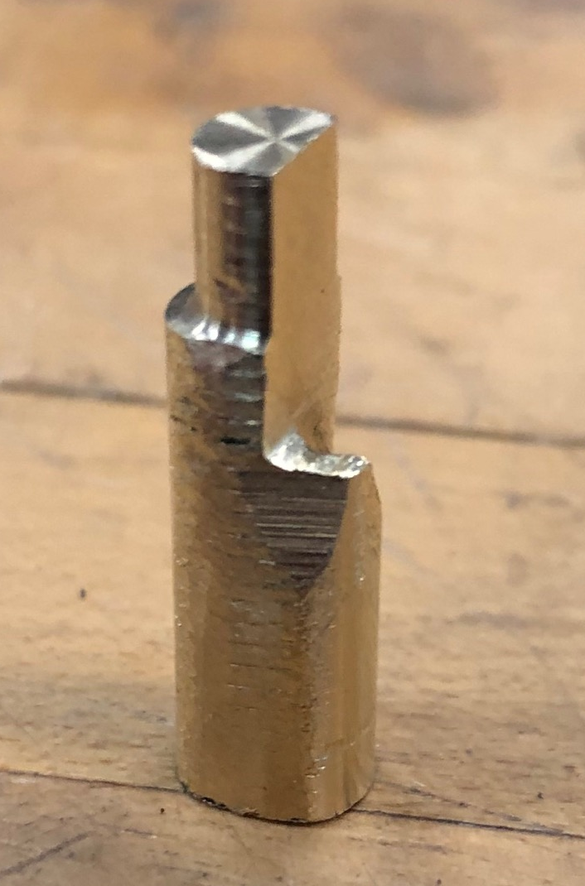
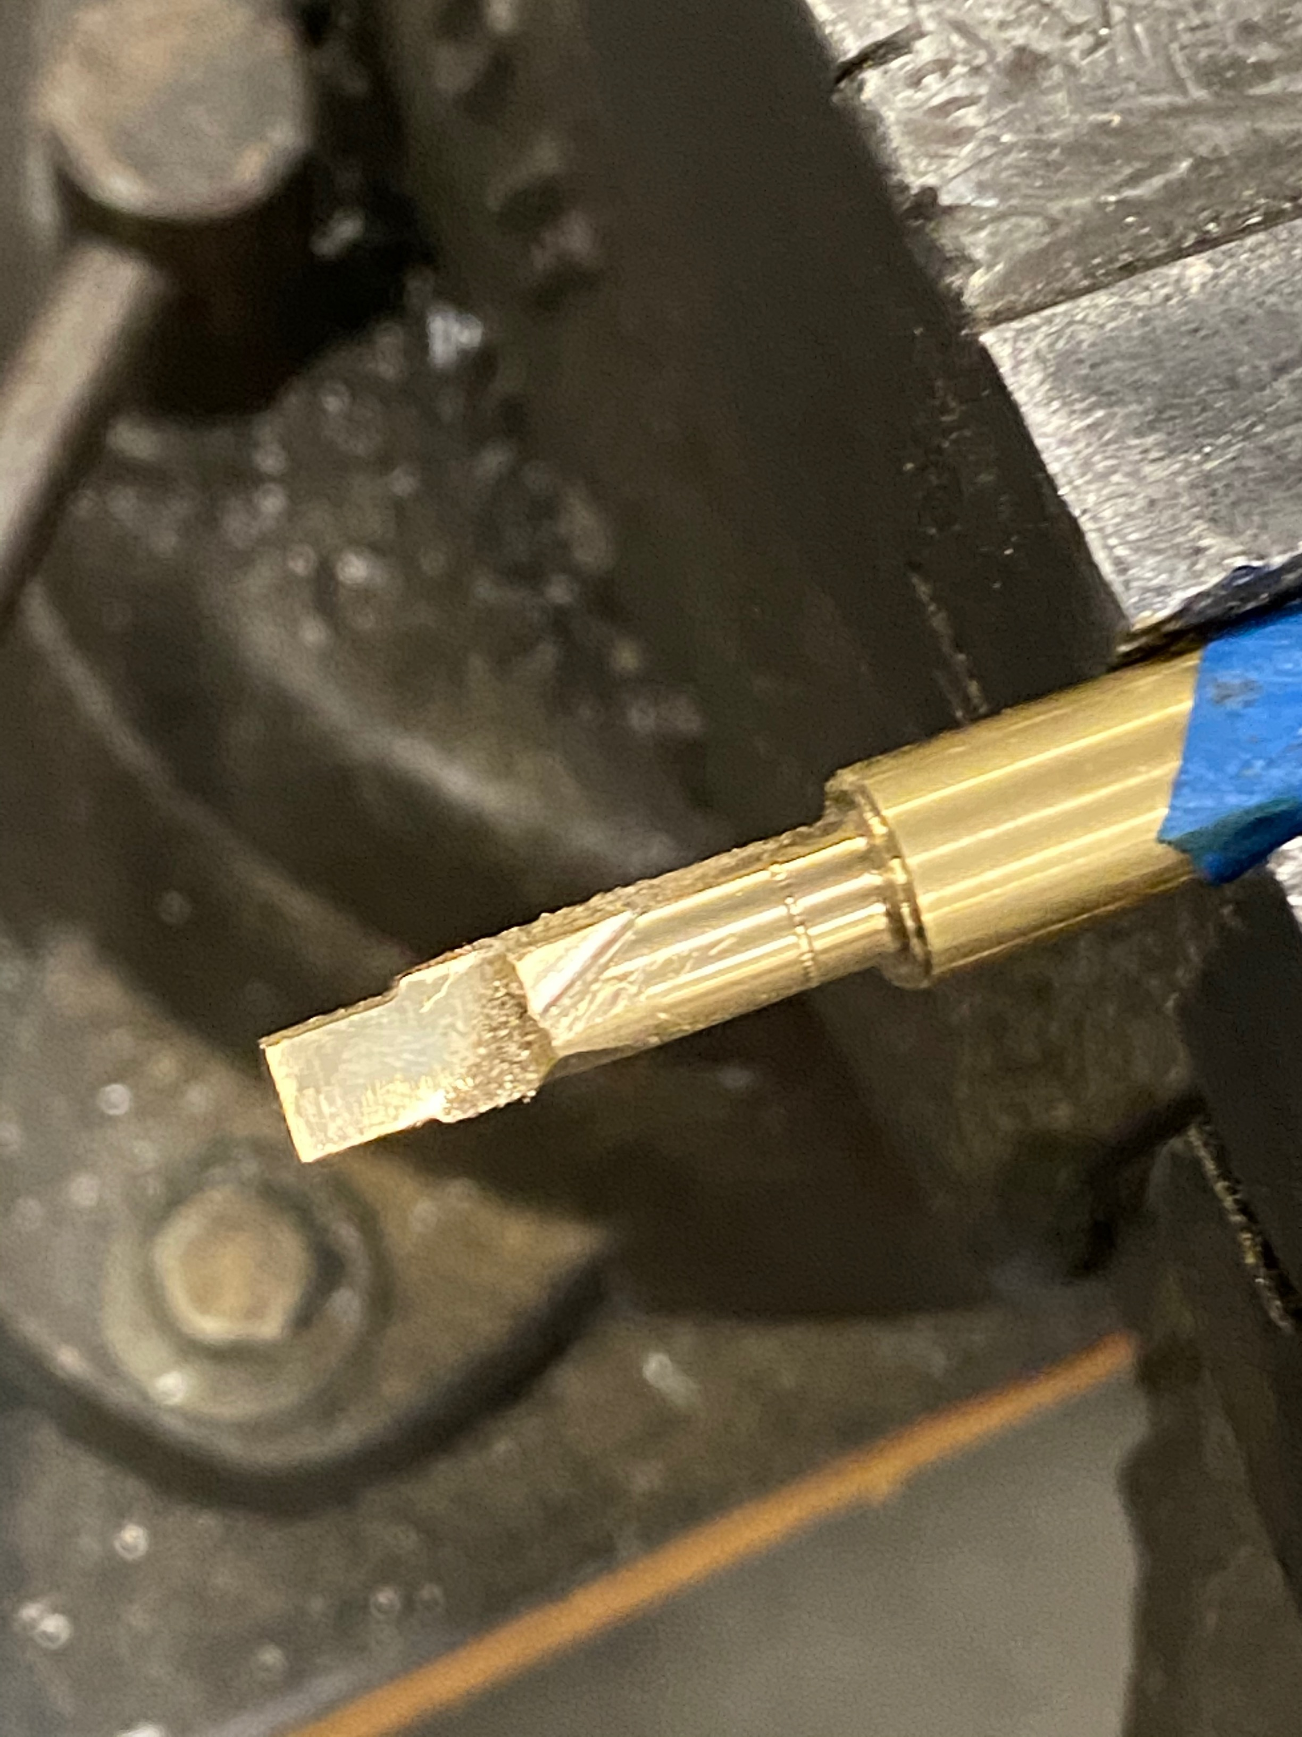
Manufacturing Cont.
NAU Machine Shop Pin Manufacturing
Created brass pin manually due to unique design
Multiple cross sections
  Circular
  Elliptical
Angled passage
Figure 33 (a) and (b): Using the lathe
Figure 34: Manufactured pin
Figure 35: pin lathe work

Slide 25
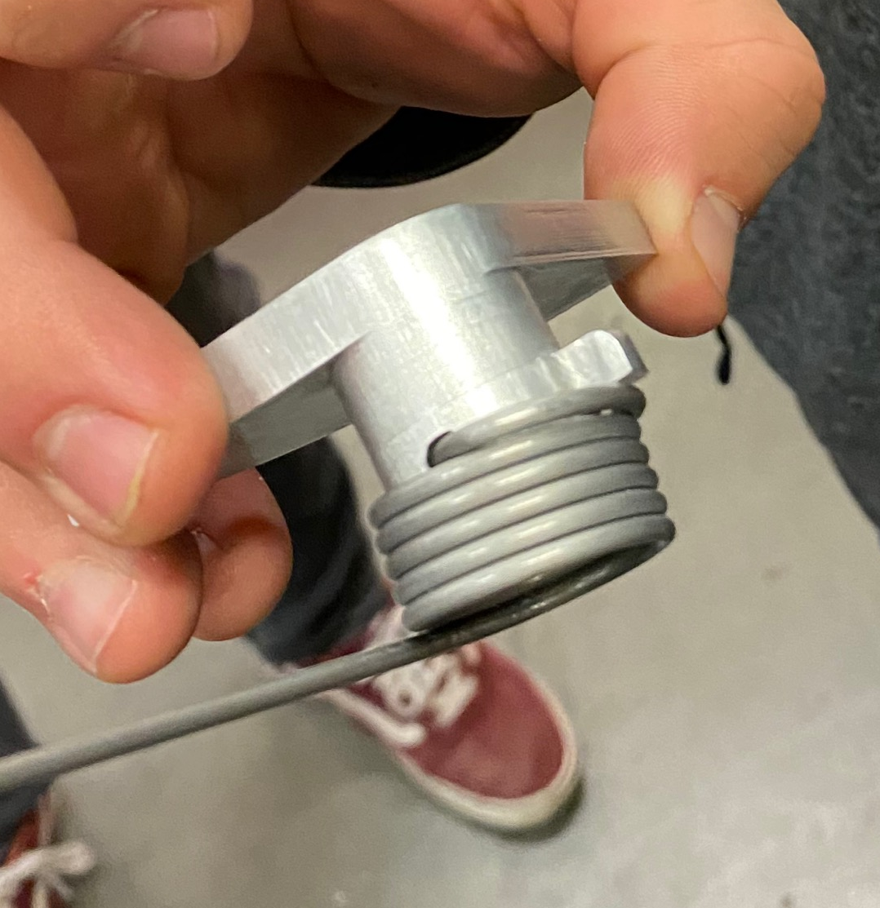
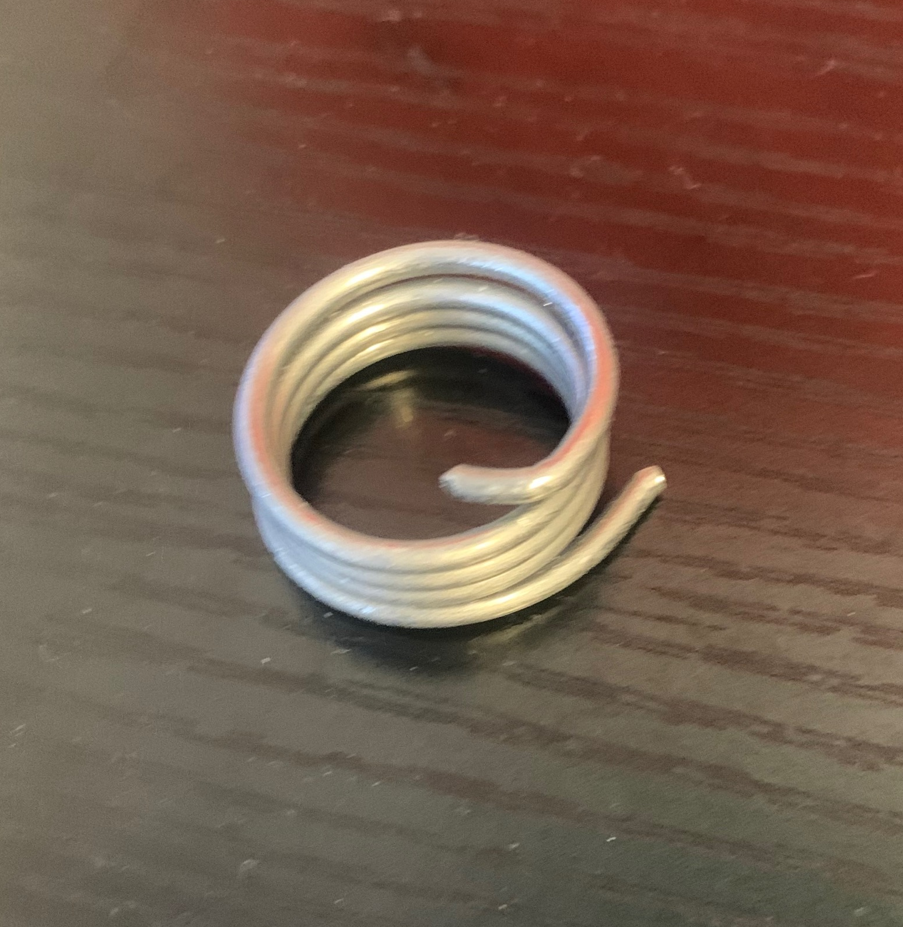
Torsion Spring Design
Tail end press fit into shaft
Excessive torque causes plates to shift
New analysis conducted to lower torque specs
Figure 37: Torsion Spring Mounted To Shaft
Figure 36: Torsion Spring

Slide 26
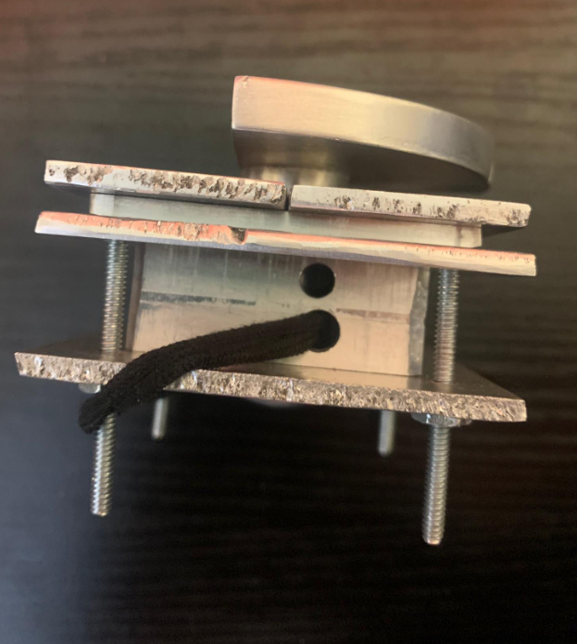
Torsion Spring and Rubber Band
Torsions springs ordered were too large for our device, replaced the elastic potential energy with a rubber band.
Small holes were drilled in the side of the device to allow for the rubber band to be attached.
Torsion spring redesign needed to fit into housing
Figure 38: Full latching system with rubber band adjustment

Slide 27
Torsion Spring Analysis
Table 7: Torsion Spring Dimensions
Table 8: Torsion Spring Design
Torsion Spring Parameters
Wire Material | Music Wire ASTM A228
A [kpsi*in^m] | 201
m | 0.145
Wire diameter [in] | 0.059
Outside Diameter [in] | 0.939
# of Coils | 8.5
Pin Diameter [in] | 0.8
Leg Length #1 [in] | 0.5
Leg Length #2 [in] | 0.4
Torsion Spring Design Parameters
Sut [kpsi] | 302.986
Sy [kpsi] | 236.329
Mean Coil Diameter [in] | 0.880
Spring Index | 14.915
Stress-Correction Factor | 1.053
Max Torque [lbf*in] | 4.527
Max Bending Stress [kpsi] | 236.329
# of Turns of Coil Body | 1.059
Loaded Clearance [in] | 0.076

Slide 28
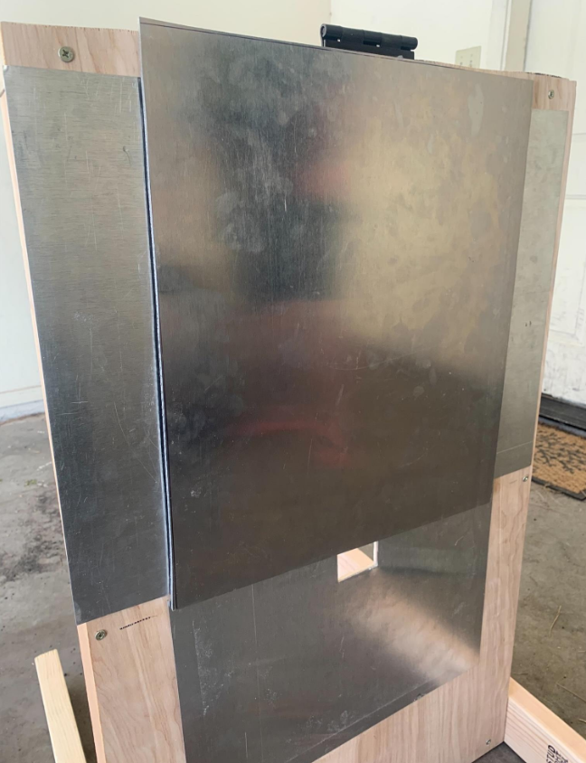
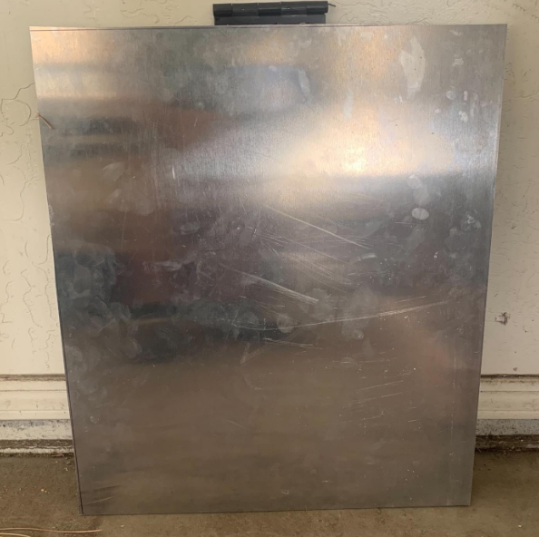
Testing Jig
Wooden frame constructed with Home Depot supplies.
  Used to simulate the exterior of rocket for full scale testing
  Designed to be constructed with 2x4’s and aluminum sheets
  1/8" Aluminum door for testing
Figure 39: Aluminum door
Figure 40: Assembled jig.

Slide 29
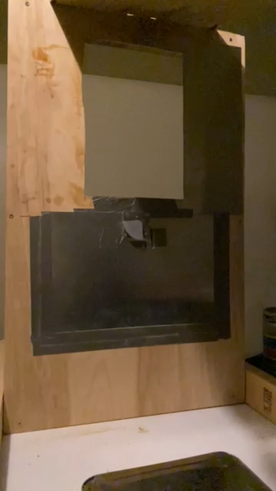
Functional Testing
Procedure
  Full latch system assembly installed into the "fairing"
  Attached wooden door to the jig to swing and hit the pin fully
  Added weight
  Door started at 90 degrees, then dropped without additional forces
  Zero interactions
Figure 41: Oven for Heat Test

Slide 30
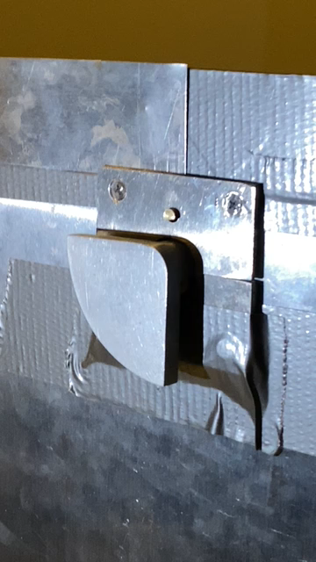
Functional Testing Cont.
Activates every time
  Lighter door
  Weaker torsion force
Holds door with minimal extra space
  Chatter concern
No Velcro implemented thus far
  Fast despite bounce we saw without latch system
Pin reset design functions
  Easily rotates and works consistently
Figure 42: Function Test

Slide 31
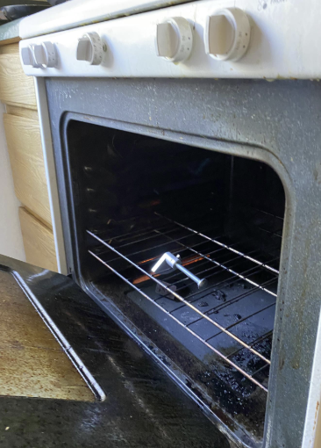
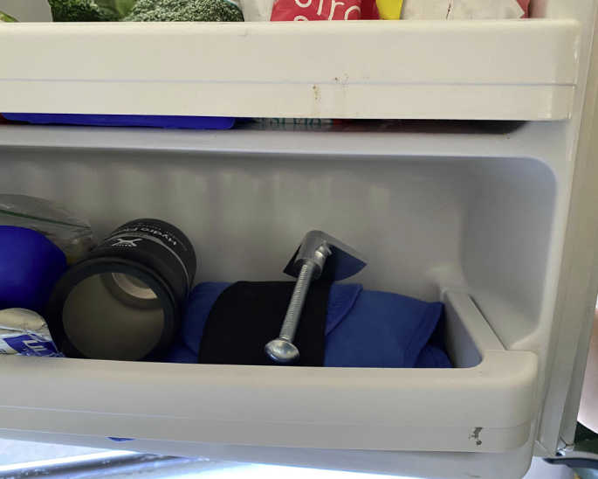
Thermal Test
Temperature test is to check functionality between the threading of the shaft and bolt assembly at various temperatures.
Procedure
Assemble the mock latch, bolt and screw.
Freeze the assembly for 2-3 hours and remove.
Try to see if the mechanism works as intended.
After, place assembly into an oven to drastically heat it.
Again, see if the mechanism works as intended.
Results
Little to no change in parts.
Everything functioned properly.
Figure 44: Oven for Heat Test
Figure 43: Freeze for Heat Test

Slide 32
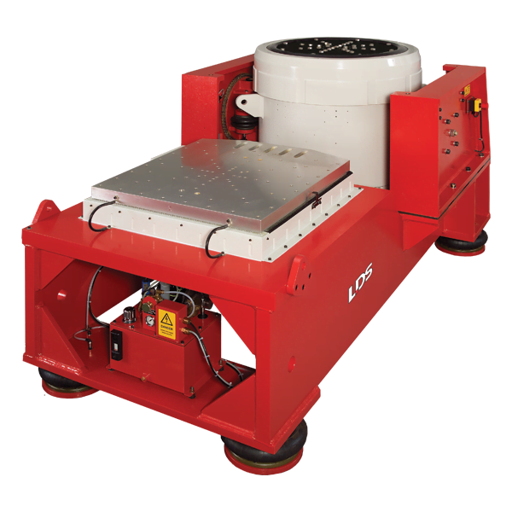
Vibration Testing
Test configuration: 24 Gs for 9 secs.
Product qualification, durability, and reliability via bouncing.
Options
  Lake Mary Rd off roading
  NAU Shaker table
  Hitting door with a hammer
Figure 45: Vibration Test Table.
Notes:
From tall building drops
If we can get to the 24Gs then maybe at the machines max, or one that matches the frequency in such a way that it will be comparable. In scale
Sound profile to get relatively close to simulate launch-induced vibration
Frequency ranges
Force rating and stroke

Slide 33
Section 4:
Future Work & Budget

Slide 34
Bill of Materials
Table 9: Bill of Materials
Part | Material | Description | Quantity | Unit Cost ($)
Aluminum Stock | Aluminum 7075 T7 | 12”x12”x2" | 1 | 313.34
Compression Spring | Music Wire ASTM A228 | 0.1x.75” | 1 | 1
Torsion Spring | 302 Stainless Wire | 1.131”x6 coils | 1 | 63.48
Steel Bolt | Zinc coated Stainless Steel | 3/8”x1” | 1 | 4
Steel Bolt & Nut | Zinc coated Stainless Steel | 1/8”x1” | 4 | 30
 |  |  | Total | 411.82

Slide 35
Budget
Table 10: Budget Planning
Material | Date | Price ($)
Aluminum 12x12x2" | 1/16/2021 | 313.34
Torsion Springs | 1/29/2021 | 63.48
Machine Shop Tooling | 2/17/2021 | 778.36
1/8" aluminum plate | 3/1/2021 | 54.66
Wood / Power tools | 3/5/2021 | 210.76
Resin / Aluminum Door | 3/23/2021 | 216.11
Saw / Aluminum Sheets | 3/20/2021 | 63.28
Nuts / Washers / Bolts | 3/29/2021 | 29.27
Pin from Xometry | 3/31/2021 | 118.88
 | Total | 1,848.14
 | Price ($)
Total Budget | 8,000
Total Spent | 1,848.16
Left Over | 6,151.86
Could have been less conservative with purchases

Slide 36
References
[1] “Antares Rocket,” Northrop Grumman. [Online]. Available: https://www.northropgrumman.com/space/antares-rocket/. [Accessed: 19-Sep- 2020].
[2] “Northrop Grumman Cargo Launch to the Space Station from NASA Wallops - YouTube.” [Online]. Available: https://www.youtube.com/watch?v=tQW_2qtBDfY. [Accessed: 12- Oct-2020].
[3] “Pegasus Rocket – Northrop Grumman.” [Online]. Available: https://www.northropgrumman.com/space/pegasus-rocket/. [Accessed: 17-Oct-2020].
[4] ASM Material Data Sheet. [Online]. Available: http://asm.matweb.com/search/SpecificMaterial.asp?bassnum=MQ304A [Accessed: 12-Nov-2020].
[5] Budynas, Richard G, J K. Nisbett, and Joseph E. Shigley. Shigley's Mechanical Engineering Design. New York: McGraw-Hill, 2011. Print.
[6] “Definitive Guide to Tormach Hacks, Upgrades, and Modifications.” [Online]. Available: https://www.cnccookbook.com/tormach-upgrades-hacks-modifications/. [Accessed: 11-Nov-2020].
[7] “(6) Protolabs: Overview | LinkedIn.” [Online]. Available: https://www.linkedin.com/company/proto-labs/. [Accessed: 11-Nov-2020].
[8] “Aluminum Honeycomb Panels,” McMaster-Carr. [Online]. Available: https://www.mcmaster.com/aluminum-honeycomb-panels/. [Accessed: 11-Oct-2020].
[9] “Aluminum stock” MetalsDepot. [Online]. Available: https://www.metalsdepot.com/aluminum-products/aluminum-square-bar.
[Accessed: 11-Oct-2020].
[10] MetalsDepot® - T304 Stainless Steel Square Bar. [Online]. Available: https://www.metalsdepot.com/stainless-steel-products/stainless-steel-square [Accessed: 11-Nov-2020].
[11] 7075 Aluminum: Get to Know its Properties and Uses [Online]. Available:https://www.gabrian.com/7075-aluminum-properties/ [Accessed: 23-Feb-2021]
[12] Materials engineering. (2012, June 02). Retrieved February 24, 2021, from http://www.substech.com/dokuwiki/doku.php?id=stainless_steel_aisi_304

Slide 38
Appendix A: ESD Information
Electrostatic Discharge is created by rubbing insulative materials against another, cause electrons to build up in on material.
Electron buildup can cause sudden charges to arc across materials and potentially damage sensitive electronics.
This is avoided when using conductive materials attached to a ground.
In the current design, all parts are made of conductive metals, and all parts have electrical paths to the fairing, which is used as the ground.

Slide 39
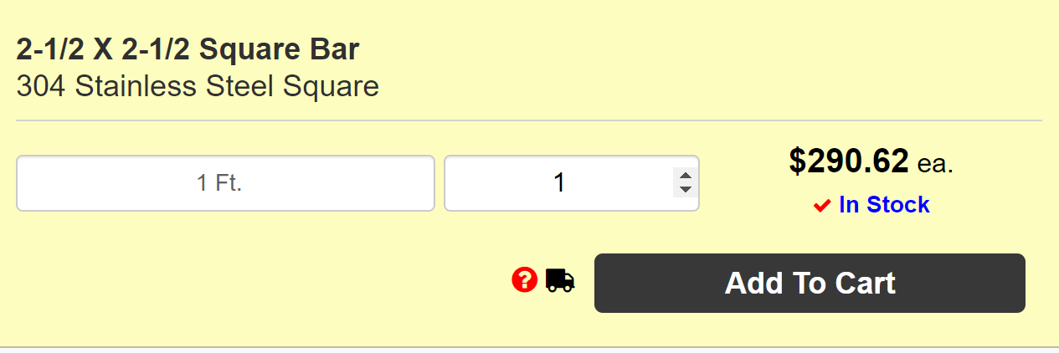
Appendix B: BOM
BOM

Slide 40
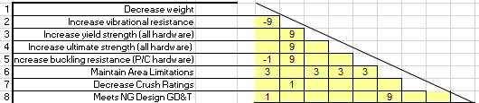

Appendix C: QFD
Legend
9 | Strong relation
3 | moderate
1 | weak
(blank) | none

Slide 41



Appendix D: Old Thickness of Latch Analysis
Table 9: Latch Analysis [7]
Latch Thickness= .3in
Factor of Safety, Yield = 1.65
Factor of Safety, Ultimate= 3.89
AISI 304 Stainless Steel
Tensile Strength, Yeild
31,200 psi
Tensile Strength, Ult
73,200psi
Estimated Door conditions |  |  | Latch Dimensions |  |  | Calculations
Width | 10 | in | a | 0.15 | in | Deflection | -2.262E-05 | in
Hight | 14 | in | b | 0.95 | in | Moment | 157.5 | lb-in
Pressure | 7.5 | psi | width | 0.8 | in | Shear | 1050 | lb
 |  |  | thickness | 0.3 | in | Normal Stress | 1312.5 | psi
Force | 1050 | lb | E | 29,000 | ksi | Bending Stress | 17500 | psi
Surface area | 0.8 | in^2 | I | 0.0018 | in^4 | Total Stress | 18812.5 | psi
Figure 49: Cantilever Beam Representing Latch
Figure 17: Rubber Bumper

Slide 42




Appendix E: Torsion Spring Analysis
Torsion Spring Parameters
Wire Material | Music Wire ASTM A228
A [kpsi*in^m] | 201
m | 0.145
Wire diameter [in] | 0.08
Outside Diameter [in] | 0.98
# of Coils | 4
Pin Diameter [in] | 0.8
Leg Length #1 [in] | 0.5
Leg Length #2 [in] | 0.4
Figure 52: Torsion Spring [8]
σ = bending stress
Ki = internal stress correction factor
C = spring index
Nb = # of coils
D’ = coil diameter under load
$${θ′}_{c}=angular deflection$$
D = mean coil diameter
d = wire diameter
F = tangential force
r = radius
Torsion Spring Design Parameters
Sut [kpsi] | 289.900
Sy [kpsi] | 226.122
Mean Coil Diameter [in] | 0.900
Spring Index | 11.250
Stress-Correction Factor | 1.071
Max Torque [lbf*in] | 10.613
Max Bending Stress [kpsi] | 226.122
# of Turns of Coil Body | 0.353
Loaded Clearance [in] | 0.053

Slide 43


Appendix F: Concept Evaluation
Table 6: Pugh Chart
Selection Criteria | Weight | DATUM | Concepts
 |  |  | 1 | 2 | 3 | 4
Ease/Safety of Installation | 7 |  | - | S | - | -
Scalable | 8 |  | S | S | S | +
Reopenable | 4 |  | - | S | S | S
Withstand Pressure Differential | 10 |  | + | + | + | +
No contaminates | 8 |  | - | S | S | +
Does not use gravity | 6 |  | - | S | S | S
Activates on launch | 10 |  | S | S | S | S
Does not interfere with nearby systems | 9 |  | - | S | + | S
Professionalism | 5 |  | S | S | S | S
Does not influence aerodynamics | 9 |  | - | S | + | -
ESD Safe | 7 |  | - | S | S | S
Indicates open/closed status | 1 |  | S | S | S | +
Total (+) |  |  | 1 | 1 | 3 | 4
Total (-) |  |  | 7 | 0 | 1 | 2
Overall Score |  |  | -6 | 1 | 2 | 2
Weighted Total (+) |  |  | 10 | 10 | 28 | 27
Figure 33: Datum Opened
Figure 34: Datum Closed
Notes:
Pugh chart to compare the 3 previous designs
Sliding /exterior /interior hinge/ twisting latch
Quantitative approach
Datum: current design used on the rocket

Slide 44
Concept Evaluation Cont.
Table 7: Decision Matrix
 |  | Sliding Door |  | Exterior Hinge |  | Interior Hinge |  | Twisting Latch
Criteria | Weight (%) | Score (1-10) | Weighted Score | Score (1-10) | Weighted Score | Score (1-10) | Weighted Score | Score (1-10) | Weighted Score
Safety Factor | 12 | 7 | 84 | 7 | 84 | 6 | 72 | 8 | 96
Vibrations | 16 | 8 | 128 | 7 | 112 | 4 | 64 | 7 | 112
Pressure Differential | 20 | 7 | 140 | 8 | 160 | 7 | 140 | 9 | 180
Budget | 8 | 3 | 24 | 9 | 72 | 7 | 56 | 9 | 72
Dimensions | 14 | 4 | 56 | 8 | 112 | 9 | 126 | 8 | 112
Weight | 10 | 2 | 20 | 9 | 90 | 7 | 70 | 9 | 90
Crush Rating of Design | 20 | 6 | 120 | 7 | 140 | 7 | 140 | 7 | 140
Totals | 100 |  | 572 |  | 770 |  | 668 |  | 802
Notes:
finalized a consensus on the criteria to analyze. Determined the weighted values (12 16 20 etc.)
then scored each design in a QUANTITATIVE manner in relation to
safety 1.6 Yield min, 2 for Ult, for metallic hardware. And composite: 2 ult min and 2.3 buckling min
vibrational effects 70Gs
pressure limitations considerations: 7.5psi in flight and 810psi compressive stress
Dimensions 203in^2 max
total cost/budget$8000
Feasibility to back up the decisions
Weak aspects...
Brainstormed how /if weak points could be improved
from our top 3 designs they ultimately were ranked x=1 y=2 z=3

Slide 45
Appendix G: Threads Analysis
Figure 52: Torsion Spring [8]
Variable Description | Variable | Value | Units
Alpha angle | 2a | 14.5000
Minor diameter | dr | 0.5000 | inches
Major diameter | d | 0.6250 | inches
Mean diameter | dm | 0.5625 | inches
Number of engaged threads | nt | 3.0000
Pitch | p | 0.1250 | inches
Lead | l | 0.1250 | inches
Force applied | F | 0.0000 | lbs
Coefficient of friction threaded pair-nut material | f | 0.1700 | (max)
Coefficient of friction thrust collar running | f_{c} | 0.0900 | (no)
Coefficient of friction thrust collar starting | f_{c} | 0.1500 | (yes)
Collar diameter max. | dc_max | 0.6300 | inches
Collar diameter min. | dc_min | 0.3500 | inches
Diameter of collar | dc | 0.4900 | inches
Torque required to raise | TR | 0.0000 | in*lbs
Torque required to lower | TL | 0.0000 | in*lbs

Slide 46


Appendix H: Additional Videos
Repeated action
Single

