Slide 1
Environmental Control System Door Redesign
Timothy Anderson, Andrea Hernandez, Sam Mangialardi, Alexander Soto, Jake West, Michael Wilson
CDR
Critical Design Review
February 26, 2021
Figure 1: Antares Rocket [1]

Slide 2
Outline
Section 1: Project Intro and Recap
Section 2: Action Items
Section 3: Manufacturing and Analyses
Section 4: Future Work and Budget

Slide 3
Section 1:
Project Introduction and Recap

Slide 4
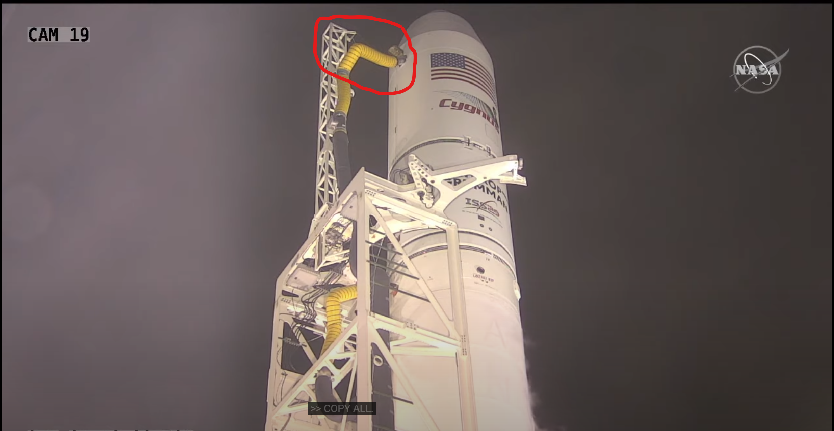
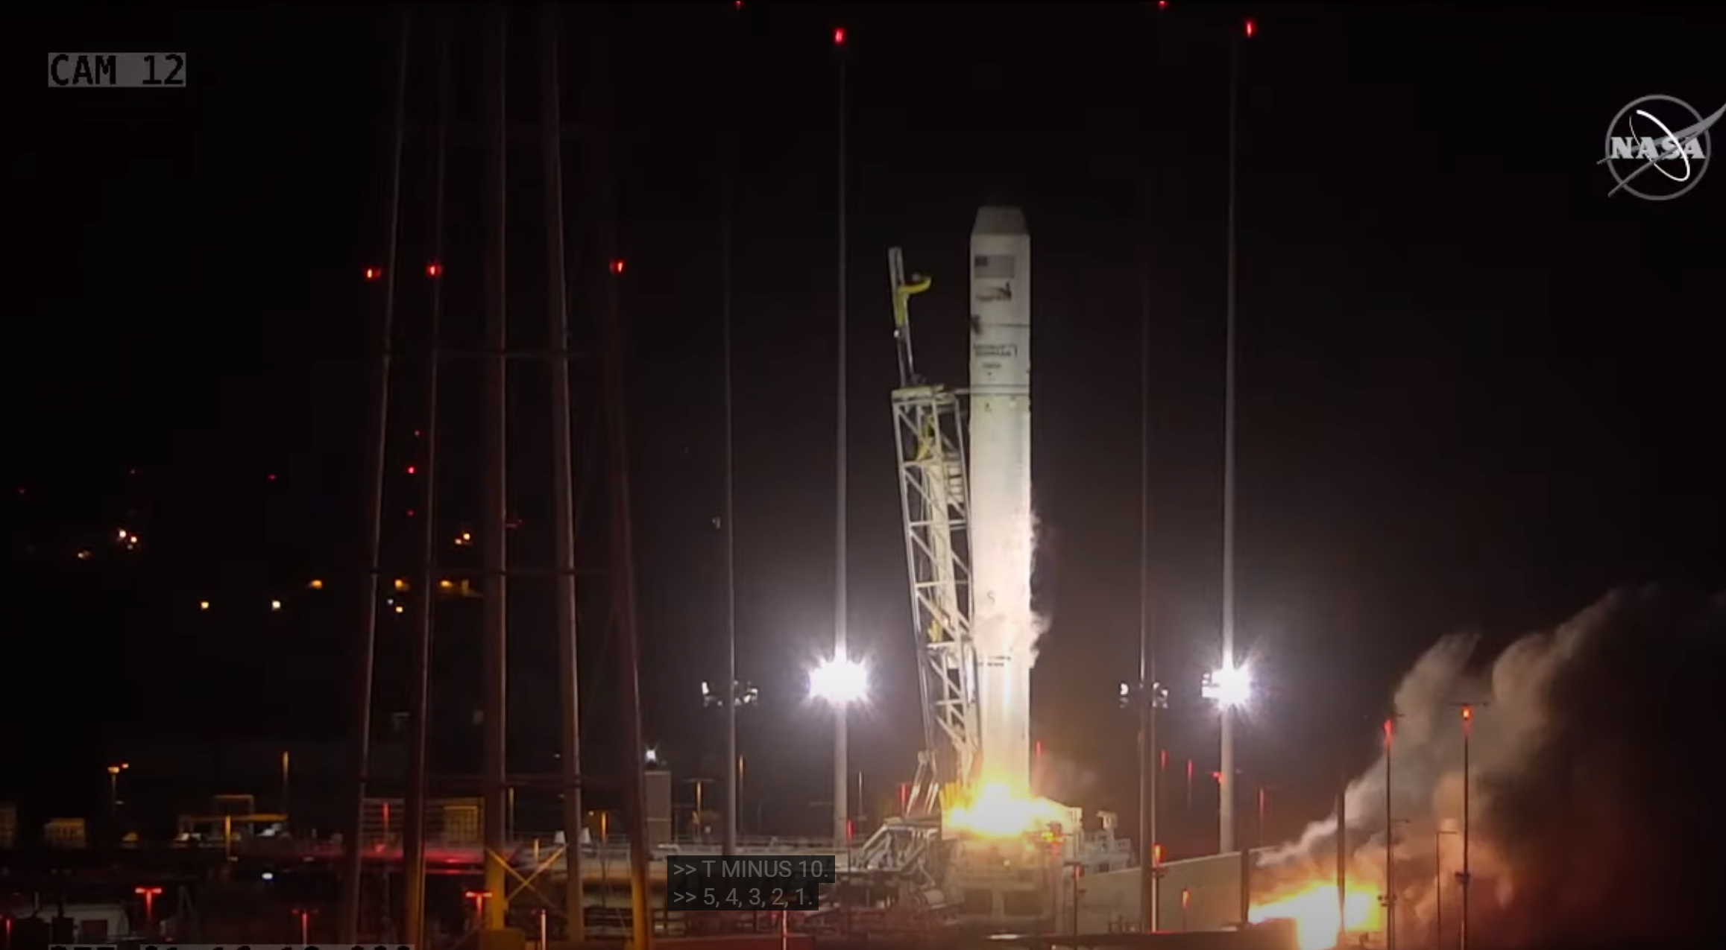
Project Intro
Sponsor: Northrop Grumman
Client: Daniel Johnson
Improve the latching system for the Antares rocket.
Our objective is to investigate potential failures of the door.
Excessive leakage of air could lead to potential failure. ​
A successful design could be implemented into other launch vehicles.
Figure 2: Nozzle in place [2]
Figure 3: Nozzle is removed [2]

Slide 5
Customer Requirements
Table 1: Rated Customer Requirements
# | Customer Requirement | Rating
1 | Ease/safety of installation | 7
2 | Scalable | 8
3 | Reopenable | 4
4 | Withstand pressure differential | 10
5 | No contaminates | 8
6 | Does not use gravity or acceleration | 6
7 | Activates on launch | 10
8 | Does not interfere with nearby systems | 9
9 | Professionalism | 5
10 | Does not influence aerodynamics | 9
11 | ESD safe | 7
12 | Indicates open/close status | 1
The level of importance was determined by a rating from 1-10. ​
Priority: ​
  Pressure differential ​
  Activates on launch characteristics​
  No interference with nearby systems​
Nice to have:​
  Indicate Open/Closed status.​
​

Slide 6
Engineering Requirements
Table 2: Listed Engineering Requirements
Provided by Northrop Grumman project proposal
High standard of design performance, reliability, durability, and safety
Quantitative Requirements
Engineering Requirement | Limiting Value
Safety Factor | Metallic: 1.6 yield and 2.0 for ultimate Plastic or composite: 2.0 ultimate and 2.3 for buckling
Vibrations | 24 Gs for 9 secs
Pressure differential | 7.5 psi
Budget | $8,000
Dimensions | Inlet Area: 203 in^2
Weight | 5 lbm
Pressure Limit on Fairing | 810 psi

Slide 7
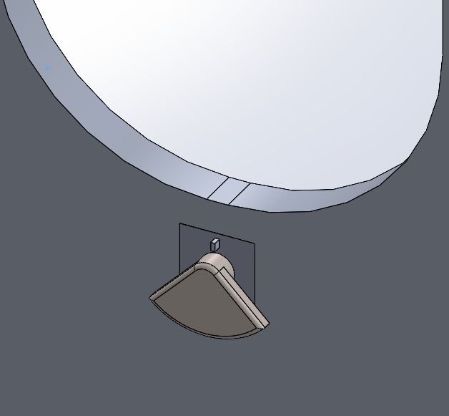
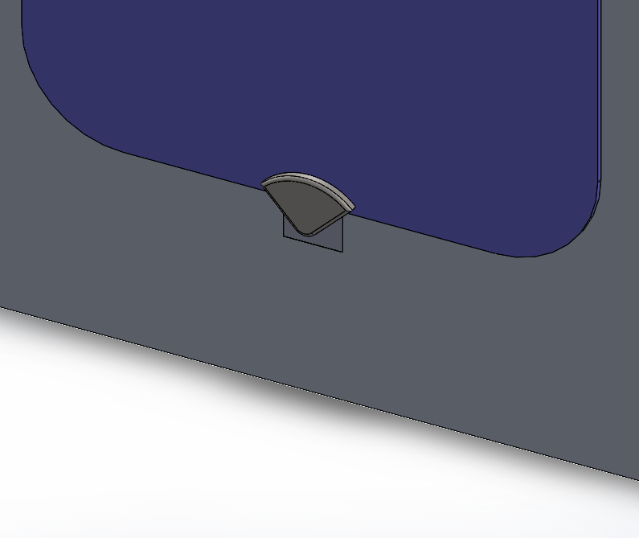
Original Twisting Latch Design
Uses exterior hinge design, with a solid aluminum door.
Latching system activates as the door hits the fairing.
Latch twists 180 degrees until it locks down the door to the fairing.
The design can be reopenable by hand, by turning the latch counterclockwise with enough force to overcome the torsion spring.
Figure 4: (a) Open Door View
(b) Closed Door View

Slide 8
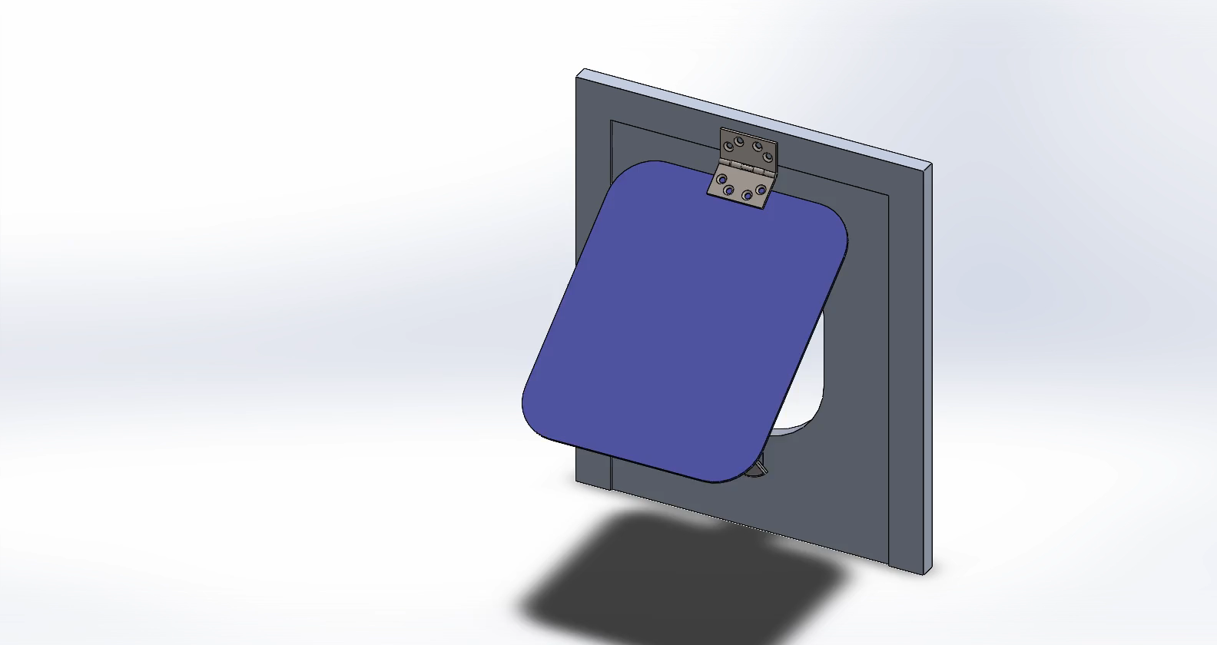
Full System Activation
Figure 5: Animation

Slide 9

Latching System Activation
Figure 6: Interior Animation

Slide 10
Section 2:
Action Items and Design Changes

Slide 11
Action Items
Door activates above the latch
Material change to 7075 T73 Aluminum
Round pin vs Square pin
Decrease weight / dimensions
Scalability of the device
Effects of Thermal Expansion?
Idea of an internal latch
Damage to the device after activation

Slide 12
Design For Manufacturing & Assembly
Standard sizing
Bolts
Pin radius
Removing or Adding fillets
  Manually apply after to reduce overall cost.
  Prevent shearing.
Decreasing parts
Pin was redesigned versus adding parts.
Open and no complex tools required

Slide 13
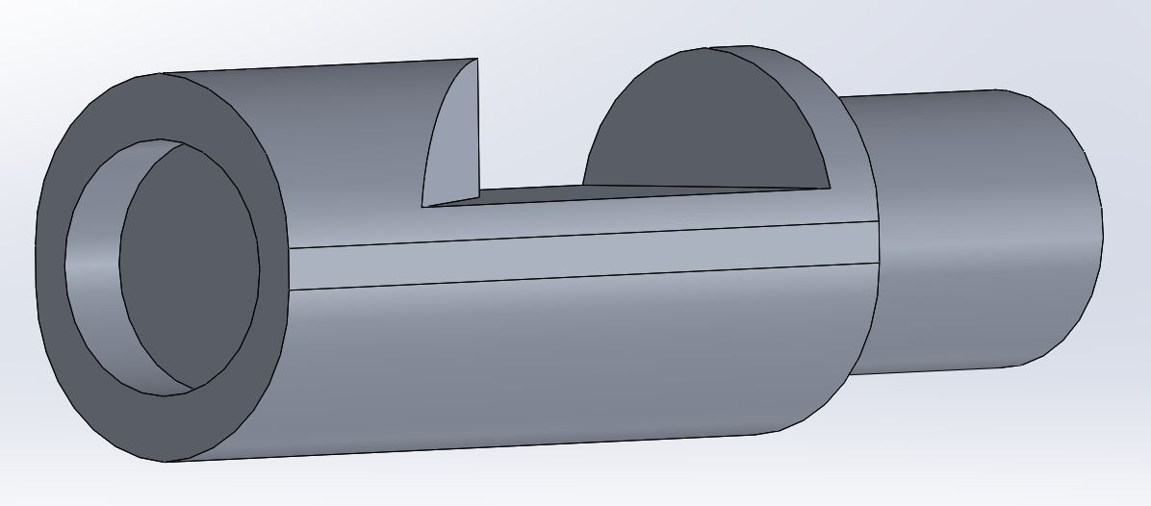
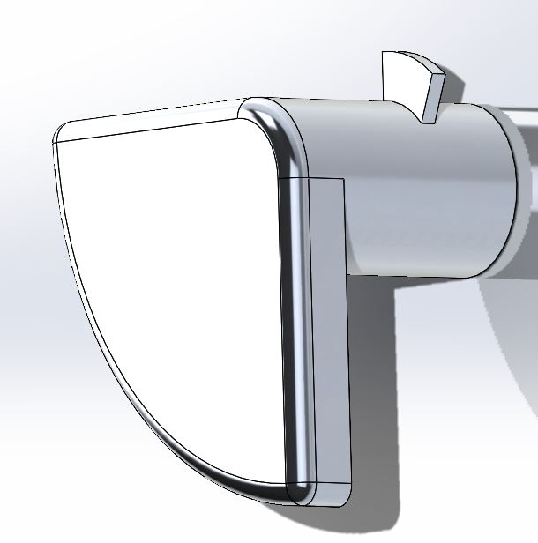
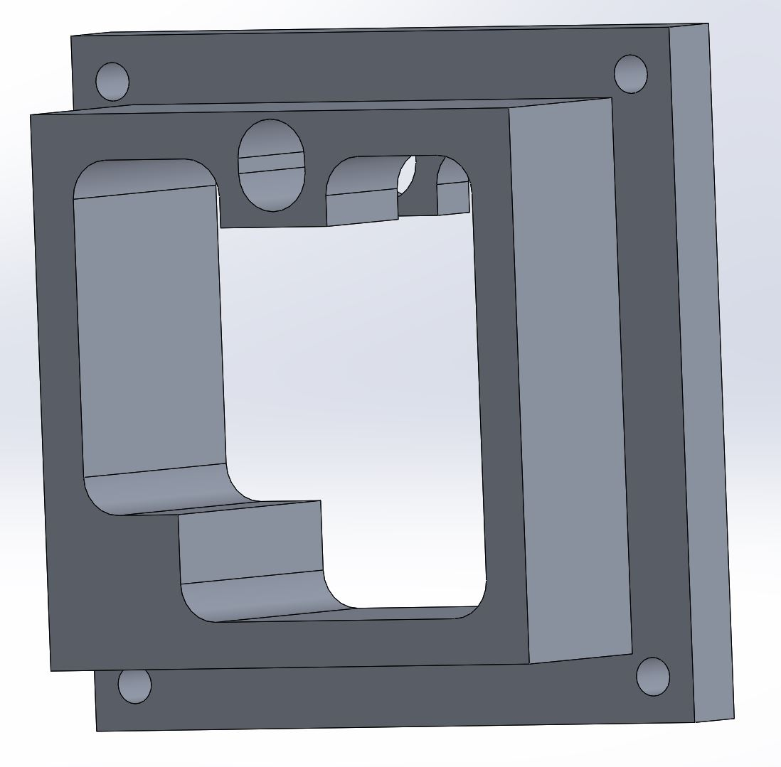
Pin and Housing Changes
Pin
Circular vs rectangular.
  0.125in radius.
  Not perfect circle.
Multiple cross sections.
Angled passage .
Housing
Squared .
Pin housing extrusion increased.
Extrusion repositioned, reshaped.
4ct bolts.
Figure 7: Pin design.
Figure 8: Shaft extrusion tab.
Figure 9: Housing design.

Slide 14
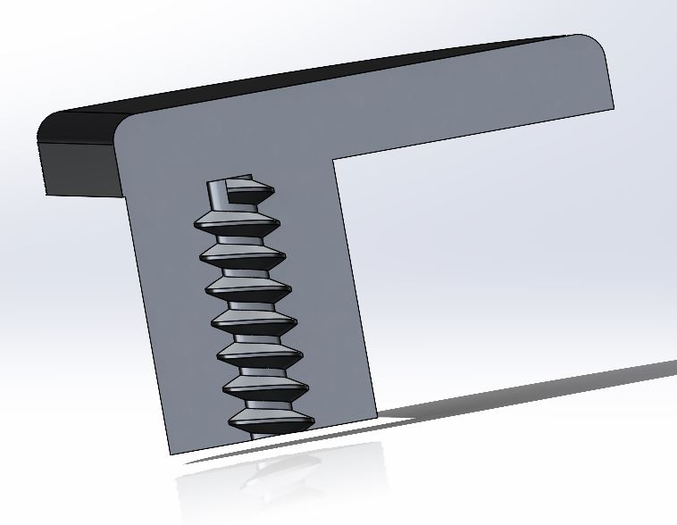
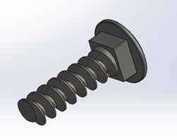
Threads and Bolt Changes
Figure 10: Shaft with thread design
Figure 11: Bolt design
1/8in to 3/8in size change
Lenth increased due to adjustable housing
Heli coils or keenserts
Steel to zinc plated steel
Length increased due to adjustable housing
Notes:
Changed the threads to accomadate new bolt dimentions
The bolt change stemed from us trying to find that bolt size easily, rather than special design.order it
WE changed it and parts as needed.

Slide 15
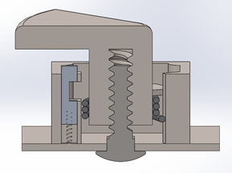
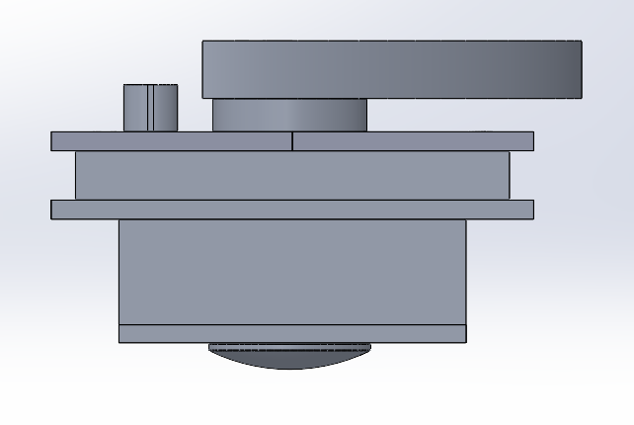
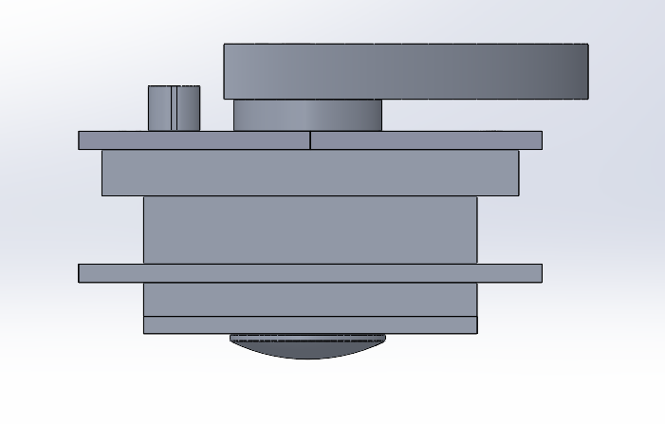
Scalability Changes
Sandwich Plate added
Used to clamp the device to the fairing
Uses bolts to secure the sandwich plate to the housing
Figure 12: Old design
Figure 13: New Design

Slide 16
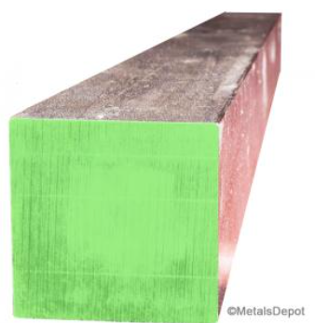
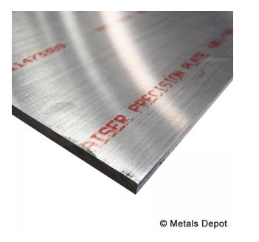
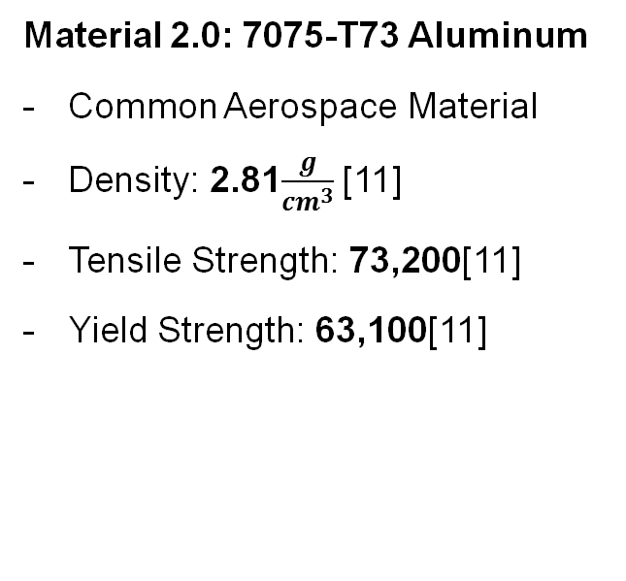
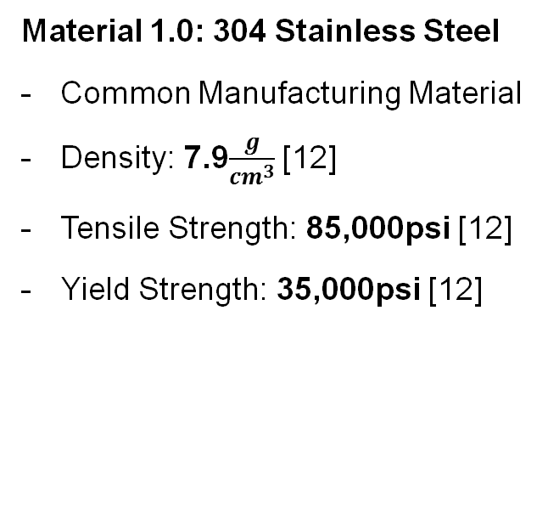
Change in Material
Material 1.0: 304 Stainless Steel
Common Manufacturing Material
Density: 7.9$\frac{g}{{cm}^{3}}$ [12]
Tensile Strength: 85,000psi [12]
Yield Strength: 35,000psi [12]
Material 2.0: 7075-T73 Aluminum
Common Aerospace Material
Density: 2.81$\frac{g}{{cm}^{3}}$ [11]
Tensile Strength: 73,200[11]
Yield Strength: 63,100[11]
Figure 14: AISI 304 Stainless Steel
Figure 15: 7075-T73 Aluminum

Slide 17
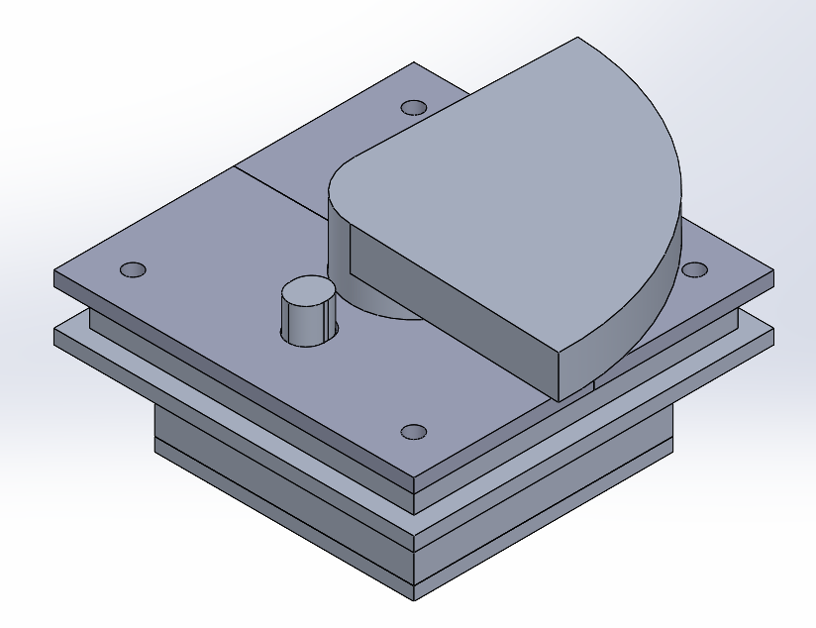
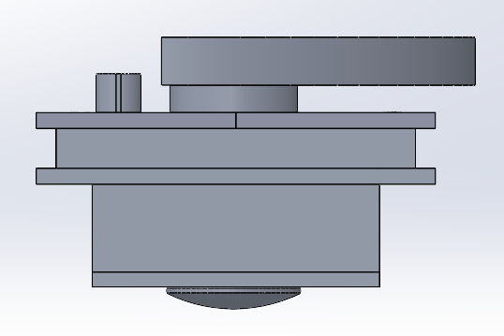
Final Design
The design allows for use in multiple fairing sizes.
Faster activation than previous design, due to stronger torsion spring and orientation.
Figure 16: Iso View Of Final Design
Figure 17: Side View

Slide 18
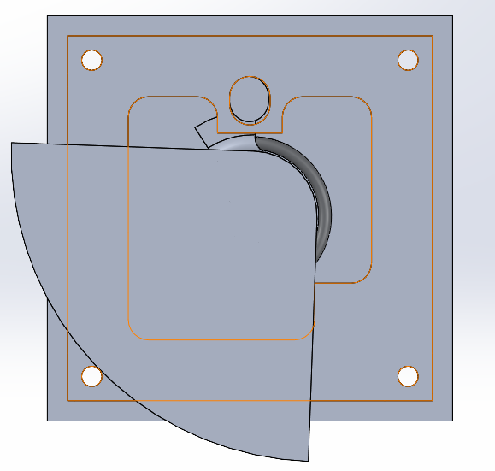
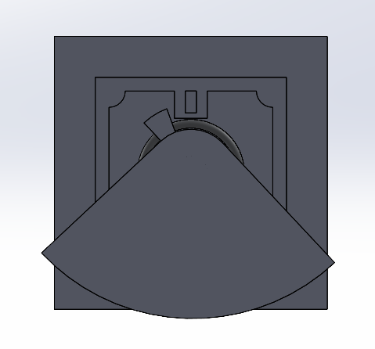
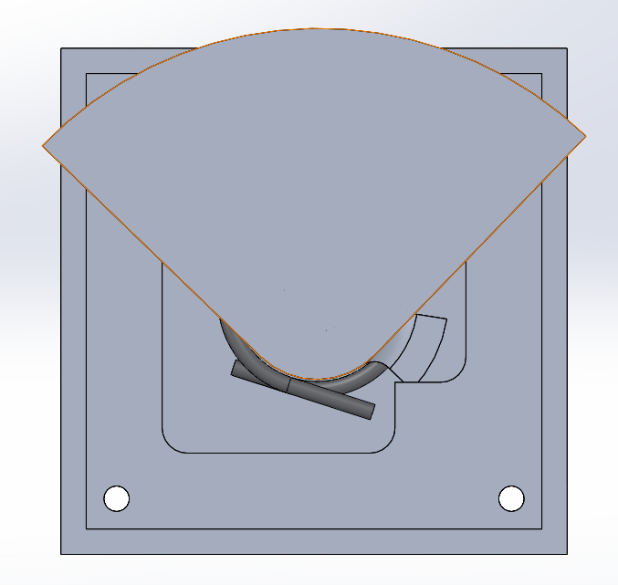
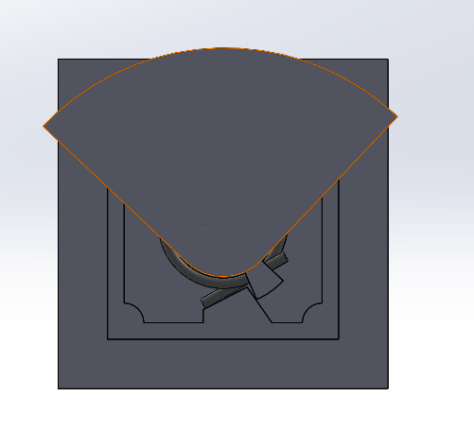
Design Orientation Change
Figure 18: New Design Orientation
Figure 19: Old Design Orientation

Slide 19
Section 3:
Manufacturing and Analyses

Slide 20
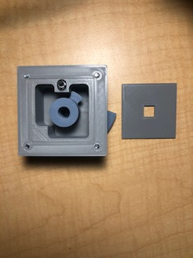
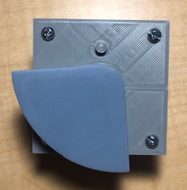
3D Printed Proof Of Concept
Printed with PLA and Photopolymer Resin.
Tolerance of +- 0.01 in.
Fully functional movement.
Figure 20: Front of Prototype
Figure 21: Back of Prototype

Slide 21
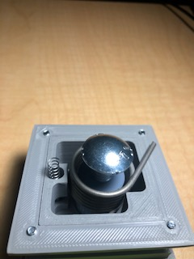
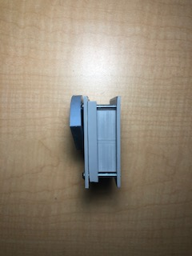
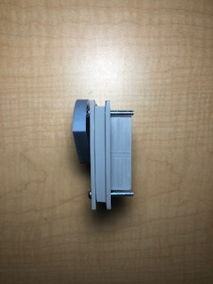
3D Printed Proof Of Concept Cont.
Figure 22: Scalability Comparison of Prototype
Figure 23: Internal Components of Prototype

Slide 22
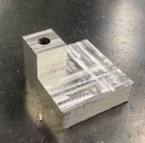
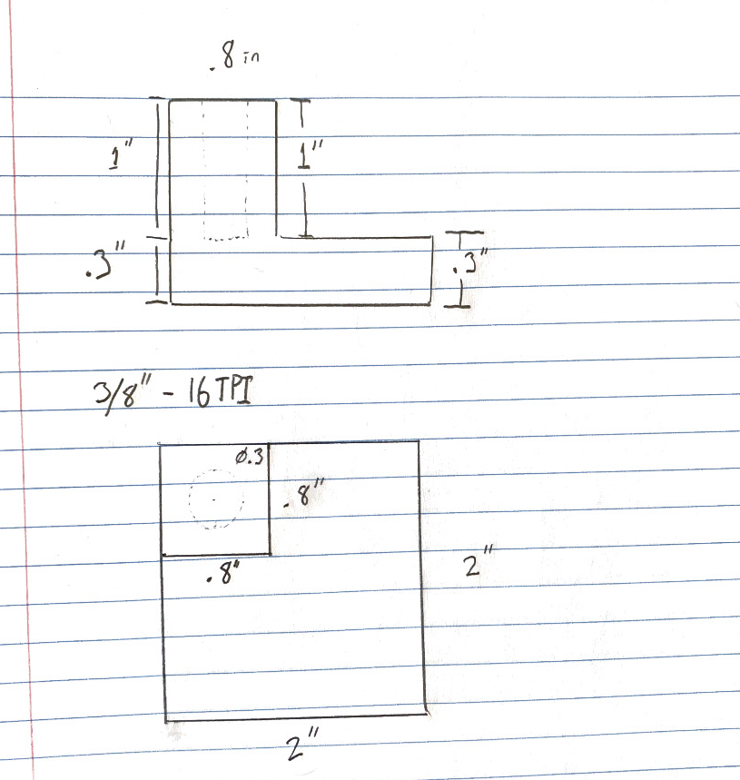
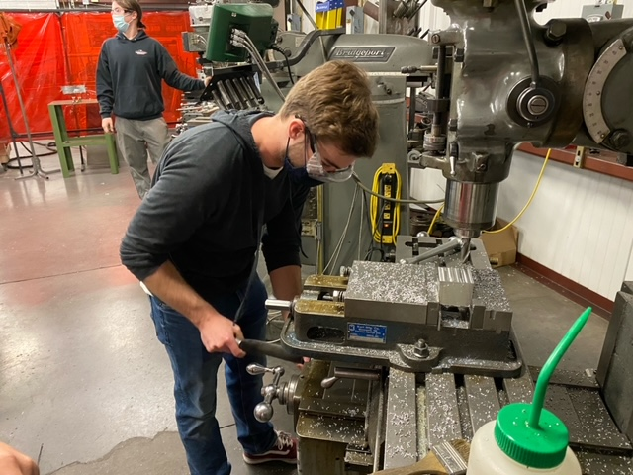
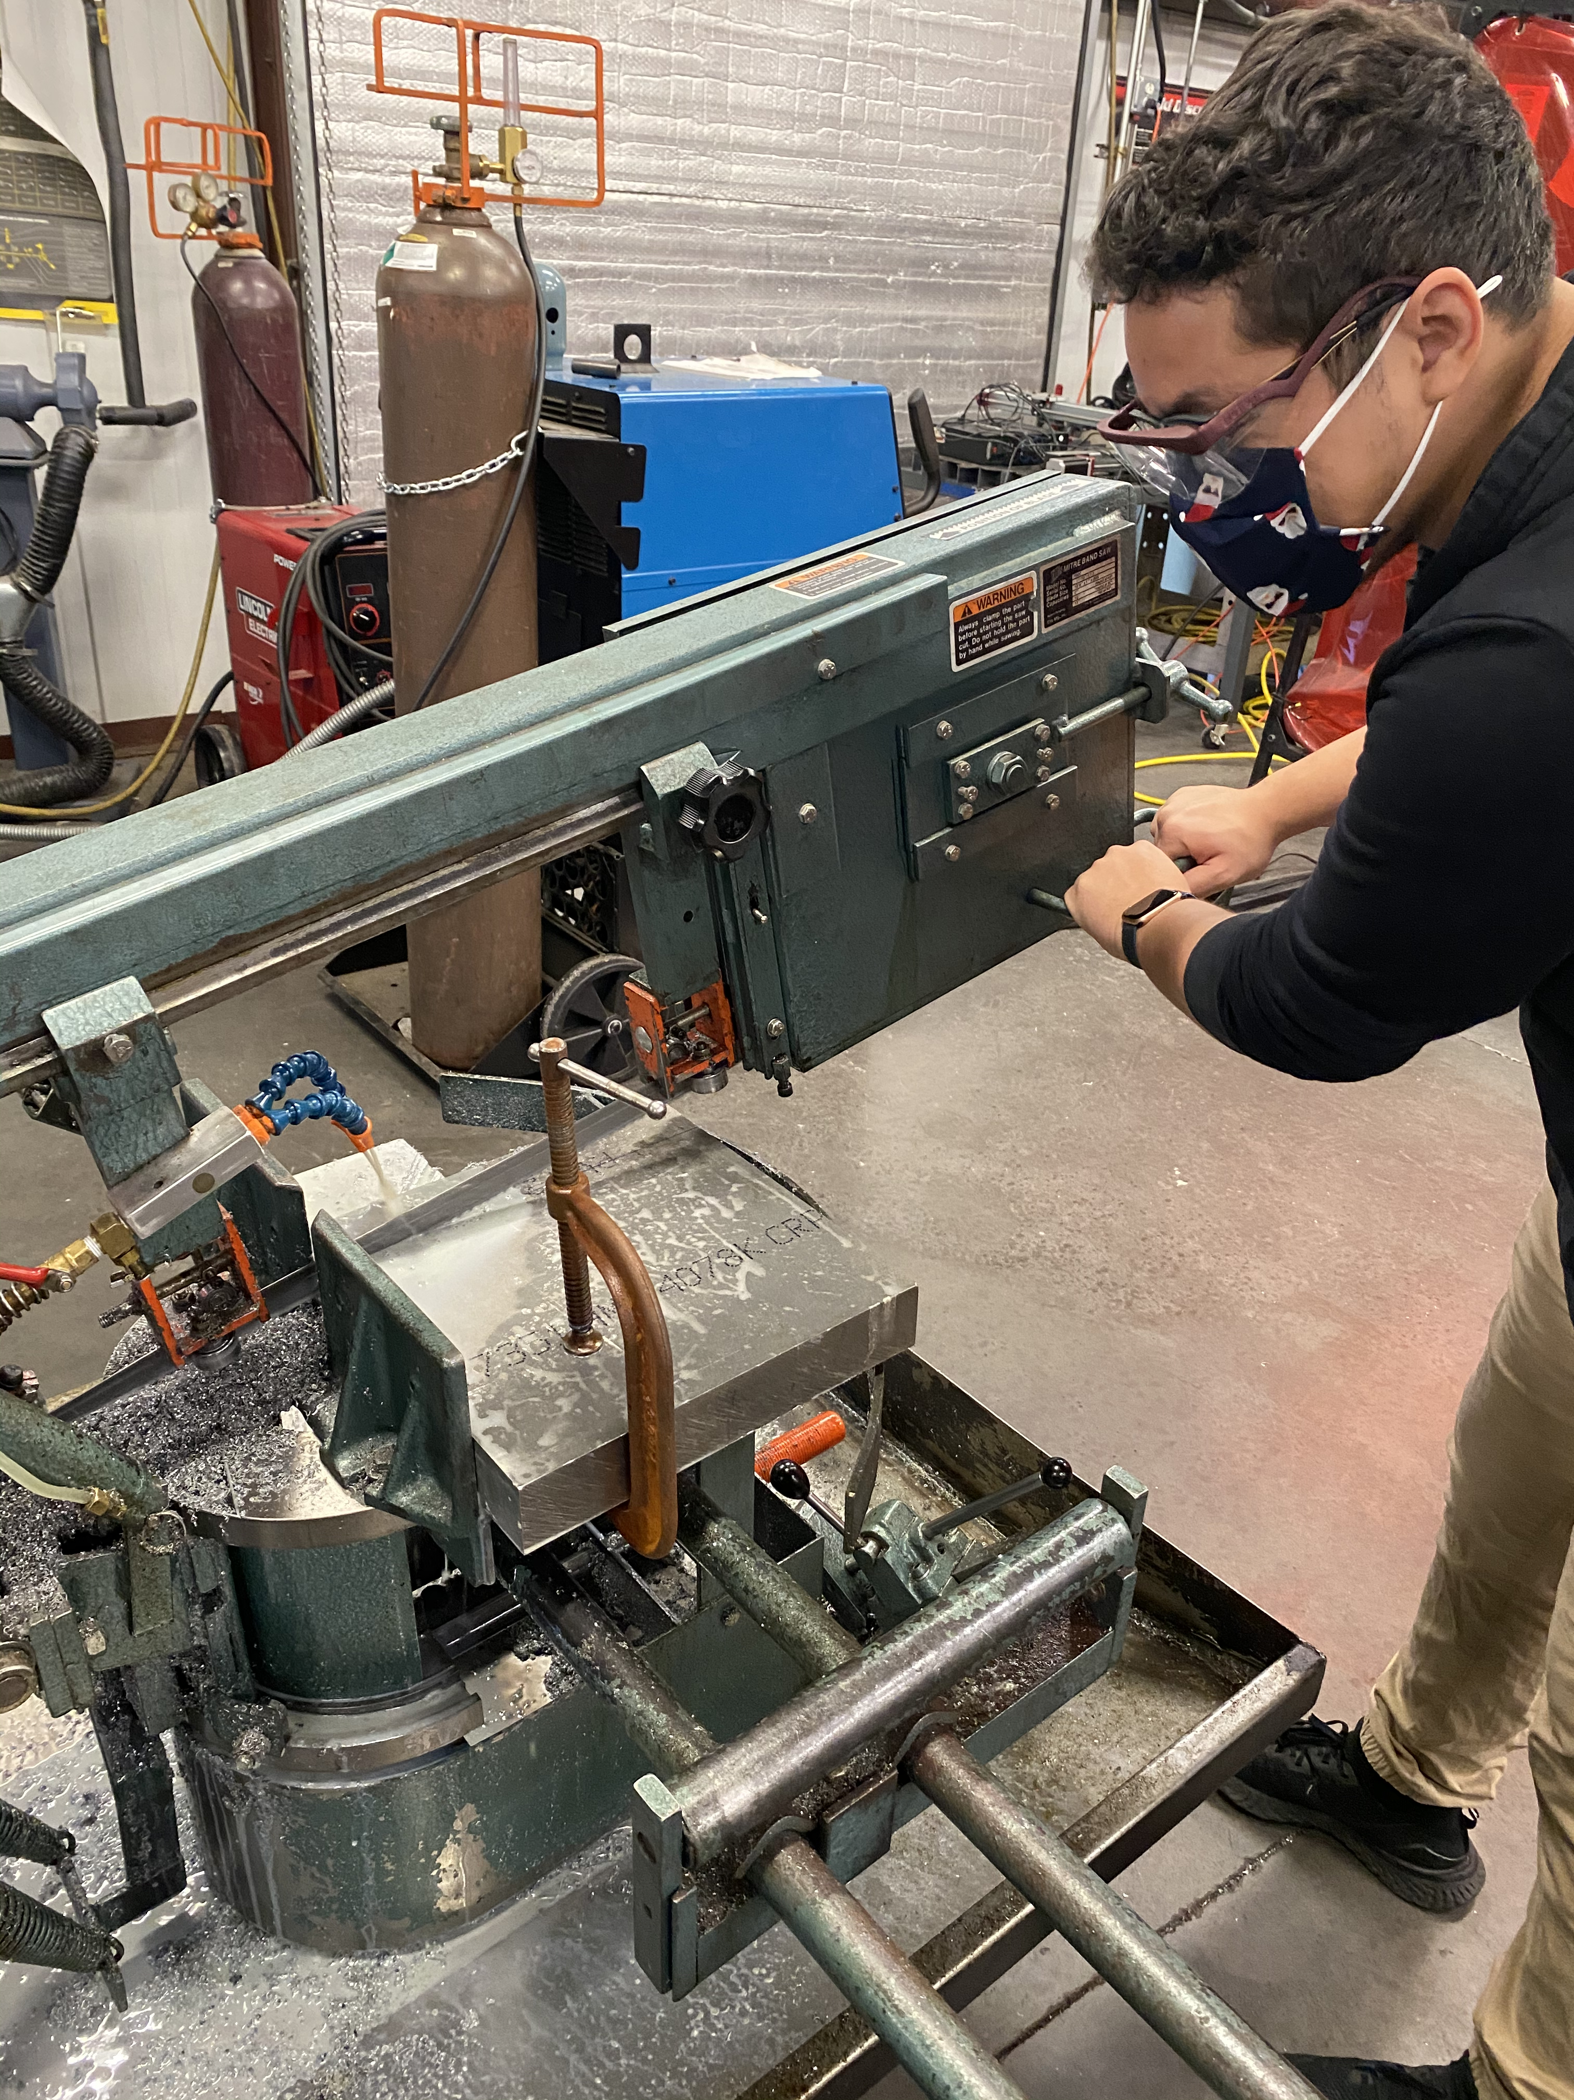
Manufacturing
Created shaft using Aluminum 7075 at Machine shop.
Tapped the hole needed for bolt.
Milled the part using HSS endmill.

Slide 23
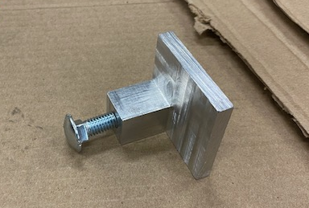
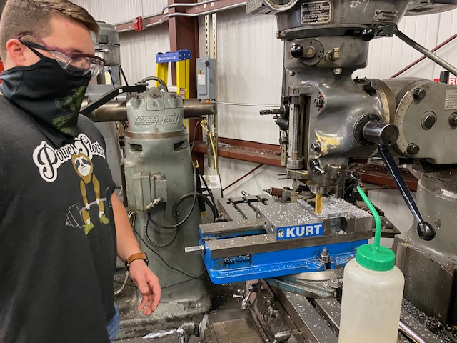
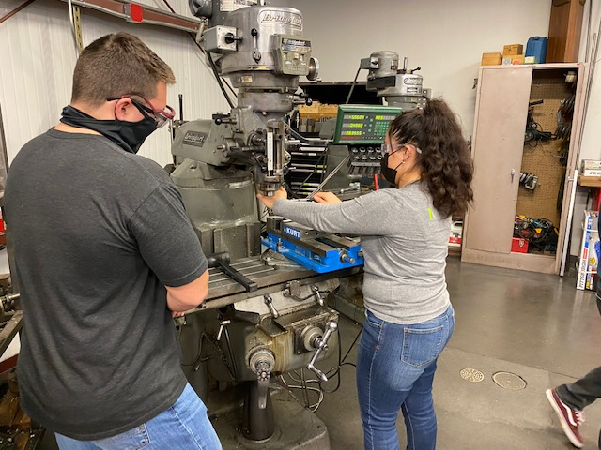
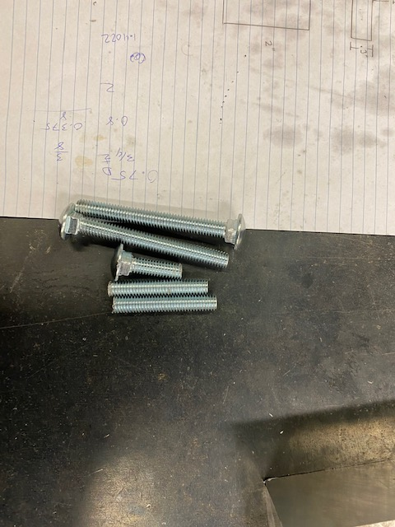
Manufacturing Cont.
Finished the prototype using carbide endmill.
Cut the bolt to correct length.
Assembled the prototype.

Slide 24
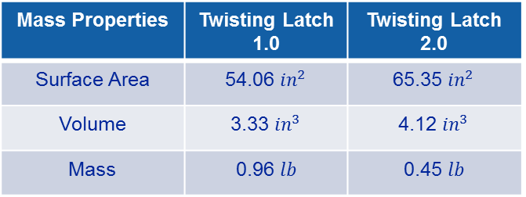
Weight Analysis
Table 3 : Part description list
Table 4 : Weight analysis of full system
Part | Material
Housing | Aluminum 7075 T7
Shaft | Aluminum 7075 T7
Bolt | AISI 304 Steel
Bottom Plate | Aluminum 7075 T7
Top Plate | Aluminum 7075 T7
Sandwich Plate | Aluminum 7075 T7
Pin | Aluminum 7075 T7
Compression Spring | Music Wire ASTM A228
Torsion Spring | Music Wire ASTM A228
Mass Properties | Twisting Latch 1.0 | Twisting Latch 2.0
Surface Area | 54.06 ${in}^{2}$ | 65.35 ${in}^{2}$
Volume | 3.33 ${in}^{3}$ | 4.12 ${in}^{3}$
Mass | 0.96 $lb$ | 0.45 $lb$
The new material selection reduces design weight by over 50%.
A low weight provides an advantage due to the high cost/lb. for space flight.

Slide 25
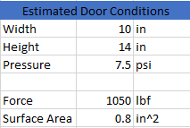


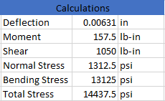
Thickness of Latch Analysis
Latch Thickness= .3in
Factor of Safety, Yield = 4.37
Factor of Safety, Ultimate= 5.07
Table 5 : Latch Analysis [11]
Figure 24: Cantilever Beam Representing Latch

Slide 26
Torsion Spring Analysis
Table 6: Torsion Spring Dimensions
Table 7: Torsion Spring Design
Torsion Spring Parameters
Wire Material | 302 Stainless Wire
A [kpsi*in^m] | 169
m | 0.146
Wire diameter [in] | 0.095
Outside Diameter [in] | 1.131
# of Coils | 6
Pin Diameter [in] | 0.8
Leg Length #1 [in] | 0.5
Leg Length #2 [in] | 0.4
Torsion Spring Design Parameters
Sut [kpsi] | 238.308
Sy [kpsi] | 185.880
Mean Coil Diameter [in] | 1.036
Spring Index | 10.905
Stress-Correction Factor | 1.073
Max Torque [lbf*in] | 14.576
Max Bending Stress [kpsi] | 185.880
# of Turns of Coil Body | 0.429
Clearance at Max Load [in] | -0.072

Slide 27

Thread Analysis NEW
Excel Calculator [8]
Table 8: Power screw calculations
Variable Description | Variable | Value | Units
Alpha angle | 2a | 14.5000
Minor diameter | dr | 0.3125 | inches
Major diameter | d | 0.3750 | inches
Mean diameter | dm | 0.3438 | inches
Number of engaged threads | nt | 3.0000
Pitch | p | 0.0625 | inches
Lead | l | 0.0625 | inches
Force applied, axial | F | 1000.0000 | lb
Coefficient of friction threaded pair-nut material | f | 0.1700
Coefficient of friction thrust collar running | f_{c} | 0.0900
Coefficient of friction thrust collar starting | f_{c} | 0.1500
Collar diameter max. | dc_max | 0.6300 | inches
Collar diameter min. | dc_min | 0.3500 | inches
Diameter of collar | dc | 0.4900 | inches
Torque required to raise | TR | 77.2892 | in*lb
Torque required to lower | TL | 56.7793 | in*lb
Figure 25: Screw full view

Slide 28
Thread Analysis NEW
Table 8: Screw calculations
Based on …
Number of engaged threads (nt) = 1
Force applied as 200ls.
Variable Description | Variable | Value | Units
Elastic 304 steel | E | 28000.0000 | kpsi
Body shear stress | τ | 2579.6984 | kpsi
Compressive axial stress | σ | -2607.5946 | kpsi
Bearing Stress | σB | -2252.0135 | kpsi
Threaded Root bearing pressure | σb | 7431.6446 | kpsi
Variable Description | Variable | Value | Units
Elastic 304 steel | E | 28000.0000 | kpsi
Body shear stress | τ | 12898.4919 | kpsi
Compressive axial stress | σ | -13037.9729 | kpsi
Bearing Stress | σB | -3753.3558 | kpsi
Threaded Root bearing pressure | σb | 12386.0743 | kpsi

Slide 29
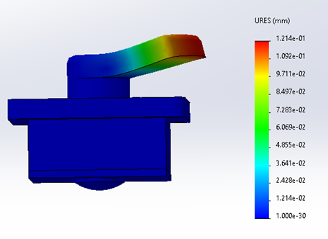
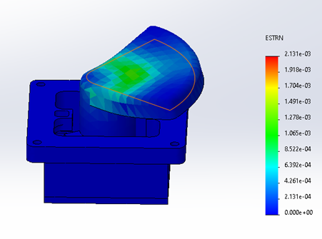
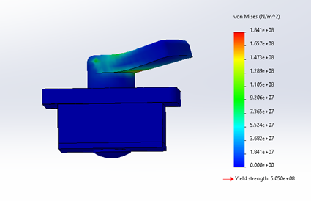
FEA Analysis
FEA assumed 1050 lbf on the latch.
It also assumed the shaft would not move due to the top plate restricting movement.
Max Deformation found was 0.01214 mm or 0.000478 in.
Figure 26: FEA Deformation
Figure 27: FEA Strain
Figure 28: FEA Stress

Slide 30
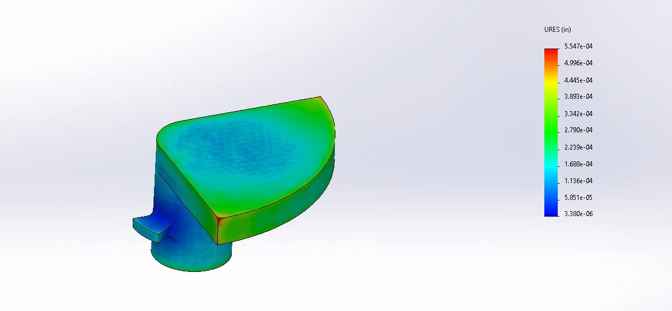
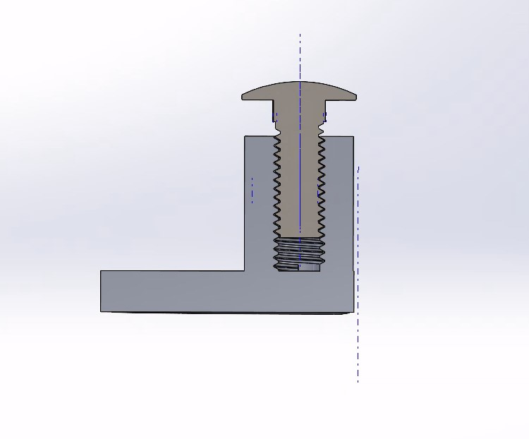
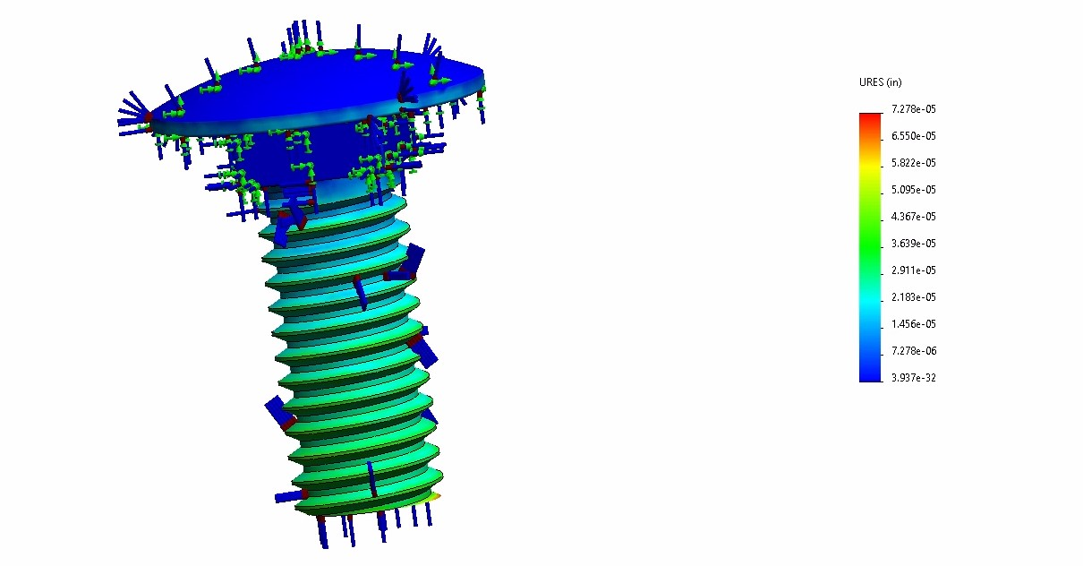
Thermal Expansion
Thermal analysis ran in Solidworks.
Range from 0-100C
Figure 30: Deformed Latch
Figure 29: Deformed Latch and Bolt Assembled
Figure 31: Deformed Bolt

Slide 31
Section 4:
Future Work & Budget

Slide 32
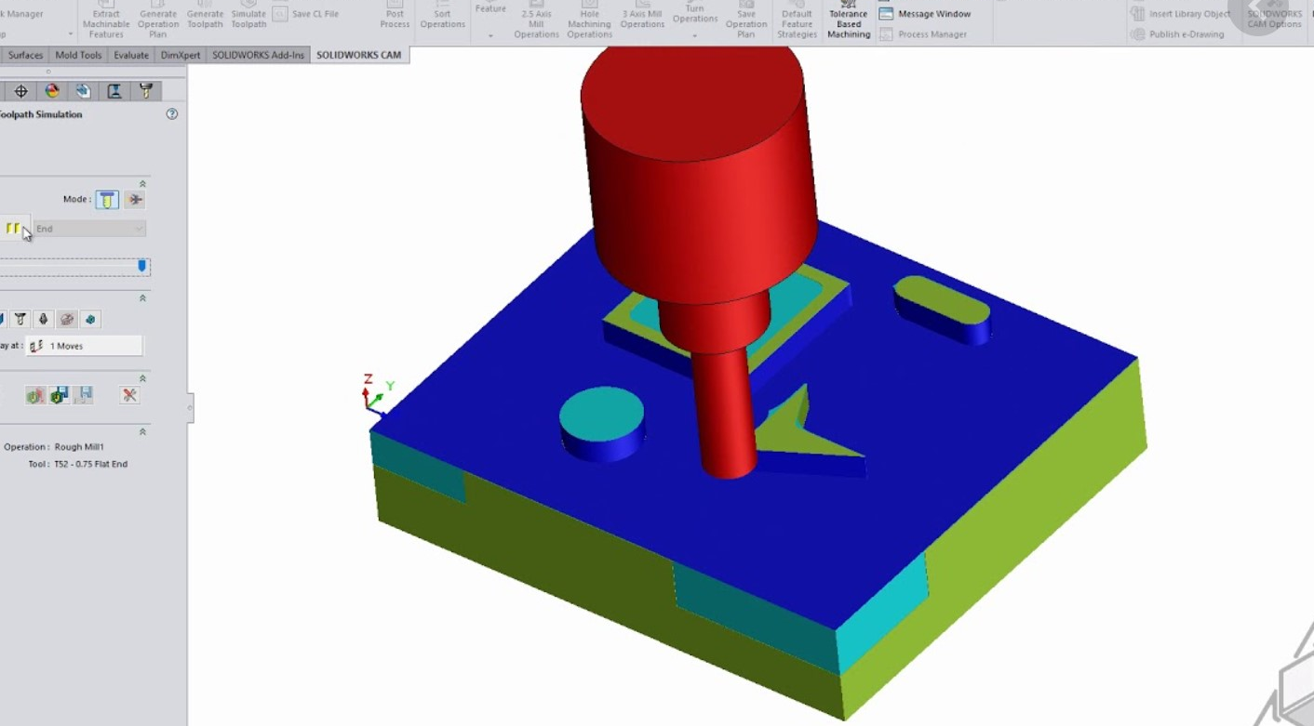
Manufacturing
Work order from NAU Machine Shop.
Continuation of mock prototypes.
CNC Machining using CAM.
Figure 32: Example of CAM in Solidworks

Slide 33
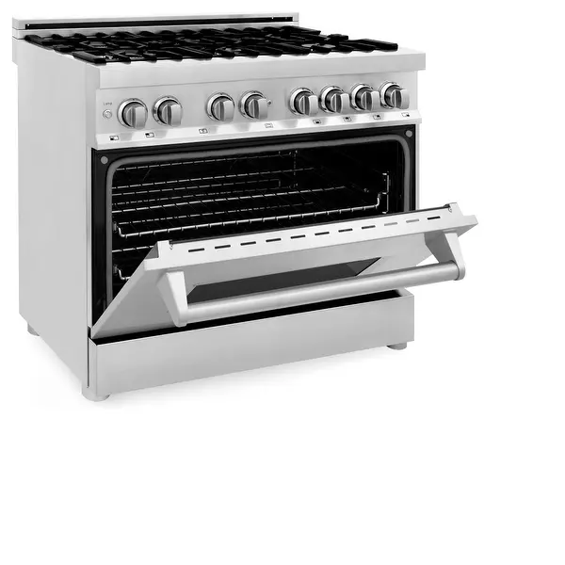
Temperature Test
Temperature test is to check the threading of the shaft and bolt assembly at various temperatures.
Procedure:
Assemble the mock latch, bolt and screw.
Freeze the assembly for 2-3 hours and remove.
Try to see if the mechanism works as intended.
After, place assembly into an oven to drastically heat it.
Again, see if the mechanism works as intended.
Figure 33: Oven for Heat Test

Slide 34
Load Testing
Considered load testing on threads and shaft deformation.
Consulted Dr. Ciocanel about use of Instron machine for load testing.
Determined that loads are not sufficient to require testing.

Slide 35
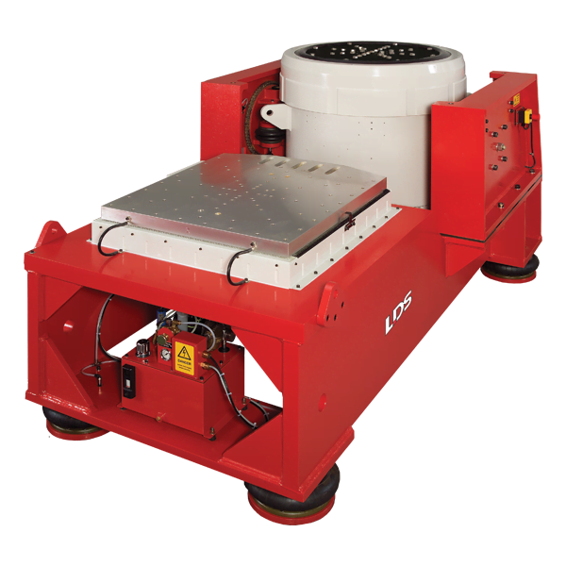
Vibration Testing
Shock testing
  Product qualification, durability, and reliability via drop tests.
Shaker table at NAU
  Professor access to one, but there are potential limitations.
  Test configuration: 24 Gs for 9 secs.
Construct our own simulator
  Acquire and set up speakers with audio of rocket launches.
Figure 34: vibration test table.
Notes:
From tall building drops
If we can get to the 24Gs then maybe at the machines max, or one that matches the frequency in such a way that it will be comparable. In scale
Sound profile to get relatively close to simulate launch-induced vibration
Frequency ranges
Force rating and stroke

Slide 36
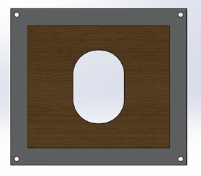
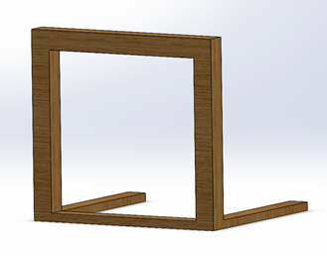

Testing Jig
Wooden frame constructed with Home Depot supplies
  Used to simulate the exterior of rocket for full scale testing
  Designed to be constructed with 2x4's and 4x4's
  Detachable aluminum exterior plates to simulate various faring thicknesses
Figure 35: Wooden Frame
Figure 36: Detachable "Fairing"
Figure 37: Opening Hatch Dimensions

Slide 37
Bill of Materials
Table 10: Bill of Materials
Part | Material | Description | Quantity | Unit Cost ($)
Aluminum Stock | Aluminum 7075 T7 | 12”x12”x2" | 1 | 313.34
Compression Spring | Music Wire ASTM A228 | 0.1x.75” | 1 | 1
Torsion Spring | 302 Stainless Wire | 1.131”x6 coils | 1 | 63.48
Steel Bolt | Zinc coated Stainless Steel | 3/8”x1” | 1 | 4
Steel Bolt & Nut | Zinc coated Stainless Steel | 1/8”x1” | 4 | 30
 |  |  | Total | 411.82

Slide 38
Budget Planning
Table 11: Budget Planning
The left-over money will serve as a cushion for any unexpected costs from now until the final product is delivered.
Type | Description | Cost
Total budget | Total budget given by Northrop Grumman | $8,000
Material Cost | Cost of every part in final design | $411.82
Current Prototyping | 3D Printed Parts, Aluminum Prototypes | $100
Future Prototyping | Testing Jig, Aluminum Prototypes | $1,000
Future Testing | Mock Vibrations Table | $1,000
Manufacturing Cost | Cost to manufacture full design | $778.36
Final Product | Final manufactured design that has not been tested on | $1,201.18
Left over |  | $3,497.64

Slide 39
Schedule
Table 12: Tentative Schedule
Resolve action items discussed in CDR
Finish full scale manufactured prototype
Complete and run test jig to confirm device’s functionality
Finish heat testing and vibrations testing
Manufacture final product
Tentative Schedule
Task | Time Frame
Action Items from CDR | 2/26/21 – 3/1/21
Full manufactured prototype | 2/26/21 – 3/14/21
Run test jig | 2/26/21-4/1/21
Run heat/vibe test | 4/1/21-4/11/21
Manufacture final product | 4/1/21-4/11/21

Slide 40
References
[1] “Antares Rocket,” Northrop Grumman. [Online]. Available: https://www.northropgrumman.com/space/antares-rocket/. [Accessed: 19-Sep- 2020].
[2] “Northrop Grumman Cargo Launch to the Space Station from NASA Wallops - YouTube.” [Online]. Available: https://www.youtube.com/watch?v=tQW_2qtBDfY. [Accessed: 12- Oct-2020].
[3] “Pegasus Rocket – Northrop Grumman.” [Online]. Available: https://www.northropgrumman.com/space/pegasus-rocket/. [Accessed: 17-Oct-2020].
[4] ASM Material Data Sheet. [Online]. Available: http://asm.matweb.com/search/SpecificMaterial.asp?bassnum=MQ304A [Accessed: 12-Nov-2020].
[5] Budynas, Richard G, J K. Nisbett, and Joseph E. Shigley. Shigley's Mechanical Engineering Design. New York: McGraw-Hill, 2011. Print.
[6] “Definitive Guide to Tormach Hacks, Upgrades, and Modifications.” [Online]. Available: https://www.cnccookbook.com/tormach-upgrades-hacks-modifications/. [Accessed: 11-Nov-2020].
[7] “(6) Protolabs: Overview | LinkedIn.” [Online]. Available: https://www.linkedin.com/company/proto-labs/. [Accessed: 11-Nov-2020].
[8] “Aluminum Honeycomb Panels,” McMaster-Carr. [Online]. Available: https://www.mcmaster.com/aluminum-honeycomb-panels/. [Accessed: 11-Oct-2020].
[9] “Aluminum stock” MetalsDepot. [Online]. Available: https://www.metalsdepot.com/aluminum-products/aluminum-square-bar.
[Accessed: 11-Oct-2020].
[10] MetalsDepot® - T304 Stainless Steel Square Bar. [Online]. Available: https://www.metalsdepot.com/stainless-steel-products/stainless-steel-square [Accessed: 11-Nov-2020].
[11] 7075 Aluminum: Get to Know its Properties and Uses [Online]. Available:https://www.gabrian.com/7075-aluminum-properties/ [Accessed: 23-Feb-2021]
[12] Materials engineering. (2012, June 02). Retrieved February 24, 2021, from http://www.substech.com/dokuwiki/doku.php?id=stainless_steel_aisi_304

Slide 41
Appendix A: ESD Information
Electrostatic Discharge is created by rubbing insulative materials against another, cause electrons to build up in on material.
Electron buildup can cause sudden charges to arc across materials and potentially damage sensitive electronics.
This is avoided when using conductive materials attached to a ground.
In the current design, all parts are made of conductive metals, and all parts have electrical paths to the fairing, which is used as the ground.

Slide 42

Appendix B: BOM
BOM

Slide 43


Appendix C: QFD
Legend
9 | Strong relation
3 | moderate
1 | weak
(blank) | none

Slide 44



Appendix D: Old Thickness of Latch Analysis
Table 9: Latch Analysis [7]
Latch Thickness= .3in
Factor of Safety, Yield = 1.65
Factor of Safety, Ultimate= 3.89
AISI 304 Stainless Steel
Tensile Strength, Yeild
31,200 psi
Tensile Strength, Ult
73,200psi
Estimated Door conditions |  |  | Latch Dimensions |  |  | Calculations
Width | 10 | in | a | 0.15 | in | Deflection | -2.262E-05 | in
Hight | 14 | in | b | 0.95 | in | Moment | 157.5 | lb-in
Pressure | 7.5 | psi | width | 0.8 | in | Shear | 1050 | lb
 |  |  | thickness | 0.3 | in | Normal Stress | 1312.5 | psi
Force | 1050 | lb | E | 29,000 | ksi | Bending Stress | 17500 | psi
Surface area | 0.8 | in^2 | I | 0.0018 | in^4 | Total Stress | 18812.5 | psi
Figure 49: Cantilever Beam Representing Latch
Figure 17: Rubber Bumper

Slide 45




Appendix E: Torsion Spring Analysis
Torsion Spring Parameters
Wire Material | Music Wire ASTM A228
A [kpsi*in^m] | 201
m | 0.145
Wire diameter [in] | 0.08
Outside Diameter [in] | 0.98
# of Coils | 4
Pin Diameter [in] | 0.8
Leg Length #1 [in] | 0.5
Leg Length #2 [in] | 0.4
Figure 52: Torsion Spring [8]
σ = bending stress
Ki = internal stress correction factor
C = spring index
Nb = # of coils
D’ = coil diameter under load
$${θ′}_{c}=angular deflection$$
D = mean coil diameter
d = wire diameter
F = tangential force
r = radius
Torsion Spring Design Parameters
Sut [kpsi] | 289.900
Sy [kpsi] | 226.122
Mean Coil Diameter [in] | 0.900
Spring Index | 11.250
Stress-Correction Factor | 1.071
Max Torque [lbf*in] | 10.613
Max Bending Stress [kpsi] | 226.122
# of Turns of Coil Body | 0.353
Loaded Clearance [in] | 0.053

Slide 46


Concept Evaluation
Table 6: Pugh Chart
Selection Criteria | Weight | DATUM | Concepts
 |  |  | 1 | 2 | 3 | 4
Ease/Safety of Installation | 7 |  | - | S | - | -
Scalable | 8 |  | S | S | S | +
Reopenable | 4 |  | - | S | S | S
Withstand Pressure Differential | 10 |  | + | + | + | +
No contaminates | 8 |  | - | S | S | +
Does not use gravity | 6 |  | - | S | S | S
Activates on launch | 10 |  | S | S | S | S
Does not interfere with nearby systems | 9 |  | - | S | + | S
Professionalism | 5 |  | S | S | S | S
Does not influence aerodynamics | 9 |  | - | S | + | -
ESD Safe | 7 |  | - | S | S | S
Indicates open/closed status | 1 |  | S | S | S | +
Total (+) |  |  | 1 | 1 | 3 | 4
Total (-) |  |  | 7 | 0 | 1 | 2
Overall Score |  |  | -6 | 1 | 2 | 2
Weighted Total (+) |  |  | 10 | 10 | 28 | 27
Figure 33: Datum Opened
Figure 34: Datum Closed
Notes:
Pugh chart to compare the 3 previous designs
Sliding /exterior /interior hinge/ twisting latch
Quantitative approach
Datum: current design used on the rocket

Slide 47
Concept Evaluation Cont.
Table 7: Decision Matrix
 |  | Sliding Door |  | Exterior Hinge |  | Interior Hinge |  | Twisting Latch
Criteria | Weight (%) | Score (1-10) | Weighted Score | Score (1-10) | Weighted Score | Score (1-10) | Weighted Score | Score (1-10) | Weighted Score
Safety Factor | 12 | 7 | 84 | 7 | 84 | 6 | 72 | 8 | 96
Vibrations | 16 | 8 | 128 | 7 | 112 | 4 | 64 | 7 | 112
Pressure Differential | 20 | 7 | 140 | 8 | 160 | 7 | 140 | 9 | 180
Budget | 8 | 3 | 24 | 9 | 72 | 7 | 56 | 9 | 72
Dimensions | 14 | 4 | 56 | 8 | 112 | 9 | 126 | 8 | 112
Weight | 10 | 2 | 20 | 9 | 90 | 7 | 70 | 9 | 90
Crush Rating of Design | 20 | 6 | 120 | 7 | 140 | 7 | 140 | 7 | 140
Totals | 100 |  | 572 |  | 770 |  | 668 |  | 802
Notes:
finalized a consensus on the criteria to analyze. Determined the weighted values (12 16 20 etc.)
then scored each design in a QUANTITATIVE manner in relation to
safety 1.6 Yield min, 2 for Ult, for metallic hardware. And composite: 2 ult min and 2.3 buckling min
vibrational effects 70Gs
pressure limitations considerations: 7.5psi in flight and 810psi compressive stress
Dimensions 203in^2 max
total cost/budget$8000
Feasibility to back up the decisions
Weak aspects...
Brainstormed how /if weak points could be improved
from our top 3 designs they ultimately were ranked x=1 y=2 z=3

Slide 48
Appendix F: Threads Analysis
Figure 52: Torsion Spring [8]
Variable Description | Variable | Value | Units
Alpha angle | 2a | 14.5000
Minor diameter | dr | 0.5000 | inches
Major diameter | d | 0.6250 | inches
Mean diameter | dm | 0.5625 | inches
Number of engaged threads | nt | 3.0000
Pitch | p | 0.1250 | inches
Lead | l | 0.1250 | inches
Force applied | F | 0.0000 | lbs
Coefficient of friction threaded pair-nut material | f | 0.1700 | (max)
Coefficient of friction thrust collar running | f_{c} | 0.0900 | (no)
Coefficient of friction thrust collar starting | f_{c} | 0.1500 | (yes)
Collar diameter max. | dc_max | 0.6300 | inches
Collar diameter min. | dc_min | 0.3500 | inches
Diameter of collar | dc | 0.4900 | inches
Torque required to raise | TR | 0.0000 | in*lbs
Torque required to lower | TL | 0.0000 | in*lbs

