Slide 1
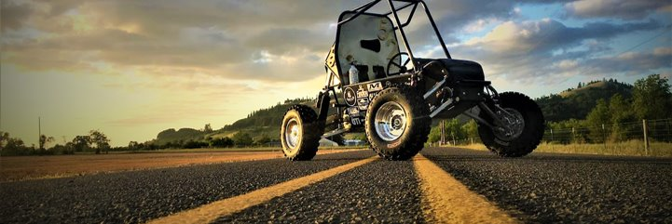
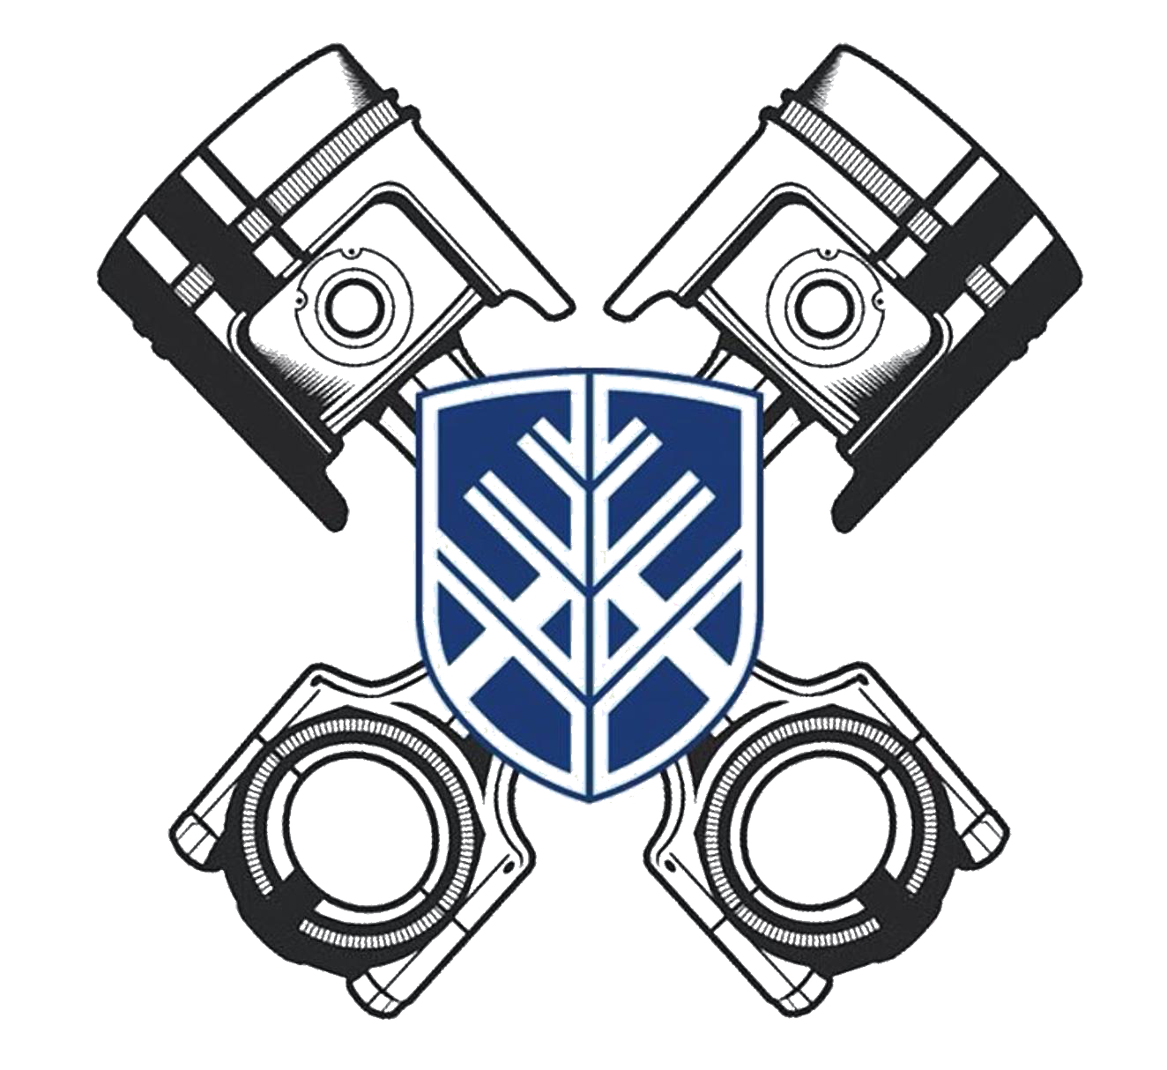
SAE BAJA - MIDPOINT PRESENTATION
Lumberjack Motorsports #20F01
Emily Kasarjian

Slide 2
PROJECT DESCRIPTION
The Baja capstone team aims to compete in the annual West Coast SAE BAJA Competition, where we can showcase our knowledge of the vehicle design to other schools and automotive industry representatives.
Team of 12 undergraduate Mechanical Engineering Students
4 Sub-teams: Frame, Drive Train, Front End, Rear End
SAE Baja sponsors are: Society of Automotive Engineers, W.L Gore & Associates, Lucas Inc., Arce, Bro-Tools, Nova Kinetics, and others. These companies provide funding for our project, which could potentially cost upwards of $30,000.
With 4 Wheel Drive included as part of this year’s project, the design can guide future NAU SAE Baja teams to succeed in competition.
Table 1: Spring 2021 Team Roster
Frame | Drivetrain | Front End | Rear End
Brendan P. | Tyler T. | Tanner G. | Colton L.
Brian C. | Emily K. | Jacob K. | Logan F.
Ashley R. |  | Ryan M. | Bailey M.
Matthew W.

Slide 3
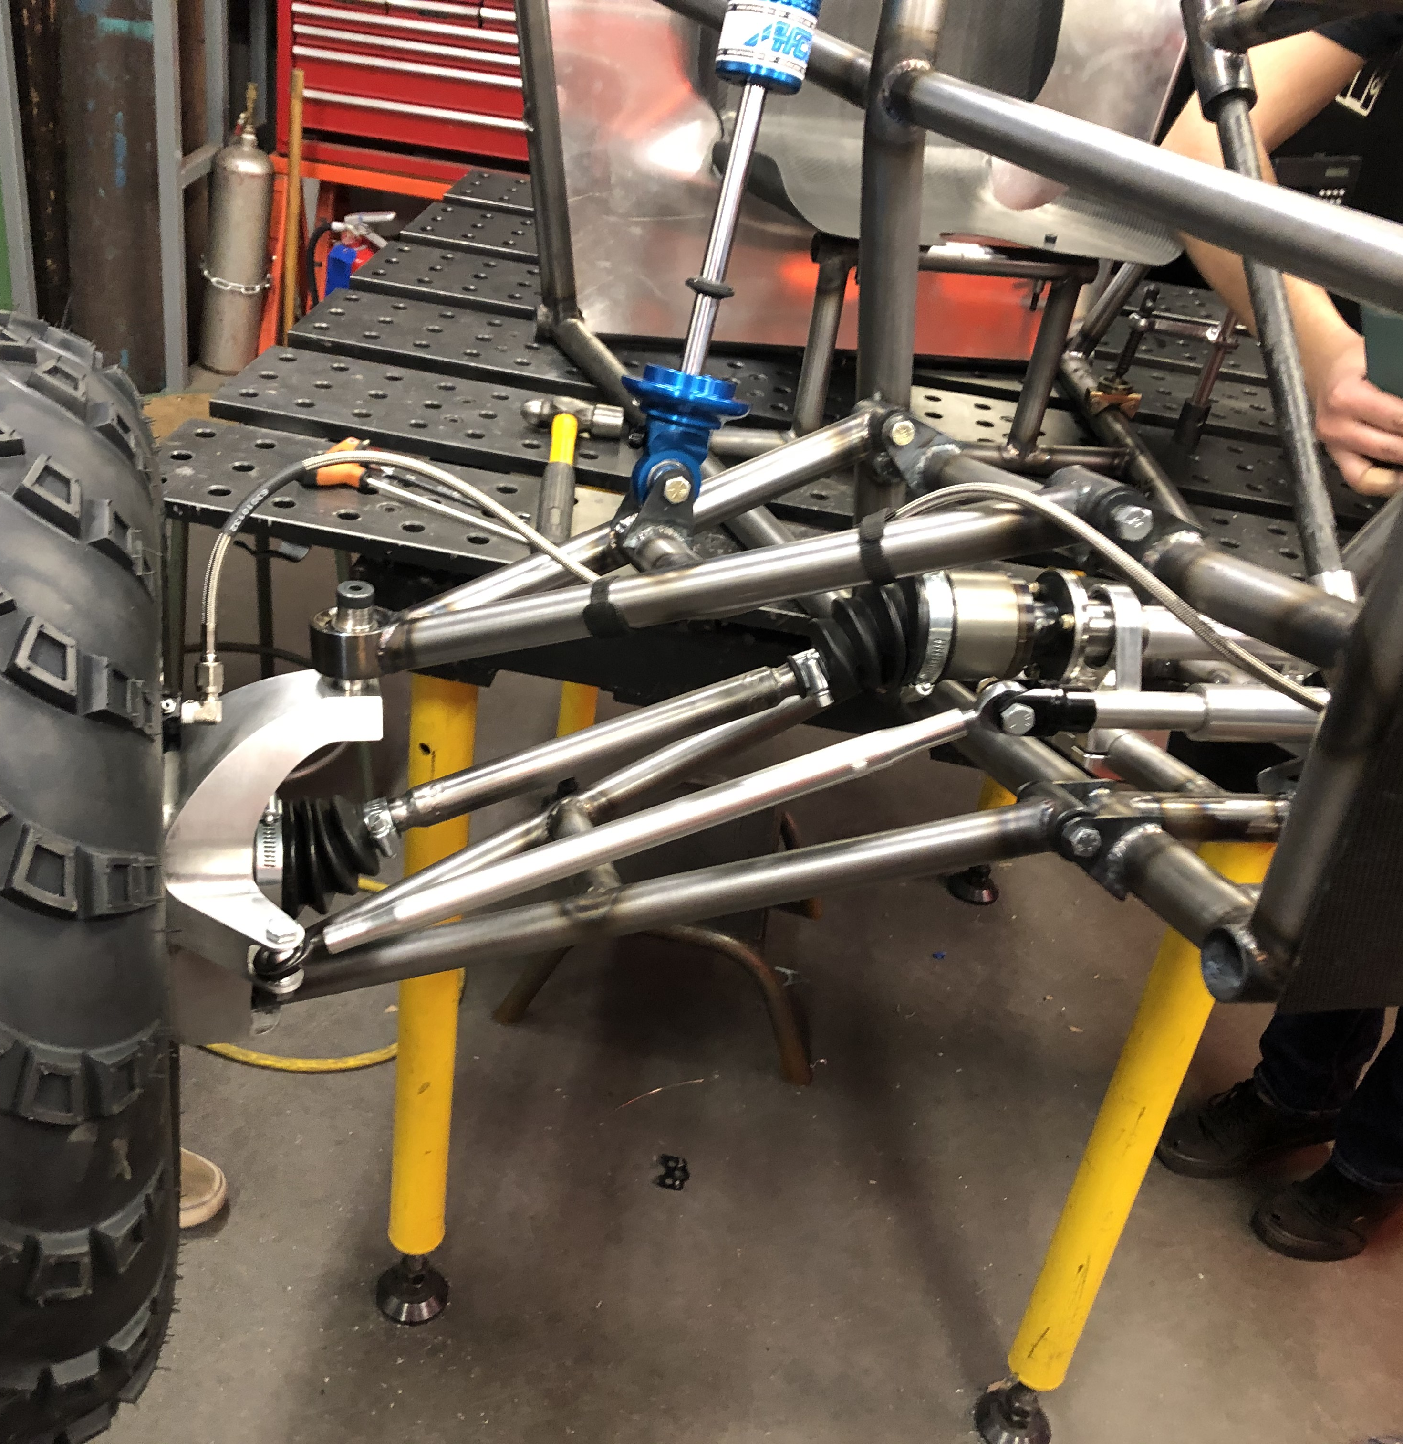
Design Description Front End
Unequal length double wishbone
Upper control arm shock mount
Steering designed for small turning radius (10 feet) for maneuverability event
Braking power increased from previous years for brake check event
Total Suspension Travel: 8 inches
Track width: 54 inches
Figure 1: Front Suspension
Ryan Meyer

Slide 4
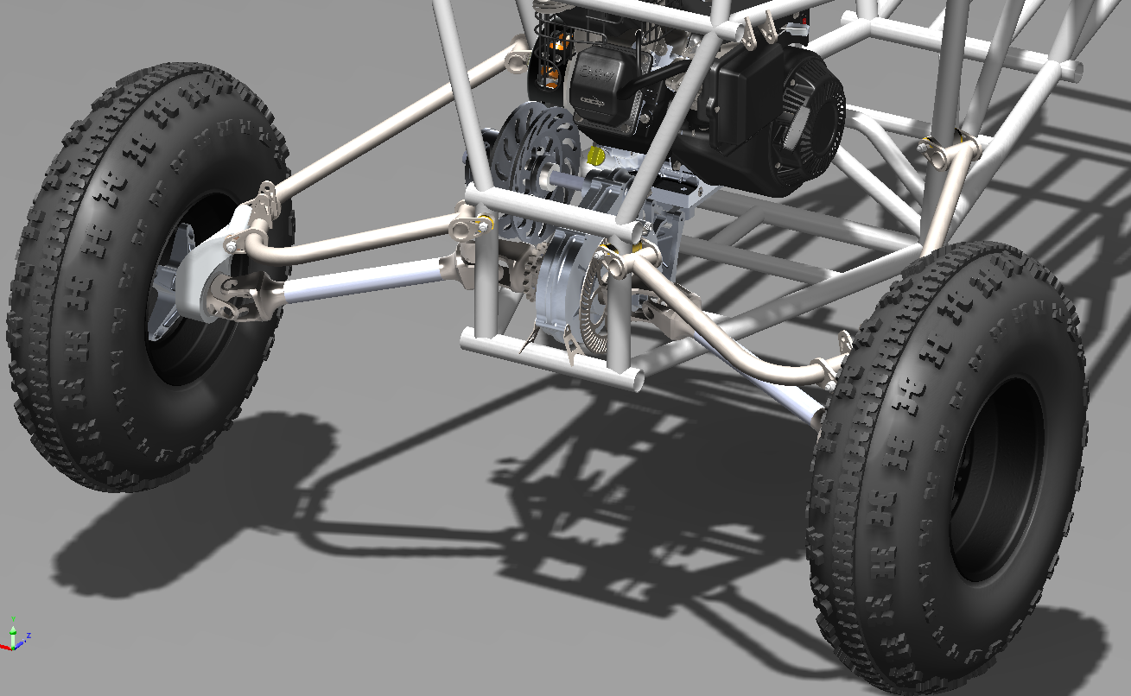
Design Description Rear End
Upper Link Lower Drive Shaft (ULDS) design
Uses standard H-arm with camber link suspension
Uses axle shafts in place of camber links
Universal joints rather than Constant Velocity (CV) joints allow for axial load on axle shafts
Figure 2: ULDS Rear Suspension

Slide 5
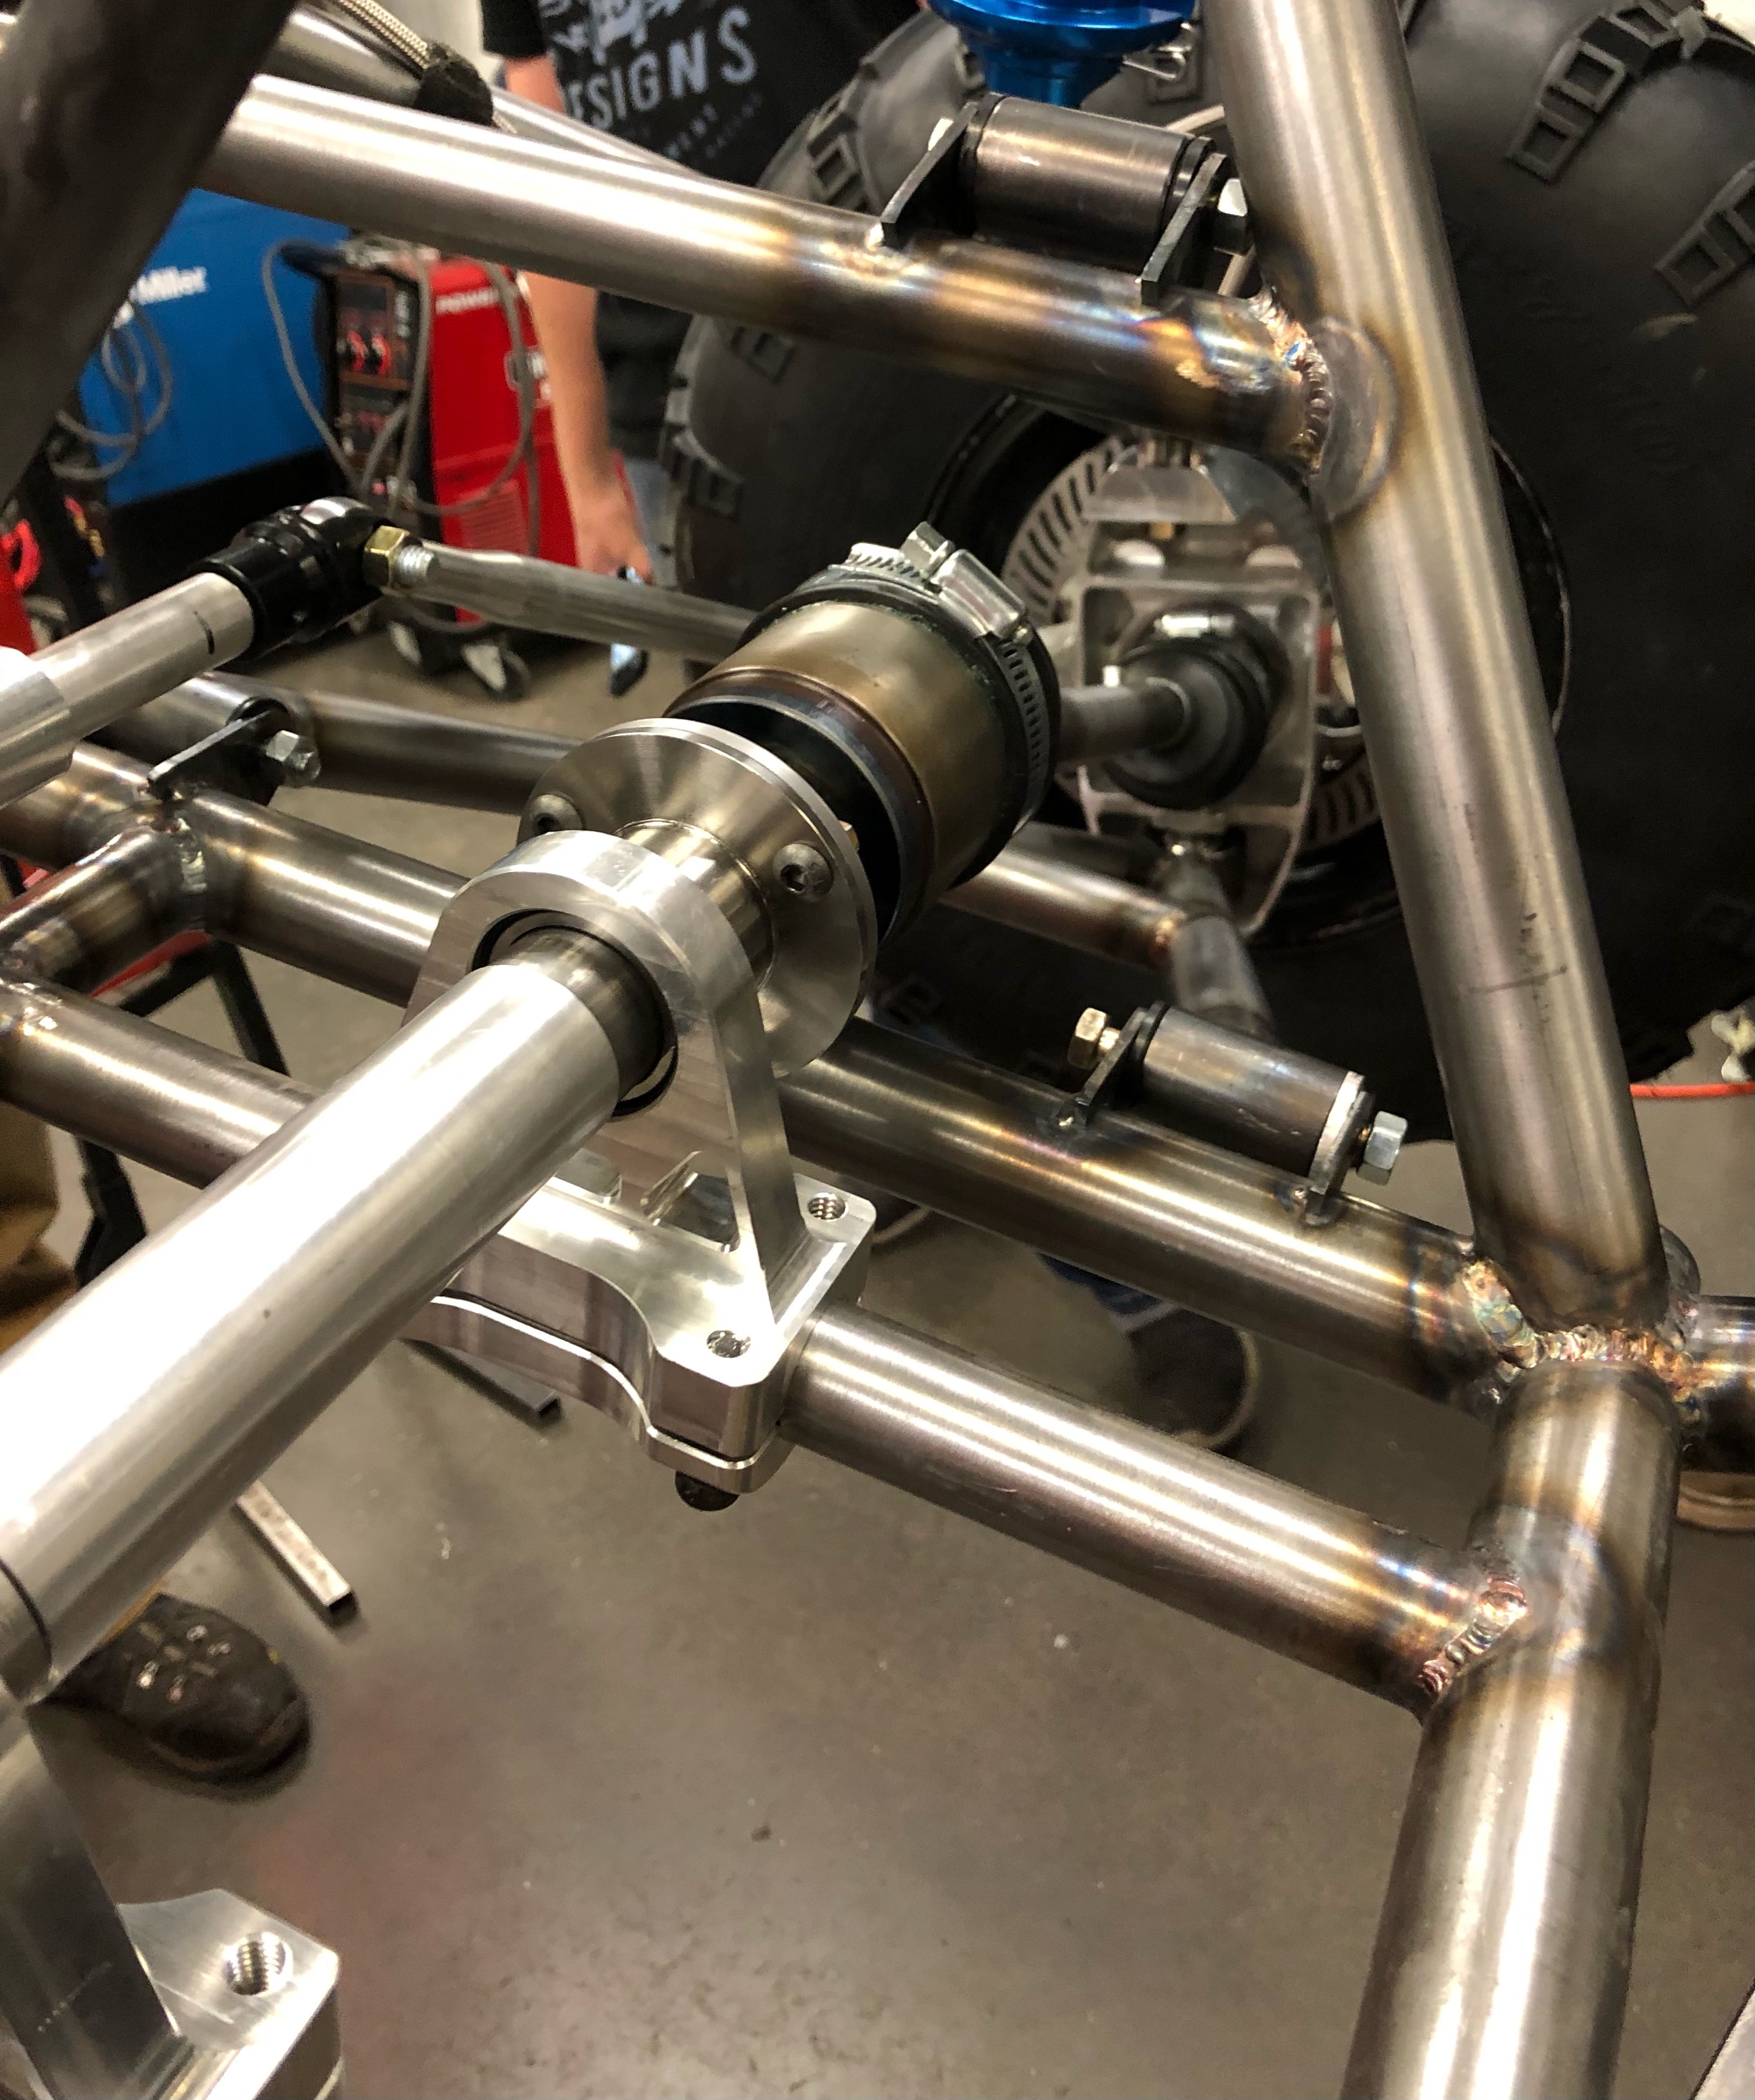
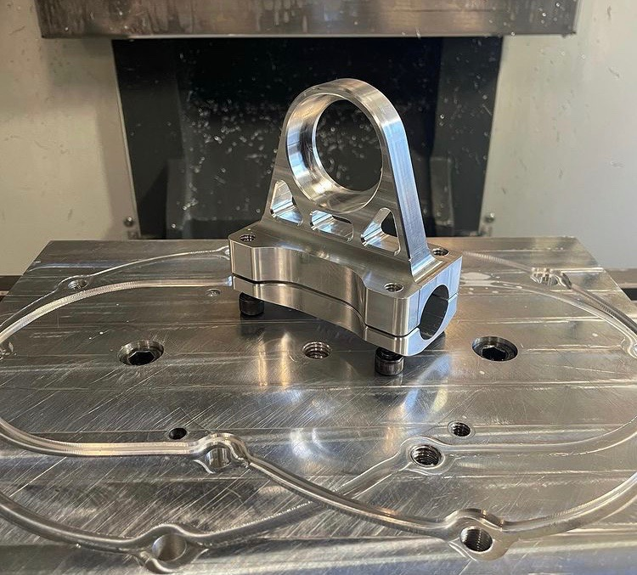
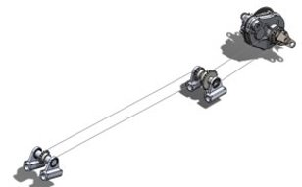
Design Description Drivetrain 4WD System
Chain drive off the output shaft on gear box:​
Extra points in competition​
2 chains with an intermediate shaft positioned behind firewall
Maneuverable Pillow Block Clamps for tension adjustment
Sprag clutches used in front hubs to maintain turning radius and allow free spin​
Front shaft underdriven so front tires only engage when rear tires slip. ​
Figure 5: front driveline
Figure 3: front driveline mount
Figure 4: drivetrain CAD model
Emily Kasarjian

Slide 6
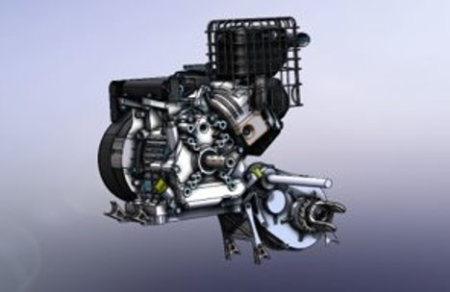
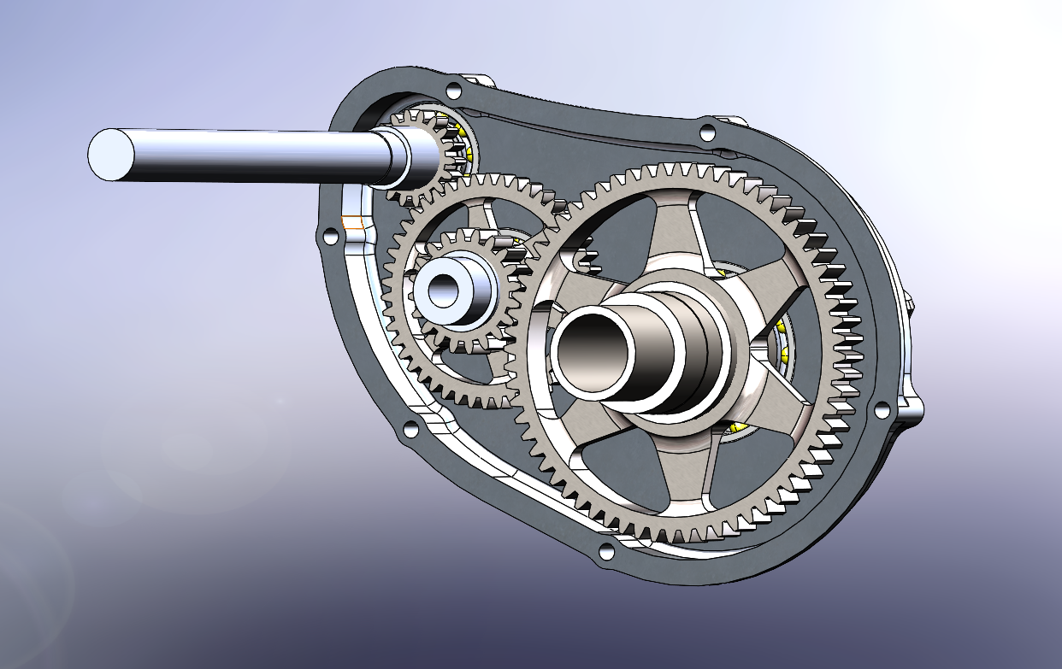
Design Description Drivetrain Gear Reduction Box
Double reduction to yield an 8:1 ratio
The gear reduction is an optimized ratio based off data collected from endurance competition
System designed for 25-hour life cycle to decrease face width and reduce inertia
The ratio was selected based on the modal competition speed
Internal gear shapes were produced using topology optimization and further evaluated using finite element analysis.
Gears made from 9310 case carburized .02" depth at 63 HRC
Shafts constructed of 4340M through hardened to 52 HRC
Figure 6: Engine and Gearbox
Figure 7: Gearbox Cutaway View
Tyler Trebilcock
Figure 10: Gearbox Design​
Figure 10: Gearbox Design​
Figure 10: Gearbox Design​
Figure 10: Gearbox Design​
Figure 10: Gearbox Design​

Slide 7
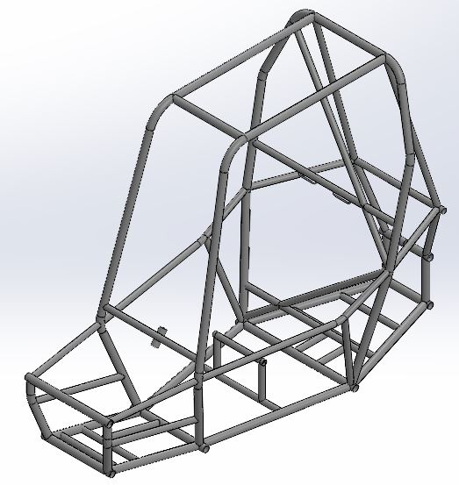
Design Description Frame
Rear Braced Frame design​
4130 Chromoly Steel​
1.25 x 0.065-in Primary Tubing​
1 x 0.035-in Secondary Tubing​
Weight savings from 69 [lbs] to 61 [lbs] from original design​
Structure clears SAE Baja 2021 Rules​
0.04-inch-thick Carbon fiber panels​
0.02-inch-thick 6061 Aluminum Firewall​
Carbon fiber seat leveled 5 inches from undercarriage for chain drive
Figure 8: CAD Model of Frame

Slide 8
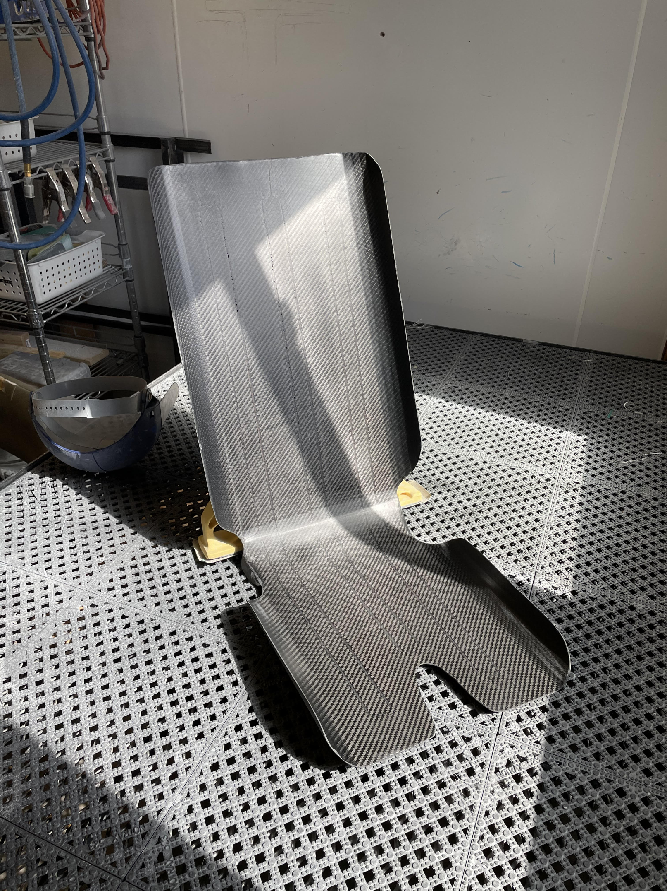
Chassis Ergonomics
Frame
Cockpit designed for 95th percentile male to the 5th percentile female (US)
Pedal system
Pushed forward for better driver comfortably and improved front weight bias 55%F. Topology optimized brake pedal (7075Al), Carbon fiber tube gas pedal.
Seat
Added flanges to laterally support driver through turns. Foam inserts to increase polar moment of inertia. Bias, straight, bias ply configuration to increase stiffness.
Steering wheel
Smaller diameter to help with clearance between drivers' knees. Constructed of carbon fiber to reduce weight.
Figure 10: Steering Wheel
Figure 9: Seat
Tyler Trebilcock

Slide 9
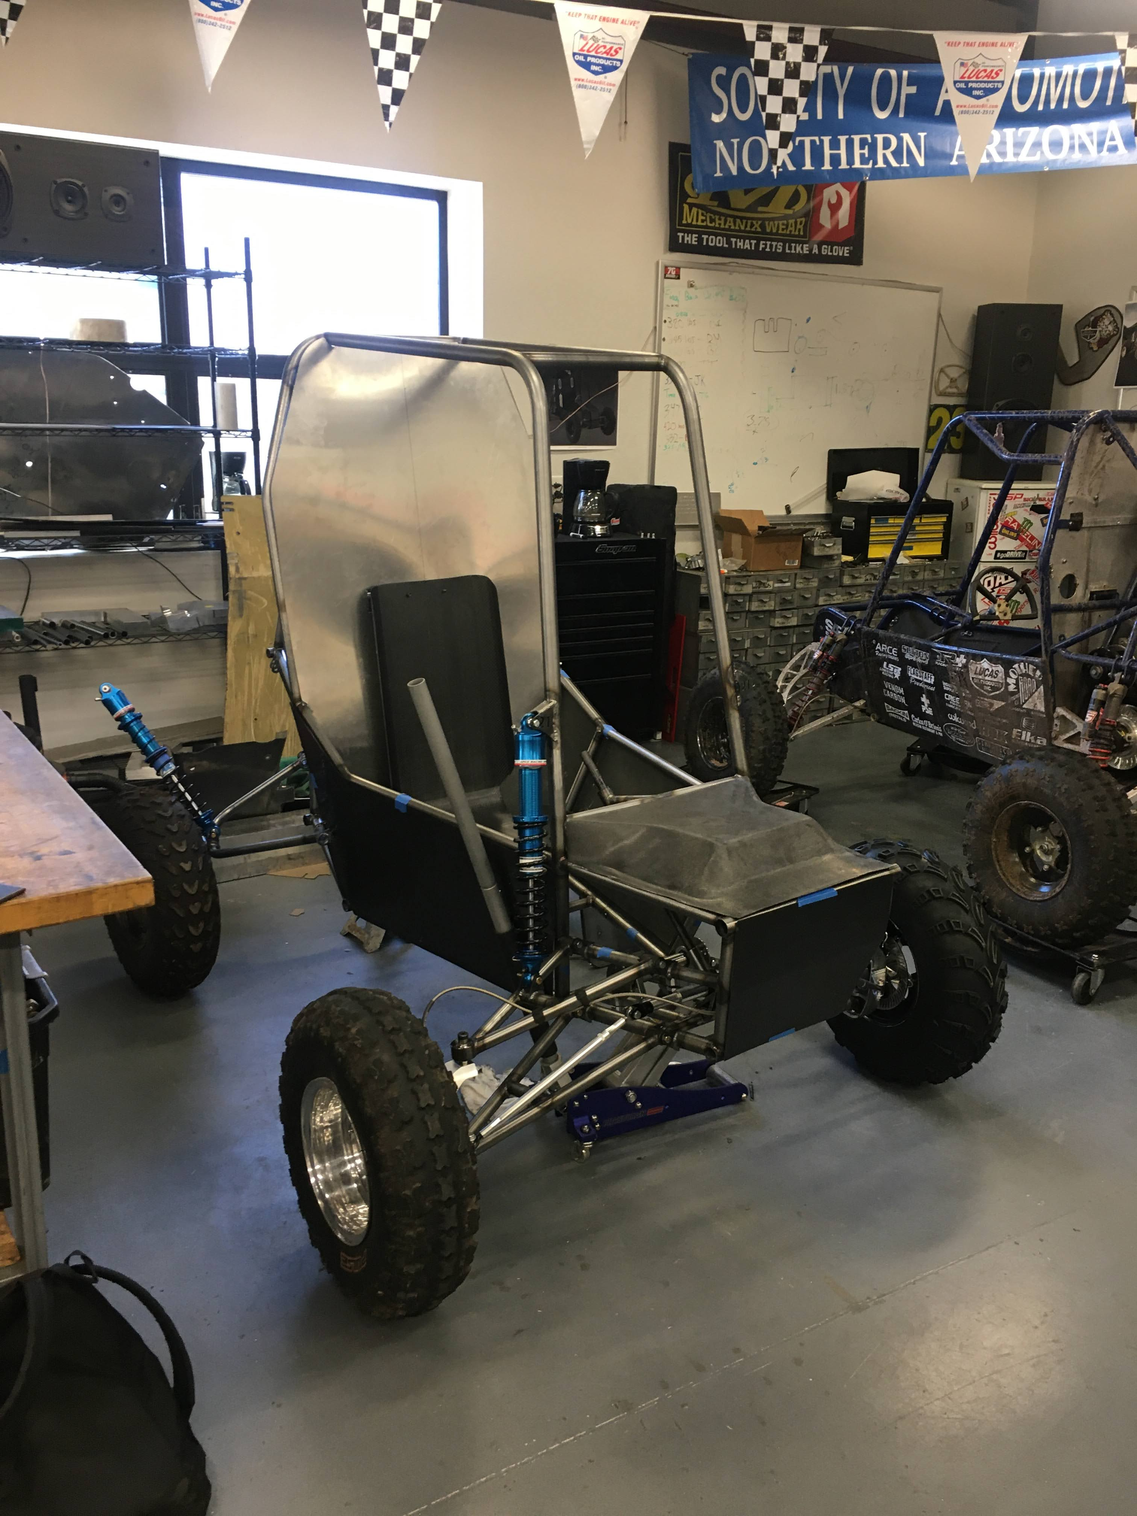
Current State of Systems: Front-End
Front-End
Front-end suspension is fully assembled and ready for driving milestone.
Components manufactured to date:
Upper and lower A-arms
Front knuckles and spare
Hubs
Shocks and shock mounts
Steering system
Engineering requirements met:
Under 400 lbs (0.035” tubing A-arms)
Total cost under $9000 (in-house manufactured)
Turning radius of 10ft (quick-ratio steering)
Remaining Manufacturing
Spare parts
Figure 11: Current Vehicle State
Notes:
Tanner

Slide 10
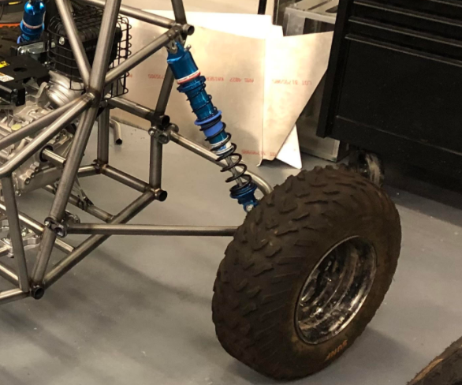
Current State of Systems: Rear-End
Progress so far:
Control arms
Knuckles
Delrin Bushings
Coil-over Shocks
Frame mounting sleeves
Upcoming progress:
Manufacturing axles and yokes
Shock tuning and strength testing
Manufacturing lighter components
Engineering requirements met:
Under 400lbs (Weight Saving Design)
Total cost under $9000 (in-house manufactured)
Figure 12: Current Rear End Suspension
Figure 13: Current Vehicle State

Slide 11
Current State of Systems: Drive Train, Frame
Progress:
Rolling Chassis
Side, front, and nose panels complete
Finished seat
Chain Drive system completely manufactured
Gears are arriving March 3rd from HT
Gearbox will be completed March 4th
Half shafts complete
Engineering Requirements met:
4WD system < 50lbs total
Total vehicle weight < 400lbs
Figure 14: Current Vehicle State
Emily Kasarjian

Slide 12
Bill of Materials
Table 2: Bill of Materials
Satisfying ER-total cost under $9000
Cost saving strategies employed:
In house manufacturing
Using previously purchased items from past Baja competitions
Actively seeking sponsorship opportunities
Items | Cost | Purchased
Front and Rear Knuckles | 117 | Yes
Control Arms | 155 | Yes
Frame Material | 1067 | Yes
Panels | 180 | Yes
Wheels | 600 | No
CV Axles | Previous | Yes
Half Shafts | 93 | Yes
Hubs | 135 | Yes
Shocks | 1750 | Yes
Safety Equipment | 200 | No
Steering Components | 100 | Yes
Wheel Bearings | 230 | Yes
Brake Components | 825 | Yes
Fuel Tank | 265 | Yes
Throttle Components | 50 | Yes
Gear Box | 275 | No
Chain System | 150 | Yes
Wiring | 32 | No
CVT | Previous | Yes
Engine | Previous | Yes
Total | $6,224.00

Slide 13
Implementation Plan
Future Action Items for final vehicle design and manufacturing:
Frame: Roll Cage Gussets/Lap Belts/Splash Shield
Drivetrain: Finish manufacturing of gear box. Install gear box.
Front-End: Run analysis on existing design, possible redesign for reduced weight and strength
Rear-End: Axle Shafts/Yokes
Miscellaneous: Brake lines and electronics, throttle linkage, engine kill switches, paint/powder-coating, suspension tuning
Tyler Trebilcock

Slide 14
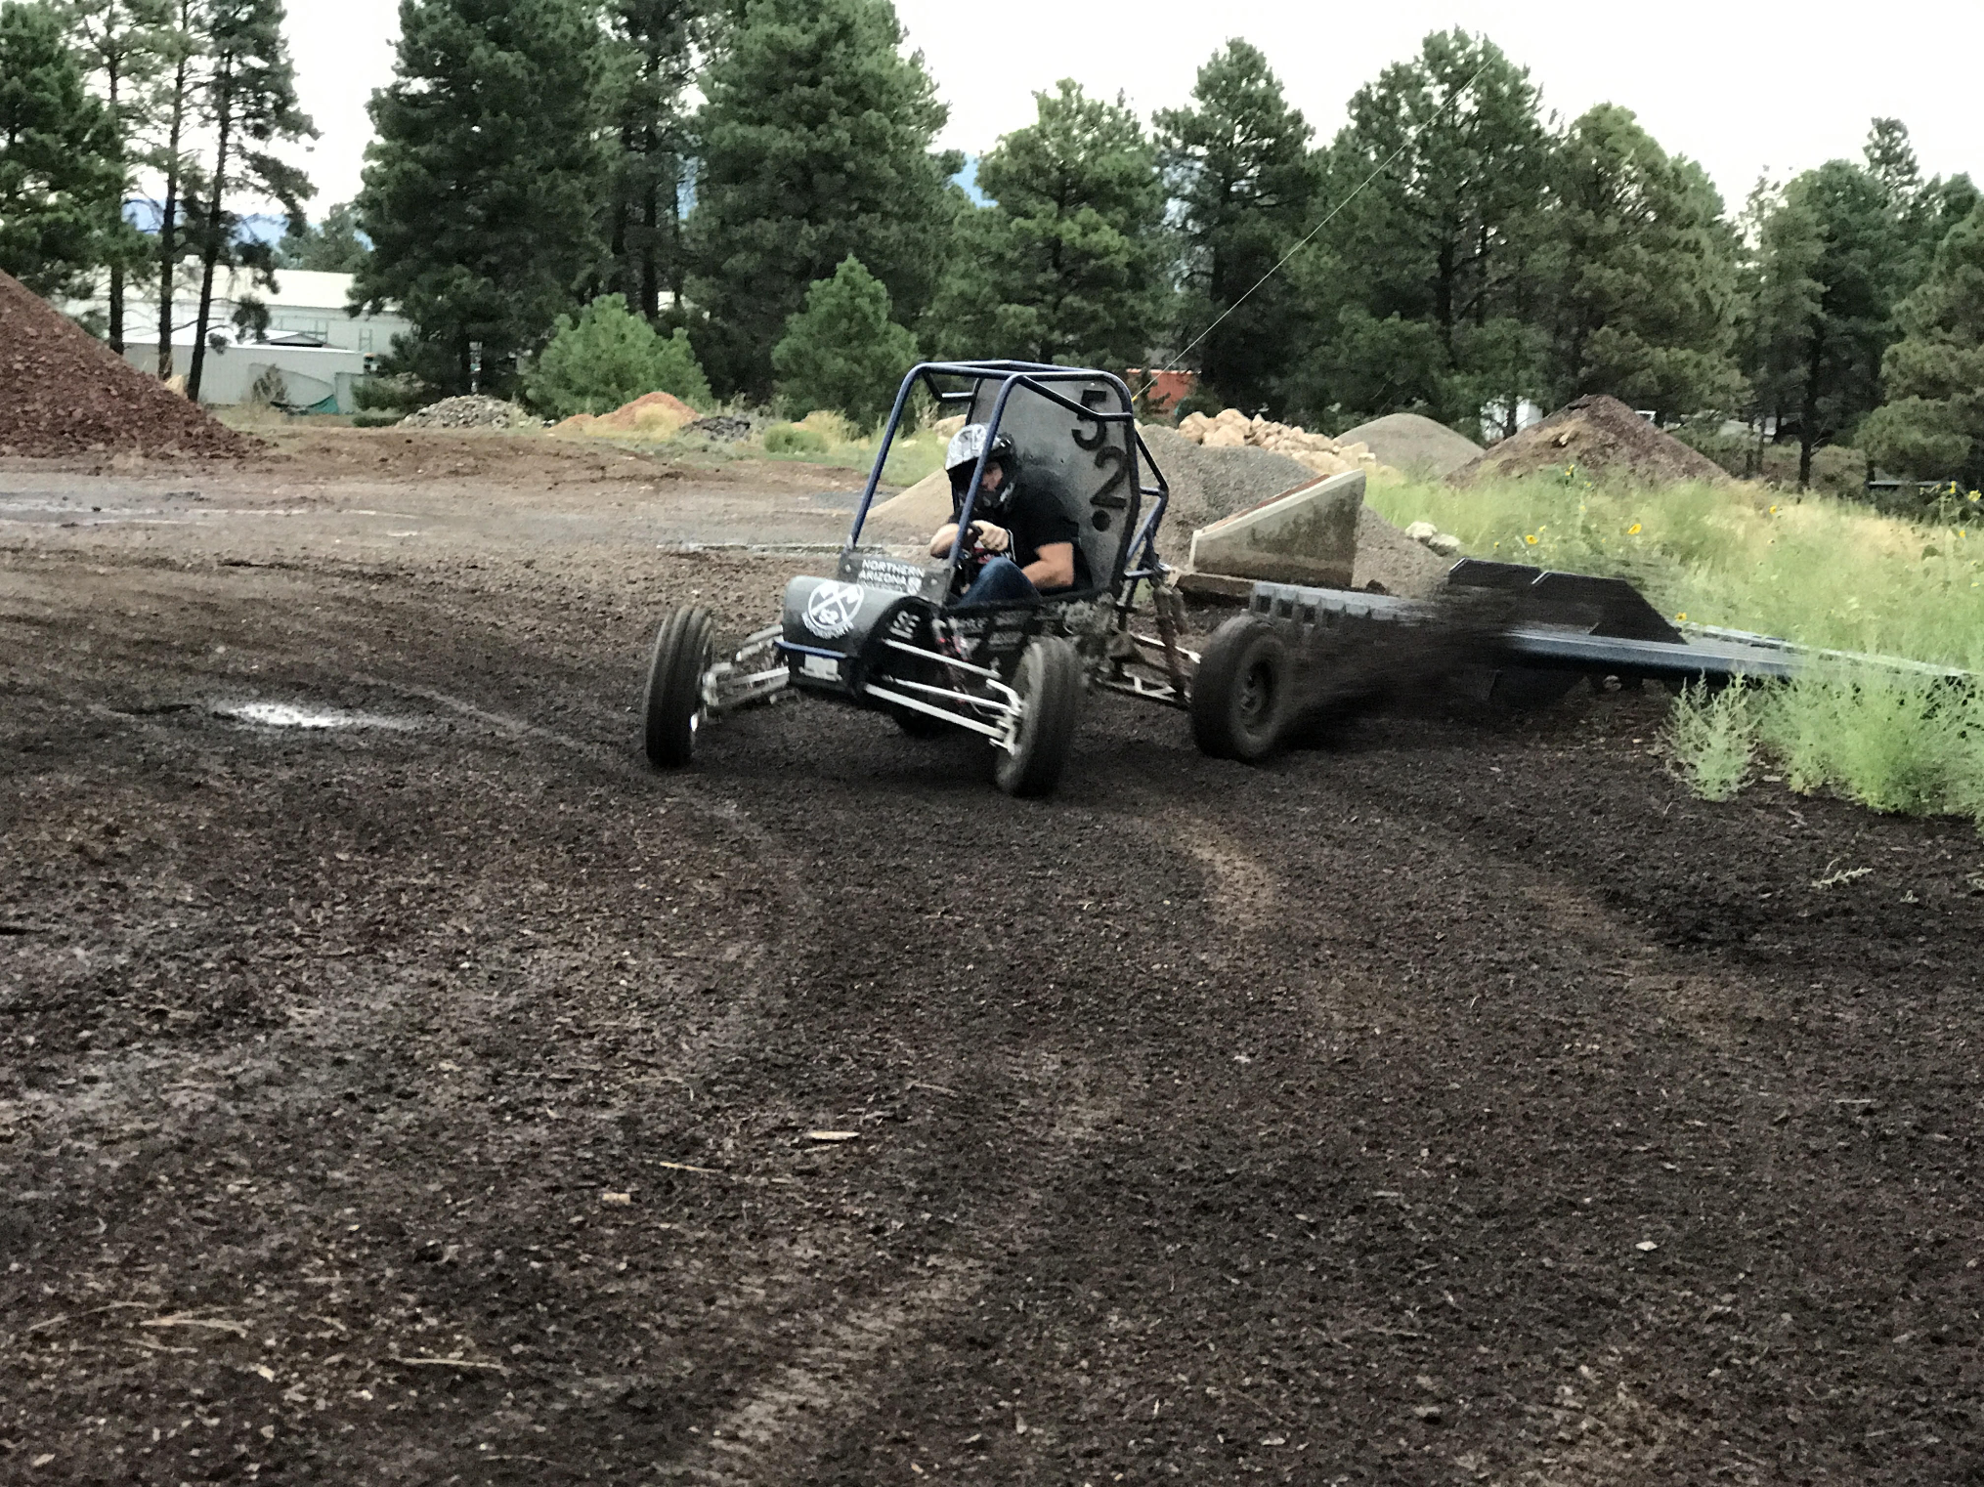
Testing Plan
Extensive driving on closed course tracks made to emulate the various Baja event
Failure modes and effects analysis on critical parts
Stress testing for sub-systems:
Jump vehicle to test full compression on front end
Drop test to shock drive train
Rear end collision loading rear half shafts in axial compression
Roll-over to test frame rigidity
Equipment is limited to the finished product and the vehicle spare components
Figure 15: Driving on Dirt Track

Slide 15
Conclusion
Thank you!
Questions?
Lumberjack Motorsports
Northern Arizona University
2112 S Huffer Ln. Flagstaff, AZ 86011
College of Engineering: (928) 523-5251
sae.nau@gmail.com
Ashley Redmond

