Slide 1
DFMA

Slide 2
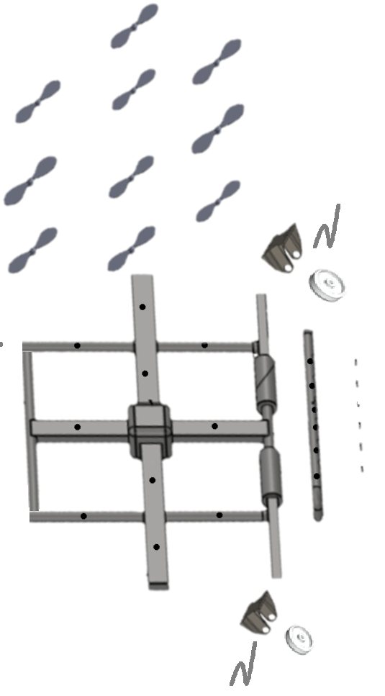
Design of Assembly (DFA)
Old Design
Assembly Time for Drone is
1200 seconds
Number of parts are 56
20 Screws
2 Nut Bolts
6 Elbows
Assembly Time drop to 300 seconds
Number of parts reduced to
1200 seconds
Number of parts are 32
0 Screws
2 Hooks
2 Elbows

Slide 3
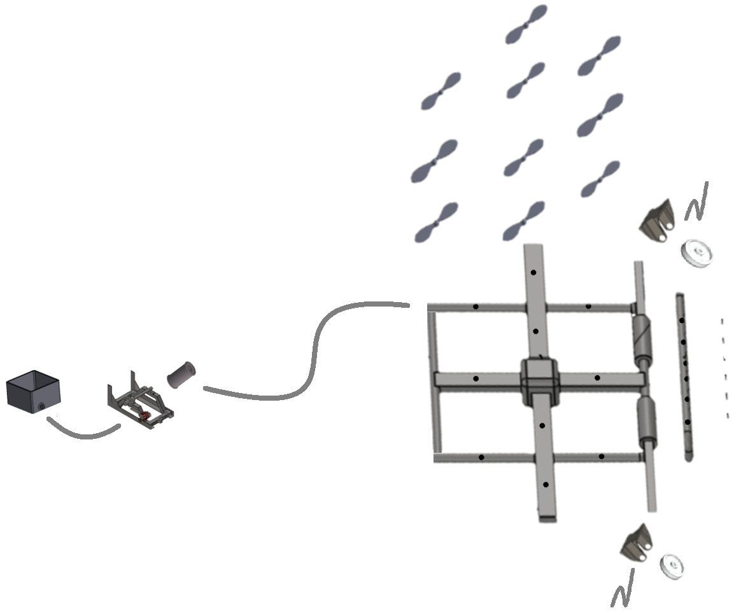
Design of Assembly
Original Design
Redesign
Old Full Design
New Full Design

Slide 4
Design of Assembly
 | Original Design | Redesign | Improvements %
Assy. Time HRS | 1.5 | 0.3 | 80
No. OF DIFF PARTS | 26 | 4 | 84.62
TOTAL NO. OF PARTS | 56 | 32 | 42.8

Slide 5
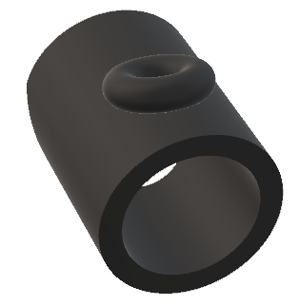
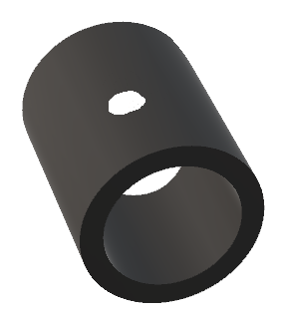
Design of Manufacturing (DFM)
Old Design for Pipe to connect propellers
New design for pipe to connect propeller without screws

Slide 6
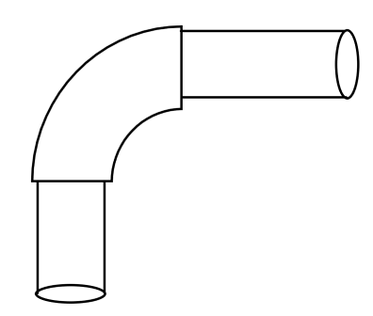
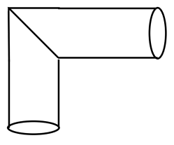
Design of Manufacturing (DFM)
Pipe Joint Old
This cost more, as elbow need to manufacture
Pipe Joint New
Cost less with no elbow

Slide 7
DFMA
Cost of manufacturing reduces by 20%
Original cost around $500
Redesign cost around $400 (elbows removed, screws removed)
Number of parts reduces in the assembly
Assembly time decreases
Labor cost decreases

