Slide 1
Team Honeywell
Jered Deal
Ilenn Johnson
Cullen Matillano
John Selee
Jacob Vedder

Slide 2
Project Description
Design, analyze and prototype an oil chip detector housing for a small turboprop engine.
Client: Honeywell
Keeping oil free of debris during engine operation.
Figure 1. Honeywell logo [1]

Slide 3
Project Description
Honeywell has asked Team Honeywell to design the housing for an oil chip detector on an engine.
The oil chip detector and input and output lines have already been designed.
The design will be mounted on an engine and will have the other parts installed into it.
There will be an oil flow through the device, and the goal is to maximize the rate at which the oil chip detector picks up impurities in the oil.

Slide 4
Elbow Joint
Right port: Inflow
Bottom port: Outflow
Left Port(s): Sensor and mounting bolt:
Note: Expansion from 3/4in diameter circle to 1.8 inch. square.
Figure 2: Current Drawing for Elbow Joint sensor housing

Slide 5
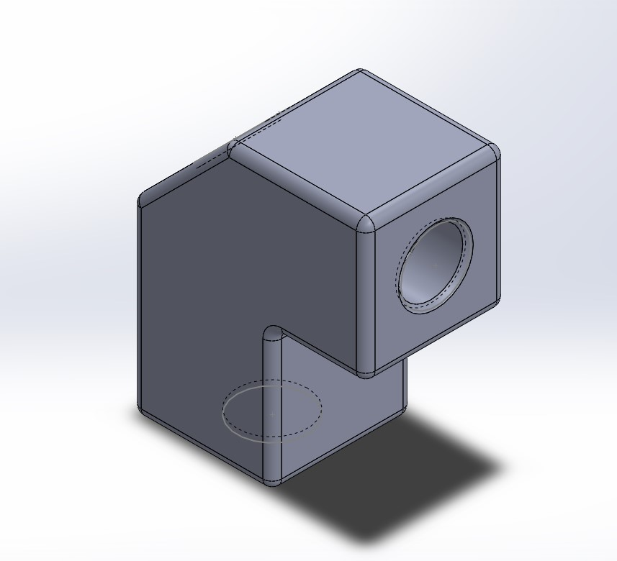
Elbow Joint
Figure 3. Engine Housing

Slide 6
Design Description
Oil comes in the inlet and flows through an expansion section.
The sensor sits at the back of the housing and engine debris flows by the sensor getting trapped by the sensor's magnets.
The oil flow is forced through the outlet into the return line.

Slide 7
Design Requirements
Table 1. Customer Requirements
Customer Requirement | Comment
Weight | (0.95 lbs.),Less than the assigned limit (1.00 lbs.)
Leak Free | Assured by material choice and machining quality
Fuel, Oil Resistant | Nonreactive and impermeable material choice
Temperature Resistant | 304 Stainless Steel; a ductile material with T_{m} > 2000°F
Size | Fits the given envelope of 3x3x2 inch.
Fitting Quality | Milled form and machined threads
Appropriate Material | Stainless; nonreactive, nontoxic, noncorroding
Slows Flow by 90% (1-4ft/s) | Satisfied by cross sectional area expansion

Slide 8
Preliminary Analysis
Hoop Stress, cylindrical pressure vessel
Continuity, Expansion
Minor head loss
Equation 1. Hoop stress equation
Equation 2. Continuity equation
Equation 3. Head loss equation

Slide 9
Preliminary Analysis
Average hoop stress assuming 1/8in wall thickness: 94.8PSI
304 SST yield stress: 31200PSI
Diameter of expansion for 90% velocity drop: 2.37in
Velocity drop from minor head loss, 90 degrees elbow: 16.3%

Slide 10
Failure Modes Engineering Analysis (FMEA)
Determines possible failures in the 3 main subsystems: Body, Seals, and the mounting bolts.
Used to calculate a Risk Priority Number (RPN)
Helps develop possible solutions to future failures.

Slide 11
Design Validation: FMEA
Table 2. Failure Modes and Engineering Analysis
Part # and Functions | Potential Failure Mode | Potential Effect(s) of Failure | Potential Causes and Mechanisms of Failure | RPN | Recommended Action
1, Body | Temperature Induced Deformation | Leaking of device, difficult to remove | Material choice incorrect, heat distribution focused on single point | 24 | Choose different material
1, Body | Ductile Rupture | Device leaks and completely unusable | Manufacturing process weakened the device, oil pressure too high for material | 6 | Adjust manufacturing process
1, Body | Corrosion by Direct Chemical Contact | Device does no last the appropriate amount of time | Materials in the oil corrode and weaken the device | 30 | Review material choice
2, Seal | Temperature Induced Deformation | Heat melts the seal, causing the device to leak | Heat from outside easily transfers into seal | 36 | Change location or material of seal
2, Seal | Corrosion by Direct Chemical Contact | Seal degrades quickly and fails | Sealant material choice is easily corroded by oil | 18 | Change sealant choice
3, Mounting Bolts | Yielding | Device difficult to remove | Bolt size incorrect for application, force applied too great | 4 | Change bolt size or mounting positioning
3, Mounting Bolts | High-Cycle Fatigue | Mounting fails, device moves while in use | Engine vibrations produce high cycles of fatigue on bolts, causing them to fail | 12 | Use more or bigger bolts

Slide 12
FMEA
The body has the most failure modes associated with the design but is not the biggest issue.
The sealants are the most likely to fail, as they have a high RPN associated with each failure mode.
Mounting Bolts hold a small RPN compared to the body and the seals.

Slide 13
Testing Procedures
The procedure is the type of tests that are being run on the prototype.
The testing criteria is what is being tested and what the data means.
The success criteria is set on a pass/scale with the criteria being provided by Honeywell
Test Article’s are the devices that are being used and how they are being utilized during the test.
Test preparation and procedure determines the way the tests will be run and what data is being collected.

Slide 14
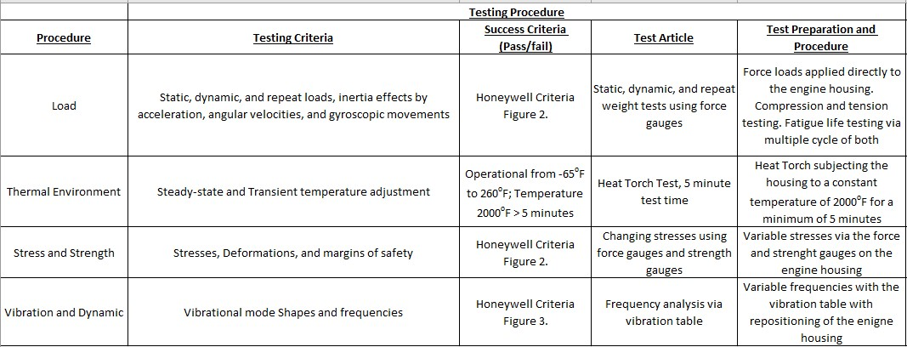
Testing Procedures
Table 3. Testing Procedures [2]

Slide 15
Testing Procedures
There are 4 main test: Load, Thermal Environment, Stress and Strength, and Vibration and Dynamic tests.
Testing procedures are given directly by Honeywell and meeting all Engineering and Customer Requirements.
Equipment that is required:
Force and Strength Gauges
Heat Torch
Vibration Table

Slide 16
Tentative Schedule-Spring
Early February Test Date TBD
Currently on track and ahead of schedule in order to stay on track with the earlier test date
Final Prototype to be complete 1st week of February

Slide 17
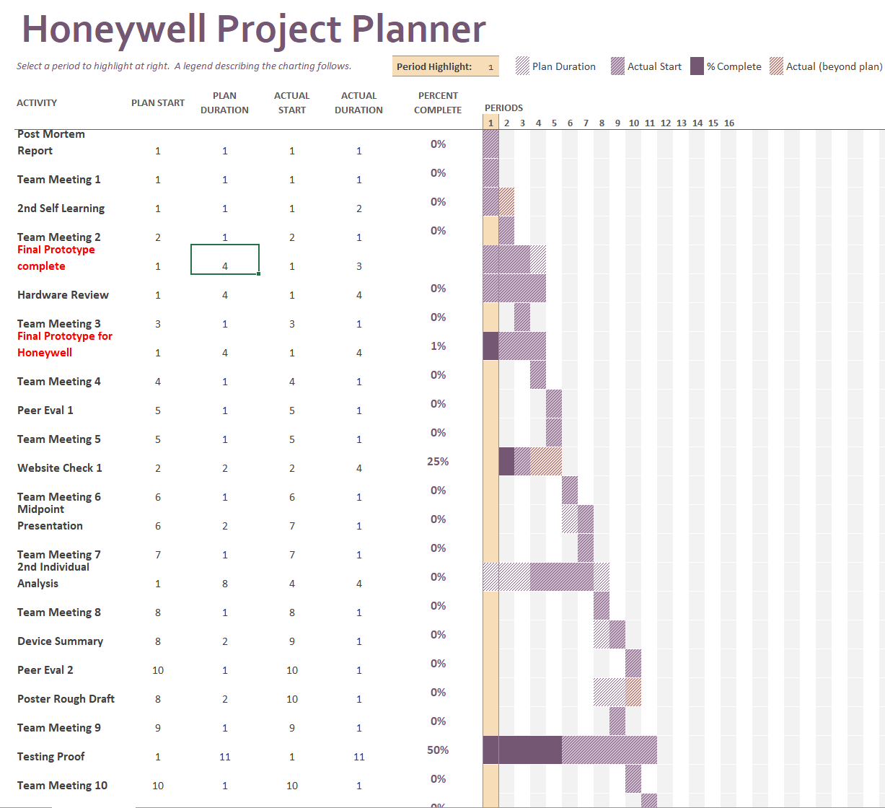
Gantt Chart
Tentative Schedule
Creating the final prototype is top priority
Full Gant Chart in Appendix A
Figure 4. Spring 2020 Gantt Chart
17

Slide 18
Budget
May be able to us tooling in NAU Machine Shop
Depending on the decided wall thickness of the housing the material price will vary.
Table 4. Budget update
Available funds | Costs | Prices
$1000 | Prototyping | $100.00
 | Tooling | $500.00 (possibly $0)
 | Materials estimate (304 Stainless Steel Square Tube 4ft) | $200.00-$300.00
 | Expenses to date | $0.00
 | Total cost (worst case scenario) | $900.00

Slide 19
Questions?

Slide 20
References
[1]“Honeywell,” Honeywell. [Online]. Available: https://www.honeywell.com/. [Accessed: 10-Sep-2019].
[2] "Procurement Specification for the Oil Chip Detector Housing," Honeywell. Phoenix, Arizona, September 11, 2019

Slide 21
Appendix A -Gantt Chart

