Slide 1
Team Honeywell
Jered Deal
Ilenn Johnson
Cullen Matillano
John Selee
Jacob Vedder

Slide 2

Project Description
Figure 1. Honeywell logo [1]
Design, analyze and prototype an oil chip detector housing.
Client: Honeywell
Knowing the quality of the oil without having to manually check

Slide 3
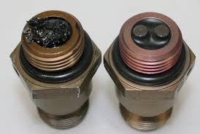
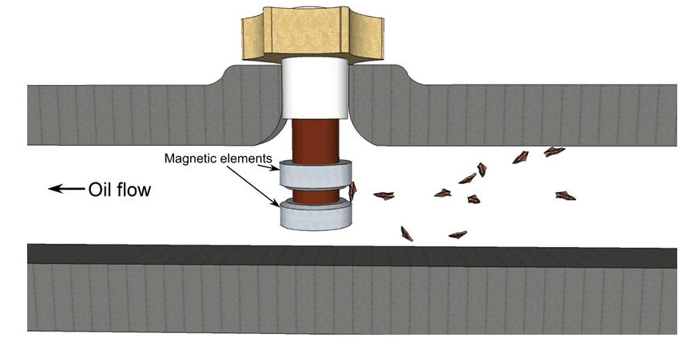
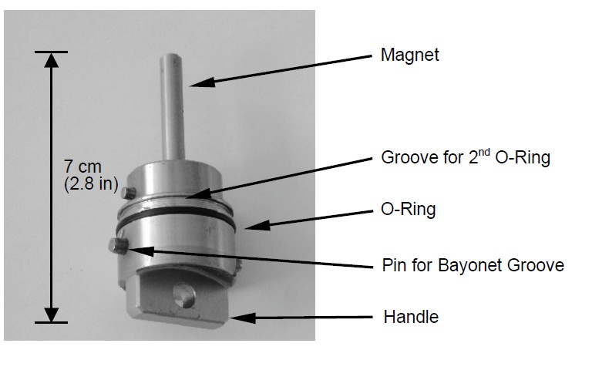
Background
Engine systems wear and release debris which oil chip detectors collect and notify users of.
Commonly used on larger vehicles such as aircraft and helicopters.
Installed in the oil line, perpendicular to the flow direction.
Figure 2. Engine sensor and housing [2]
Figure 3. Engine housing sensor [3]
Figure 4. Engine sensor [4]

Slide 4
Benchmarking
Housings for on-line sensors aren't commercially available.
In-line sensors are generally self-contained.
Current benchmarking will include pros and cons of each design/model
  Modularity
  Universal fitments
  Maximum efficiencies

Slide 5
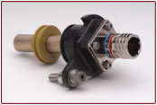
Benchmarking -Allen Aircraft Products, Inc
Figure 5. Complete in-line design by AAP with strainer attached; specifically for aircraft engines. [5]

Slide 6
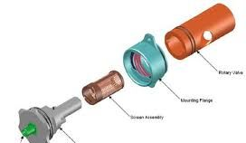
Benchmarking – Meggitt Sensing Systems
Figure 6. An exploded CAD view of a Swiss-built Meggitt Sensor. Notable innovations include variable pulse outputs to differentiate between chip sizes as the oil flows through the center.[6]

Slide 7
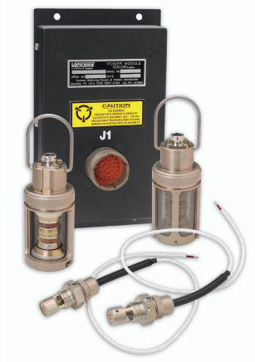
Benchmarking - Eaton
Figure 7. The Eaton Zapper System, a comprehensive kit from a reputable manufacturer intended for aircraft engines and transmissions. This model is designed for on-line use.[7]

Slide 8
Literature Review
Wearing of on-line oil chip detector systems[8]-Ilenn
Oil Debris Monitoring in Aerospace Engines and Helicopter Transmissions[9]-Jacob
Signal Processing to Overcome Random Vibration Interference in an Oil Debris Monitor (ODM) sensor[10]- Cullen
Experimental Investigation on the Influence of Engine Oil Additives on Silicone Rubber[11] - Jered
In-line oil debris monitor for aircraft engine condition assessment[12] - John

Slide 9
Customer Requirements
Characteristic | Expectation
Weight | <1lb
Temperature Resistance | 5 min at 2,000°F; 2 min at 310°F
Operating Temperature | -65° to 260°F
Size | Given Envelope, TBD dimensions
Shock Resistance | 6g operating, 20g crash
Withstand Operating Oil Pressure | TBD psig
Altitudes | -2,000 to +55,000 feet
Table 1. Primary Customer Requirements

Slide 10
Engineering Requirements
Need | Design Requirement
Within Budget | < $2000
Durable | TBD Use Time,
Reliable | Works through changes in temperature, altitude, attitude
Safe in Operation | Holds operating pressure with FoS>TBD
Appropriate Material | Non-Reactive metals with melting point > 2000°F
Table 2. Engineering Requirements

Slide 11
Phase 1
House of Quality (HoQ) correlates Customer Needs to Engineering Requirements
Phase 1 includes ATI and RTI
Table 3. Phase 1 House of Quality (HoQ)

Slide 12
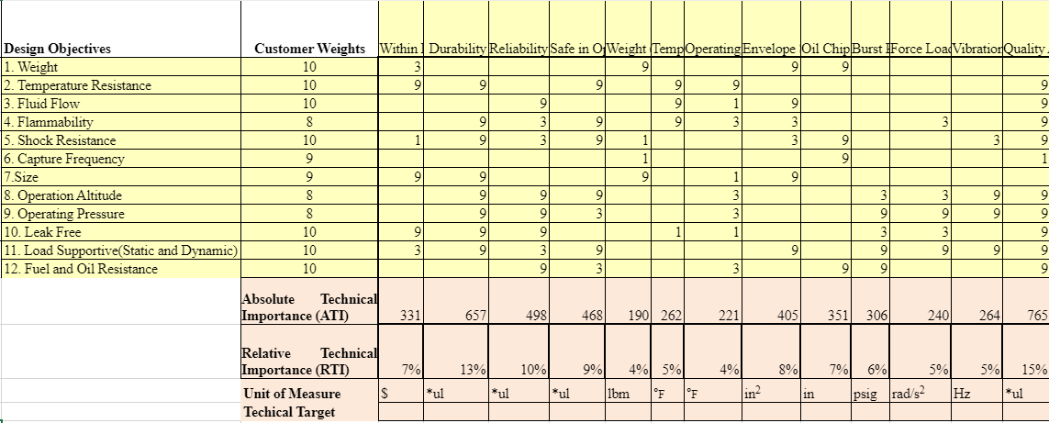
Table 4. House of Quality

Slide 13
Phase 2
Correlates specifications to possible parts
Determines the Relative Weight of each possible part
Table 5. Phase 2 HoQ

Slide 14
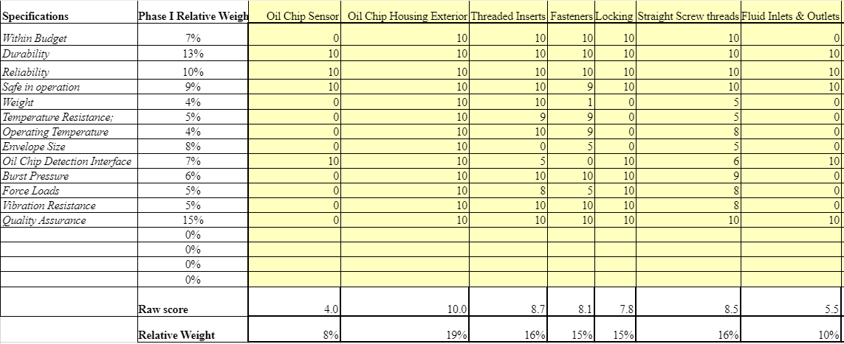
Figure 6. Phase 2 HoQ

Slide 15
Schedule
Gantt Chart used to establish project tasks and Deadlines
Currently ahead of schedule
Prototype ready to test by February 2020

Slide 16
Gantt Chart
Table 7. Gantt Chart

Slide 17
Budget
Total budget: $1000-2000
Anticipated expenditures per device:
  Machining process: $200
  Materials: $100
Machining can be done on NAU campus
Prototypes can be tested with Honeywell
4 prototype models are expected to be made and 1 final model will be made
Expected remaining budget: $500

Slide 18


Questions?

Slide 19
References
[1]“Honeywell,” Honeywell. [Online]. Available: https://www.honeywell.com/. [Accessed: 10-Sep-2019].
[2] Australian Transport Safety Bureau, "Engine Failure Lake Burbury, Tasmania 5 February 2006," Australian Government, Canberra City, 2007.
[3] I. Lad, "Mag Chip Detector," Isambardkingdom, 8 January 2012. [Online]. Available: http://isambardkingdom.com/?attachment_id=537. [Accessed 10 September 2019].
[4] K. V. Sagar, "Clogging Of Oil Filters, Oil Jets, Its Consequences and a requirement of pressure relief valve (PRV) in oil filters of jet engines," International Journal of Mechanical Engineering and Technology (IJMET), vol. 8, no. 6, pp. 156-166, 2017.
[5]“Chip Detectors,” Allen Aircraft Products, Inc. [Online]. Available: http://www.allenaircraft.com/products/chip_detectors.html. [Accessed: 10-Sep-2019].
[6]“Oil debris monitoring: MeggittSensing,” Meggitt Sensing Systems, 10-May-2017. [Online]. Available: https://meggittsensing.com/aerospace/product/oil-debris-monitoring/. [Accessed: 10-Sep-2019].
[7]“Sensors and Limit Switches,” Sensors and Limit Switches for Automation and Control Applications, 2019. [Online]. Available: https://www.eaton.com/ecm/groups/public/@pub/@eaton/@aero/documents/content/ct_194538.pdf . [Accessed: 10-Sep-2019].
[8]Z. Yunbo and G. Yuhai, "Research of the on-line system for detecting metal particles in oil," 2017 13th IEEE International Conference on Electronic Measurement & Instruments (ICEMI), Yangzhou, 2017, pp. 98-102.
[9] S. Showalter, S. Pingalkar and S. Pasha, "Oil debris monitoring in aerospace engines and helicopter transmissions," 2012 1st International Symposium on Physics and Technology of Sensors (ISPTS-1), Pune, 2012, pp. 157-160.
[10] W. Chen, "Signal Processing to Overcome Random Vibration Interference in an Oil Debris Monitor (ODM) Sensor." Order No. MR86285, University of Ottawa (Canada), Ann Arbor, 2012.
[11]Kusuhara, S., Yoshimura, K., Kunieda, K., Suzuki, N., Matsuki, S. and Shitara, Y. (2017). Experimental Investigation on the Influence of Engine Oil Additives on Silicone Rubber. SAE International Journal of Fuel & Lubricants, [online] 10(2), pp.461-468. Available at: http://eds.b.ebscohost.com.libproxy.nau.edu/ehost/detail/detail?vid=0&sid=aa09a570-99af-47f4-9316-d7ad0840a8db%40sessionmgr103&bdata=JnNpdGU9ZWhvc3QtbGl2ZSZzY29wZT1zaXRl#AN=122441314&db=a9h [Accessed 13 Sep. 2019].
[12]J. Miller and D. Kitaljevich, “In-line oil debris monitor for aircraft engine condition assessment,” 2000 IEEE Aerospace Conference. Proceedings (Cat. No.00TH8484).

