Slide 1
Team Honeywell
Jered Deal
Ilenn Johnson
Cullen Matillano
John Selee
Jacob Vedder

Slide 2

Project Description
Design, analyze and prototype an oil chip detector housing for a small turboprop engine.
Client: Honeywell
Keeping oil free of debris during engine operation.
Figure 1. Honeywell logo [1]

Slide 3
Project Description
Honeywell has asked Team Honeywell to design the housing for an oil chip detector on an engine.
The oil chip detector and input and output lines have already been designed.
The design will be mounted on an engine and will have the other parts installed into it.
There will be an oil flow through the device, and the goal is to maximize the rate at which the oil chip detector picks up impurities in the oil.

Slide 4
Design Requirements
Table 1. Customer Requirements
Customer Requirement | Comment
Weight | (0.95 lbs.),Less than the assigned limit (1.00 lbs.)
Leak Free | Assured by material choice and machining quality
Fuel, Oil Resistant | Nonreactive and impermeable material choice
Temperature Resistant | 304 Stainless Steel; a ductile material with T_{m} > 2000°F
Size | Fits the given envelope of 3x3x2 inch.
Fitting Quality | Milled form and machined threads
Appropriate Material | Stainless; nonreactive, nontoxic, noncorroding
Slows Flow by 90% (to 4ft/s) | Satisfied by cross sectional area expansion

Slide 5
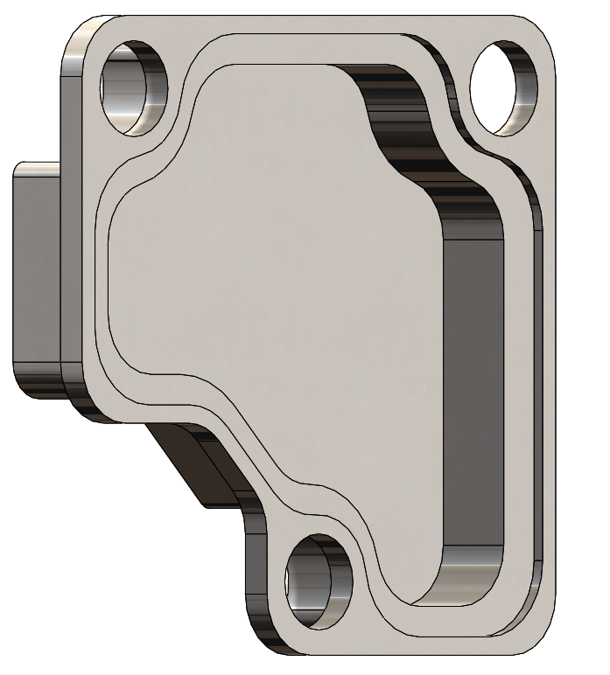
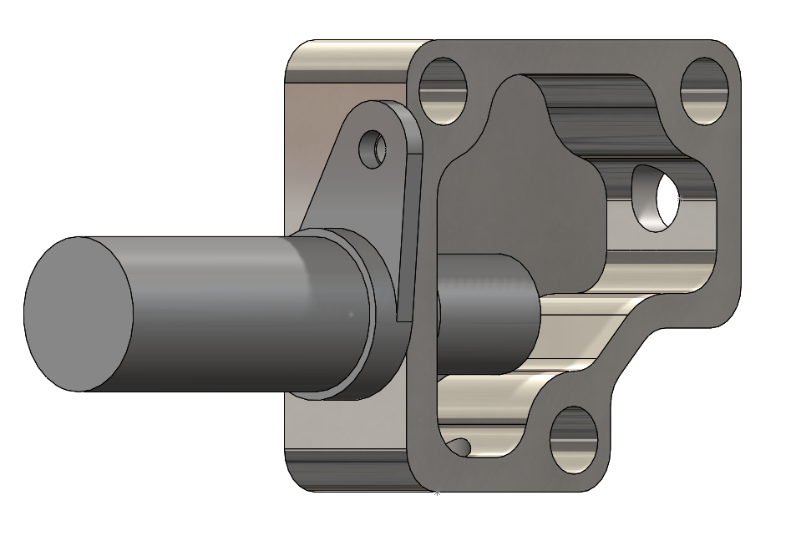
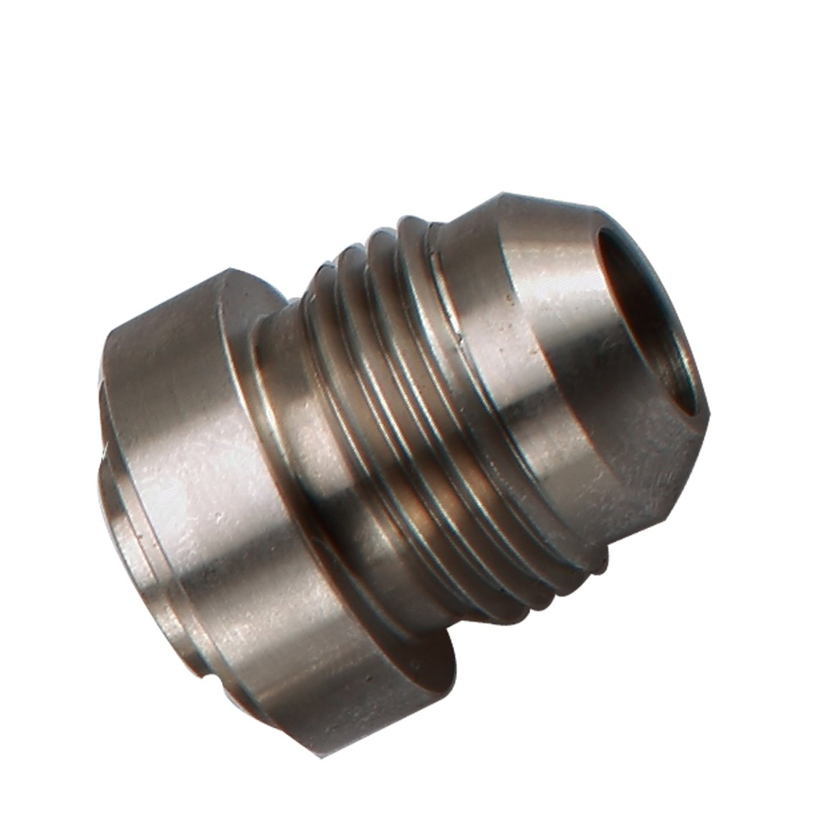
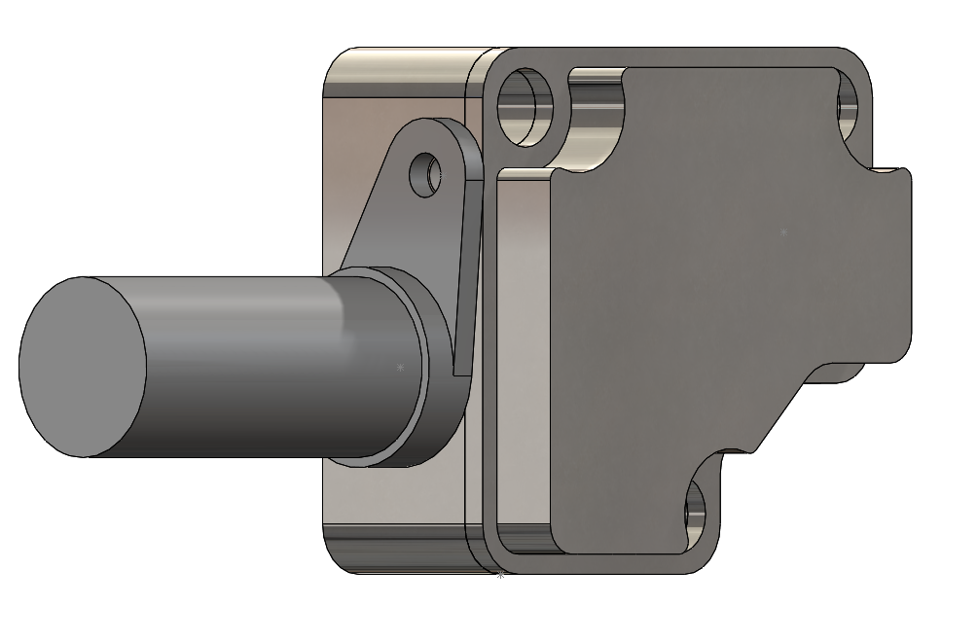
Current State
0.95 lbs.
304L Stainless Steel
~4ft/s by the probe(10 gpm, 30psig inlet)
Overall 2.74 x 2.86 x 1.50 in.
Weld bungs - 08AN Male(304)
Nitrile Graphite gasket(0.063 in.)
Gasket seat cut at 0.059±0.003in,(5%±4%)
M10 main mounting holes(25/64", counterbored 0.39±0.010" for socket cap screws)
M6x15 stud, sealed or possibly welded inside
Probe sealed with s.113 O-ring
Mounting Bolt Torque specs: 11.5 lb.-ft minimum, 45 lb.-ft preferred to hit 4100psi
Figure 3: Gasket Seat
Figure 2: Cutaway
Figure 4: Complete Housing
Figure 5: Weld Bung[2]

Slide 6
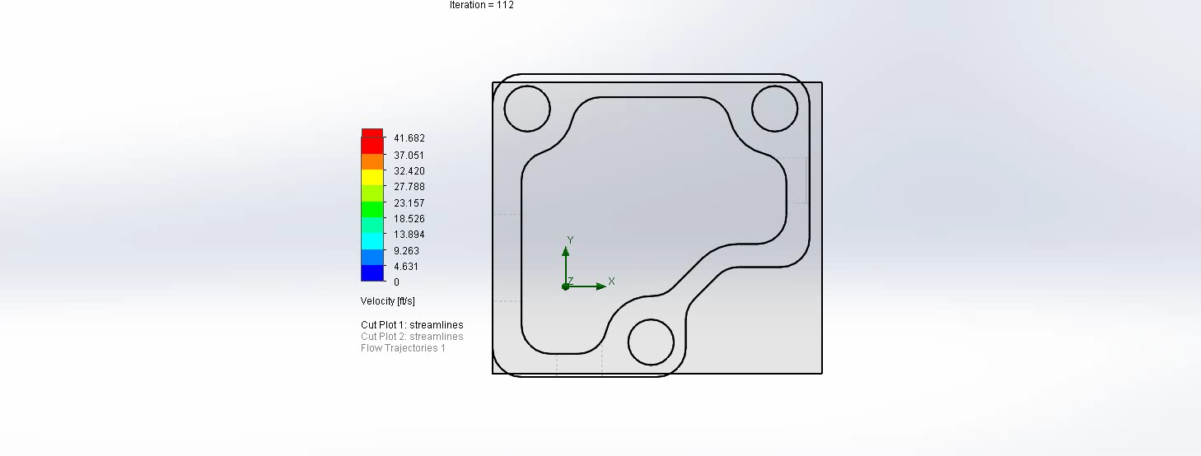
Current State-Flow
Customer requirement is for the flow around the sensor to be 4 ft/s
Inlet flow rate is 10 gal/min and a pressure of 30 psi
Flow analysis shows flow rate of approximately 4 ft/s

Slide 7
BOM
Material | Cost
Stainless 304/304L 0.75”x3”x16” | $73.94
Stainless 304/304L 1.5”x3”x16” | $142.83
Graphite Nitrile gasket | $98.16
-8 Stainless-steel weld bung | $18.86
Shipping/other | $116.46
Total | $450.24
Remaining Budget | $549.76

Slide 8
Manufacturing
The machine shop will be manufacturing the device
Nitrile gasket will be cut using the Silver Bullet provided by the NAU Cline Library

Slide 9
Testing
All tests will have been performed by Honeywell during their testing period in approximately 2 weeks
Tests that will be performed include the following:
  Weight: Housing will be weighed with a scale
  Vibration: Housing will be mounted on the engine during testing, must not fail
  Envelope Size: Calipers will be used to measure housing size
  Operating Pressure: Tapping's will be used by Honeywell
  Internal Interface: Calipers will be used to measure flow area around housing
  Temperature Resistance: Housing will be exposed to a flame test, must not fail

Slide 10
Questions?

Slide 11
References
[1]“Honeywell,” Honeywell. [Online]. Available: https://www.honeywell.com/. [Accessed: 10-Sep-2019].
[2]“Stainless Steel weld bung AN4-AN10,” Home, 2020. [Online]. Available: https://www.racingzone.ca/en-US/catalog/products/site/detail/93/stainless-steel-weld-bung-an4-an10. [Accessed: 03-Mar-2020].

