Slide 1
Team Apollo project #6
By
-Esmael Abdullah -Andres Rodriguez
-Fahad Esmaeil -Dakota Hanks
-Trenton Black

Slide 2
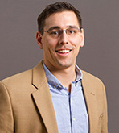
Project Description
Description:
Determine the position and orientation of an object relative to a solar location.
Sponsor:
Dr. Michael Shafer
Importance:
Global positioning, wildlife monitoring, geocaching, space travel, spectrum data logging.

Slide 3
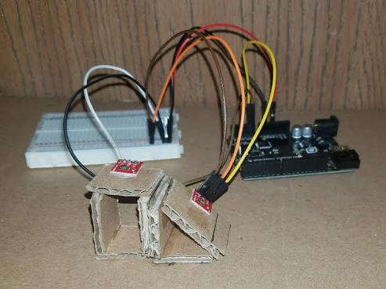
What is New
Concept Modeling and Testing:
Technical Distribution:
Trenton Black // Project manager // SolidWorks & Data Logging
Dakota Hanks // Website Developer // Programming
Andres Rodriguez // Document Manager // Sensor Sub-Circuits
Esmael Abdullah // Budgeter // Power Conversion and supply
Fahad Esmaeil // Client Contact // Power Storage and supply

Slide 4

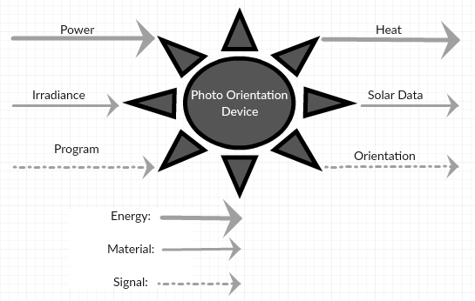

Black Box

Slide 5
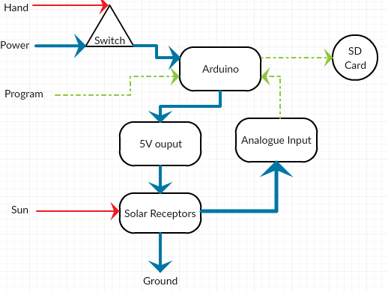
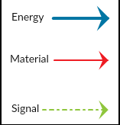
Decomposition
Trenton
Esmael & Fahad
Dakota
Andres
Trenton

Slide 6
Break down
Design Criteria
Engineering/Technical Requirements
cost
Manufacturing
Sensor Quantity
Energy Storage
Size
Product life/durability
Accuracy
Processor type
Sensor to board design
Sensor/cell type
Power source
Size of the device
Housing material
Battery life

Slide 7
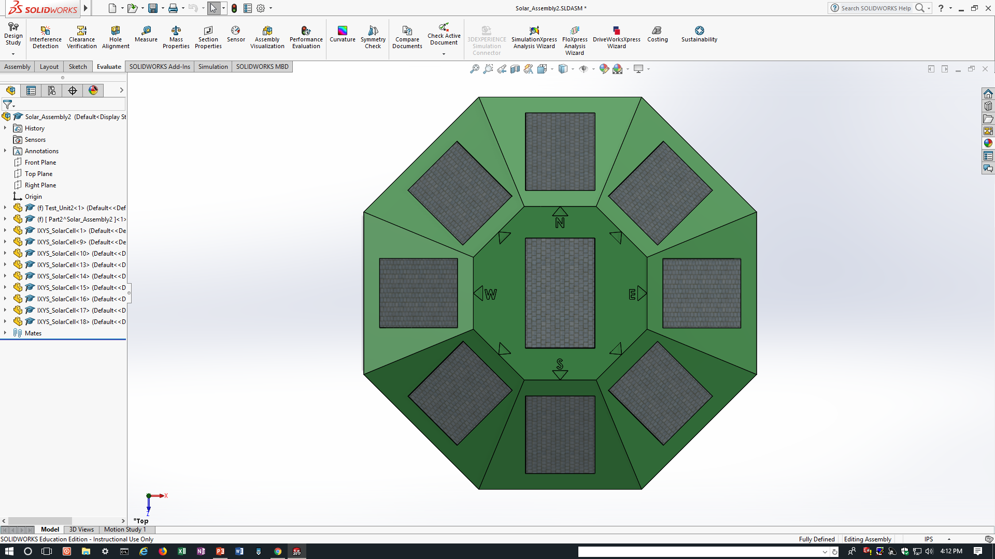
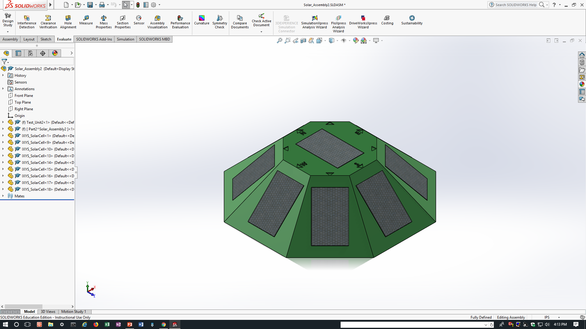
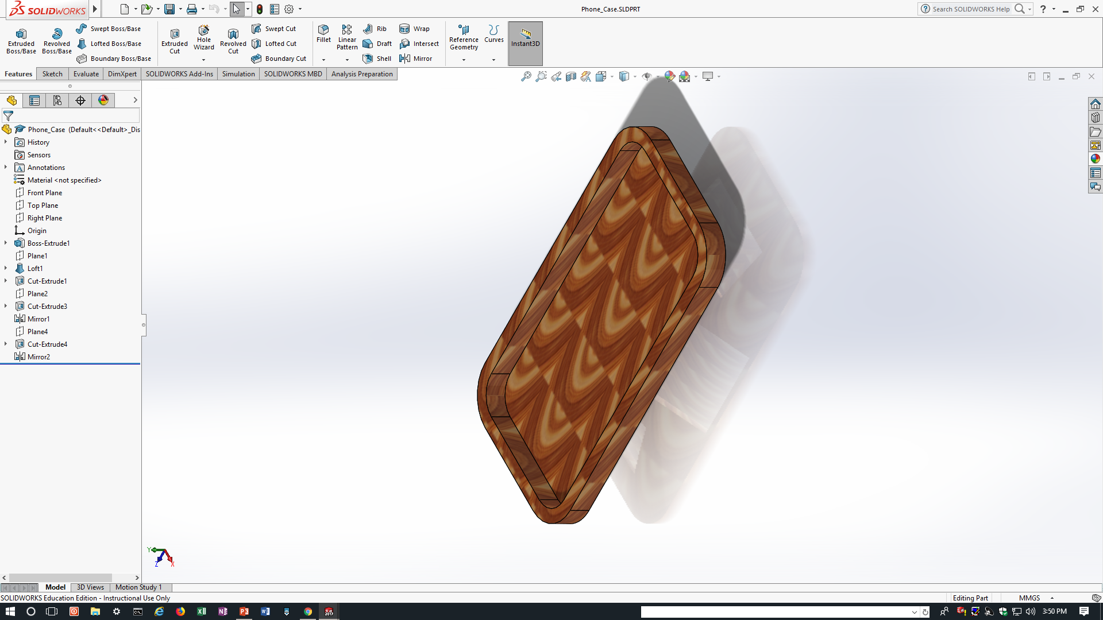
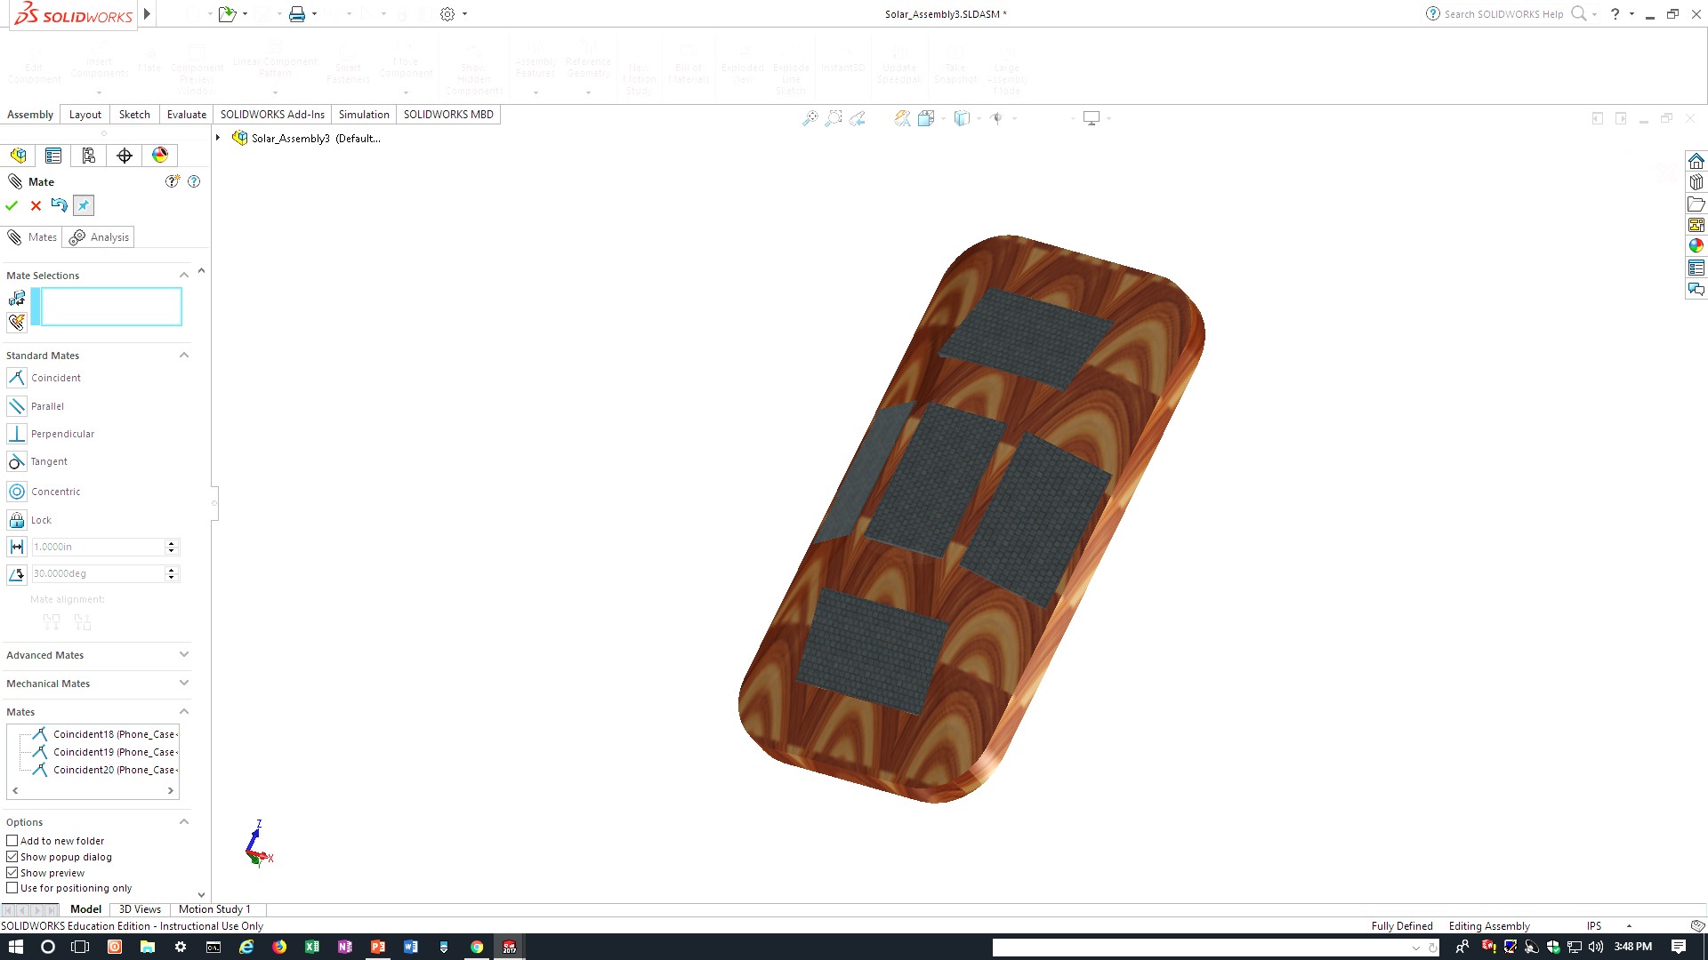
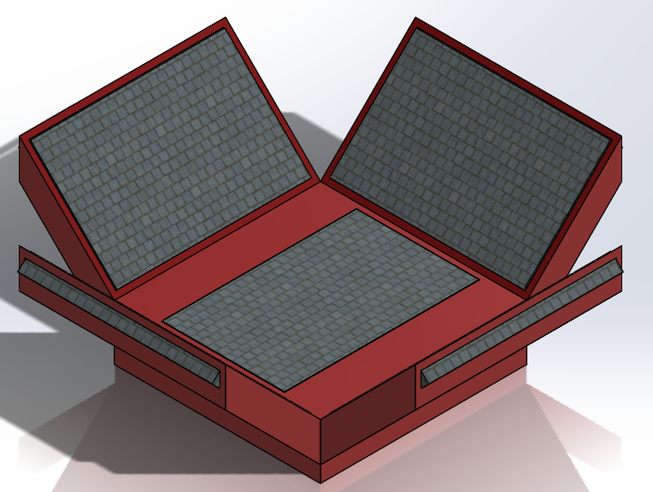
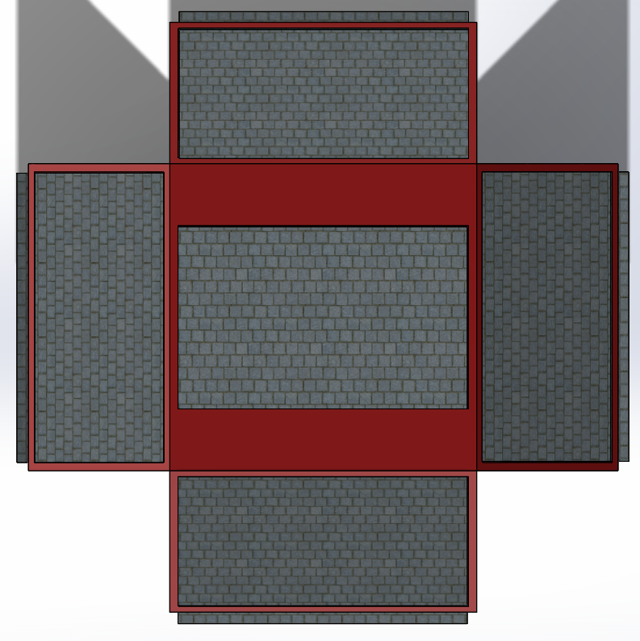
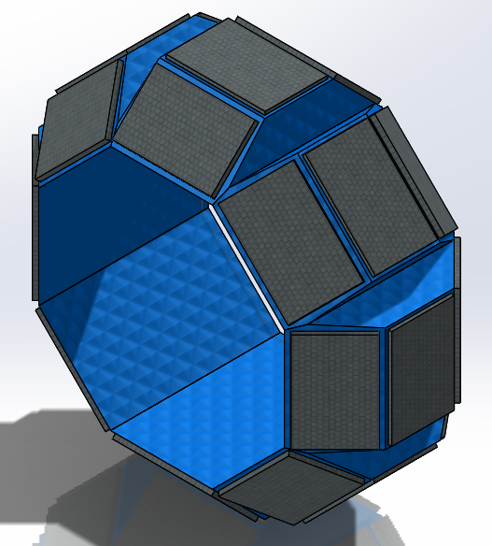
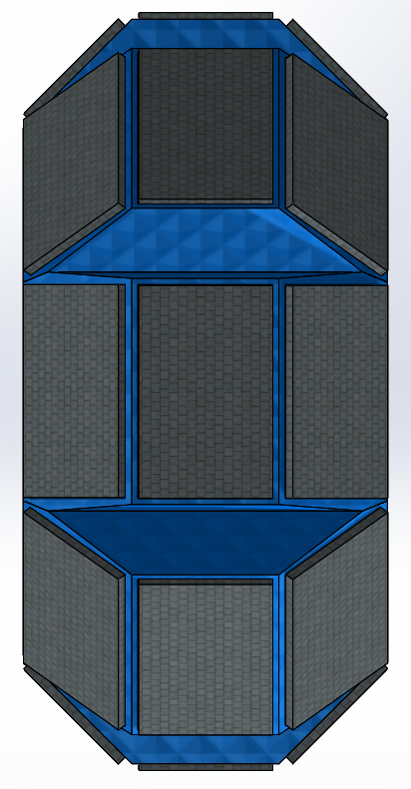
Designs Considered
Design 2:
Design 1:
Design 4:
Design 3:

Slide 8
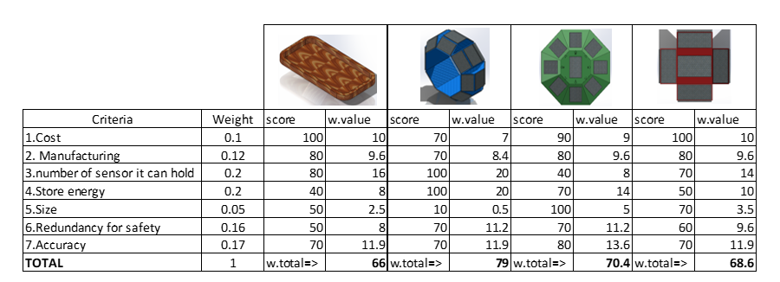
Decision matrix

Slide 9
Design Selected
Selected Design: #3
superior solar cell Capacity
Possible energy Generation
Versatility in calculating a broader orientation range
Ability to be equipped to an individual or object.
Size
Design 3:

Slide 10
Schedule
Course Deliverables: (Hand out)
Status: On Schedule/Ahead
Team and Sponsor Deliverables:
-Multi-Panel Prototype Solar Locater (proof of concept) – 03/14/2018 (Group)
-Testing
-Integrate Compass – 04/04/2018 (Group)
-Testing
-Integrate Clock – 05/02/2018 (Group)
-Testing

Slide 11
Budget
Quantity | Material | Cost ($)
1 | Breadboard – Mini Module | 3.95
2 | Sparkfun Solder-able Breadboard - Mini | 2.95
1 | RobotDyn – Data logger | 9.99
1 | Wire | 16.95
1 | Solar Battery (Store Energy)
Total Cost: $36.79
Based on Preliminary budget:
Est. Cost: >200$

Slide 12
Next Steps
3D print a demo/testing unit
Validate and record program accuracy & precision of 2 panels
Begin integrating 7 more panels to fill the demo unit displayed above.

Slide 13

FEEDBACK
Thank You

Slide 14
References
[1]

