Slide 1
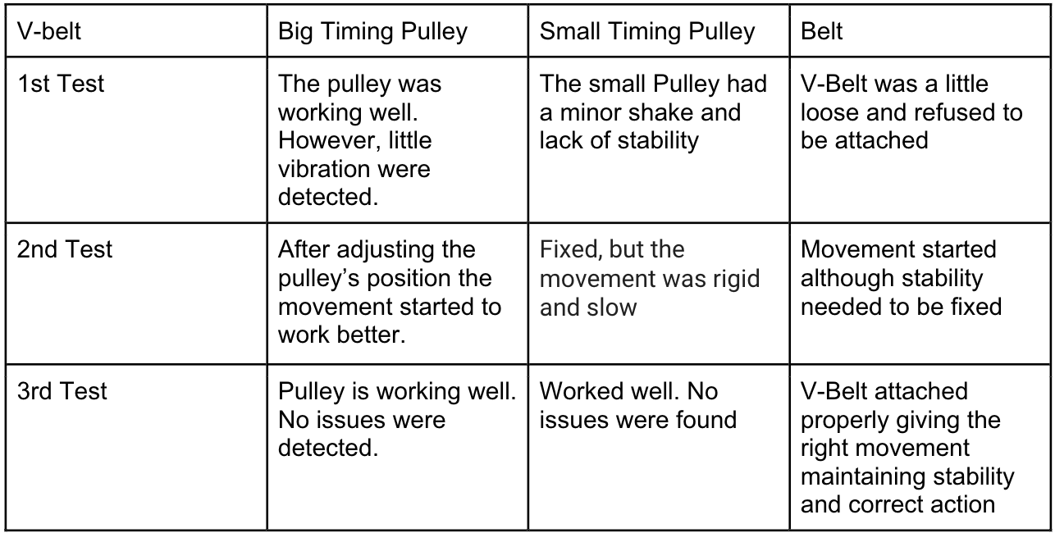
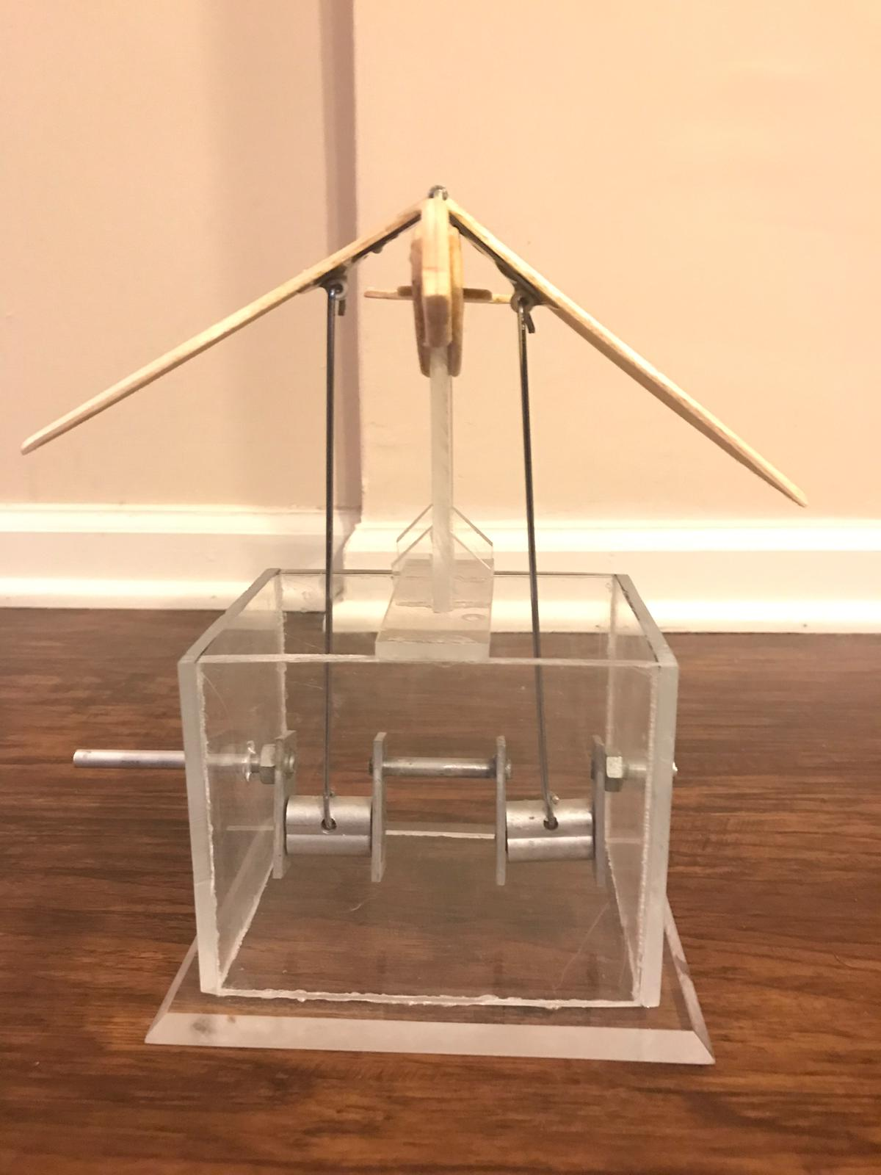
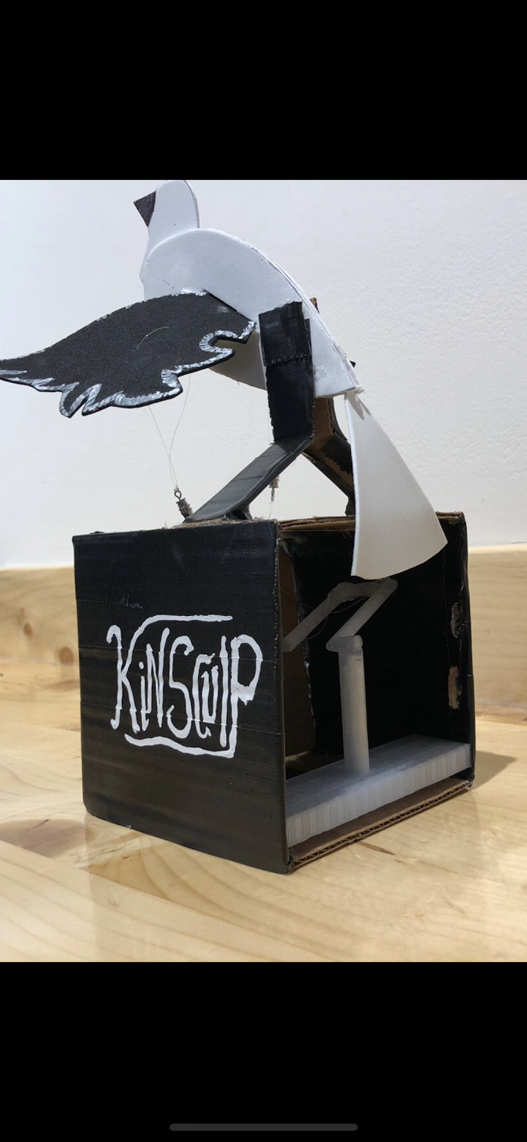
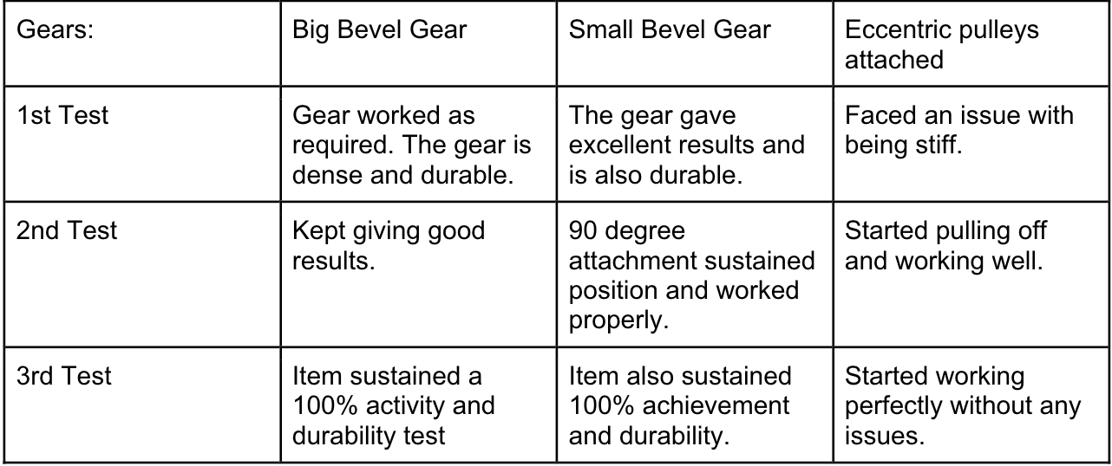
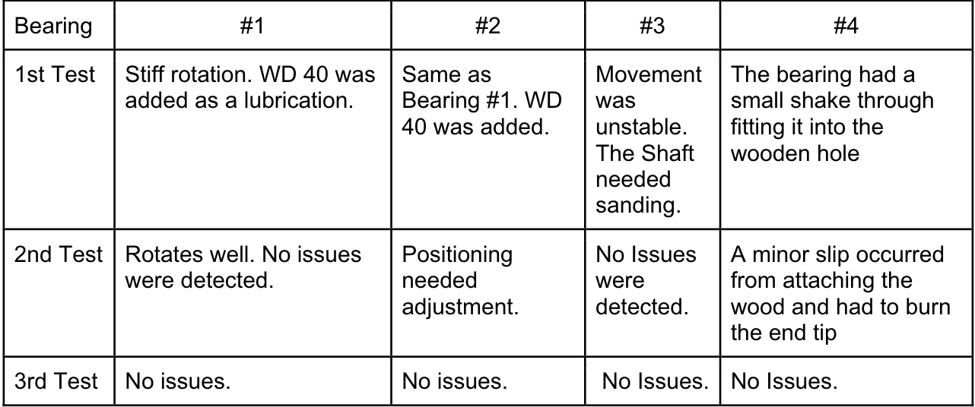
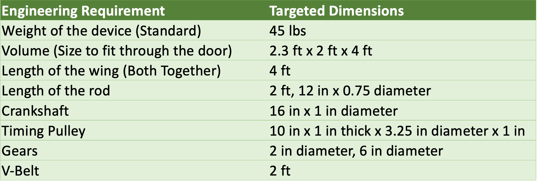
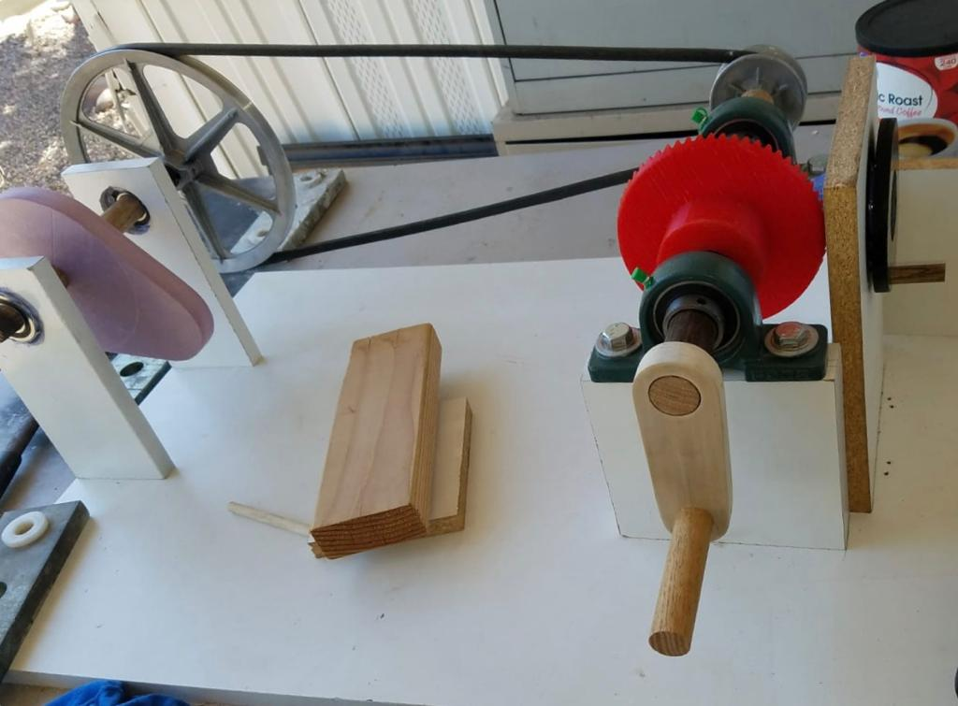
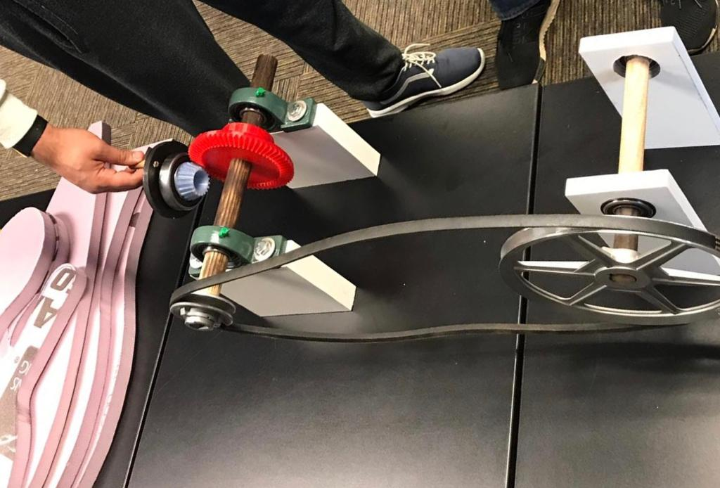
Symbol of Peace
Abdulaziz Hussain, Ahmad Alharbi, Mishary Alhooli, Mahmoud Shaban, Ahmad Altheyaib
Engineering, Northern Arizona University, Flagstaff, AZ 86011
Abstract
Initial Design
Performance & Testing
The purpose of this project is to create a kinetic sculpture that contains several engineering concepts that illustrates moving parts which helps inspire newcomers and visitors approaching Northern Arizona University (NAU). Inspiration would be through the process of combining art and engineering creativity by the operating systems available. The artistic part of this project will be illustrated through the bird movement of wings and tail with the assistant of mechanical engineering concepts. The project also utilizes methods of artistic creative skills by using engineering equipment along with different materials that completes the sculpture. The sculpture consist of two main sections, one is the bird model that includes moving wings and a tail. The second section is a box that contains the mechanism. The mechanism starts by a user interaction. The user will start the sculpture’s movement by rotating a crank handle that rotates the crankshaft which transfers the energy to the remaining mechanical parts such as; gears, rods and a pulley system. The aim of this project is to inspire to assist the user into deciding a future path at NAU.
The initial design was based on one principle that is the crankshaft. Within this principle, inspirations started to build more ideas and mechanism. At first, two initial designs were created. Starting with a design based on 3-D printing and cardboard box. For the second initial design it was based on a shaft and two rods connected to the wooden wings of the bird.
Problem Definition
Background: Nowadays sculptures are making a big contribution with influencing customers into purchasing products as well as inspiring people to decide their career path. Furthermore, the field of art and inspiration is becoming a big target throughout the world due to media and newly upgraded designs. Kinetic sculpture is an artificial man-made structure used for the purpose of expression and inspiration. In this sculpture we are utilizing the power of expressing our mechanical engineering principles.
Project goals:
Our goals in this project to inspire young kids as well as astonish visitors coming into Northern Arizona Mechanical Engineering Department. Using influential mechanical principles such as gears, a shaft, and a V-belt. Covering the mechanical box and principles using an acrylic glass to create a box to help show the working system. It also consists of three tapering spear-like forms thrusting vertically.
Engineering Requirement:
Results:
Crankshaft
Stable and has minimum amount of energy loss
Bevel Gears
Maintained it’s stability and acquired the 9- degree applicability
V-Belt
The application of transferring energy from the crankshaft to the towards the opposite side of the bird where the tail is located
Bird
Wings functioning realistically and the wingspan all together is 4 ft
The length of the bird body and tail is 4 ft in height
Major Modifications
Major developments and insertions were added to the initial design to help develop the final design:
Bevel gears created using a 3D printer
A V-Belt attached at the end of the shaft to transfer energy
From a wooden designed bird to a very dense Styrofoam bird
Metal rods to PEX plastic pipe rods
Melamine board used as a base
Mechanical principles
Acknowledgments
Final Product
The product is based on a hand powered crankshaft rotating on a clockwise rotation moving the bevel gears connected in the middle of the shaft to cause an eccentric timing pulley vertically with the PEX plastic pipes attached to the wings. At the end of the shaft a V-Belt is attached to transfer the energy to a rod and another timing pulley moving similarly to the other timing pulley to cause a tail movement.
Client: Dr. Sarah Oman Professor: Dr. David Trevas

