Slide 1

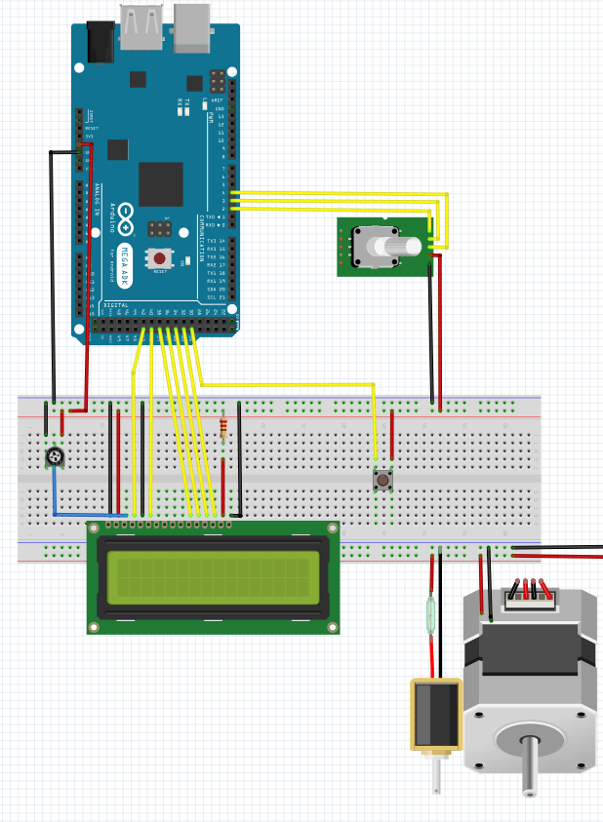
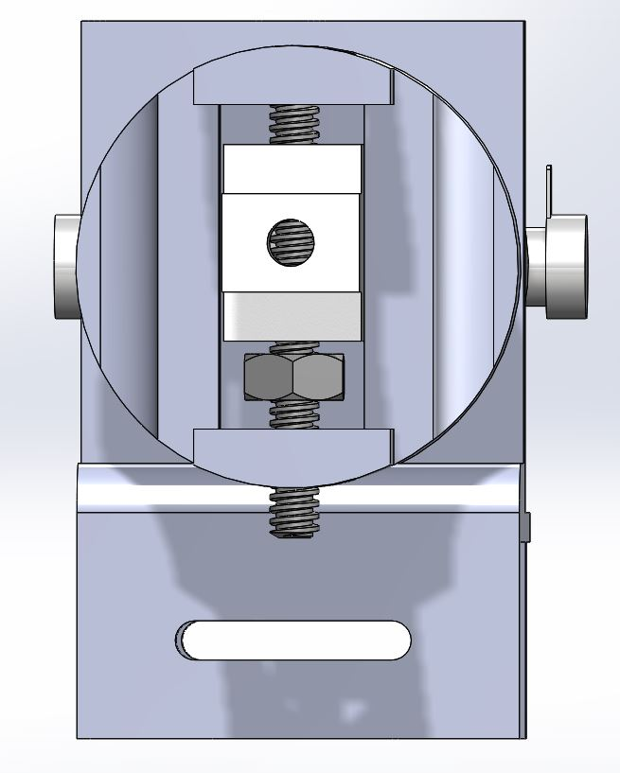
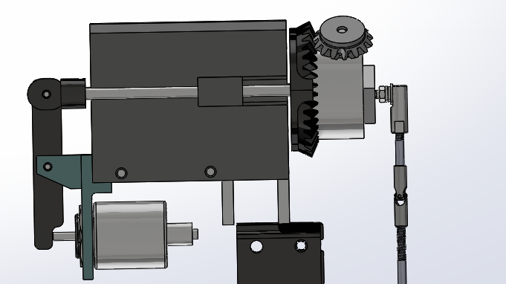
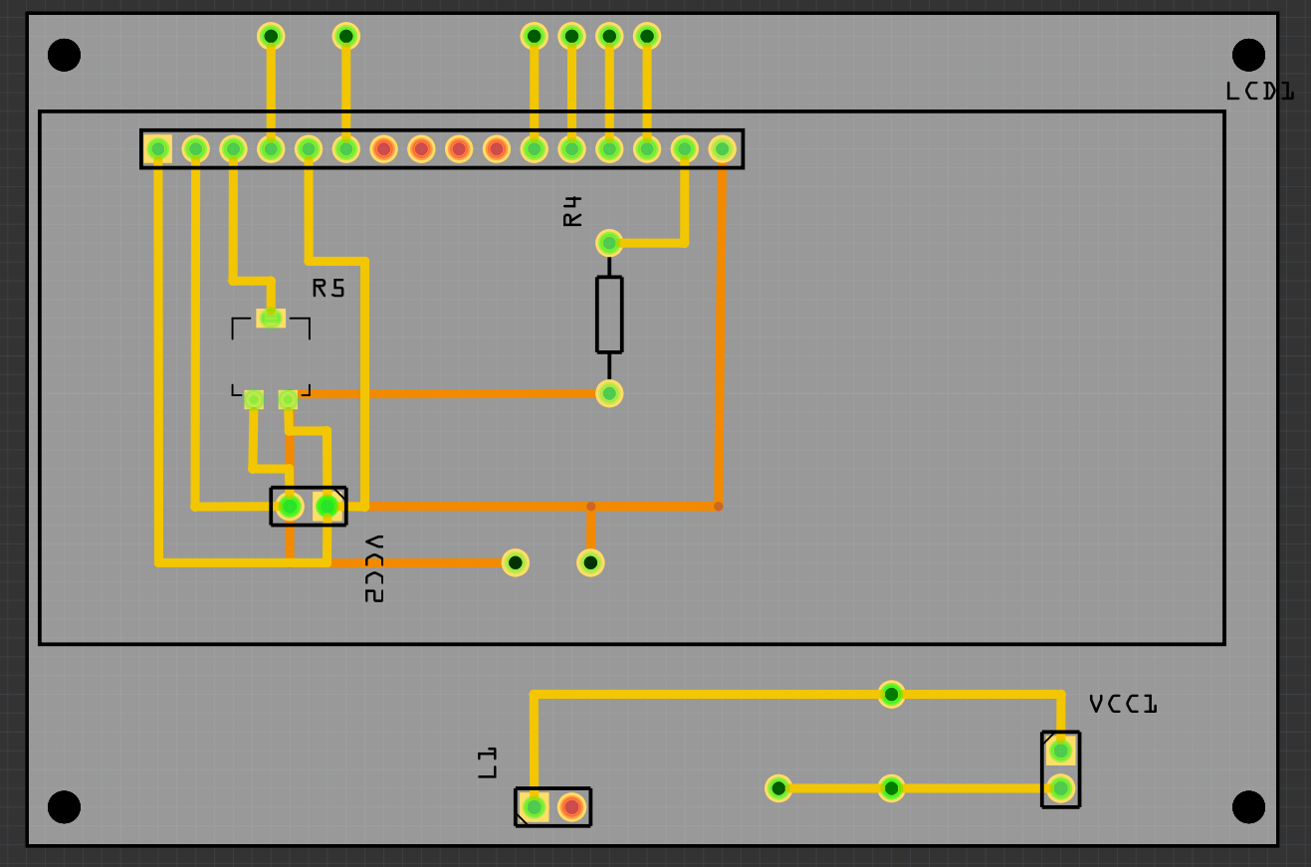
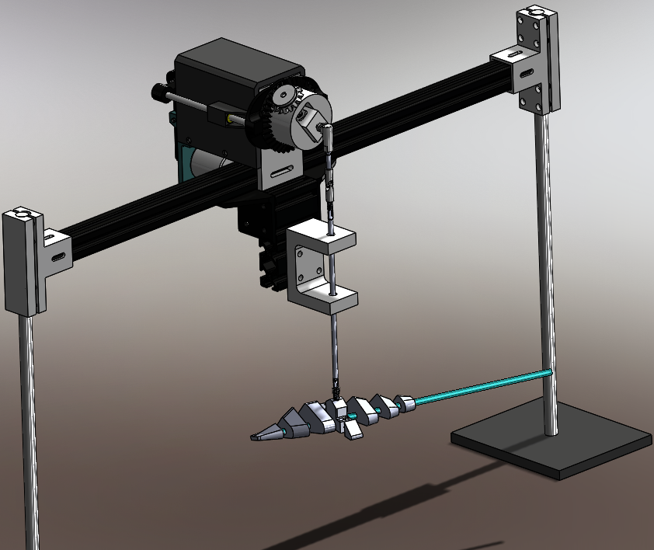
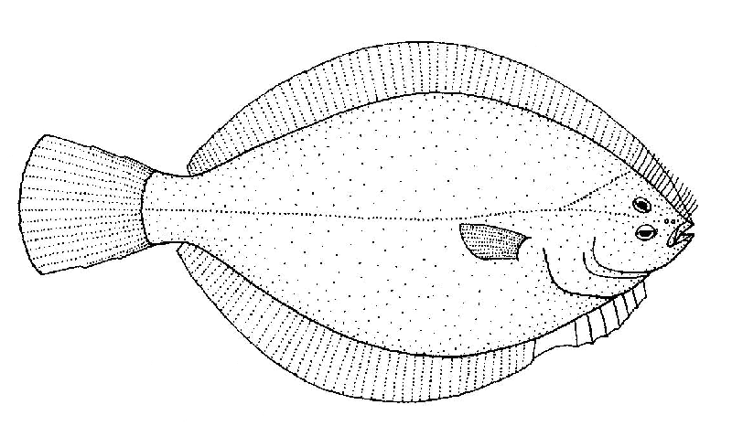
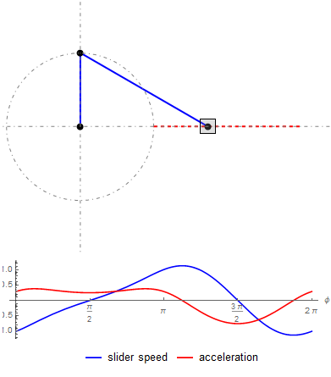
Biomimetic Robotic Fish
Abdulrahman Alnebari, Shuaib Alshuaib, James Brooks, Nathan Servis
Engineering, Northern Arizona University, Flagstaff, AZ 86011
Abstract
Design
Arduino
Fish bury in sand to hide from predators. This project is on a machine that will be used to study the mechanisms which fish use to bury in sand. The machine will grip onto a prototype fish-sample, and shake it up-and-down until burial.
Device Features:
1. Automated Amplitude Adjustment
2. Variable RPM
3. Oscillations End on Down-Stroke
The research produced by the results of this device may lead to the solutions necessary for the advancement of underwater-drone technology, and boat anchors that do not easily drag across the ocean floor.
The Design consist of three main components The Base, the Motor Mount and the Motor Hub.
The base utilizes two ring stands and a T-slot to hold the design above the testing tank.
The motor mount is 3D printed and contains a Nema 23 Stepper motor and 12v Solenoid.
The Motor hub contains the amplitude adjustment system and is machined out of steel.
The device is controlled via an Arduino mega
An 16x2 character LCD monitor is used to display the menu options.
The stepper and solenoid are powered by a 12v power source.
The max speed supported is 2400 rpm or 40 Hz
The device connected via a custom made PCB
Picture of Base with ring stands
Project Goal
Results
The devices is successfully able to bury the sample.
[Show picture of buried sample]
[ Show Graph of Percent buried compared to Speed]
The Client, Alice Gibbs, asked that the team create a device that mimics the burying movements of common flatfishes, such as the sol or flounder.
Flatfish bury themselves by undulating their body up and down to temporarily make the granular particulates under it act as a fluid, this process is known as fluidization.
        [ Put Picture of Fish Fluidizing
        Sand, may draw, or just put a
        picture of typical fluidization]
To accurately mimic this process the device must have
    Variable Oscillation
    Variable Amplitude
    Be Biomimetic
The team took the clients request and designed around the seven engineering requirements shown below.
Arduino Controlled
Consistently bury the Sample
Test Variable Sample Sizes
Figure : [Will be final photo of the design] Final Design setup
References
Crank Slider Analysis
Put references for pictures and resources used if required
The team wanted to ensure that a Crank Slider mechanism would be sufficient in meeting the teams needs.
The team required it to…
  Convert rotational Movement to Linear.
  Have minimum speed reduction.
  Be able to have an adjustable amplitude.
The Analysis showed the device would be able to convert meet all requirements, the graph on the right shows the speed and acceleration of the slider.
Acknowledgements
Special Thanks to Alice Gibbs (Client), Sarah Oman (Professor), Chuck Vallance ( Technical Advisor), Poba Medical Company(Sponsor) and the Alnebari Family (Sponsor)

