Slide 1
Problem Formulation and Poject Plan
Shell Eco-marathon
October 7, 2013
Jericho Alves, Daniel Chief, Moneer Aljawad, Benjamin Kurtz

Slide 2
Overview
Introduction
Need / Goal
Objectives
Constraints
  Chassis, Safety, and Steering
Project Plan
Conclusion

Slide 3
Introduction
Client: Society
    Competition hosted by Shell
    Capstone project representing SAE NAU

Slide 4
Need / Goal
Need
  High volume greenhouse gas emissions from vehicles contribute to global warming
Goal
  Design, build, and compete with a car prototype that maximizes high fuel efficiency. The car needs to be highly aerodynamic, lightweight, and inexpensive while following all rules and regulations provided by Shell
  Focus on chassis, steering, and safety

Slide 5
Objectives
Objectives for chassis and steering systems
  Both systems should be rigid
  Both systems should be aerodynamic
  Both systems should be lightweight
  Both systems should be inexpensive

Slide 6
Objectives
Objective | Measurement basis | Units
Rigid | Deflection under load | cm
Aerodynamic | Coefficient of drag from coasting at a fixed speed on a test track | unitless
Lightweight | Weight of systems | kg
Inexpensive | Unit manufacturing cost for production | US dollars

Slide 7
Chassis/Fairing Design
Chassis/Fairing Specific Needs
  Current chassis designs need to be reassessed in order to improve overall fleet fuel efficiency
  Vehicle chassis must contribute to/maintain the overall safety of the vehicle
  Chassis and fairing design must allow room to incorporate all safety, steering, and braking systems

Slide 8
Dimensional Constraints
Length: 350cm Maximum
Width: 130cm Maximum
Height: 100cm Maximum
Track Width: 50cm Minimum
Wheelbase: 100cm Minimum
Height/Width Ratio: 1.25 Maximum

Slide 9
Chassis Constraints
The chassis must incorporate a roll bar that extends 5cm above the drivers head, and past the width of the drivers shoulders with the driver in the standard driving position with the seatbelts fastened. The roll bar must be able to withstand a 700N load without deflecting.
The vehicle must have a full floor that will prevent the driver from any contact with the ground at any point during normal operation.

Slide 10
Safety Constraints
Minimize the risks by creating a vehicle that includes all safety essentials
Two Major Safety Coverages
  Driver’s Safety
  Vehicle’s Safety

Slide 11
Driver Safety
Seat belt has 5 mounting points with 1 single buckle
2 types of helmets
Insulation between engine and driver
Vehicle access
  Enough space for driver
  Exiting without assistance
Exhaust system
  Gas produced must be evacuated outside
Fire extinguisher must be on-board

Slide 12
Vehicle Safety
First and Last Minute Inspection
  Parts must firmly be attached together
  Frame must be installed and settled correctly
  Chassis must ensure the solidity
Two Independent braking systems
  System 1 must act on the front wheels only
  System 2 must act on the rear wheels only
Emergency Shut-down system
  Two independent shut-down switches
Fire extinguisher must be on-board

Slide 13
Steering Constraints
Tires and wheels
  All types are allowed
  Wheels and tires must be compatible
  Wheels and driver should be separated by bulkhead
  Wheels must be free of coming into contact with other parts of the vehicle

Slide 14
Steering Constraints
Turning radius
  Team has choice of front or rear wheel steering
  Vehicle is required to turn safely on the track
  Vehicle might be required to run the slalom course
  Indirect electronic steering system is permitted

Slide 15
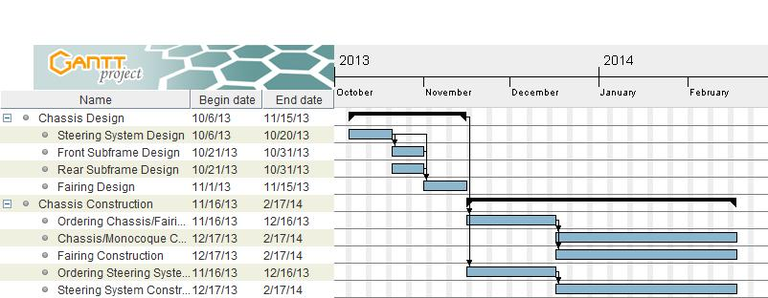
Project Planning

Slide 16
Conclusion
Design and build a fuel efficient car prototype to reduce greenhouse gas emissions
Chassis and steering systems
  Must be designed to maximize fuel efficiency
  Must meet the requirements set by Shell
Numerous safety checks done throughout project
Initial timeline shows limited design time

Slide 17
References
Shell Eco-marathon, "Offical Rules 2014 Chapter 1,"http://s01.static-shell.com/content/dam/shell-new/local/corporate/ecomarathon/downloads/pdf/sem-global-official-rules-chapter-1-2014.pdf, 01 Oct. 2013.
"Sources." EPA. Environmental Protection Agency, n.d. Web. 03 Oct. 2013.

Slide 18
Questions

