Slide 1
Concept Generation and Selection
October 28, 2013
Jericho Alves, Daniel Chief, Moneer Al-Jawad, Benjamin Kurtz

Slide 2
Overview
Project Overview
Chassis / Fairing
Safety Systems
Steering System
Project Plan
Conclusion

Slide 3
Project Description
Shell Eco-marathon competition
High fuel efficiency vehicle
Focus on chassis/fairing, safety, and steering

Slide 4
Fairing Concept Generation
Streamlined Open Wheel
Streamlined Enclosed Wheel
Semi-Streamlined / Flat Floor
Decision Considerations
Cost and material availability
Available tools and facilities
Component selection

Slide 5
1. Streamlined Open Wheel Fairing
Benefits
Ease of construction
Overall fairing size can be reduced
Front wheels are separated from any contact with driver
Wheel size can vary to some extent without changing the chassis design
Design allows for greater steering angle
Drawbacks
Drag effects caused by having the wheels exposed
Less design opportunity to support the front wheel axles in dual shear.

Slide 6
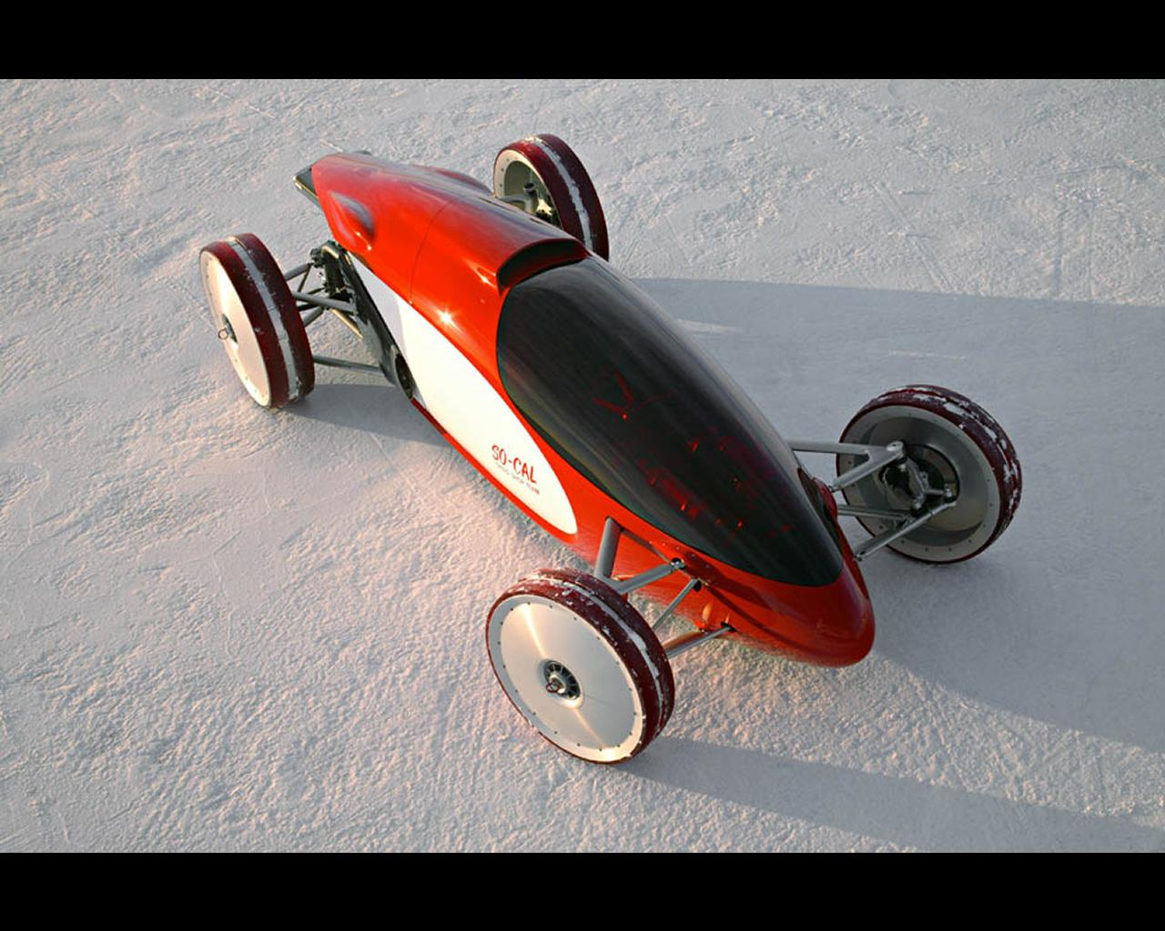
1. Streamlined Open Wheel Fairing
http://www.autoconcept-reviews.com/cars_reviews/gm/GM-belly-tank/cars_reviews-gm-belly-tank.html

Slide 7
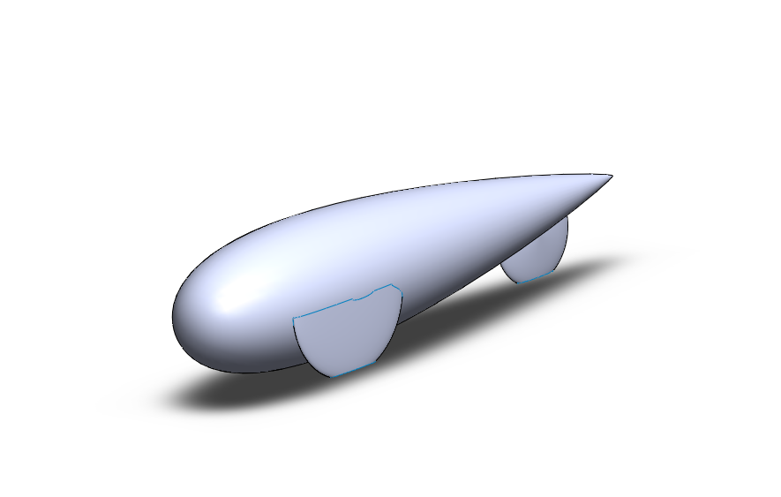
2. Streamlined Closed Wheel Fairing
Benefits
Minimizes drag created by wheels
Offers an exterior structure to support the outer front axles in dual shear
Drawbacks
Construction complexity.
Wheels that intrude into the fairing must be separated from the driver

Slide 8
3. Semi-Streamlined Fairing
Benefits
Single Layup Construction
Further upright driving position could allow for better driver visibility
Drawbacks
Drag effects caused by turbulent air at the leading edge of the vehicle
Requires a full floor
More Materials used in overall construction

Slide 9
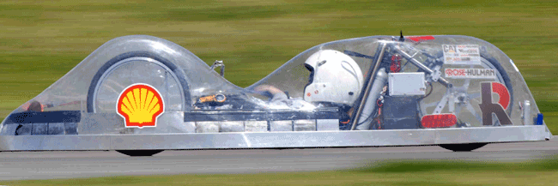
3. Semi-Streamlined Fairing
http://thinkorthwim.com/2007/09/06/the-worlds-most-fuel-efficient-car-12000-miles-per-gallon/

Slide 10
Decision Considerations
Cost and material availability
Composite cost
Available budget
Available tools and facilities
Mold making
Composite fabrication
TIG welding
Component selection
The chassis design is heavily dependent on the vehicle subsystems and as such will be highly iterative up until all components are finalized.

Slide 11
Safety Fire Systems
Side Sprinkler System
Overhead Sprinkler System
Long Hose Fire Extinguisher
Decision Considerations
Efficiency
System Weight
Simplicity
Cost

Slide 12
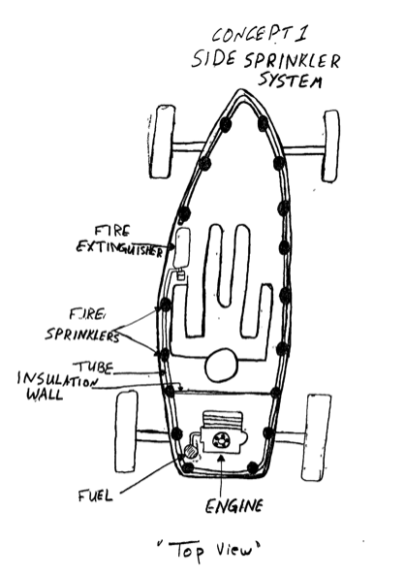
1. Side Sprinkler System
Benefits
Covers both driving and engine sections
Drawbacks
Area is obstructed by driver

Slide 13
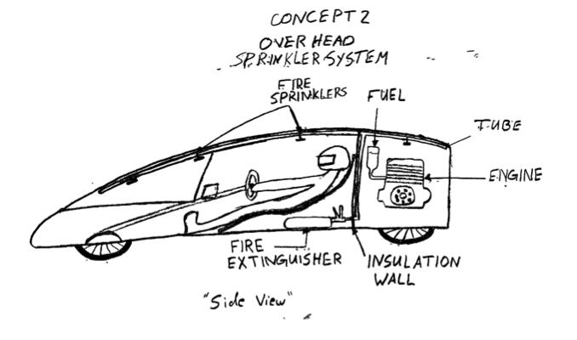
2. Overhead Sprinkler System
Benefits
Very efficient
More area covered
Drawbacks
Complex

Slide 14
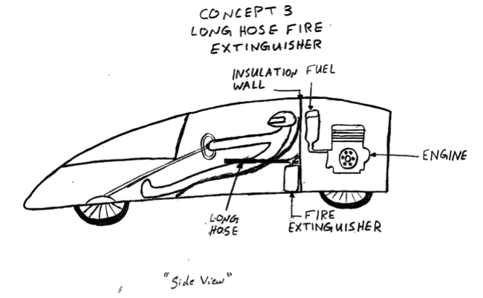
3. Long Hose Fire Extinguisher
Benefits
Takes less space
Simple
Drawbacks
Not efficient for this design
Manual
Limited movement

Slide 15
Safety System Design Matrix
 | Relative Weight | Side Sprinklers | Overhead Sprinklers | Long Hose
Efficiency | 0.50 | 5 | 8 | 3
System Weight | 0.25 | 3 | 5 | 2
Simplicity | 0.15 | 4 | 5 | 1
Cost | 0.10 | 2 | 2 | 2
Raw Score |  | 14 | 19 | 8
Weighted Total |  | 4.05 | 6.20 | 2.35

Slide 16
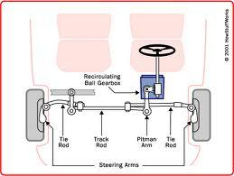
Classifications of Steering
Pitman Arm
Worm and Roller
Worm and Nut
Without Pitman Arm
Rack and Pinion

Slide 17
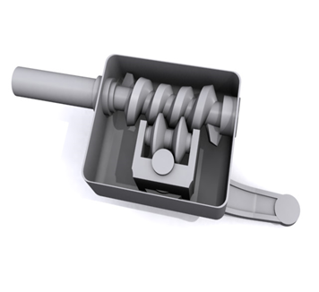
1. Pitman Arm - Worm and Roller
Benefits
Easy to build and maintain
Simple in construction
Little effort in turning
Drawbacks
Friction between worm and roller

Slide 18
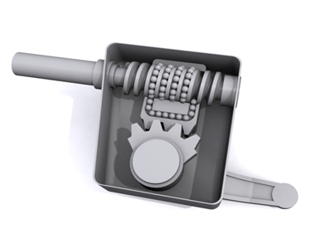
2. Pitman Arm - Worm and Nut
Also known as recirculating ball type
Benefits
Less degree of feedback
Recommended for large trucks when robust, maintainability and mechanic advantage is important
Drawbacks
It has a dead spot in the middle

Slide 19
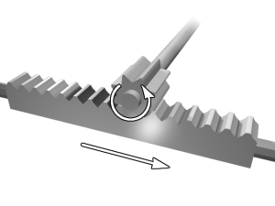
3. Without Pitman Arm -Rack and Pinion
Benefits
Large degree of feedback and more direct steering
Fewer moving parts
Smaller and takes up less space
Drawbacks
It is not adjustable when it wears

Slide 20
Decision Considerations
 | Relative Weight | Worm and Roller | Worm and Nut | Rack and Pinion
Cost | 0.30 | 5 | 7 | 8
Space | 0.10 | 3 | 3 | 5
Efficiency | 0.45 | 4 | 2 | 6
Weight | 0.15 | 2 | 2 | 3
Raw Score |  | 14 | 14 | 22
Weighted Total |  | 3.9 | 3.6 | 6.05

Slide 21
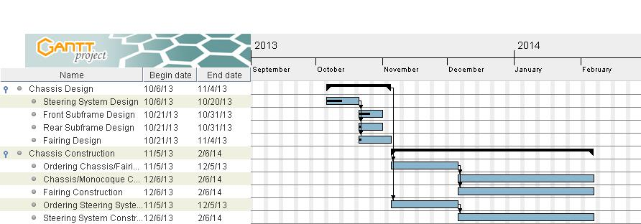
Project Plan

Slide 22
Conclusions
Multiple chassis construction methods and layouts are still being explored. The final method and design will be determined once we have more complete understanding of what resources are available to us.
Overhead sprinkler system is the best option for our vehicle design.
Due to the simplicity of the rack and pinion, it is the best option.

Slide 23
References
1. "Steering." Wikipedia. Wikimedia Foundation, 22 Oct. 2013. Web. 28 Oct. 2013.
2. Gear Nomenclature, Definitions of Terms with Symbols: AGMA Standard. Alexandria, VA: American Gear Manufacturers Association, 2005. Print.
3. "How Car Steering Works." HowStuffWorks. N.p., n.d. Web. 28 Oct. 2013.
4. "Steering : Essential to Driving." Car Bibles: The Car Steering Bible. N.p., n.d. Web. 28 Oct. 2013.

Slide 24
Questions

