Slide 1

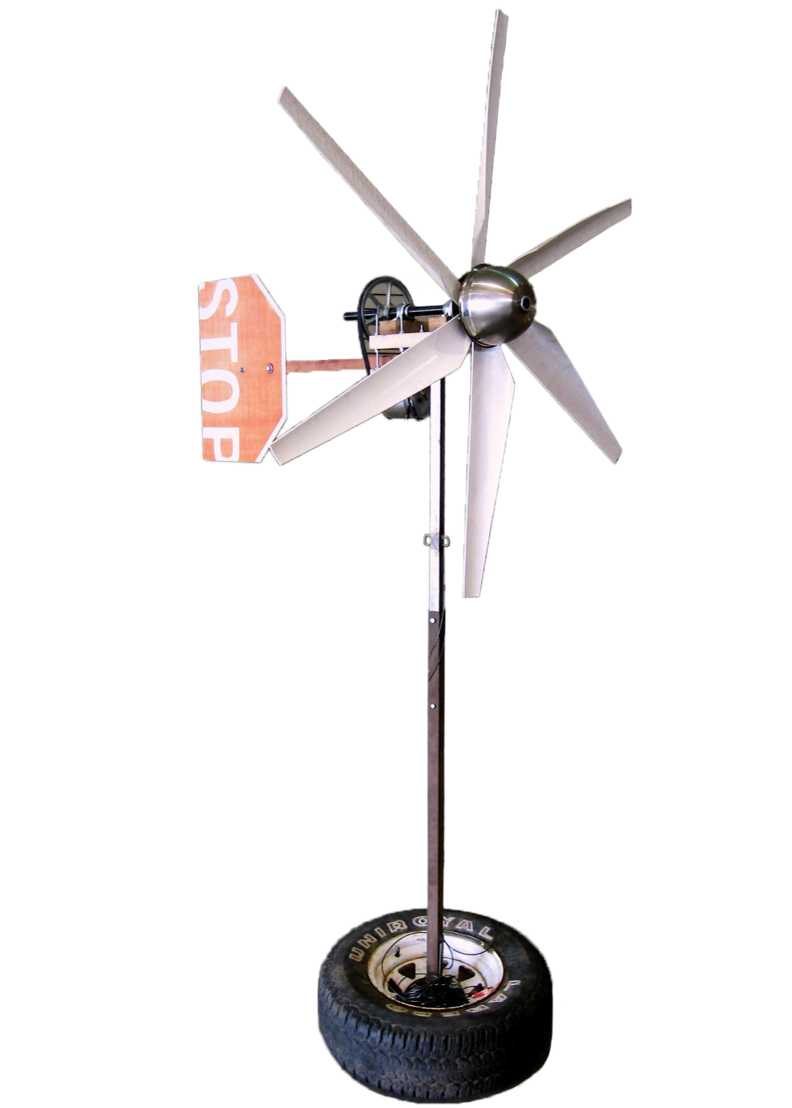

Harnessing Wind Energy with Recyclable Materials
Katie Carroll, Margo Dufek, Andrew McCarthy, Leanne Willey
Department of Mechanical Engineering, Northern Arizona University
Abstract
Final Design
Results
Materials
The goal of this project is to provide inexpensive electricity to citizens of third world countries who have limited access to electricity. The scope of this goal is to design an inexpensive, portable wind turbine system to harness wind energy and supply enough electricity to power a light and a fan (approximately 100 W combined) for five hours per day. The wind turbine system includes both a wind turbine to generate electricity and a means of storing the electricity generated. The final design is made from recycled and scrapped materials, including blades cut from PVC piping, a shaft from an evaporative cooler, a recycled generator, scrap lumber and sheet metal, and a car battery to store electricity. The turbine is five feet in diameter, and is designed to be mounted either on the roof or side of a house, or on a wooden post sunk into the ground. The prototype serves as an example to show individuals in remote locations how to create their own wind turbines, based on materials they can salvage.
Figure 1 shows a picture of the final prototype:
The test results were analyzed using linear regression to account for errors in the measurement process.
Figure 2 shows both the measured power output from the turbine and the theoretical maximum power output (Betz limit) plotted versus wind speed. As expected, the measured output is less than the theoretical output, but both curves have the same overall shape.
Table 1 lists the components used to construct the prototype and their associated costs.
Table 1 – Bill of Materials
Component | Cost
Generator | $64
Battery | $35
Pulleys | $27
Bearings & Shaft Collars | $25
Steel Bowl for Nose Cap | $16
Shaft | $10
Epoxy | $9
Electrical wiring components | $5
V-Belt | $4
Caster Wheel | Scrapped
PVC Pipe | Scrapped
Wood | Scrapped
Metal Posts | Scrapped
Sheet Metal | Scrapped
Car Tire | Scrapped
Solder | Scrapped
Total Cost | $195
Requirements & Constraints
Requirements:
Generate & store 0.5 kWh of energy per day.
Able to withstand high wind speeds.
Easy to assemble.
Portable – can be transported to remote locations.
Constraints:
Maximum total weight of 100 lbs.
Budget of $50.
Figure 2: Power Output vs. Wind Speed
As shown in Table 1, the total cost to construct the prototype was $195, which exceeded our budget of $50. The most expensive components were the generator and battery. These components proved difficult to find salvaged. Other components, including the pulleys, bearings, shaft, and shaft collars were purchased to save time, but could reasonably be found in junkyards.
Figure 3 shows the efficiency of the turbine plotted versus wind speed. The efficiency ranges from 35% to 45% as the wind speed varies, which is equivalent to the efficiency of commercial two blade wind turbines. In comparison, the maximum efficiency (Betz limit) is 59%.
Figure 1: Final Prototype
Testing Procedure
The prototype stands 8’ tall, and has six 2.5’ long blades. The turbine hub can rotate approximately 180º to face into the wind.
The turbine blades are cut from 6” diameter PVC pipes, and are shaped to roughly approximate an airfoil. PVC was chosen because it is lightweight, durable, and commonly available.
The blades are attached to the generator through a pulley system, providing a 4:1 gear ratio. This causes the generator to spin four times faster than the blades, allowing the turbine to generate electricity with lower wind speeds.
A weather vane and a caster wheel allow the turbine to rotate as the wind direction changes, increasing efficiency. As the wind changes direction, the normal force exerted on the weather vane causes the hub to rotate around the caster wheel, mounted between the hub and the post, until the turbine faces into the wind.
References
To test the power output of the turbine, the prototype was fastened in the back of a truck and driven at various speeds while the voltage and current output was recorded using two multimeters.
The power output was then calculated as:
Power = voltage x current
The measured power output was compared to the theoretical maximum output, called the Betz limit, to determine the efficiency of the turbine.
The test was limited to wind speeds below 8 m/s (18 MPH), because the generator reached its maximum power output. However, if a larger generator were used, the output could be tested at higher wind speeds.
Dr. Srinivas Kosaraju, Northern Arizona University.
Jones, B. 2009. A Brief Wind Power Tutorial. http://ecorenovator.org/wind-power-tutorial.
Knight, B. 2012. DIY Wind Turbine Project. http://greenterrafirma.com/DIY_Wind_Turbine.html.
Professor David Willy, Northern Arizona University.
PVC Pipe Size Dimensions, Identification & Pressure Ratings. 2012. http://flexpvc.com/PVCPipeSize.shtml.
Sizing Your Wind Turbine Tail. 2010. http://www.windynation.com/articles/windturbine-tail-fin/sizing-your-wind-turbine-tail.
Sprague, J., Huff, S., Solomon, K., & Waggy, M. Research and Development of Small Wind Turbine Blades. http://researchgroups.msu.edu/system/files/content/DevelopmentofSmallWindTurbineBlades.pdf.
Twidell, J, & Anthony D. W. 2006. Renewable Energy Resources. (2nd ed.; London: E & FN Spon)
Acknowledgments
Figure 3: Coefficient of Performance vs. Wind Speed
Northern Arizona University
- Dr. Srinivas Kosaraju
- Professor David Willy
Engineering Design

