Slide 1

Combined Heat and Power System
Ryan Christie
Nathan Duray
Cory Donavon
Joseph Mudd
Jason Dikes
Ronald Stepanek
Supreme Manufacturing

Slide 2
Project Proposal
Problem Statement
Power Production – Budget Analysis and Generator
Heat Recovery System – Proposed designs and current design
Control System – Revised Cost Analysis and configuration
Gantt Chart

Slide 3
Problem Statement
Supreme Manufacturing is dissatisfied with the cost, reliability, and overall efficiency of their current power supply.

Slide 4
Power Production

Slide 5
budget analysis
The budget produced by a $23,646 94 kW, 480V, 1426cuft/hr, Generac Generator
 | 2 years of operation | 5 years of operation | 10 years of operation
fuel price of $7/1000cuft | -$19,434 | -$13,116 | -$2,586
fuel price of $5/1000cuft | -$7,570 | $16,544 | $56,735
fuel price of $3/1000cuft | $4,294 | $46,205 | $116,057
The budget produced by a $4,500 18 kW, 240V, 261cuft/hr, Briggs & Stratton Generator
 | 2 years of operation | 5 years of operation | 10 years of operation
fuel price of $7/1000cuft | -$4,455 | -$4,385 | -$4,271
fuel price of $5/1000cuft | -$2,590 | $273 | $5,047
fuel price of $3/1000cuft | -$727 | $4,933 | $14,366

Slide 6
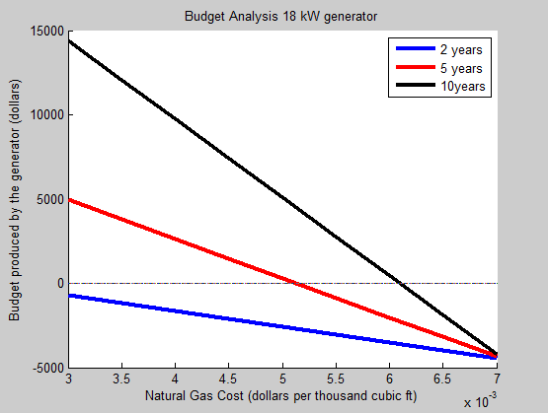
budget analysis

Slide 7
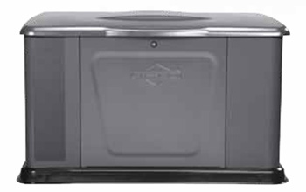
Power Production
Briggs & Stratton 18kW
  4 year warranty
  Cost effective
  Fuel efficient

Slide 8
Heat Recovery

Slide 9
Proposed Ideas
Auxiliary power cycle
  Pros
    Additional Power supplied to facility
  Cons
    Expensive
    Limited gain

Slide 10
Direct Heat Use
  Pros
    Reduced overall energy usage
    Increased overall efficiency
    Simple
  Cons
    Heat loss through transport of exhaust gases

Slide 11
Scaled Design
Designed to function with 18kW Briggs and Stratton generator
  Smaller generator
    Can get closer to ovens
      Minimizes heat loss

Slide 12
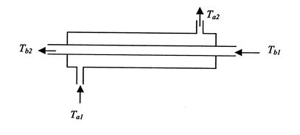
Heat Exchanger
Counterflow Concentric Heat Exchanger
  High heat exchange
  High output temperature to ovens
  Minimal exhaust restriction (backpressure)

Slide 13
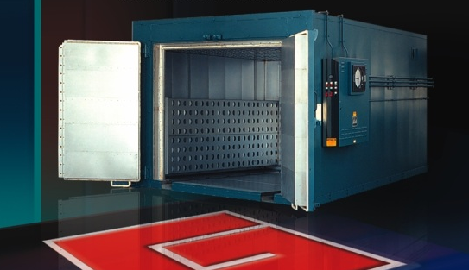
Heat Exchanger
Insulated
  Fiberglass insulation
Bolt on to generator
  Replace exhaust
Tie into oven’s intake or add a tie-in port

Slide 14
Control System

Slide 15
Cost Analysis
Component | Price ($)
Barebone Computer | 200
Touch Screen (GUI) | 255
CPU | 50
RAM | 40
Hard Drive | 50
Operating System | 100
Data Acquisition Unit | 400
Motors, Actuators, Servos | 500
Total | 1595
MATLAB | 2150

Slide 16

Configuration
Temperature Control
  Oven and Heat recovery system
Heat exchanger throttling
  Cross flow exchange

Slide 17
Connection to grid
  Communicating with utilities
Installation process
Choreographed assembly
Disassembly and Transportation
On-site installation

Slide 18
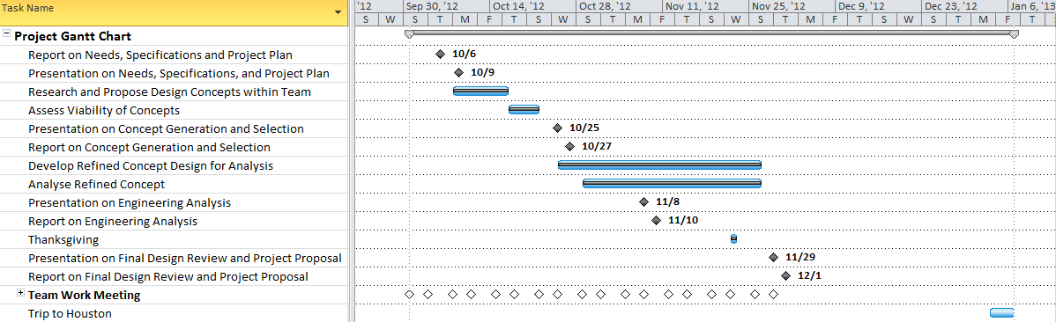
Timeline

Slide 19
Questions

Slide 20
References
Barebone Computer Picture and Price – http://www.newegg.com/Product/Product.aspx?Item=N82E16856101124
Touch Screen Picture and Price – http://www.newegg.com/Product/Product.aspx?Item=N82E16824638075
CPU Picture and Price – http://www.newegg.com/Product/Product.aspx?Item=N82E16819116409
RAM Picture and Price – http://www.newegg.com/Product/Product.aspx?Item=N82E16820231314
Hard Drive Picture and Price – http://www.newegg.com/Product/Product.aspx?Item=N82E16820227510
Operating System Picture and Price – http://www.newegg.com/Product/Product.aspx?Item=N82E16832416550

Slide 21
Generator specs
http://www.bsapowersolutions.com/pages/Briggs-16kW-20kW-Generator.php

