Slide 1

Alternative Power Source for Dental Hygiene Device
Engineering Analysis
Team 15:
Nizar Almansouri
Ningbiao Jiang
Francisco Heath
Jin Niu
Jiaqi Xie

Slide 2
Contents of Presentation
Problem Statement
Design Overview
Battery Specifications
Inverter Selection
Packaging
Charge Indicator
Gantt Chart
References
1

Slide 3
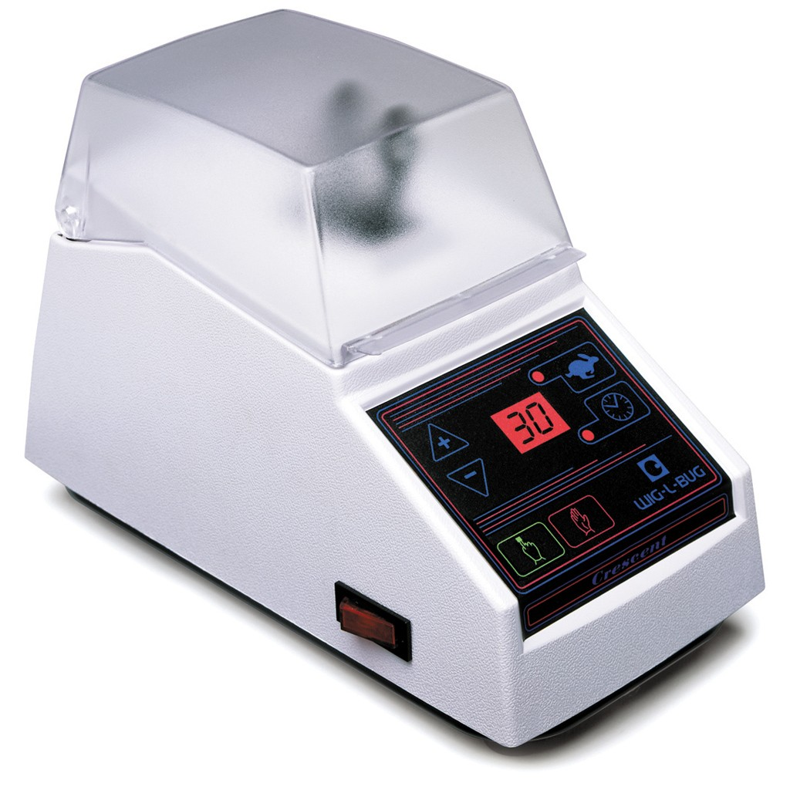
Problem Statement
NAU Department of Dental Hygiene
Humanitarian work in remote areas
No electricity available to power Wig-L-Bug

Slide 4

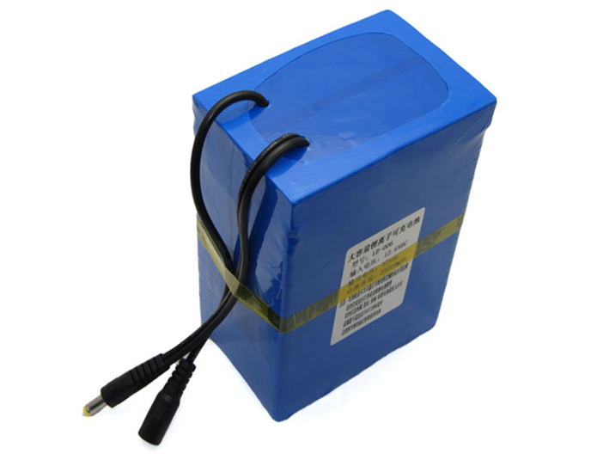
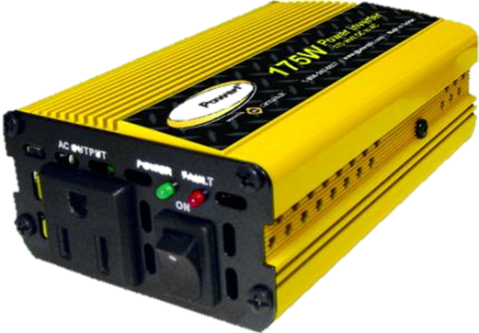
Design Overview
Battery
Inverter
Wig-L-Bug

Slide 5

FAA Regulations
Equivalent Lithium Content (ELC). ELC is a measure by which lithium ion batteries are classified.
8 grams of equivalent lithium content are equal to about 100 watt-hours.
25 grams of equivalent lithium content are equal to about 300 watt-hours.
Passengers can carry Up to 2 spare lithium ion batteries, not installed in a device (between 8 and 25 grams aggregate)

Slide 6

Battery Specifications
Capacity | 250Wh
Nominal Voltage | 12.6V
Max Discharge Rate | 10 A
Dimensions | 5 x 4 x 2 in
Weight | 2.4 lb
Grams equivalent lithium | ~ 20 g
Two batteries will provide enough power to run the device all day
Batteries will be separate to meet FAA regulations

Slide 7
Inverter Analysis
Specification | Pure sine wave inverter | Modified sine wave inverter
Input Voltage | 10~15V DC | 10~15V DC
Output Waveform | Pure Sine Wave | Modified Sine Wave
Output Voltage | 120V AC at 60Hz | 120V AC at 60Hz
Maximum Power | 250W | 210W
Continuous Power | 150W | 150W
Maximum Efficiency | 90% | 90%
THD | <3% | <40%
Size | 7.25×5×2.25in | 5×3.25×1.8in
Weight | 2lb | 1.5lb
Cost | $65 | $25

Slide 8
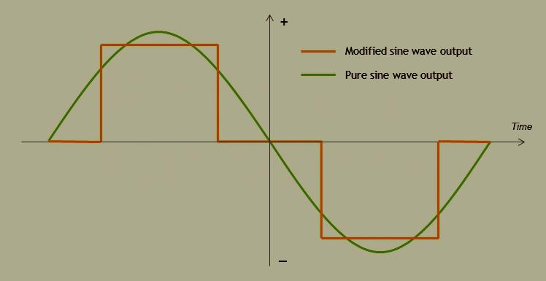
Inverter Analysis
Output Waveform
Pure sine wave and modified sine wave

Slide 9
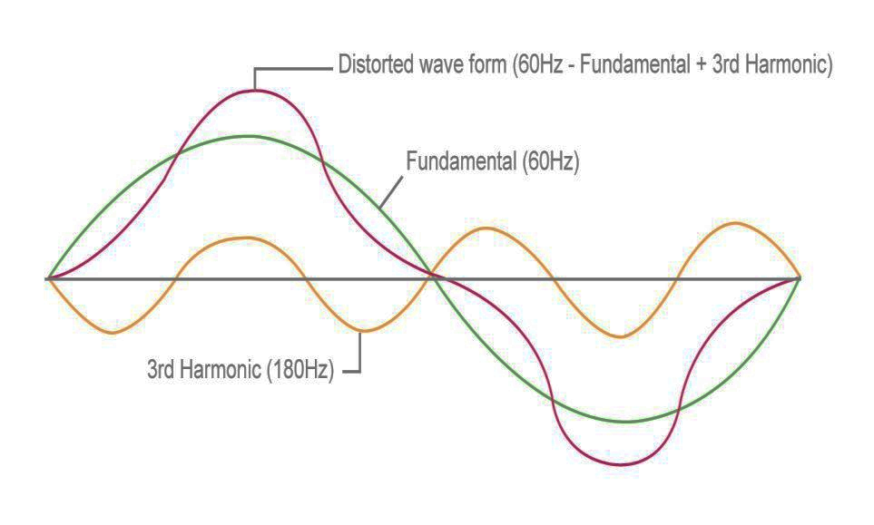
Inverter Analysis
Harmonic Distortion
Harmonic distortion of the electrical current waveform

Slide 10
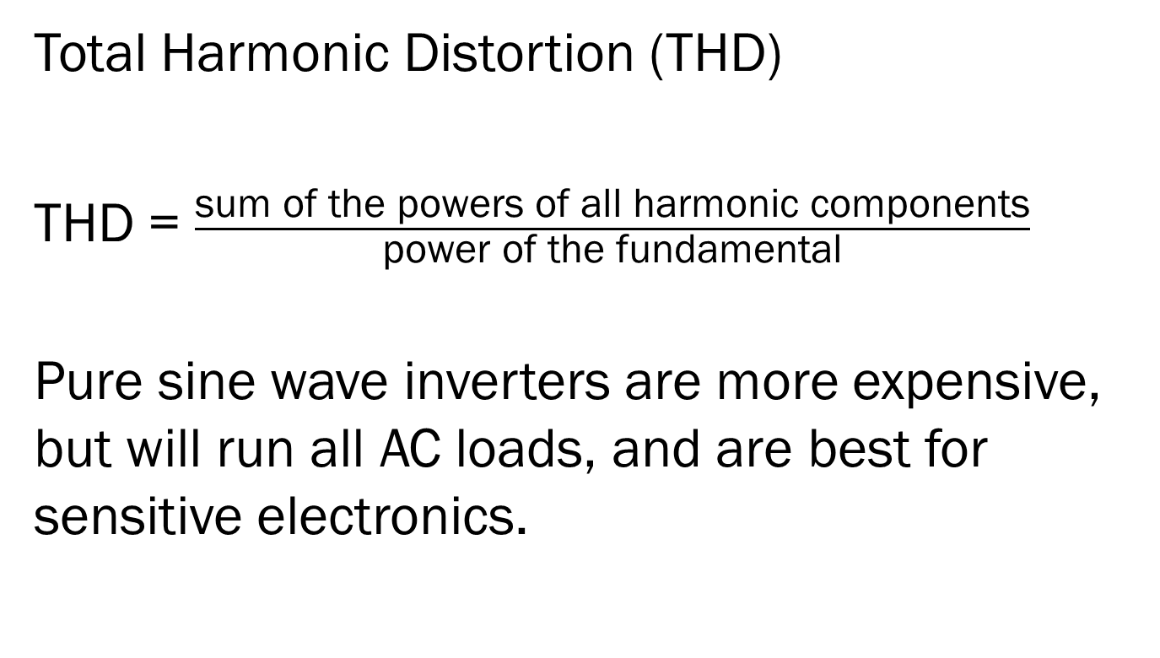
Inverter Analysis
Total Harmonic Distortion (THD)
THD = $\frac{\text{sum} \text{of} \text{the} \text{powers} \text{of} \text{all} \text{harmonic} \text{components}}{\text{power} \text{of} \text{the} \text{fundamental}}$
Pure sine wave inverters are more expensive, but will run all AC loads, and are best for sensitive electronics.

Slide 11
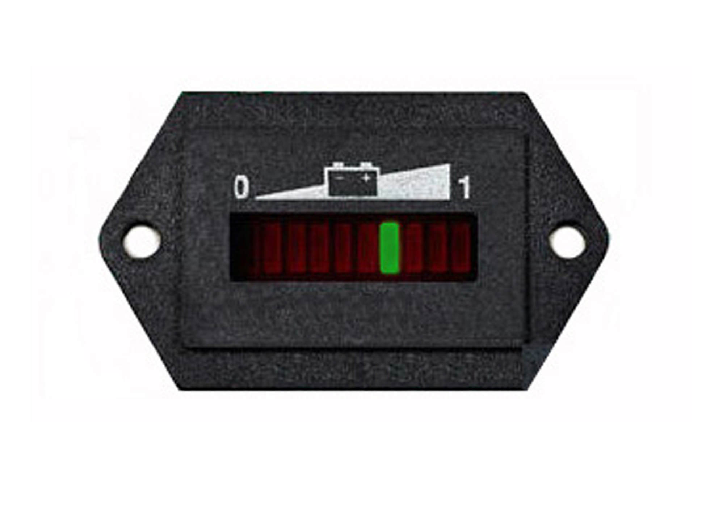
Charge Indicator
A small set of LEDs that indicates state of charge
Possible addition if time allows

Slide 12
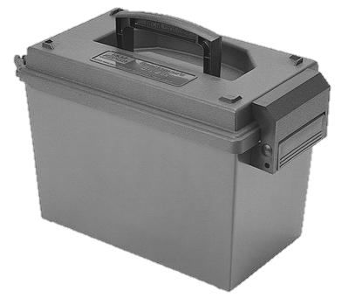
Packaging
Resists rough handling
Complies with FAA regulations
Cheap and Lightweight

Slide 13
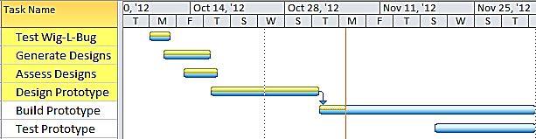
Gantt Chart

Slide 14
Conclusion
Battery only Design
Battery Specifications
Inverter Analysis
Charge Indicator
Packaging
Total Cost | $350
Total weight | 9lb
Packaged Size | 8 x 5 x 7 in
Energy Capacity | 500 Wh

Slide 15
References
http://www.bomara.com/powerware/wp_harmonics.htm
http://www.stecasolar.com/index.php?Inverter_selection
http://www.ebay.com/itm/DC-12V-5A-Lithium-battery-pack-20000-Mah-capacity-2A-charger-for-CCTV-camera-/150900422397?pt=US_Rechargeable_Batteries&hash=item23225db6fd
http://safetravel.dot.gov/

Slide 16
Questions ?

