Slide 1

Alternative Power Source for Dental Hygiene Device
Concept Generation and Selection
Nizar Almansouri
Ningbiao Jiang
Francisco Heath
Jin Niu
Jiaqi Xie

Slide 2
Contents of Presentation
Problem Statement
Design Summaries
Criteria Comparisons
Gantt Chart
Conclusion
References

Slide 3
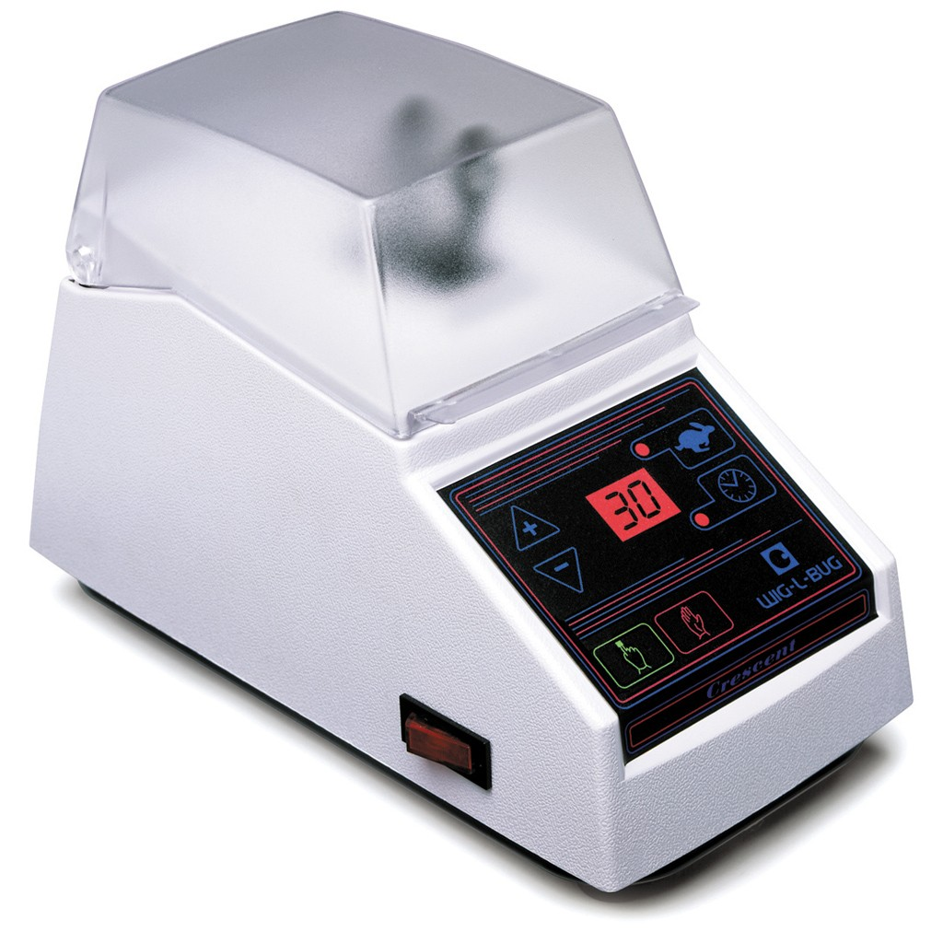
Problem Statement
NAU Department of Dental Hygiene
Humanitarian work in remote areas
No electricity available to power Wig-L-Bug

Slide 4
Possible Solutions
Solar + Battery
Manual Charger + Battery
Battery Only

Slide 5
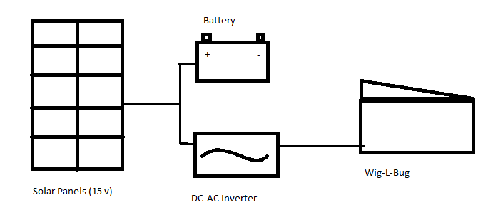
Solar + Battery
Flexible Solar Panel, 2 square meters
Battery and Inverter connected in Parallel
Calculations based on average insolation in December

Slide 6
Detail of Solar Battery Method
Component | Size(in) | Weight(lb) | Cost($) | Quantity | Total Cost($)
Solar Charger | 8.5×14.5 | 3.2 | 940 | 1 | 940
24V Inverter Modified Sinewave | 5×2.25×7.25 | 4.2 | 40 | 1 | 40
Cable | 36 | 0.8 | 30 | 1 | 30
Total | 14.5×8.5×5 | 8.2 |  |  | 1010

Slide 7
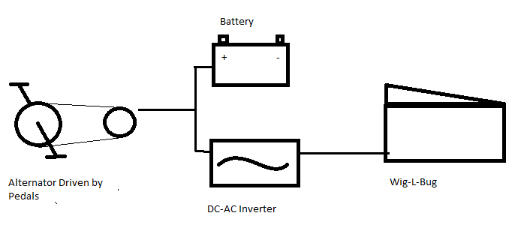
Manual Generator + Battery
×
A Bicycle style crank will turn an alternator with a belt or chain drive
Off-the-shelf bicycle parts will ensure good efficiency and reliability
100 watts of input at the pedals is a sustainable level for average college student

Slide 8
Manual Generator + Battery Details
Part | Cost($) | Weight (lb)
Alternator | 75 | 8
Battery | 100 | 1
Inverter | 50 | 1
Frame | 75 | 8
Gears, Cranks, Pulleys, etc | 150 | 5
Wiring, electronics, etc | 50 | 1
TOTAL | 500 | 24

Slide 9
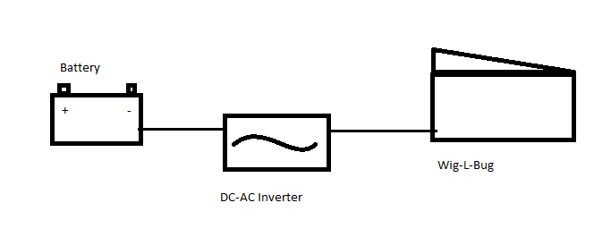
Battery Only
Battery Cell Details
Cell Voltage | 3.7 V
Capacity | 120 Watt hours
Charge Current | 1.8 Amps
Discharge Current | 1.2 Amps
Weight | 5 lbs

Slide 10
Battery Only
Parts | Quantity | Price ($) | Subtotal ($)
Battery | 4 | 60 | 240
Charger | 1 | 30 | 30
Inverter | 1 | 20 | 20
Frame | 1 | 20 | 20
 |  | Total | 310

Slide 11
Raw Comparison
 | Solar | Generator | Battery
Uninterrupted Power (% Down Time) | 20 | 0 | 0
Cost ($) | 1000 | 450 | 300
Weight (lb) | 12 | 25 | 25
Life Span (hours) | 500 | 1000 | 500
Size (Within 56 x 45 x 25 cm) | yes | yes | yes
Peak Output (watts) | 120 | 400 | 250

Slide 12
Normalized Data
 | Solar | Generator | Battery
Uninterrupted Power (% Down Time) | 0 | 10 | 10
Cost ($) | 0 | 5.5 | 7
Weight (kg) | 10 | 5 | 5
Life Span (hours) | 5 | 5 | 10

Slide 13
Weighted Comparison
 | Uninterrupted Power | Cost | Weight | Lifespan | Raw Total | Normalized Total
Uninterupted Power | 1 | 2 | 3 | 3 | 9 | 0.425
Cost | 0.5 | 1 | 3 | 2 | 6.5 | 0.307
Weight | 0.33 | 0.33 | 1 | 2 | 3.66 | 0.173
Lifespan | 0.33 | 0.2 | 0.5 | 1 | 2.03 | 0.096
Certain Criteria, like size and peak output, either meet constraints or they don’t.
Others, like weight and cost, should be as low as possible

Slide 14
Weighted Criteria
 | Solar | Generator | Battery
Uninterrupted Power (% Down Time) | 0 | 4.25 | 4.25
Cost ($) | 0 | 1.6885 | 2.149
Weight (kg) | 1.73 | 0.865 | 0.865
Life Span (hours) | 0.48 | 0.48 | 0.96
Total (Higher is Better) | 2.21 | 7.2835 | 8.224

Slide 15
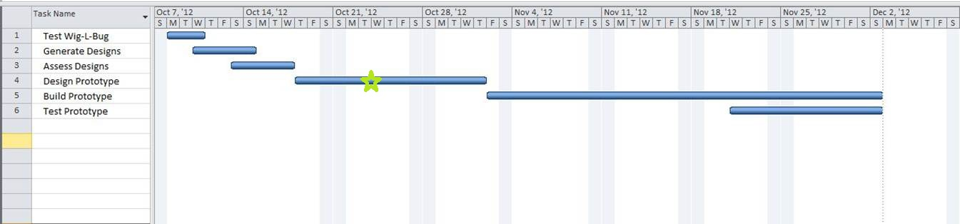
Gantt Charts

Slide 16
Summary
Problem Statement
Design Concepts
Comparison
Design Selection
Gantt Chart

Slide 17
References
www.solar-electric.com
www.batteryspace.com
www.autozone.com/autozone/parts/Alternator
www.weatherbase.com/weather

