Slide 1
SAE AERO
Chase Beatty (Team Leader)
Brian Martinez (Organizer)
Mohammed Ramadan (Financial Officer)
Noe Caro (Historian)
Brian Martinez

Slide 2

CUSTOMER description
Dr. John Tester
  SAE advisor since 2000
Judges at AERO competition
Academic advisor
  Dr. Tom Acker
Brian Martinez

Slide 3
Society of Automotive Engineers AERO Design
SAE is a student engineering club
Annual SAE Aero competition west has three competition classes
  Regular- Size limitation, Engine limitation, payload bay limitations, recommended for undergraduates
  Advanced- No size limitation, no engine limitation, requires advanced electronic distance measuring device, requires braking device recommended for graduate students
  Micro- Must be hand thrown, must be extremely lightweight, must carry a large payload, all electric system including engine.
Main purpose of all three classes is to carry as much weight as possible
Competing in regular class
Choose as senior design project
Brian Martinez

Slide 4
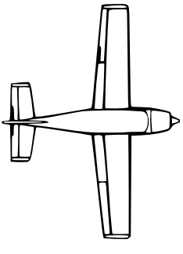
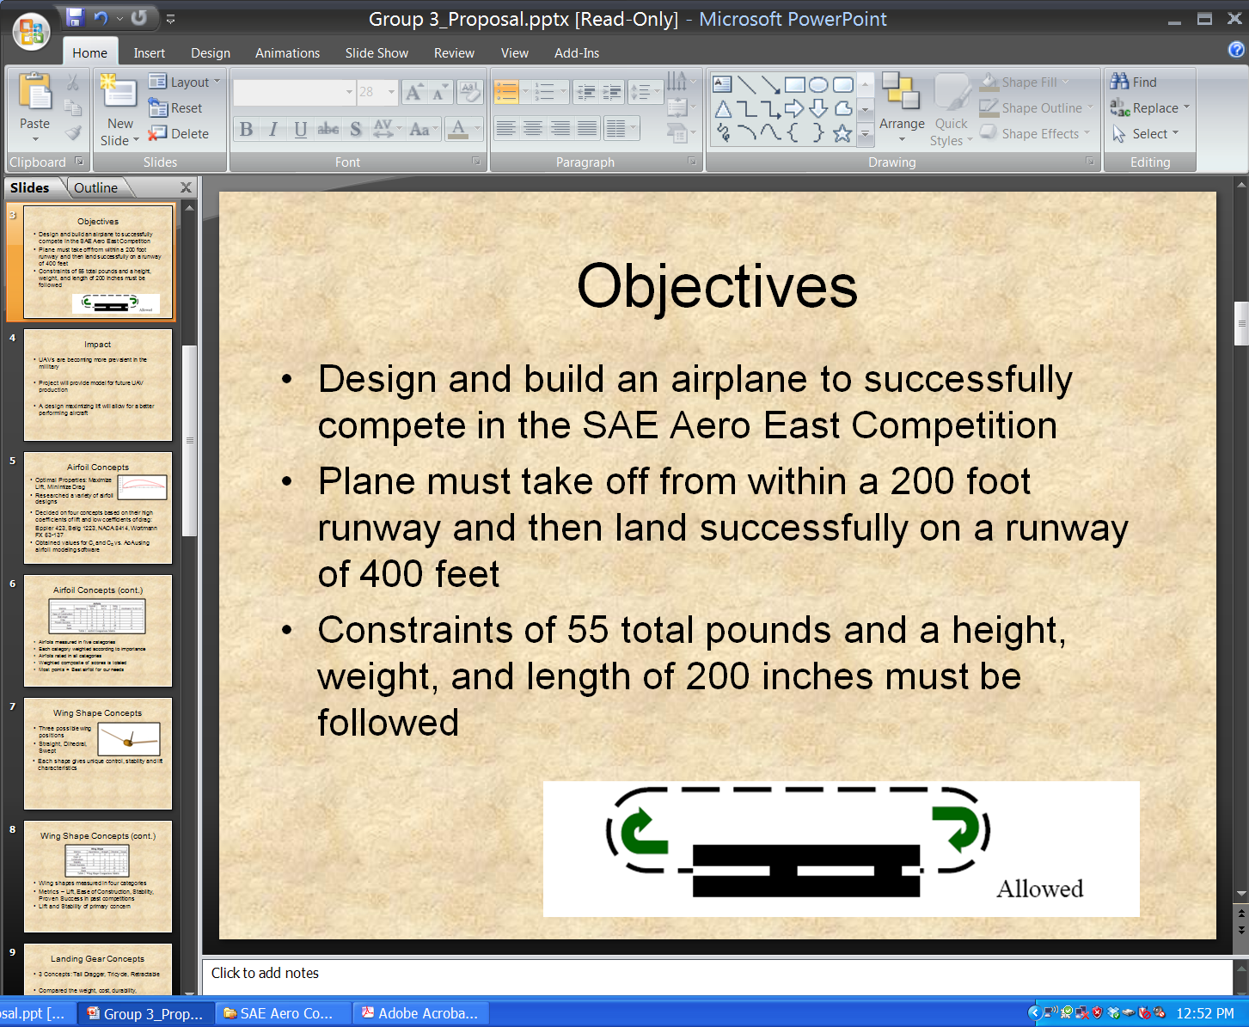
Project description
Design and build an airplane to lift as much payload as possible
Combined dimensions cannot exceed 225”
Take off within 200ft
Land and stop within 400ft
Payload and airplane cannot exceed 55lbs
Fly in a circle at least once
No lighter than air aircrafts or helicopters
Land within 400 ft.
Take off 200 ft.’
Brian Martinez

Slide 5
Project Schedule
Phase 1: Research
  09/19/11 – 03/01/12
  Equations, materials and airplane design
Phase 2: Fundraising
  09/19/11 – 12/27/11
  Wing-a-thon
Phase 3: Design the Prototype
  10/17/11 – 01/20/12
  Solidworks model
Brian Martinez

Slide 6
Project Schedule Cont.
Phase 4: Competition Report
  01/03/12 – 02/06/12
  Analysis of aircraft design
Phase 5: Construction of Final Aircraft
  01/20/12 – 03/10/12
  Wing
  Fuselage
  Landing Gear
Phase 6: Competition
  03/16/12 – 03/18/12
Phase 7: Final Report
  03/18/12 – 05/04/12
Brian Martinez

Slide 7
Budget
 | Estimated Budget (dollars)
Registration | 600
Fuel Cost (Transportation) | 450
Hotel Cost (4 nights) | 300
Food/Drink Cost | 600
Balsa Wood | 30
Bass Wood | 20
Monokote | 30
O.S. 61FX | 150
Servos | 50
Receiver | 100
TOTAL | 2330
 | Updated Budget (dollars)
Registration | 600
Fuel Cost (Transportation) | 0
Hotel Cost (2 nights) | 240
Food/Drink Cost | 160
Balsa Wood | 117.40
Bass Wood | 5.80
Monokote | 60
O.S. 61FX | 0
Servos | 176.95
Receiver | 0
Glue/Misc. | 50
TOTAL | 1440.15
Brian Martinez

Slide 8
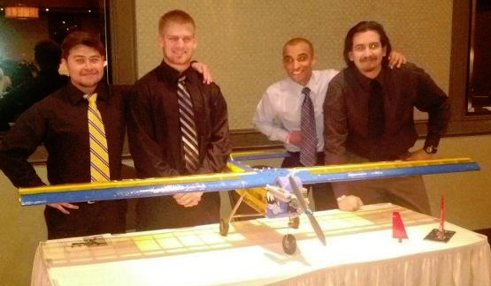
Deliverables
Constructed airplane
Competition Results
Final Report
Brian Martinez

Slide 9
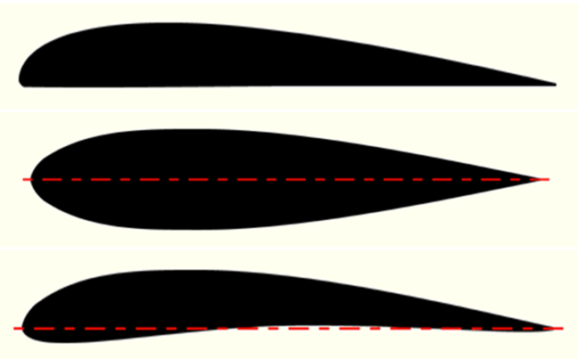
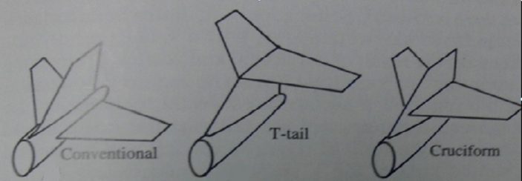



Design Research
Airfoil profile
Wing geometry
Tail configuration
Mohammed Ramadan

Slide 10
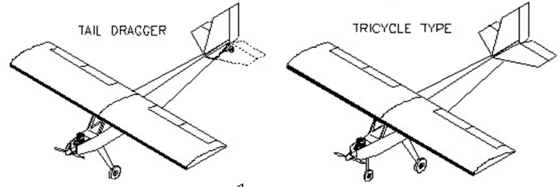
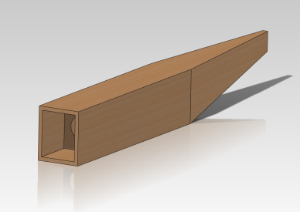
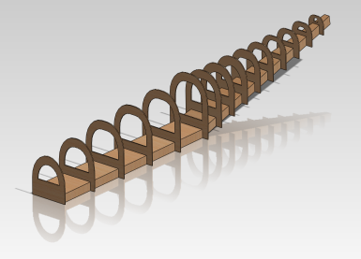
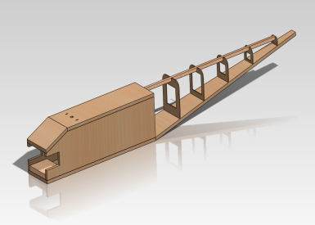
Design Research cont.
Fuselage-Square edge, tear drop, combination
Landing Gear- tail dragger or tricycle landing gear
Mohammed Ramadan

Slide 11
Design Summary
Part | Configuration
Wing construction | Two-piece construction
Airfoil profile | Under Cambered
Wing geometry | Rectangular
Fuselage | Combination Design
Tail | Convectional tail
Landing Gear | Tricycle landing gear
Mohammed Ramadan

Slide 12
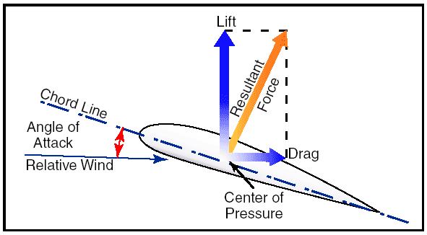


Airfoil Key Parameters
$$C_{l}=\frac{L^{′}}{0.5ρV_{∞}^{2}c}$$
$$C_{d}=\frac{D^{′}}{0.5ρV_{∞}^{2}c}$$
Stall: is a sudden drop in the lift coefficient when reaching a critical AoA
  C_{L} – Lift Coefficient , C_{d} – Drag Coefficient , Stall , α – Angle of Attack (AoA)
  $\frac{Cl}{Cd}$ Lift to Drag Ratio
Mohammed Ramadan

Slide 13
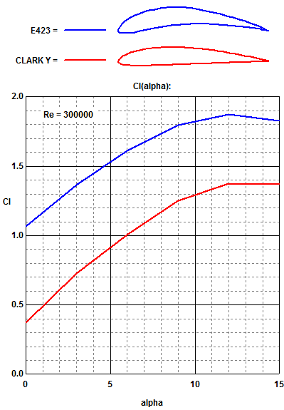
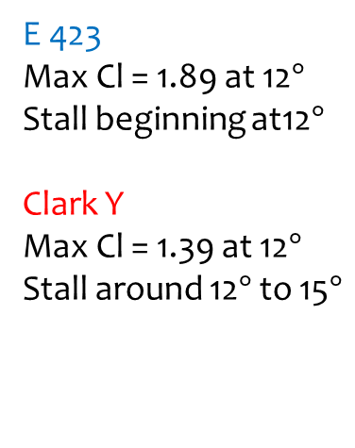
Airfoil Analysis
(Lift Coefficient vs AoA)
E 423
Max Cl = 1.89 at 12$°$
Stall beginning at12$°$
Clark Y
Max Cl = 1.39 at 12$°$
Stall around 12$°$ to 15$°$
Profili
Mohammed Ramadan

Slide 14
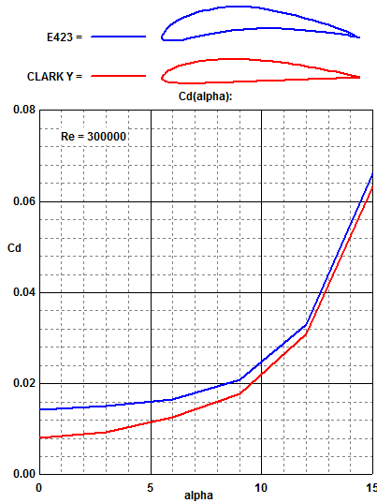
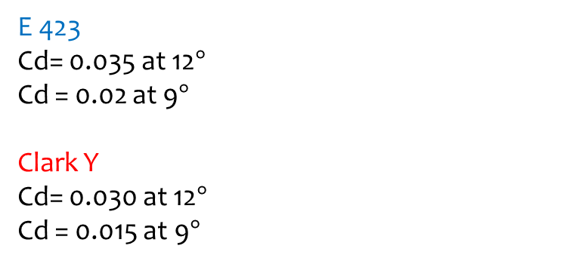
Airfoil Analysis CONT.
(Drag Coefficient vs AoA)
E 423
Cd= 0.035 at 12$°$
Cd = 0.02 at 9$°$
Clark Y
Cd= 0.030 at 12$°$
Cd = 0.015 at 9$°$
Profili
Mohammed Ramadan

Slide 15
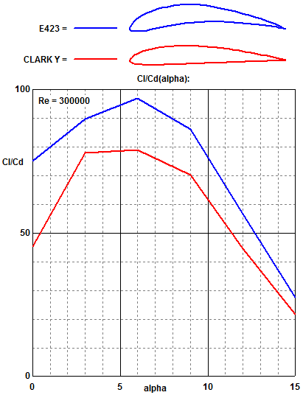
Airfoil Analysis CONT.
(Lift to Drag Ratio vs AoA)
E 423
L/D max = 97 at 6°
Clark Y
L/D max = 79 at 6°
Maximum L/D is an
important parameter
in airfoil performance
efficiency
Profili
Mohammed Ramadan

Slide 16
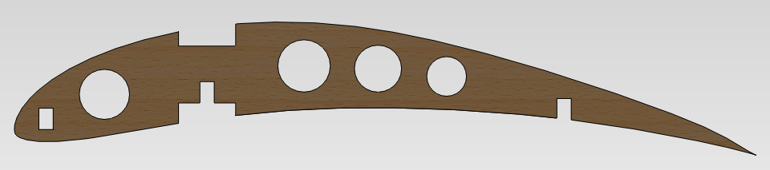

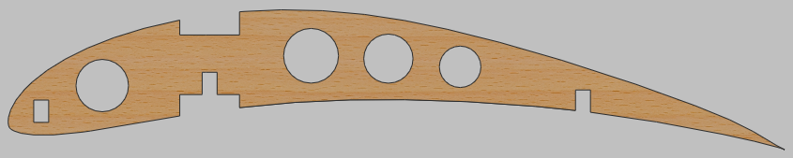
Airfoil Design
SolidWorks & Profili
4 lightening holes
3 spar locations
Initial chord = 13 inches
Max thickness = 1.63 inches
Mohammed Ramadan

Slide 17
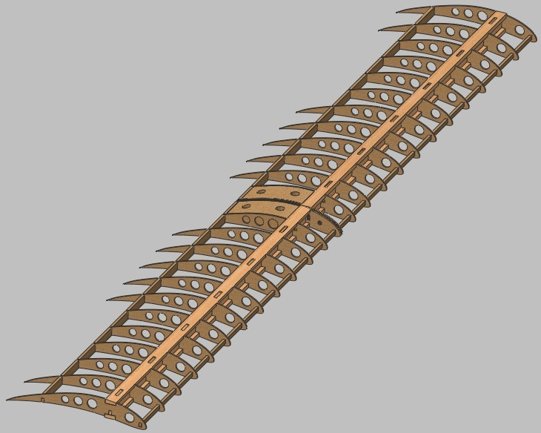
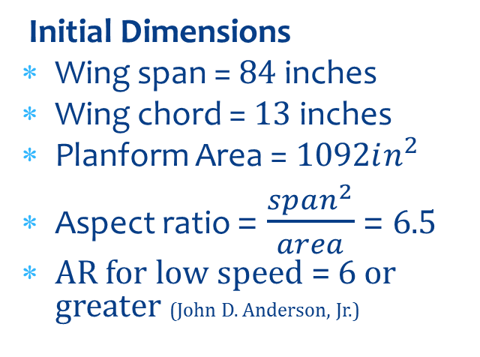
Wing Dimension Summary
Initial Dimensions
Wing span = $84$ inches
Wing chord = $13$ inches
Planform Area = $1092in^{2}$
Aspect ratio = $\frac{span^{2}}{area}$ = 6.5
AR for low speed = 6 or greater (John D. Anderson, Jr.)
Wing calculation
${(Cl}_{max})=0.9{(cl}_{max})$ , $V_{stall}= {(\frac{W}{\frac{1}{2}ρA_{p}C_{L,max }})}^{1/2}$ , $\frac{W}{Ap}=\frac{1}{2}ρC_{L,\max{V_{stall}} }$
Mohammed Ramadan

Slide 18
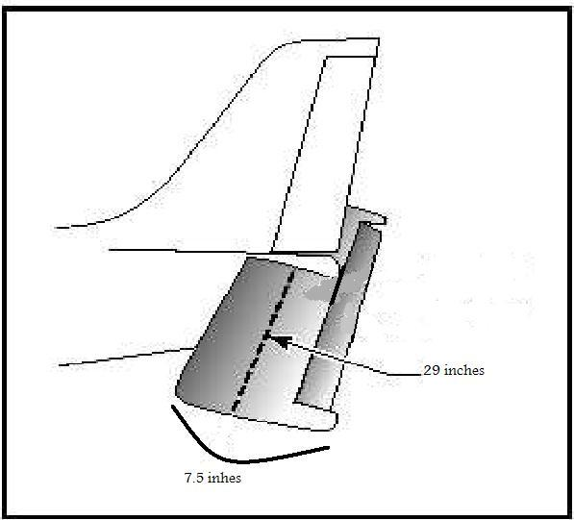
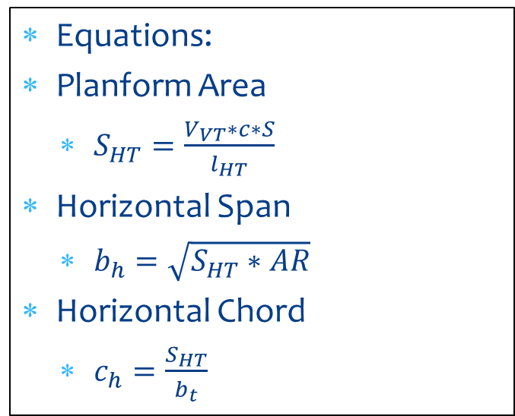
Horizontal Tail section
An Aspect Ratio of 4 will be used for the horizontal tail section
  This horizontal span will be about 32 in with a chord of 9 in
There will be no taper in the horizontal tail
Equations:
Planform Area
  $S_{HT}=\frac{V_{VT}∗c∗S}{l_{HT}}$
Horizontal Span
  $b_{h}=\sqrt{S_{HT}∗AR}$
Horizontal Chord
  $c_{h}=\frac{S_{HT}}{b_{t}}$
(Anderson)
Noe Caro

Slide 19
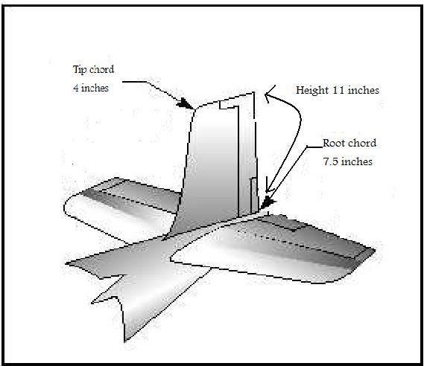
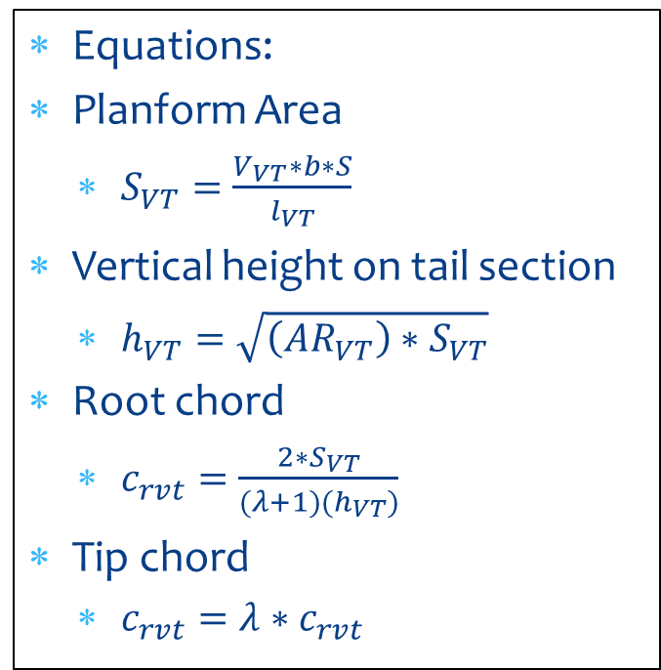
Vertical tail section
Aspect Ratio will be 1.5
The vertical tail will be tapered at a ratio of 50%
Will have a root chord of 11.75 in
Will have a tip chord of 4.5 in
Will have a span of 14 in
Equations:
Planform Area
  $S_{VT}=\frac{V_{VT}∗b∗S}{l_{VT}}$
Vertical height on tail section
  $h_{VT}=\sqrt{\left({AR}_{VT}\right)∗S_{VT}}$
Root chord
  $c_{rvt}=\frac{2∗S_{VT}}{(λ+1)(h_{VT})}$
Tip chord
  $c_{rvt}=λ∗c_{rvt}$
Noe Caro

Slide 20
PROPULSION TESTING
Testing done with different propellers at elevation similar to Van Nuys.
Results indicated should use a 14*4 propeller
Propeller | RPM | Thrust (lbs)
14*6 | 16000 | 6
11*6 | 13000 | 7
14*4 | 16000 | 9
13*6.5 | 11000 | 8
Noe Caro

Slide 21
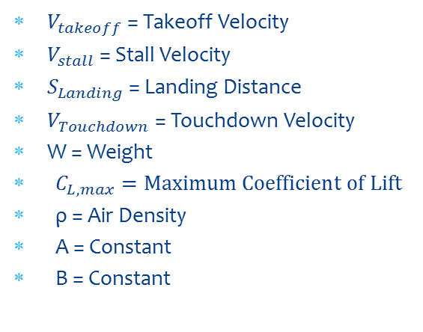
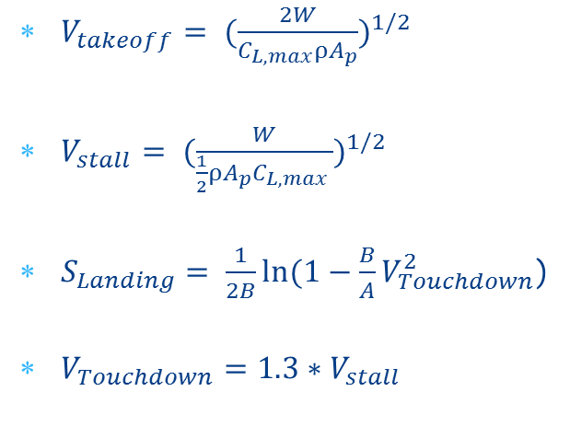
Takeoff and landing calculations
$V_{takeoff}= {(\frac{2W}{C_{L,max}ρA_{p}})}^{1/2}$
$V_{stall}= {(\frac{W}{\frac{1}{2}ρA_{p}C_{L,max }})}^{1/2}$
$S_{Landing}= \frac{1}{2B}ln⁡(1−\frac{B}{A}V_{Touchdown}^{2}$)
$V_{Touchdown}=1.3∗V_{stall}$
$V_{takeoff}$ = Takeoff Velocity
$V_{stall}$ = Stall Velocity
$S_{Landing}$ = Landing Distance
$V_{Touchdown}$ = Touchdown Velocity
W = Weight
  $C_{L,max}=Maximum Coefficient of Lift$
  ρ = Air Density
  A = Constant
  B = Constant
We calculated our design to take-off within 200 ft with a 22 lb payload
Noe Caro

Slide 22
Payload Prediction Graph
Noe Caro

Slide 23
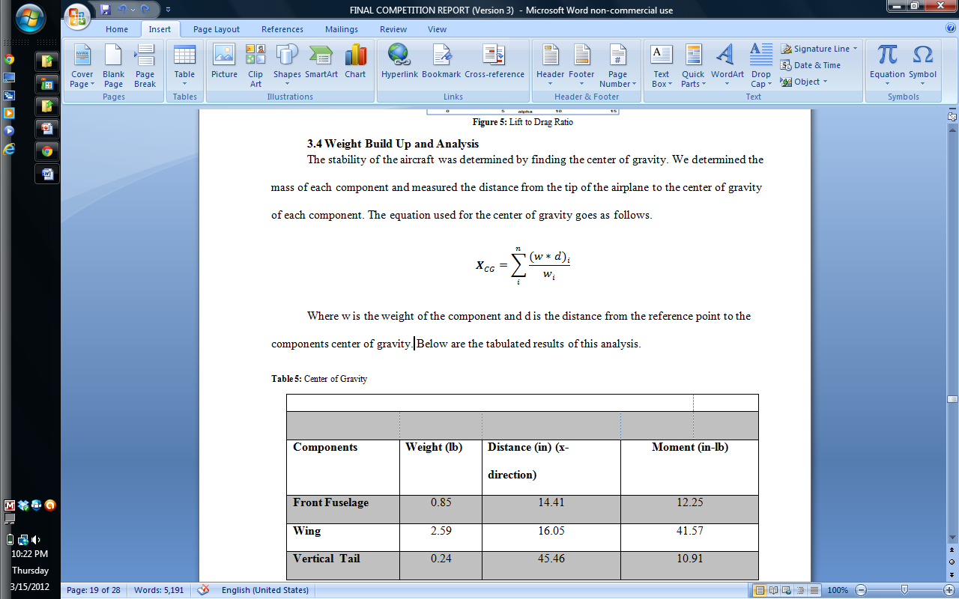
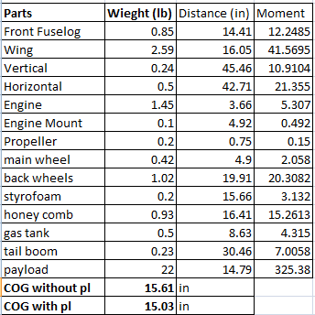
Center of gravity analysis
C.G. is located 15.61 inches without payload from the tip of engine
C.G. is located 15.03 inches with payload from the tip of the engine
Noe Caro

Slide 24
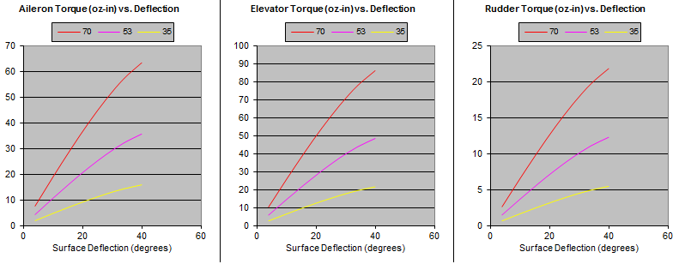
Stability and Control
With C.G. we found the static margin using Aerodynamics, Aeronautics, and Flight Dynamics, John Wiley
Found that the plane was stable with and without payload
Neutral points were 2.18 and 2.74 inches from C.G.
Using different speeds in mph
Based on results used different servos for elevator than the rudder and ailerons.
Noe Caro

Slide 25
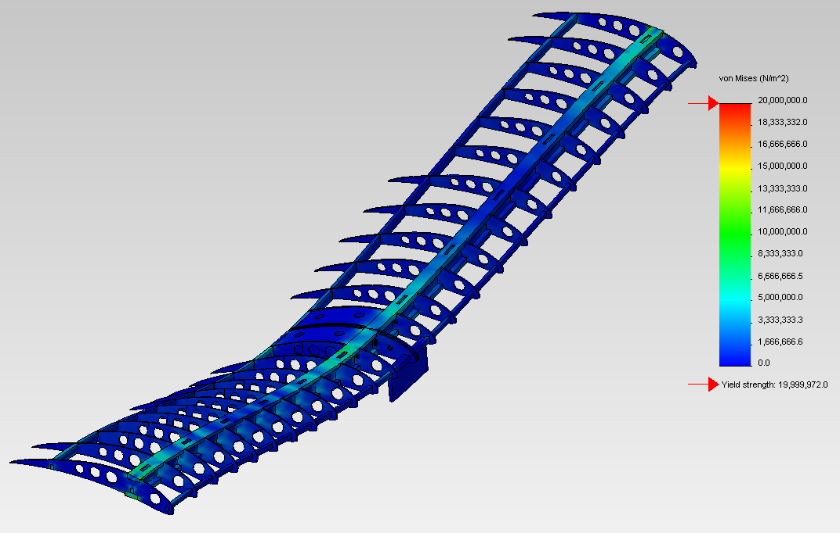
Wing Structural Analysis
22 lb loading with ends of the wings fixed
Maximum Stress- 2600 psi
Maximum displacement- 1.1 in
Yield Stress of balsa-3000 psi
Noe Caro

Slide 26
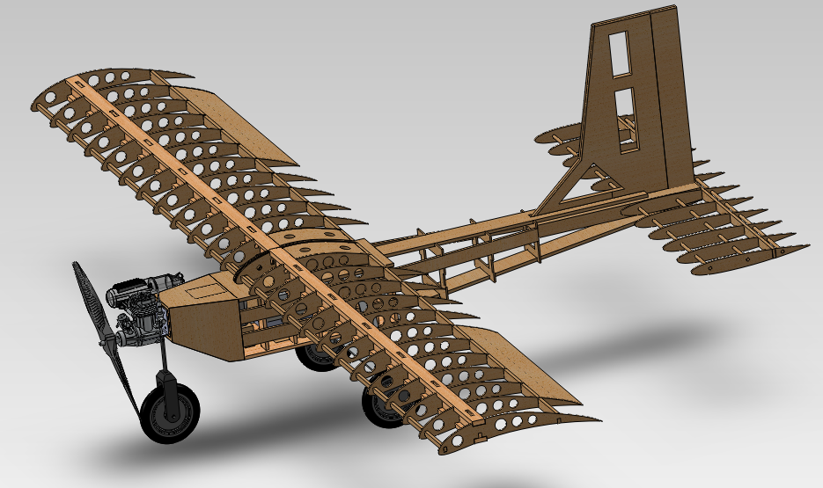
Construction process
Chase Beatty

Slide 27
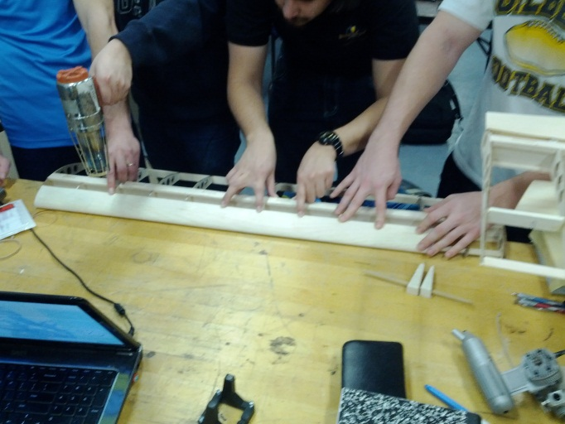
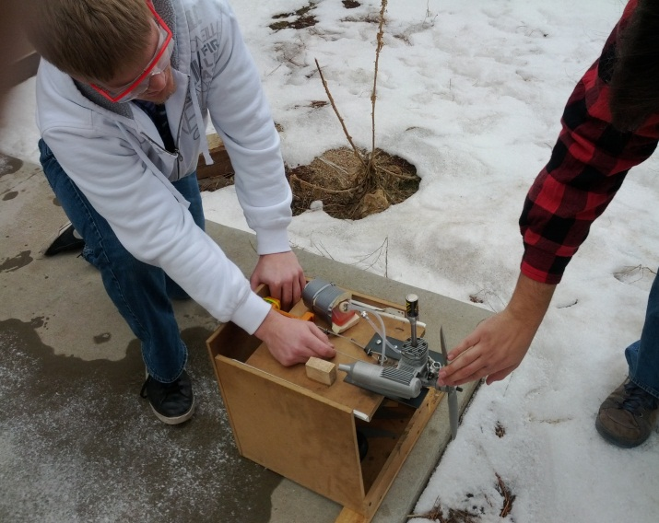
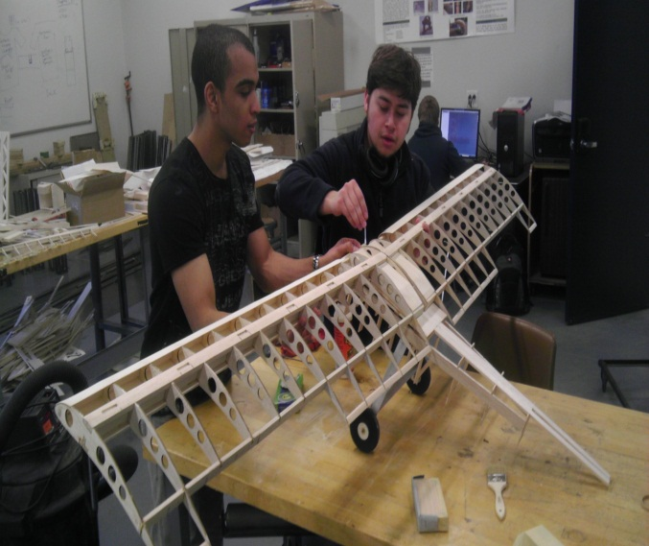
Construction process cont.
Chase Beatty

Slide 28
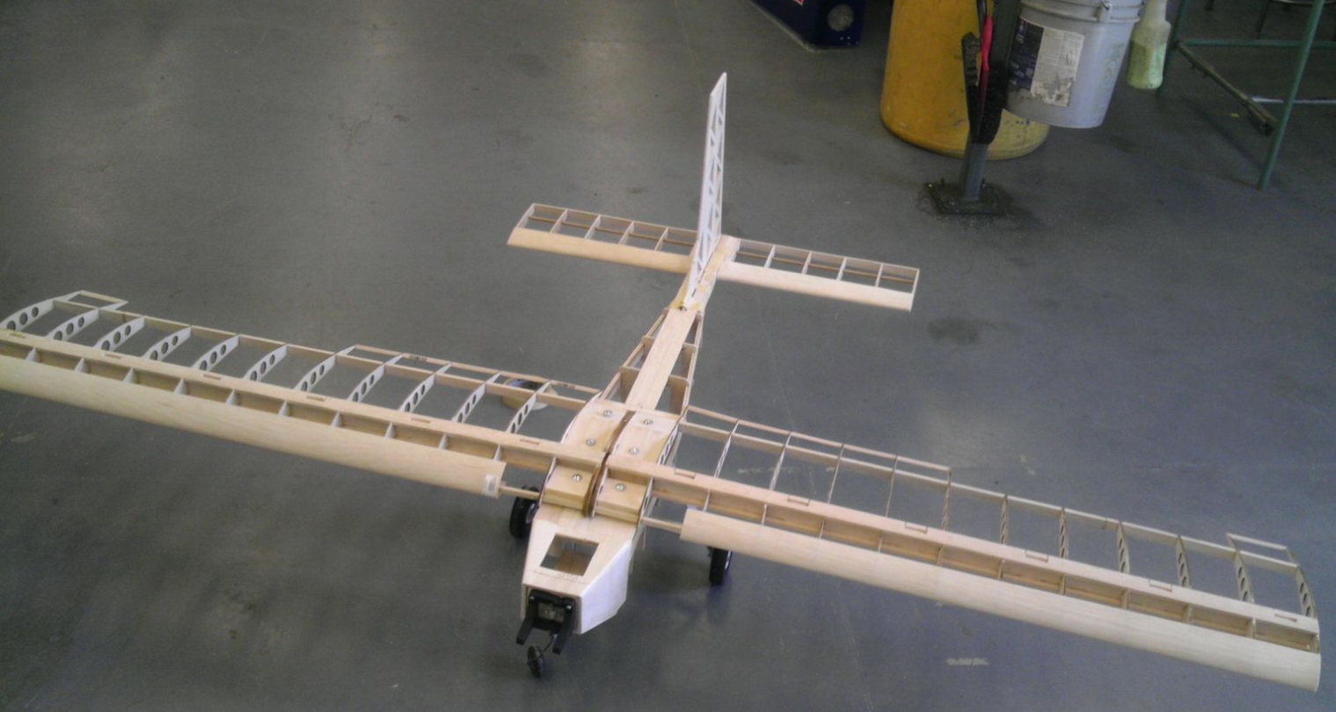
Construction process cont.
Chase Beatty

Slide 29
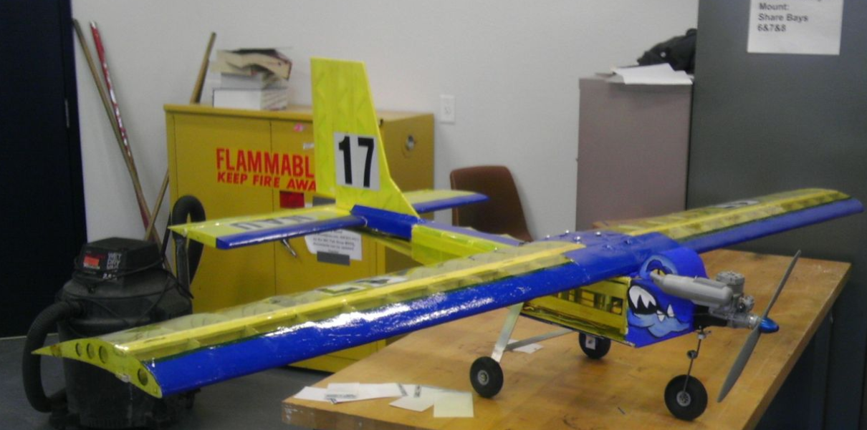
Final Design
Chase Beatty

Slide 30
Man Power
1st semester – 72 hours per person
2nd semester until spring break – 180 hours per person
Estimated remaining time – 50 hours per person
Total time – 302 hours per person
Chase Beatty

Slide 31
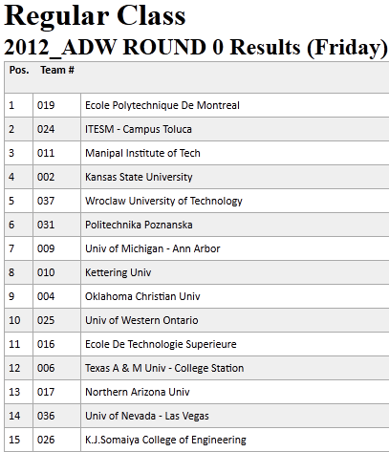
Results of competition
Placed 13th out of 35 universities at competition in Van Nuys, California on the report and presentation scores
Flew the day before competition and successfully completed 3 circles while taking off and landing flawlessly
Calculated a 45 feet take-off distance compared to the actual take off distance of about 30 feet with no payload
Chase Beatty

Slide 32
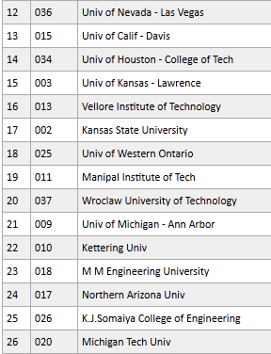
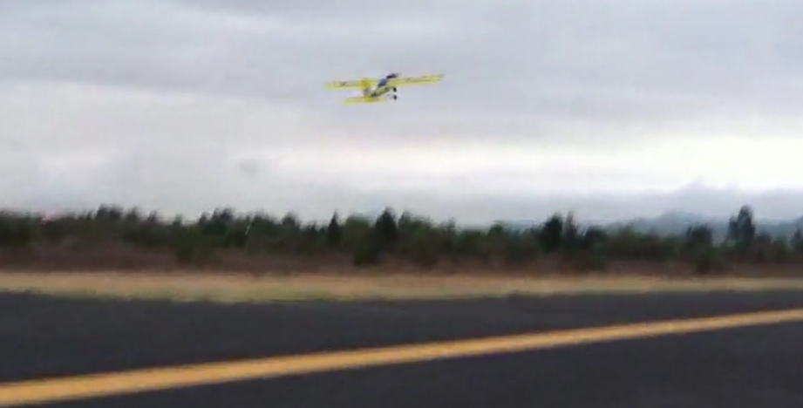
Conclusion
Finished 24th out of 35 overall while taking a zero in our flying score due to unfavorable weather conditions
Chase Beatty

Slide 33
Questions?

Slide 34
REFRENCES
Anderson, John D., fundamentals of Aerodynamics, McGraw-Hill, New York, 2011
B. W. McCormick, Aerodynamics, Aeronautics, and Flight Dynamics, John
Wiley, 1995
Garner, W. B., “Model Airplane Propellers” 2009
Nicolai, Leland M., Estimating R/C Model Aerodynamics and Performance, Lockheed Martin, 2009
Aircraft Proving Ground. -http://www.geistware.com/rcmodeling/calculators.htm
Raymer, Daniel P., Aircraft Design: A Conceptual Approach, American Institute of Aeronautics and Astronautics, Virginia, 1999
Philpot, Timothy. Mechanics Of Materials. Hoboken: John Wiley and Sons Inc, 2008. 411-421.
Anderson, John D., aircraft performance and design, McGraw-Hill, New York, 1999

