Slide 1
SAE AERO
Chase Beatty (Team Leader)
Brian Martinez (Organizer)
Mohammed Ramadan (Financial Officer)
Noe Caro (Historian)
Chase Beatty

Slide 2

CUSTOMER description
Dr. John Tester
  SAE advisor since 2000
Judges at AERO competition
Academic advisor
  Dr. Tom Acker
Chase Beatty

Slide 3
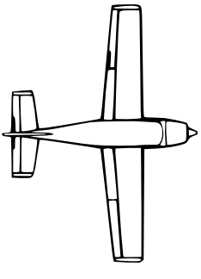
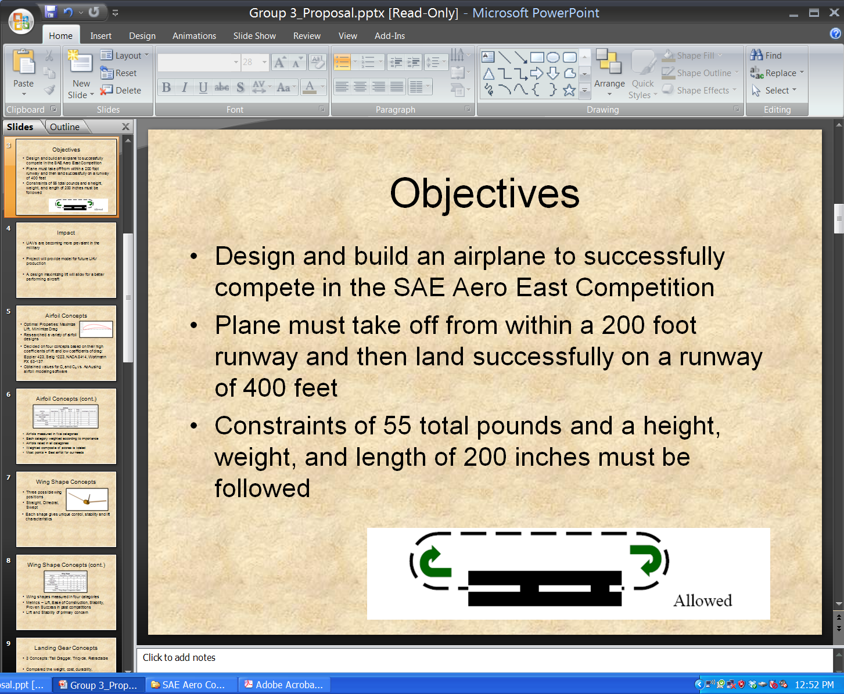
Project description
Design and build an airplane
Combined dimensions cannot exceed 225”
Take off within 200ft
Land and stop within 400ft
Payload and airplane cannot exceed 55lbs
Fly in a circle at least once
No lighter than air aircrafts or helicopters
Land Land within 400’ 0’
Takeoff within 200’
Brian Martinez

Slide 4
Project description cont.
Propeller cannot be made out of metal
Fiber-Reinforced Plastic is prohibited
No fuel pump
Cannot used gear boxes—gear ratio
Fuel supplied by competition
No gyroscope
Must raise our own funds
Brian Martinez

Slide 5
Project schedule
Phase 1: Research
  09/19/11 – 03/01/12
  Equations, materials and airplane design
Phase 2: Fundraising
  09/19/11 – 12/27/11
  Wing-a-thon
Phase 3: Design the Prototype
  10/17/11 – 12/18/11
  Solidworks model
Brian Martinez

Slide 6
Project schedule cont.
Phase 4: Construction of Final Aircraft
  12/28/11 – 02/15/12
  Wing
  Fuselage
  Landing Gear
Phase 5: Testing the Aircraft
  02/16/12 – 03/07/12
  Performance analysis
Phase 6: Competition
  03/16/11 – 03/18/11
Brian Martinez

Slide 7
budget
 | Estimated Budget (dollars)
Registration | 600
Fuel Cost (Transportation) | 450
Hotel Cost (4 nights) | 300
Food/Drink Cost | 600
Balsa Wood | 30
Bass Wood | 20
Monokote | 30
O.S. 61FX | 150
Servos | 50
Receiver | 100
TOTAL | 2330
Brian Martinez

Slide 8
Man power
Time Frame | Hours per week per person | Total hours per person
Fall (9/19-12/16) | 8 | 104
Winter (12/19-1/13) | 35 | 140
Spring (1/16-3/15) | 20 | 180
Total Project Length |  | 424
Chase Beatty

Slide 9
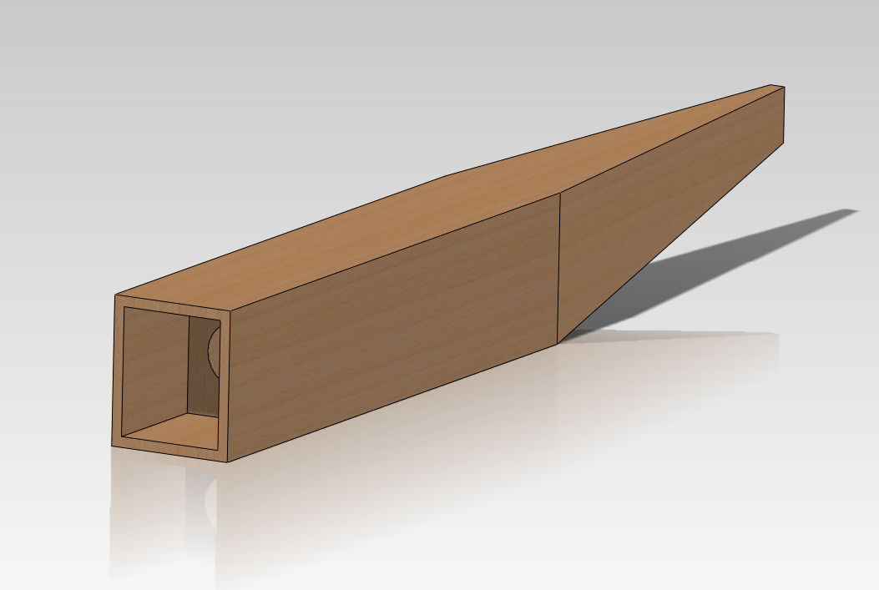
Fuselage Design 1
Balsa wood shell
Balsa wood ribs inside
Easy wing mounting
Easy tail mounting
Angled tail end
Chase Beatty

Slide 10
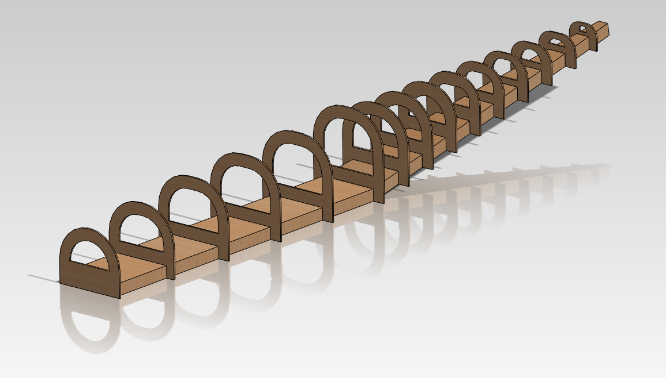
Fuselage design 2
Monokote wrapped around ribs
Hard to mount wings
Lighter weight than Balsa shell
Weaker fuselage
Angled tail end
Chase Beatty

Slide 11
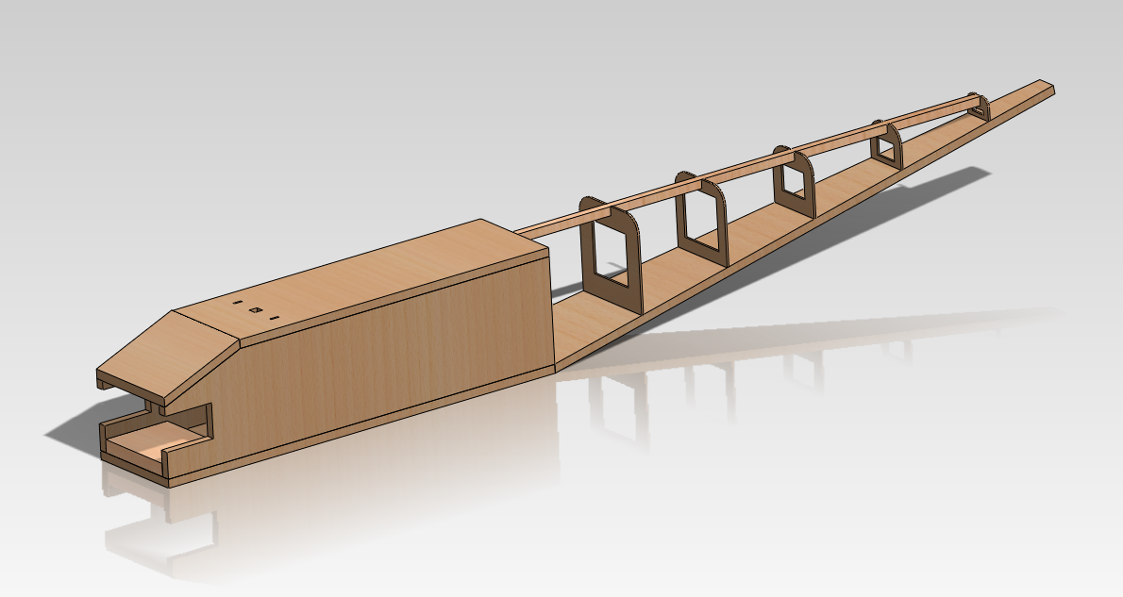
Fuselage design 3
Combination of first two designs
Solid balsa shell for easy wing mount
Monokote for tail end for lighter weight
Angled tail end
Chase Beatty

Slide 12
Aerodynamics analysis
Airfoil research
Research
Previous teams selection
2010 – E 423
2009 – E 423
Common airfoil
E 423
Clark Y
Our selection for aerodynamics analysis and comparsion
E 423
Clark Y
Mohammed Ramadan
Notes:
We should change this slide. This looks like all we’re doing is copying designs from previous years.

Slide 13
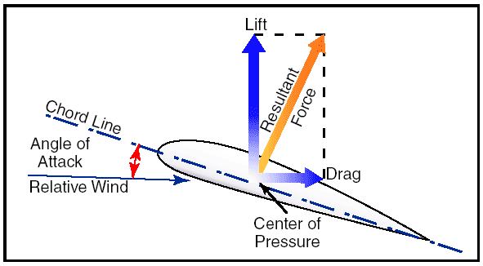


Airfoil Key Parameters
$$C_{l}=\frac{L^{′}}{0.5ρV_{∞}^{2}c}$$
$$C_{d}=\frac{D^{′}}{0.5ρV_{∞}^{2}c}$$
Stall: is a sudden drop in the lift coefficient when reaching a critical AoA
  C_{L} – Lift Coefficient , C_{d} – Drag Coefficient , Stall , α – Angle of Attack (AoA)
  $\frac{Cl}{Cd}$ Lift to Drag Ratio
Mohammed Ramadan

Slide 14
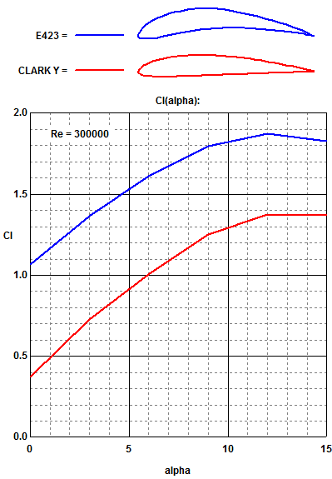

Airfoil Analysis
(Lift Coefficient vs AoA)
E 423
Max Cl = 1.89 at 12$°$
Stall beginning at12$°$
Clark Y
Max Cl = 1.39 at 12$°$
Stall around 12$°$ to 15$°$
Profili
Mohammed Ramadan

Slide 15
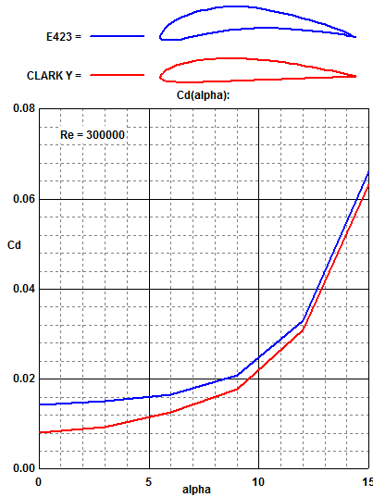
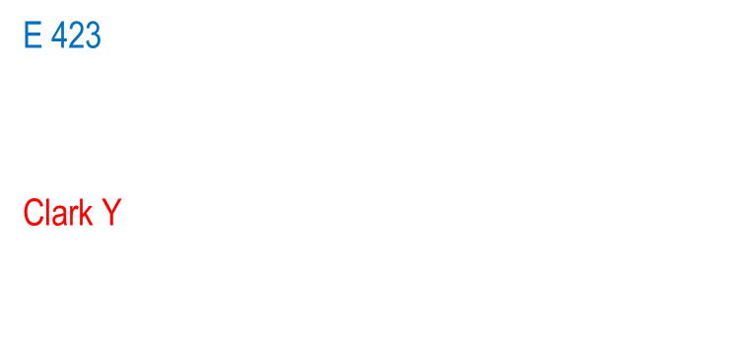
Airfoil Analysis CONT.
(Drag Coefficient vs AoA)
E 423
Cd= 0.035 at 12$°$
Cd = 0.02 at 9$°$
Clark Y
Cd= 0.030 at 12$°$
Cd = 0.015 at 9$°$
Profili
Mohammed Ramadan

Slide 16
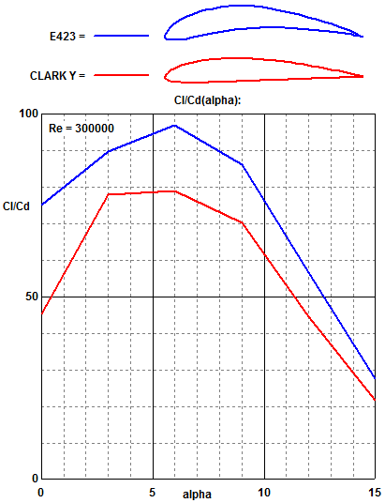
Airfoil Analysis CONT.
(Lift to Drag Ratio vs AoA)
E 423
L/D max = 97 at 6°
Clark Y
L/D max = 79 at 6°
Maximum L/D is an
important parameter
in airfoil performance
efficiency
Profili
Mohammed Ramadan

Slide 17
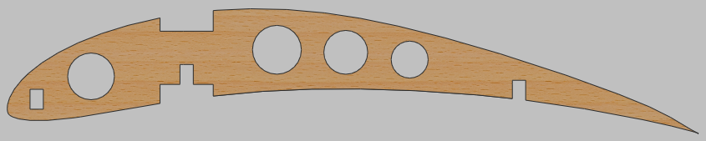

Airfoil Design
SolidWorks & Profili
4 lightening holes
3 spar locations
Initial chord = 13 inches
Max thickness = 1.63 inches
Mohammed Ramadan

Slide 18


Wing Planform
Rectangular
Ideal for low speed
Ease to construct
Tapered
Harder to construct
Good for high speed
Mohammed Ramadan

Slide 19
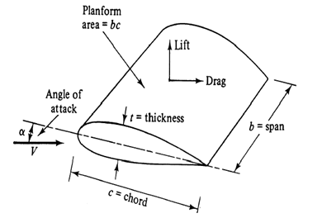

Wing Dimension
Initial Dimensions
Wing span = $90$ inches
Wing chord = $13$ inches
Area = span X chord = $1170in^{2}$
Aspect ratio = $\frac{span^{2}}{area}$ = 6.9
AR for low speed = 6 or greater (John D. Anderson, Jr.)
${(Cl}_{max})=0.9{(cl}_{max})$ , $V_{stall}= {(\frac{W}{\frac{1}{2}ρA_{p}C_{L,max }})}^{1/2}$ , $\frac{W}{Ap}=\frac{1}{2}ρC_{L,\max{V_{stall}} }$
Wing calculation
Mohammed Ramadan

Slide 20
Wing analysis
Static analysis for load distributions
Mechanics of materials for yield strength.
Mohammed Ramadan

Slide 21
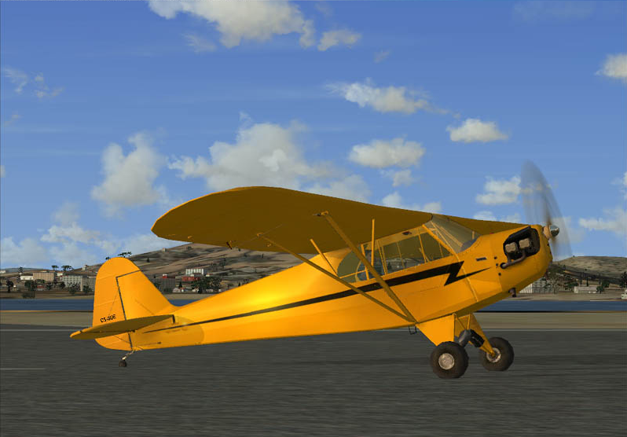
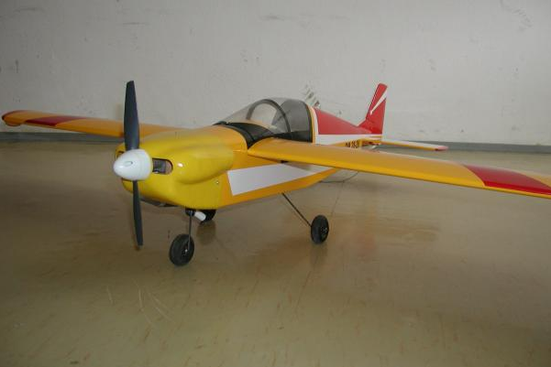
Landing gear
Tail dragger or Tricycle
COG
Takeoff
Landing
Brian Martinez

Slide 22


Takeoff and landing calculations
$V_{takeoff}= {(\frac{2W}{C_{L,max}ρA_{p}})}^{1/2}$
$V_{stall}= {(\frac{W}{\frac{1}{2}ρA_{p}C_{L,max }})}^{1/2}$
$S_{Landing}= \frac{1}{2B}ln⁡(1−\frac{B}{A}V_{Touchdown}^{2}$)
$V_{Touchdown}=1.3∗V_{stall}$
$V_{takeoff}$ = Takeoff Velocity
$V_{stall}$ = Stall Velocity
$S_{Landing}$ = Landing Distance
$V_{Touchdown}$ = Touchdown Velocity
W = Weight
  $C_{L,max}=Maximum Coefficient of Lift$
  ρ = Air Density
  A = Constant
  B = Constant
Brian Martinez

Slide 23
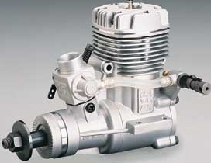
engine
OS .61 FX
Required for regular class at SAE competition
19.4 oz
2,000 – 17,000 RPM
1.90 HP @ 16,000 RPM
Research for equations involving the engine still in progress
Brian Martinez

Slide 24
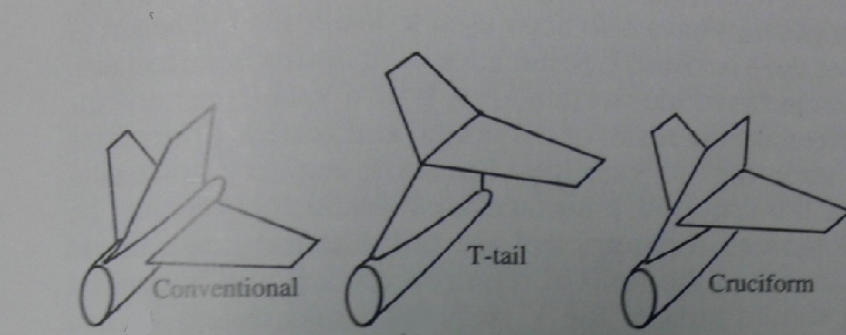
Tail End selection
We did research on three different tail sections
  Convectional
  T-Tail
  Cruciform
We will use a Convectional tail with a NACA-0012 airfoil
  Easy to manufacture
  Vertical tail will have a taper
  NACA airfoil is popular and should provide necessary stability
(Raymer)
Noe Caro

Slide 25
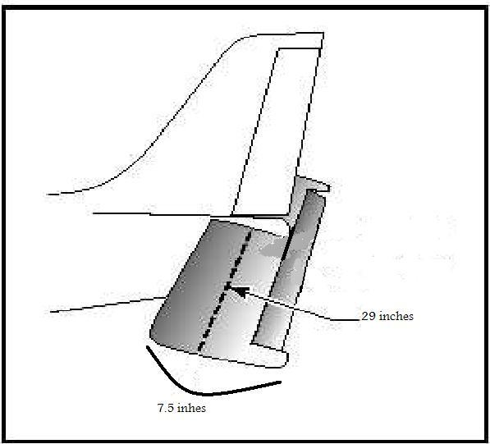

Horizontal Tail section
Equations:
Planform Area
  $S_{HT}=\frac{V_{VT}∗c∗S}{l_{HT}}$
Horizontal Span
  $b_{h}=\sqrt{S_{HT}∗AR}$
Horizontal Chord
  $c_{h}=\frac{S_{HT}}{b_{t}}$
An Aspect Ratio of 4 will be used for the horizontal tail section
  This horizontal span will be about 29 in with a chord of 7.5 in
There will be no taper in the horizontal tail
(Anderson)
Noe Caro

Slide 26
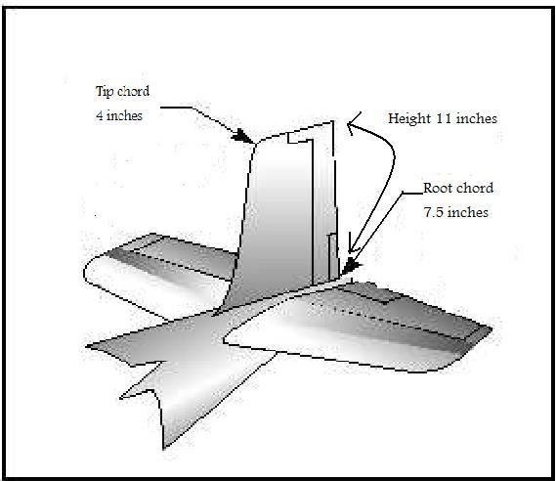
Vertical tail section
Equations:
Planform Area
  $S_{VT}=\frac{V_{VT}∗b∗S}{l_{VT}}$
Vertical height on tail section
  $h_{VT}=\sqrt{\left({AR}_{VT}\right)∗S_{VT}}$
Root chord
  $c_{rvt}=\frac{2∗S_{VT}}{(λ+1)(h_{VT})}$
Tip chord
  $c_{rvt}=λ∗c_{rvt}$
Aspect Ratio will be 1.5
The vertical tail will be tapered at a ratio of 50%
Will have a root chord of 7.5 in
Will have a tip chord of 4 in
Will have a span of 11.5 in
Noe Caro

Slide 27
Conclusion
Calculate equations related to the airfoil, fuselage, tail wing and engine
Put together final solid works model
Put together a materials list
Order materials needed to construct prototype
Noe Caro

