Slide 1
SAE AERO
Chase Beatty (Team Leader)
Brian Martinez (Organizer)
Mohammed Ramadan (Financial Officer)
Noe Caro (Historian)
Chase Beatty

Slide 2
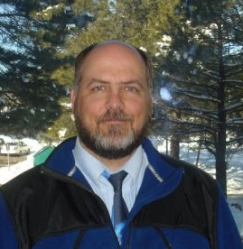
CUSTOMER description
Dr. John Tester
  SAE advisor since 2000
Judges at AERO competition
Academic advisor
  Dr. Tom Acker
Chase Beatty

Slide 3
Society of Automotive Engineers
Student engineering club
Annual SAE Aero competition west
Aero capstone project since 2009
Competing in regular class
Choose as senior design project
Chase Beatty

Slide 4
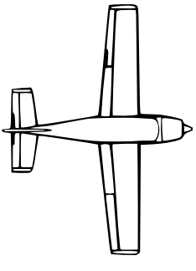
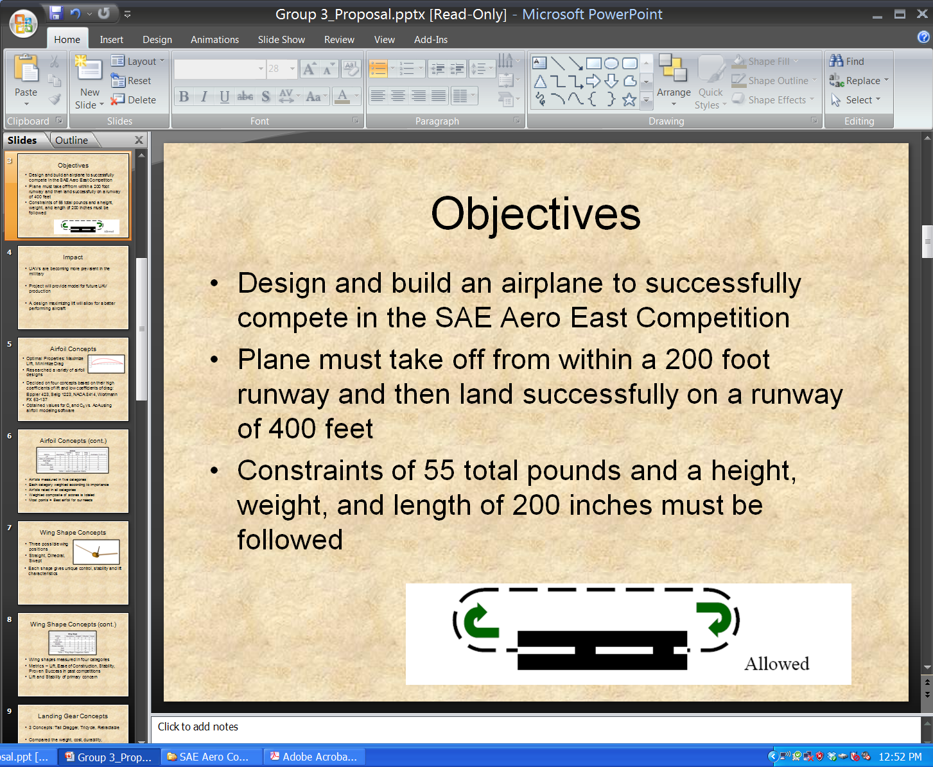
Project description
Design and build an airplane
Combined dimensions cannot exceed 225”
Take off within 200ft
Land and stop within 400ft
Payload and airplane cannot exceed 55lbs
Fly in a circle at least once
No lighter than air aircrafts or helicopters
Land Land within 400’ 0’
Takeoff within 200’
Brian Martinez

Slide 5
Project description cont.
Propeller cannot be made out of metal
Fiber-Reinforced Plastic is prohibited
No fuel pump
Cannot used gear boxes—gear ratio
Fuel supplied by competition
No gyroscope
Brian Martinez

Slide 6
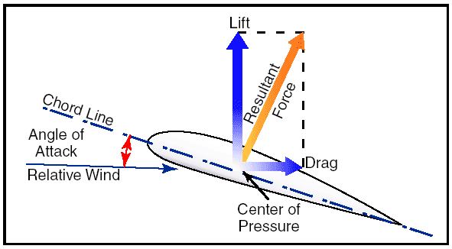


Airfoil Key Parameters
$$C_{l}=\frac{L^{′}}{0.5ρV_{∞}^{2}c}$$
$$C_{d}=\frac{D^{′}}{0.5ρV_{∞}^{2}c}$$
Stall: is a sudden drop in the lift coefficient when reaching a critical AoA
  C_{L} – Lift Coefficient , C_{d} – Drag Coefficient , Stall , α – Angle of Attack (AoA)
  $\frac{Cl}{Cd}$ Lift to Drag Ratio
Mohammed Ramadan

Slide 7
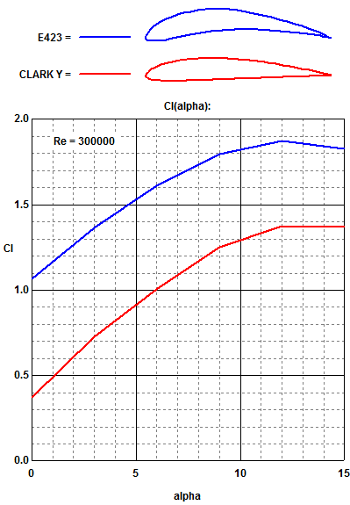
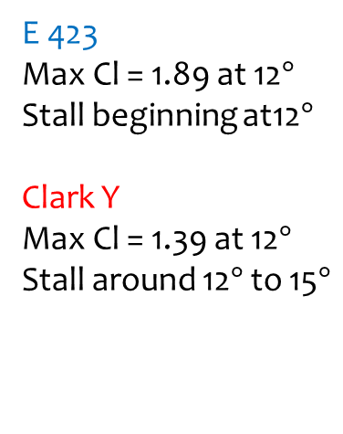
Airfoil Analysis
(Lift Coefficient vs AoA)
E 423
Max Cl = 1.89 at 12$°$
Stall beginning at12$°$
Clark Y
Max Cl = 1.39 at 12$°$
Stall around 12$°$ to 15$°$
Profili
Mohammed Ramadan

Slide 8
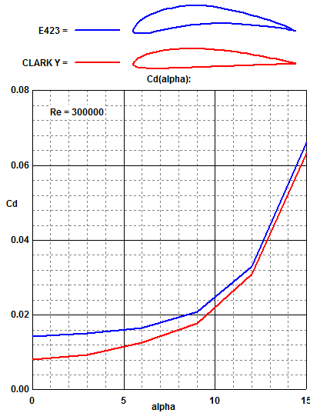
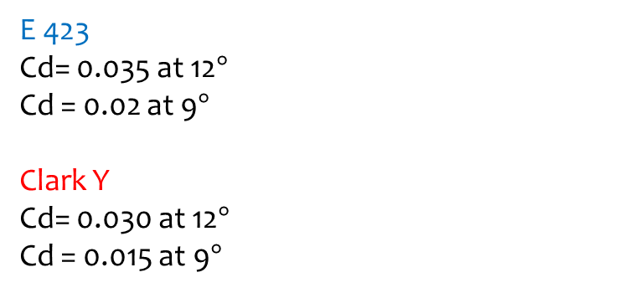
Airfoil Analysis CONT.
(Drag Coefficient vs AoA)
E 423
Cd= 0.035 at 12$°$
Cd = 0.02 at 9$°$
Clark Y
Cd= 0.030 at 12$°$
Cd = 0.015 at 9$°$
Profili
Mohammed Ramadan

Slide 9
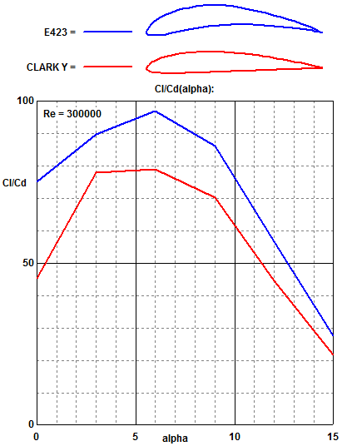
Airfoil Analysis CONT.
(Lift to Drag Ratio vs AoA)
E 423
L/D max = 97 at 6°
Clark Y
L/D max = 79 at 6°
Maximum L/D is an
important parameter
in airfoil performance
efficiency
Profili
Mohammed Ramadan

Slide 10
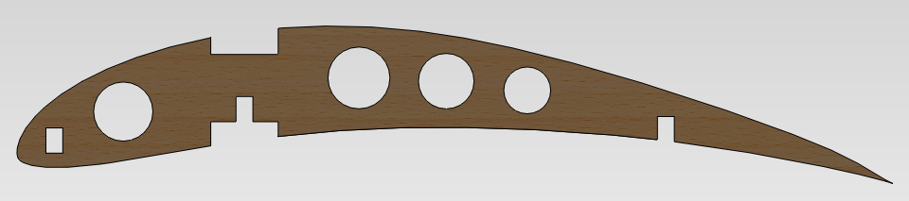

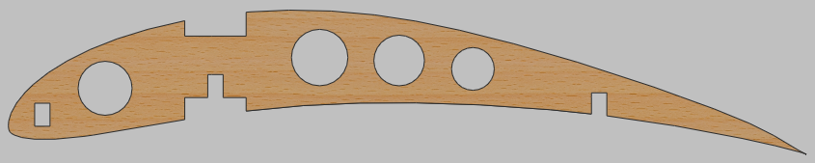
Airfoil Design
SolidWorks & Profili
4 lightening holes
3 spar locations
Initial chord = 13 inches
Max thickness = 1.63 inches
Mohammed Ramadan

Slide 11
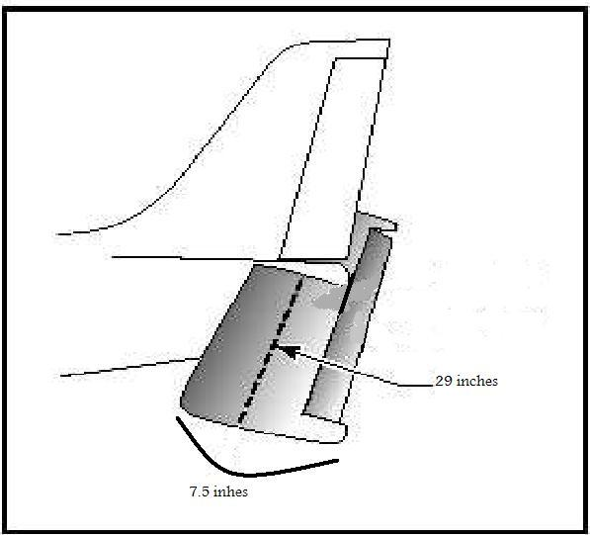
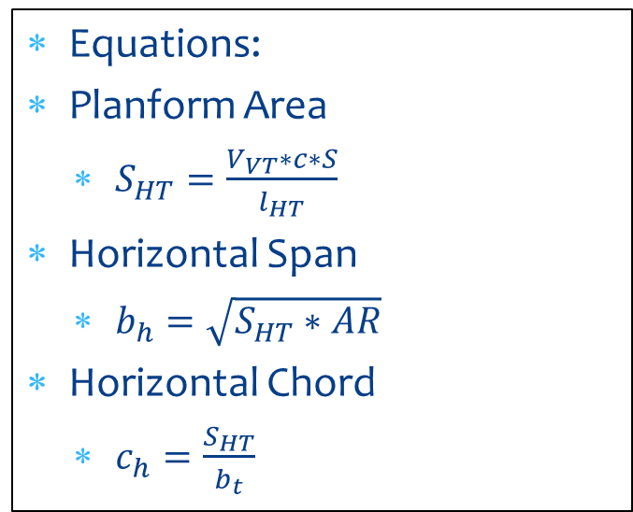
Horizontal Tail section
An Aspect Ratio of 4 will be used for the horizontal tail section
  This horizontal span will be about 32 in with a chord of 9 in
There will be no taper in the horizontal tail
Equations:
Planform Area
  $S_{HT}=\frac{V_{VT}∗c∗S}{l_{HT}}$
Horizontal Span
  $b_{h}=\sqrt{S_{HT}∗AR}$
Horizontal Chord
  $c_{h}=\frac{S_{HT}}{b_{t}}$
(Anderson)
Noe Caro

Slide 12
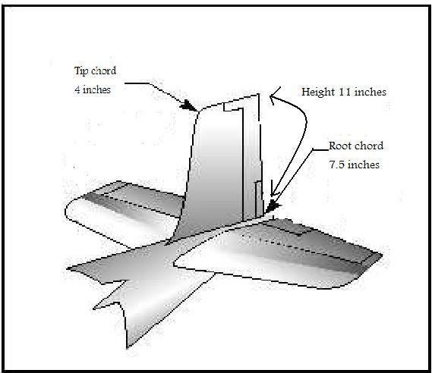
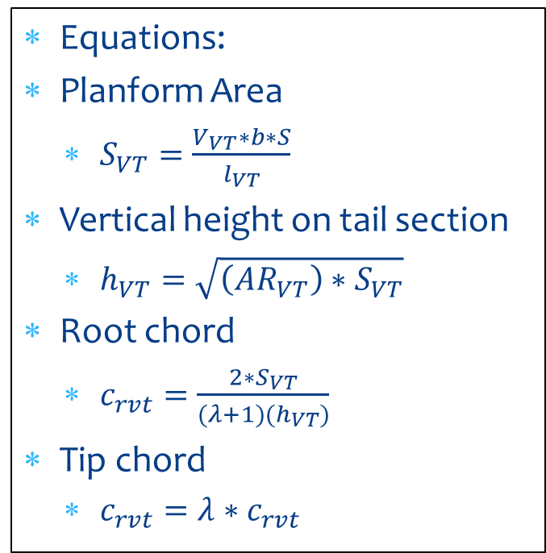
Vertical tail section
Aspect Ratio will be 1.5
The vertical tail will be tapered at a ratio of 50%
Will have a root chord of 11.75 in
Will have a tip chord of 4.5 in
Will have a span of 14 in
Equations:
Planform Area
  $S_{VT}=\frac{V_{VT}∗b∗S}{l_{VT}}$
Vertical height on tail section
  $h_{VT}=\sqrt{\left({AR}_{VT}\right)∗S_{VT}}$
Root chord
  $c_{rvt}=\frac{2∗S_{VT}}{(λ+1)(h_{VT})}$
Tip chord
  $c_{rvt}=λ∗c_{rvt}$
Noe Caro

Slide 13
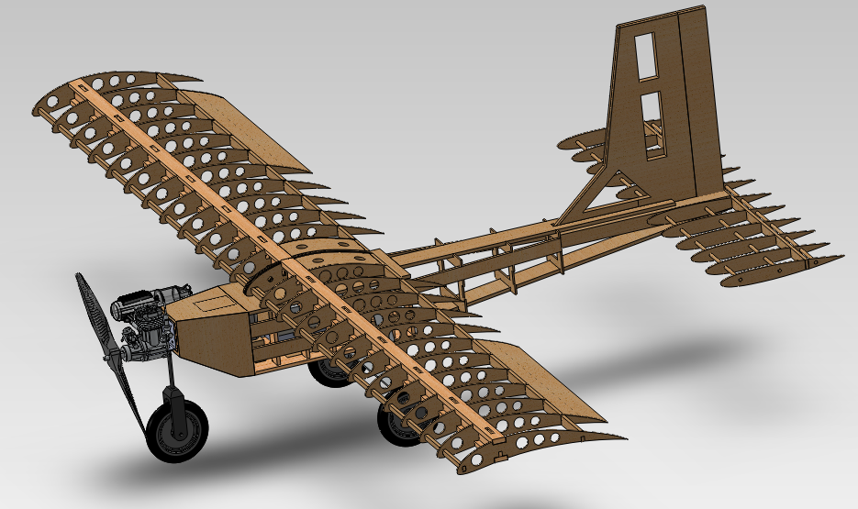
Final Design
Noe Caro

Slide 14
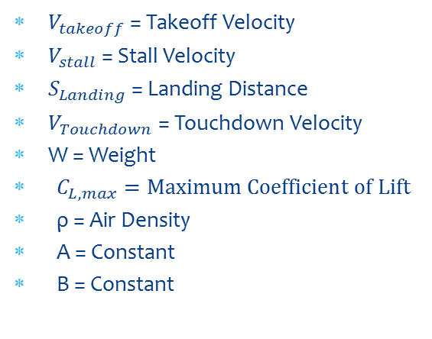
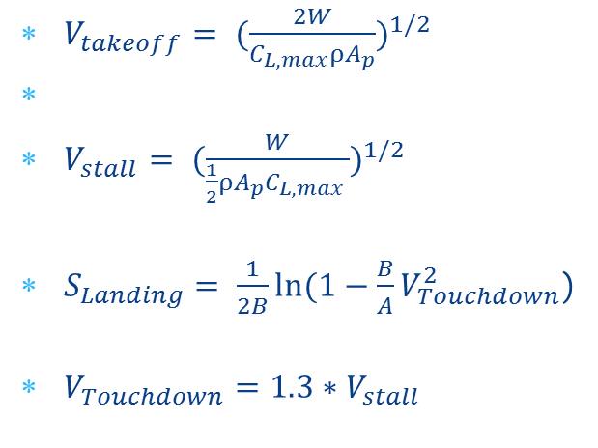
Takeoff and landing calculations
$V_{takeoff}= {(\frac{2W}{C_{L,max}ρA_{p}})}^{1/2}$
$V_{stall}= {(\frac{W}{\frac{1}{2}ρA_{p}C_{L,max }})}^{1/2}$
$S_{Landing}= \frac{1}{2B}ln⁡(1−\frac{B}{A}V_{Touchdown}^{2}$)
$V_{Touchdown}=1.3∗V_{stall}$
$V_{takeoff}$ = Takeoff Velocity
$V_{stall}$ = Stall Velocity
$S_{Landing}$ = Landing Distance
$V_{Touchdown}$ = Touchdown Velocity
W = Weight
  $C_{L,max}=Maximum Coefficient of Lift$
  ρ = Air Density
  A = Constant
  B = Constant
We calculated our design to take-off within 200 ft with a 22 lb payload
Chase Beatty

Slide 15
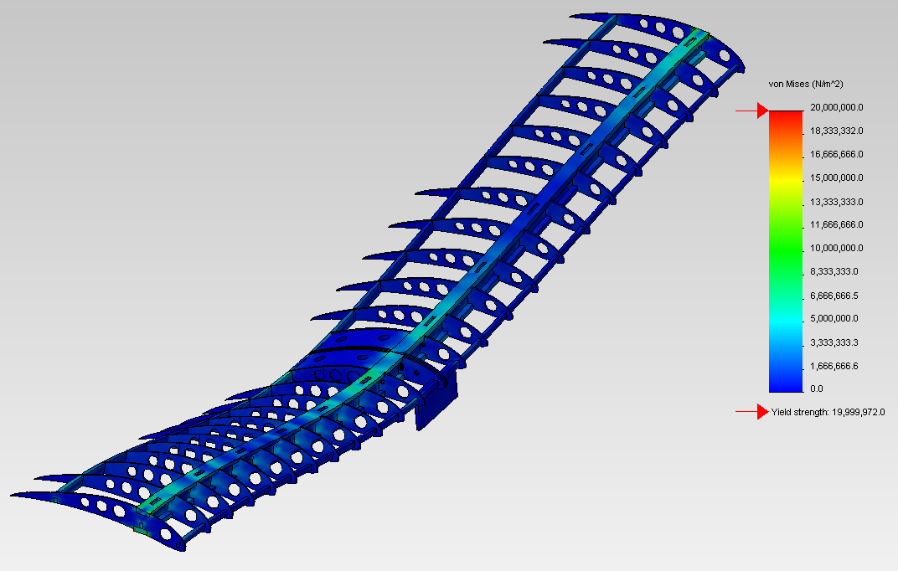
Wing Structural Analysis
22 lb loading with ends of the wings fixed
Maximum Stress- 2600 psi
Maximum displacement- 1.1 in
Yield Stress of balsa-3000 psi
Chase Beatty

Slide 16
Deliverables
Constructed airplane
Competition
Final Report
Brian Martinez

Slide 17
Budget
 | Estimated Budget (dollars)
Registration | 600
Fuel Cost (Transportation) | 450
Hotel Cost (4 nights) | 300
Food/Drink Cost | 600
Balsa Wood | 30
Bass Wood | 20
Monokote | 30
O.S. 61FX | 150
Servos | 50
Receiver | 100
TOTAL | 2330
 | Updated Budget (dollars)
Registration | 600
Fuel Cost (Transportation) | 450
Hotel Cost (3 nights) | 327
Food/Drink Cost | 600
Balsa Wood | 117.40
Bass Wood | 5.80
Monokote | 30
O.S. 61FX | 0
Servos | 176.95
Receiver | 0
TOTAL | 2307.15
Brian Martinez

Slide 18
Current Stage of Construction
Noe Caro

Slide 19
Project Schedule
Finish Servo connection and placement (3/3)
Monokote Aircraft (3/3)
Complete web page (4/24)
Finish poster (4/26)
Finish final report (5/4)
Noe Caro

Slide 20
Conclusion
Finish airplane electronics
Finish making payload
Construct back up set of wings
Test airplane in flight by certified pilot Fred (3/10)
Competition (3/16-3/18)
Noe Caro

