Slide 1
Dataforth Battery Charger
Final Presentation
Hamad Aldossary
Hunter Browning
Sean Conlin
Darby DeGan
1
04 / 15 / 2022

Slide 2
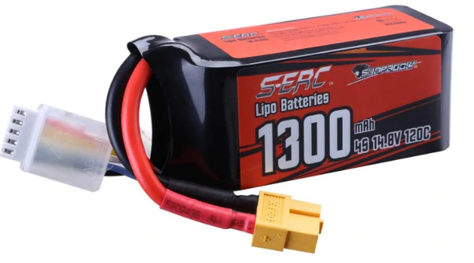
Project Introduction
4-Cell lithium polymer(LiPo) battery charger
Texas Instruments MSP430, Dataforth MAQ20
Dataforth Corporation
John Lehman: VP of product development
Trade show demonstrations
Showcase MAQ-20 data acquisition
Career development
Exposure to working in industry
2
Hamad

Slide 3
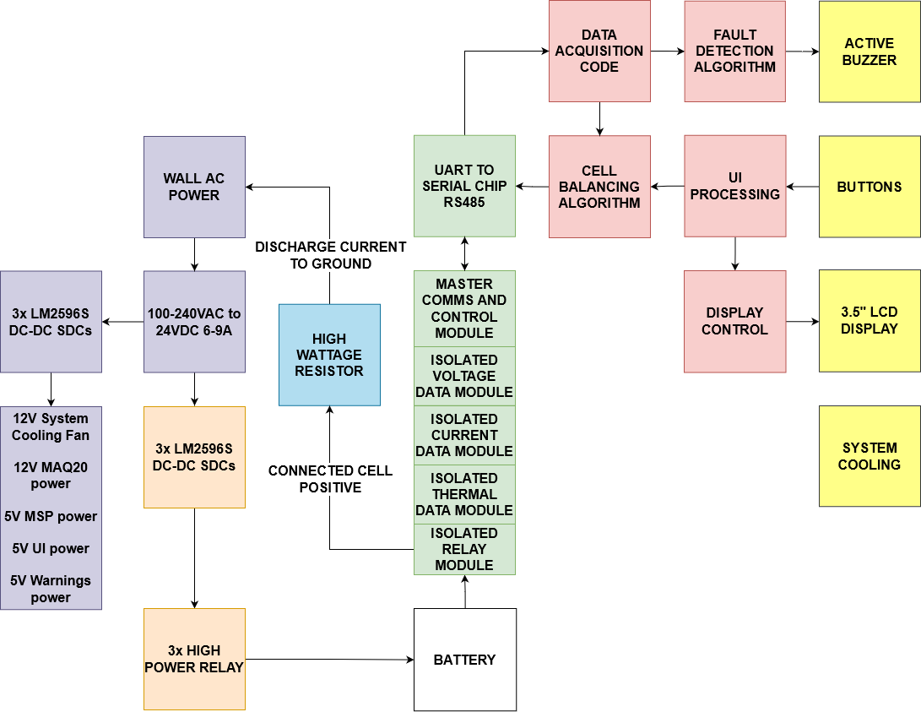
System Architecture Overview
Purple = primary power and system rails
Orange = charging circuitry
Blue = discharging circuitry
Red = MSP430/Firmware
Yellow = UI and peripherals
Green = Dataforth MAQ-20 data acquisition and requisite communication interface
Figure 1: System block diagram
3
Hamad

Slide 4
Project Requirements
Charge/Discharge battery
Charge battery at a safe rate of 1C
Discharge battery to prevent cell damage and overcharging
Monitor Battery
Monitor voltage drop across cells
Monitor temperature for safety
Integrate Dataforth products
Communicate with MAQ20 for system control and data acquisition
4
Hamad

Slide 5
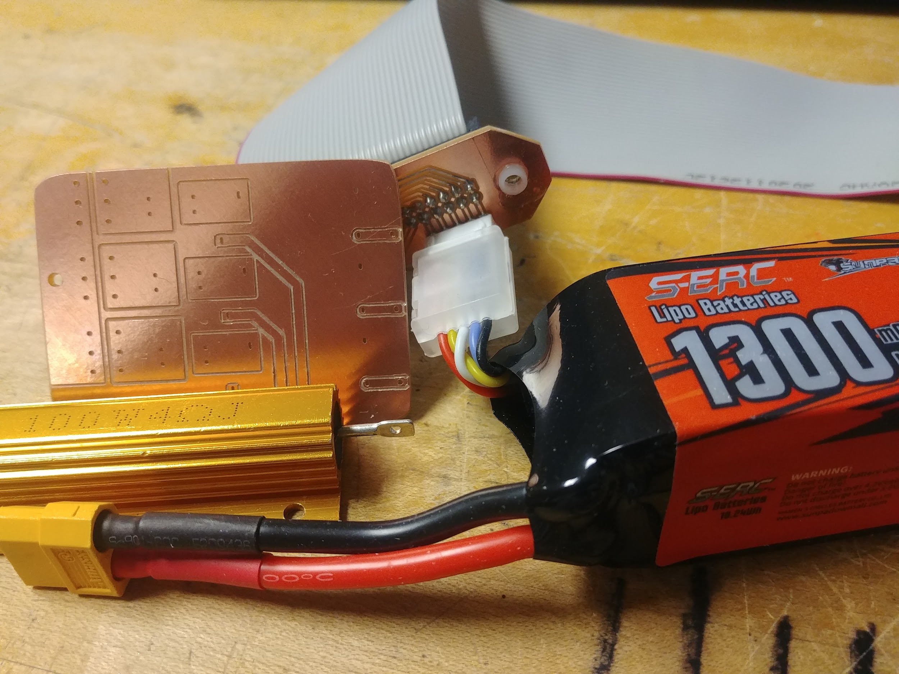
Prototypes
User interface
2x16 LCD with rotary encoder
Move away from rotary encoder
Safe power discharge
Single cell nominal
Multiple cells at once to ensure no thermal runaway
Minimum 1C charge rate
Step down converter limited to 1C at slightly higher voltage than battery pack
Confirmed charge rate using ammeter
Figure 2: From left to right - High wattage resistor, prototype charging PCB, 5 to 40 pin bus connector, LiPo battery
5
Darby

Slide 6
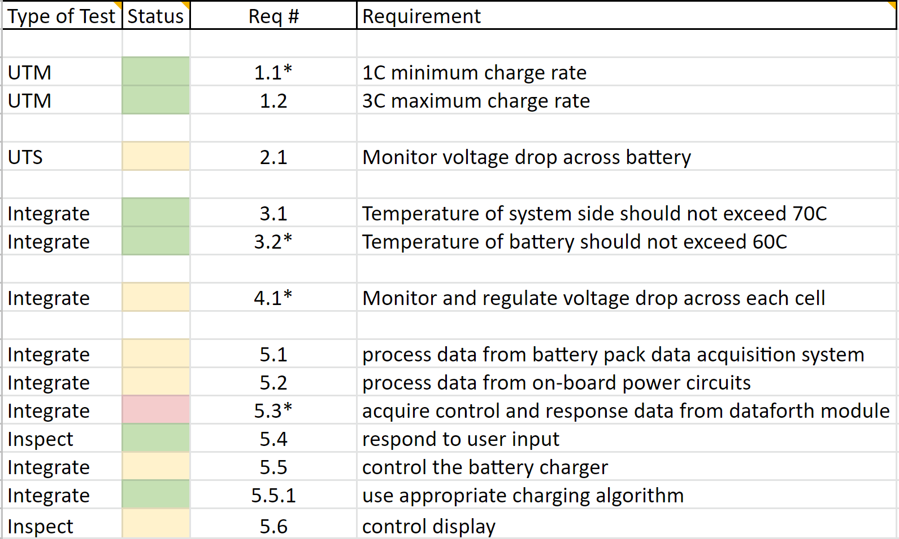
Important Testing Results
Charge/Discharge battery test
Foundation of project
Acquire control and response data from Dataforth module (MAQ 20)
Affects whole system
User Interface test
LCD integral to see data
Table 1: Testing results
6
Darby

Slide 7
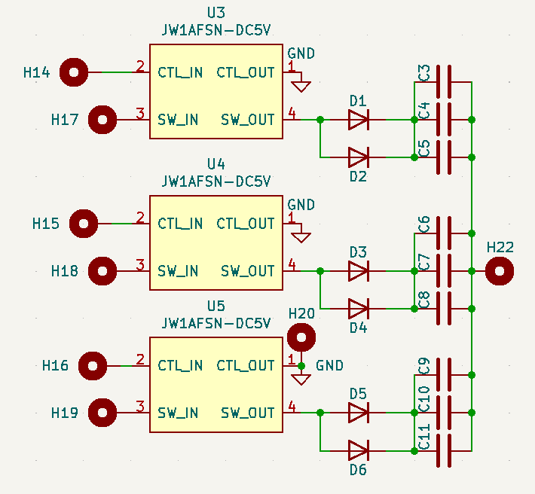
Charging circuit for test
Primary power supply feeds parallel buck step-down converters set to 1C each
The SDCs connect to high power 10A rated solid-state relays which switch to adjust charge rate
Decade capacitors used for noise attenuation and relay debouncing
Diodes used for EMI shielding
Can charge at rates of 1C, 2C, or 3C
Figure 3: Charging Block Diagram and Relay Circuit
7
Hunter

Slide 8
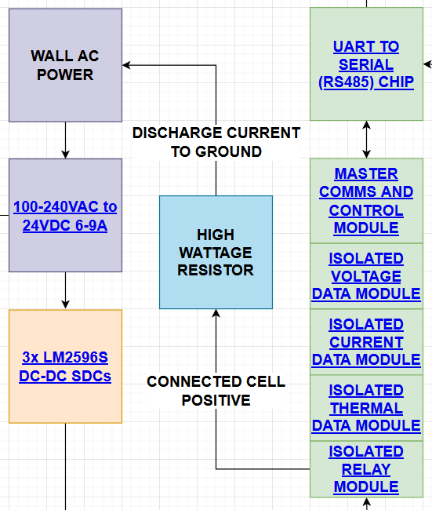
Discharging circuitry for test
10-100W 4Ω resistor to ground
Discharge bus from MAQ-20 DORLY module connects selected cell positive to ground for discharge
Nominal cell discharge of 1A 4W
Higher wattage chosen for contingency of loss of power during relay switch
DORLY is latching
Figure 4: Discharging Block Diagram
8
Hunter

Slide 9
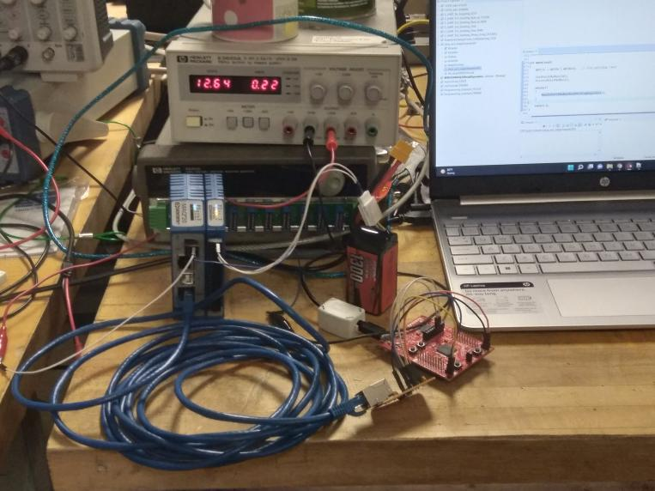
Technical Challenges: MAQ-20 Interface
MSP430 has a protocol for utilizing USCI modules for UART communication
ISO3086 Transceiver can convert between UART Tx & Rx signals and RS485 in full duplex
MAQ20 utilizes industry standard MODBUS protocol for RS485
MODBUS protocol sends a signal to the slave device (MAQ20 COM4) that includes function code, data I/O, error checking, and Cyclic Redundancy Check (CRC)
Figure 5: MAQ20 Data Acquisition Module with IS03086 Transceiver and MSP430
9
Sean

Slide 10
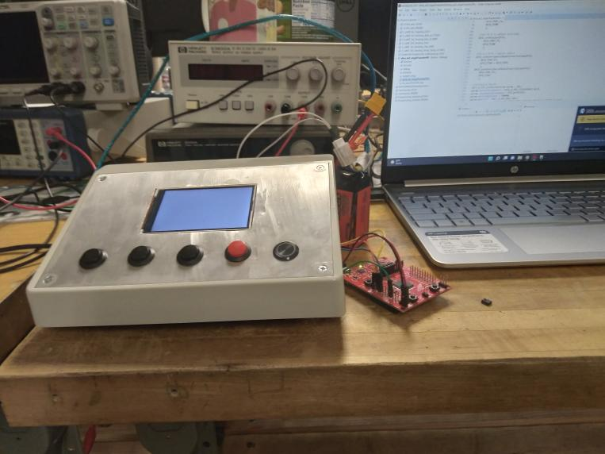
Technical Challenge: User Interface
SPI Interface with LCD Screen
New to SPI communication
Multiple SPI types (4 wire or 3 wire)
ILI9488 not commonly used with MSP430
Code Composer Studio
No libraries for the ILI9488 chipset
Data sending to one pixel at a time
Figure 6: Testing Setup for User Interface & MSP430
10
Sean

Slide 11
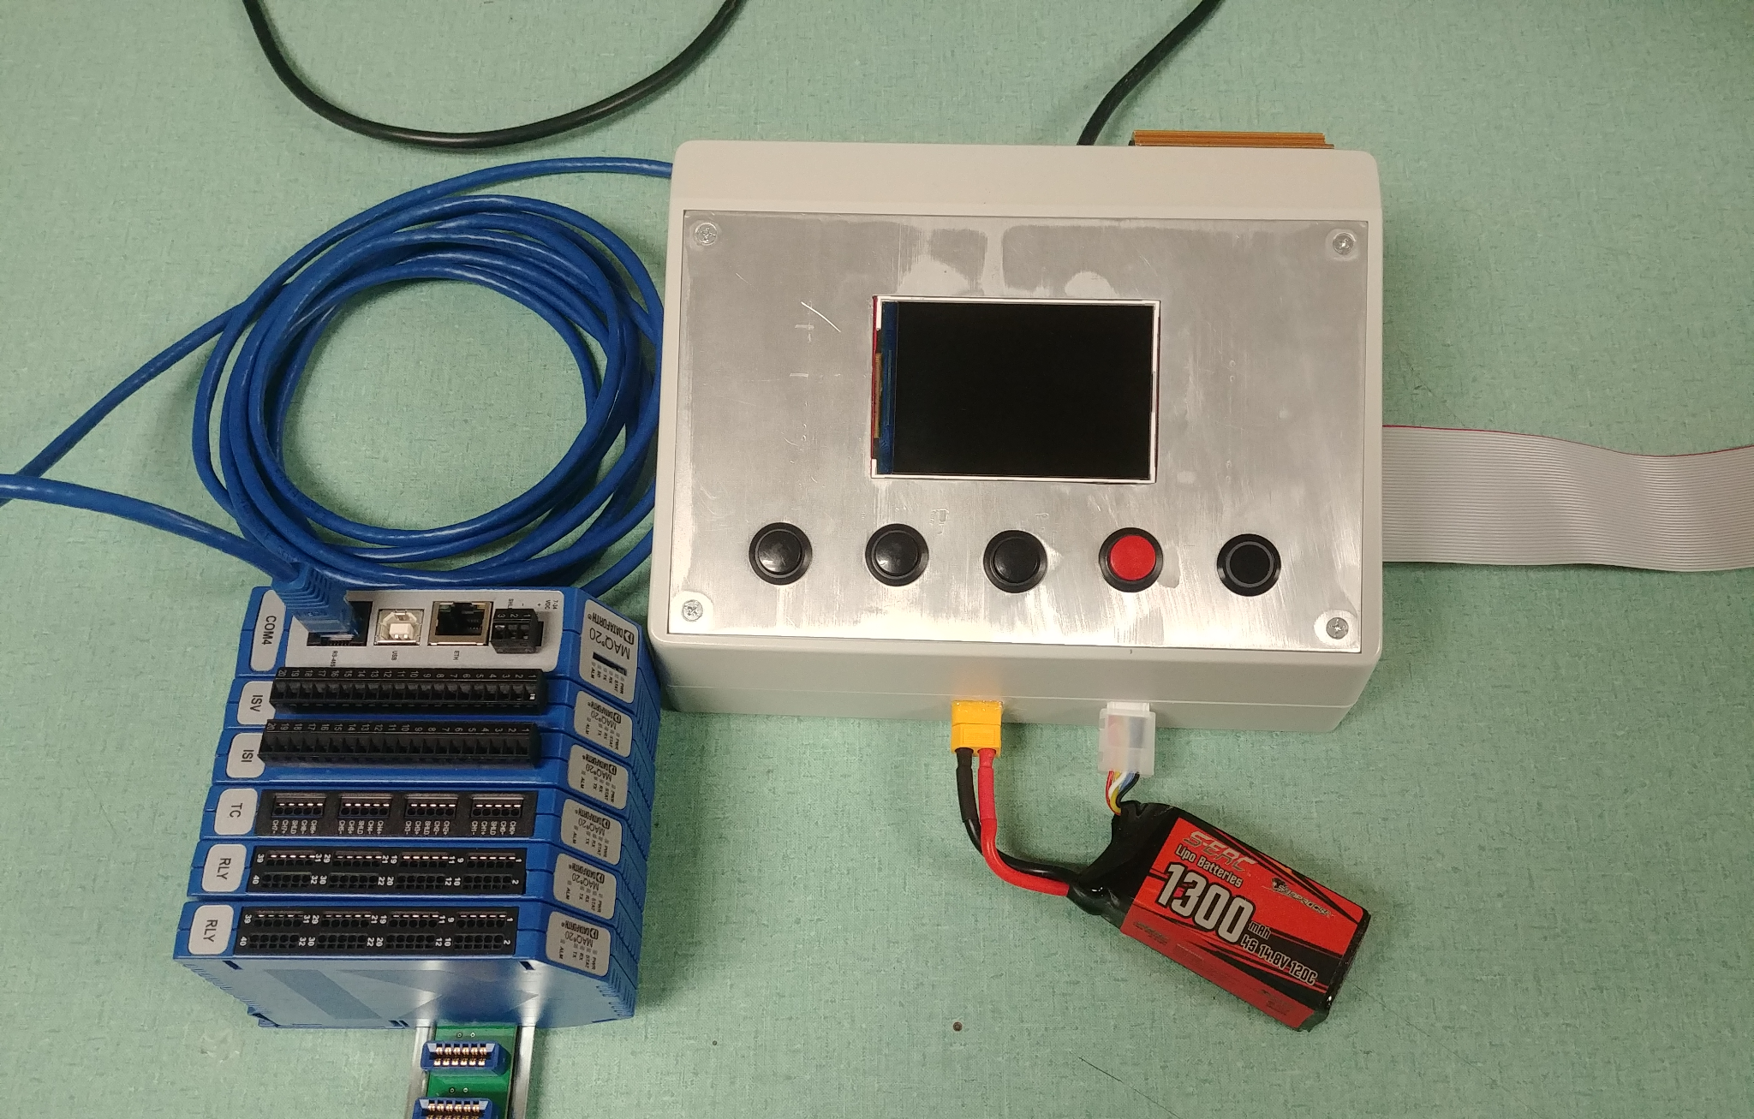
Conclusion
The requirement of charging the battery was met with the success of the charging circuit testing
Limitations of the system were due to oversights in communication with peripheral components
UART - RS485 MODBUS between MSP430 & MAQ20
SPI Communication between user display & MSP430
Figure 7: Full system
11
Sean

