Slide 1
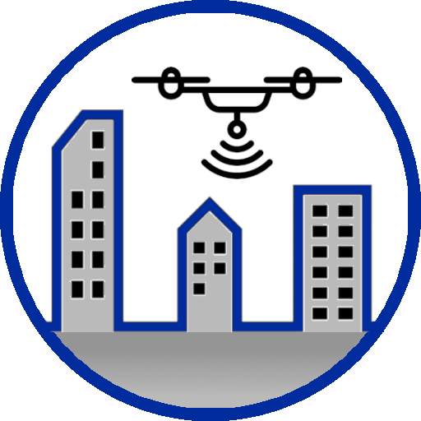
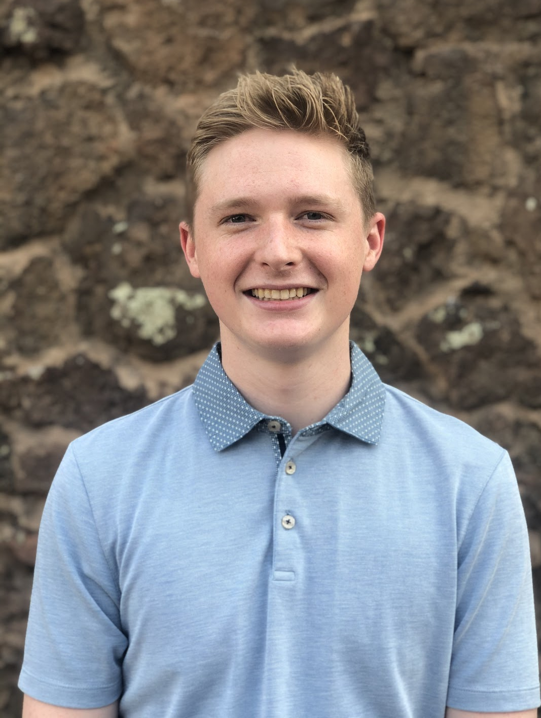
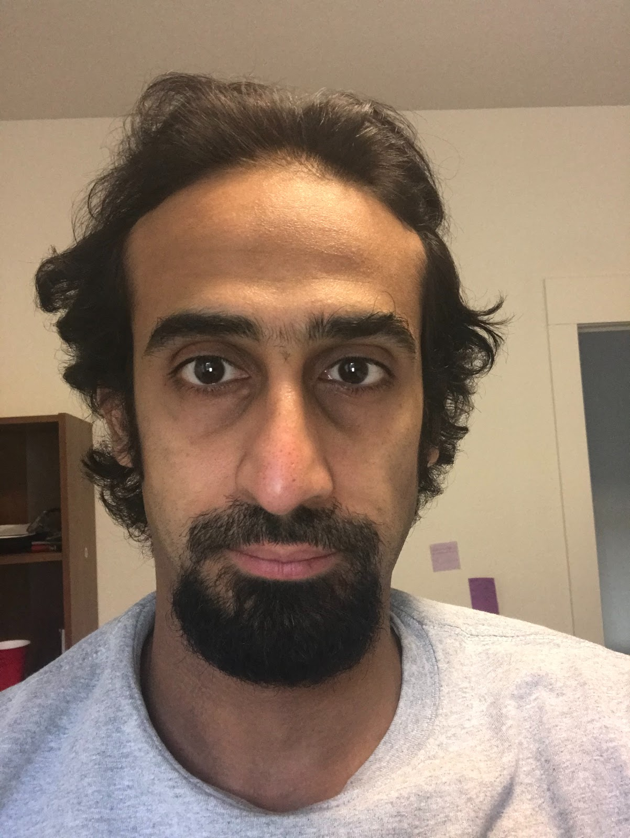
Final Presentation 21 April 2021
Mohammed Almershed
Daniel Copley
Noah Levie
Notes:
Hello everyone, my name is Noah Levie. I am the team leader of Team Skeyes, and I am joined today by my teammates Mohammed Almershed and Daniel Copley. We are here to offer our final capstone presentation of the Spring 2021 semester: the Skeyes Structural Monitoring Drone.

Slide 2
Introduction
Client: Dr. Abolfazl Razi
Director of Wireless Networking and Smart Health (WiNeSH) research laboratory
Predictive modeling for a variety of applications
Supported by the NSF, NIH U54, US Airforce Research Laboratory, and Arizona Board of Regents (ABOR)
Motivation
Goal is to make an easily-operatable, low-risk, and effective solution to the common issue of building inspection
Building inspections have always been necessary, and now they are almost always performed using drones
Manual building inspection can be expensive and dangerous
Avoid injuries, insurance, long inspection times, unnecessary expenses, or extensive training
Develop a novel method of machine learning implementation
Mohammed
Notes:
Our client, Dr. Razi, is a professor here at NAU in the School of Informatics, Computing, and Cyber Systems and is the Director of the Wireless Networking and Smart Health Laboratory. He has worked on a number of projects in his years here centered around predictive modeling for a variety of applications. Over the last year, we have been working with Dr. Razi to develop a novel method of combining aerial drone inspection and image processing. Using a self-navigating drone and a two-stage object recognition to image classification system, we have developed a more streamlined approach to performing routine building inspections – our device, the Skeyes Structural Inspection Drone.
Our goal with this project is to make an easily-operable, low-risk, and sophisticated solution to the commonplace issue of building inspection. Building inspections have always been necessary, in almost any industry – nowadays, however, they are almost always performed via the use of a drone. Conventional approaches to building inspection are laborious, costly, and dangerous. Building inspectors may have to traverse obstructive or treacherous terrain, and as a result they may have to use ladders, construction lifts, or even constructed scaffolding. All of these things have associated risks – they can take long amounts of time, incur liabilities which companies have to insure, they can be dangerous for inspectors to use or climb – sometimes there could simply not be enough space to bring in the necessary equipment. Using an inspection drone, however, inspectors can acquire high-quality videos of buildings without endangering themselves or using any other overhead. This solution offers the added benefit of being able to save the high-quality footage for later review.
Our project brings this idea to the next level. Often the drones that are used are manually controlled, meaning that the operator must constantly be within line of sight and appropriate range of the drone. Our drone, however, is autonomous. Using an integrated flight-controller software, our operator sets the flight path and sends the drone on its way, up and around the building. A gimbal mounted on our drone stabilizes a camera, which records the nearby building and streams the video data back to the ground control station. Within the ground control station, this video data is presented to the operator; meanwhile, our two-stage feature analysis system is run in the background, identifying relevant features, and highlighting them for the user. Identified objects, such as gutters and windows, are outlined in the video feed for the operator to see, and a trained deep neural network identifies whether this specific feature is nominal or defective. If a feature is determined to be nominal, the drone simply continues with its mission. If the feature is defective – that is to say, a window is cracked or a gutter is clogged – the drone pauses its mission and waits for the user to allow it to continue, storing its stabilized video footage. Ultimately, the idea behind this drone is to bring an even more convenient and thorough approach to building inspection, while developing a novel method of machine learning implementation.

Slide 3
Requirements
The drone must be operable using a user interface.
The drone will use image processing in order to isolate and identify features relevant to the operator, which should be at least 80% accurate.
Each YOLOv4 feature should be recognizable with at least 90% accuracy.
Feature detection within the video feed will trigger appropriate commands to be sent via MAVLink.
Mohammed
Notes:
We had four main requirements when developing this product.
First, The drone must be operable using a user interface. The purpose of the graphical user interface is to configure the drone upon start-up, as well as to ensure a smooth display of information and prompts to the user. This requirement is important to our client because he would like the drone to be theoretically operable by an individual who is not an engineer or software designer. It should be clearly laid-out and easily operable by reading the user manual, which will detail the recommended settings and parameters of the drone. This requirement is a core feature of our project, and if it were not met then this drone would never (theoretically) go into production or distribution, since it would be largely inoperable by the general populace.
Second, The drone will use image processing in order to isolate and identify features relevant to the operator, which should be at least 80% accurate. The system necessarily will use image processing and feature detection in order to semi-automate the inspection process. In order to ensure that the drone would actually be effective in practice, we have set a baseline accuracy of 80% when both the object recognition and damage classification systems are implemented. This requirement is important to our client because his field of study largely involves image processing and machine learning applications. If the device did not effectively implement machine learning, it would simply be a video-recording drone, which is not particularly innovative or revolutionary. If we were to fall short of the accuracy threshold, the project would not be ruined, as long as we were able to provide proof of concept; however, we would not want to deploy the device in a real-world setting.
Third, Each YOLOv4 feature should be recognizable with at least 90% accuracy. This requirement indicates that the You Only Look Once v4 (YOLOv4) object recognition system should have a mean average precision (mAP) of 90%. This means that the when the average precisions of all the classes are averaged, the result should be 90%. This is important to our client because it is a central feature of the drone as an inspection and analysis device. If this threshold were not met, once again, the project would not be ruined, but we would not want to deploy the device in a real-world setting.
Fourth and finally, Feature detection within the video feed will trigger appropriate commands to be sent via MAVLink. This requirement means that the YOLOv4 object detection event will instruct the drone to halt its mission in order to investigate; if the feature is classified as defective, the drone will prompt the user to give input, otherwise, the mission will continue. This feature is additionally important to our client in order to distinguish it from a simple video recording drone. The drone should be able to react dynamically to the visual stimuli that it is receiving, otherwise the drone is fairly mundane, and the project is ultimately a failure.

Slide 4
Prototypes
Classification Network
Developed by Noah
Receive an image or set of images and detect the location and size of specific objects, returning an image with a rectangle drawn around the object
Ultimately unable to successfully create a neural network that was able to detect features within images
Returned to this prototype much for our feature analysis system
Flight Simulator
Developed by Daniel
Research and configure a simulation environment
“Gazebo” simulator is open source and supports several real-world enhancements such as GPS noise and configurable scenes
We were able to compile and simulate the flight control stack and send it commands to take off and land
Noah
Notes:
Our team implemented two low-level prototypes early in the design phase to model several of our earlier branches of development: image classification and drone navigation/path planning. This was performed so that members of the team could begin researching and specializing into their specific fields of development, which are described below.
The first prototype that we developed was a classification network. This was headed by Noah Levie, and one goal that we pursued was the development of a neural network that can receive an image or set of images and detect the location and size of specific objects, returning an image with a rectangle drawn around the object. These processes will determine the areas of concern to report back to the operator, as well as prompt the drone to perform a closer inspection on certain regions. During the development of this prototype, we attempted to learn several things: firstly, the very basics of machine learning so that we can branch into our specific application of the technology. The goal is to learn how to create a neural network that can identify the location and size of objects within images and draw a box around them. We expected the entire prototype to be challenging, as we had never worked with machine learning before, so it is entirely new. This prototype should provide a strong basis upon which we can continue to develop our machine learning protocol. This is one of the core features of our product, so it is good to begin development early. Ultimately, we were not able to successfully create a neural network that was able to detect features within images. We got close to the extent that the neural network is currently able to identify whether an image contains certain features – we used Garfield the Cat as an experiment, since there are tons of slightly varied pictures of him readily available on the internet where he is the focus of the image. The idea was to extend this implementation in order to be able to identify the size and location of an object (in this case, draw a rectangle around Garfield). This prototype was originally a failure; however, we did learn quite a lot about the implementation of TensorFlow in Python. Ultimately, we did return to this prototype much later though as we decided to implement the second stage of our feature analysis system - the binary classification. We then used some of this research to jumpstart our development in this field.
The second prototype was the flight simulator, headed by Daniel Copley. To ensure safe and responsible operation, our first priority was researching and configuring a simulation environment. Fortunately, PX4 has out of the box simulation integration with several great options. We chose “Gazebo” simulator because it is open source and supports several real-world enhancements such as GPS noise and configurable scenes. Most importantly, we expected to learn how to send control packets to the drone through the simulation environment. This would be absolutely critical for testing our autonomous control systems. We had great success while researching the simulation options for our drone. The Gazebo simulator has many great features such as: real world failure assertion, GPS noise, environment factors, real time control and command input, and sensor configuration. The combination of these features would greatly reduce the risk of testing all of our autonomous building inspection code, in terms of our hardware and safety. Ultimately, we were able to compile and simulate the flight control stack and send it commands to take off and land. We were also able to create a small graphical environment to explore in the future. The logical next step in developing this prototype was exploring what programming interfaces are available so that our machine learning model could receive images from the simulation and our autonomous flight control software could send control commands back.

Slide 5
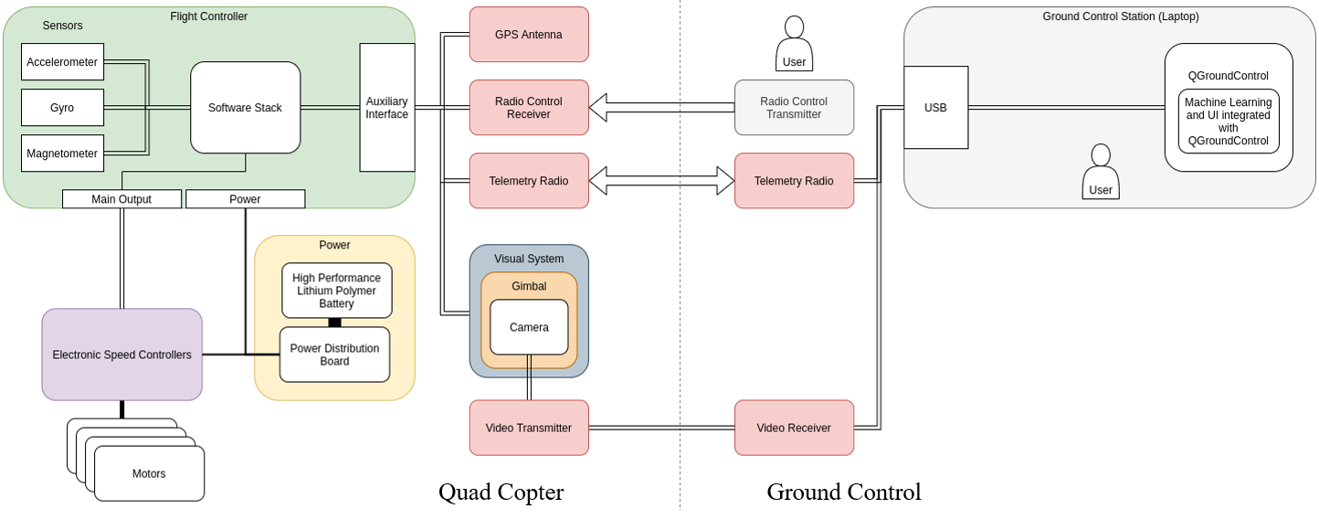
System Architecture pt. 1
Fig. 1 Hardware System Architecture
Daniel
Notes:
Daniel:

Slide 6
System Architecture pt. 2
Fig. 2 Software Data Flow
Daniel
Notes:
The hardware system architecture shown in this slide is kind of seperated into two sections. The ground control station on the right and the quadcopter on the left. The GCS receives a video stream from the drone and run custom software and machine learning algorithms to detect, and classify features. From there it generates an action and sends it to the drone via the two-way telemetry radio. Moving over to the left. The quadcopter is made up of a couple main components. The flight controller, speed controllers / motors, and the power system. To the right you can also see our auxiliary interfaces.

Slide 7
Testing results
YOLOv4 Object Recognition
Damage Severity Classifier
Integration – Feature Detection
Daniel
Notes:
The testing of our yolov4 object recognition model and damage severity classifier and then finally our integration tests were widely successful. Starting with our yolov4 detection models, our goal for mean average precision was 80%. We fell slightly short and were able to achieve a mean average precision of 78.85%. Still, within acceptable margins. Still, in practice, we were able to achieve high confidence detection for both windows and gutters. Moving on to the damage severity classifiers, we again fell slightly short on the mean average precision tests. However, when we ran test images through the network, the damage was successfully classified for all of our test cases. Moving on to the integration test, the integration test is a black box test we designed to test all of our design features together. We were able to pass all of the integration tests, with the exception of two. Both were image processing tests. The first failure resulted from the fact that the gutter borders were incorrectly calculated. The second came from the fact that the image severity classifier classified a broken window as a nominal window

Slide 8
Testing analysis
Basic functionalities were completely effective under the test conditions
Very modular and organized, which allowed us to efficiently design each file systematically and cleanly.
High-level wrapper code ensures that all the inputs and outputs are normalized and in the proper format
Video input stream, YOLO output cropping function, feature isolation and image filtering, annotated display, and action generation all work completely nominally
System did not seem to function as well on raw data that we collected using the drone flights
The results were relatively close to what we expected
neural network accuracies were lower than we had originally intended them to be
Two of the primary requirements were not met in their entirety
the overall precision
object recognition precision
Graphical user interface and action generation requirements were met.
Noah
Notes:
All of the basic functionalities were completely effective under the test conditions. The core of our software design was very modular and organized, which allowed us to efficiently design each file systematically and cleanly. The overall implementation worked perfectly well, as did the general flow of image data since the high-level wrapper code ensures that all of the inputs and outputs are normalized and in the proper format. The video input stream, YOLO output cropping function, feature isolation and image filtering, annotated display, and action generation all work completely nominally. We were able to store and implement the YOLO and TensorFlow models and weights files and retrain them as needed without having to change the wrapper code. In a controlled environment, with high quality images and videos, the system worked fairly well, bounded only by the accuracy and reliability of our neural networks. We were somewhat concerned since the system did not seem to function as well on raw data that we collected using the drone flights – data that was less curated. Ultimately, the YOLOv4 network had a mean average precision of about 79% and the classifier networks had a mean average precision of about 72%, which is only about a 57% overall precision.
The results were relatively close to what we expected. We were disappointed to find that the neural network accuracies were lower than we had originally intended them to be. We had hoped to achieve at least an 80% overall precision, which we were unable to do with such limited datasets. Two of the primary requirements were not met in their entirety – the overall precision and the object recognition precision – since we did not achieve the thresholds that we were aiming for; however, we were able to get close enough to create a functioning system, regardless of accuracy or correctness. That said, the graphical user interface and action generation requirements were met.

Slide 9
Technical challenges
Drone Crashing
GPS antenna came loose, and we had to press the kill-switch to stop the drone from flying away
A propellor came loose resulting in complete loss of control of the drone
Difficulties of creating a custom dataset
We gathered our own dataset utilizing a mix of images gathered around flagstaff as well as the internet
we were not able to collect many images of broken features around Flagstaff
Difficulties with high-level abstraction when testing ML modules
Mohammed
Notes:
Throughout the process of developing our structural inspection drone, we had a lot of things go wrong. During our first unmanned test flight of the drone, an assembly oversight led to the GPS antenna coming loose and falling out of position. As a result, we hit the kill switch to keep the drone from aimlessly flying away. It then fell from the sky and broke. On another occasion, we faced a similar issue where a propeller became unfixed during the flight, resulting in the drone falling to the earth. These setbacks were unfortunate and inconvenient, but we rebuilt and utilized lock tight and other methods to prevent more mechanical failures from happening.
One of the biggest challenges for this project was developing the machine learning models. For all of us, this was our first real time using machine learning for image processing, so it was an area of huge growth for us. We got our models working pretty well, however, without access to vast quantities of good image data, it wasn't possible to get it working as well as it could have. We gathered our own dataset utilizing a mix of images gathered around flagstaff as well as the internet. Finding high quality images of broken or damaged items was very difficult. Many of them were cartoon drawings or otherwise not useful for our set. Additionally, we weren't able to collect many images of broken features around Flagstaff because people usually fix broken things. In the future, the dataset is definitely one of the areas in need of improvement. Doing so would vastly improve the quality of our object detection and image classification, and furthermore the performance of the entire system.
Our tests, for the most part, were well written and strictly defined. We had no real difficulty testing our system according to our tests. One of the particularly frustrating aspects of our tests, however, was that several of them were on our machine learning models. The machine learning tests were frustrating for two reasons. Firstly, if it isn’t behaving the way you expect, there is no real way to know why. It is simply not possible to look at the model and understand the decisions it makes. If something is wrong, fixing it is largely guessing and check. Secondly, creating a new model takes a lot of time. Training our object detection network took in the order of days, so these were not easily fixed.

Slide 10
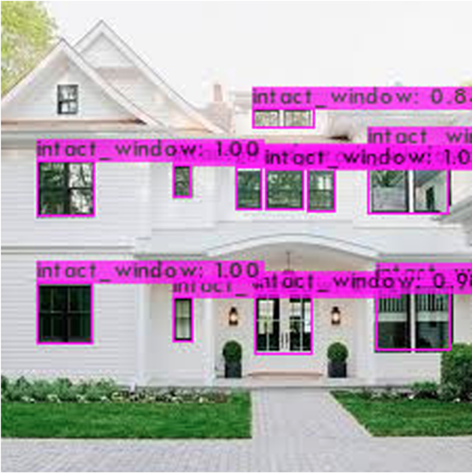
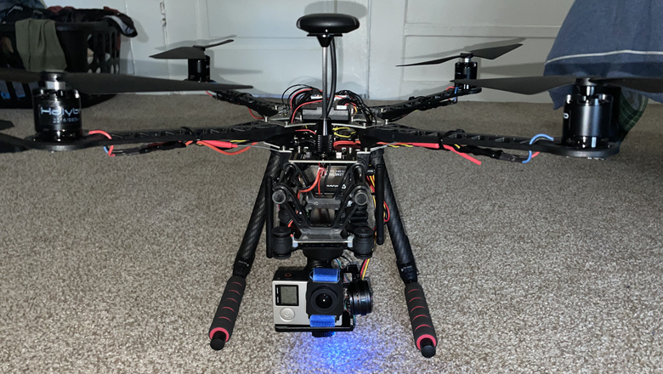
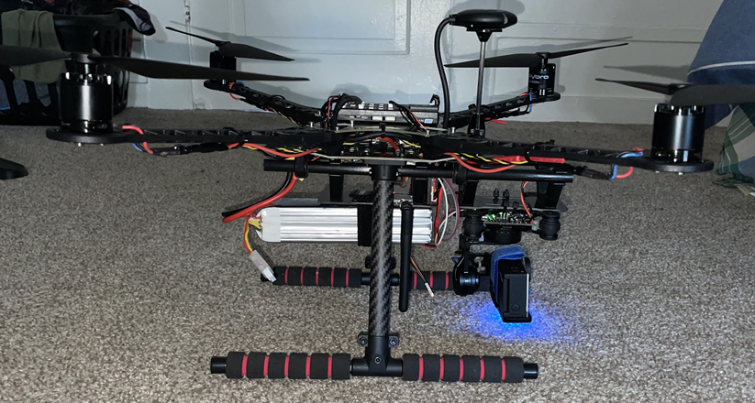
conclusion
Ultimately, the YOLOv4 network had a mean average precision of about 79% and the classifier networks had a mean average precision of about 72%, which is only about a 57% overall precision.
More of a proof of concept and attempting to implement novel ML strategy
Had a few difficulties but given a more robust dataset, we believe that the field efficacy of this product could be very high.
Fig. 3 Hardware System Architecture
Fig. 4 Hardware System Architecture
Fig. 5 Sample Feature Detection Output
Noah
Notes:
In conclusion, our YOLOv4 network had a mean average precision of about 79% and the classifier networks had a mean average precision of about 72%, which is only about a 57% overall precision. This was below the intended accuracy of 80%; however, this still allowed us to implement our design as a proof of concept and novel method of implementing machine learning – even if it would not be entirely useful in practice in its current state. Although we encountered a number of difficulties, we believe that if we had access to a more robust dataset, we would be able to greatly improve the efficacy of this product, since that was our greatest limiter throughout development and testing. At the bottom of this slide, you can see in Figures 3 and 4 images of our fully-assembled drone with all of its components, as well as a sample output of our feature detection program in Figure 5.

