Slide 1


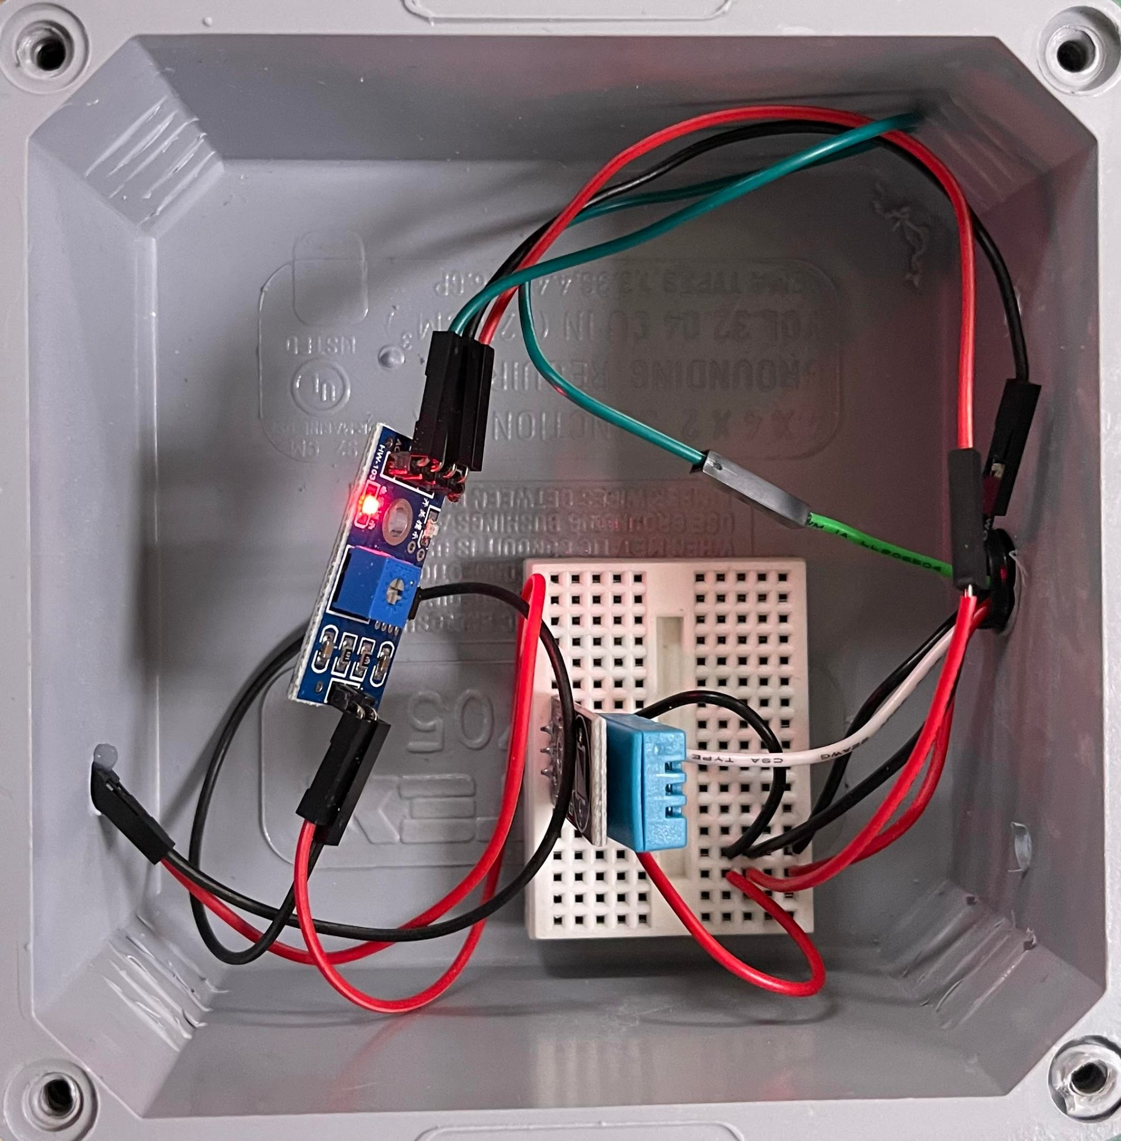
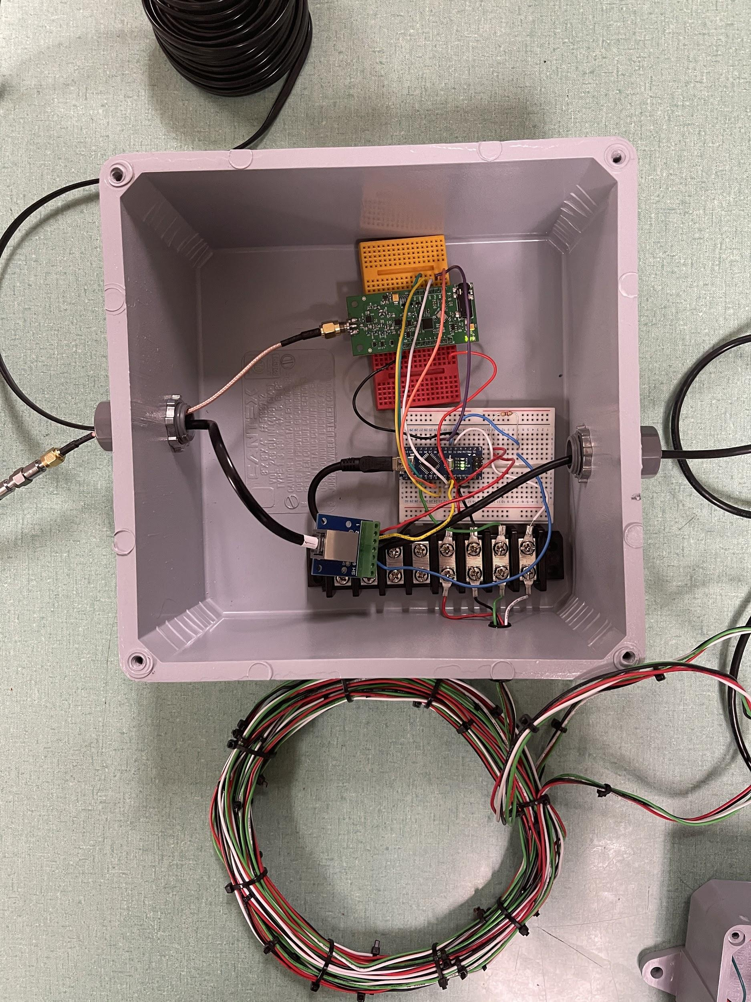

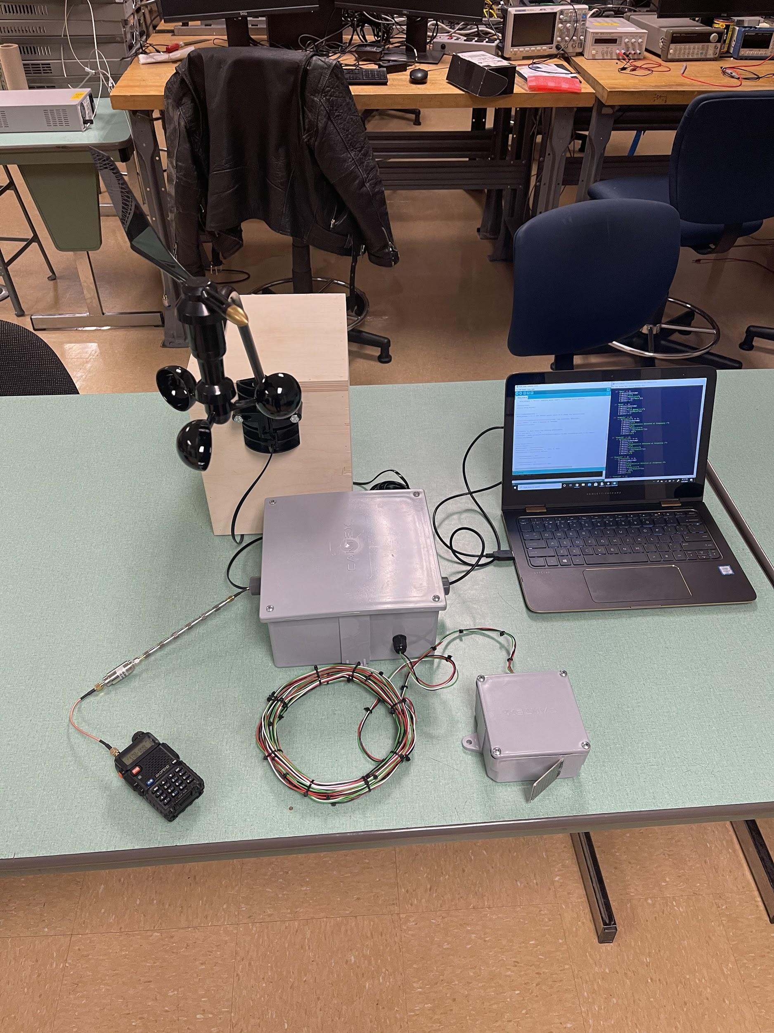
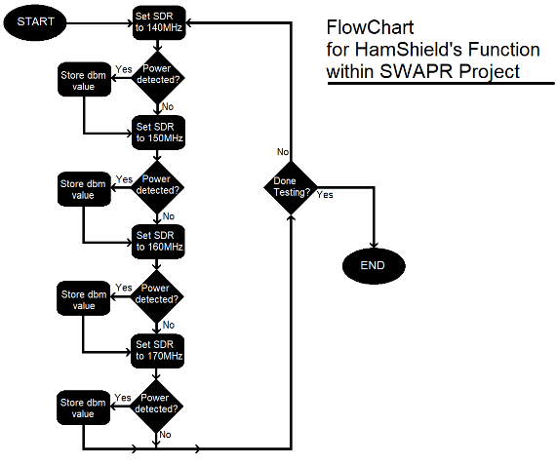
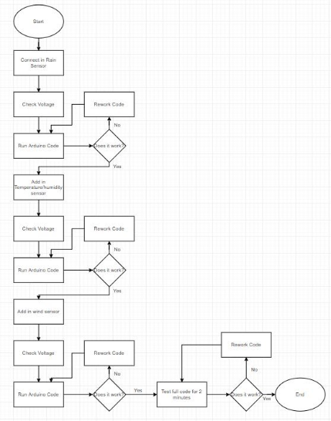
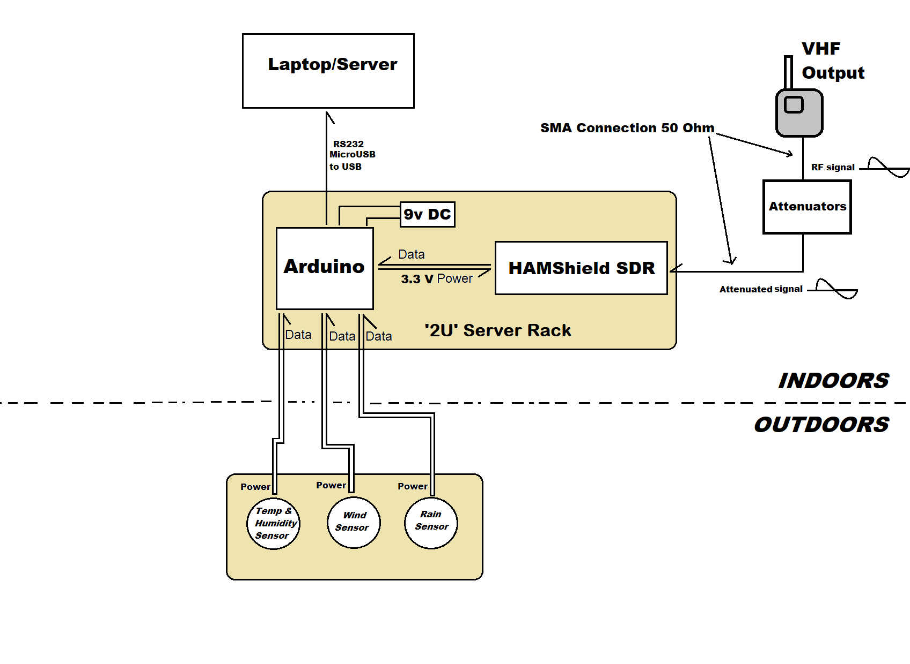
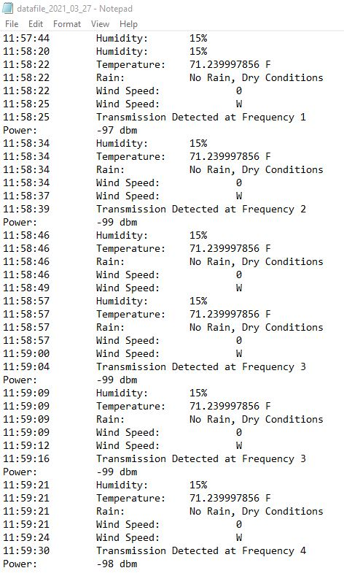
Site Weather and Power Recorder (SWAPR)
Anthony Galdi, Luke McGowan, Brendan Smith, and Bryce Vegh
011
Abstract
Testing
Final Design
Our client General Dynamics Mission Systems is a technology integrator and original equipment manufacturer who provides various mission critical solutions to civil government, defense, intelligence and cybersecurity customers. These services help those who serve, from soldiers to sailors, to complete their missions safely and efficiently. This project specifically aids the General Dynamics Rescue 21 system, which assists the U.S Coast Guard advanced command with Search and Rescue Operations (SAR).
Our project is to develop a device to measure power transmission and verify site weather conditions at an unmanned facility owned by General Dynamics. The goal of this is to prevent our client from having to send technicians out to the site in person as the device would handle it without their presence. More specifically, this device will be measuring the VHF radio output in order to determine if the radio is transmitting properly and will also measure the immediate local weather conditions. The benefits of such a device will provide our customer with the ability to securely view the current weather conditions of a remote location, as well as determine important information about local VHF signals regarding power of the transmission. Securing access to such information allows for the customer to make important decisions without having to be on site themselves.
Our design incorporates an Arduino, a laptop, a Hamshield Mini, attenuators, and weather sensors that are used to gather data for our weather and power station. The weather portion of our device will use wind, temperature/humidity, and rain sensors to gather the weather data. The power portion of our device will use a Hamshield Mini and attenuators to gather the power of the radio signal that is being transmitted from the radio. Once the weather and power data is gathered it will be sent through the COM port. Finally, a Python program on the laptop will be used to access the COM port to be able to take in the data and record the data with a timestamp in a text file that can be accessed on the laptop at a later time.
Please scan the QR code below to be directed to a video produced by our client, General Dynamics, about the Rescue 21 program that our team has been designing the Site Weather and Power Recorder device for.
Figure 1: Rescue 21 Youtube Video QR Code
Temperature/Humidity Testing:
The temperature sensor needed to meet the requirement of being able to measure the ambient temperature within two degrees Fahrenheit. Ice water and a hot plate were used to produce the desired temperature and a matrix test was designed and implemented to test the accuracy of the sensor at different temperatures.
Wind Testing:
The anemometer is required to detect wind direction and speed. The testing for the direction was a simple inspection test to ensure that direction was recorded as N,NE,E, etc. as well as corresponded to the correct direction of the vane. The speed relies on RPM of the sensor so another inspection test was used to correctly count the number of revolutions.
Rain Testing:
The testing consisted of placing a specific number of drops on to the rain sensor in a five second period and confirming that the correct output is displayed. This test required a rain sensor that was wired to an Arduino and hooked up to a computer, a water dropper, and a cloth to dry the sensor.
Full Weather Station Testing:
The three weather sensors had to be integrated together. The testing was done by adding one sensor at a time until each sensor was added. While each sensor was added, the voltage at the device was checked, the code was compiled to verify no errors were present, and the output of the station was checked to verify the correct output was being outputted.
Power Recording Station Testing:
The testing revolved around using built in Software Defined Radio (SDR) functions within the code to test specific frequencies and then observe how the SDR reacted to the situation, based around the flowchart (Figure 3) describing the final expected function of the SDR.
Full Device Integration Testing:
The weather and power station needed to be integrated into one piece of code that functioned and met the requirements developed by our team at the beginning of this process. Testing was done by wiring in all components of the device and running the code to determine if the correct outputs were being outputted by our device. Changes were made when necessary to get the device to function correctly.
The final design incorporated all the major components for recording the various weather data inputs and signal power data that were fed to the Arduino microcontroller, which then logged the data onto the Laptop using the python script. The physical designed required that the wiring and sensors were properly protected from the harsh weather conditions that the device was expected to be used in.
Figure 6: Weather Station Inside View
Figure 7: Arduino and Power Station Inside View
System Overview
Figure 8: Full System Design
Conclusion
Figure 3: Flowchart for Power Station’s SDR
Figure 4: Flow Chart for Integration Testing on Weather Station
Results
Our team successfully built a SWAPR device for our client that was able to measure weather conditions at Remote Fixed Facilities (RFF) as well as measure the power being transmitted at specific VHF frequencies. We were able to complete our Capstone project successfully by using the Engineering Design Process. We began by identifying the problem and developing requirements through discussion with our client, professor, and GTA. Next, we found and researched prior work with similarities to our project to develop a thorough understanding of the problem and to begin analyzing possible solutions. At this point, we began to brainstorm ideas and design our device. We then began to prototype modules of our device, such as the individual weather sensors. After prototyping, we built the remaining modules of our device and began the testing phase. The testing process consisted of many unit tests on the individual modules, and once successful, we integrated the entire project and performed integration testing. The Engineering Design Process guided our team through this process and helped lead us to a successful project.
Our team is satisfied with our results, but have listed some possible additions and improvements that could be made in the future:
Measure center frequency of the signal
Measure static electricity present in the area
Increase accuracy of the rain sensor
Allow monitored frequencies to be easily changed
Design a program to sort the data and present the data in a more aesthetically pleasing format
Our project performed well under the test conditions that we subjected the device to. Each individual unit matrix test on the weather station sensors were entirely successful. Each sensor code was debugged and any hardware issues were resolved during prototyping and early white box testing, so that when it was time for the actual testing, everything went smoothly and as expected. The weather station integration test initially failed because the temperature/humidity sensor was outputting invalid values. Through debugging, we found that the attached interrupts from the wind sensor code was causing this issue. We resolved the problem and after this fix, the integrated weather station performed successfully and as expected. The unit step-by-step test for the Hamshield behaved as expected and was able to detect power transmission as desired. The final integration test of the entire system was successful and performed as expected. All weather station sensors sensed and recorded correctly and the Hamshield recorded power in dBm for the tested frequencies. A few of our client’s requirements have changed over the course of this project, but even with these changes, our project meets or exceeds all of the current requirements from our client, General Dynamics, and also meets a few of the optional requirements.
Figure 2: System Architecture
Most Critical Requirements
Record sensed data from the weather station
Record sensed data from the power station
Output data to the laptop and store on a file
Weather resistant housing for device components
All components of the design must be hardwired
Acknowledgements
Figure 5: Output Data from Full SWAPR Device
Our team would like to thank our capstone leader from General Dynamics, Amir Vahidi, and General Dynamics for giving us this opportunity to work on this project with them and for guiding us throughout the whole process of developing the device to the final testing and building of the device. Our team would also like to thank Dr. Severinghaus and Mahsa Keshavarz for assisting us with all phases of our capstone project from the research phase all the way to building and testing our device.

