Slide 1



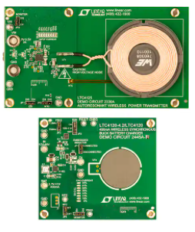
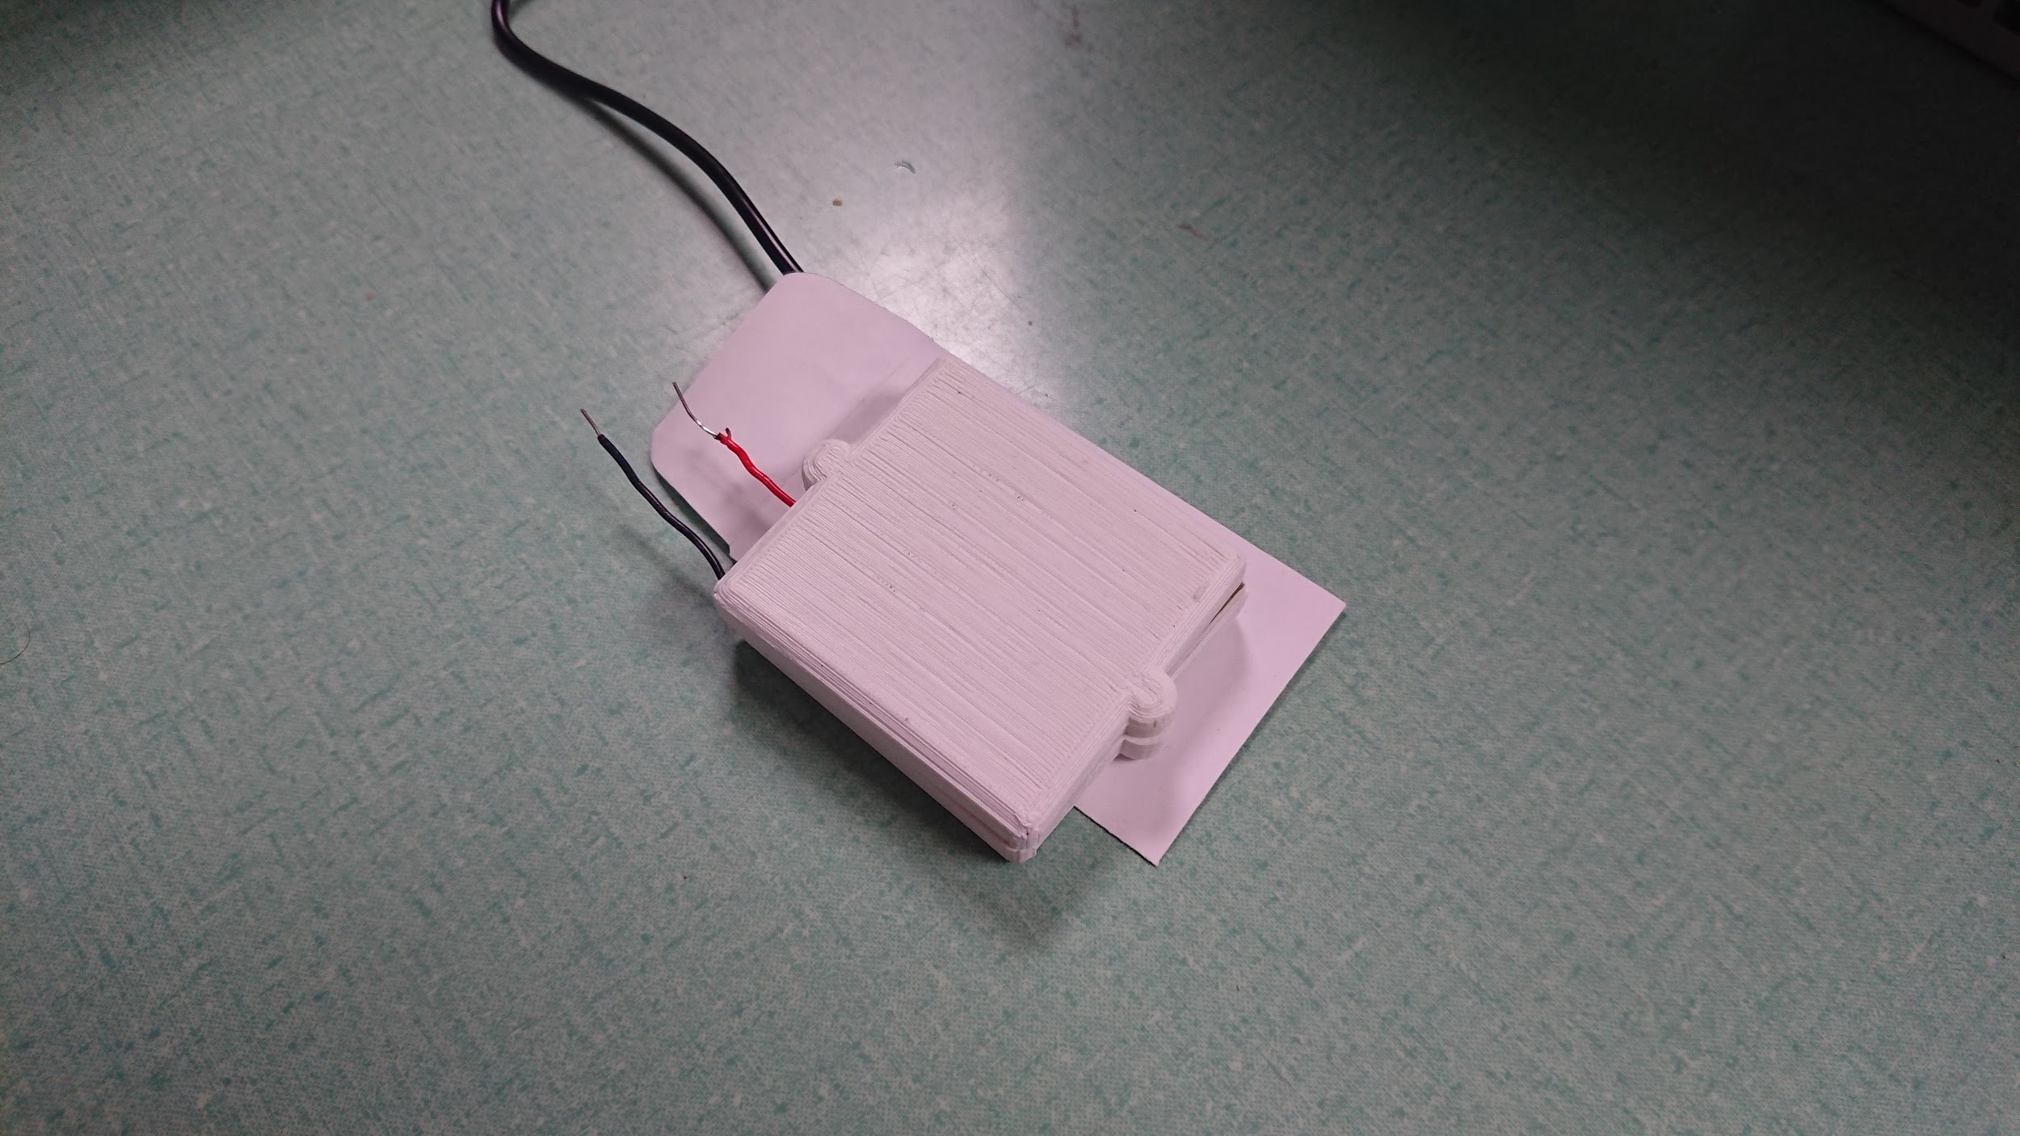
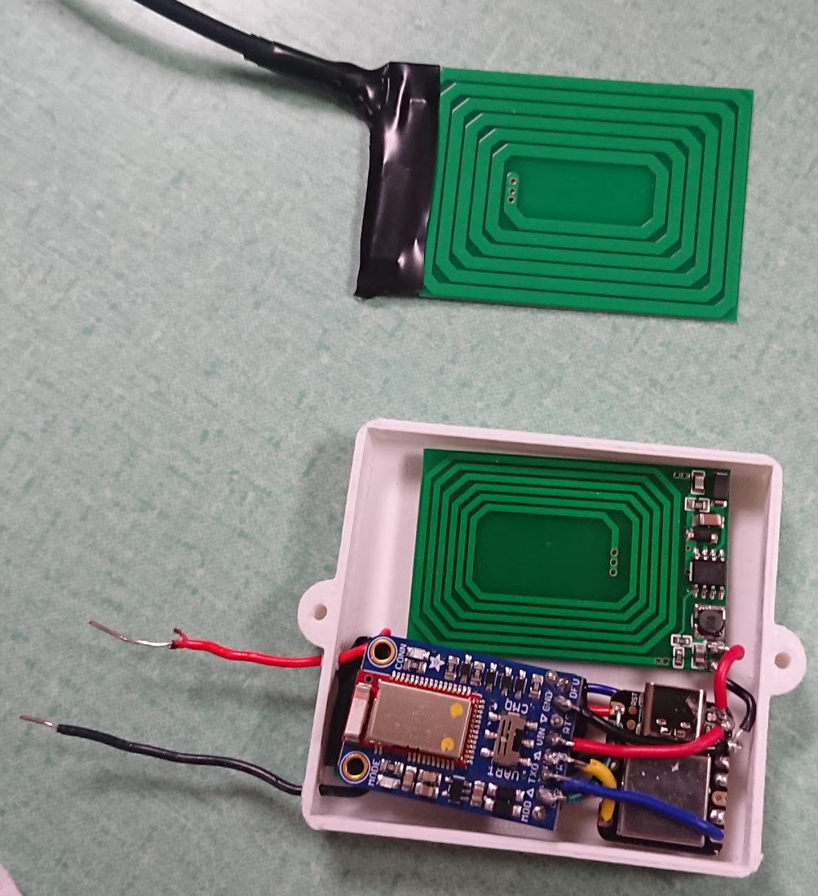
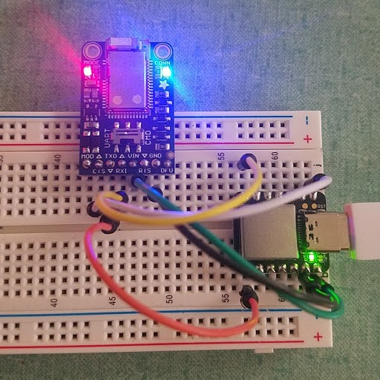
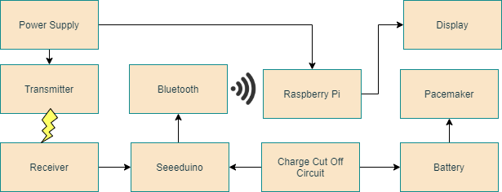
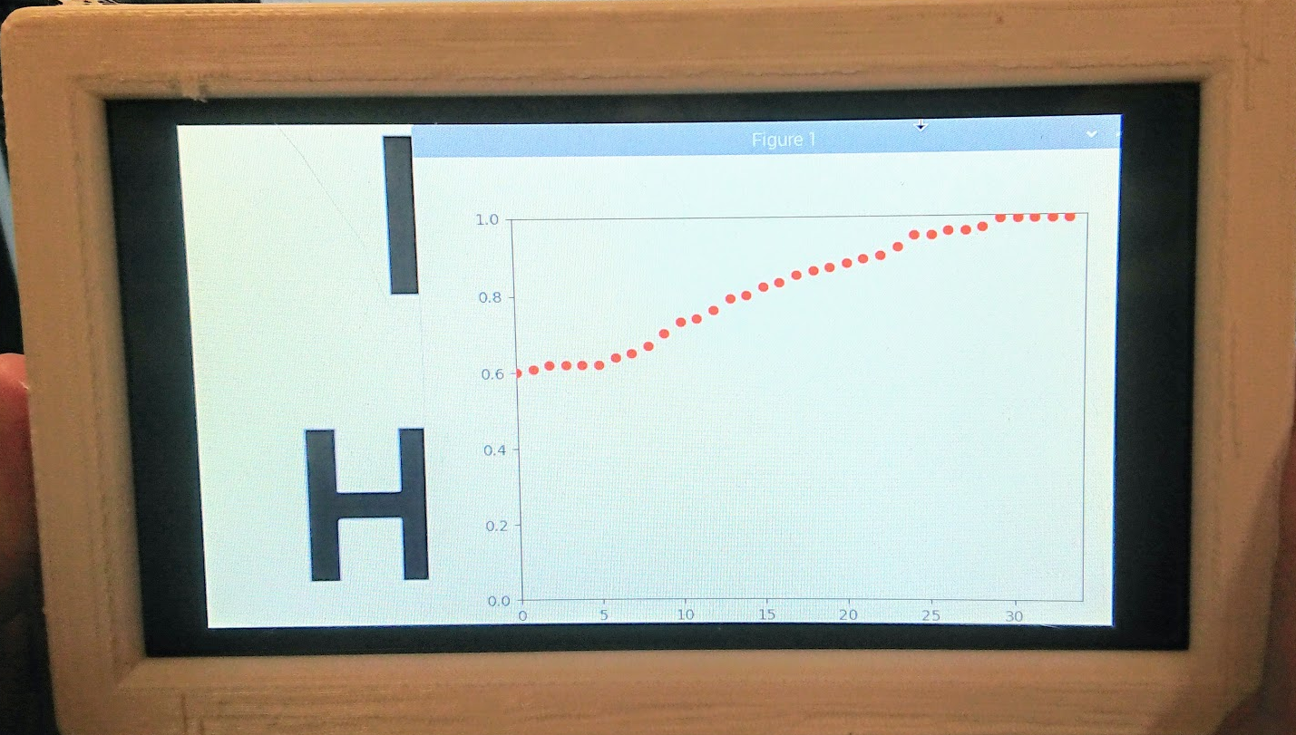
Bioelectric Generator
Andrew Kendall, David Short, Ethan Ankley,
Zachary Schweikert, Zachary Mungillo
Abstract
Details of Design
Results
The pacemaker is a revolutionary device that is used to reorchestrate the rhythm of one’s heartbeat if it has become irregular. It accomplishes this task by providing a light electrical pulse to the heart when necessary. Pacemaker batteries currently have an average lifespan of 5-15 years. Once the battery of the pacemaker dies, a surgery must be done to replace the old pacemaker with a new one. Though the pacemaker and the implantation of it have been polished over the years of its use, that does not take away from the fact that the implantation surgery is very invasive, expensive, and can lead to unwarranted outcomes for the patient. This also means that based on the age of the patent, they could be facing multiple heart surgeries that revolve around a pacemaker problem.The current standard for a pacemaker battery is single Lithium-Ion (Li-ion) battery that is rated at ~3.7V. Our team was tasked with designing a device that will charge the battery of a pacemaker, so that any additional surgery to replace a dead pacemaker would be unnecessary.
The method of wireless charging that out team selected was resonant inductive coupling. We based our design off of the Analog Devices DC2386-B demo board which is capable of:
Operating up to 1.5MHz
Charge distance up to 2 cm
Load Detection
When the coils are aligned, the EMF can efficiently charge at up to 2 cm and travel safely through the human body. The receiving module is also responsible for powering the internally CPU, the Seeeduino, which is responsible for operating the charge cutoff circuit and the bluetooth module.
We did not use this specific board in our final product due to its larger size, and instead opted for smaller inductive coupling boards that are pictured in figure 5.
Implant size is ~6cm*6cm*1.5cm
Transmitter size ~6cm*6cm*0.5cm
Display size is ~20cm*12cm*3cm
The only two exposed wires are the connections for the modern pacemaker battery
The wires were left long on purpose to allow for more flexibility when implanted. They can be trimmed safely
Receiver is enclosed in plastic housing for durability
Transmitter is lightweight and can be strapped to the chest to be hands-free
The strap is adjustable to allow for multiple body sizes and proportions
Display is separate so it can be easily viewed
Display is optional and can be substituted for an Android phone
Requirements
Figure 2: Resonant Inductive Coupling Circuit
Power Output: It must provide a safe and steady charge that will be able to effectively reach the battery.
Charge Rate: It must charge the battery at a slow enough rate so as to not harm the battery. It also must stop when the battery is fully charged, so as to not overcharge it.
Wireless Communication: It must record and report the charge of the battery.
Biocompatibility: It must be safe enough to implant in a patient.
Utilizing the Seeeduino microprocessor, two relays, four resistors, and one diode the receiver circuit can monitor the charge of the battery and shut off the charging when it is full. The discrete components are necessary because the Seeeduino cannot output a high enough voltage or current to charge the battery directly.
The Seeeduino monitors the battery voltage and turns off the corresponding relay when the voltage reaches its charged value. In pacemakers and our experiments, Li-Ion style batteries are used and overcharging this type of battery could lead to high temperatures, battery bursts, and/or severe degradation of the battery health. The battery is NOT charging by default for safety reasons.
The Bluetooth module used is an Adafruit Bluefruit LE UART Friend. The sample libraries make it easy to transmit values via UART and integrate into receiving devices. Using Bluetooth technology can cut down on costs as any Android phone already in use can double as the receiver.
System Overview
Figure 5: The receiving circuit with the cases on (left) and the internals revealed (right)
Has an effective range between transmitter and receiver of about 2 centimeters. Can effectively penetrate flesh-like substances with a negligible loss in received power.
The transmitter and receiver maintain low temperatures and will not burn the patient. No wires, metal, or circuitry is exposed (except for the wires for connecting to the existing pacemaker battery) to limit the chance of electrical shock or ESD damage.
The case was sanded down to be the smallest height possible that still completely covered the electronics and remove potentially sharp edges leftover from the 3D printing process.
Figure 3: Seeeduino and Bluetooth Module
References
Figure 1: System Architecture
The Raspberry Pi 4 displays the battery charge over time and is updated in real time. It also provides the user with an estimated time until fully charged (not pictured). Future improvements will include a way to monitor the battery health, estimated amount of pacemaker discharges per day, and overall system integrity.
This specialized Raspberry Pi display was designed to show that the transmitted Bluetooth signal can interface with multiple devices and to show the specific monitoring features of our device.
[1] T. Campi, S. Cruciani, F. Palandrani, V. De Santis, A. Hirata and M. Feliziani, "Wireless Power Transfer Charging System for AIMDs and Pacemakers," in IEEE Transactions on Microwave Theory and Techniques, vol. 64, no. 2, pp. 633-642, Feb. 2016, doi: 10.1109/TMTT.2015.2511011.
[2] A. K. RamRakhyani, S. Mirabbasi and M. Chiao, "Design and Optimization of Resonance-Based Efficient Wireless Power Delivery Systems for Biomedical Implants," in IEEE Transactions on Biomedical Circuits and Systems, vol. 5, no. 1, pp. 48-63, Feb. 2011, doi: 10.1109/TBCAS.2010.2072782.
To accomplish the task of charging the pacemaker battery, we designed a wireless charging system capable of safely and efficiently charging a Li-ion battery used in a pacemaker. The device will send an Electromagnetic Field (EMF) from one coil outside the body to another coil inside the body, which will induce a current that charges the battery. We will then transmit data regarding battery voltage via bluetooth to an outside display.
Our system consists of 4 different sub-systems:
Resonant Inductive Coupling circuit
Charge cutoff circuit
Bluetooth Module
Raspberry Pi and display
Acknowledgements
Figure 4: Raspberry Pi Display User Interface
DJ Mongeau of W.L. Gore and Associates - We thank for being our project sponsor and providing helpful advice when we were lost in the process.
Dr. Severinghaus and Han Peng of Northern Arizona University - We thank for helping us through this entire process, and showing us the ropes of the design process.

