Slide 1








Biolectric Generator
Final Presentation
Team 8 - Ionic Hearts
April 21, 2021
Andrew Kendall, David Short, Ethan Ankley, Zachary Schweikert, Zachary Mungillo
Zach S.
Notes:
Hello and welcome to our final presentation over our capstone project. We are capstone team number 8, named Ionic Hearts, and our team members are [names]. Together us five worked with our sponsor, W.L. Gore and were able to create a Bioelectric generator. I’ll get to what that means a little bit more on the next slide.
To make our product, we each took a role upon ourselves.
Andrew took care of all of our purchasing requests, and worked on the wireless power transmission system.
David was the secretary who documented our progress, and worked on the charge cut-off circuit.
Ethan was the document coordinator who made sure we were all on the same page as far as assignments go, and worked on the Raspberry Pi display and receiving communications.
Zach S. was the team leader who helped to define goals and keep us going in the same direction, and worked primarily on the wireless communication transmitting circuit.
[and] Zach M. was the client liaison that kept us tied to W.L. Gore, and worked on the wireless power transmission system.

Slide 2
Introduction
Pacemakers shock a patient’s heart back into rhythm if it beats irregularly due to a heart condition. It must be surgically implanted into the patient to work.
Pacemaker batteries require replacing every ~7-15 years. In order to replace the battery, the patient must undergo another invasive heart surgery. They may have many of these surgeries over their lifetime, which can be very taxing and life threatening.
W. L. Gore & Associates, a manufacturing company with a large hand in the medical industry, wants to reduce the amount of these surgeries to prevent complications for the patient. They hired us to build a device that can charge a pacemaker battery while it is still inside the patient.
Zach S.
Notes:
Here is some background information for our project, and why it was necessary.
Pacemakers shock a patient’s heart back into rhythm if it beats irregularly due to a heart condition. It must be surgically implanted into the patient to work. Modern day pacemakers are very well refined and last for a long time, but still require electricity to function and so require an internal battery.
Pacemaker batteries require replacing every ~7-15 years. In order to replace the battery, the patient must undergo another invasive heart surgery. They may have many of these surgeries over their lifetime, which can be very taxing and life threatening. Obviously finding some alternative that could prevent the need for an invasive surgery to replace the battery would be excellent, and that is where we come in.
W. L. Gore & Associates, a manufacturing company with a large hand in the medical industry, wants to reduce the amount of these surgeries to prevent complications for the patient. They hired us to build a device that can charge a pacemaker battery while it is still inside the patient. That is where the term Bioelectric Generator comes in. Our project was to build a device that would charge the battery without the need for the patient to be cut open. We were given a list of requirements, which will be covered on the next slide, but overall the list was short, leaving room for our team to research and determine the most efficient way to solve the problem.

Slide 3
Requirements
The major requirements our device has to reach in order to be considered “successful” are:
Our device must safely and steadily charge the battery.
The charge rate must be slow enough so as to not harm the battery.
Our device must stop charging the battery when full.
The device must be safe enough to work inside the patient. As such:
  It cannot leak harmful substances into the patient’s body.
  It must be small enough so as to not interfere with vital bodily functions.
  Operating frequency must be in a safe range for the body.
Andrew.
Notes:
In this slide we show what our initial requirements were and how they evolved along with creating our own specifications. Initially we had the problem of solving some very simple constraints such as: charging the pacemaker battery from inside the body, preventing any surgeries to remove future batteries, and the need for the patient to be safe with our design implemented. After sitting down and thinking each given constraint out, we were then able to come up with the following specifications: the charge of the battery must be steady and safe, the charge must be slow enough to keep the battery from having any charge problems, the overall device must stop charging when at a specific amount to prevent over charging, and finally the most important specification is that it must be safe for the person. This includes things such as preventing foreign material from harming the body, it must meet a size requirement inside the body, and the operating frequency must be in a safe range.

Slide 4
Prototypes
During the prototyping phase we established 4 different subsystems:
Charge cutoff circuit
Wireless data transmission (Bluetooth)
External CPU and display (Raspberry Pi and display)
Charging device (Piezoelectric, wireless, or thermal)
Through prototyping we settled on wireless charging via Resonant Inductive Coupling, as Piezoelectric was not durable enough and thermal was not efficient enough.
Andrew.
Notes:
Next, I would like to talk about the prototyping stage of our project that took place near the end of the first semester and continued on over the winter season. Creating a prototype design from scratch was pretty challenging first we had to take our constraints and turn them into subsystems that we could then work on individually. Each of these subsystems would eventually make it into the final product one way or another. To meet the specifications that would consider the battery health and the overcharging of the battery, we came up with the charge cutoff circuit part of our design. The next part of our prototype was the data collection and transmission of our product, here we met some extra specifications that we made and turned it into its own subsystem. The blue tooth module would then help us to read and control the inner working of our design. Another subsystem from our prototype would be the external CPU and display, this would come in the form of a raspberry pi touch screen display system to show graphs and data, as well as, help control the blue tooth module. These later go hand in hand when implementing the final design later on. The final subsystem in our prototype is the charging device that we would then select for the final design. We broke these down into three available options consisting of piezoelectric or kinetic generation, wireless charging, and thermal generation. We made three separate prototypes for each of these and through those devices and research, we were able to come to the conclusion that the wireless charging method was the way to go. This was due to the fact that the wireless charging overall performance was better and the fact that the piezoelectric was not as durable as we once thought and the fact that the thermal generation was not efficient enough.

Slide 5
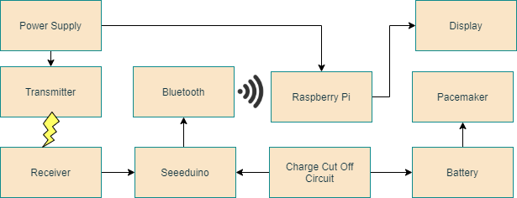
System Architecture
Zach M.
Notes:
Here is an overview of our system architecture which shows the 4 main subsystems and how they interact. On the left, you will see our wireless charging system which is shown by a transmitting coil which is outside the body. This transmitting coil shoots an electromagnetic field into the body hitting the receiving coil. This receiving coil then powers the microcontroller in the body which is the Seeeduino. This seeeduino is responsible for controlling the charge cut off circuit and the bluetooth module. If the battery is fully charged, the cut off circuit completely cuts off current flowing into the battery. The bluetooth module then sends data regarding the battery voltage level to an external raspberry pi, which then displays that data on a touch screen display for a user to read.

Slide 6
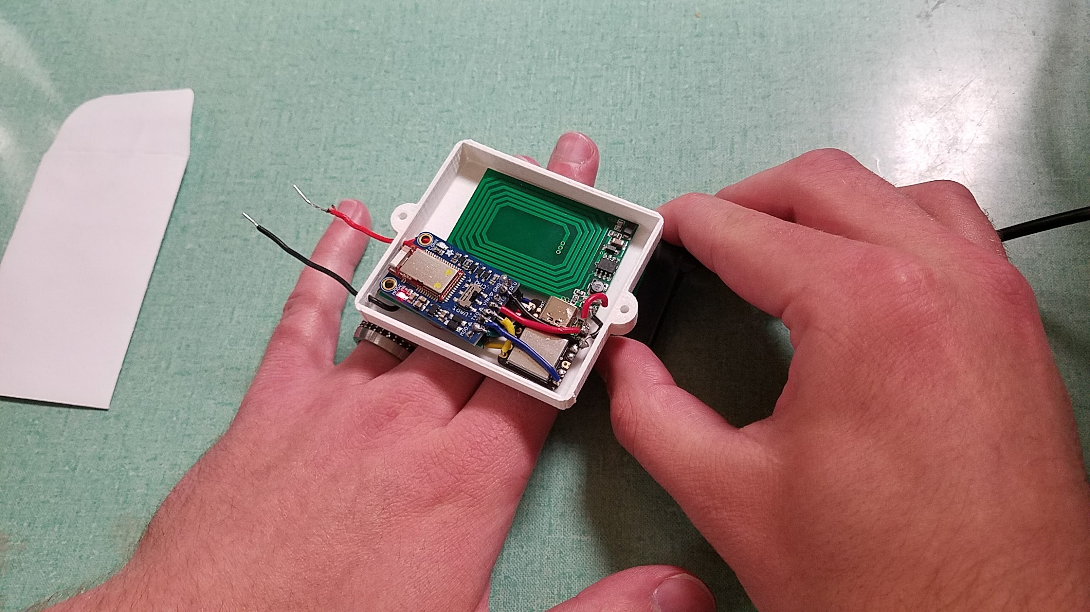
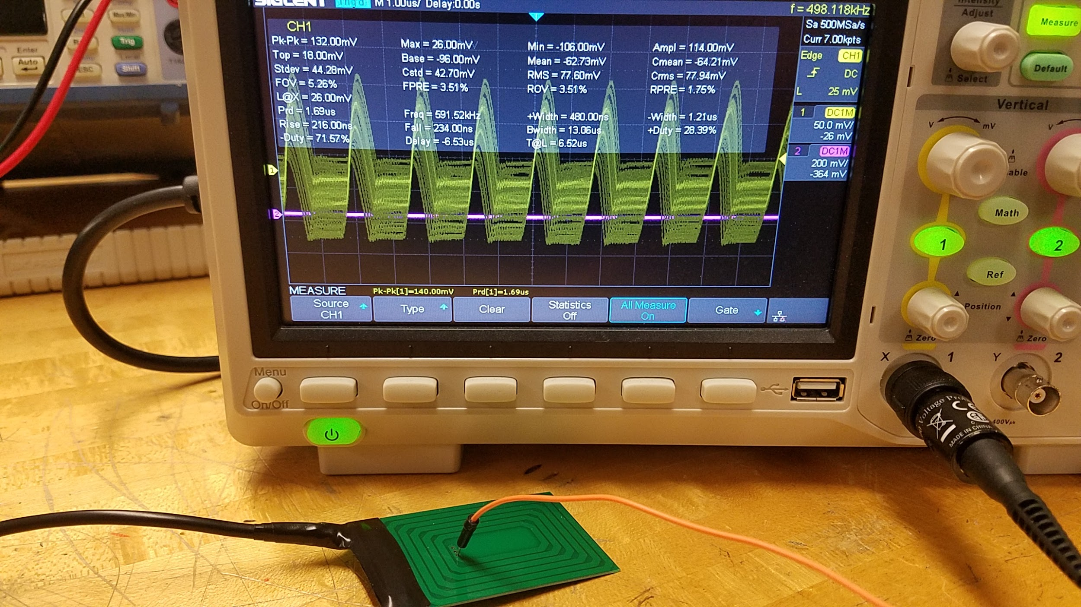
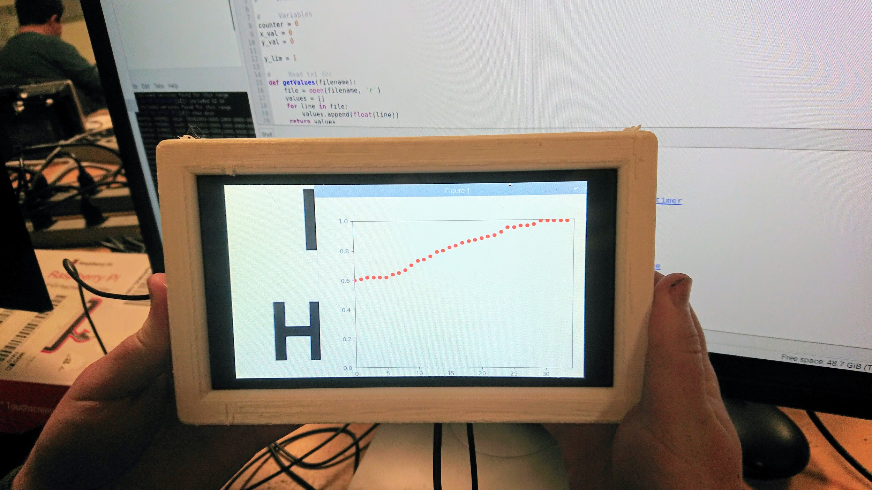
Important Tests
Testing if the circuit can transmit/receive charge through biomaterial (using a hand as a substitute).
Testing the frequency of the transmitter.
Test of Raspberry Pi display with Graph program running.
David.
Notes:
Alright, moving on, we performed several tests for our prototype to ensure that we have built a viable solution to our problem. Some of these tests were conducted on the fully integrated prototype, while some of them were conducted on different subsystems. The images in this slide show different tests we have performed on our device, On the left we have our frequency test, where we tested out the frequency of the charge rate produced by the transmission coil. We found that the maximum limit for the frequency that is safe to the human body is 750 kHz, and though it’s hard to see in the picture, our device functions well below that threshold at about 590 kHz. In the middle we are testing if the device can transmit charge through human tissue. We tested this with our hands, as we believed that that would be a good substitute for testing an actual implant, given the fact that we couldn’t possibly test this out on a real patient. And on the right we were testing if the device could send readings of the battery’s charge to our Raspberry Pi display. The display was supposed to take in the data, show the voltage of the battery, and show the how the charge of the battery charges over time. Aside from these tests, we performed others like testing out the temperature of the device, testing out its ability to send data via Bluetooth, and testing the maximum distance that the transmitter and receiver can be apart before power is no longer being transmitted.

Slide 7
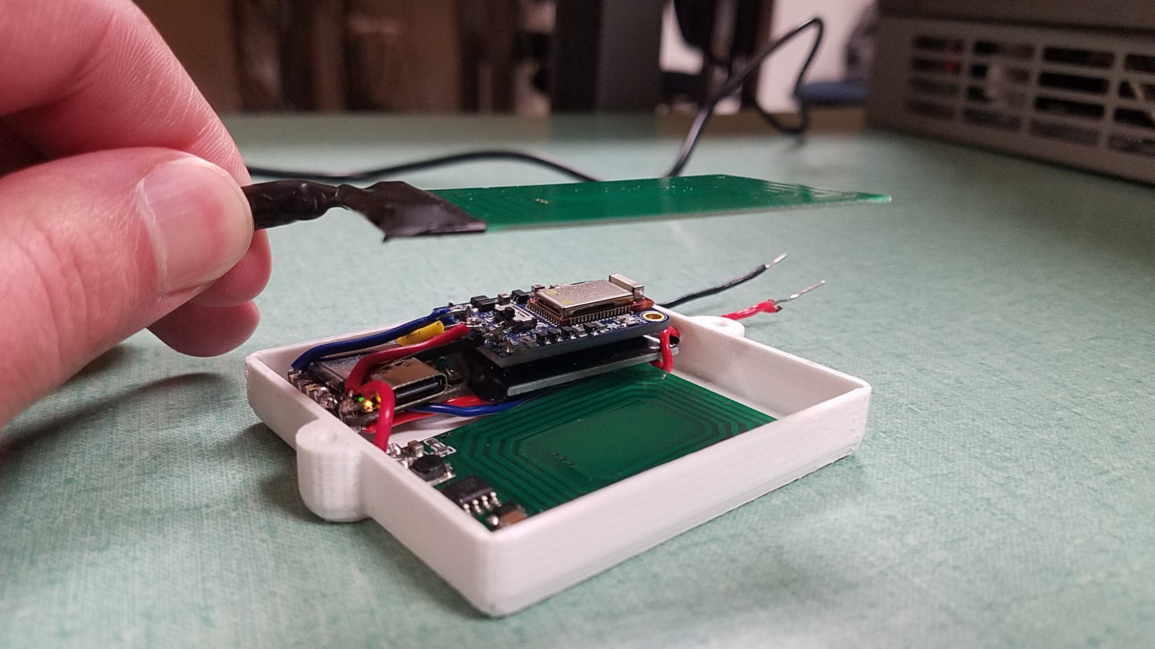
Results
Our wireless charger was capable of:
Charging up to ~2.50cm
Outputting a steady current to charge a Li-ion battery
Bluetooth module capable of sending accurate data regarding the voltage of the battery
A display that allows the user to read the data from the bluetooth module
Charge cutoff circuit that completely cuts off output current to the battery when fully charged
Charge Transmitter
Bluetooth Transmitter
Charge Receiver
Seeeduino Microprocessor
David.
Notes:
Here in this slide, we have a summary of the results of some of the most important tests we performed on our device. To the right is an image of our prototype being tested for the maximum distance that the transmitter coil and receiver coil can be apart before charge is no longer being transmitted. Here in our prototype you can see the charge transmitting and receiving coils, circled in green, the Bluetooth transmitter, circled in blue, and our Seeeduino XIAO microprocessor, circled in cyan. In this test we simply started out with the transmission and receiving coils almost on top of each other, and then slowly raised the transmission coil until charge was no longer being transmitted. The way we could tell whether or not charge was being transmitted was by looking at whether or not the Seeeduino microprocessor and the Bluetooth transmitter was on by seeing if their LEDs were still on. Though it is hard to see in the picture, the LEDs for the Seeeduino and Bluetooth chip are on, which shows that charge is still being sent through that gap in space. Our distance test showed that the coils can be roughly 2.5 cm apart from each other, or about 1 inch. We also verified that our device could output a steady current and viable voltage that can charge the 3.7 V Lithium-Ion battery that we were testing on by using a Digital Multimeter. We were able to verify that the device could transmit the data of the battery’s charge level via Bluetooth by using the “Bluefruit Connect” app that connected to our “Bluefruit LE Friend UART” chip. The app displayed the numbers of the battery’s charge, which, when fully charged, correctly showed that the battery’s voltage was around 3.7 V. Testing our display’s capabilities showed that our device could connect to the display via Bluetooth and send the charge-level data to it. Similarly to the app, the goal of our display was to take in the data of the battery’s charge and present that to the patient. Our display will be able to show both the current charge of the battery and graph it over time to show how the battery is charging. And last but not least, our device was able to cut off current from reaching the battery when the battery’s charge level reached a certain threshold. We set this threshold at 3.7 V because we were testing on the 3.7 V Lithium-Ion battery.

Slide 8
Challenges
Utilizing Bluetooth communications protocols
  Utilizing the Bluetooth module with their branded Android application was easy. Using Bluetooth to interface with a Raspberry Pi was more challenging than anticipated.
Passively draining the battery’s charge
  After creating initial circuits we discovered that the SEEEDUINO could be powered from any input and would drain the battery’s charge as a result. Relays were added to prevent unwanted battery drainage.
Inductive coupling board’s refresh period
  The specialized inductive coupler board we were planning to use has a built in refresh period where it checks for a load. During this quarter second, power to the receiver is cut off, disrupting the SEEEDUINO and Bluetooth communications.
Ethan.
Notes:
Summary of Technical challenges
Throughout the project we overcame many challenges. Some of which include learning a Bluetooth Low Energy command system as the Raspberry pi we acquired did not support that specifically. Another challenge was the seeeduino we used was receiving power from multiple inputs. We solved this problem by adding relays to the varying inputs that prevent the microcontroller from shorting and draining unexpectedly. The final major challenge we worked through was the original inductive couple we chose. While initially testing this coil we found that when it checks for loads it would temporarily quash its receiving power. This made our seeeduino and bluetooth module also turn off and disrupt the functionality of these devices. We solved this by choosing another transmitter and receiver coil.

Slide 9
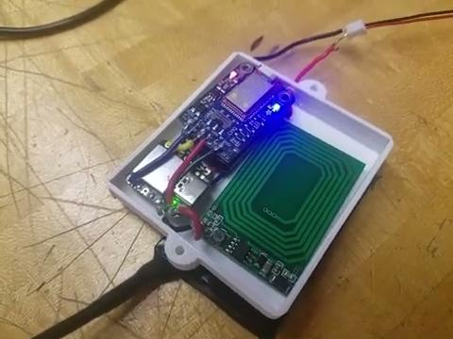
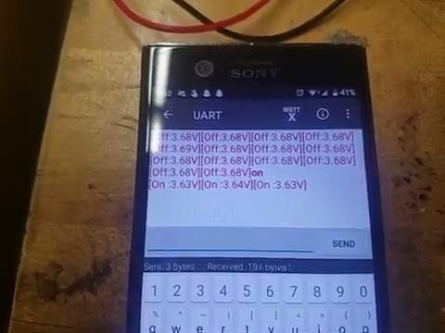
Conclusion
Thank you to W.L. Gore and Northern Arizona University for giving us this opportunity to create something new. We believe what we created to be a successful product, and that it can one day be improved and utilized to prevent the need for pacemaker battery replacement surgeries.
Ethan.
Notes:
Conclusion, final product pictures/video
Here you can see two videos that show the integration tests we conducted on our final product. On the left you can see when the receiver is placed over the transmitter our seeeduino powers on and in turn so does the bluetooth module. This is visibly confirmed by the red LED in the furthest position being illuminated. Following shortly after that is the blue LED which signifies the bluetooth module being connected to an external device. The video on the right shows our concept of where our device will be placed on the body while in use. Additionally it shows the transmission of data displayed through the brand application. As you can see after the “ON” command is relayed there is a small drop in battery charge, which then starts to climb as the battery is charged. We would like to take these last moments to thank W.L. Gore and Associates as well as Northern Arizona University for their assistance and guidance through this project. It was a rewarding and informational experience that we have learned from and are eager to apply in the industry.

