Slide 1

Low Cost Platform
for Electric Drive Experimentation
Ali Muqeem
Ali Alfadhli
Ahmad Alfaresi
Salman Alajmi

Slide 2

Introduction
Client: Dr. Venkata Yaramasu
  Assistant Professor
  Research interests: Wind and photovoltaic energy,
high power converters, model predictive control.
GTA: Han Peng
Salman Alajmi

Slide 3
Reminder of Our Project
dSPACE platform is used in Electric Drives courses and this platform cost a lot.
The process of adding hardware and upgrading the software is expensive.
Alternative solution is to use the Arduino board to implement the dSPACE labs.
With the Arduino board the student can have access to the dSpace experiments at home.
Ali Alfadhli

Slide 4
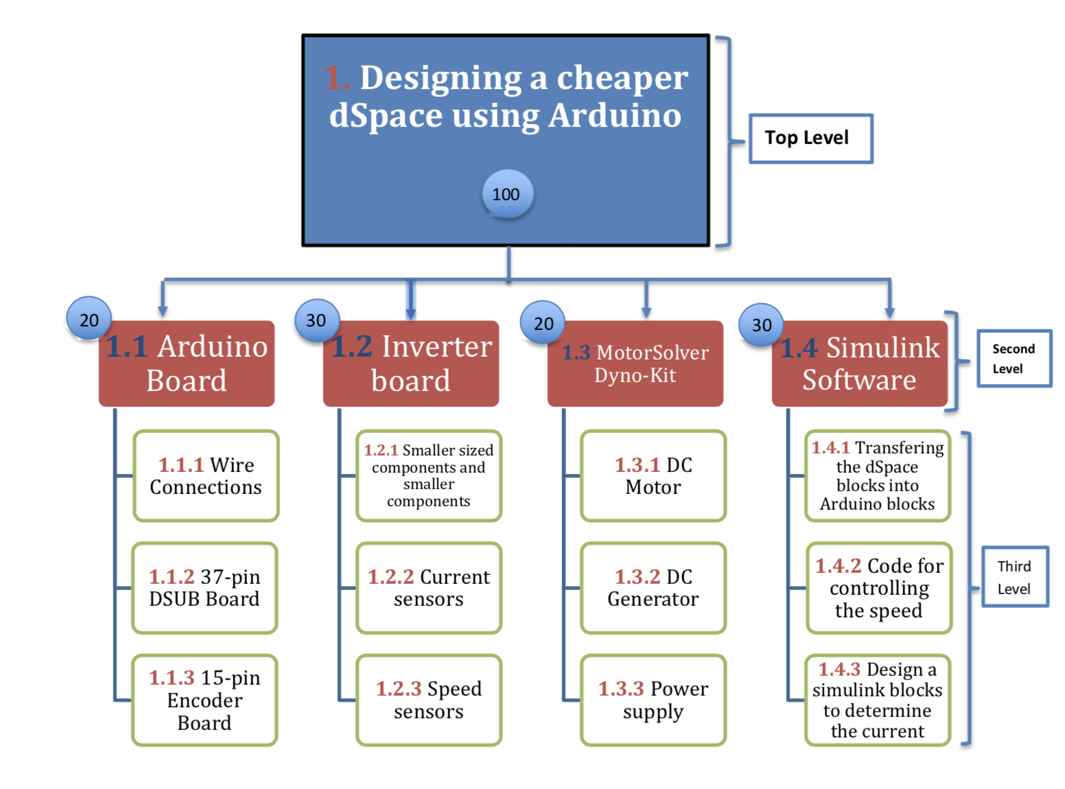
Work Breakdown Structure
Ali Muqeem

Slide 5
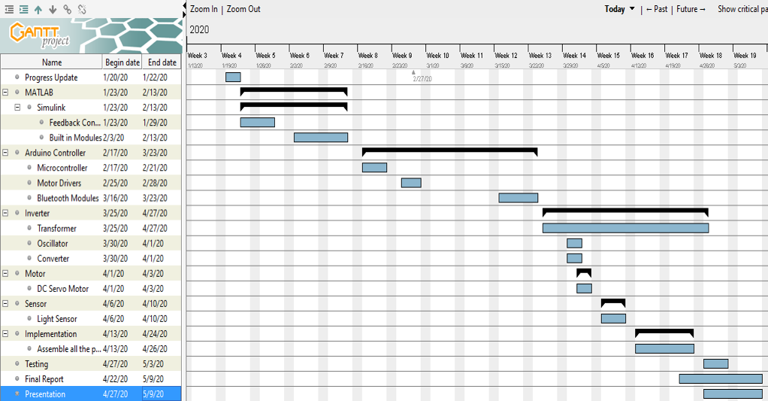
Overview of Schedule
Ahmad Alfaresi

Slide 6
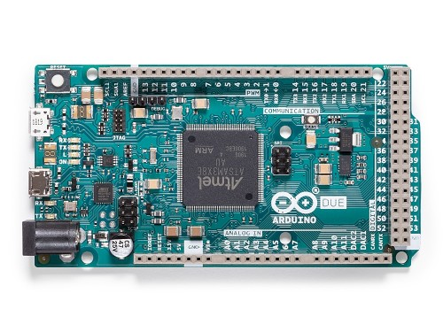
Subsystem 1: Arduino Board
The Arduino board is the cheaper alternative for the
dSPACE.
Arduino board will be used to control the motor.
With the right wiring and components, the Arduino can
be used to control the DC motor.
Salman Alajmi

Slide 7
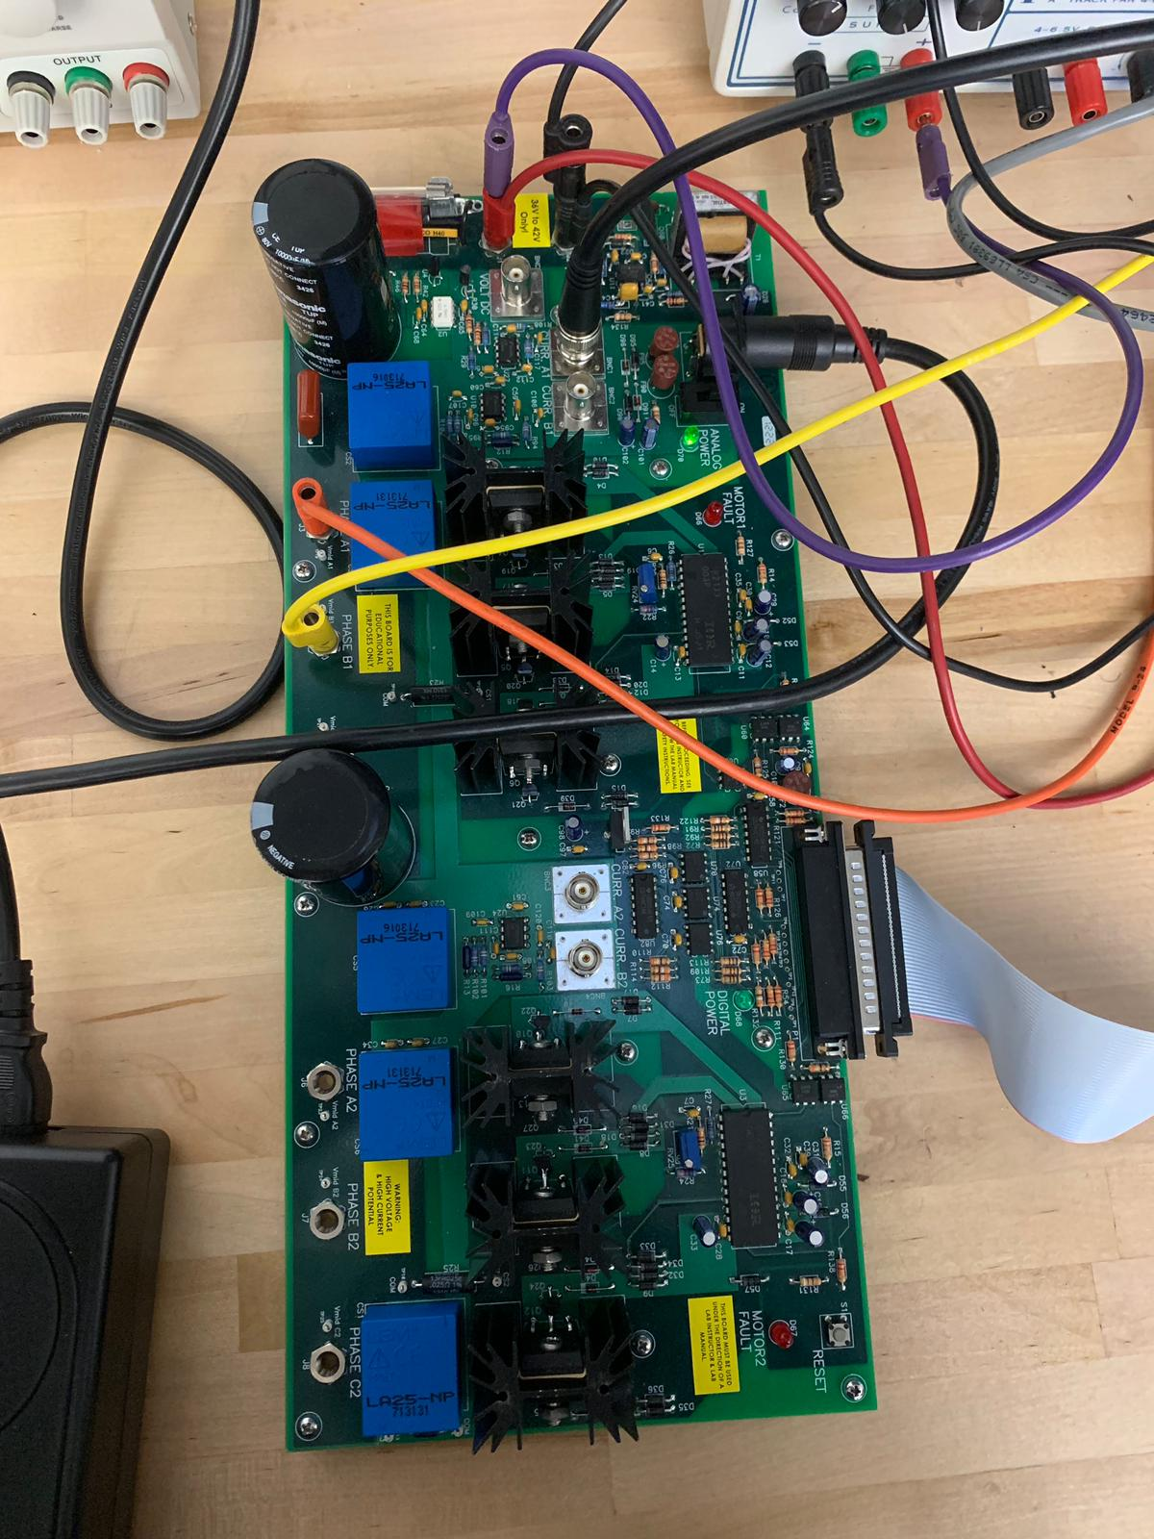
Subsystem 2: Inverter Board
The inverter board is the link between the Arduino and the motor to operate the system.
Inverter board will be used to run the motor and combine experiment for both Arduino
and dSpace to get results.
The board can also be used to get important information such as, get current and
voltage measurements.
Ahmad Alfaresi

Slide 8
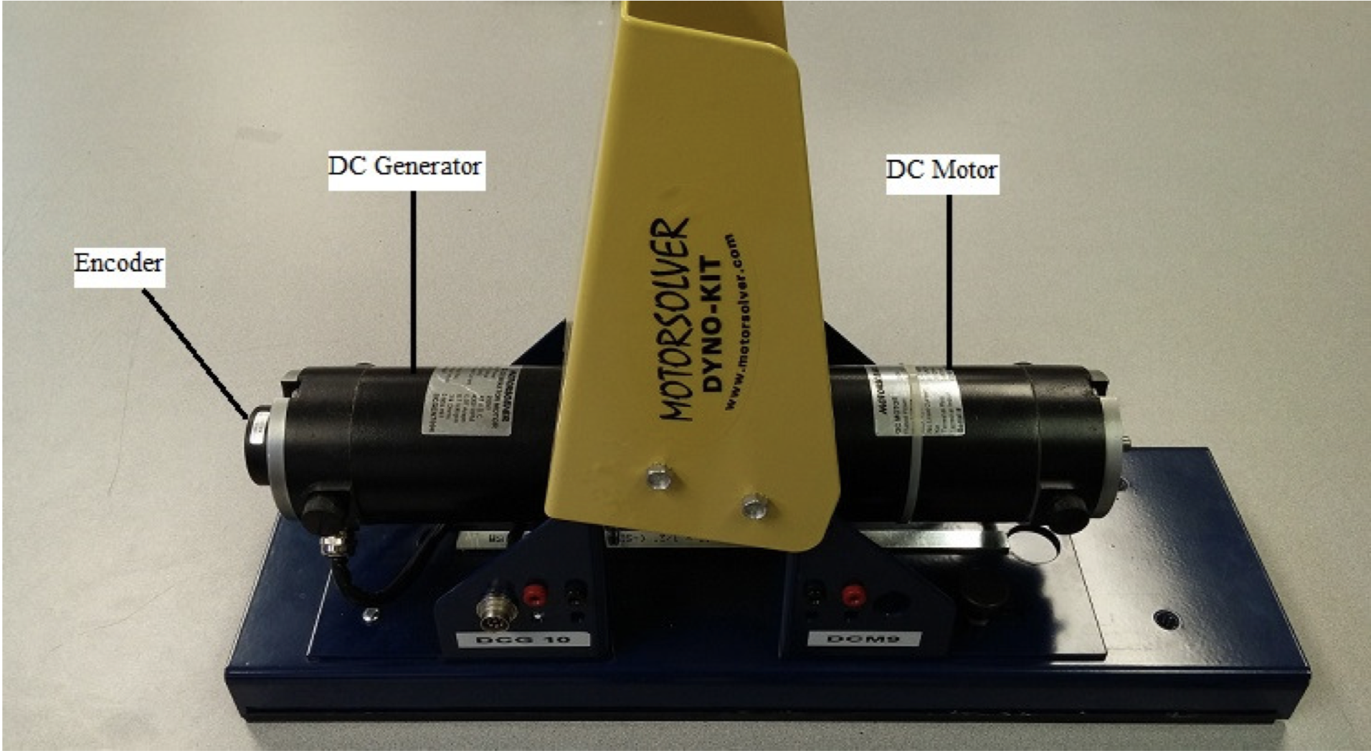
Subsystem 3: MotorSolver
The MotorSolver Dyno- kit consist of:
  DC Motor
  DC Generator
How DC Motor subsystem related to the Arduino Board ?
  Works by connecting Arduino Board to the DC Motor using the 15-pin encoder cable.
How DC Motor subsystem related to the Inverter Board ?
  We supply the motor with power by connecting the inverter board using banana cables.
Ali Alfadhli

Slide 9
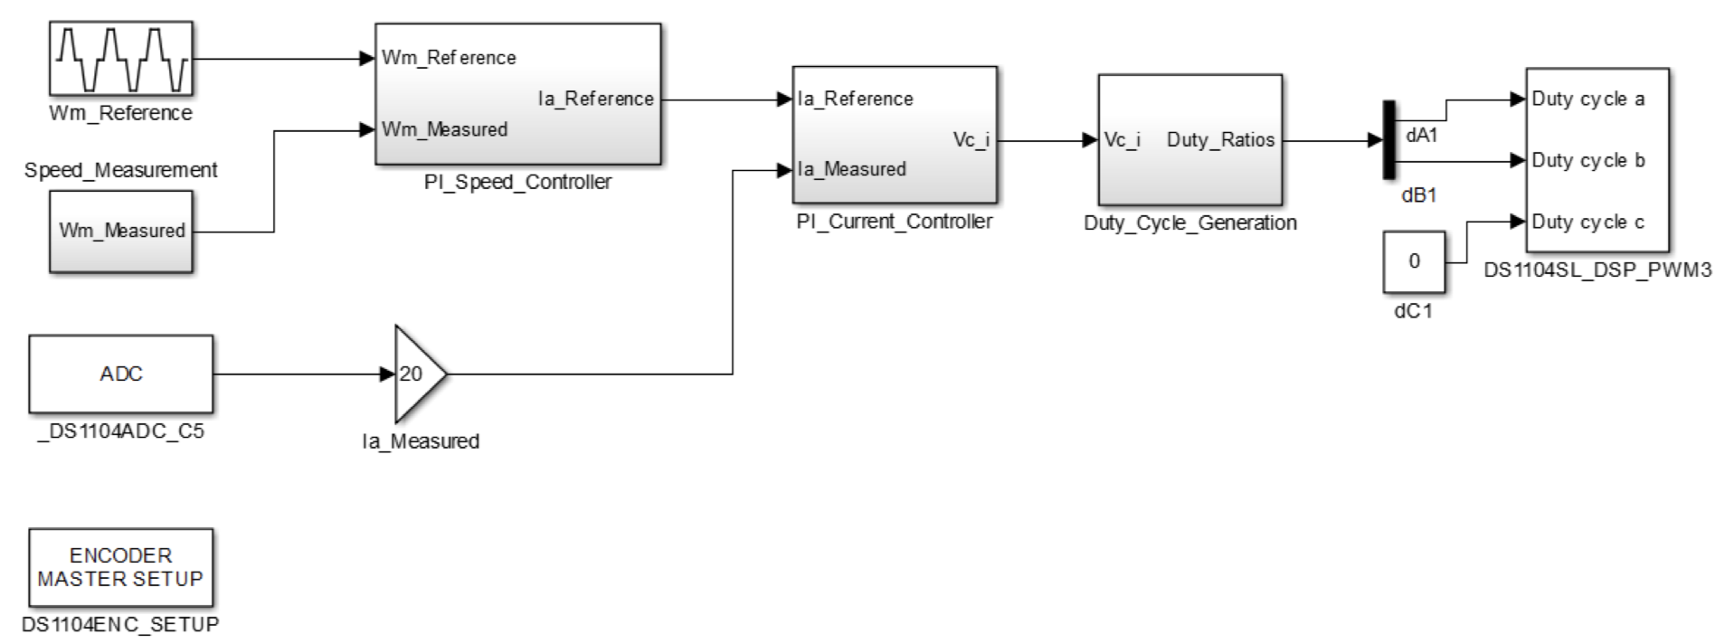
Subsystem 4: MATLAB Simulink
MATLAB Simulink software is used to design a system
to be controlled.
The Simulink blocks are used to give specific commands
in order to have a complete system.
Converting dSPACE experiments using Simulink blocks by
installing Arduino support package on MATLAB Simulink.
Ali Muqeem

Slide 10
Closing
We have four main subsystems that will function together to make this project work.
One of our tasks is to design a new inverter board that is smaller than the one provided in our labs.
The team worked on implementing dSPACE experiments on an Arduino board using MATLAB Simulink.
Our task is to put everything together and make the experiments work on the Arduino board.
Ali Muqeem

