Slide 1
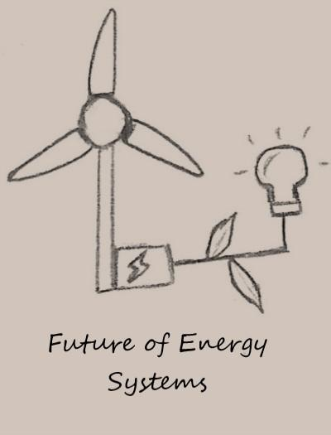
Wind Power Converter
Group Members: Mohammad Alenezi, Fahad Alazemi, Abdullah Alghasab, Hamad Abdulmalek
Client: Dr. Yaramasu Mentor: Ashwija Korenda

Slide 2
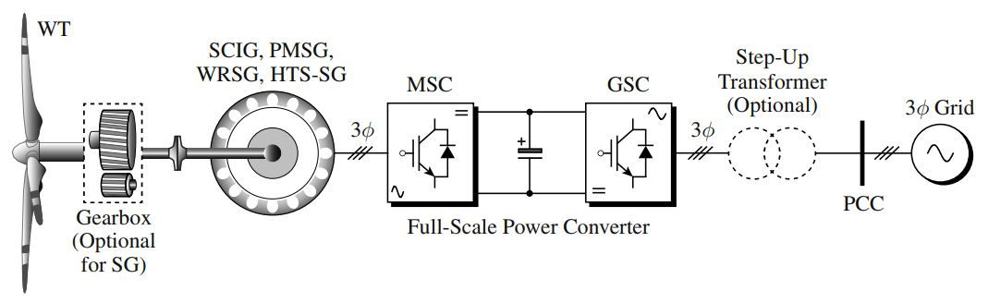
Introduction
Overall idea.
Our goal in this project is to build a power converter that used in wind turbine.
NPC (Neutral Point Clamped) converter.
[1] Type 4 : WECS
Mohammad Alenezi

Slide 3
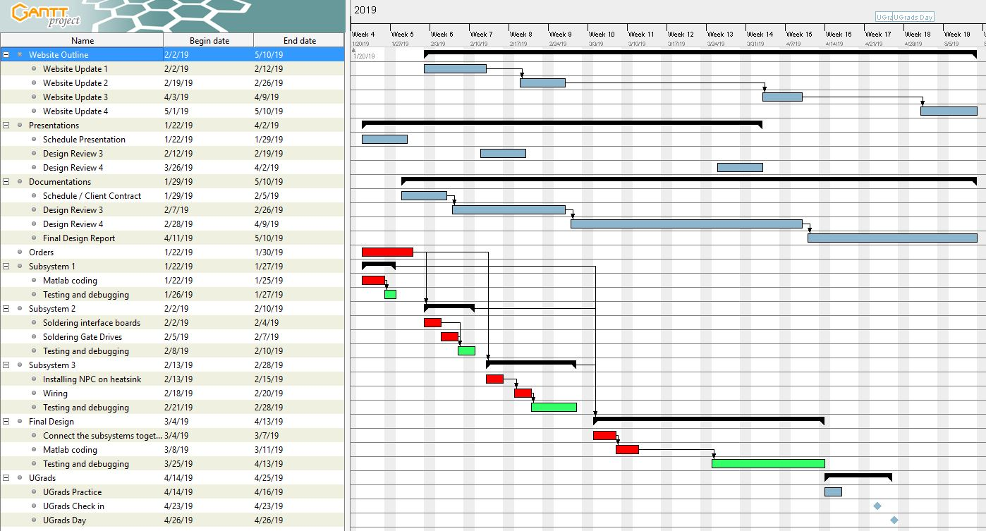
Overview Schedule
Fahad Alazemi

Slide 4
Subsystem 1: Motor/Generator
The motor and the generator will be used as a wind source.
Using Simulink to check the frequency and speed of the motor/generator.
Abdullah Alghasab

Slide 5

Subsystem 2: Voltage/Current sensors
Used to check the values of the convertor.
Soldering a new interface boards.
Abdullah Alghasab

Slide 6
Subsystem 3: NPC Converter
Building NPC converter
  Drilling two heatsinks.
  Install Diodes and IGBT to build rectifier and inverter.
  Connect the rectifier to the inverter.
Hamad Abdulmalek

Slide 7
Conclusion
NPC (Neutral Point Clamped) Converter.
Subsystem 1 is done.
Subsystem 2 in progress.
Mohammad Alenezi

Slide 8
Reference
[1] Y. Venkata & W. Bin. “BASICS OF WIND ENERGY CONVERSION SYSTEMS (WECS)”.

Slide 9
Questions?

