Slide 1
Motorized Tricycle Capstone
James Sigler, Khalid Alghamdi, Mohammed Allahyani, Yu Sun

Slide 2
Outline
Introduction
Subsystems and Timeline
  Motor Controller
  Torque Sensor
  Cadence Sensor
  Motor Controller
Recap
James Sigler 2
Notes:
James

Slide 3
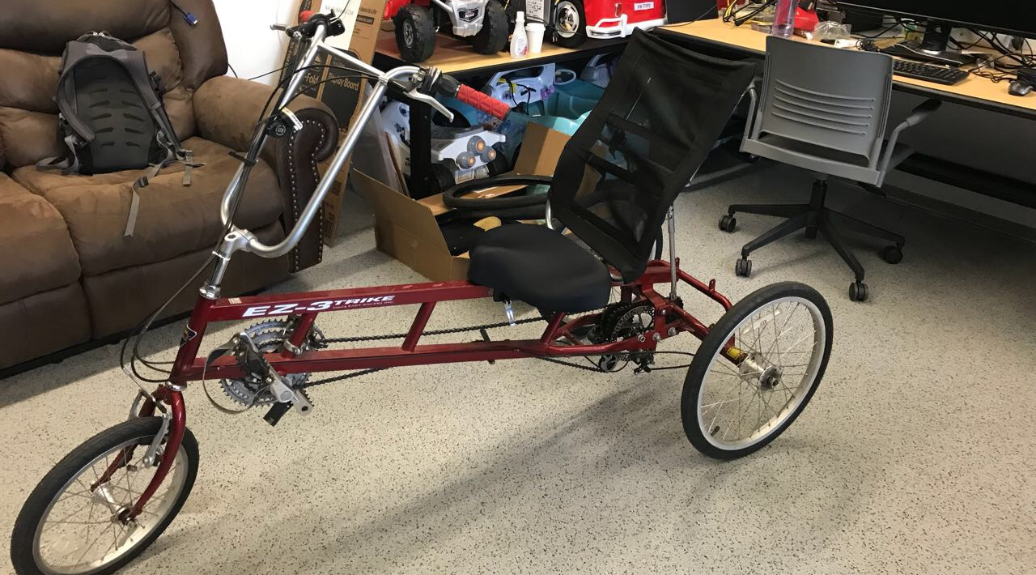
Introduction
Name of project: Motorized Tricycle
Client: Dr. Jane Scott
Faculty mentor: Dr. Kyle N. Winfree
James Sigler 3

Slide 4
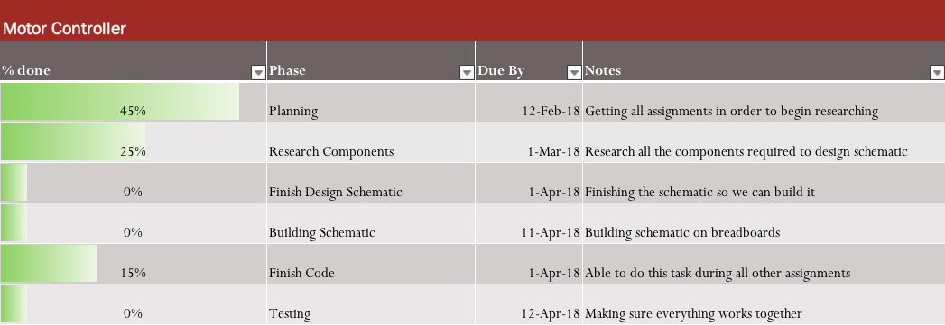
Motor Controller
James Sigler 4

Slide 5
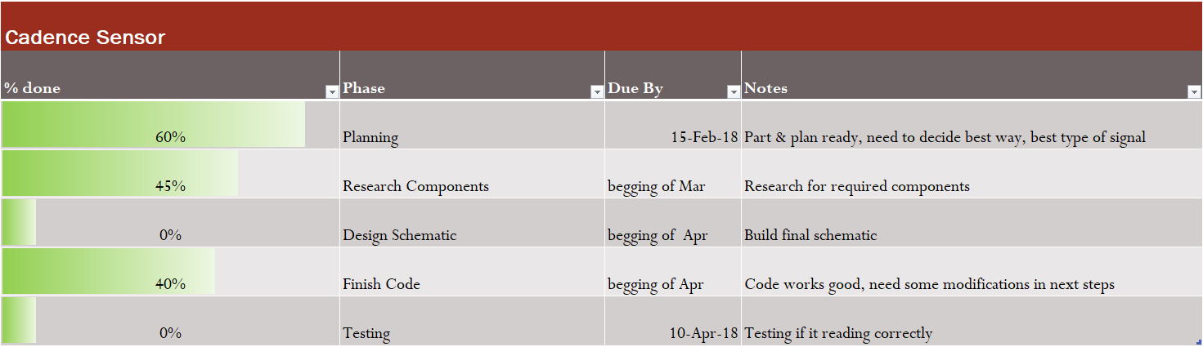
Cadence Sensor
Khalid Alghamdi 5
Notes:
Cadence sensor bla bla bla
Its related to:-
Motor: give the motor controller the correct reading of speed & paddling N. to make the motor work in correct mode.
Display: give the display speed & paddling. To help the user and give him the best way to ride the bike.
We almost finish 50% in this part, just we need to connect everything together and test it! And fix it if we need.

Slide 6
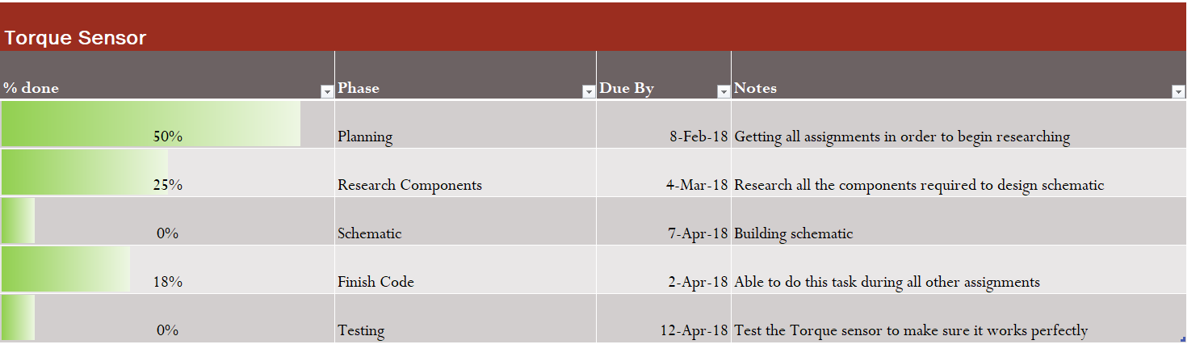
Torque Sensor
Mohammed Allahyani 6
Notes:
-Torque sensor will be connected to the controller, and it will calculate if the bike needs more power or not from the motor.
-

Slide 7
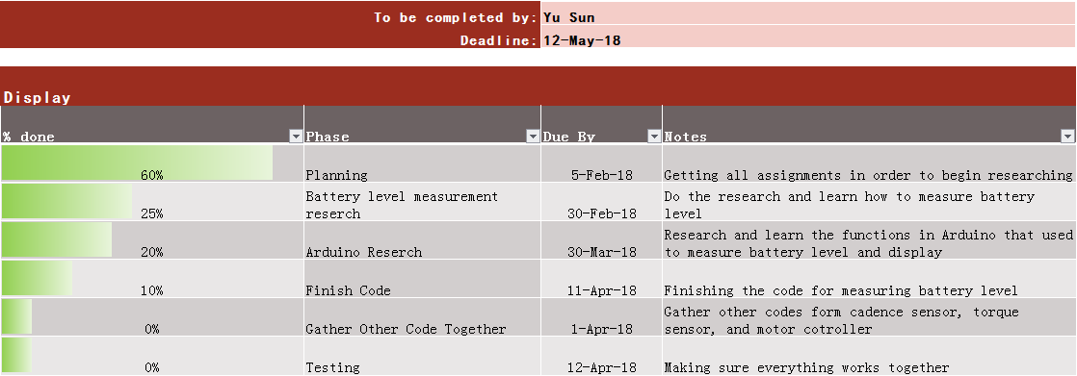
Display
Yu Sun 7

Slide 8
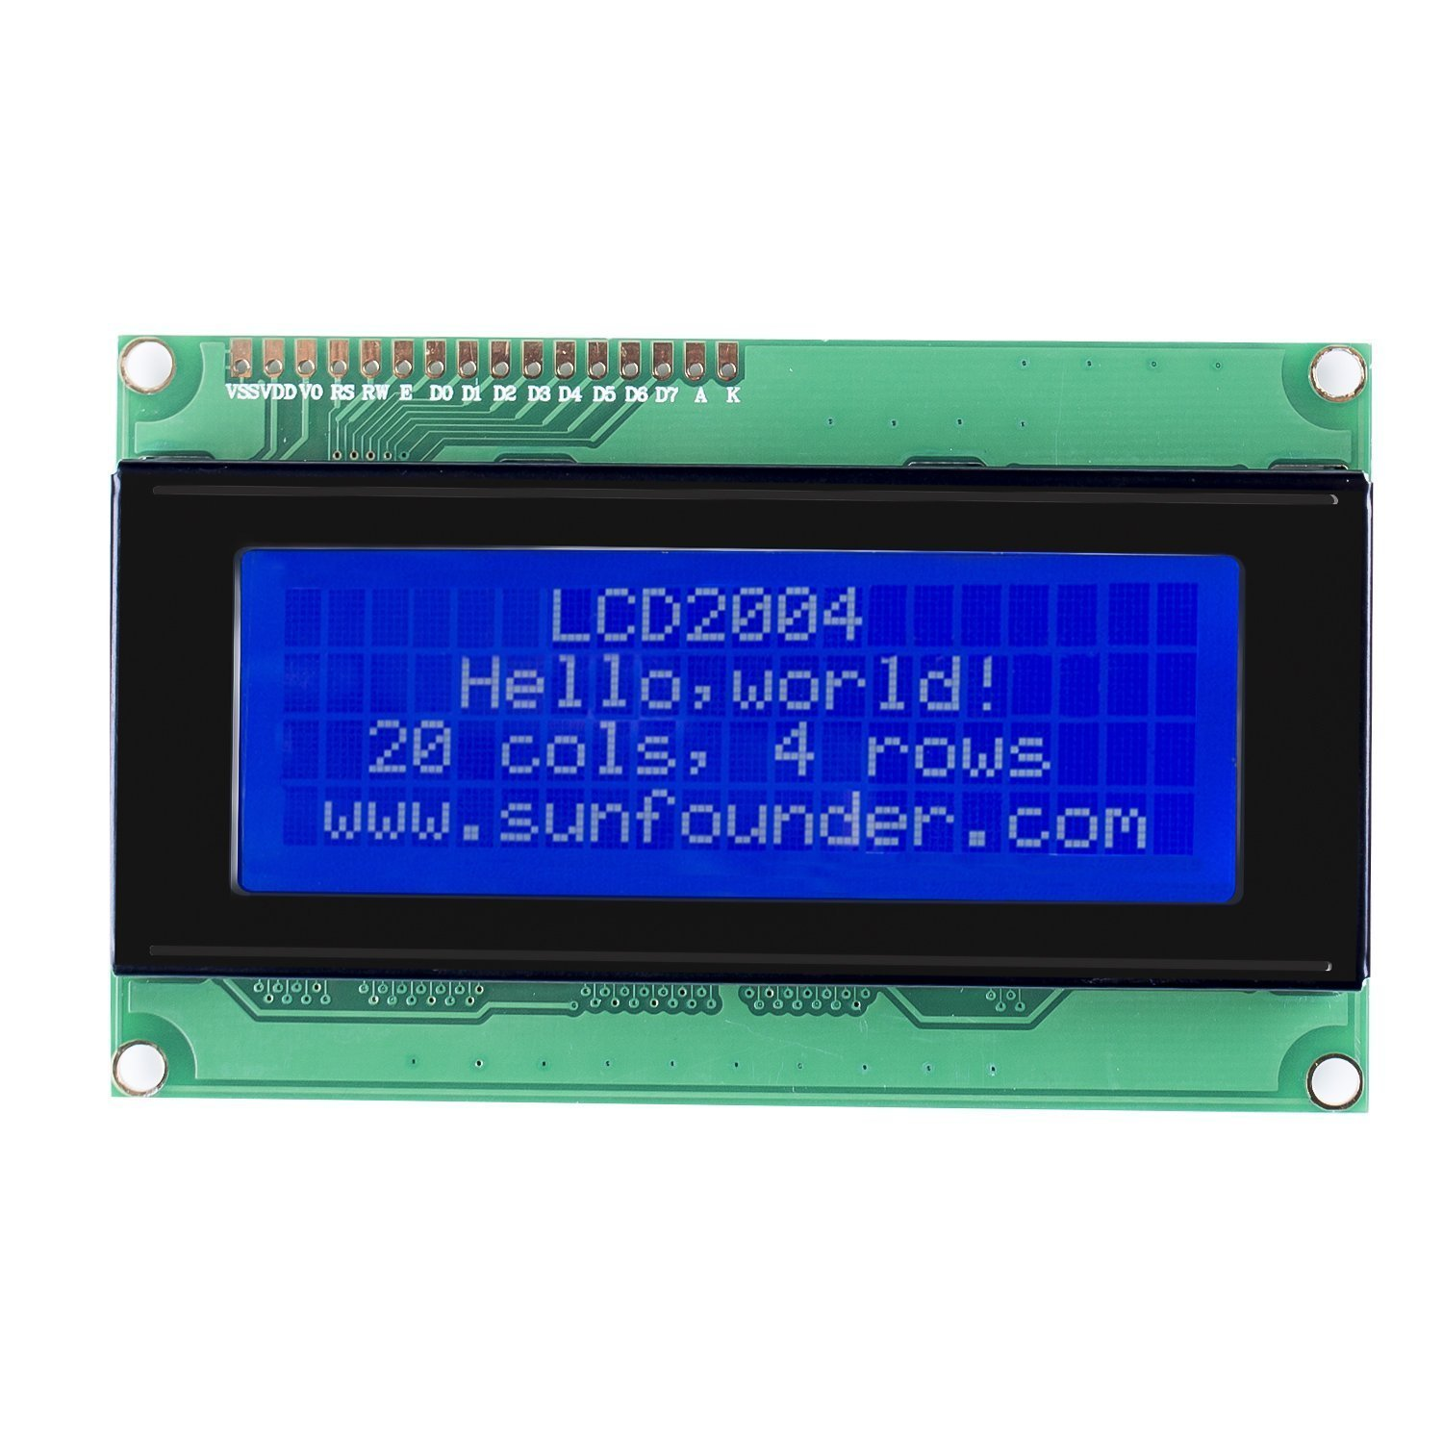
Display
Power Assist Model
Pedal Power
Torque Sensor
Yu Sun
(Subsystem 2)
Speed of Tricycle
Electricity Remaining
Miles Remaining
Charging Indicator
Battery
(Collect voltage value)
Miles/hour
Motor Controller
How fast that the wheels revolve
Cadence Sensor
(Subsystem 1)
(Subsystem 3)
Yu Sun 8

Slide 9
Thank You
More info visit https://www.cefns.nau.edu/capstone/projects/EE/2018/MotorizedTrike/

