Slide 1
Motorized Tricycle
Mohammed Allahyani, Khalid Alghamdi, Yu Sun, James Sigler

Slide 2
Outline
Introduction
Problem Overview
Subsystems and Possible Solutions
Cadence Sensor
Torque Sensor
Display
Motor Controller
Recap
Notes:
James

Slide 3
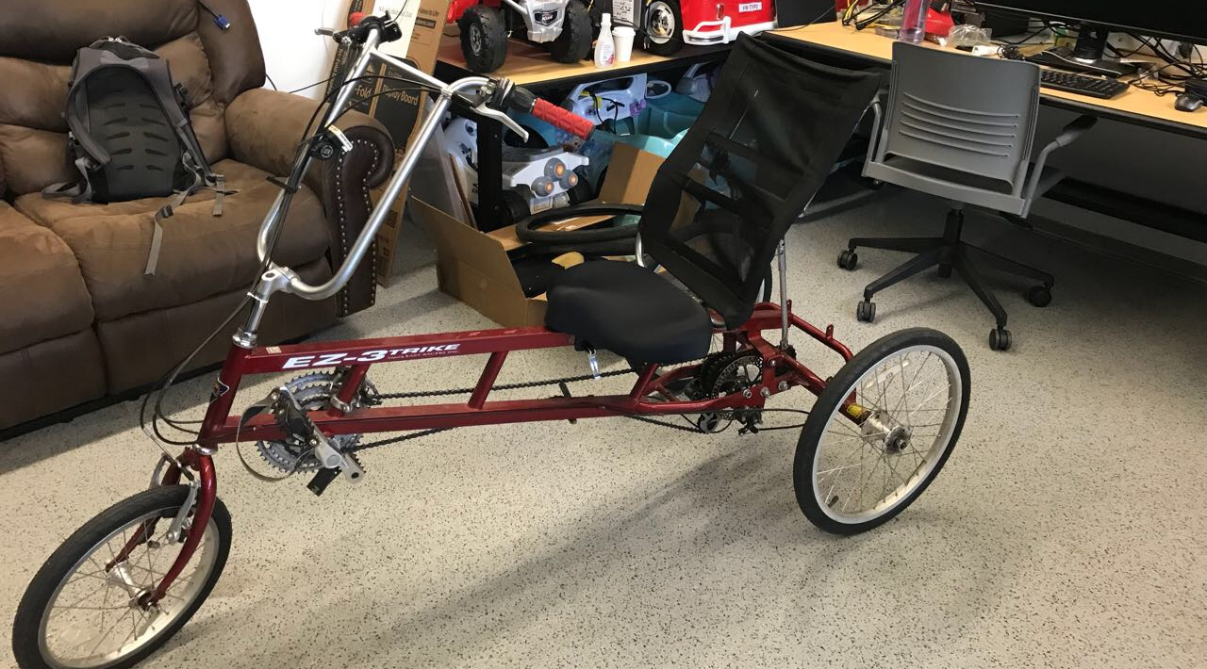
Introduction
Name of project: Motorized Tricycle
Client: Dr. Jane Scott
Faculty mentor: Dr. Kyle N. Winfree

Slide 4
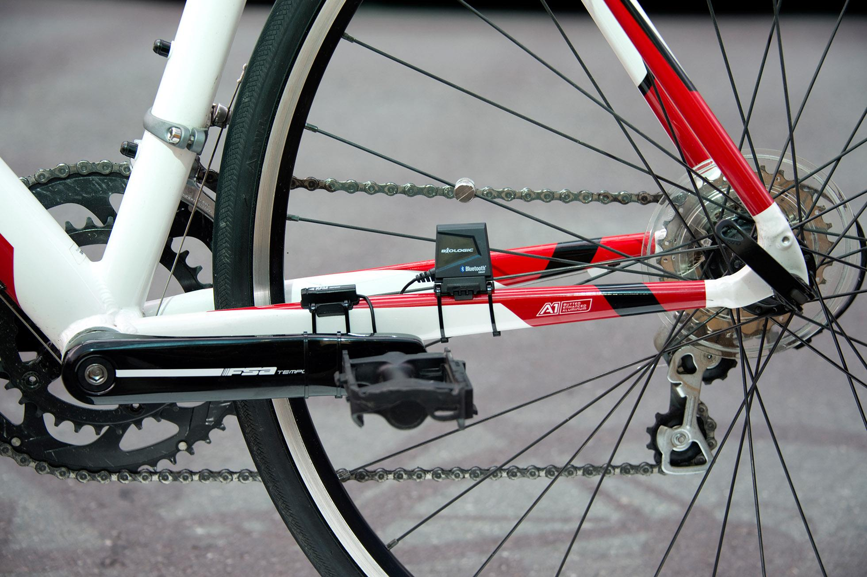
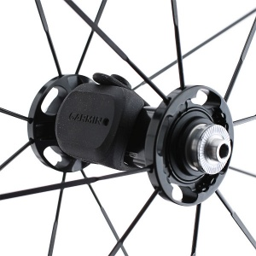
Speed and Cadence Sensors
Determine speed of tricycle
Calculate number of pedal revolutions per minute
GPS to determine speed? why
Notes:
The speed sensor is accurate than GPS, especially in places where you may lose signal. Also, the sensor allows you to gather speed and distance data.
GPS device does not.
But, we found three options for Speed/Cadence sensors
Garmin
Polar
Wahoo

Slide 5
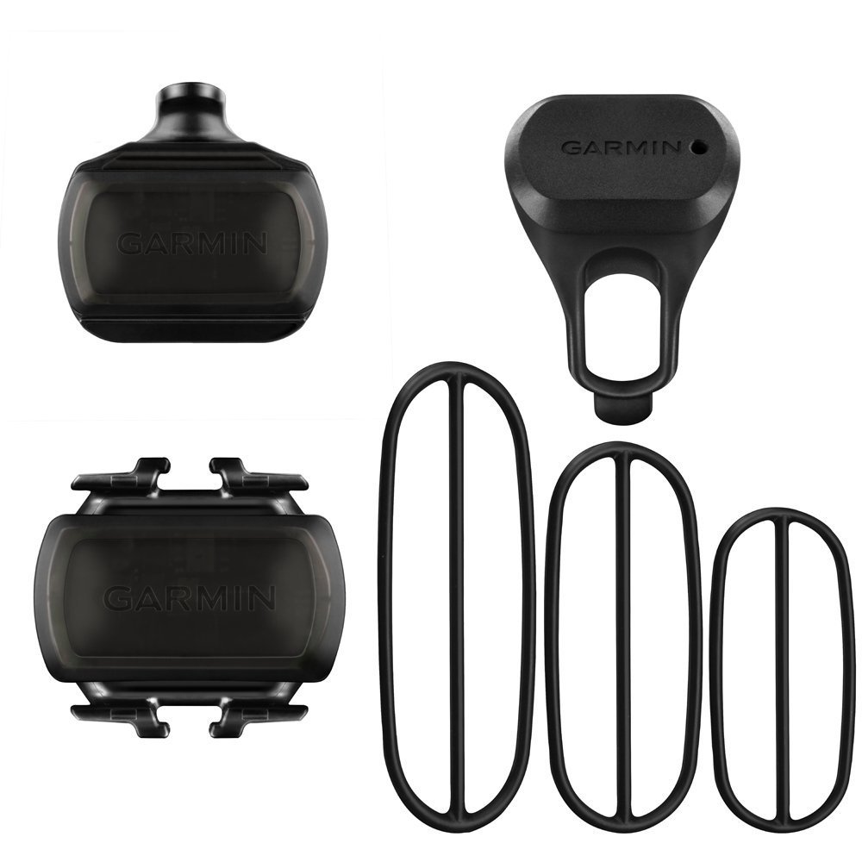
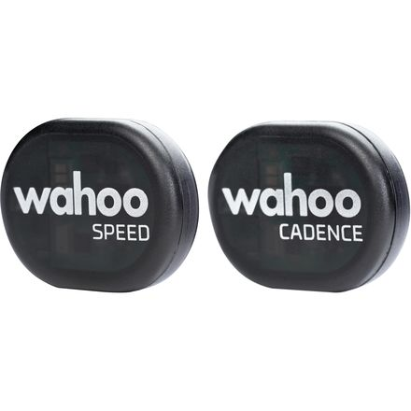
Speed and Cadence Sensors
# | Polar | Wahoo | Garmin
Cost | 1 | 2 | 3
Ease of use | 4 | 3 | 3
Ease of code | 2 | 2 | 2
Efficiency | 3 | 3 | 3
Total | 10 | 10 | 11
Notes:
Easy-to-install - Simply attach the sensors and ride. With no magnets or other exposed parts to line up, these sensors are easy to install, maintain and move between bikes.
Speed sensor - Attaches to the hub and self-calibrates with your Garmin Edge to give you accurate speed and distance
Cadence sensor - Fastens to any crank arm size and measures pedal strokes per minute so you can get the most out of your training.

Slide 6
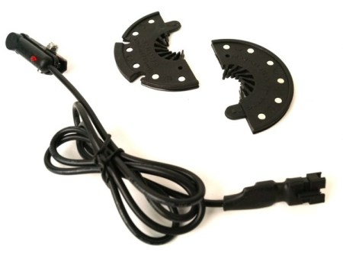
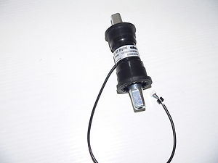
Torque Sensors:
To determine how much power the motor need.
There are different types of Torque sensors:
A torque sensing bottom bracket
A Ring of magnets:

Slide 7
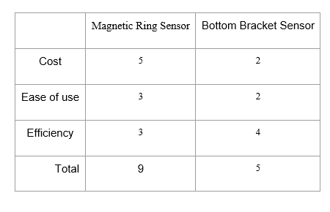
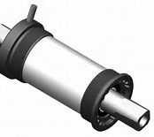
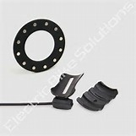

Slide 8
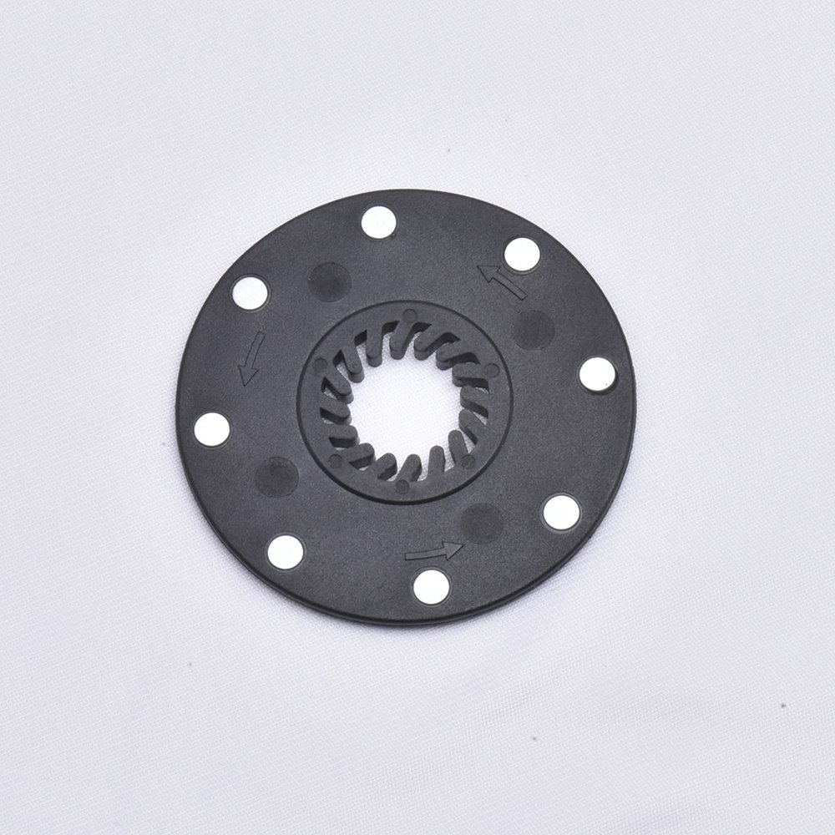
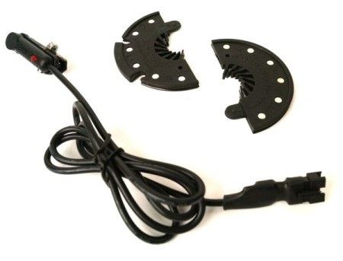
Torque Sensor (Ring of Magnet) :
Widely Use
Standard Connections
Easy installation
Powerful Functions

Slide 9
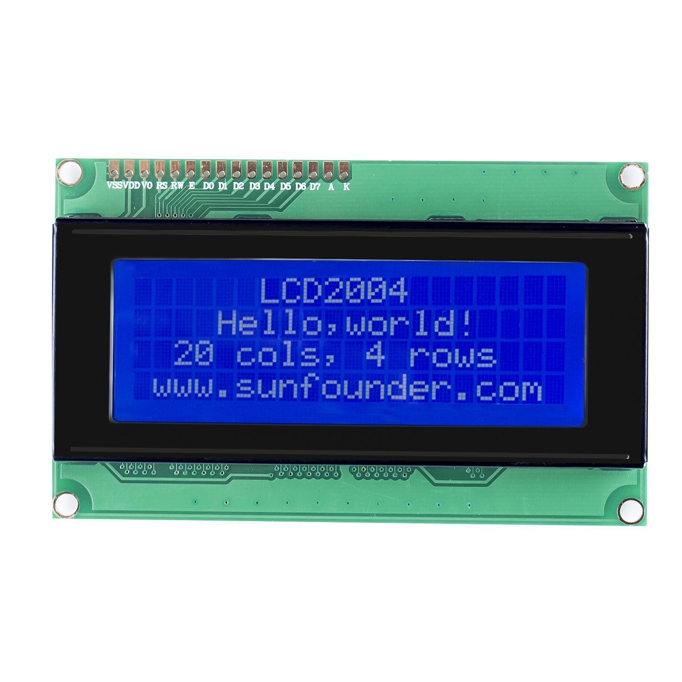
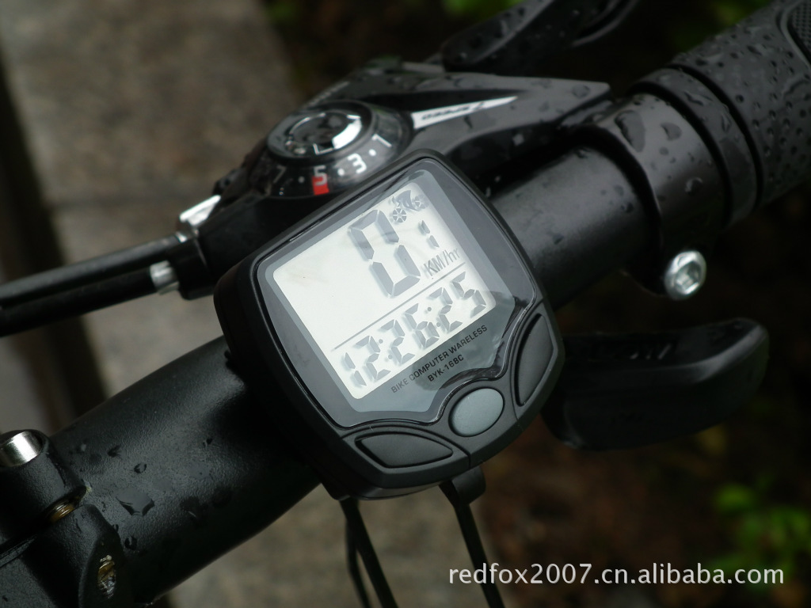
Display Subsystem
Requirements:
The model that the user choose to provide power assist
Speed in miles/hour
Miles remaining before recommended charge
Electricity remaining
Charging indicator, and charge complete indicator

Slide 10
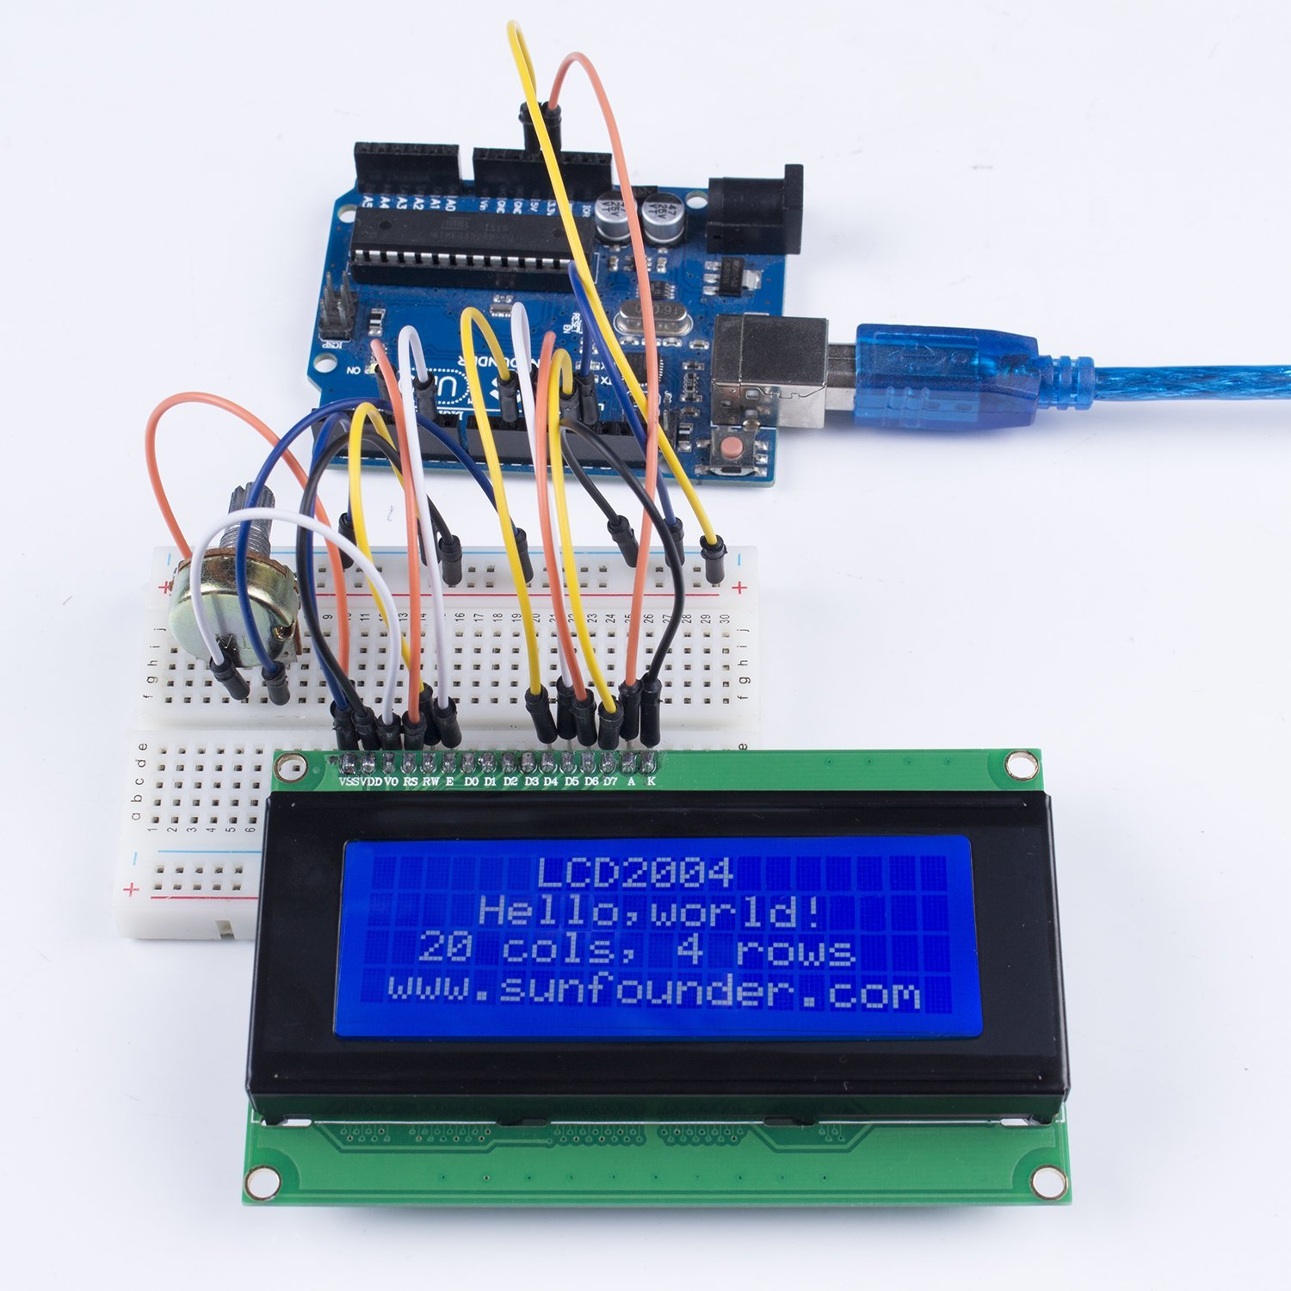
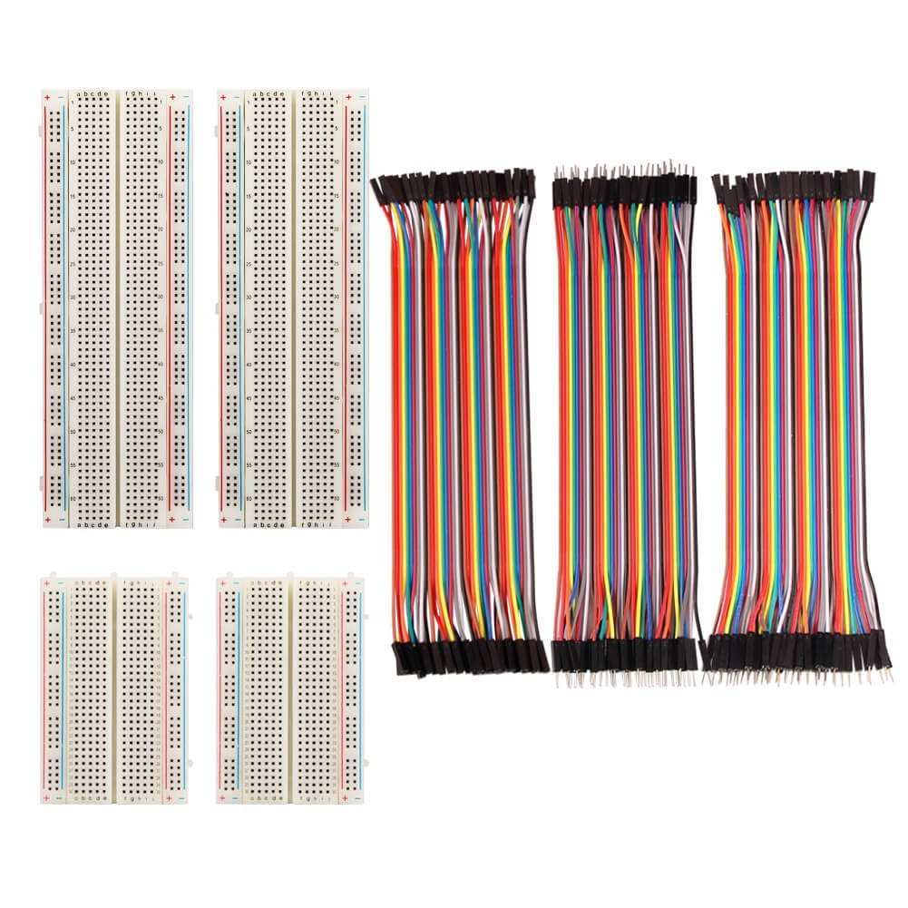
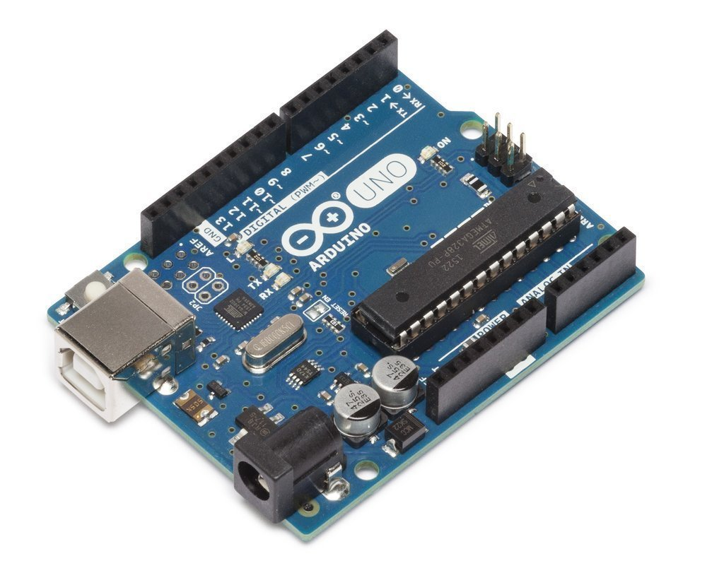
Devices for designing display system
Garmin Bike Speed Sensor
Arduino Uno R3 Microcontroller
Paxcoo 4 Pieces Breadboards（Jumper Wires）
LCD 2004 Module

Slide 11
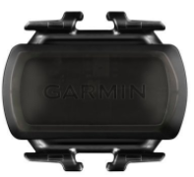
Solutions to display speed information
Collect pulse signal
Signal Collection
analog signal
Microcontroller
digital signal
LCD
I/O interface(pin)
I/O interface(pin)
Code for calculating speed

Slide 12
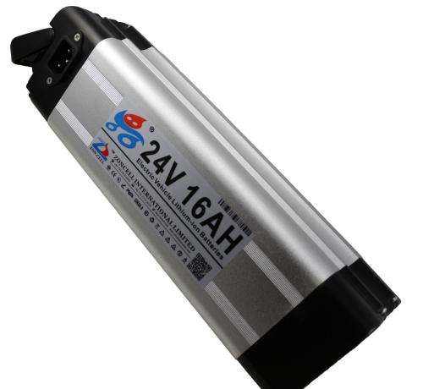
Solutions to display electricity remaining
Collect battery voltage
Battery
Electricity
Microcontroller
digital signal
LCD
analog signal
I/O interface(pin)
AD converter function

Slide 13
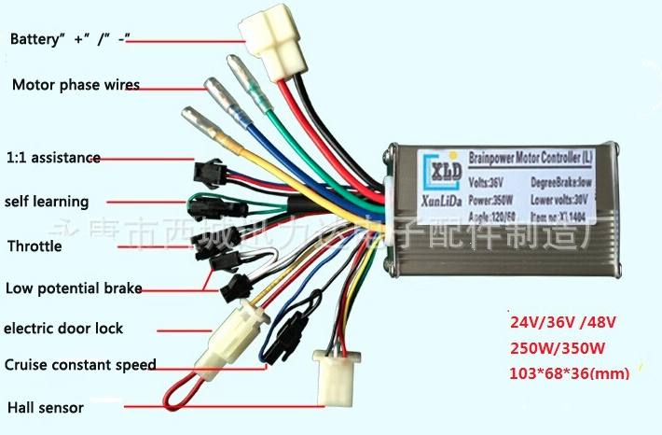
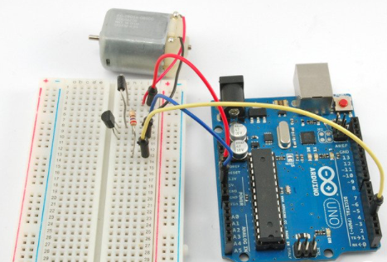
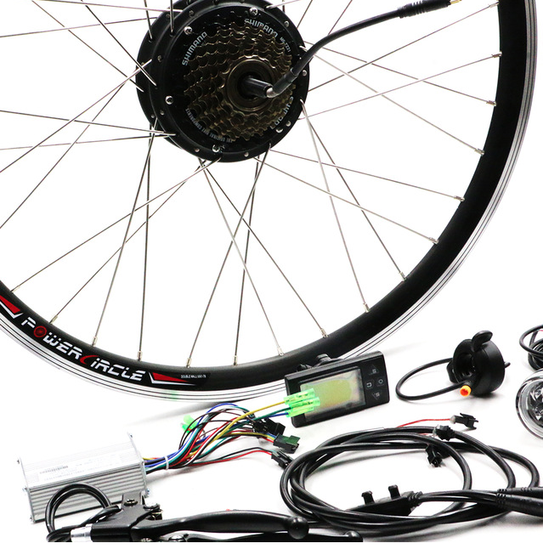
Motor Controller
Controlling motor speed
Three possible solutions
Motor Package
Arduino Build
3rd Party

Slide 14
Motor Controller
*Rankings determined best out of three solutions
 | Motor Package | Arduino Build | 3rd Party
Cost | 1 | 3 | 2
Ease of use | 3 | 2 | 1
Ease to code | 2 | 3 | 1
Efficiency | 3 | 1 | 2
Total | 9 | 9 | 6

Slide 15
Recap
Cadence Sensor
Torque Sensor
Display
Motor Controller

Slide 16
Thank You
More info visit https://www.cefns.nau.edu/capstone/projects/EE/2018/MotorizedTrike/

Slide 17
References
[1] M. Balmer, “History of Pedal-Assisted Bicycles”, Electric Bike Association, 2016. [Online]
[2] J. Turner, “Understanding Electric Bike Motors with Jim Turner of Optibike,” 2014. [Online]. Available: https://www.youtube.com/watch?v=KL7tTUZCFDs. [Accessed: 01-Oct-2017].
[3] J. D. Goodman, “An Electric Boost for Bicyclists,” New York Times, Jan. 2010.
[4] Bill Cummings, “Why Don’t More E Bikes Use Regenerative Braking?,” Evelo, 2017. [Online]. Available: https://www.evelo.com/bikes-use-regenerative-braking/. [Accessed: 05-Oct-2017].
[5] Hook slide: http://www.ebikeclass.com/buying-guides/facts-electric-bikes/

