Slide 1
Motorized Tricycle Capstone
Mohammed Allahyani, Khalid Alghamdi, Yu Sun, James Sigler

Slide 2
Outline
Introduction
Problem Overview
Subsystems WBS
  Speed/Cadence Sensor
  Torque Sensor
  Display
  Motor Controller/Assembly
Recap
1 Mohammed Allahyani
Notes:
James

Slide 3
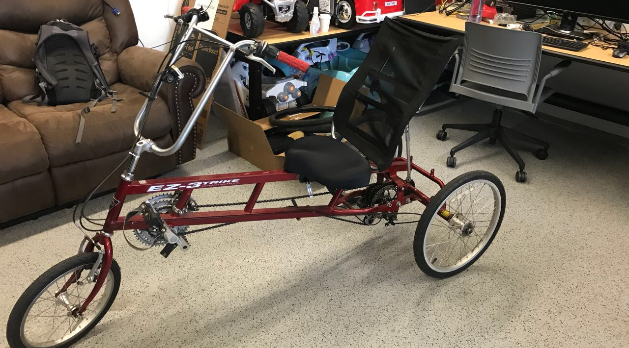
Introduction
Name of project: Motorized Tricycle
Client: Jane Scott
Faculty mentor: Dr. Kyle N. Winfree
2 Mohammed Allahyani

Slide 4
Problem Overview
Our project is to convert a tricycle to an electric tricycle
In this presentation we will focus on WBS for each subsystem
We have four major subsystems
Speed/Cadence Sensor
Torque sensor
Display
Motor controller/Assembly
3 Mohammed Allahyani

Slide 5
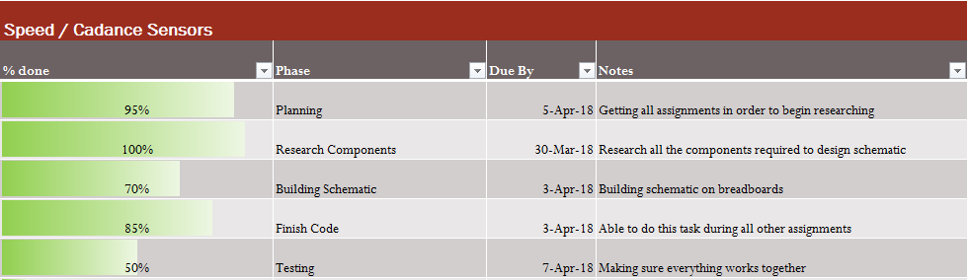
4 Mohammed Allahyani
Notes:
For this sub-sys, we did:
We almost finish the planning but we need to decide to take signals from cadence sensor, or take the signal from the torque sensor.
We finished the research.
We need to wait until we chose between the two options.
We almost finish the code, we just need add some calculations for (Speed/ paddles N.)
We did finish test the sub-sys, but we have to test it with other sysS.

Slide 6
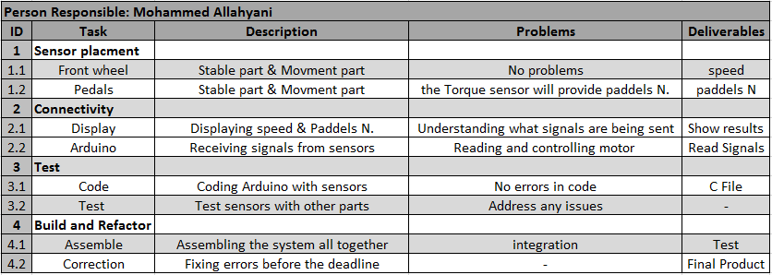
Speed/Cadence sensors (WBS)
5 Mohammed Allahyani
Notes:
Speed and cadence sensors [Notes]
Sensors placement
For speed sensor there are two parts stable part and movement part
The stable part attached on the fork.
The movement attached on the wheel
For cadence sensor there are two parts: stable part and movement part
The stable part attached on the frame
The movement attached on pedals
The torque sensor that Khalid order it will provide cadence signal, thats mean we have two options.
Connectivity
speed/cadence sensors are connected with two other subsystems: Display and Arduino
Display: displaying speed in m/s and displaying pedal revolutions per minute rpm
Arduino: receiving signals from the sensors
Test
Code: we almost finish the code for both sensors! Just we need to add some math.
We can modification the code for new sensor [if we need]
Test: when finish all previous steps, then we need to test it to make sure everything are good
Build and Refactor
Assemble: Assembling the system altogether and test it
Correction: Fixing errors before the deadline

Slide 7
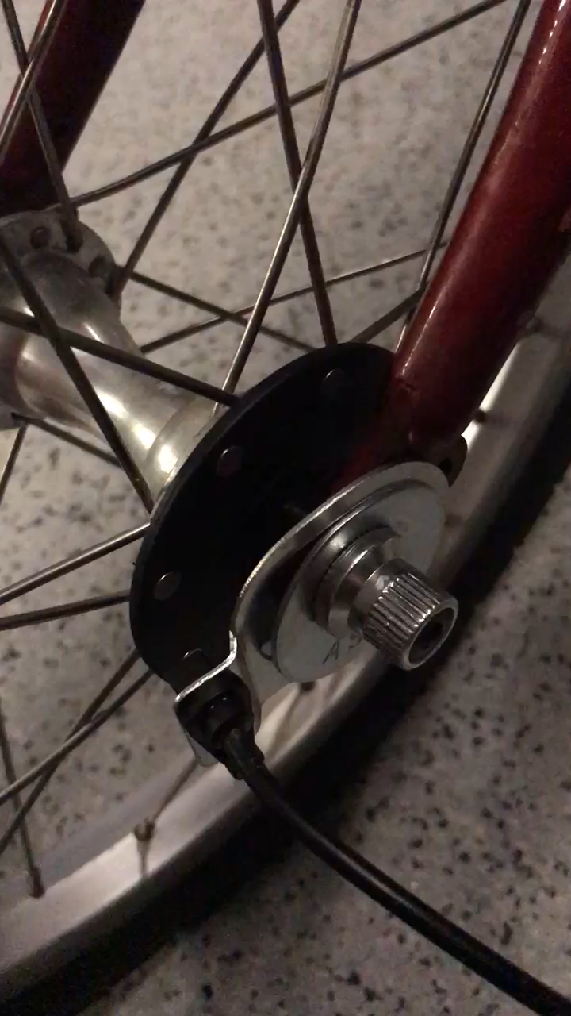
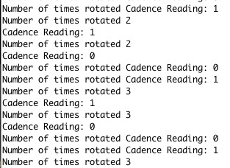
Cadence Sensor - Demo
6 Mohammed Allahyani
Notes:
This is first demo for cadence sensor. We attach it in front wheel just to test it, because we can not attach it in crank this time (tolls problems)
Then, when we decide to use it for calculate speed or paddles number. We will just change the formula inside the code.
In this video we demonstrate for you our cadence sensor and how its work.
The cadence sensor have two parts
First part will rotate with the wheel and it has 8 magnetics
Second part will attach in fork and will be stable and detect the magnetics
So, the sensor calculate one rotate if (detect 8 magnetics = 1 rotate)
Finally we got these results

Slide 8
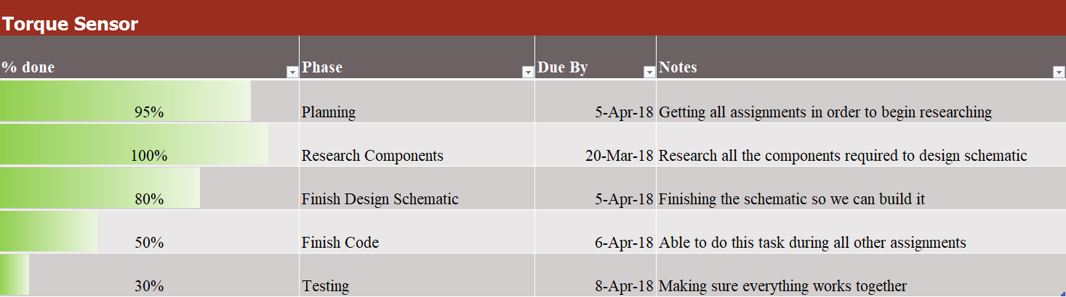
7 Khalid Alghamdi

Slide 9
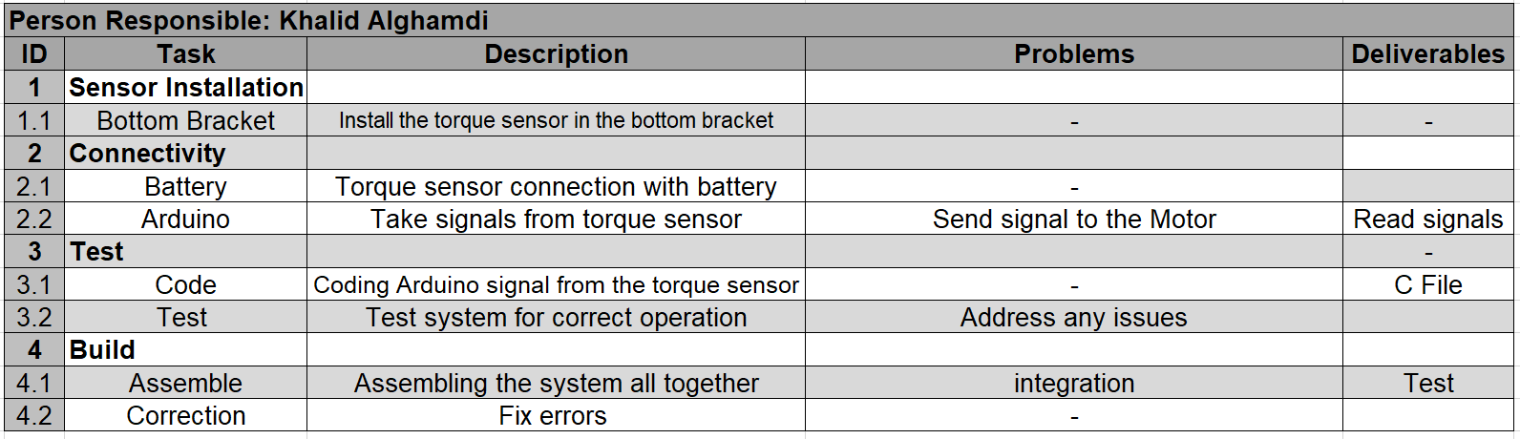
Torque Sensor
8 Khalid Alghamdi

Slide 10
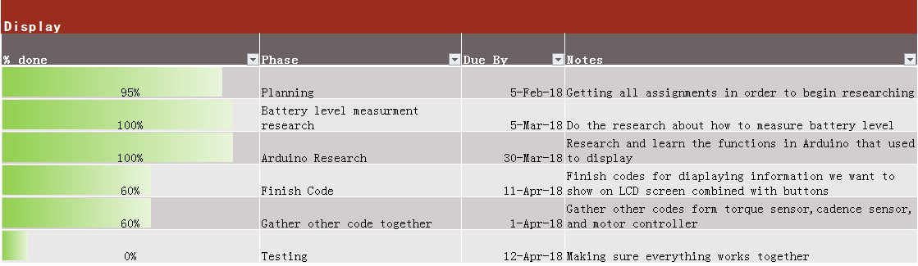
Display
9 Yu Sun

Slide 11
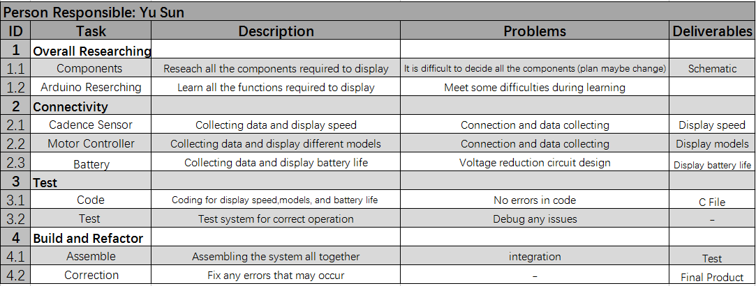
Display
10 Yu Sun

Slide 12
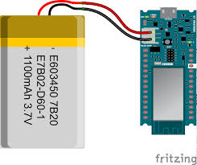
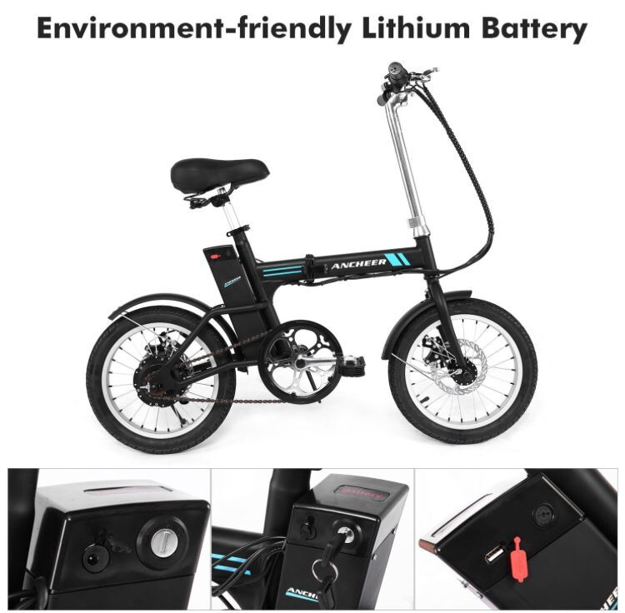
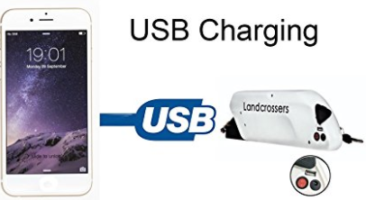
Problem in measuring battery level
V.S
11 Yu Sun

Slide 13
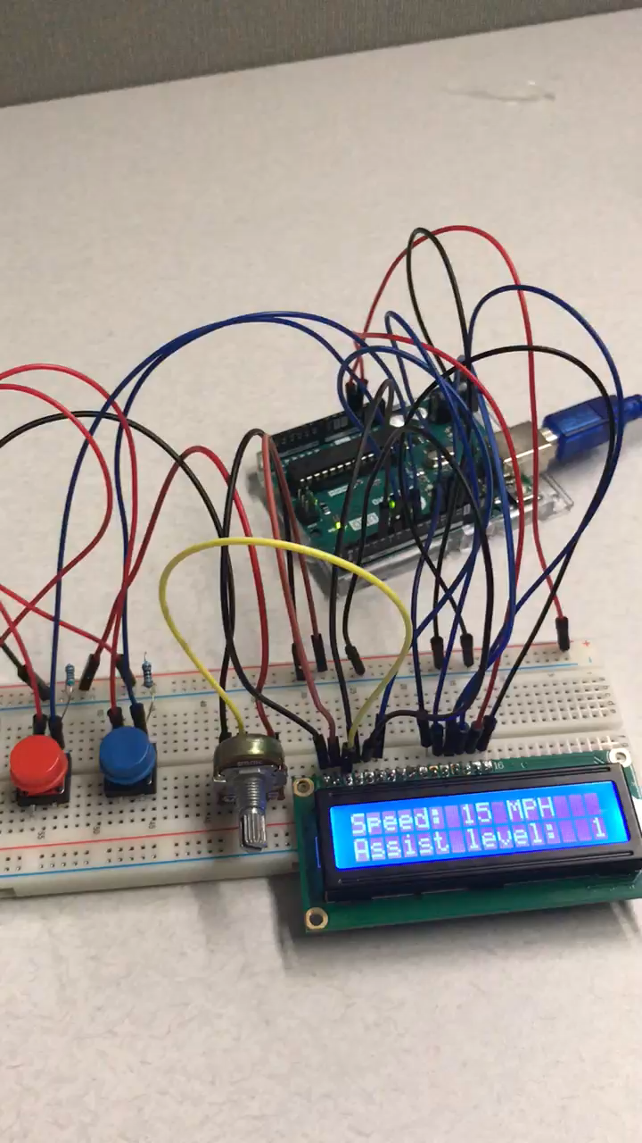
Display Demo
12 Yu Sun

Slide 14
Motor Assembly
Motor Assembly changes
  Fork
  Motor Choice
  Alternatives
Scavenge parts from new bike
  Hub motor
  Battery
  Motor Controller
13 James Sigler

Slide 15
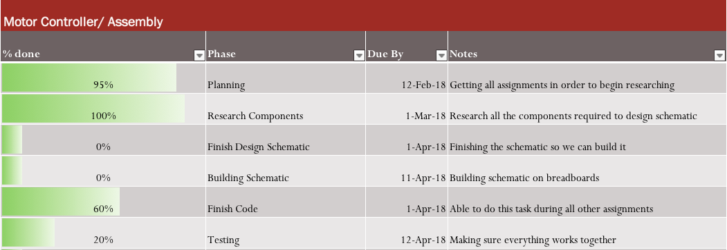
Motor Assembly Plan
14 James Sigler

Slide 16
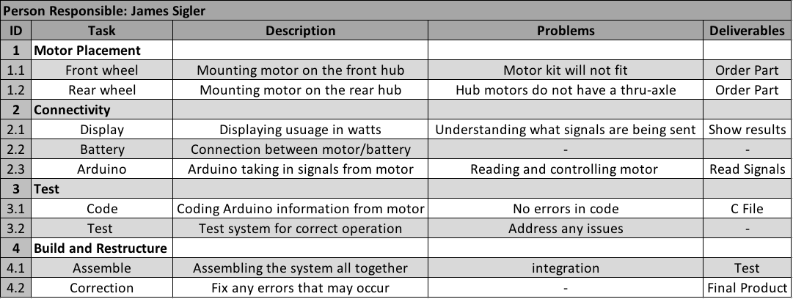
Motor Assembly WBS
15 James Sigler

Slide 17
Recap/Future Steps
Completion of subsystems
Motorized Tricycle for a person in need of assistance
  User friendly
  Last for at least a year
Create design to hold housing of components and display
  3D printing
Ordered Parts
  Should come in this week
16 James Sigler

Slide 18
Thank You
More info visit https://www.cefns.nau.edu/capstone/projects/EE/2018/MotorizedTrike/

