Slide 1
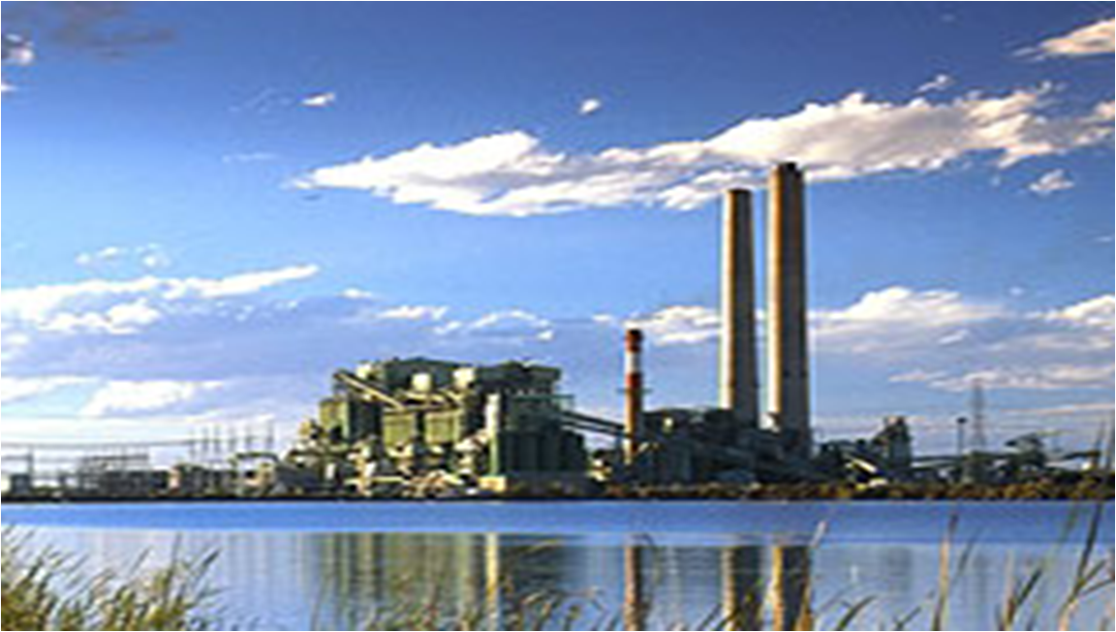
Improving Efficiency at the APS Cholla Power Plant

Slide 2
Team Members
David Bruce - Secretary, Faculty Advisor Liaison, Vendor Liason/Buyer, Document Coordinator
Caleb Breazeale - Team Leader, Sponsor Liaison, Presentation Coordinator
Joseph Davidson - Treasurer, Website Coordinator

Slide 3


Thanks
NORTHERN
ARIZONA
UNIVERITY
Tim Vachon – APS
Project Sponsor
Ralph Bushman – APS Technical Advisor
Dr. David Scott – Capstone Instructor
Dr. Niranjan Venkatraman – Faculty Technical Advisor
David Bruce

Slide 4

Summary
Project Overview
Background
  APS Cholla Plant
  Excitation Systems
Procedures
Results
Conclusion
David Bruce

Slide 5
Project Overview
The project goal was to research upgrading the generator
excitation systems on units 1, 2, and 3 at the APS Cholla
Power Plant in Joseph City.
The reason for replacing the excitation systems is to
improve efficiency and reduce forced outages.
The project was an investment return study.
David Bruce

Slide 6
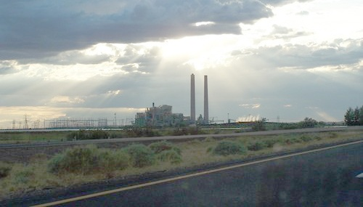
APS Cholla Power Plant
Unit 1 - 120 MW Westinghouse 1961
Unit 2 - 297 MW Siemens / Westinghouse 1978
Unit 3 - 297 MW Siemens / Westinghouse 1980
Unit 4 - 380 MW General Electric1978
David Bruce

Slide 7
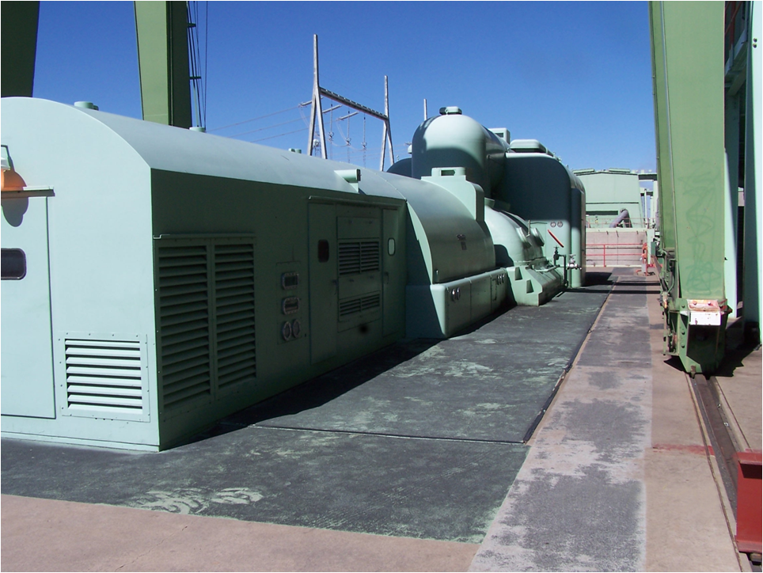
APS Cholla Power Plant
David Bruce

Slide 8
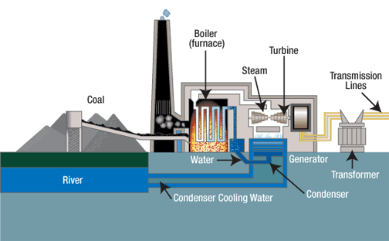
Coal Fired Generators
David Bruce

Slide 9
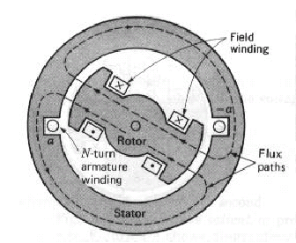
Introduction to Excitation Systems
The excitation system provides power to the generator rotor to establish a precisely controllable rotating magnetic field.
Caleb Breazeale

Slide 10
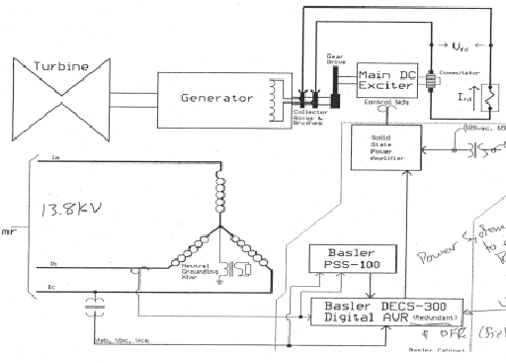
Unit 1 Rotating Exciter System
Caleb Breazeale

Slide 11
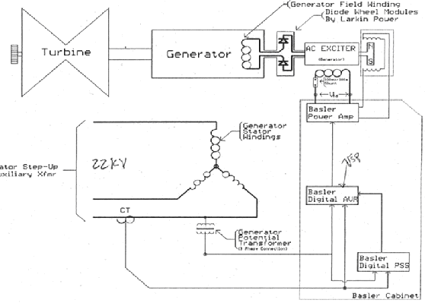
Units 2 and 3 Rotating Exciter System
Caleb Breazeale

Slide 12
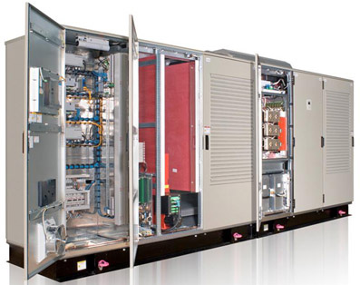
Static Excitation Systems
Caleb Breazeale

Slide 13
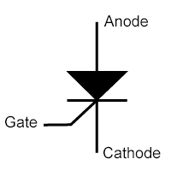
Thyristor Semiconductor
Static excitation systems rely upon thyristor
semiconductors to regulate power.
Caleb Breazeale

Slide 14
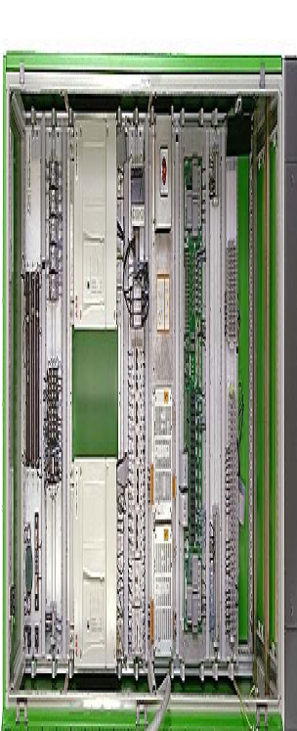
Digital Regulators
Static excitation systems
use digital automatic voltage
regulators (AVR) to control the
thyristor semiconductors.
Caleb Breazeale

Slide 15
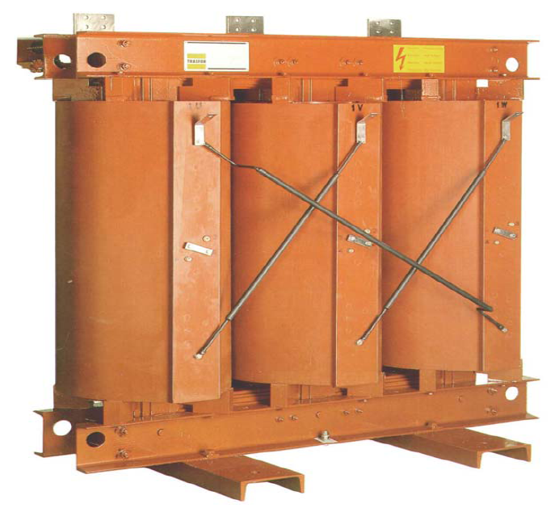
Power Potential Transformer
Static excitation systems
require a power potential
transformer.
Caleb Breazeale

Slide 16
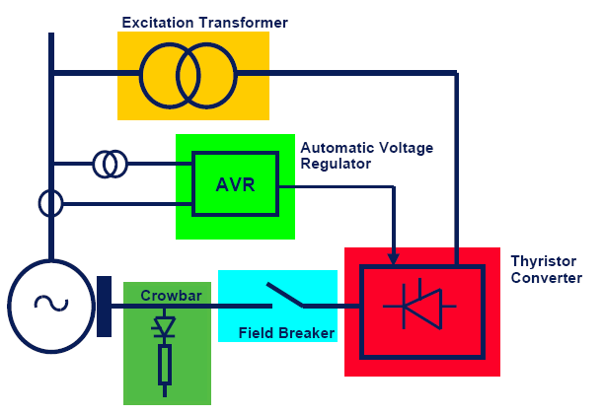
Static Excitation Systems
Caleb Breazeale

Slide 17
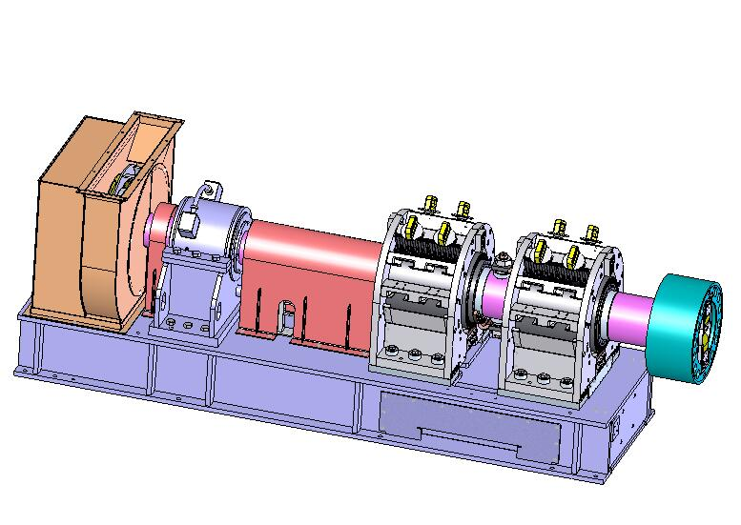
Units 2 and 3 Collector Assembly
Caleb Breazeale

Slide 18
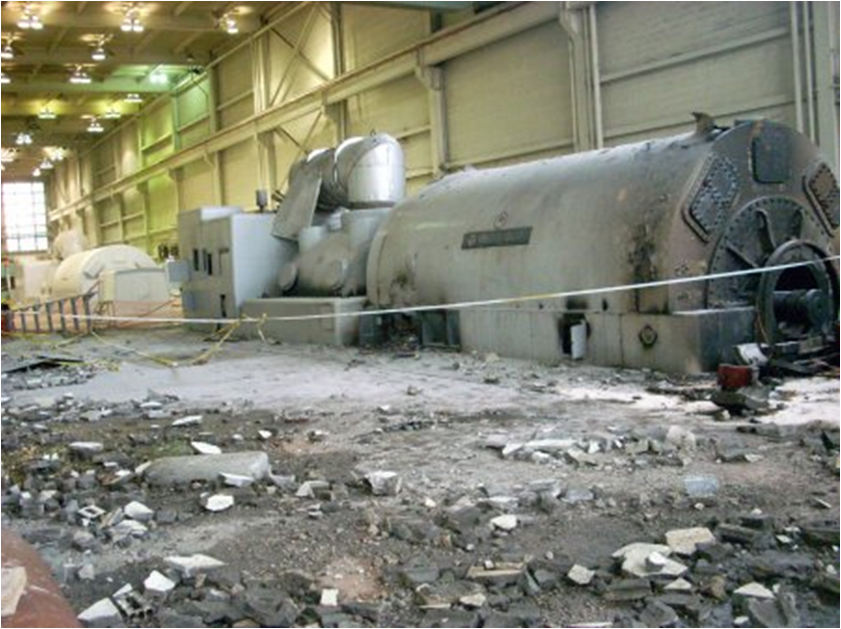
Benefits for Excitation System Upgrade
Performance Improvements
  Quicker response to load changes
  More efficient
  Generator up-rate
Feature Enhancements
  Remote system operation
  Reduced operator demand
  Data logging
Improved Reliability / Availability
  Redundancy
  Reduced maintenance costs
  Elimination of moving parts
  Parts availability
Siemens exciter meltdown
Caleb Breazeale

Slide 19
Procedures
Analyze costs associated with existing systems
Determine cost of upgrade
Predict operational costs of upgrade
Determine payback time
Joseph Davidson

Slide 20
Current Operating Conditions
Unit 1 is worth about $112,000 per day.
Unit 1 has about 1 annual forced outage day due to the
exciter system.
Unit 2 is worth about $265,00 per day.
Unit 2 has about .2 annual forced outage days due to
exciter system.
Joseph Davidson

Slide 21

Budget Quotes
Vendor | Unit 1 | Units 2 & 3
 | $1,405,500 | $2,230,500
 | $1,305,328 | $2,850,328
 | $1,270,500 | $2,125,500
Joseph Davidson

Slide 22
ABB Unit 1 Budget Quote
Joseph Davidson

Slide 23
ABB Units 2 & 3 Budget Quote
Joseph Davidson

Slide 24
Efficiency Improvement
Unit 1: 160 kW (from APS)
Units 2 & 3: 0 kW (assumed)
Joseph Davidson

Slide 25
Investment Payback Model
INSTALLED SYSTEM COST ($)
PAYBACK YEARS =
CAPACITY VALUE + REPLACEMENT CAPACITY VALUE + REDUCED OUTAGE VALUE
Efficiency improvement
value ($/year)
($/year)
Joseph Davidson

Slide 26
Model Parameters
Energy: $ .038 / kWh
Replacement Capacity: $100/kW/year
Unit 1 Capacity: 122,500 kW
Unit 1 Cost: $1,327,109 (averaged)
Units 2 / 3 Capacity: 290,000 kW
Units 2 / 3 Cost: $2,402,109 (averaged)
Joseph Davidson

Slide 27
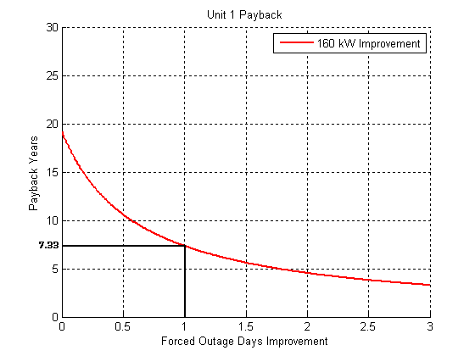
Unit 1 Payback
Joseph Davidson

Slide 28
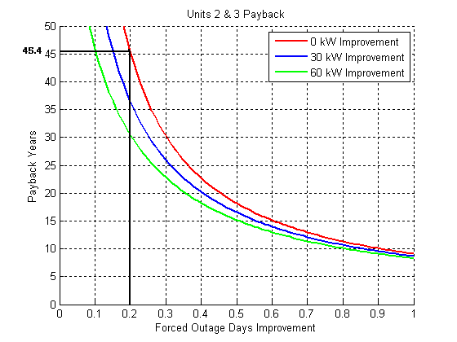
Units 2 & 3 Payback
Joseph Davidson

Slide 29
Requirements / Results Comparison
All of the static excitation systems that were quoted met the minimum electrical, environmental, and mechanical requirements.
The key requirement of payback years was determined.
Unable to determine exact efficiency improvement of units 2 and 3.
David Bruce

Slide 30
Project Deliverables
System quotes
Research information gathered
Payback model and results
  Matlab source code
  Excel files
David Bruce

Slide 31
Lessons Learned
Be specific when requesting quotes.
Allow ample time for vendors to produce a quote.
David Bruce

Slide 32
Possible Future Refinements
Catastrophic failure consideration
Old equipment value
Generator up-rate value
David Bruce

Slide 33
Conclusion
Unit 1 – Worth it, the investment payback time is about 7
years.
Units 2 & 3 – Not as good of an investment. With existing
reliability, the payback time is about 45 years.
David Bruce

Slide 34
Hours Spent on Project
Problem Identification and Requirements ~ 20 man-weeks
  - Project proposal- ensured we fully understood what APS wanted
Research ~ 9 man-weeks
  - Gathered generator performance information.
  - Identified excitation systems.
Vendor communication ~ 9 man-weeks
  - System Quotes
Results ~ 9 man-weeks
  - Payback model
David Bruce

Slide 35
Questions ?
Poster
Room A, 2nd floor DuBois Center
Website
www.cens.nau.edu/Academic/Design/D4P/EGR486/EE/08-Projects/APSCholla/
David Bruce

