Slide 1
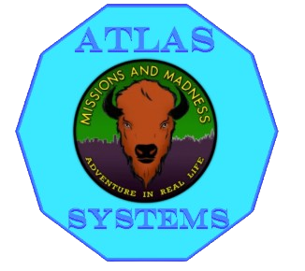

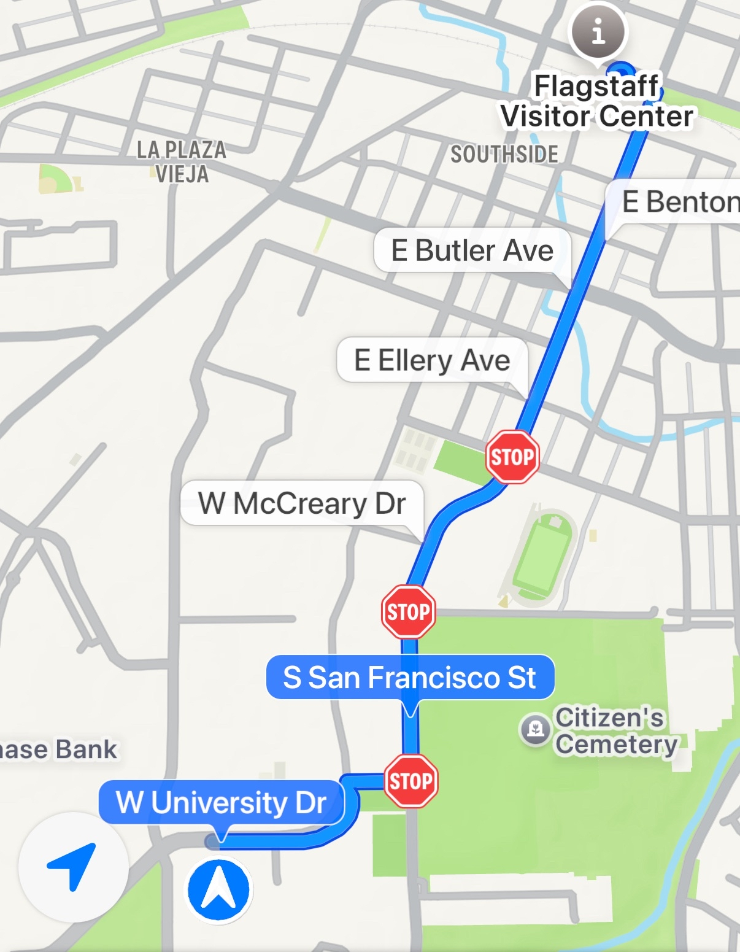
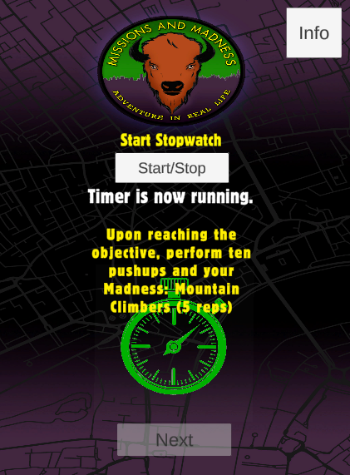
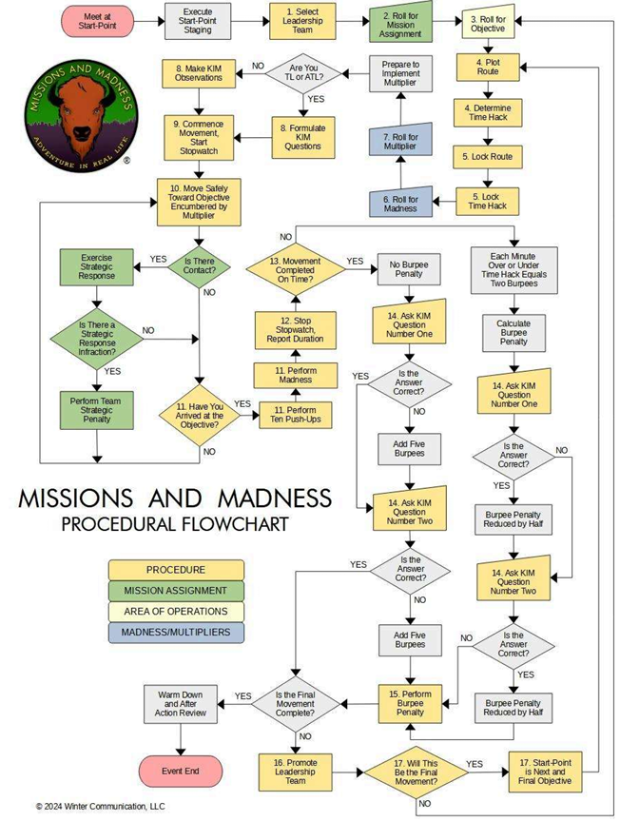
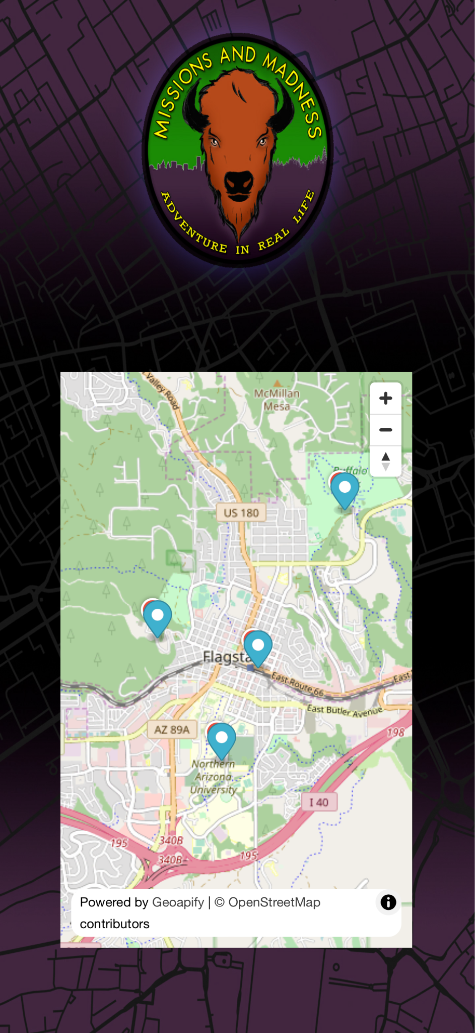
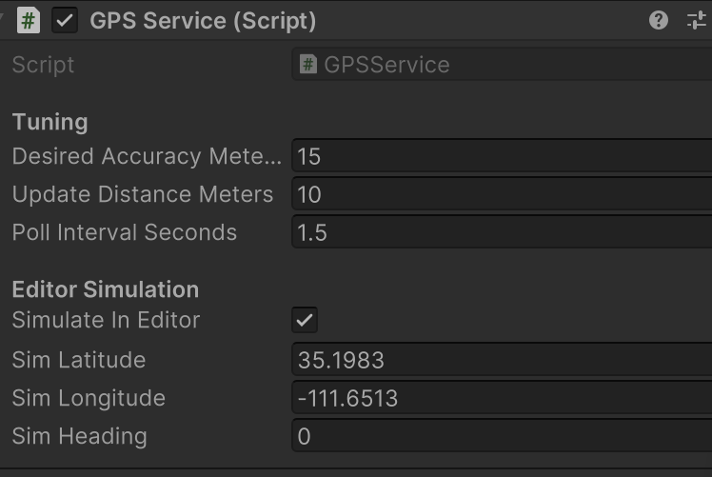
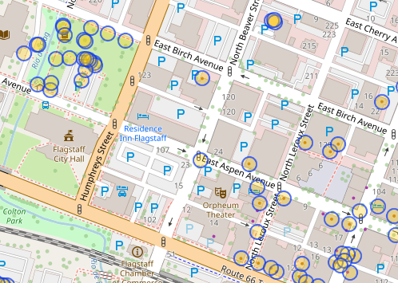
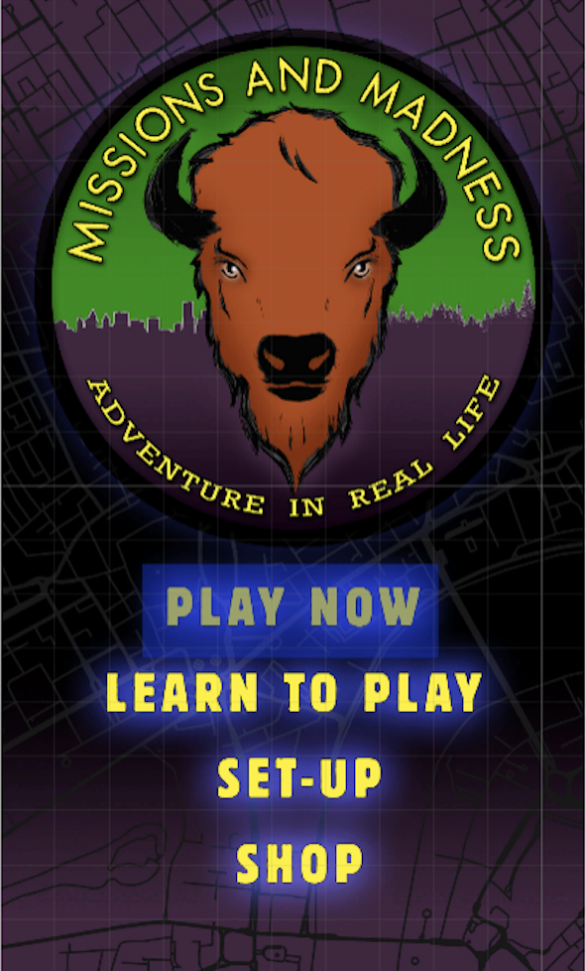
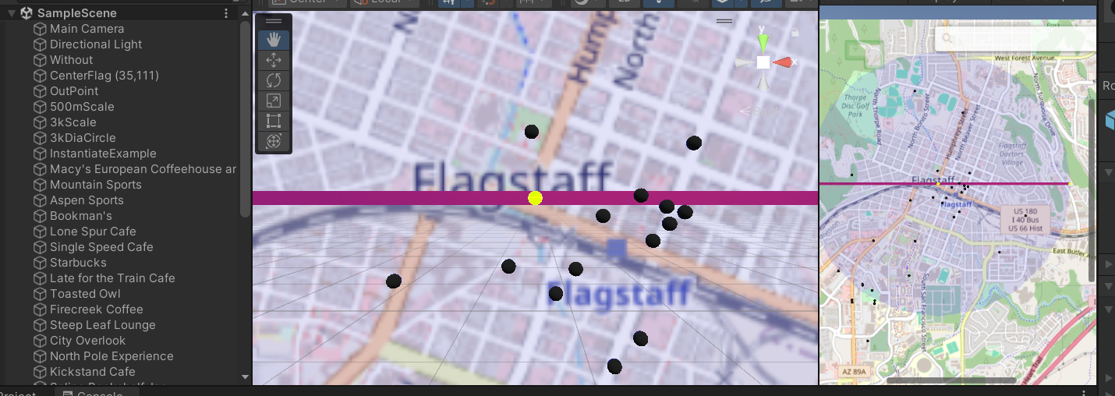
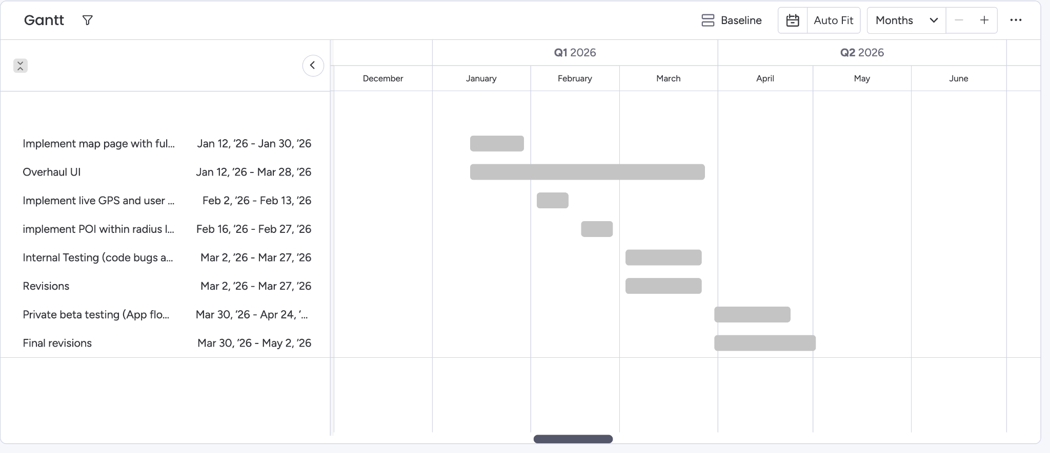
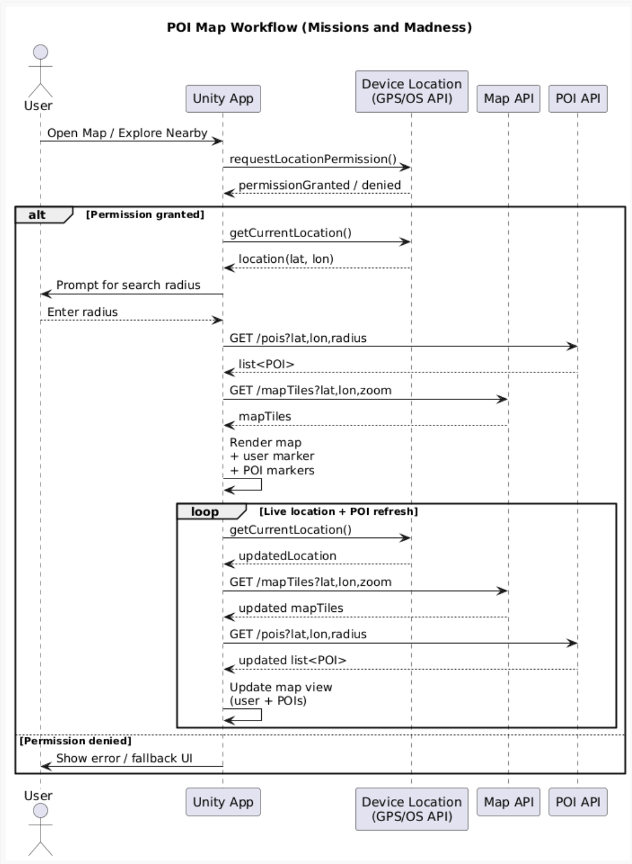
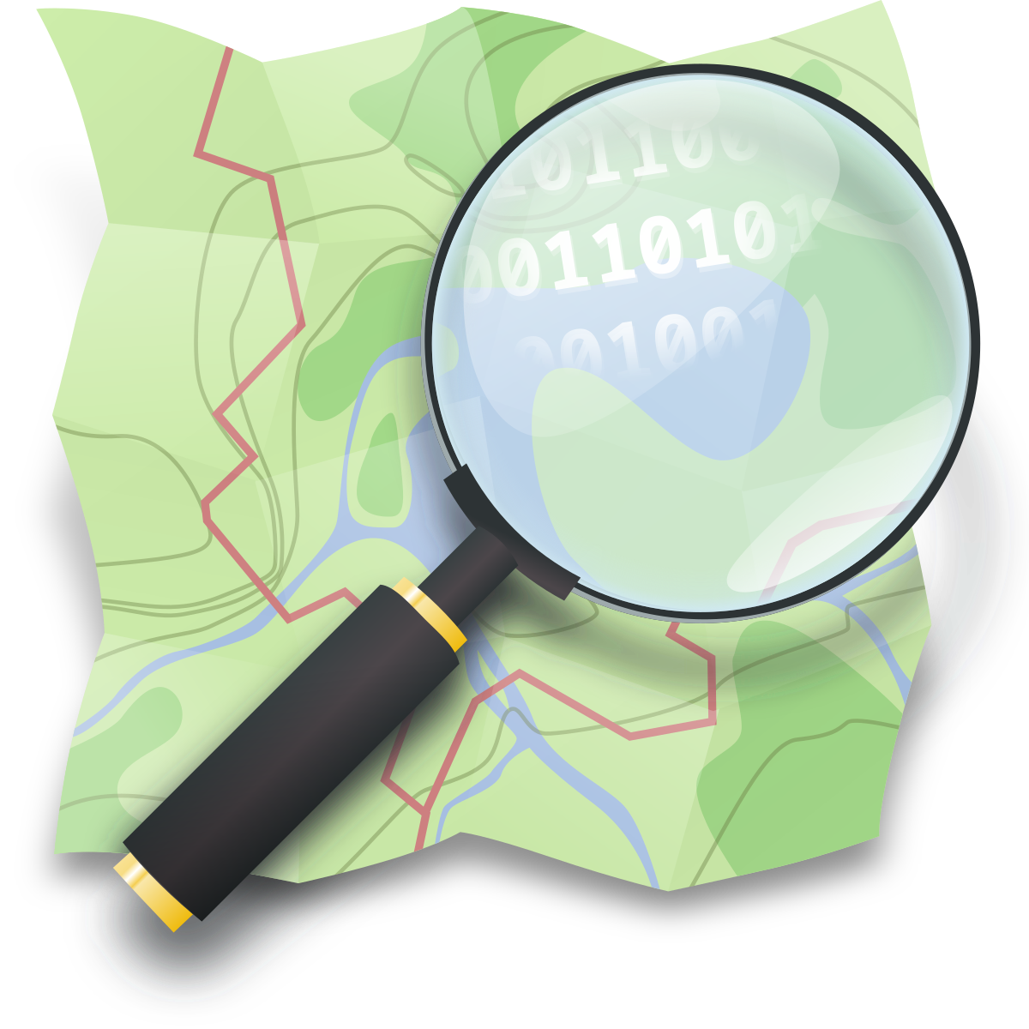
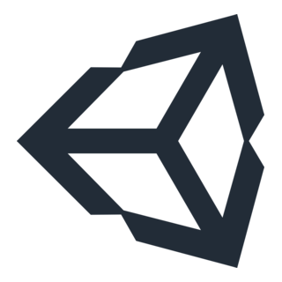




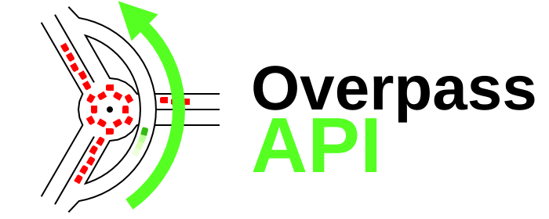

Missions and Madness
Team: Hunter Beach, Tristen Calder, Mitchell Morris, John Zeledon
Client: Morgan Boatman, Winter Communications LLC, Flagstaff, AZ
Team Mentor: Ogonna Eli
Problem Statement
Proposed Solution
Prototypes
Missions and Madness began as a small scale location based adventure game, but our client wants to expand it! To do so we need to up scalability
Through meetings with our client - We came up with this core idea of a version with 3 key aspects:
After work in our tech feasibility we have found this all to be rather feasible, with the following prototypes already developed!
[1] A connected Map and GPS to help guide the user, with varying levels of information
[2] A connected Database of Points Of Interest (POIs), making the game playable anywhere!
Fig. 3 Our prototype of Maps via GeoApify - Fig. 4 Our prototype of GPS Coordinates with Unity Packages
Fig. 1 Current Image of gameplay, wanted to be more interactive - Fig. 2 UML Flowchart of game play
[3] A refined a polished UI to give a better User experience, as well as implementing tutorials.
Plans and Goals
Fig. 5 Our prototype of Querying POIs (OverPass Turbo) from inside Unity
Solution Schema
Technologies
Fig. 6 Current flow of our plans for future production
We will deliver an application for both iOS and Android mobile devices that is easy to use for new players and has a modern, clean UI that can be used nationwide at launch
Unity
GeoAPIfy
OverPass Turbo API
Hits OpenStreetMaps DB
WikiData API
Hits Wikipedia DB
Android
iOS
We will start the with implementing the map, then we will connect the GPS and POIs, and during all of this we will overhaul the UI, and finally we will end with beta testing and revisions.
Fig. 7 Current tech flow of our product

