Slide 1
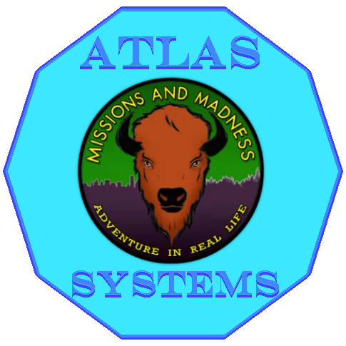
Missions and Madness
Atlas Systems
2026 / March
Notes:
Hello everyone we are team atlas systems for project missions and madness and this will be our design review 3 following up our design review 2 and we will now introduce the team

Slide 2

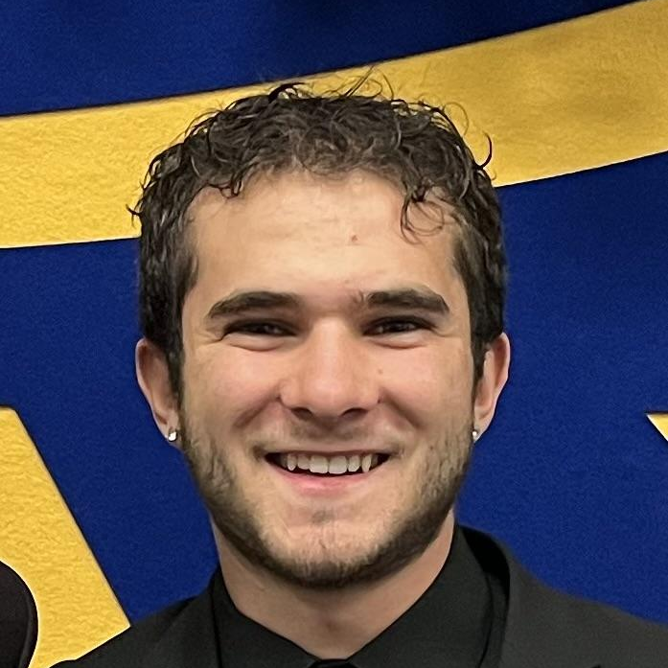


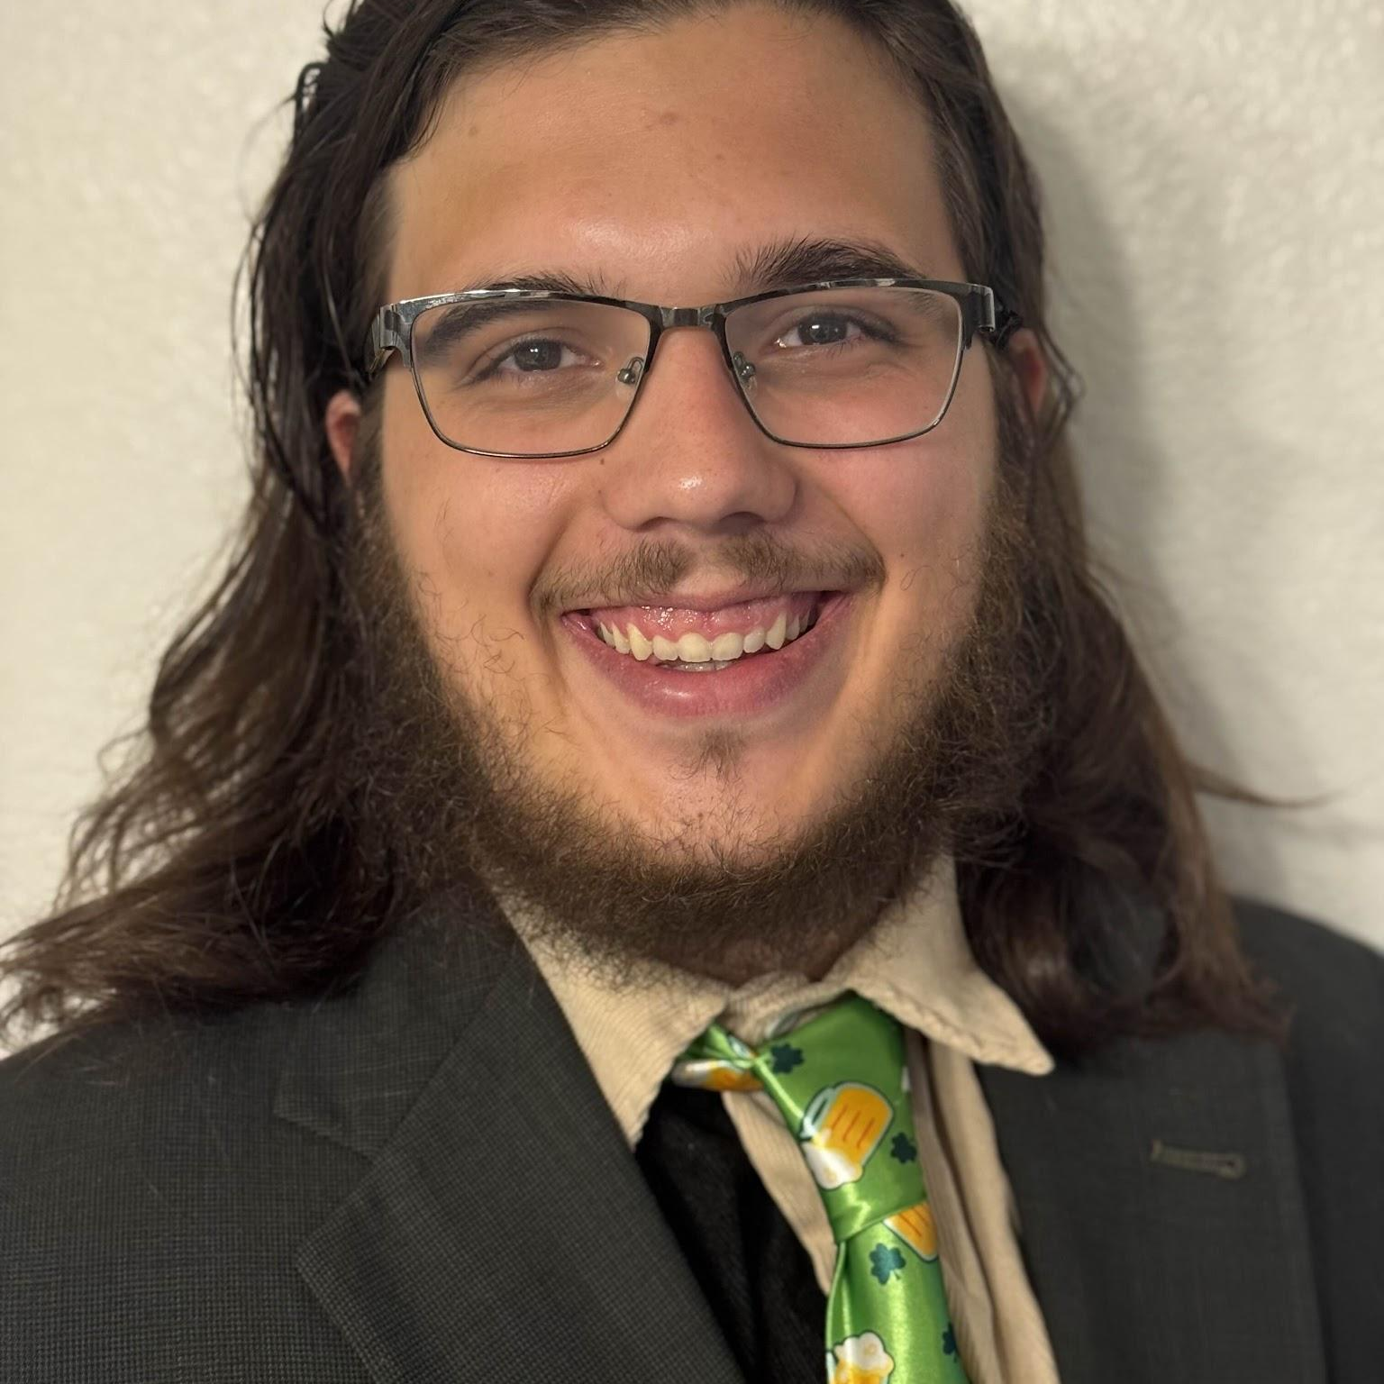
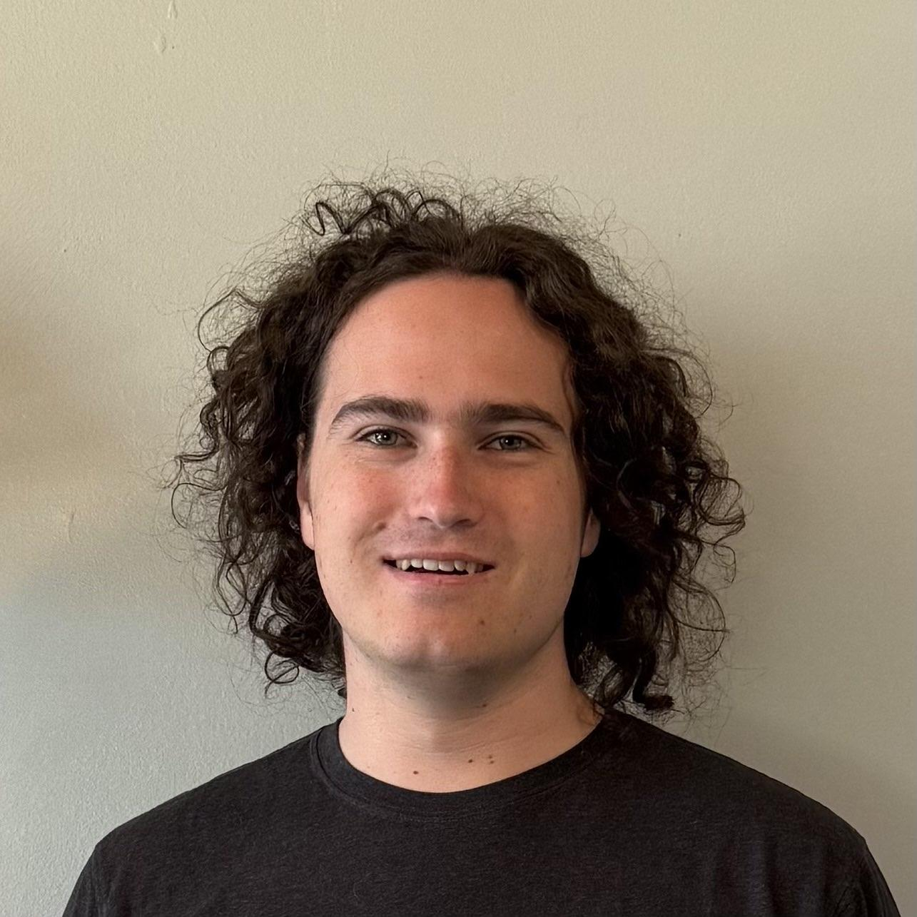
Atlas Systems
2026 / March
Meet the team
John Zeledon
Team Lead, Coder
Mitchell Morris
Recorder, Coder
Morgan Boatman
Client
Ogonna Eli Mentor
Hunter Beach
Architect, Coder
Tristen Calder
Release Manager, Coder
Notes:
This is a page of who is apart of our team with me as team lead and here with (rest of group) following up with that is our client Morgan Botman who we are working with which is morgan and we are guided by our mentor ogonna who has been along this journey with us guiding us

Slide 3
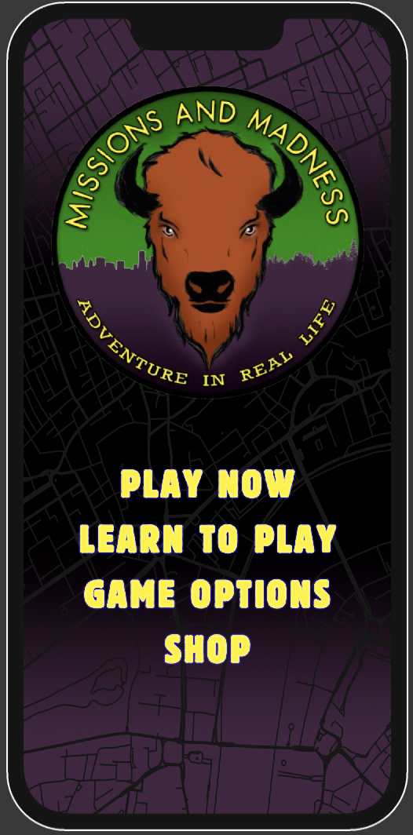
Atlas Systems
CLIENTS NEEDS
2026 / March
Live GPS of User
Live location
Visual on map
Automated Points Of Interest (POI)
Take users location
Give locations
Point them on same map
Easy to Follow User Interface (UI)
Better wording
Visually better
Easy flow
Notes:
Missions and Madness is an exploration and adventure game that builds team bonding as well as improves the teams spatial awareness. In this day and age technology is so vast and apart of a lot of people's lives and we thought this would be revolutionary to update the apps previous placeholders and start renovating the game itself by adding more. Our client Morgan has 3 big needs from our team. The very first things is that he wants a live gps of the user locations so the user can use this anywhere. From there Morgan would like to use the user’s location to put certain points around the user so they can explore new cities. The last big thing that Morgan wanted is an easier to follow UI which will give the user a better experience and this would include an easier flow of the game, visually appealing buttons and pages, locations as well as the user on maps, and textual help on the pages help the user flow through the application. As of now our team is making great progress on all of these new features.

Slide 4
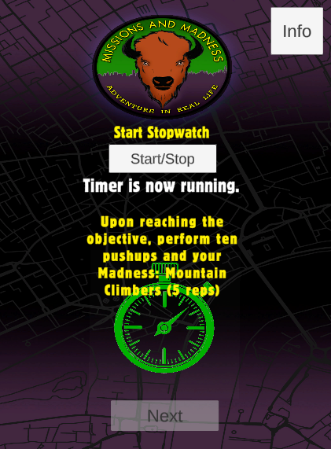
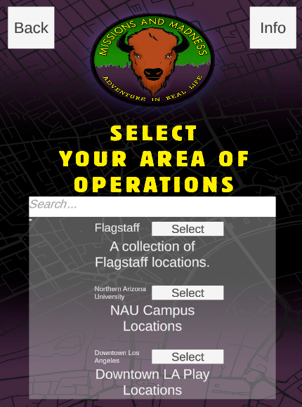
Atlas Systems
PROBLEM STATEMENT AND SOLUTION
2026 / March
End Users
Casual mobile players exploring their city
Students, community groups, wellness participants
New players needing simple onboarding
Targeted Audience
Ages 16-50 mobile users
Fans of location-based or social games
People interested in outdoor exploration & community events
What's Working
Live GPS map working on real devices
POI databases returning nearby locations
Core mission flow functional
Scalable UI framework in place
Next Improvements
Clear tutorials for onboarding
Simplified navigation flow
Continued UI clarity and polish
Notes:
Our target audience is pretty much anyone 16 and up no real focal point for a target audience and we have done so much so far such as integrating live GPS tracking along with getting a grasp on mission flow in the game and also fixing up the UI design. We also have a POI database returning nearby locations. Moving forward we wanna focus on making the app easier to understand with new and improved tutorials to get the audience engaged and excited to play the game and work on navigation through the app that way its not a struggle to move through the app and finally continue to polish the UI because we believe that Continuous UI refinement ensures an app remains fresh and new for players and regular updates adapt to evolving user preferences, increase task efficiency, and fix navigation frustrations, turning first-time users into engaged customers

Slide 5
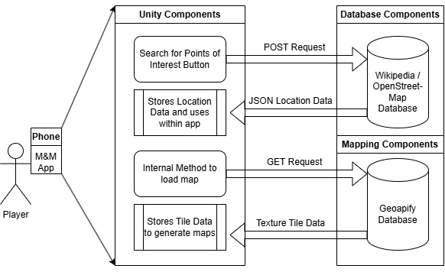
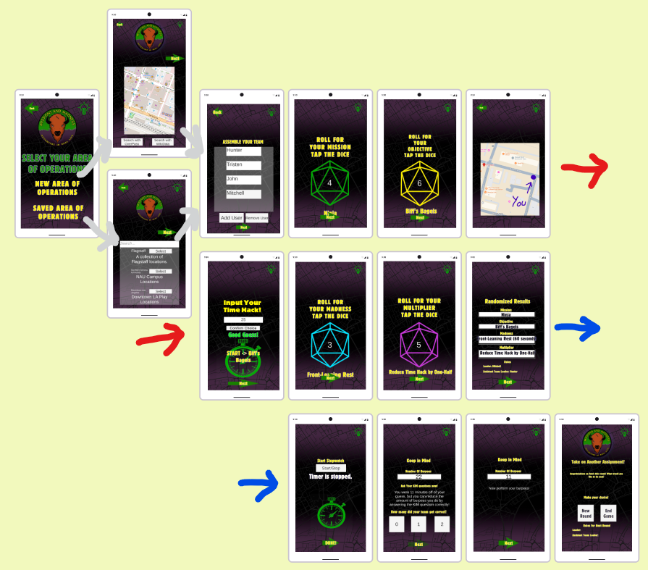
Atlas Systems
SOFTWARE DESIGN OVERVIEW
2026 / March
Major 3 Components
Unity
Scenes
Prefabs
Android && Apple
POI Databases
Overpass Turbo
Additions
Wikidata
Mapping Databases
GeoApify

Slide 6
Atlas Systems
Testing Plan
Internal Testing
Revision
Closed Beta
Revision
Handoff
2026 / March
We will give copies of the app to our close friends and family members to provide feedback
We will build on the feedback and improve the app. Testing will likely highlight unintuitive UI issues.
We will organize a real test run of the game with the client and real users to stress test it in the real world
We will further revise the app based on any and all feedback we receive to prepare the app for final handoff
We will hand the codebase and app over to the client in late April or early May just before graduation.
Notes:
Here’s our testing plan moving forward. We’ll start with internal testing by sharing early builds with friends and family to quickly surface usability issues. Based on that feedback, we’ll revise and improve the UI and overall experience. Next, we’ll move into a closed beta with real users and our client to test how the app performs in real-world conditions. After that, we’ll do a final round of revisions based on all feedback, and then hand off the completed codebase and app to the client in late April or early May.

Slide 7





DEMONSTRATION
2026 / March
Click Here for a Cool new Demo!
Notes:
Practice a Shorter Demo

Slide 8



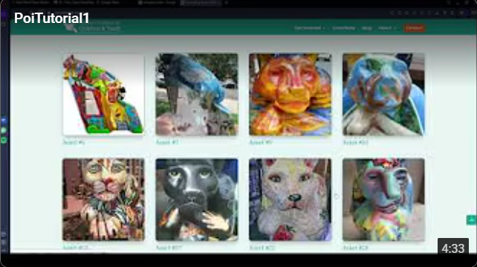
Atlas Systems
CHALLENGES AND RESOLUTIONS
Potential challenge
How we will/did respond
User Understanding
We are inbetween Audio, Textual, and pop-up tutorials, once a decision has been made, we can implement them.
1
The Git LFS Bug
We were able to rewrite the Repo Commit history & Ignore to stop this.
2
2026 / March
POI Database API Limitations
We can respond by setting the code to cancel if it hangs and re-search, with a loading icon to be responsive
3
Limited POI Points
We have added more Art and History POIs as well as a tutorial!
4

Slide 9
Atlas Systems
FUTURE PLANS
1
2
3
4
2026 / March
A quick preview of our plans
Continued UI Refinements
Additional Features
Closed Beta Testing
Product Delivery
We will continue to work through any bugs and issues with the UI and incorporate feedback from users.
We will add additional features to make our product stand out. We will add any feature requested by the client to the best of our ability.
In the coming months we hope to perform closed beta testing, in the real world with real users and collect feedback to help us refine the application
We are on track to deliver a high quality product to our client in early May 2026, with possible releases to the Apple AppStore and Google PlayStore
Notes:
Looking ahead, our focus is on four key areas. First, we’ll continue refining the UI by fixing bugs and improving usability based on user feedback. Second, we plan to add additional features, especially anything requested by the client that enhances the product. Third, we’ll conduct closed beta testing with real users to validate performance and gather insights. Finally, we’re targeting product delivery in early May 2026, with potential releases on the Apple App Store and Google Play Store.

Slide 10
Atlas Systems
CONCLUSION
Increased Accessibility
Access Anywhere
Easy to Play
2026 / March
Mobile Application
Uses your location
Flow of the game is quick and easy
Deployment to multiple OS
Gives locations around you
UI is helpful and easy to follow
Notes:
In conclusion the importance of what Atlas Systems is doing for Missions and Madness is 1. Creating a community, 2. Allowing people to explore new places while also building team bonding skills and 3. Being able to do all this in one application. With the new updates Missions and Madness will be accessible to anyone with a mobile device, people can play whenever they have service and the application allows users to play the game whether they are a new user or constant enthusiast. Atlas Systems is taking Missions and Madness to the next level.

Slide 11
THANK YOU
Mission and Madness Application coming soon(er)
Notes:
Thank you for your time. Does anyone have any questions?

