Slide 1
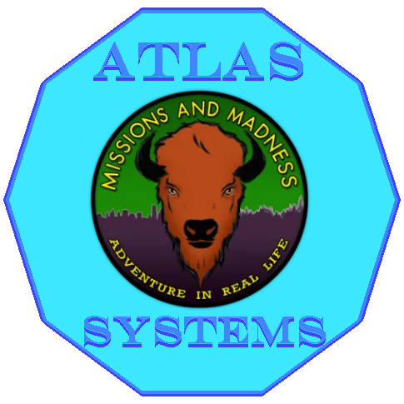
Missions and Madness
Atlas Systems
2026 / February

Slide 2





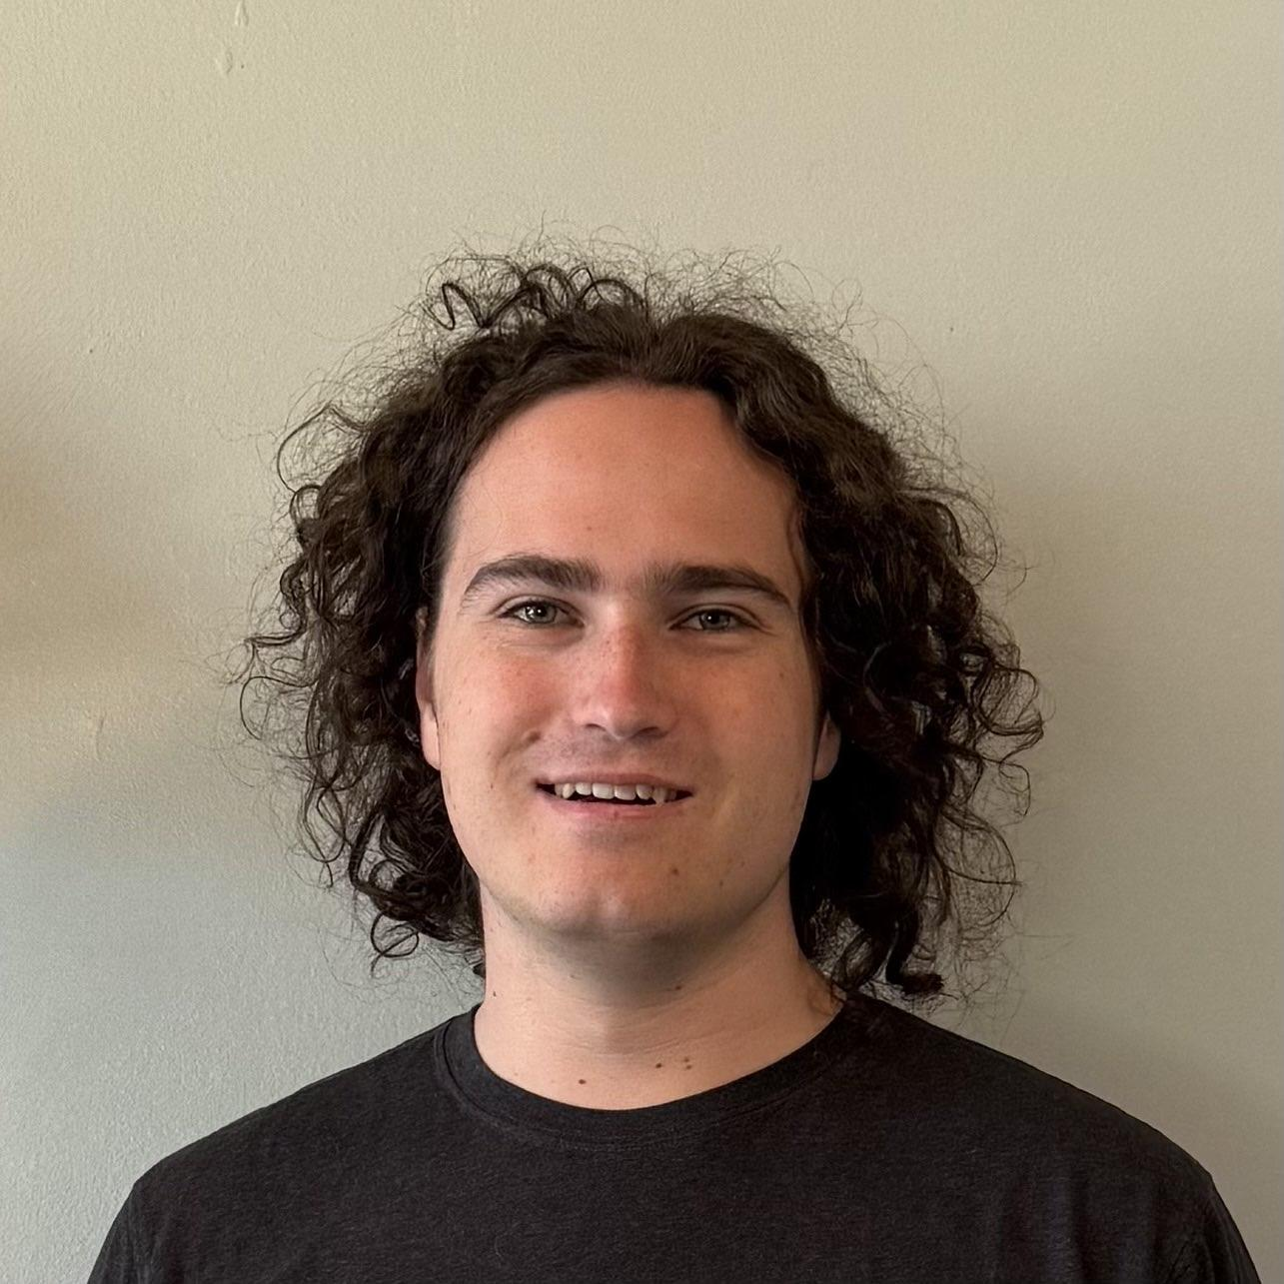
Atlas Systems
2026 / February
Meet the team
John Zeledon
Team Lead, Coder
Mitchell Morris
Recorder, Coder
Morgan Boatman
Client
Ogonna Eli
Mentor
Hunter Beach
Architect, Coder
Tristen Calder
Release Manager, Coder

Slide 3
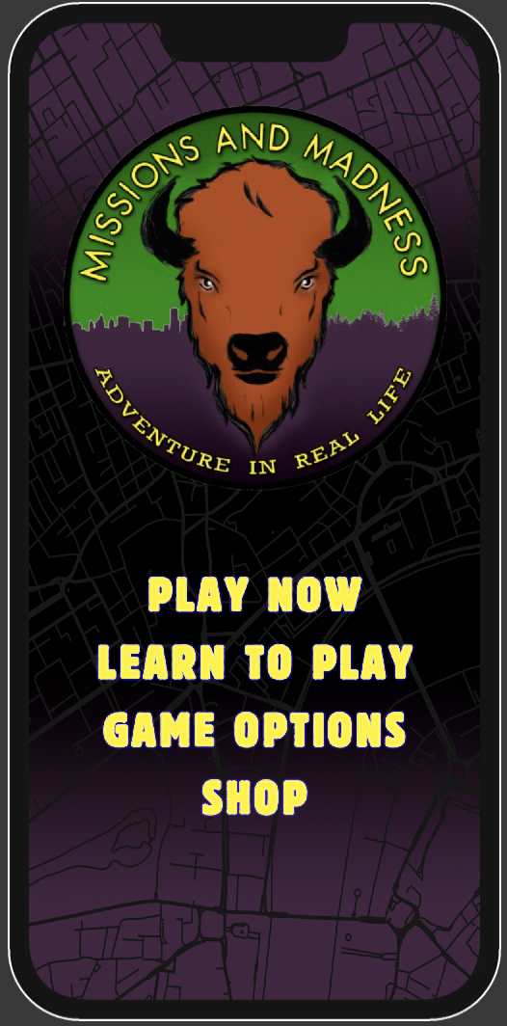
Atlas Systems
CLIENTS NEEDS
2026/February
Live GPS of User
Live location
Visual on map
Automated Points Of Interest (POI)
Take users location
Give locations
Point them on same map
Easy to Follow User Interface (UI)
Better wording
Visually better
Easy flow
Notes:
Missions and Madness is an exploration and adventure game that builds team bonding as well as improves the teams spatial awareness. Our client Morgan has 3 big needs from our team. The very first things is that he wants a live gps of the user locations. This is so we can get their location and put this on a map for visual help. From there Morgan would like to use the user’s location to put certain points around the users location on the same map as the user. The last big thing that Morgan wanted is an easier to follow UI which will give the user a better experience and this would include an easier flow of the game, visually appealing buttons and pages, and the words on the pages help the user flow through the application.

Slide 4
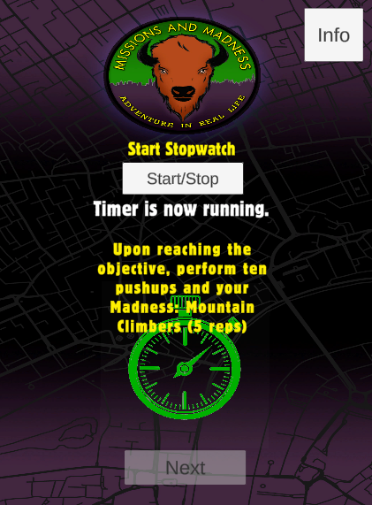
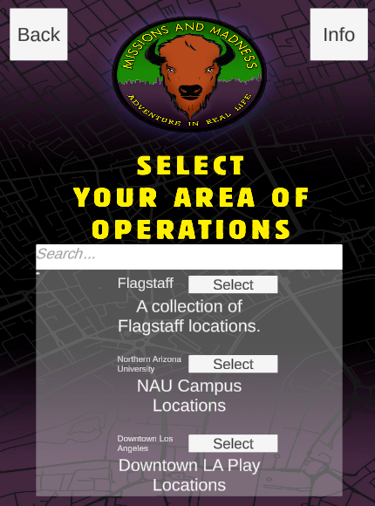
Atlas Systems
PROBLEM STATEMENT AND SOLUTION
2026 / February
Next Improvements
Clear tutorials for onboarding
Simplified navigation flow
Continued UI clarity and polish
End Users
Casual mobile players exploring their city
Students, community groups, wellness participants
New players needing simple onboarding
Targeted Audience
Ages 16-50 mobile users
Fans of location-based or social games
People interested in outdoor exploration & community events
What's Working
Live GPS map working on real devices
POI databases returning nearby locations
Core mission flow functional
Scalable UI framework in place
Notes:
Our end users are casual mobile players, students, and community groups who want to explore their surroundings.
Our target audience is people interested in location-based games, outdoor activity, and collaborative experiences.
What’s working so far is our live GPS tracking, POI integration, mission flow, and scalable UI framework.
Moving forward, we’re focusing on tutorials, clearer navigation, and continued UI polish to improve usability.

Slide 5
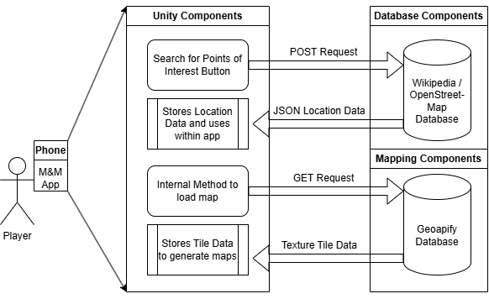
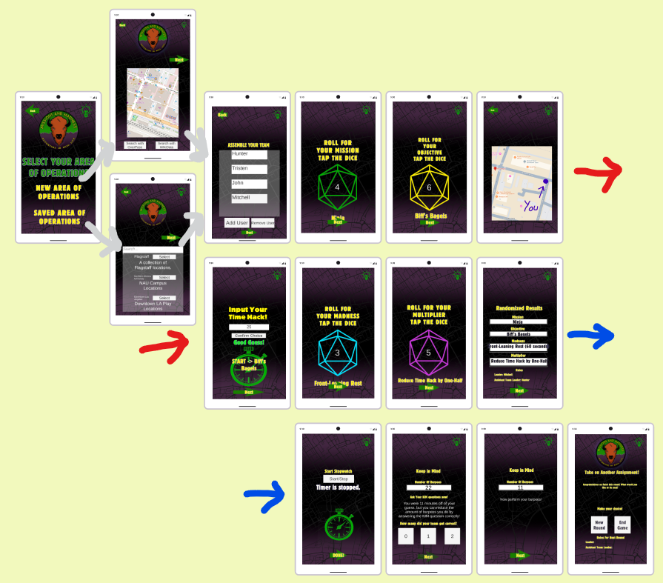
Atlas Systems
SOFTWARE DESIGN OVERVIEW
Major 3 Components
Unity
  Scenes
  Prefabs
  Android && Apple
POI Databases
  Overpass Turbo
    Additions
  Wikidata
Mapping Databases
  GeoApify

Slide 6



DEMONSTRATION
Click Here for a Cool new Demo!
Notes:
Practice a Shorter Demo

Slide 7
Atlas Systems
CHALLENGES AND RESOLUTIONS
Potential challenge
How we’ll respond
POI Database API Limitations
Since the databases we use are public, many people all over the world are hitting the API at the same time, requests have around a 20% chance to hang and drop – We can respond by setting the code to cancel if it hangs and re-search, with a loading icon to be responsive
1
Limited POI Points
Currently, public POIs are somewhat just restaurants and buildings – to respond to this we can ADD to these public databases and teach our users how to as well.
2
2026/ February

Slide 8
Atlas Systems
FUTURE PLANS
1
2
3
4
2026 / February
A quick preview of our plans
Continued UI Refinements
Additional Features
Closed Beta Testing
Product Delivery
We will continue to refine the user interface of the application to ensure a professional looking, easy to use product for the client and the consumers
We will add additional features to make our product stand out. Possible features include game difficulty modes and multiplayer
In the coming months we hope to perform closed beta testing, in the real world with real users and collect feedback to help us refine the application
We are on track to deliver a high quality product to our client in early May 2026, with possible releases to the Apple AppStore and Google PlayStore
Notes:
Looking ahead, our focus is on four key areas. First, continued UI refinements. We want the app to feel polished, intuitive, and production-ready. Second, we’ll likely expand functionality with additional features such as adjustable difficulty and multiplayer to increase engagement and replay value, time permitting.
Third, we plan to conduct closed beta testing with real users to gather feedback and validate our design decisions in real world conditions. Finally, we’re on track for product delivery in early May 2026, with possible releases to both the Apple App Store and Google Play

Slide 9
Atlas Systems
CONCLUSION
Increased Accessibility
Access Anywhere
Easy to Play
2026/February
Mobile Application
Uses your location
Flow of the game is quick and easy
Deployment to multiple OS
Gives locations around you
UI is helpful and easy to follow
Notes:
To conclude with this project we are making Missions and Madness available to everyone that has a mobile device. With the application it will be able to deploy to different devices like Apple and Samsung. Not only that but this application will be able to use anywhere because we are using the user’s location to give them locations around them which will make communities and cities easier to explore and learn about. This application with the new updates will be easier to follow and understand how to complete a Mission and won’t cause any confusion. With all of the new updates our team is providing Missions and Madness can give people the opportunity to easily explore cities with the ability to also build team bonding skills, and increase social awareness by having fun in new cities.

Slide 10
THANK YOU
Mission and Madness Application coming soon

