Slide 1
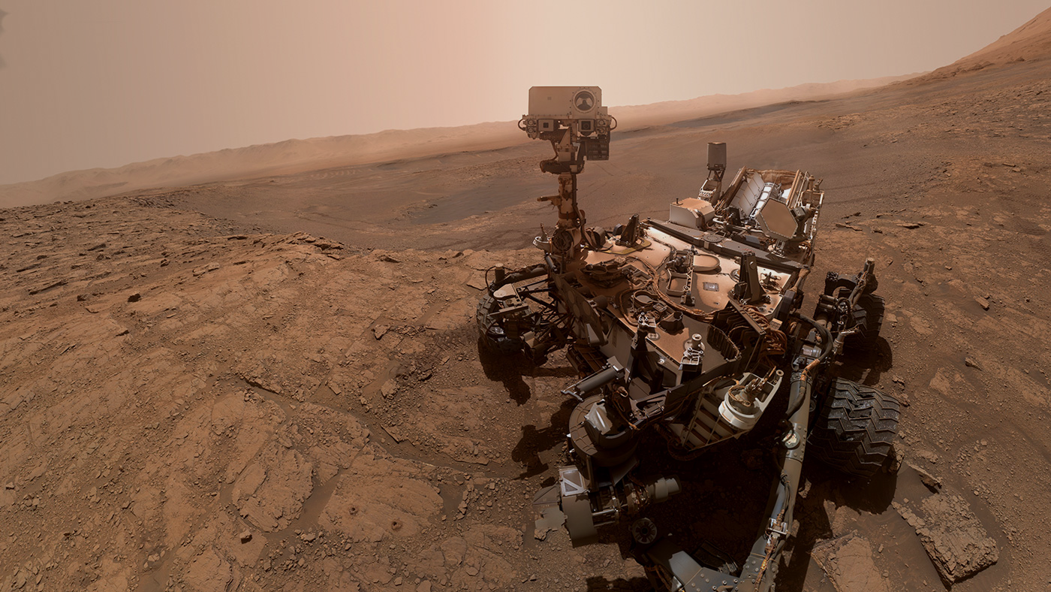




ArtemiS3
An intelligent search tool for AWS S3 buckets.
Sponsored by: USGS Astrogeology Science Center
1
Notes:
Introduction
This open-source project is sponsored by the USGS Astrogeology Science Center here in Flagstaff

Slide 2


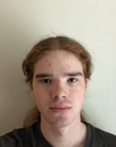



Jeffrey Hoelzel Jr
Architect
jmh2338@nau.edu
Joseph Laity
Team Lead
jbl265@nau.edu
Samuel Bodenheimer
Release Manager
swb79@nau.edu
Travian Lenox
Software Lead
tjl379@nau.edu
Md Nazmul Hossain
Capstone Mentor
Trent Hare
Client
2
Notes:
Introduction
List-off names and roles of each team member
Working with our client, Trent Hare, and NASA to make their S3 buckets searchable

Slide 3
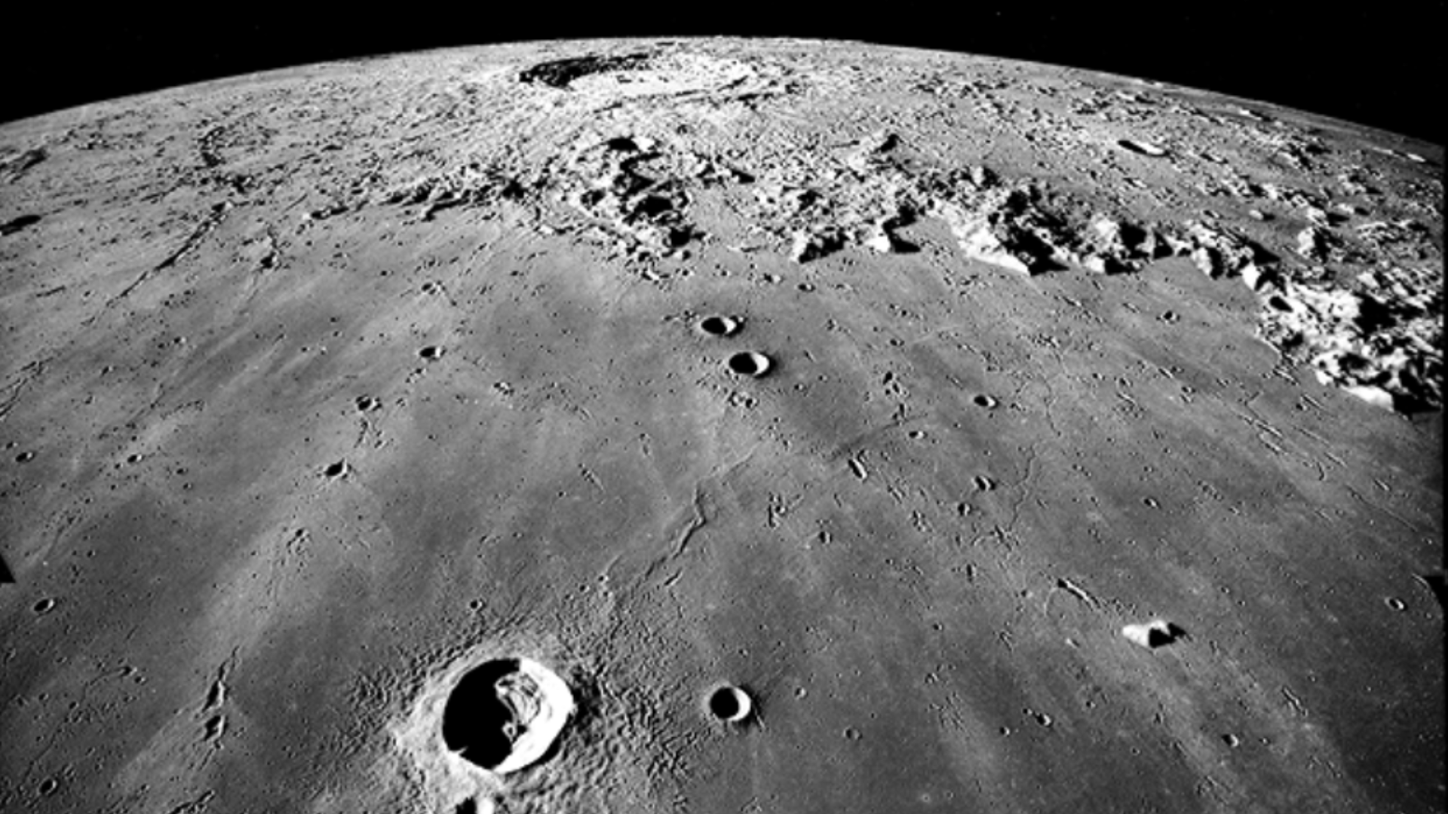
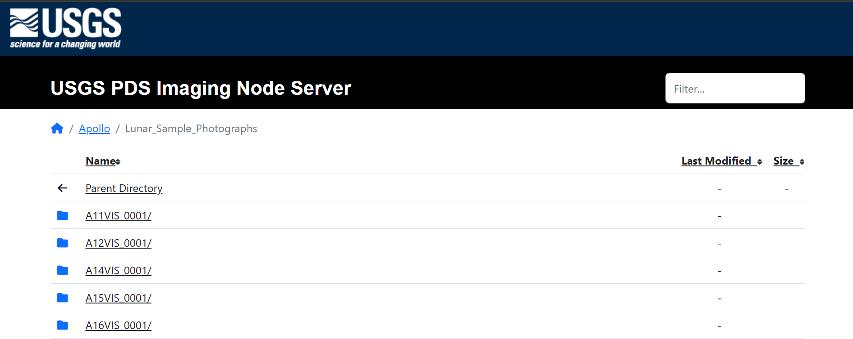
NASA’s Data is Growing Faster than Scientists Can Navigate It
3
Notes:
NASA and the USGS release TBs of mission data
Datasets power scientific discoveries worldwide
Problem:
Accessing this data means digging through massive AWS S3 buckets
Clicking folder by folder with no search bar,
no indexing,
and no efficient method to find data
forcing researchers to waste hours locating mission data

Slide 4
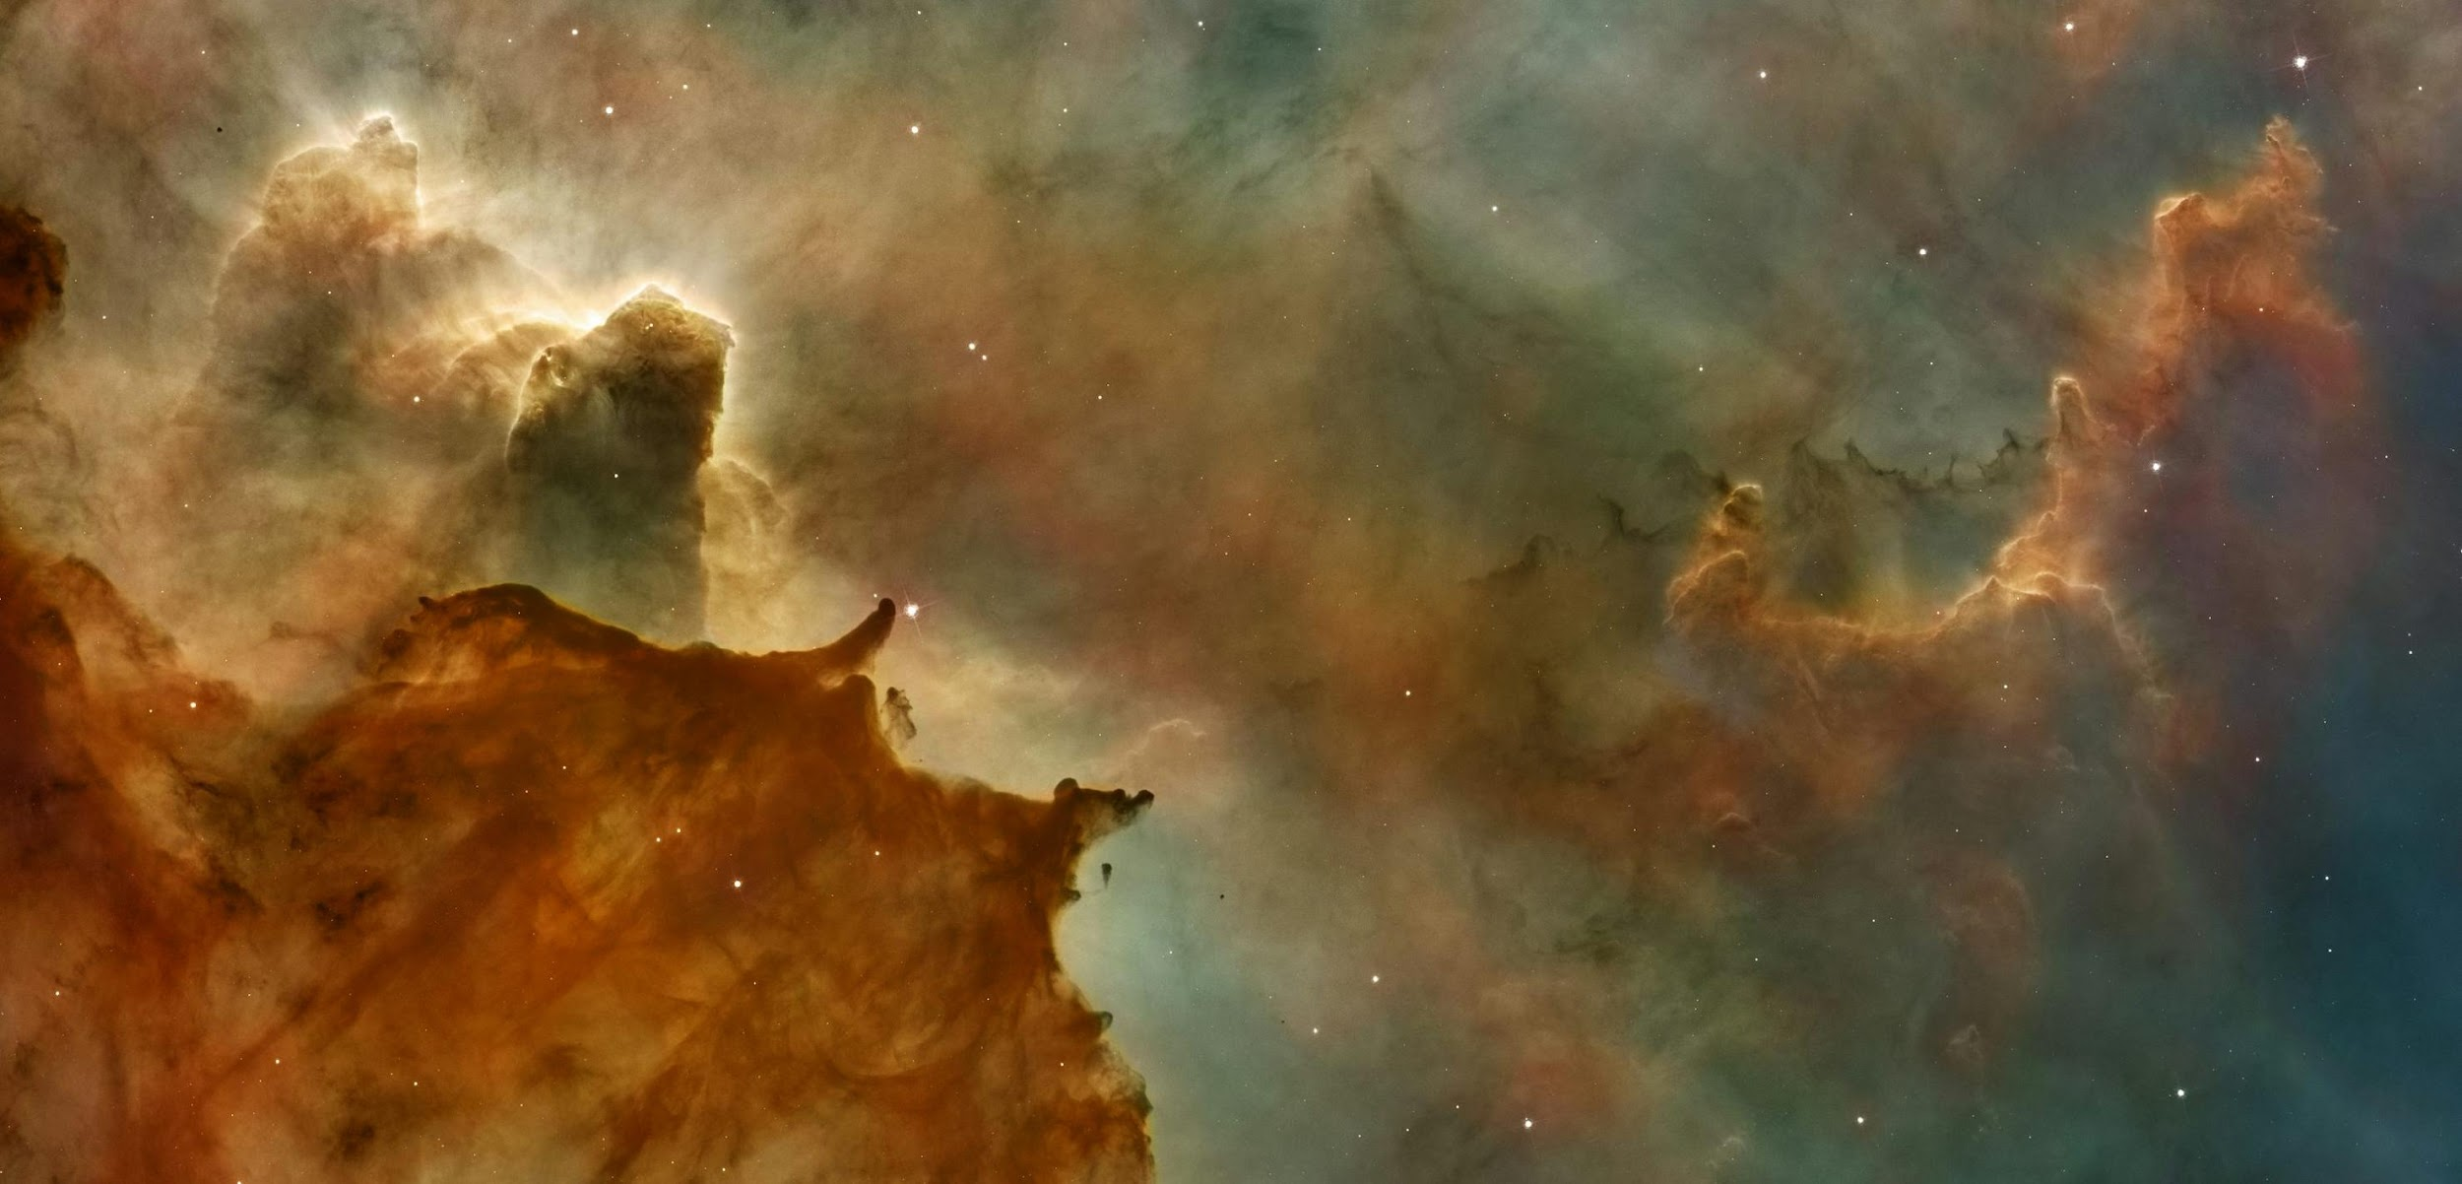

Slow Data Access = Slow Science
Thousands of objects per bucket.
Slows down research, delays publications.
No full-text or metadata search.
And creates friction for scientists, students, and NASA teams.
4
Notes:
Imagine trying to understand Mars geology,
But spending more time hunting for the right image file than analyzing it
With thousands of objects per bucket and inconsistent metadata, important information gets buried
This slows down research,
delays publications,
and creates unnecessary barriers for the global scientific community relying on NASA data

Slide 5

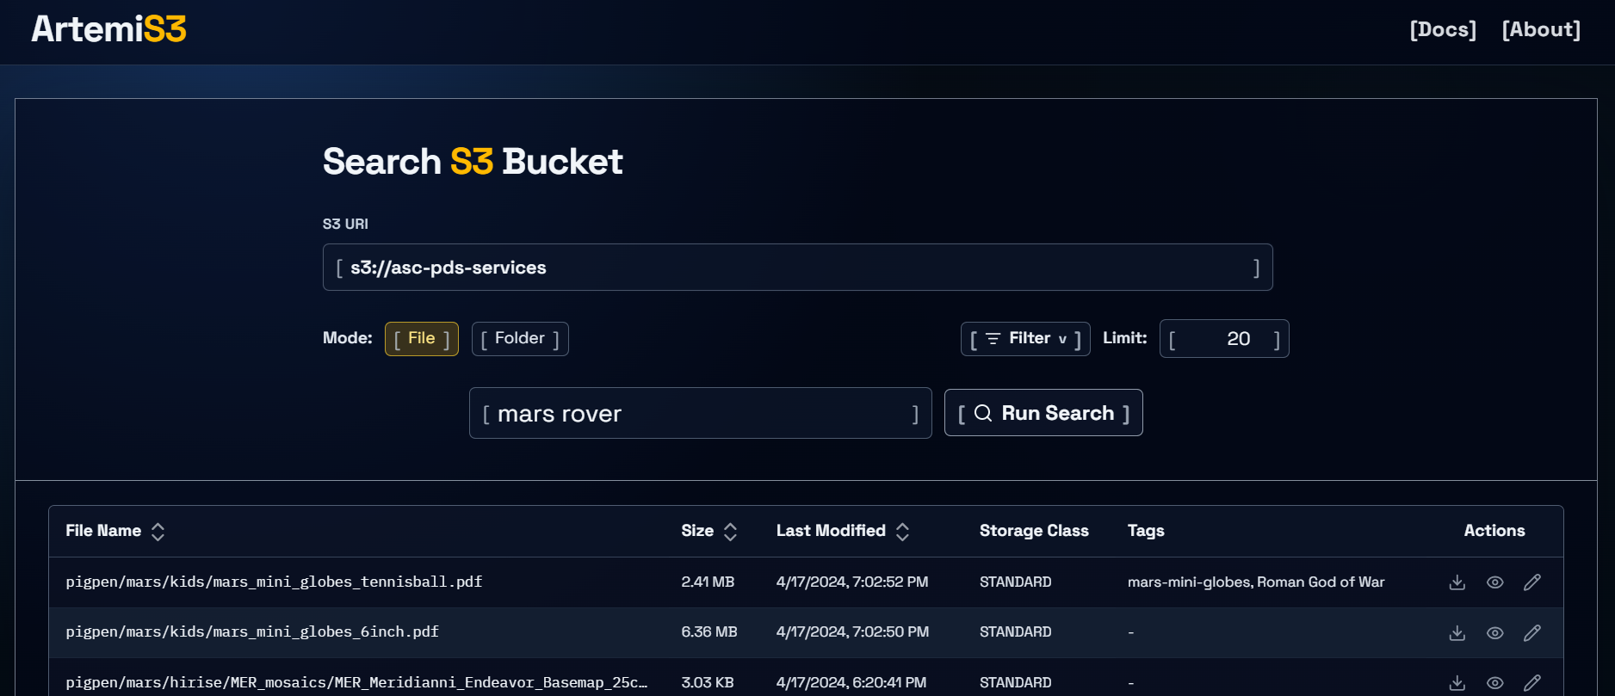
Index. Search. Visualize. Discover.
Full-text and metadata search.
Instant filtering by type, size, and date.
File previews + metadata insights.
User tagging and collaboration.
5
Notes:
That’s why we’re building ArtemiS3:
an intelligent search platform purpose-built for AWS S3 buckets.
ArtemiS3 indexes public S3 buckets, extracts metadata automatically, and gives researchers an intuitive dashboard to
search,
filter,
preview,
and tag mission files instantly
Hand-off to Sam to discuss architecture

Slide 6
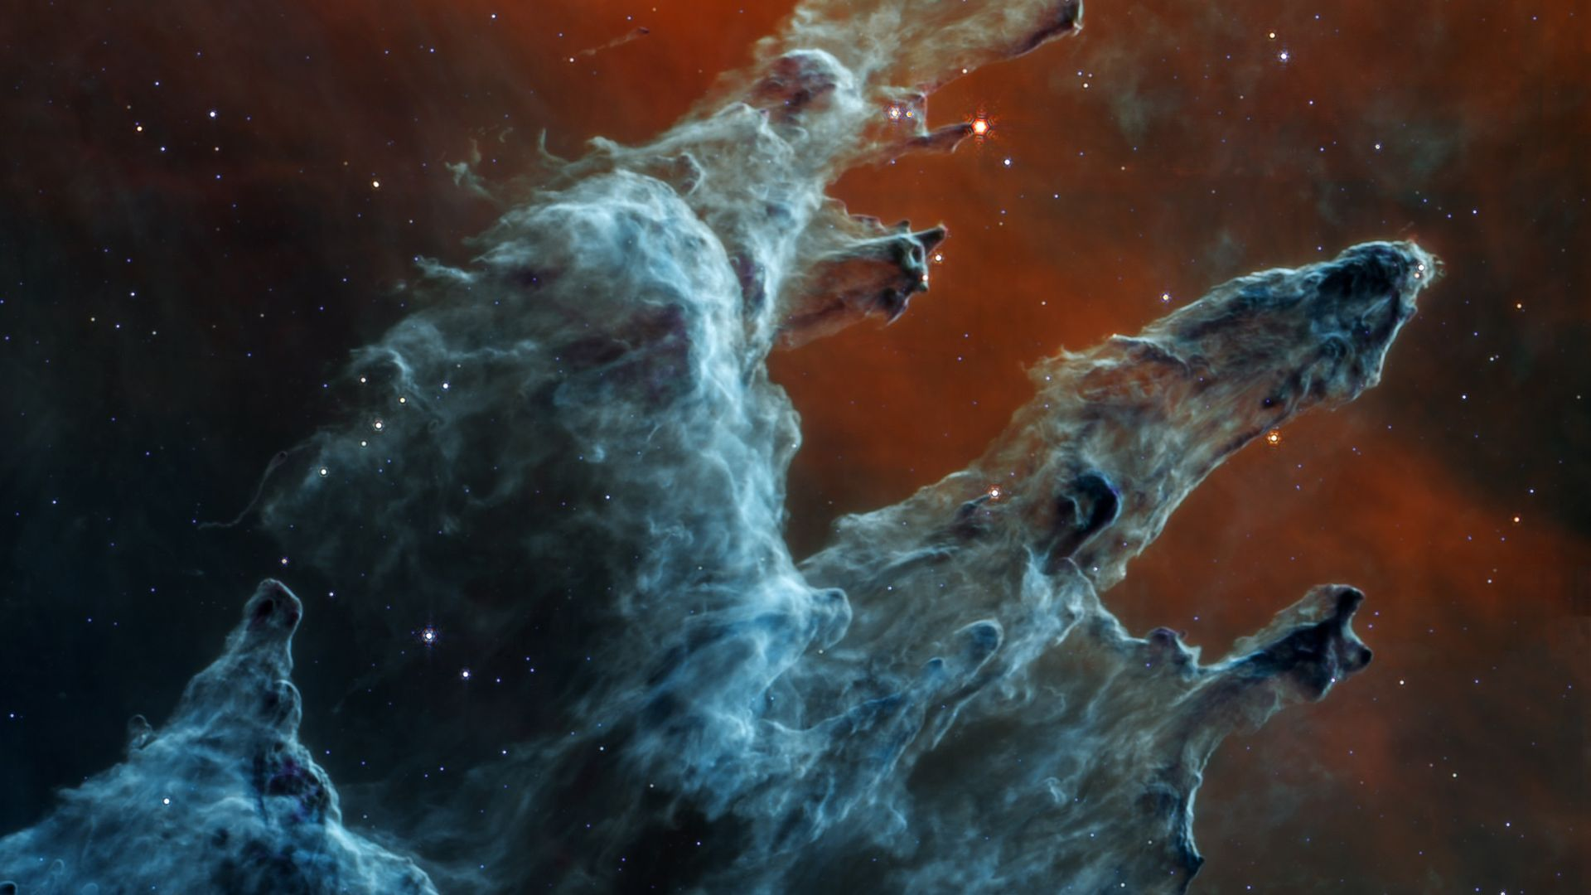
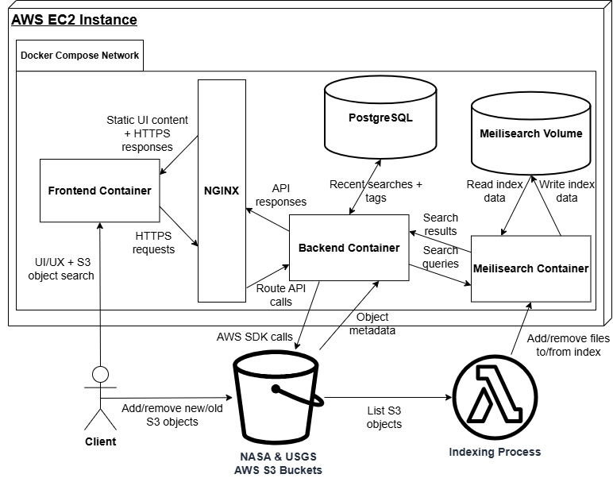
Modern, Fast, and Fully Open-Source
6
Notes:
ArtemiS3 delivers fast
full-text and metadata search,
collaborative tagging,
and previews
All packaged into a clean, lightweight interface designed for performance and accessibility.
This is made possible using a modern stack of tools such as FastAPI, Meilisearch, Svelte, PostgreSQL, and Boto3
The frontend user interface is made with Svelte and Tailwindcss making it fast, stylish, and lightweight
This is where the user can:
Enter search queries
Apply filters
As well as Sort, preview, and download results
It interfaces with the backend API through an NGINX reverse proxy for security and load balancing
The backend is implemented with FastAPI, making it responsive and reliable
It interfaces directly with Amazon S3 through Boto3, allowing easy access to the stored data
Our search engine of choice, Meilisearch, is locally hosted on a docker container and interfaces directly with the backend for lightning fast full-text search
It’s indexing process is hosted using AWS Lambda, allowing the index to be automatically refreshed upon changes to the tracked S3 buckets
Additional data such as file tags are stored on postgres
Lastly the entire system is dockerized to ensure system independence and redeployability
When combined, these systems work together to make ArtemiS3 a comprehensive solution that accelerates and enhances the user experience with data access

Slide 7

Testing & Quality Assurance
Testing for verification of:
  Core-logic
  Interservice contracts
  User workflows
Unit Testing: with Svelte’s testing library and Pytest
  Python functions, TypeScript utilities, and Svelte components
Integration Testing: using Postman in a testing environment
  frontend ↔ backend communication
Usability testing: USGS researcher surveys
  Ensuring UI is intuitive
7
Notes:
In order to provide quality assurance, we use a layered testing approach including
unit, integration, and usability testing
Which verifies the correctness of the
core logic
interservice contracts
and user workflows
We complete unit tests with Svelte’s testing library and pytest to ensure that the
Python functions
Typescript utilities
And svelte components
Behave correctly and provide the expected results.
We complete integration tests with Postman in an isolated testing environment to ensure that interservice communication is correct and services are upholding their contracts.
Additionally, we complete usability testing by having real USGS researchers test ArtemiS3 and provide feedback.
Our unit and integration tests are core aspects of our development cycle to verify the quality of every change.
Lastly, we make sure to consider every single piece of user feedback so we can improve the application as much as possible.
Next, let’s get into alpha demo 2.

Slide 8

Notes:
Here’s a quick little demo video on the changes we’ve made since Alpha Demo 1.
Our first major change was a complete UI overhaul. We moved from a light theme to a dark theme and updated several input fields to feel more modern.
Next is an enhancement to our filtering system. We added the ability to include custom file types not available by default, as well as an adjustment to size constraints that is a bit more intuitive than the last system. To top off the filtering, we added the ability to save filters. As you can see, applying the same filters is now as simple as opening 'Saved Filters' and clicking on the one I just created.
Our client recently gave us feedback on the previewing system and asked us to implement XML, LBL, and LAB file previews. Because of their similarities to text files, when we added previewability for those requested types, we also added it to text and ascii files
Another change we made is file tagging. Tagging creates cross-type file clusters, letting you group related files together even if the naming conventions or file types don't allow for an easy filter. This allows them to appear in the same search result, making it easier to pull up every piece of a connected dataset regardless of the file format.
Lastly, we added a completely unique view to Artemis. Folder View allows you to traverse the S3 bucket as if it were the file explorer on your own Mac or Windows computer. This view is especially useful when someone knows the specific location of the file they need, but perhaps not the exact file name.
That concludes our demonstration.

Slide 9
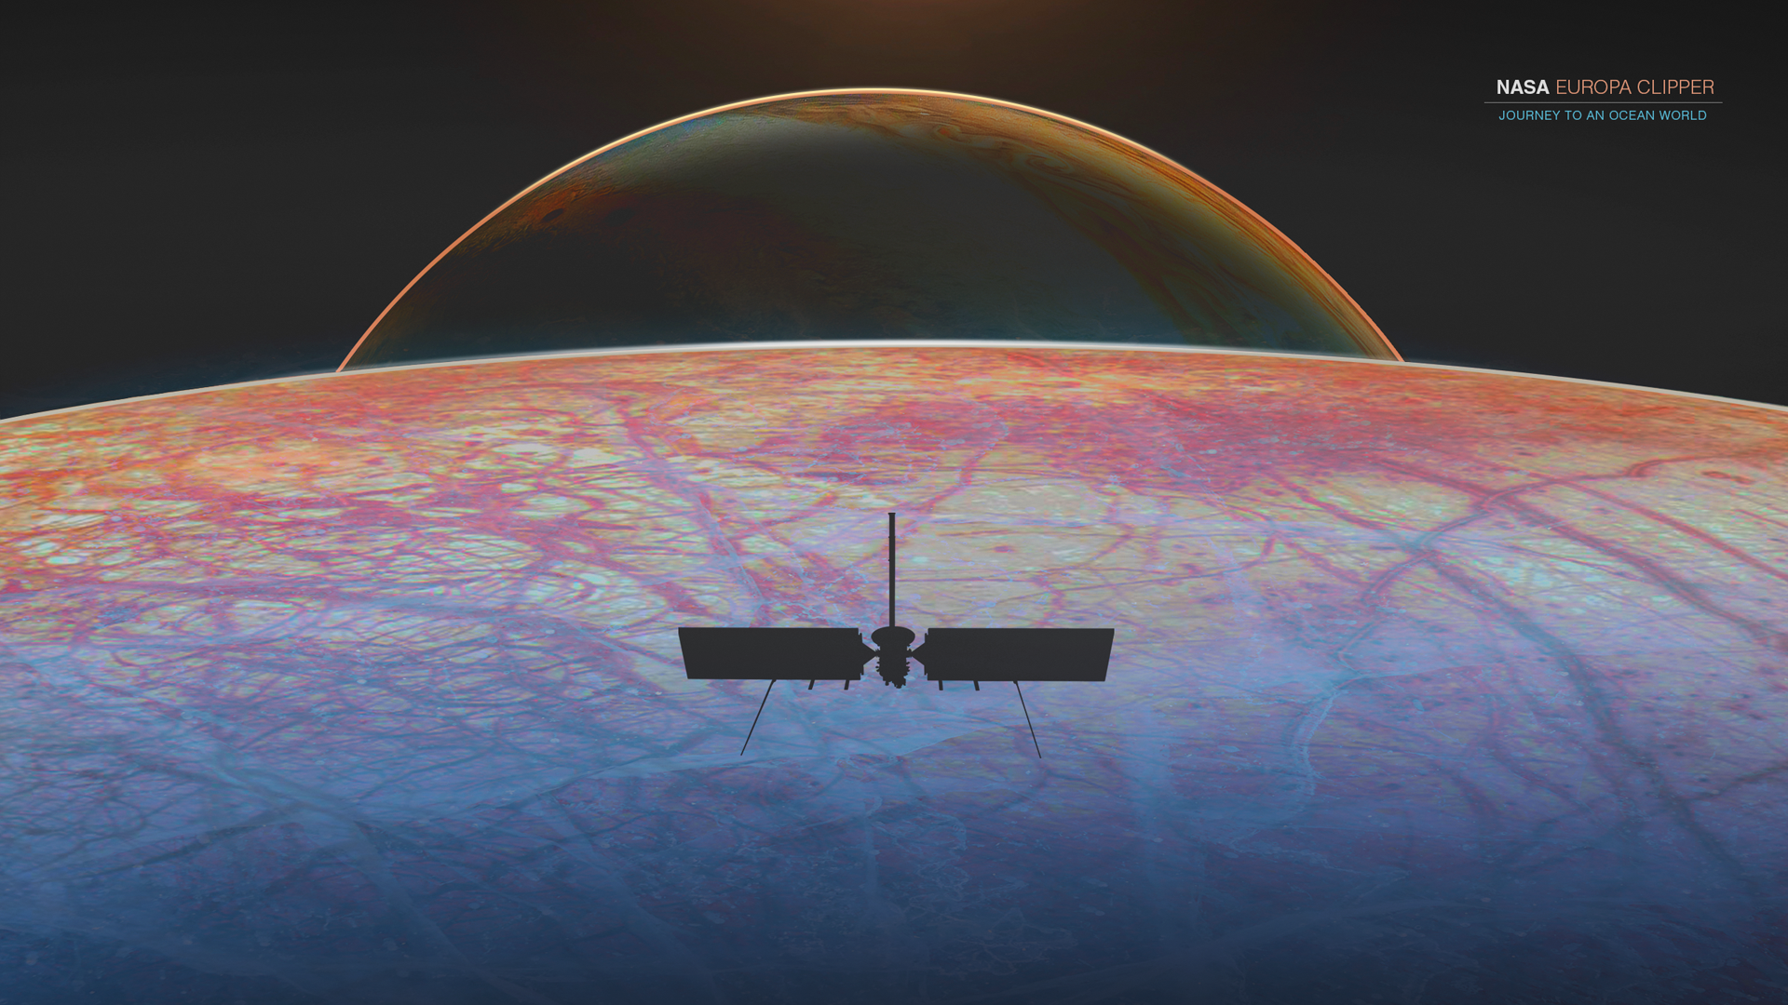
Challenges & Resolutions
Creating clean and visually appealing UI
  Simple list layout of search results
  Limited the color palette
Ensuring the application worked reliably through testing
  Catch edge cases
  Created repeatable test cases for core features
  Fixed bugs when found
9
Notes:
One of the challenges we faced during was with the UI
We wanted it to be clean and visually appealing
We accomplished this by going with a simple list layout for search results so it’s easy to read and navigate
We also limited the color palette to keep everything consistent and not overwhelming for the user
Another challenge we faced was testing
Our focus was making sure the application worked reliably and that we caught any edge cases
We created repeatable test cases for all of our core features which helped consistently verify functionality.
One thing we started doing early on in development was fixing bugs as soon as we found them to avoid bigger issues later.

Slide 10
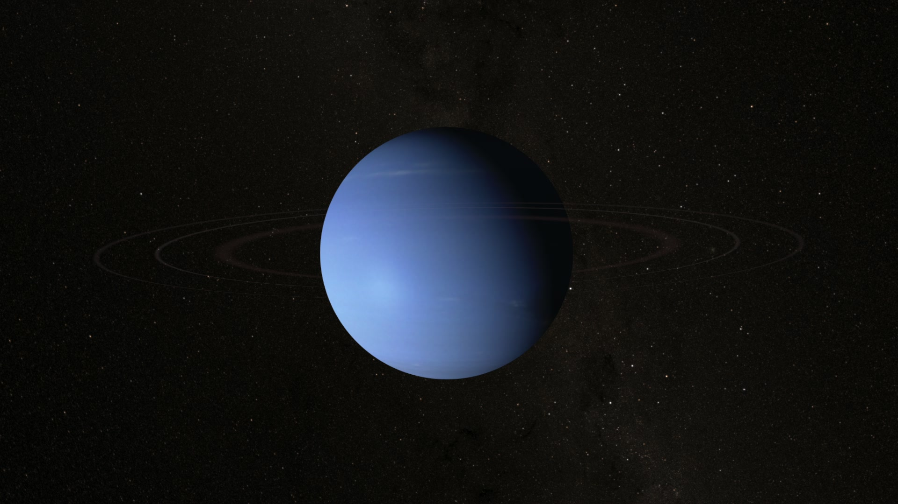
Current Schedule
ArtemiS3's core functionality is fully operational
  Search, sort, filter, and indexing
  Confirmed with testing
Frontend is polished
Next Phase:
Implement any optional features in a order of priority
10
Notes:
Right now, ArtemiS3’s core functionality is fully operational
Search, sorting, filtering, and indexing are all working end-to-end and functionality is confirmed through testing
Moving into the next phase our focus is on implementing optional features.
These are enhancements that aren’t required for core functionality but will improve usability and overall experience.

Slide 11
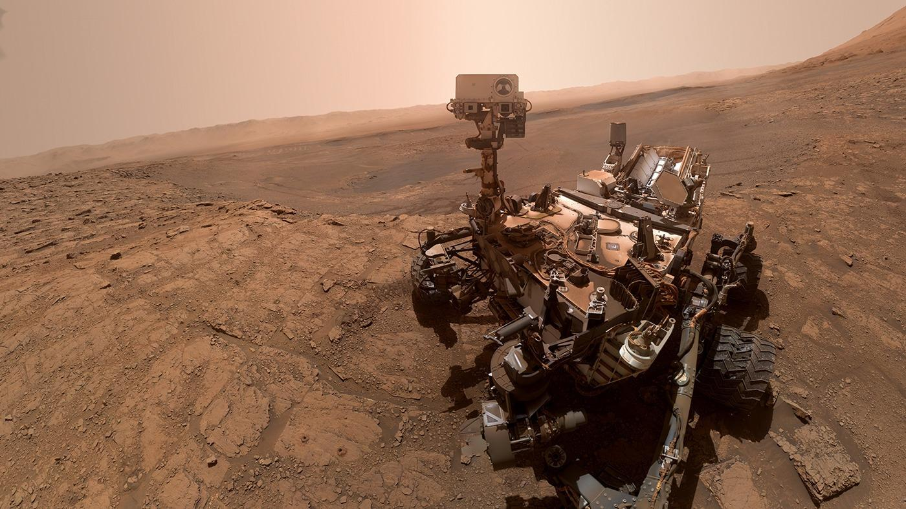




Jeffrey Hoelzel Jr
Architect
jmh2338@nau.edu
Joseph Laity
Team Lead
jbl265@nau.edu
Samuel Bodenheimer
Release Manager
swb79@nau.edu
Travian Lenox
Software Lead
tjl379@nau.edu
Thank you
ArtemiS3
*This presentation includes publicly accessible content provided by NASA and the United States Geological Survey (USGS). All such materials are used in accordance with their public use guidelines.
Notes:
ArtemiS3 reimagines S3 storage as a fast and intelligent search platform for mission data.
With the core system complete and a polished UI, we’re moving into final improvements and deployment.
The result is a scalable solution built to deliver long-term impact.
Thank you!

