Slide 1

GeoKings Intro
By: Andrew Usvat, Zack Bryant, Alex Poole, John Cardeccia, Jackson Brittain

Slide 2
Introduction
How do we analyze digital data nowadays?
What is spatial data?
An advantage of spatial data is…
How is the USGS contributing to this matter?

Slide 3




Our Client
Dr. Jay Laura
United States Geological Survey
Amy Stamile
Trent Hare
https://www.usgs.gov/

Slide 4
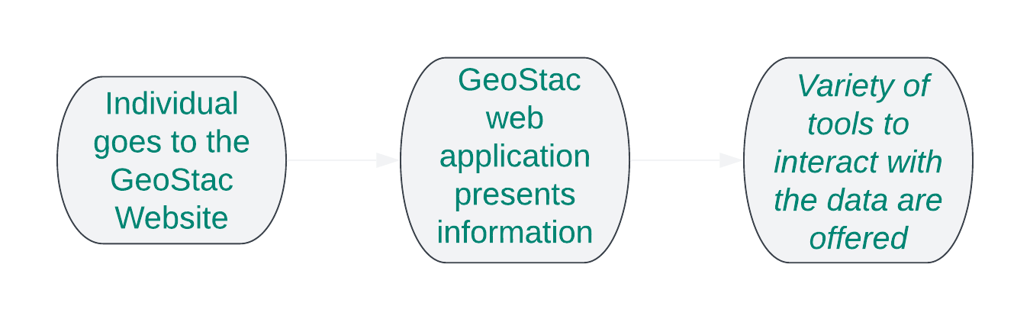
How USGS Operates

Slide 5
CartoCosmo GeoSTAC
Current Status
Only supports Raster Data
Simple searches with only a few parameters
Minimal visualizations basic leaflet styling
Project Goal
Add support for vector data
Update searching to be more specific and interactive
Updated styling and add visualizations on web map to support vector data

Slide 6
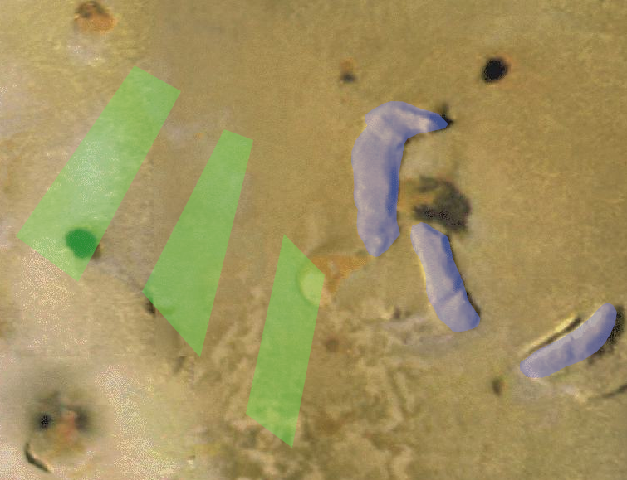
Plan for development
Requirements acquisition/refinement
Weekly meeting with client’s to discuss requirements
Review design choices with client
Technical Investigation
Rendering visualization of the vector data to the map
Ability to search and download data of spatial data from maps
Ability to stylize the vector features
Vector data bering visually represented with polygons on a map

Slide 7
Closing
The value of GeoSTAC: Easy access to raster map data
The value that this project will add: Vector data, UI enhancements
Challenges will be in the detail: Accessible styling rules for the vector data
Anticipated Result: Increased research value and accessibility

