Slide 1

Project Clarity
Design Review #3
Hannah Trenary, Mya Davis, Kelene Moore, Nick Botticelli, and Luke Frazer

Slide 2
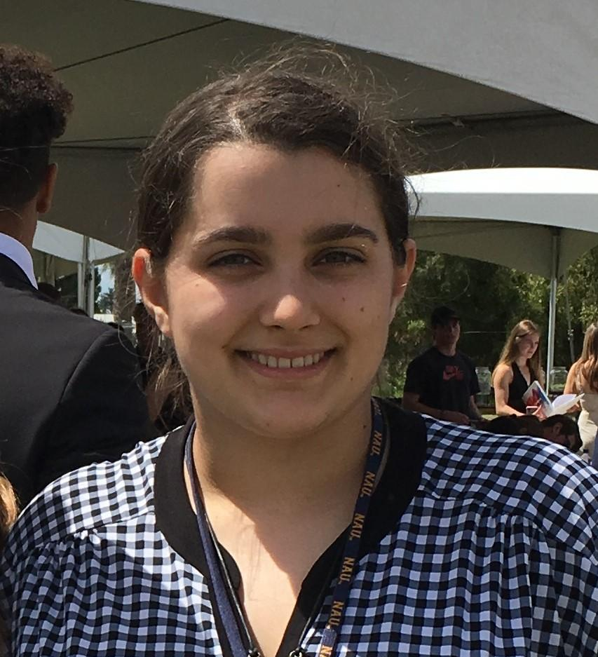
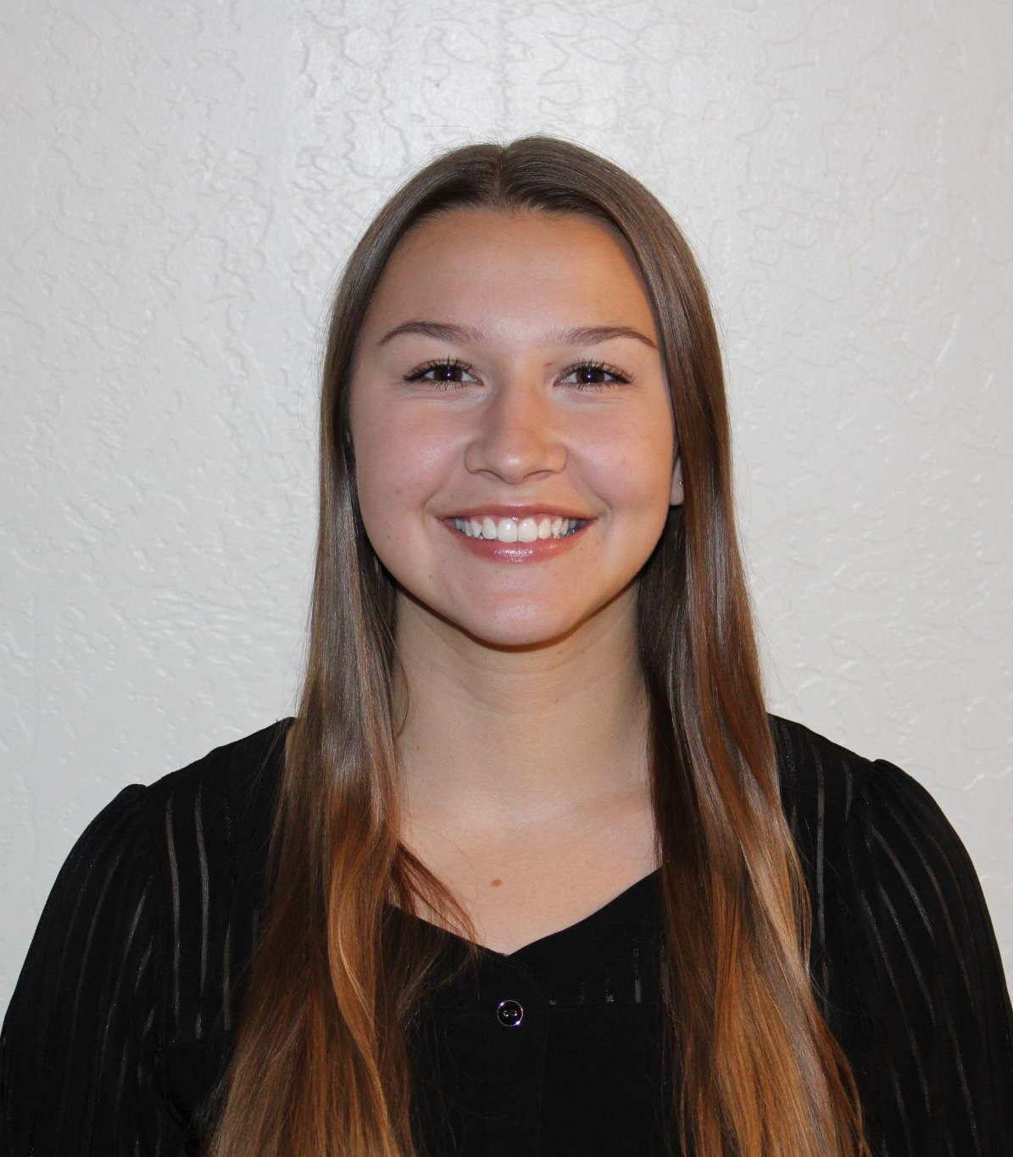
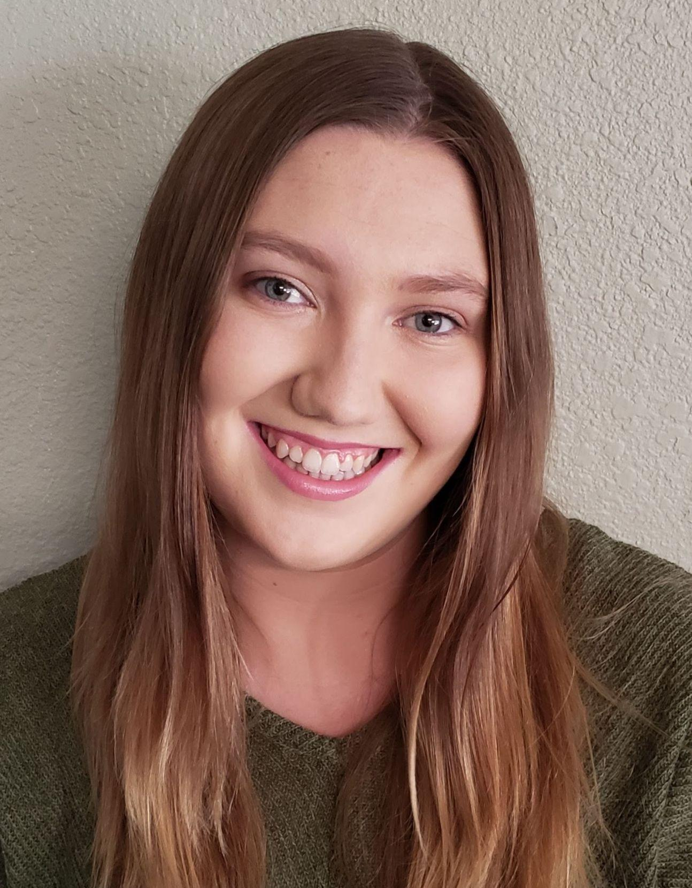
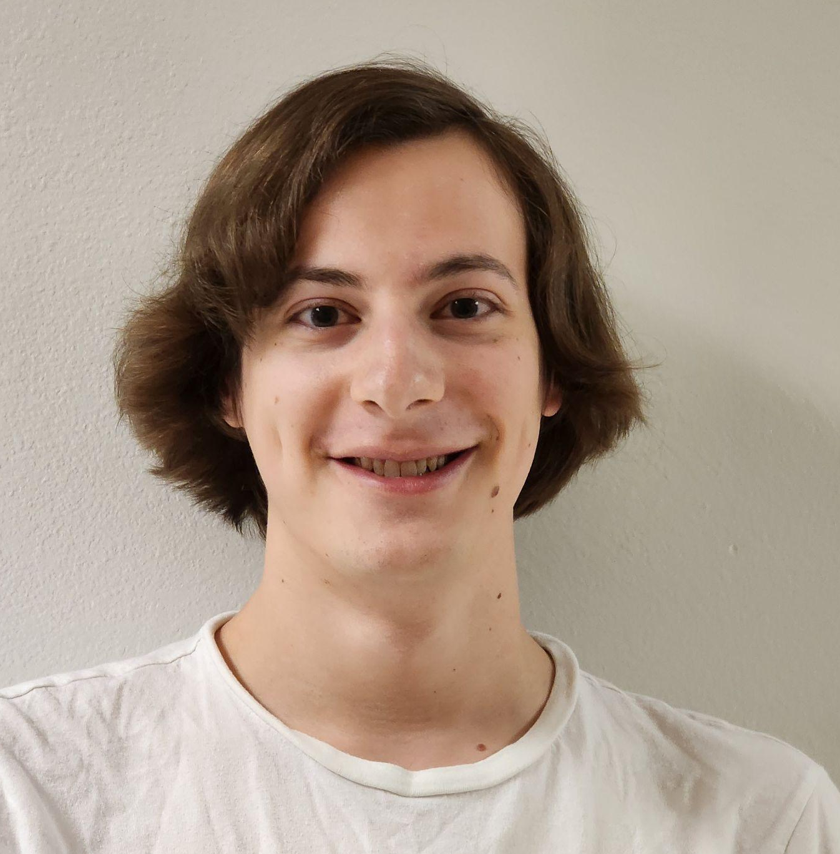
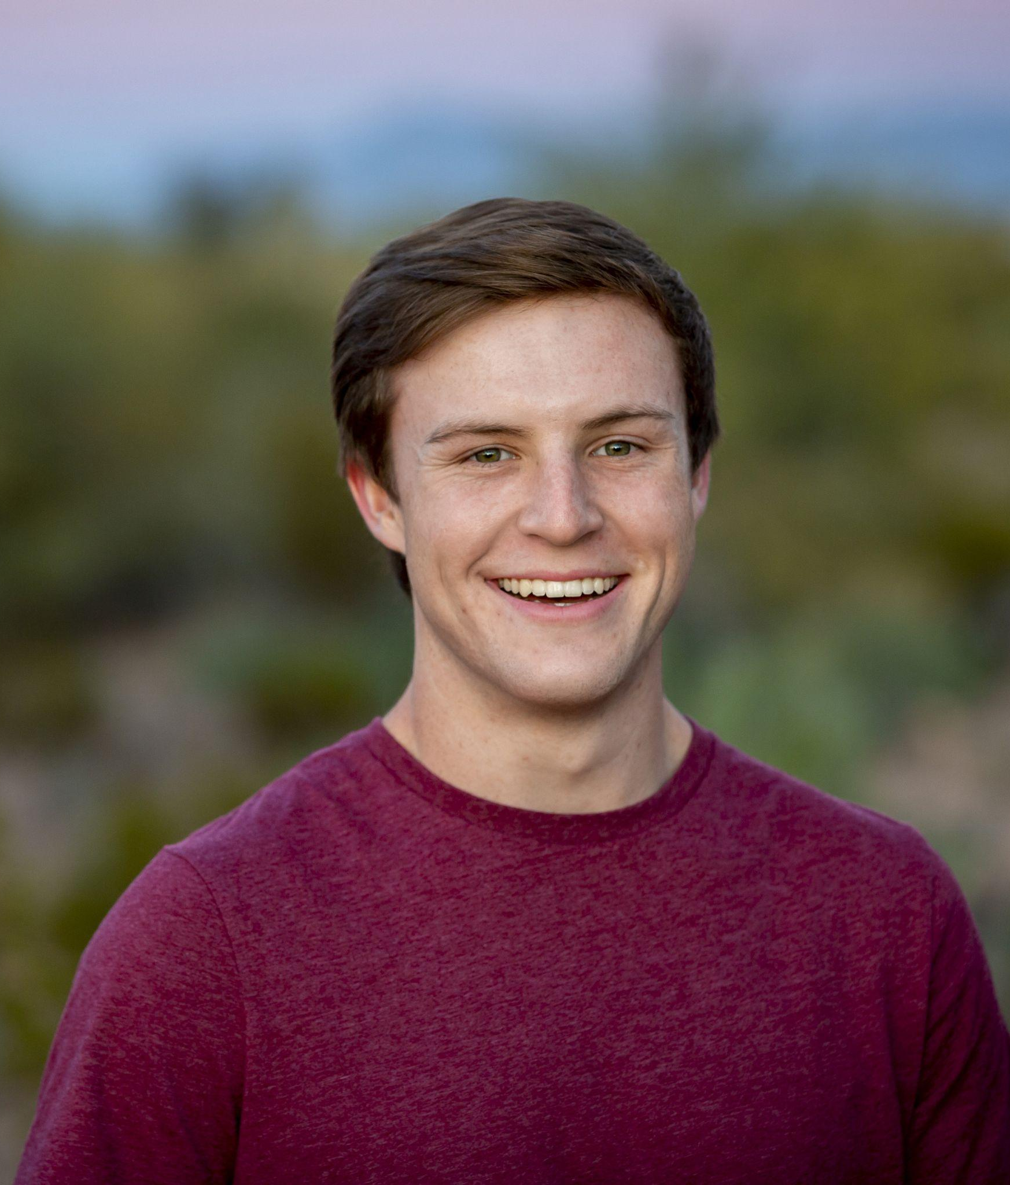
Team Introduction
Release manager
Full-stack coder
Nick Botticelli
Architect
Full-stack coder
Luke Frazer
Hannah Trenary
Team lead
Back-end coder
Kelene Moore
Website lead
Front-end coder
Mya Davis
Recorder
Full-stack coder

Slide 3

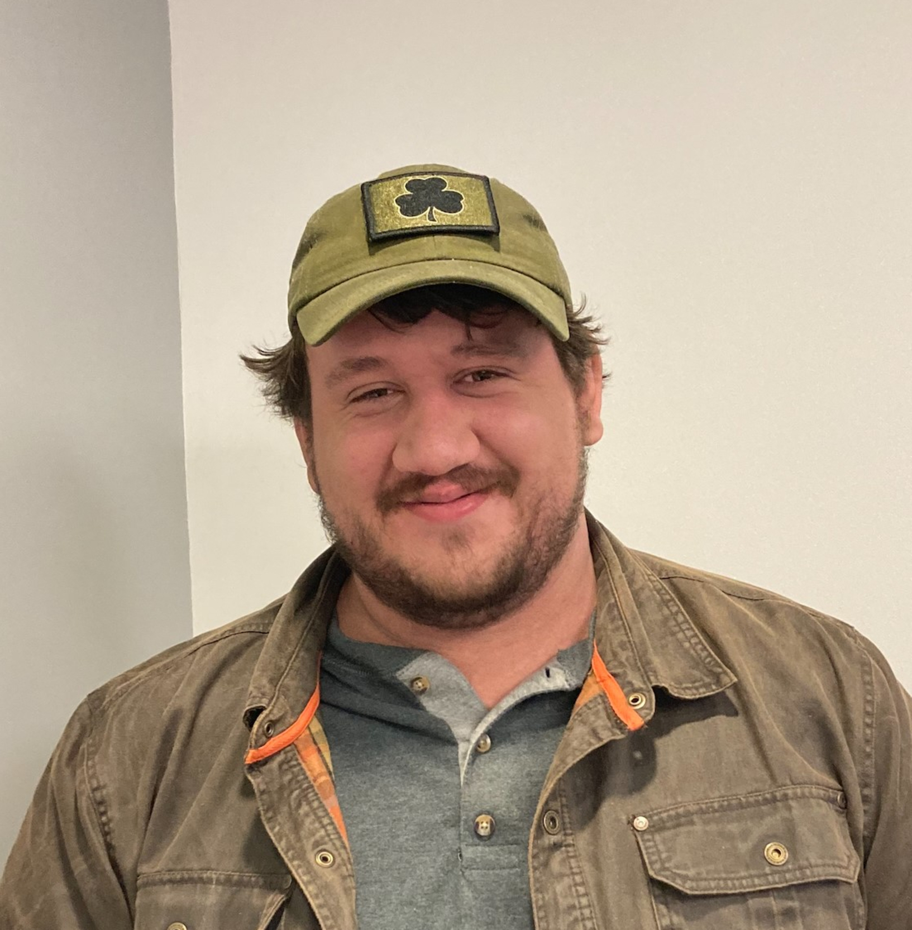
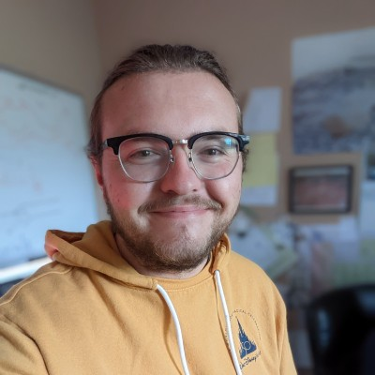
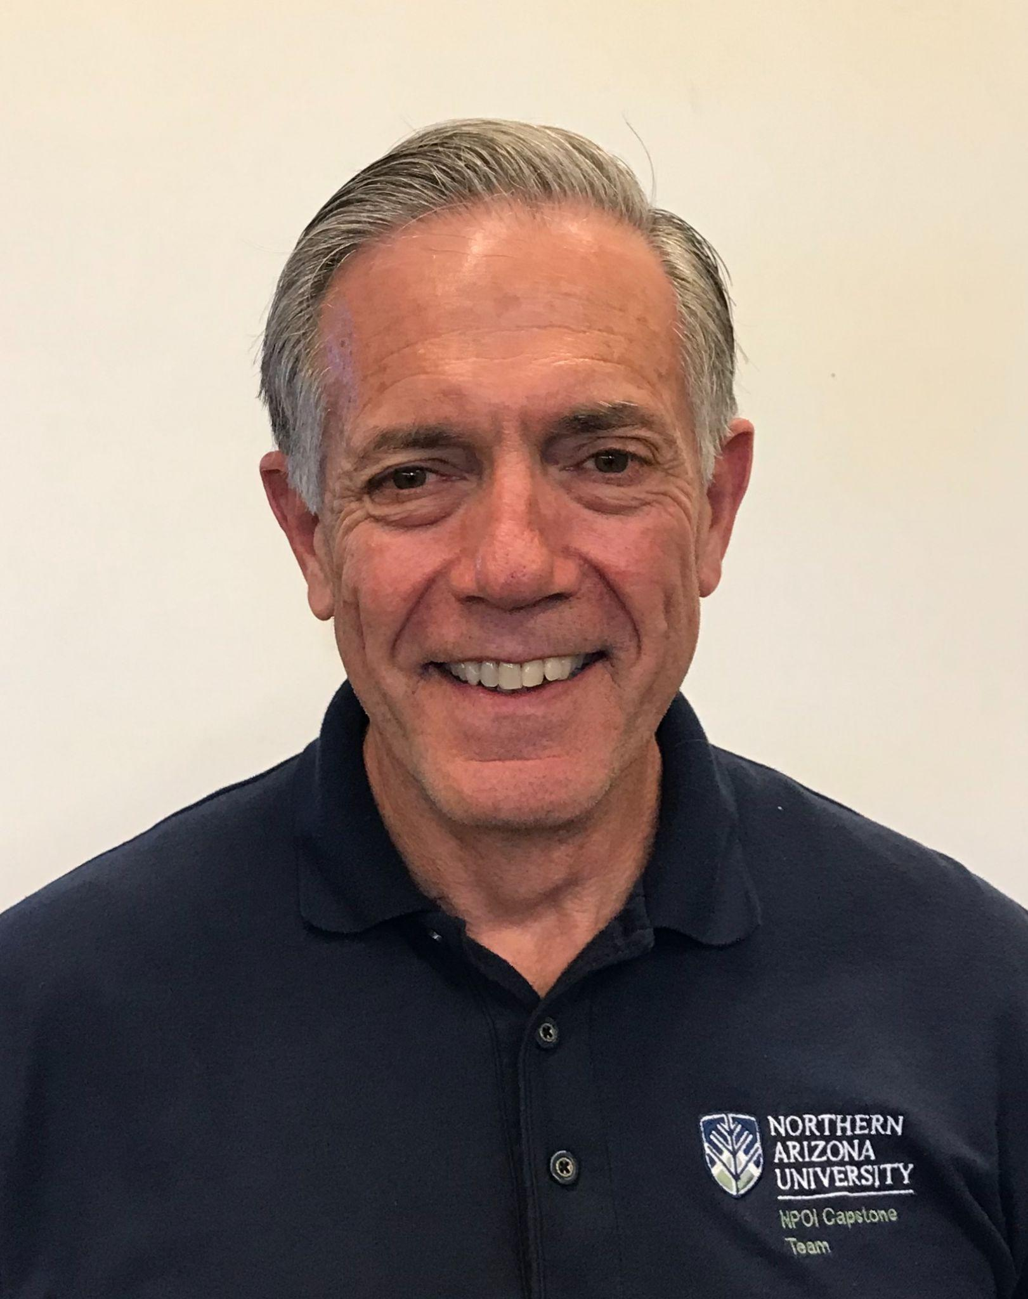

Project Introduction
Project Title: NPOI Camera Centering Software
Client: Navy Precision Optical Interferometer (NPOI)
Mentor: Rudhira Talla
Our Sponsors:
Peter Kurtz
Software Engineer
Nick Green
Systems Engineer
Jim Clark
Director

Slide 4
Problem Statement
Camera alignments at NPOI currently require:
Manual, eyesight-based evaluation of if a camera is aligned properly
Manual mechanical adjustments based upon visual judgment
This system of camera alignments is fundamentally flawed, lacking quantitative measurements.
Eyesight is different from each engineer, creating noise in images
Mechanical adjustments are not based upon any actual measurement
Notes:
Presented by: Kelene

Slide 5
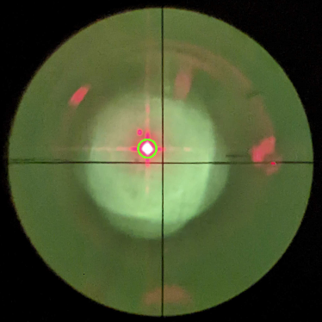
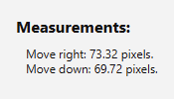
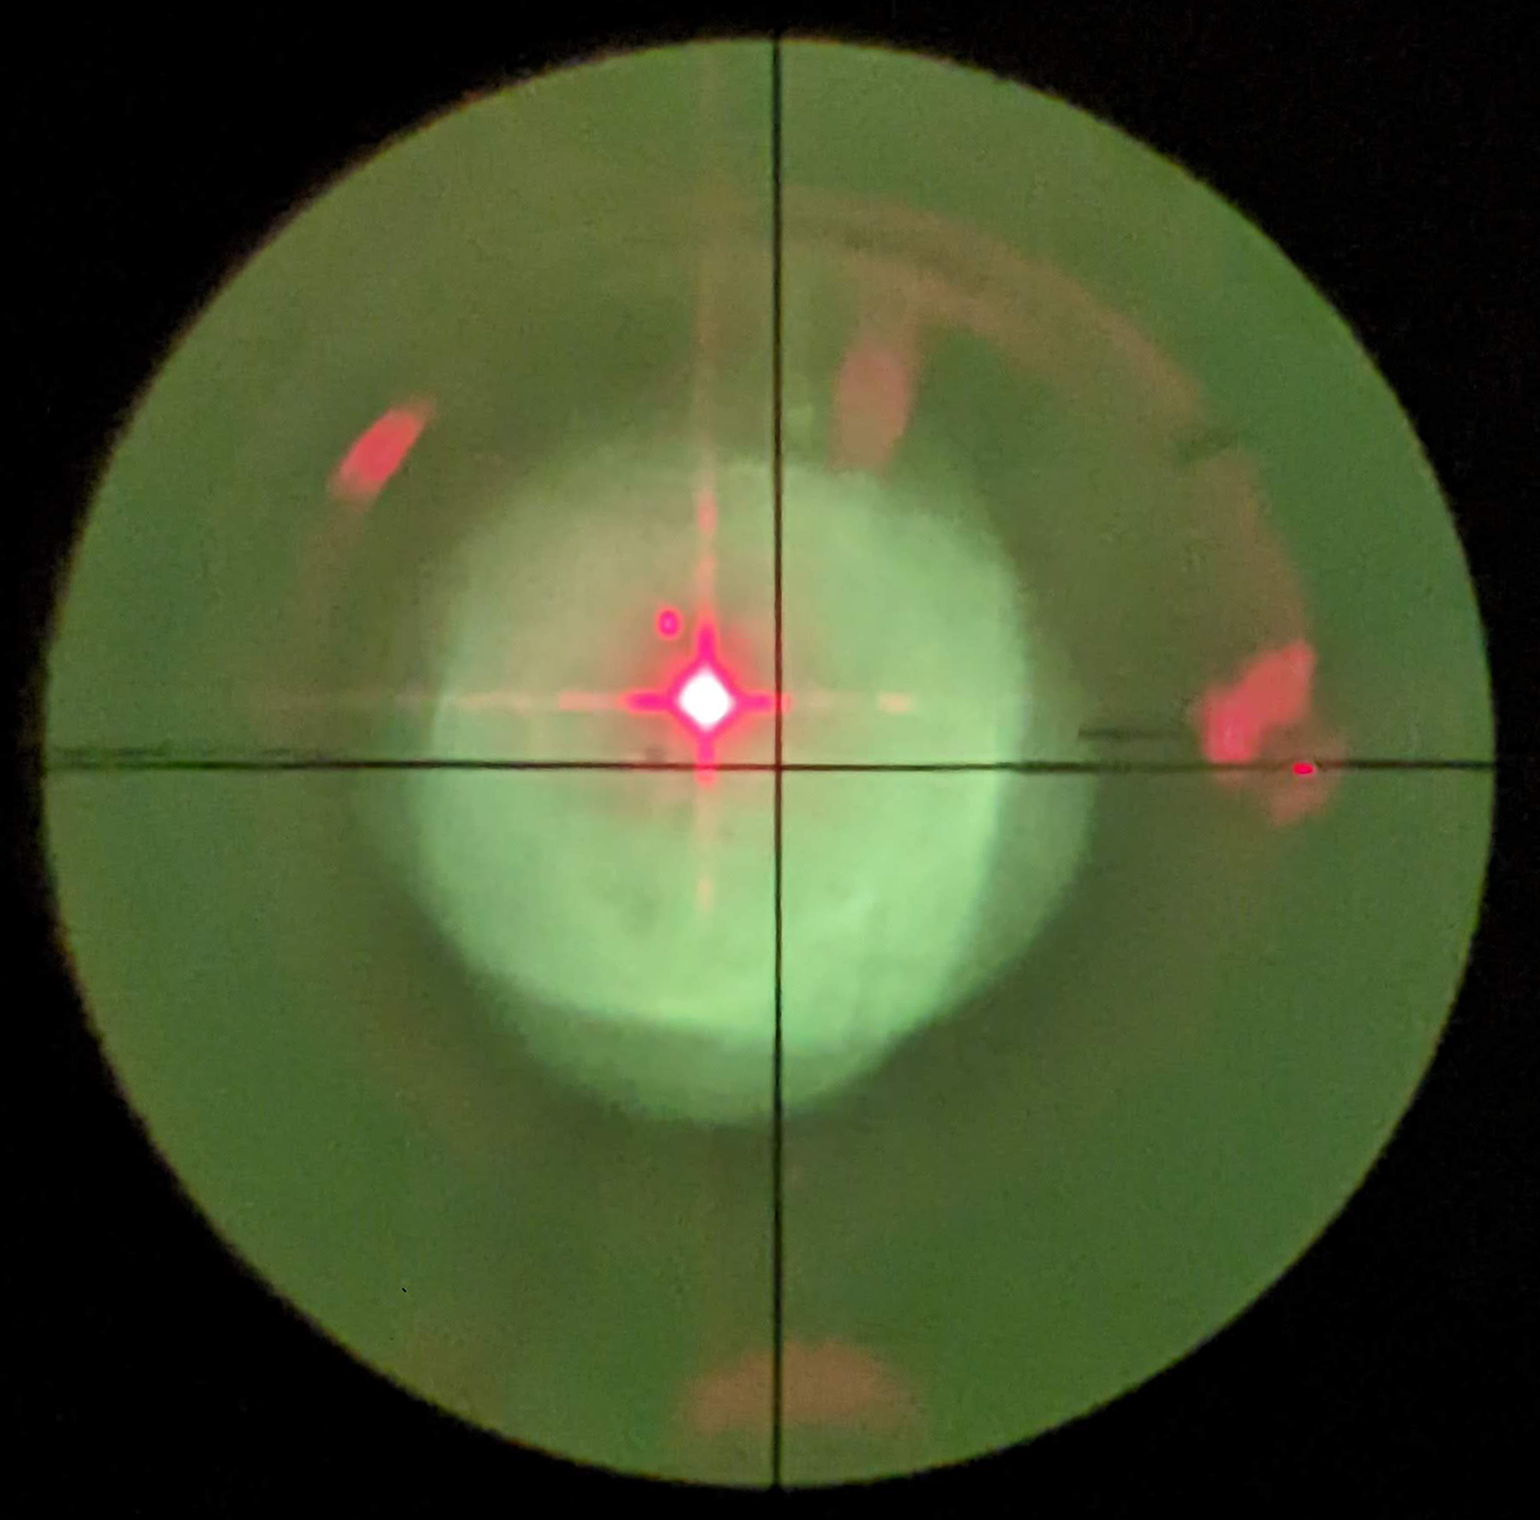
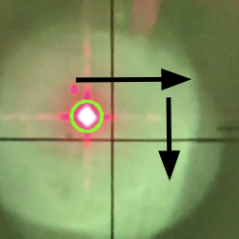
Solution Overview
1. Take in video as frames
4. Display adjustments
3. Find distance to cross-hair
2. Frame is process with OpenCV

Slide 6




Tools Used in Solution
IntelliJ IDEA
IDE used for project
OpenCV
Object detection framework
Java
Language used for development
JavaFX
User interface platform

Slide 7
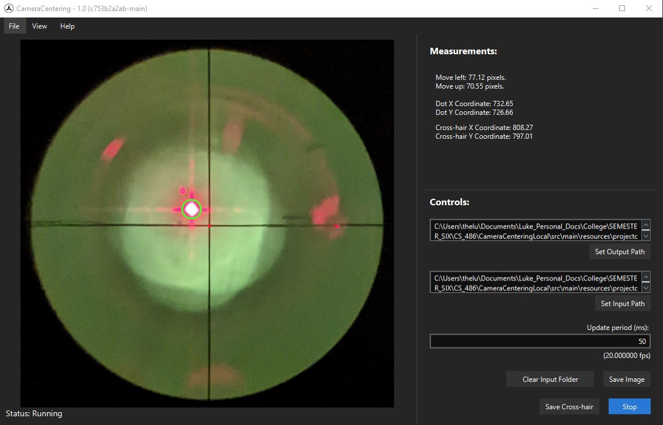
Our Program
Live Measurement Data
Additional Options and Info
Dot Indicator
Live Camera Feed
Crosshair Indicator
Program Status
Controls and Configuration

Slide 8
Key Requirements
Graphical user application compatible with Windows
  Display key information such as a live image, position calculations, and instructions to center the target LED
Record images from the attached camera
Detect the position of the LED target in the image and compare it to the cross-hair
  High precision (consistent and within 5 pixels)
  Efficient performance (< 2 second latency)

Slide 9
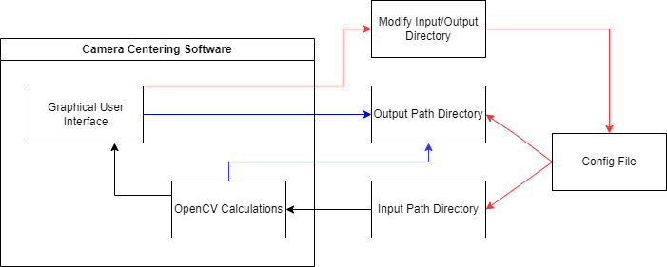
Architecture and Implementation Review
Internal
External

Slide 10

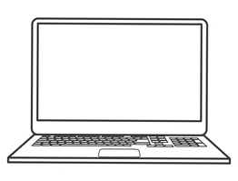
Challenges & Resolutions
Challenges
Resolutions
Confirmed inaccessibility of NPOI hardware
Consequential restructuring of input pipeline
Recreation of camera feed environment
Notes:
Presented by: Hannah

Slide 11
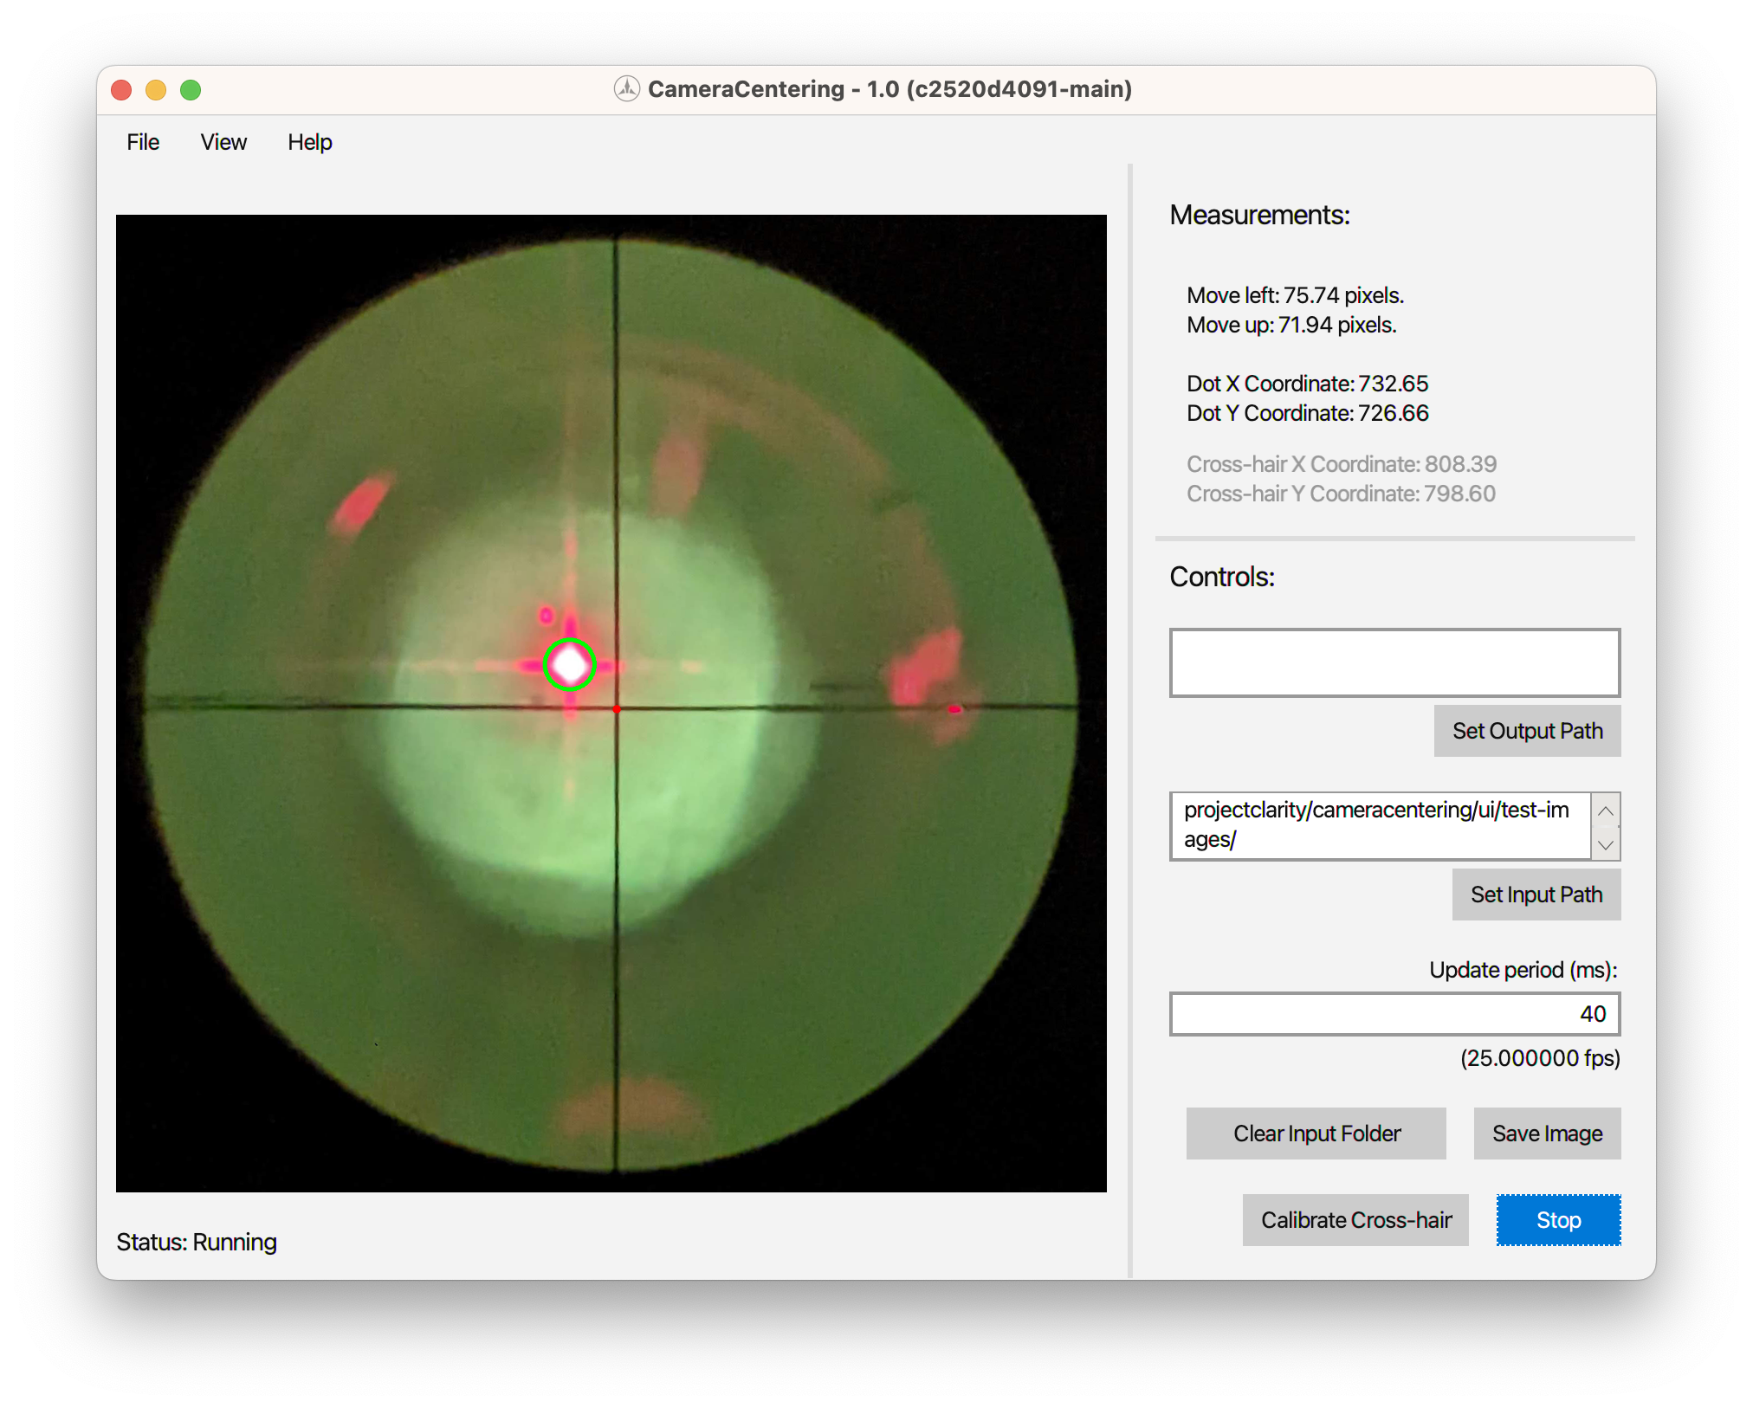
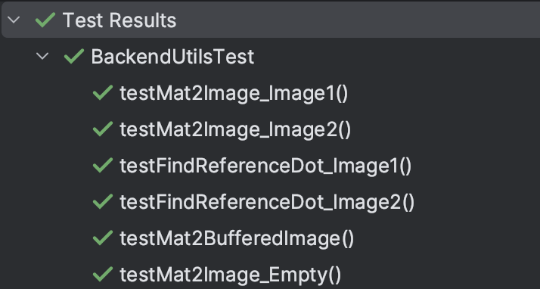

Testing Plan
Automated Testing
Manual Testing
Unit + integration testing
  Written in Java code via JUnit 5
  Built-in IntelliJ & Gradle interoperability
User interface (UI) testing
  Basic user interface functionality and design
Acceptance testing
  Full application functionality

Slide 12
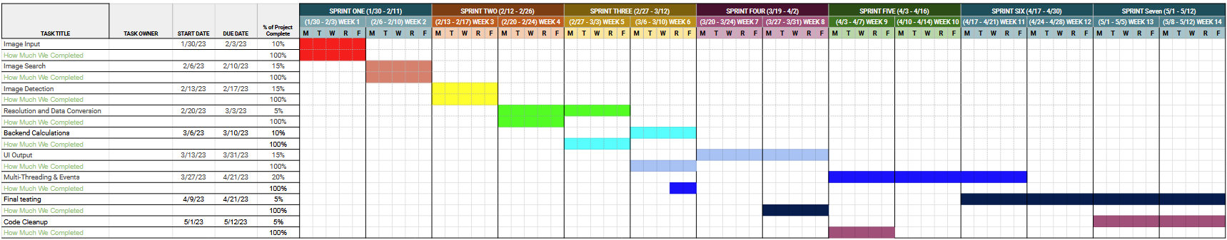
Schedule
Notes:
Presented by: Mya

Slide 13
Conclusion
Camera Centering Software working with NPOI
Manual alignment is unreliable
Next Step:
  Finishing the website
  Finishing the Final Documentation
Notes:
Presented by: Mya

